Slide 1


Team Details
  Team name: Kairos AI
  Team leader name: Puneet Pahuja
  Problem Statement: Manufacturing - Intelligent Operations & Industrial Efficiency: autonomous remote fault diagnosis & self-healing for power devices to cut downtime
Team members: Khushboo Verma, Anurag Verma

Slide 2

Note: Please download this template to make your edits and submit the final version.
To download, go to File > Download > Microsoft PowerPoint (.PPTX). Kindly refrain from sending edit requests.

Slide 3
Brief about the idea
Kairos AI puts an expert reliability engineer inside every power device.
It learns each device from its own documentation - datasheets, register maps and event-log structure - using retrieval-augmented generation on Vertex AI, then continuously monitors live telemetry and event logs remotely.
A five-agent engine detects anomalies, diagnoses the root cause with cited evidence, decides with confidence-gated autonomy, acts to self-heal or escalate (human-in-the-loop), and verifies the fix - quantifying the downtime and cost avoided. The same engine serves both historical and live analysis.
Built end-to-end on Google Cloud: Gemini 2.5 Flash on Vertex AI, Vertex embeddings, Firestore, Cloud Storage, BigQuery and Secret Manager - deployed on Cloud Run.

Slide 4
Opportunities
How different is it from existing ideas?
Existing tools only alert. Kairos AI explains the root cause, correlates cascading alarms across the dependency chain, and closes the loop - decide, act, verify - with human approval, not just detection.
How will it solve the problem?
Remote, autonomous diagnosis in seconds removes the wait for an on-site engineer, cutting downtime. Every answer is grounded in the device's own manuals, so a junior technician gets senior-grade insight.
USP of the proposed solution
Self-configuring monitoring - the agent reads the datasheet to pick parameters, thresholds and decode event logs - plus one engine for live and historic data, and honest, cited, human-in-the-loop AI on a deep Google Cloud stack.

Slide 5
List of features offered by the solution
• Role-based multi-device platform (admin / engineer / viewer) with hashed authentication.
• Per-device knowledge base via RAG using Vertex AI embeddings (text-embedding-004).
• Knowledge ingestion: upload PDF / Word / Excel, or pull from GitHub and Confluence.
• Ask the device - agentic assistant with Ask / Plan / Agent modes; generates datasets, test cases and code.
• Five-agent analysis engine: Monitor -> Diagnose -> Decide -> Act -> Verify.
• Datasheet-driven live monitoring over REST, with automatic event-log decoding.
• Quantifies diagnosis accuracy, downtime avoided and cost avoided against a baseline.
• One engine for both historical datasets and live streams; secure secrets via Secret Manager.

Slide 6
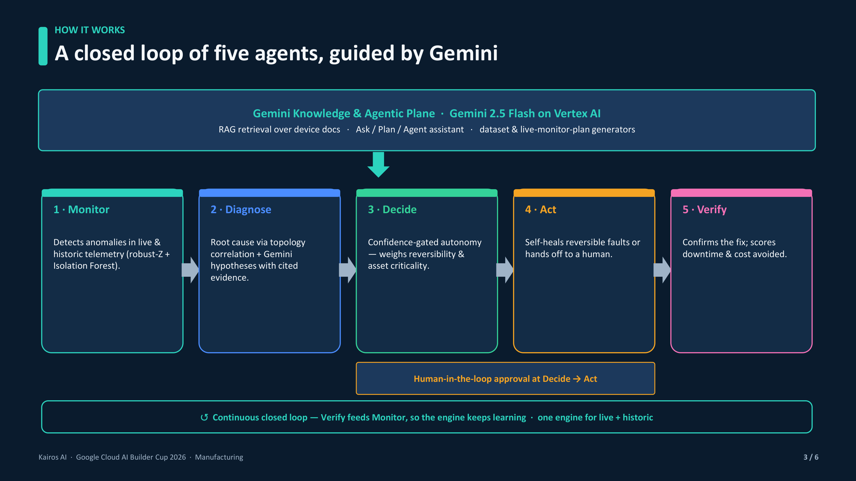
Process flow diagram or Use-case diagram

Slide 7
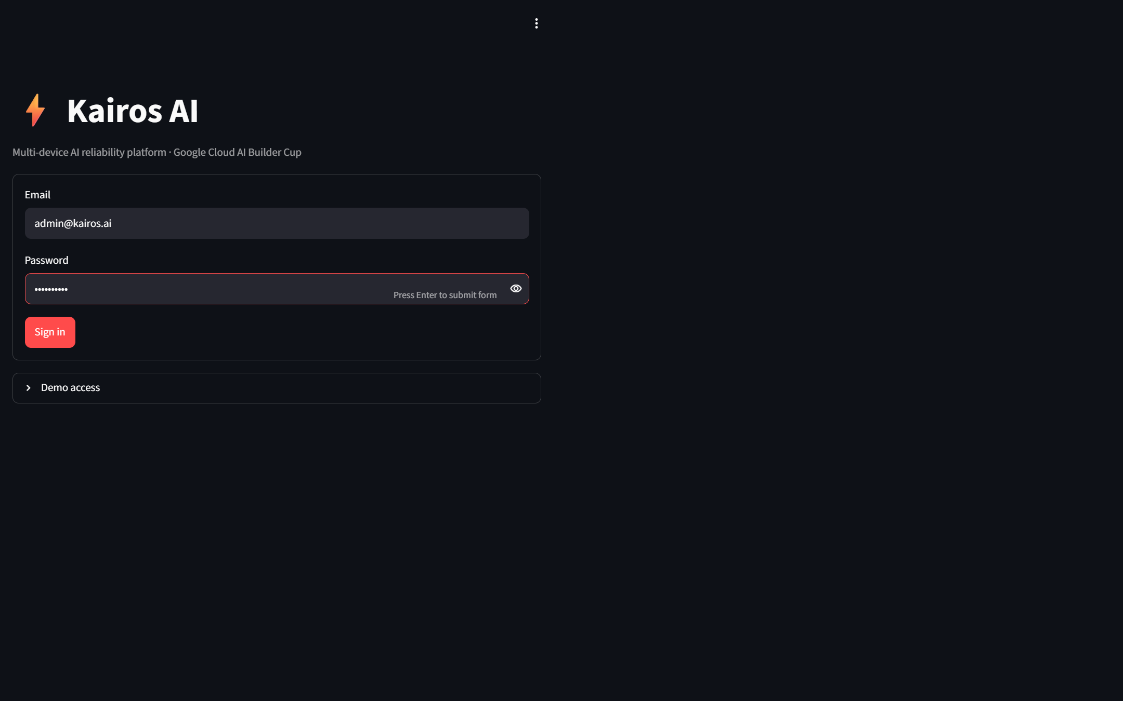
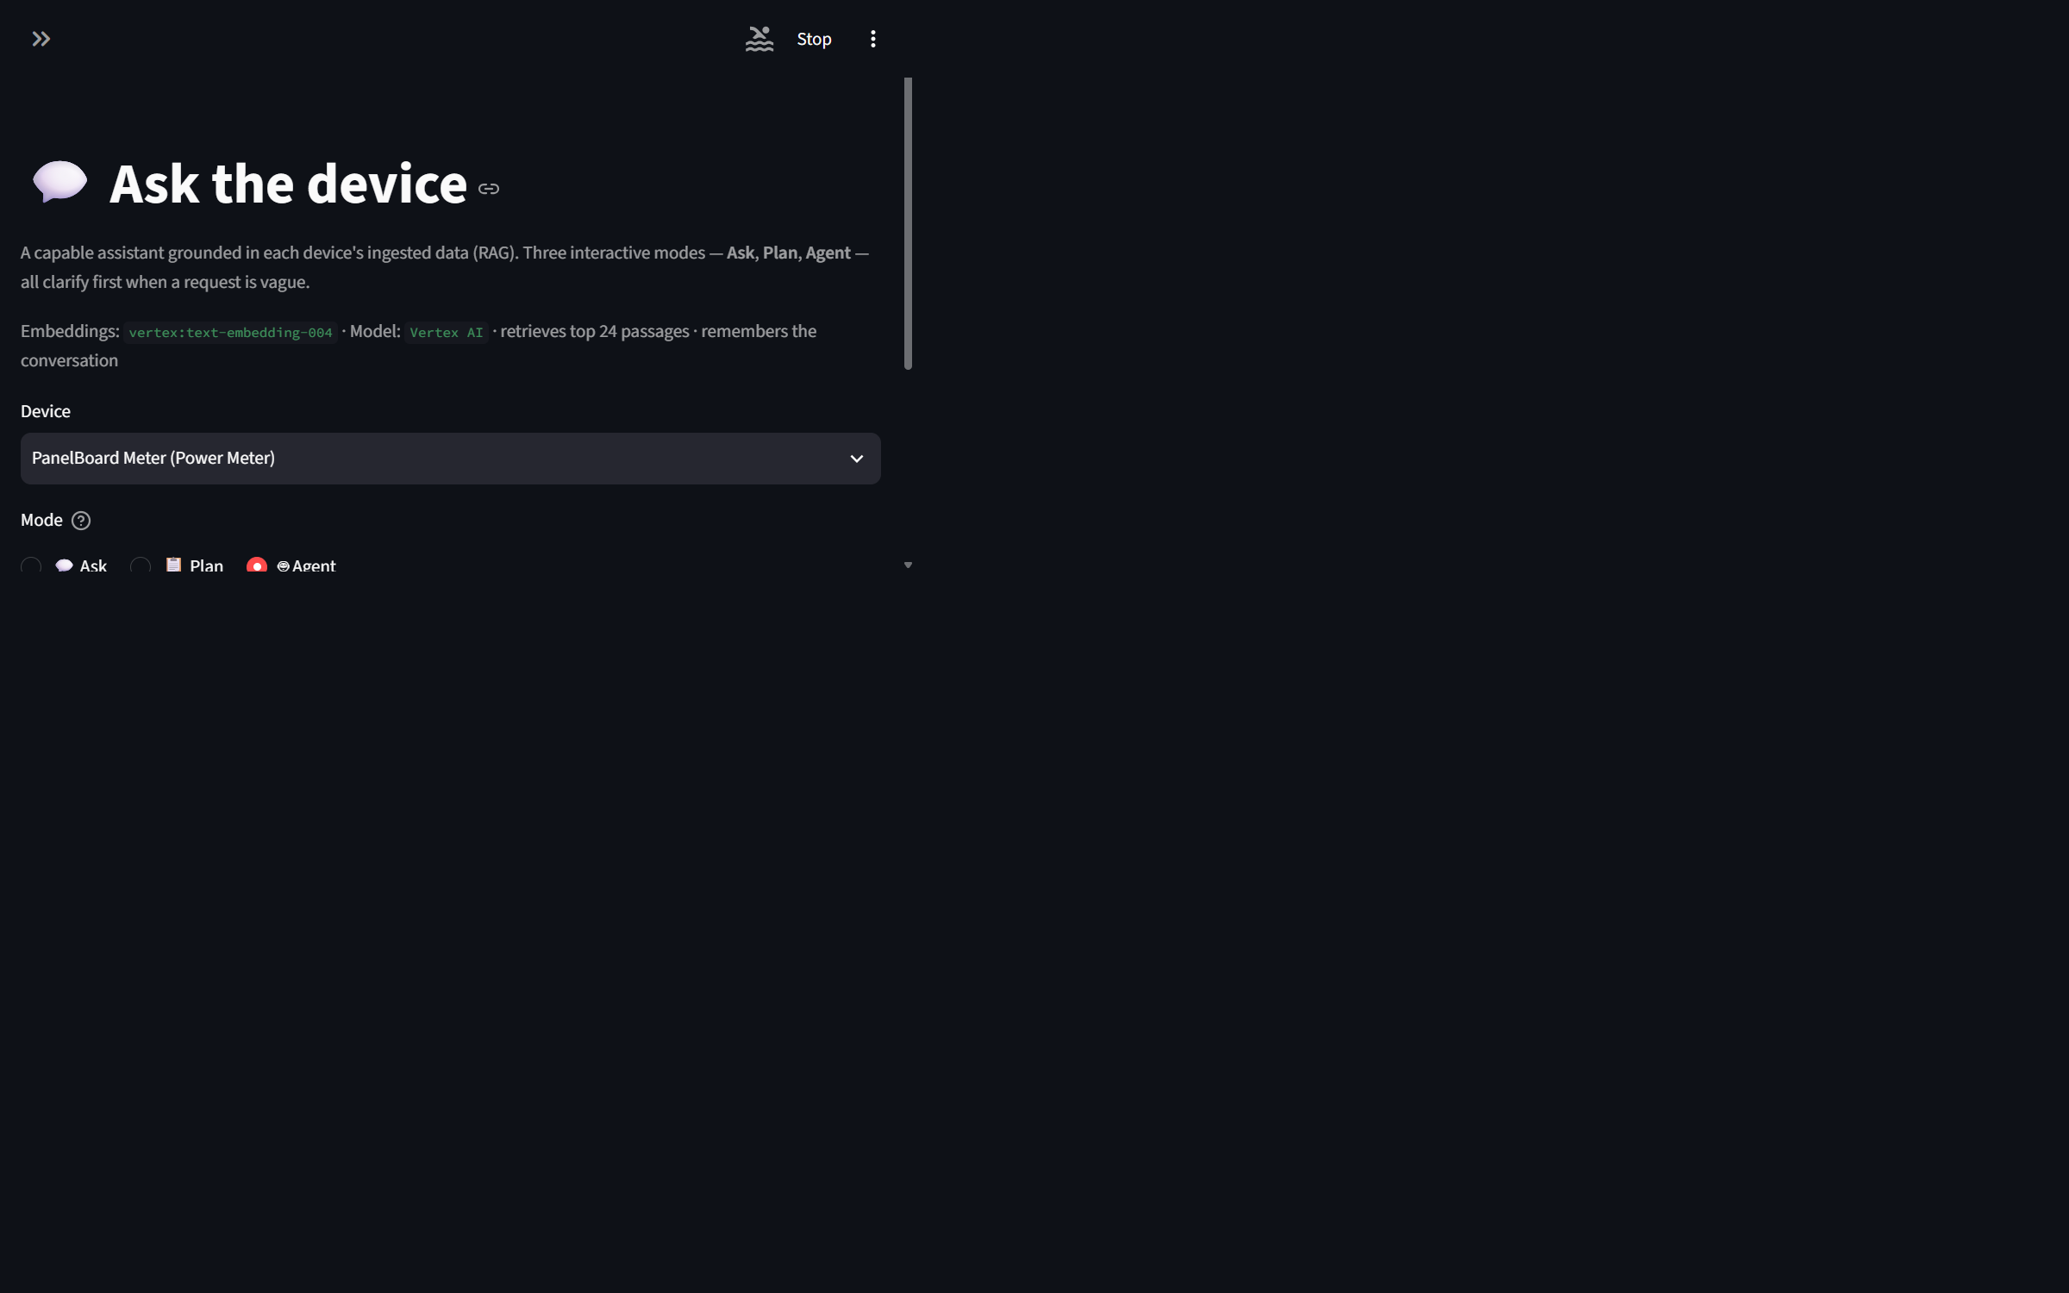
Wireframes/Mock diagrams of the proposed solution (optional)

Slide 8
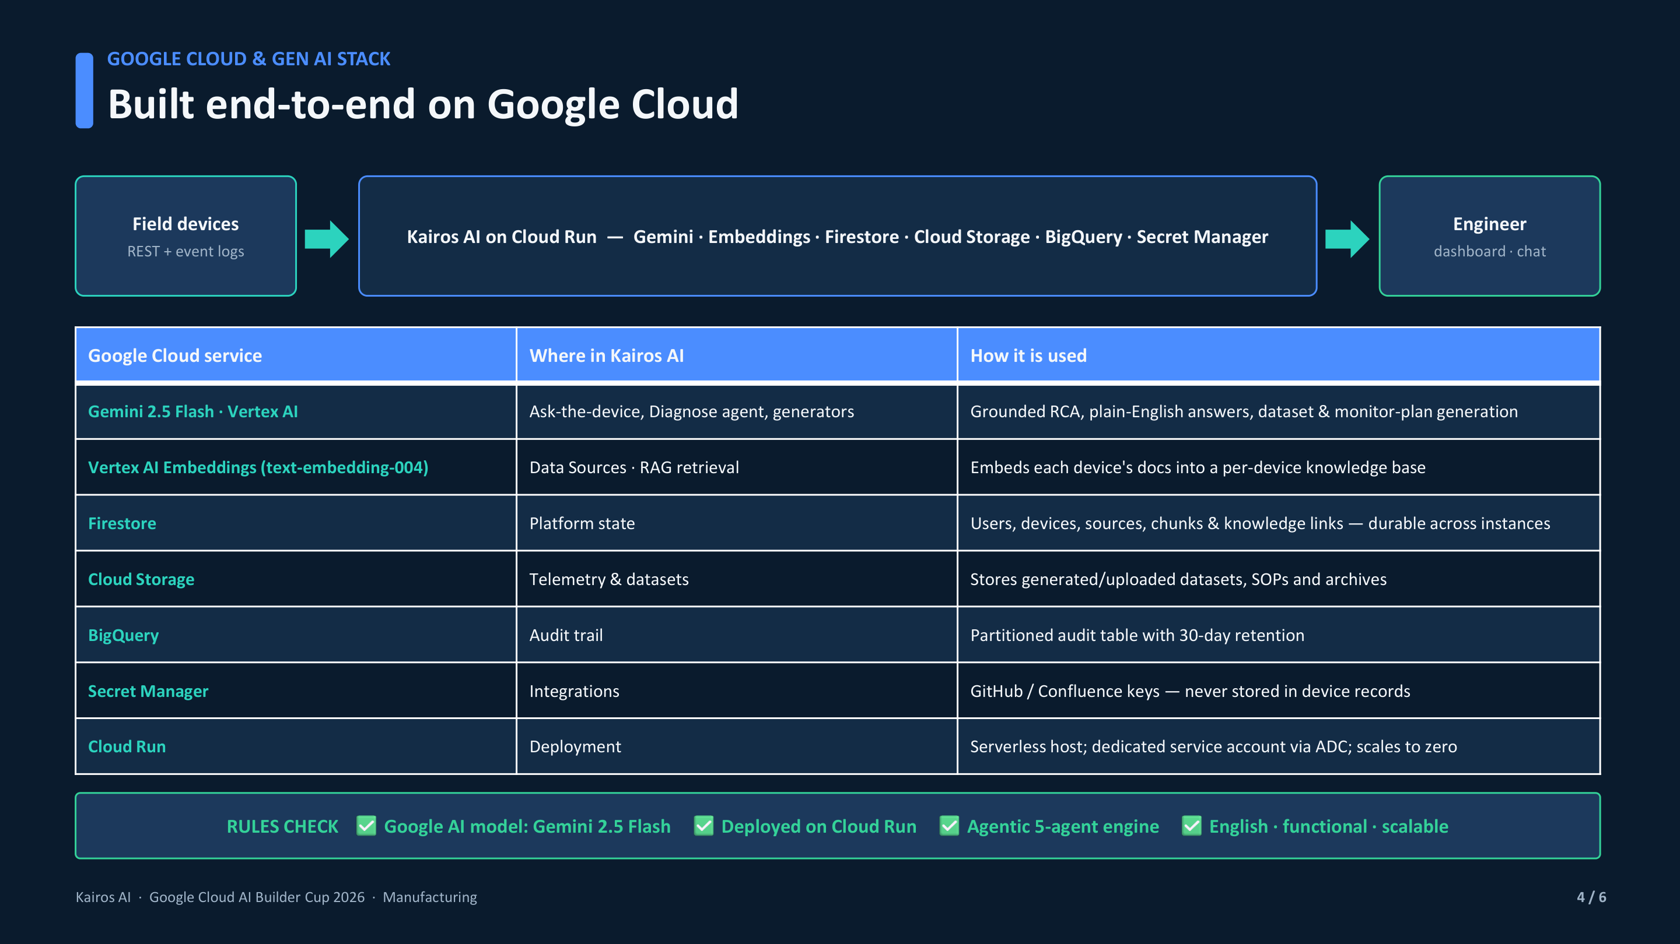
Architecture diagram of the proposed solution

Slide 9
Technologies to be used in the solution
• Gemini 2.5 Flash on Vertex AI - grounded reasoning, root-cause analysis and generation.
• Vertex AI Embeddings (text-embedding-004) - RAG retrieval over device documents.
• Firestore - platform state: users, devices, sources, chunks and knowledge links.
• Cloud Storage - telemetry and generated/uploaded datasets.
• BigQuery - partitioned audit trail with 30-day retention.
• Secret Manager - integration keys, never stored in device records.
• Cloud Run - serverless deployment; dedicated service account via ADC; scales to zero.
• Python, Streamlit, scikit-learn (robust-Z + Isolation Forest) for the engine and UI.
Rules check: uses a Google AI model (Gemini) and is deployed on Google Cloud via Cloud Run.

Slide 10
Estimated implementation cost (optional)
• Cloud Run - scale-to-zero; ~$0 when idle, pay only per request.
• Vertex AI (Gemini + embeddings) - per-token pricing; low for a demo workload.
• Firestore / Cloud Storage / BigQuery - minimal at demo scale (free-tier friendly).
Estimated demo running cost: under $50 / month.
Production cost scales roughly linearly per device and per analysis, with no fixed server cost.
(Illustrative estimate - actual cost depends on usage, region and data volume.)

Slide 11
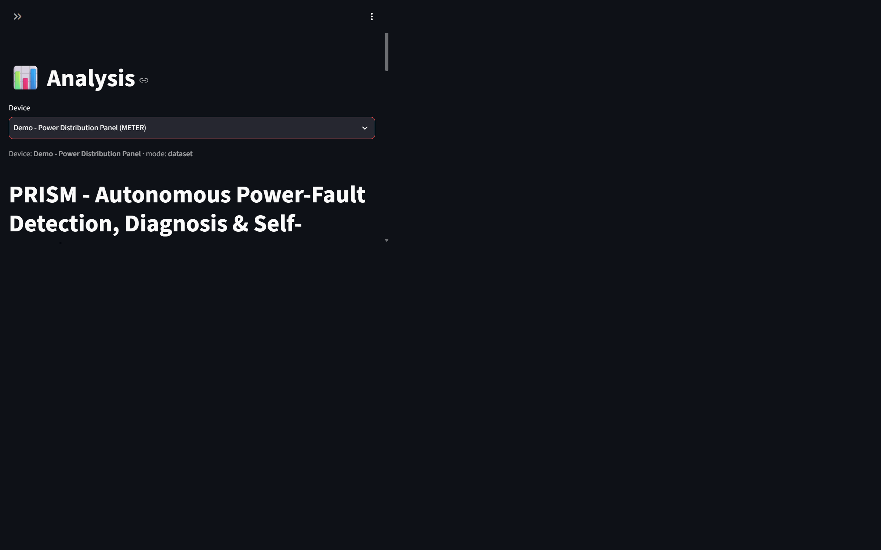
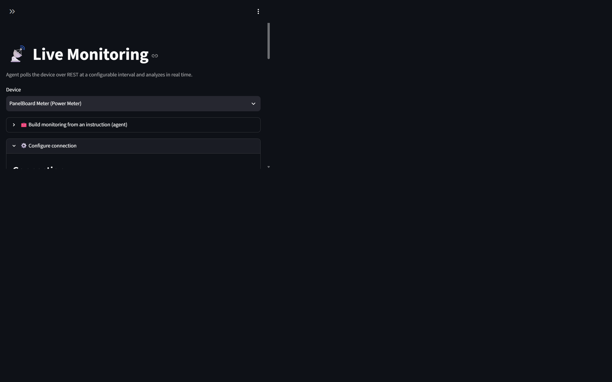
Snapshots of the prototype

Slide 12
Prototype Performance report/Benchmarking
• 121 automated tests passing (auth, RAG, generation, engine, live bridge, PRISM parity).
• Demo analysis: 3 assets with 3 injected faults -> 100% diagnosis accuracy vs ground truth.
• Illustrative impact: 223 minutes of downtime avoided and $153,550 cost avoided across 6 incidents, each scored against a no-platform baseline (synthetic scenarios, not realized savings).
• MTTR drops from tens of hours to 1-2 analysis cycles.
• Deployed and verified live on Cloud Run - Firestore-backed, Gemini on Vertex AI, zero runtime errors.

Slide 13
Additional Details/Future Development (if any)
• Real edge-sensor and IoT integration via Pub/Sub and Dataflow for always-on ingestion.
• Multi-device fleet modeling with topology correlation across an entire site.
• Predictive maintenance - forecasting failures before they occur.
• Support for additional industrial protocols (Modbus, DLMS and others).
• Mobile alerts and automated work-order dispatch; multi-tenant SaaS for operators.
• Domain-tuned models and on-device inference for low-connectivity sites.

Slide 14
Provide links to your:
GitHub Public Repository:
https://github.com/puneetpahuja-eaton/kairos-ai
Demo Video (3 minutes):
[Add your public YouTube / Vimeo / Drive link here after recording]
Final Product (deployed on Cloud Run):
https://kairos-ai-498775210896.asia-south1.run.app

Slide 16


