Slide 1

Docker

Slide 2
Agenda
History Before Containerization
Reason to use Containers
What is Docker?
What is Docker Architecture?
Docker file, Images & Container
Docker Hub
Basic Commands

Slide 3
History Before Containerization
Before containerization came into the picture, the leading way to isolate, organize applications and their dependencies was to place each and every application in its own virtual machine.
These machines run multiple applications on the same physical hardware, and this process is nothing but Virtualization.
But virtualization had few drawbacks
Bulky in size
Running multiple virtual machines lead to unstable performance
Boot up process would usually take a long time
Portability take less time rather than dedicated server
Software updates

Slide 4
Reason to use Containers
Containers have no guest OS and use the host’s operating system. So, they share relevant libraries & resources as and when needed.
Processing and execution of applications are very fast since applications specific binaries and libraries of containers run on the host kernel.
Booting up a container takes only a fraction of a second, and also containers are lightweight and faster than Virtual Machines.

Slide 5
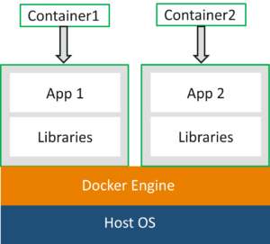
What is docker
Docker is a platform which packages an application and all its dependencies together in the form of containers.
This containerization aspect ensures that the application works in any environment.

Slide 6
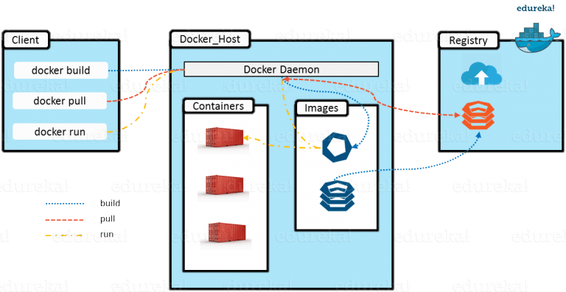
Docker Architecture?

Slide 7
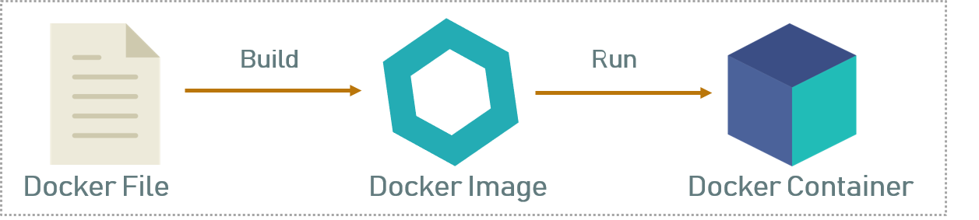
Docker file, Images & Containers
A Dockerfile is a text document which contains all the commands that a user can call on the command line to assemble an image. So, Docker can build images automatically by reading the instructions from a Dockerfile
Docker Image,In layman terms, Docker Image can be compared to a template which is used to create Docker Containers. So, these read-only templates are the building blocks of a Container. You can use docker run to run the image and create a container.
Docker Container, it is a running instance of a Docker Image as they hold the entire package needed to run the application. So, these are basically the ready applications created from Docker Images which is the ultimate utility of Docker.

Slide 8
Docker Hub
Docker Images are stored in the Docker Registry
It can be either a user’s local repository or a public repository like a Docker Hub which allows multiple users to collaborate in building an application.
Docker Hub is a hosted repository service provided by Docker for finding and sharing container images with your team.
Key Features like Private/Public repos, Automated Builds, Teams & Organizations, Official Images etc

Slide 9
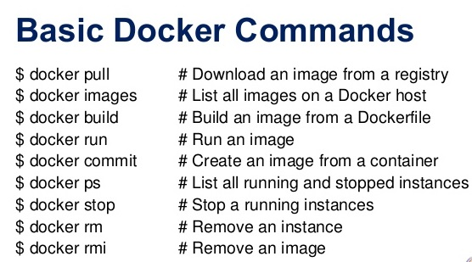
Basic commands

Slide 10





Thanks for now
Meet again in next session to see
How to use docker
How to configure docker in local machine
How to use docker image
How we can create custom docker image
Practically gone through docker commands

