Slide 1

Active-Learning Framework for On-Road Vehicle Recognition and Tracking
DATE :- 08-09-2017
SUBMITTED BY :-
Puneet Saluja (2015KUCP1019)
Tanmay Sonkusle (2015KUCP1023)

Slide 2
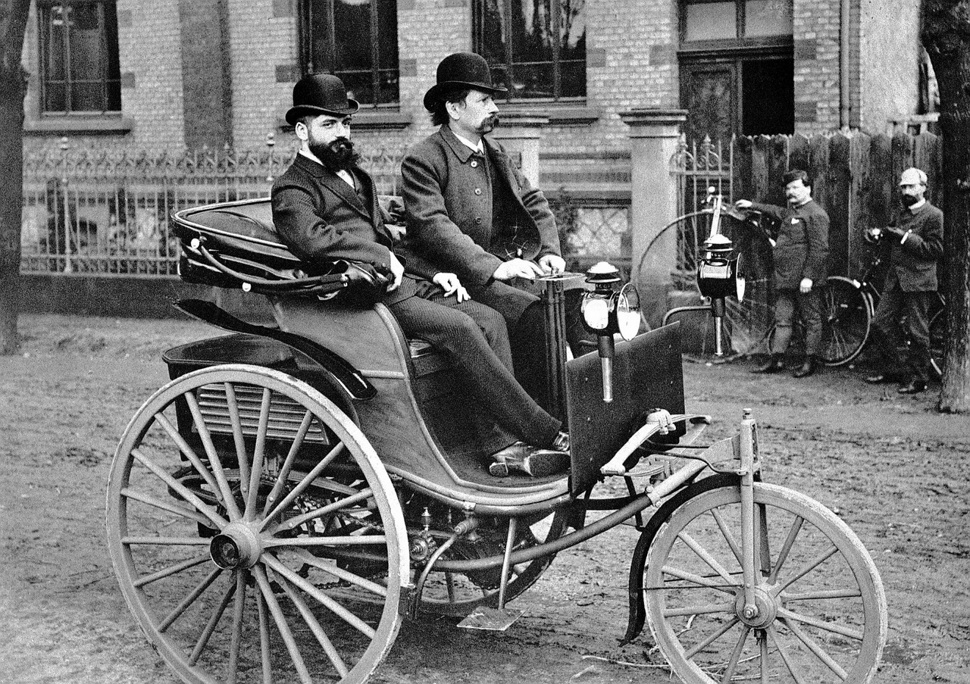
Source : https://in.pinterest.com/pin/312929874079845947

Slide 3
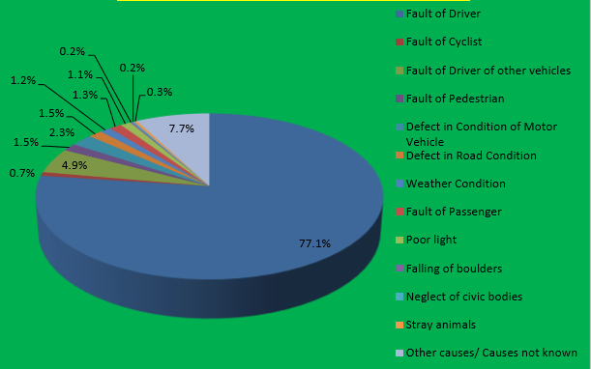
Worldwide automotive accidents injure between 20 and 50 million people each year, and at least 1.2 million people die as a result of them.
(source : WHO)
Source : GOVERNMENT OF INDIA MINISTRY OF ROAD TRANSPORT & HIGHWAYS TRANSPORT RESEARCH WING

Slide 4
ABSTRACT
Active learning approach to build a vehicle recognition and tracking system.
Robust vehicle detection using Adaboost and Haar like features.
Tracking of multiple vehicles using Particle Filter.
This framework yields an accurate, reliable and efficient safety system.

Slide 5
UNDERSTANDING YOUR SURROUNDING

Slide 6
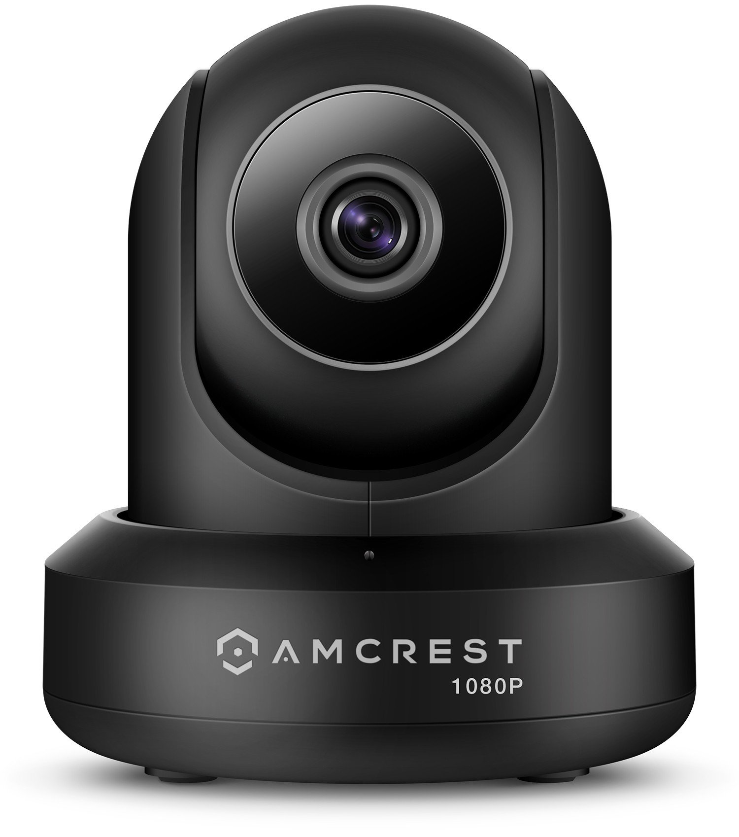
VISUAL SCANNING USING VIDEO CAMERA
Captures image quickly.
Less computation work.
Short range of view.
Lack of precise information of object.
Source : https://amcrest.com/video-camera-pt.html

Slide 7
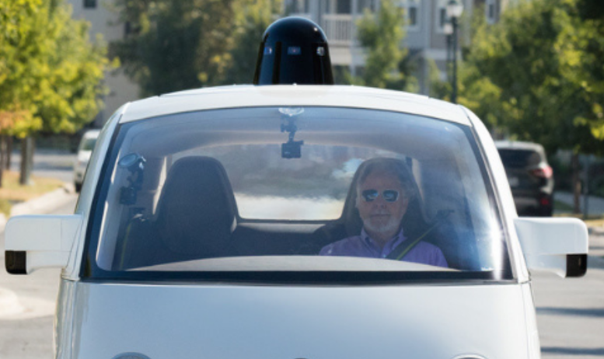
VISUAL SCANNING USING LASER
Calculates accurate distance of the object.
Calculate geometric information of the object in its field of view.
Too much computation costs.
Source : waymo.com

Slide 8
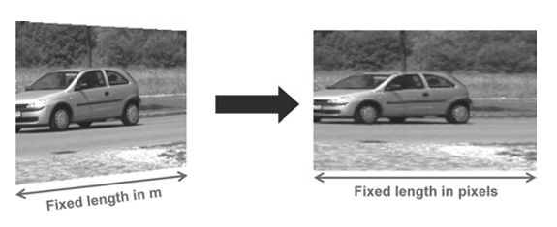
FUSION OF LASER SCANNER AND VIDEO CAMERA
Less computation cost.
The system fuses laser scanner measurements with images of a video sensor.
Source : References[3]

Slide 9
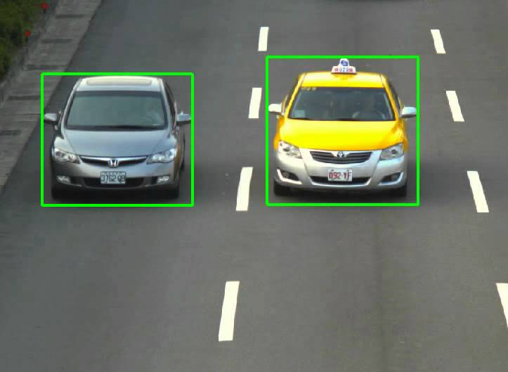
VEHICLE DETECTION
Source : https://www.youtube.com/watch?v=mjBKPmINEcQ

Slide 10
HAAR LIKE FEATURES
Edge Features
It is a machine learning based approach where a cascade function is trained from a lot of positive and negative images.
Initially, the algorithm needs a lot of positive images (images of cars) and negative images (images without cars) to train the classifier.
Line Features
Four-rectangle features

Slide 11
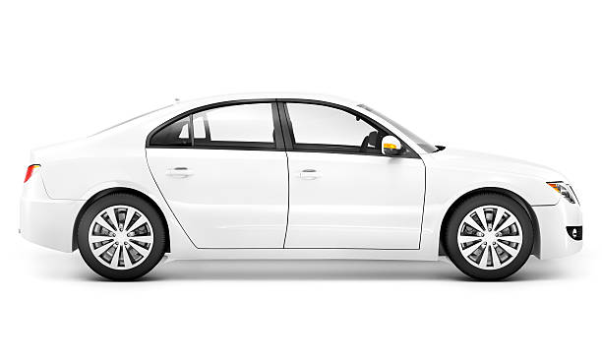
HAAR LIKE FEATURES ON VEHICLE
Source : https://images.cardekho.com/images/accord/Honda_Accord.png

Slide 12
HOW IT WORKS..?
Each feature is a single value obtained by subtracting sum of pixels under white rectangle from sum of pixels under black rectangle.
Every feature is applied on all the training images.
For each feature, it finds the best threshold which will classify the cars to positive and negative.

Slide 13
INTEGRAL IMAGE
1 | 2
3 | 4
1 | 3
4 | 10
It simplifies calculation of sum of pixels, how large may be the number of pixels, to an operation involving just four pixels.
Sum of pixels = (A+D) – (B+C)

Slide 14
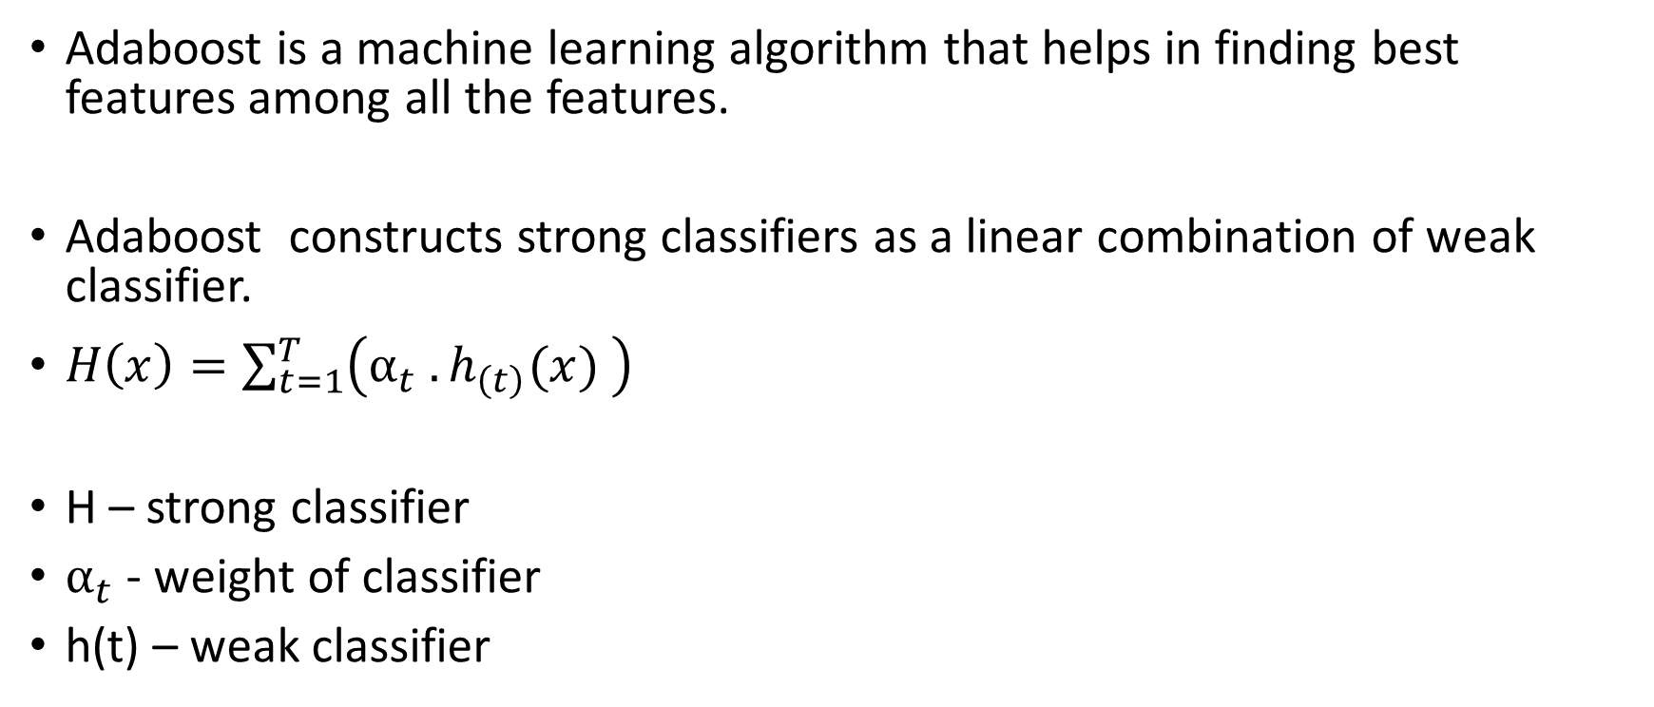
ADABOOST
Adaboost is a machine learning algorithm that helps in finding best features among all the features.
Adaboost constructs strong classifiers as a linear combination of weak classifier.
$H\left(x\right)=\sum_{t=1}^{T}{\left(α_{t} .h_{\left(t\right)}(x) \right)}$
H – strong classifier
$α_{t}$ - weight of classifier
h(t) – weak classifier

Slide 15
CASCADING
Feature must pass all stages in the cascade to be concluded as a vehicle.
Feature
Pass
Pass
……
Car
Stage 0
Stage 1
Stage n
Fail
Fail
Fail

Slide 16
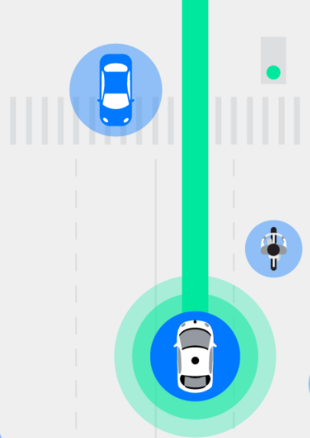
VEHICLE TRACKING
Source : waymo.com

Slide 17
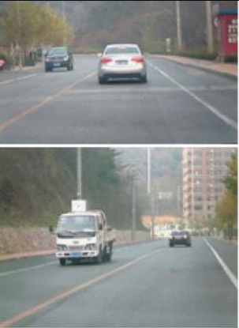
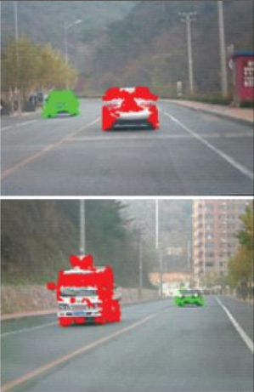
PARTICLE FILTER
Mainly used to detect/track the objects.
Used by applying different colors to different objects to remove the unnecessary particles surrounded by an object.
Source : References [1]

Slide 18
LIKELIHOOD FUNCTION
This function is used to reduce the number of particles surrounded on the object.
Particles that lies on the object have some RGB value.
Particles that lies outside of the object have some other RGB value.
Particles which are having more weight will generate new particles near them and remaining are move on to the object.

Slide 19
FLOWCHART
Background Image Initialization
Video Sequence
Background Image Update
Background Subtraction
Moving Object Detection
Selected particular object
Did not select a particular object
Selected Object Tracking

Slide 20
ACTIVE-LEARNING BASED VEHICLE RECOGNITION AND TRACKING

Slide 21
ACTIVE LEARNING
It includes discovering, processing and applying information.
Engage in learning process rather than passively absorbing information.
Using active learning yields a signiﬁcant drop in false positives per frame and false-detection rates, while maintaining a high vehicle-recognition rate

Slide 22
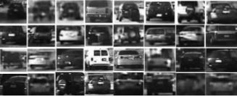
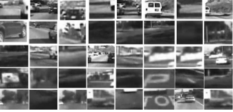
INITIALIZATION
The initial passively trained Adaboost cascaded classifier was trained using 7500 positive training images and 20500 negative training images.
Positive Training Data
Negative Training Data
Source : Base Paper

Slide 23

QUAIL
QUAIL evaluates the passively trained vehicle-recognition system on real-world data and provides an interface for a human to label and archive the ground truth.
Detection is automatically marked green
Missed detection is marked red by the user
False positives are marked blue by the user.
True detection is left green.
Source : Base Paper

Slide 24
QUERY AND RETRAINING
Source : Base Paper

Slide 25
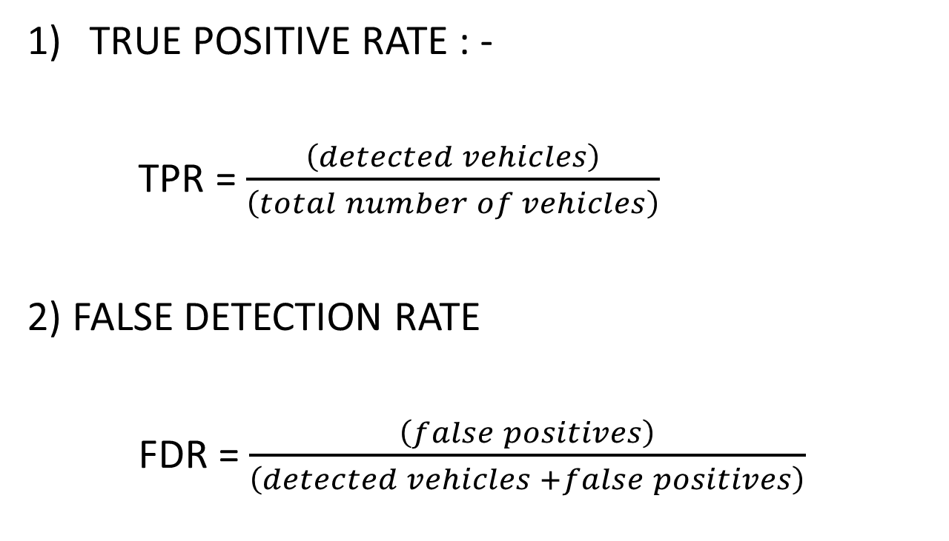
EXPERIMENTAL EVALUATION
TRUE POSITIVE RATE : -
TPR = $\frac{\left(detected vehicles\right)}{\left(total number of vehicles\right)}$
2) FALSE DETECTION RATE
FDR = $\frac{\left(false positives\right)}{\left(detected vehicles +false positives\right)}$

Slide 26
PERFORMANCE METRICES
Recognition/Tracking System | TPR | FDR
Passively Trained Vehicle Detection | 89.5% | 51.5%
ALVeRT | 95.0% | 6.4%
EXPERIMENTAL DATA SET 1: JANUARY 28, 2009, 4 P.M., San Diego (Base Paper)

Slide 27
CONCLUSION
Selective sampling was performed using QUAIL.
Using active learning, a full vehicle-recognition and tracking system has been implemented.
In future research efforts can be made to include pedestrian-protection systems, automatic parking and to develop autonomous vehicle.

Slide 28
REFERENCES
BASE PAPER :- Sayanan Sivaraman , “A General Active-Learning Framework for On-Road Vehicle Recognition and Tracking”, VOL. 11, NO. 2,JUNE 2010.
M.Gopi Krishna, A. Srinivasulu, “Face Detection System On AdaBoost Algorithm Using Haar Classifiers”, Vol. 2, Issue. 5, Sep.-Oct. 2012
S. Wender and K. Dietmayer, “3D vehicle detection using a laser scanner and a video camera,” IET Intell. Transp. Syst., vol. 2, no. 2, pp. 105–112, Jun. 2008.
P. Viola and M. Jones, “Rapid object detection using a boosted cascade of simple features,” in Proc. IEEE Conf. Comput. Vis. Pattern Recog., Dec. 2001, vol. 1, pp. 511–518.
Ted Talk – “Chris Urmson: How a driverless car sees the road” link – https://www.youtube.com/watch?v=tiwVMrTLUWg

Slide 29
THANK YOU

