Slide 1


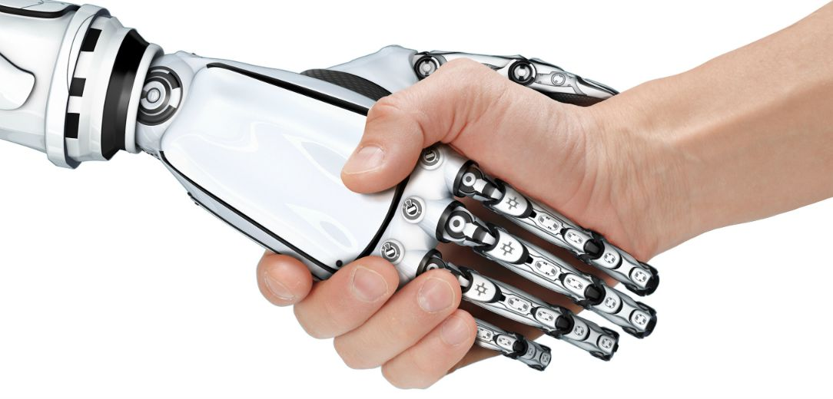

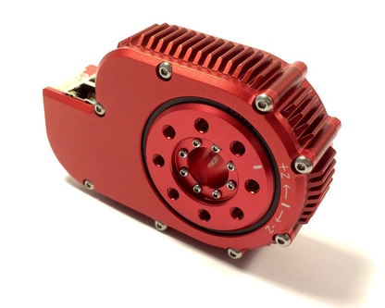
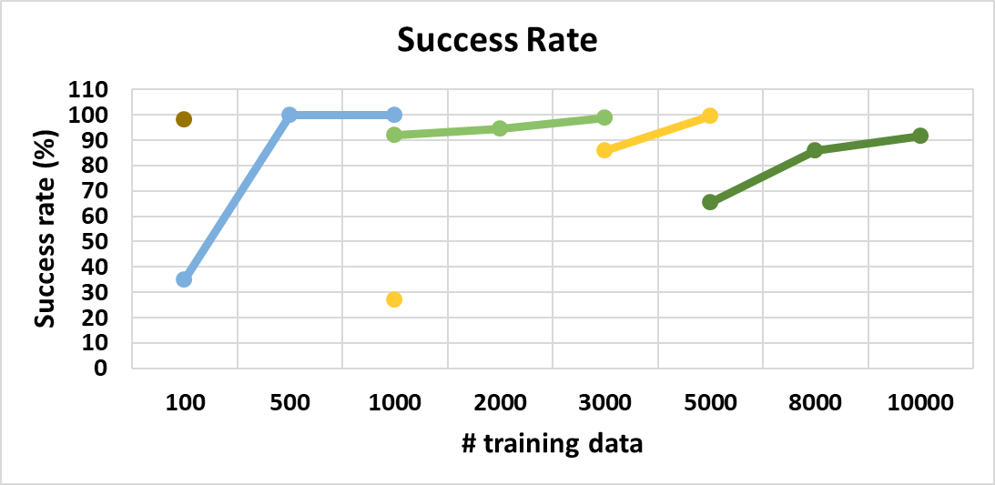
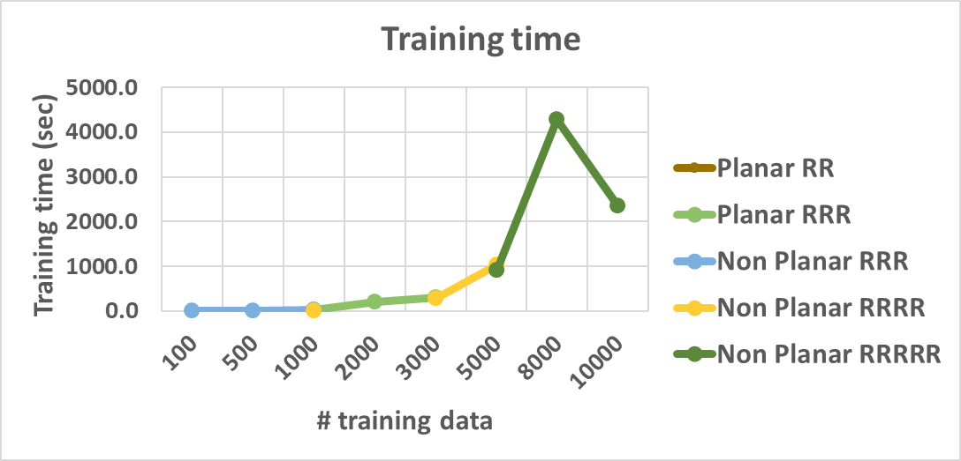
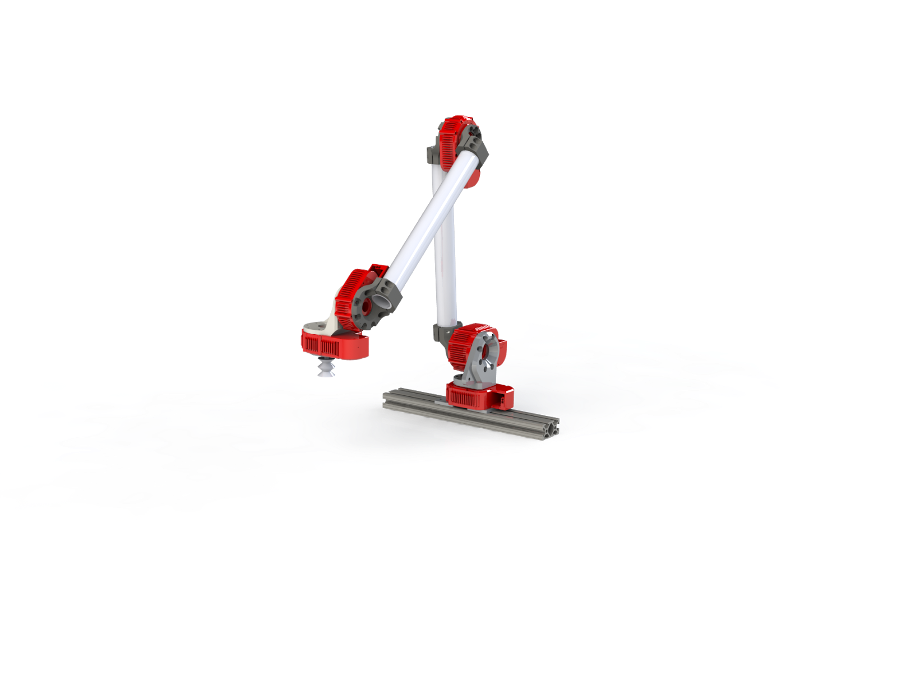

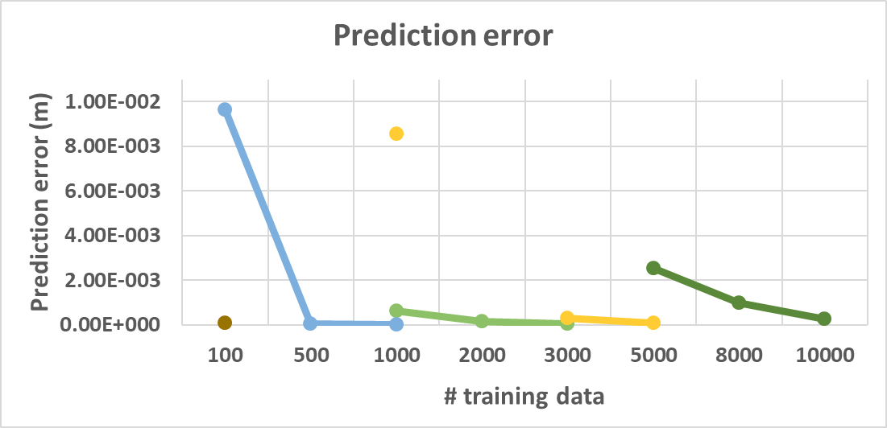
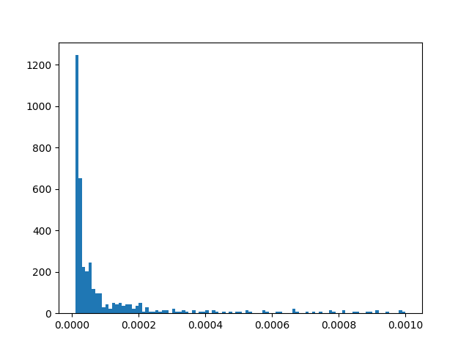
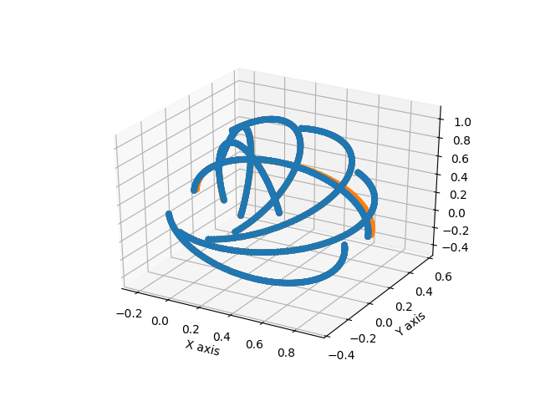
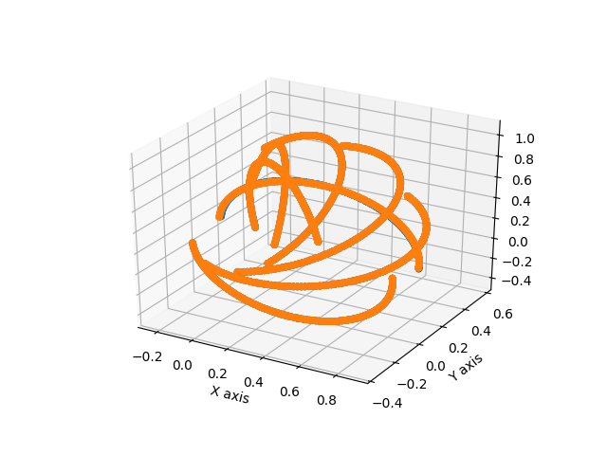
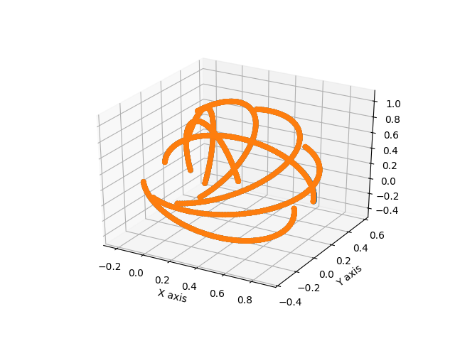



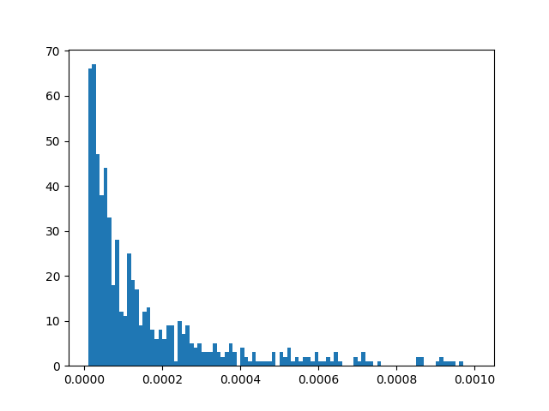

Machine learning approaches to kinematic and dynamic modeling of
modular manipulator arm with series elastic actuators
Puneet Singhal¹, Guillaume Sartoretti², Hadi Salman²
Advisor: Howie Choset², Matthew Travers²
¹ Mechanical Engineering Department and ² Robotics Institute
_{MOTIVATION}
_{Approach}
Manipulator Arm
Manufacturing
Search &
Rescue
Assistive
Robots
Forward Kinematics
Neural Network
Gaussian Process Regression
Inverse Kinematics
Neural Network
Gaussian Process Regression
Forward Dynamics
Neural Network
Inverse Dynamics
Gaussian Process Regression
Neural Network
Gaussian Process Regression
Koopman operator
Input pre-processing; using knowledge of system
Efficient sampling approaches such as Bayesian Optimization, Active Learning.
Key Ideas:
Collaboration
Dynamics
Learning
Series Elastic Actuators
_{Results}
Additional problems: Uncertainties in parameters (measurement errors)
_{SYSTEM}
Joint 3
GeForce 1070 GTX
8x Intel® Core™ i7-6700K
CPU @4.00GHz
Memory: 16 GB
Error Histogram
Joint 4
Joint 2
Joint 5
Joint 1
5-dof manipulator arm
5 degrees of freedom arm
5000 samples
8000 samples
10000 samples
_{LITERATURE}
Forward dynamics of planar RR arm
Error Histogram
Lagrangian Dynamics:
$$M\left(q\right)\ddot{q}+C\left(q, \dot{q}\right)\dot{q}+G\left(q\right)=τ$$
Number of test samples
Does not capture uncertainty
Spring dynamics is not modeled analytically
Error (in m)
Model Learning using Gaussian Process Regression (GPR):
_{FUTURE WORK}
$$M\left(q\right)\ddot{q}+C\left(q, \dot{q}\right)\dot{q}+G\left(q\right)=τ+τ_{ε}$$
Bayesian Optimization with Gaussian Process Regression
Learning for inverse kinematics and inverse dynamics
Explore local GP to improve computation
$$τ_{ε}=𝒢𝒫(m\left(x\right), k\left(x,x^{′}\right))$$
Does not capture uncertainty
Captures nonlinearities but requires inverting matrix, O(n³), and hence best for Task-based learning
_{REFERENCES}
[1] J.M. Hollerbach, A Recursive Lagrangian Formulation of Manipulator Dynamics and a Comparative Study of Dynamics Formulation IEEE Trans. on Systems, Man, and Cybernet SMC-10, 11, NOV. 1980, pp. 730-736. [2] Kostic, D.; de Jager, B.; Steinbuch, M.; Hensen, R.: Modeling and identification for high performance robot control: an RRR-robotic arm case study. IEEE Trans. Control Syst. Technol. 12(6), 904–919 (2004) [3] Nguyen-Tuong, D., Seeger, M., and Peters, J., 2008. “Local gaussian process regression for real time online model learning and control”. Advances in Neural Information Processing Systems, 22, pp. 1–8. [4] J. J. Uicker, "On the dynamic analysis of spatial linkages using 4x4 matrices," Ph.D. dissertation, Northwestern Univ., Aug. 1965. [5] M. E. Kahn, "The near-minimum-time control of open-loop articulated kinematic chains," Stanford Artificial Intelligence Project Memo. AIM-106, Dec. 1969. [6] G. A. Pratt and M. M. Williamson, "Series elastic actuators," Proceedings 1995 IEEE/RSJ International Conference on Intelligent Robots and Systems. Human Robot Interaction and Cooperative Robots, Pittsburgh, PA, 1995, pp. 399-406 vol.1. [7] Ian Abraham, Gerardo De La Torre and Todd D. Murphey, ”Model-Based Control Using Koopman Operators”, arXiv:1709.01568v1 [8] J Snoek, H Larochelle, RP Adams, “Practical Bayesian Optimization of Machine Learning Algorithms” [9] Goldberg, Ken ; Pearlmutter, Barak, “Using backpropagation to learn the dynamics of a real robot arm”. [10] Woodard Ky. “Rapid Tasked-Based Learning Using Gaussian Processes for Modular Robots”. Mater thesis at Carnegie Mellon University

