Slide 1
Information Retrieval And Web Search - Sports Tweets
Group 5 - Athleticalyze : A Twitter Sports Search Engine
Puneet Singhania
Sanjana Senthilkumar
Manoj Nagarajappa
Gayatri Bhosale
Susmita Purushothaman

Slide 2
Problem Statement
To develop a search engine to index and retrieve Tweets
A search engine for sports data may be used for a variety of purposes in the real world, including supplying data for sports journalism and analysis, assisting fans in following their favorite teams and athletes and visualization of the data for different geographical locations.

Slide 3
Crawling Strategy
Extract Tweets related to popular sporting events and figures
Extracted fields: id,tweet,time,lat,long,screen_name, hashtags and tweet url
Cleaned and preprocessed data, removed duplicates
Stored in CSV format
Total file size - 520 MB
No of hashtags - 152

Slide 4
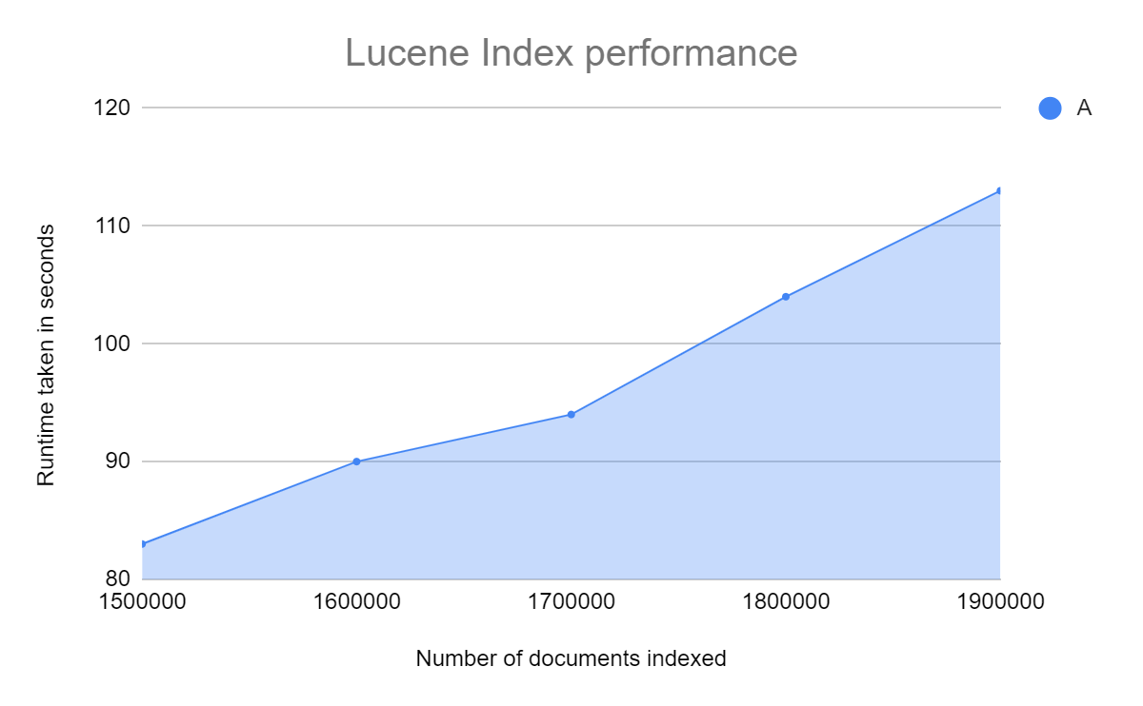
Lucene Indexing
After gathering the complete data using the crawler, we used pylucene to index the dataset based on a few fields, like hashtags, and tweet.
Standard Analyzer for tweets and Keyword Analyzer for hashtags were employed here.
Additionally, we looked at the performance of pylucene as the number of documents increases. Overall, for more than 1900000 documents, the indexing takes around 113 seconds.

Slide 5

BERT Indexing Strategy
BERT indexing strategy can be applied in various NLP methods such as question answering, information retrieval etc.
We’ve used BERT to create embeddings using a pre-trained BERT model.
Embeddings are added to an index for retrieving documents based on the query.
A number of methods can be used to store the indexes.
We’ve used FAISS indexing to store the embeddings.
The query is also embedded to retrieve similar documents.

Slide 6
BERT Architecture
We’ve used all-distilroberta-v1 pre-trained model and tokenizer.
FAISS is used for storing index.
The same all-distilroberta-v1 model is used to create embeddings for query.
Cosine similarity is used to calculate similarity.
FAISS index retrieves most similar embeddings.

Slide 7
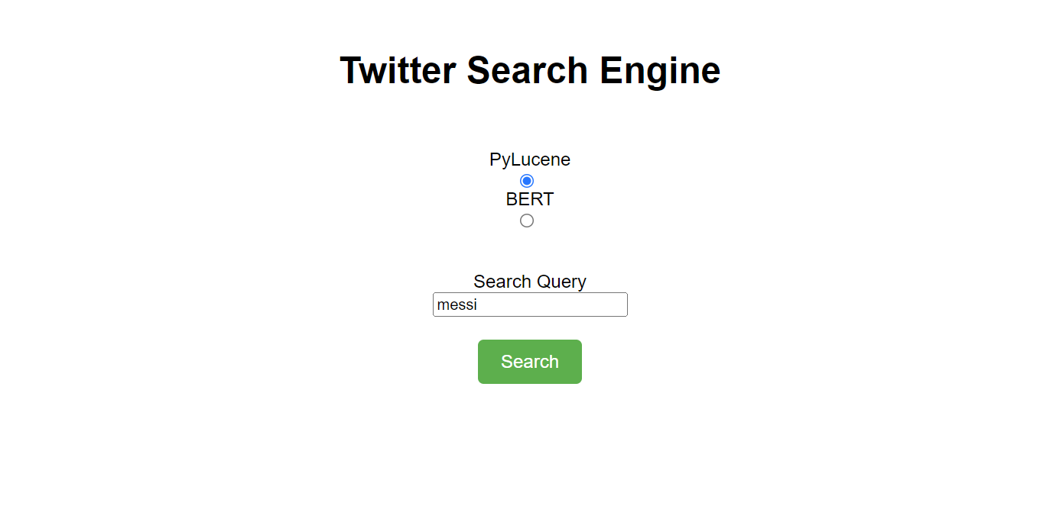
Project Demo : Home Page

Slide 8
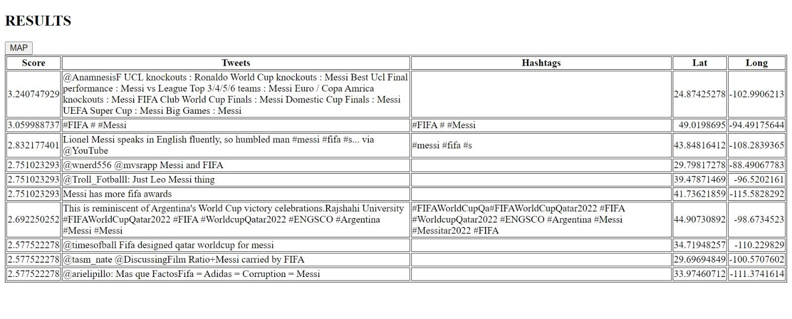
Project Demo : Lucene Retrieval UI

Slide 9
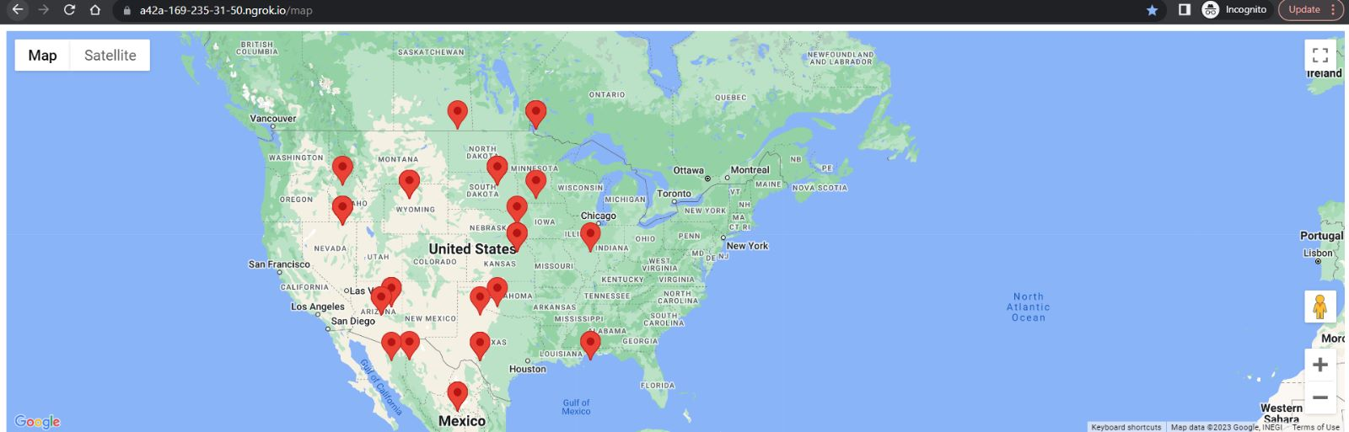
Project Demo : Representation on a Map

Slide 10
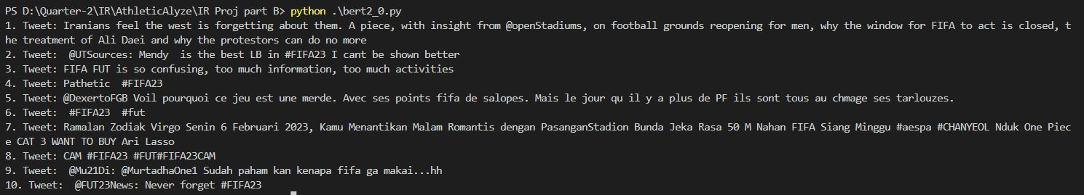
Project Demo : BERT Indexer

Slide 11

THANK YOU

