Slide 1
DATE-A-SCIENTIST
Machine Learning Fundamentals
Puneet Sran
November 17, 2018

Slide 2
Table of Contents
Exploration of Dataset
Question(s) to Answer
Augmenting the Dataset
Classification Approaches
Regression Approaches
Conclusion/Next Steps

Slide 3
Exploration of Dataset
To explore the dataset:
Plotted histograms for Height, Age, and Income to see frequency of data
Looked at the different variety of data within each column of dataset
Ex: Location had more varying data as compared to education
Both education and job inputs were filled by majority of users
Income did not have inputs from users

Slide 4
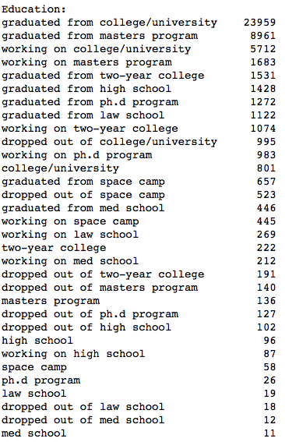
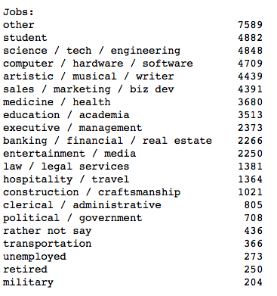
Value Counts: Education & Jobs

Slide 5
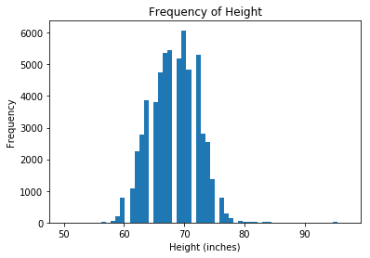
Height Frequency
Majority of height is clustered between 60 inches to about 78 inches.
(All histograms created by extracting desired column from .cvs file and selecting histogram as type of graph)

Slide 6
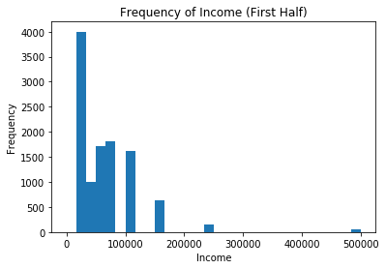
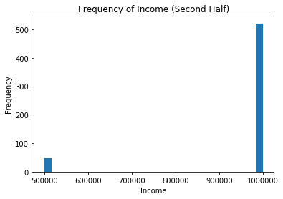
Income Frequency
Majority of income is zero as most people either do not have an income or chose to not share their income

Slide 7
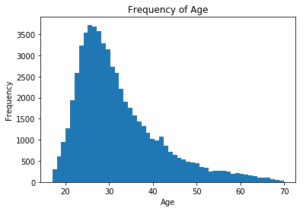
Age Frequency
Illustrates a better variance as compared to previous two graphs (however it should be noted that x-axis does not span a large array of numbers)

Slide 8
Question to Answer #1
Main Question:
Can I predict age, based on:
education
job
How I arrived at this question?
With age having the large variance in this dataset, it made sense to predict age;
It is possible to predict age, given education and job:
At 18, most people have graduated high school;
Upon completion of their post-secondary education, they are likely 2 to 5 years older than 18;
If a person has retired, they are likely over the age of 50 (or whatever the retirement age is of their given state)
Additionally, if they have a job and have had an education, it adds a few more years to their age.

Slide 9
Question to Answer #2
Secondary Question (just to see how regression & classification would perform)
Can I predict height based on:
education
job
How I arrived at this question?
Realistically, there is no correlation between height and education/job therefore this is mostly to see how the model performs if we feed it something arbitrary
Since I had already mapped data for education and job, I decided to use the data I already had

Slide 10
Augmenting the dataset
To augment the dataset:
Created codes (new columns) for two different categories:
Jobs
Education
How I did it?
Printed .value_counts() for the data I wanted (job, and education), and cleared NaN’s from the data using dropna() function
Mapped each option onto a number
Ex: for jobs, military is mapped to #19

Slide 11
Job Codes used
Job | job_code
student | 0
science / tech / engineering | 1
computer / hardware / software | 2
artistic / musical / writer | 3
sales / marketing / biz dev | 4
medicine / health | 5
education / academia | 6
executive / management | 7
banking / financial / real estate | 8
entertainment / media | 9
law / legal services | 10
hospitality / travel | 11
construction / craftsmanship | 12
clerical / administrative | 13
political / government | 14
rather not say | 15
transportation | 16
unemployed | 17
retired | 18
military | 19
other | 20

Slide 12
Classification Approaches
NAÏVE BAYES CLASSIFIER
K-NEAREST CLASSIFICATION

Slide 13
NAÏVE BAYES CLASSIFIER
Probably the most simple from the classifier approaches as it takes data as is and generates predictions
Since it’s best suited for text classification, it makes sense to use this approach as majority of our data is text
Time to run: 0.0427 milliseconds
Accuracy: 6.12 %
Precision: [0. 0. 0. 0. 0. 0. 0. 0. 0. 0.06123508 0. 0. 0. 0. 0. … ]
Recall: [0. 0. 0. 0. 0. 0. 0. 0. 0. 1. 0. 0. 0. 0. 0. 0. 0. … ]

Slide 14
K-NEAREST CLASSIFIER
Quite simple overall but requires determination of k-values:
can be slightly tricky to determine
k-values can overfit or underfit the data, and thus affect the accuracy
Time to run: 0.4655 milliseconds
Accuracy: 6.86%
Precision: [0.15384615 0.1875 0. 0.06666667 … ]
Recall: [0.14285714 0.20930233 0. 0.01219512 … ]

Slide 15
Comparison of Classification Approachess
The Naïve Bayes Classifier:
took less time to run (9.17 % of the time it took K-Nearest)
was slightly more accurate (by 10.79%)
Indicates that both approaches had similar results
was slightly less precise than K-Nearest
had a slightly worse recall than K-Nearest
Overall
Both approaches generated very similar results with the exception of time taken to run. Both did not have good accuracies but had good predictions
Sample of predicted data using K-Nearest:
[31 29 31 ... 24 21 26]

Slide 16
Regression Approaches
MULTIPLE LINEAR REGRESSION
K-NEAREST REGRESSION

Slide 17
MULTIPLE LINEAR REGRESSION
Probably the most simple to implement from the two regression approaches and allows us to see which variable affects a dependent variable most strongly
Since I am predicting age, the most strongest variable is whether a user has had an education; however, having an job will also factor into a person’s age therefore it is a dependent variable
Time to run: 0.0030 milliseconds
R² score: 0.0120
Variance Score: 0.0120
Mean Absolute Error: 7.3634

Slide 18
K-NEAREST REGRESSION
Similar to the classification approach, the k-nearest regression approach is simple but requires determination of k-values
Time to run: 0.2642 milliseconds
R² score: 0.1516
Variance Score: 0.1532
Mean Absolute Error: 6.7488

Slide 19
Comparison of Regression Approaches
Multiple Linear Regression
took less time to run (only 1.14% of the time it took K-Nearest)
K-nearest
had a better R² score but neither was close to 1
had a better Variance Score but neither was close to 1
had a better mean absolute error
Overall
Both approaches generated similar results with the exception of time taken to run.
Both approaches had small absolute mean errors, with Variance and R² score values being close to zero – indicating the model disregards the input features
Prediction of age using K-Nearest:
[34.55555556 32.55555556 34.55555556 ... 34.66666667 23.66666667 35. ]

Slide 20
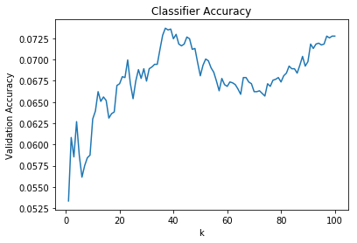
Graph of k
As k increases, accuracy also increases (overall), but with large dips
As learnt during lessons, underfitting and overfitting can occur if you increase or decrease the k-value

Slide 21
Question 2
Upon running the model based on question 2, results for both regression and classification were very different
Both classification approaches were more accurate as compared to Question #1
Regression approaches stayed approximately the same but with approximately half the mean absolute error
However, they had much smaller values for both R² score and Variance Score

Slide 22
Question 2 continued
 | Naïve Bayes | K-Nearest Class. | MLR | K-Nearest Regr.
Time to run | 0.0647 ms | 0.3225 ms | 0.0036 ms | 0.4004 ms
Accuracy | 10.46% | 9.27% | - | -
Precision | Similar for both with small variance |  | - | -
Recall | Similar for both with small variance |  | - | -
R² score | - | - | 0.0035 | 0.0075
Variance Score | - | - | 0.0037 | 0.0078
Mean Absolute Error | - | - | 3.1763 | 3.1446

Slide 23
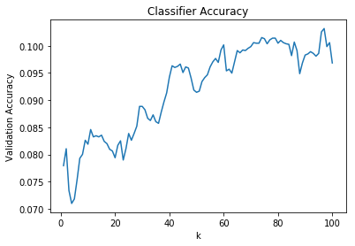
Question 2 continued
As k increases, accuracy also increases overall but has larger dips as compared to Question 1
As learnt during lessons, underfitting and overfitting can occur if you increase or decrease the k-value

Slide 24
Conclusion
In conclusion:
Due to low accuracy of regression and low R² score, we can concluded that the model did not perform well.
This is possibly due to ‘other’ option within jobs and;
Overlap within the education dataset
Ex: education has the following options: ‘high school’, ‘graduated from high school’, and ‘working on high school’. In this case, could ‘high school’ be in the same category as ‘graduated from high school’ or ‘working on high school’?
Additionally, those who have put in ‘graduated from high school’ but are actually 50+ made it difficult for the model to predict as they are clearly close to retirement age
While it is theoretically possible to predict age, given education and job; to model it best, we might need duration of how long the user was in school for and how long they have been at their job.
Perhaps we need to add more variables into the data such as offspring (as most people over the age of 30 are likely to have children)
We can possibly create additional columns for each option within education and job
Ex: Graduated from College/University can have a numerical value of 4 (as university graduation typically takes 4 years)
This requires additional research and some more thought.

Slide 25
Next Steps
Question:
Since job and location data seem to have better user inputs, perhaps I can predict which city (or state) has what kind of jobs
Ex: predict if tech-related jobs are in San Francisco
Ex: predict if entertainment jobs are in Los Angeles
Could also predict age with offspring added as a variable
Next Step:
I will try to create a ‘state’ column for each user and see if I can predict their job type (tech-related, entertainment, etc.) based on location or vice versa
Will try to map offspring data and add it as a variable

