Slide 1
DATE-A-SCIENTIST
Machine Learning Fundamentals
Puneet Sran
November 17, 2018

Slide 2
Table of Contents
Exploration of Dataset
Question(s) to Answer
Augmenting the Dataset
Classification Approaches
Regression Approaches
Conclusion/Next Steps

Slide 3
Exploration of Dataset
To explore the dataset:
I plotted columns for Height, Age, and Income to see frequency of data
Looked at the different variety of data within each column
Ex: Location had more varying data as compared to education
Income did not have inputs from users

Slide 4
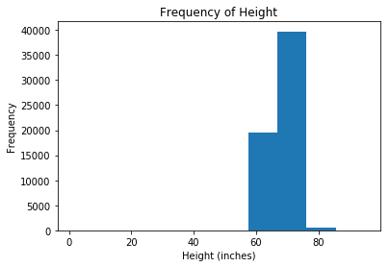
Height Frequency
Majority of height clustered between 60 inches to about 78 inches.
Created by extracting Height column from .cvs file and selecting histogram as type of graph

Slide 5
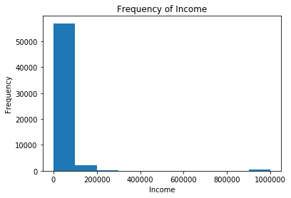
Income Frequency
Majority of income is zero as most people either do not have an income or chose to not share their income
Created by extracting Income column from .cvs file and selecting histogram as type of graph

Slide 6
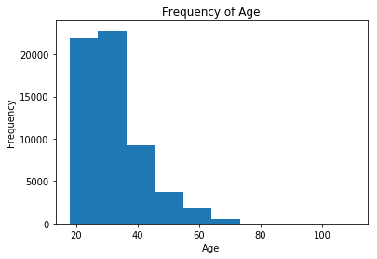
Age Frequency
Illustrates a better variance as compared to previous two graphs (however it should be noted that x-axis does not span a large array of numbers)
Created by extracting Age column from .cvs file and selection histogram as type of graph

Slide 7
Question to Answer
Main Question:
Can I predict income, based on:
education
job
age
location
How I arrived at this question?
In the real world, one is likely to generate an income if they have an education and a job. In addition, if they are older, they likely have a job and thus income. Lastly, populated cities tend to have more jobs, therefore one is likely to have an income if they live in a populated city.
Secondary Question (just to see how regression & classification would perform and for fun)
Can I predict location based on:
education
job
How I arrived at this question?
When I ran my code using question 1, the regression approaches were not accurate, therefore I input different variables to see how they would react.
Since I had already mapped data for education and job, I decided to use the data I already had

Slide 8
Augmenting the dataset
To augment the dataset:
Created codes (new columns) for three different categories:
Jobs
Education
Location
How I did it?
Printed .value_counts() for the data I wanted (job, education, and location), and cleared NaN’s from the data using dropna() function
Mapped each option onto a number
Ex: for jobs, military is mapped to #19

Slide 9
Job Codes used
Job | job_code
student | 0
science / tech / engineering | 1
computer / hardware / software | 2
artistic / musical / writer | 3
sales / marketing / biz dev | 4
medicine / health | 5
education / academia | 6
executive / management | 7
banking / financial / real estate | 8
entertainment / media | 9
law / legal services | 10
hospitality / travel | 11
construction / craftsmanship | 12
clerical / administrative | 13
political / government | 14
rather not say | 15
transportation | 16
unemployed | 17
retired | 18
military | 19
other | 20

Slide 10
Classification Approaches
NAÏVE BAYES CLASSIFIER
K-NEAREST CLASSIFICATION

Slide 11
NAÏVE BAYES CLASSIFIER
Probably the most simple from the classifier approaches as it takes data as is and generates predictions
Since it’s best suited to text classification, it makes sense to use this approach as majority of our data is text
Time to run: 0.0130 milliseconds
Accuracy: 77.78%
Precision: [0.77778931 0. 0. 0. 0. 0. 0. 0. 0. 0. 0. 0. 0. ]
Recall: [1. 0. 0. 0. 0. 0. 0. 0. 0. 0. 0. 0. 0.]

Slide 12
K-NEAREST CLASSIFIER
Quite simple overall but requires determination of k-values:
can be slightly tricky to determine
k-values can overfit or underfit the data, and thus affect the accuracy
Time to run: 0.2036 milliseconds
Accuracy: 77.38%
Precision: [0.77933928 0.26595745 0. 0. 0. 0. 0. 0. 0. 0. 0. 0. 0. ]
Recall: [0.99159327 0.0448833 0. 0. 0. 0. 0. 0. 0. 0. 0. 0. 0. ]

Slide 13
Comparison of Classification Approachess
The Naïve Bayes Classifier:
took less time to run (only 6.39% of the time it took K-Nearest)
was slightly more accurate (by 99.49%)
Indicates that both approaches work well
was also slightly more precise
had a slightly better recall
Overall
Both approaches generated very similar results with the exception of time taken to run. With the kind of data given, both performed well and were fairly accurate
Since majority of income was -1, the models predicted based on what the majority was ([0.99159327 0.0448833 0. 0. 0. 0. 0. 0. 0. 0. 0. 0. 0. ])

Slide 14
Regression Approaches
MULTIPLE LINEAR REGRESSION
K-NEAREST REGRESSION

Slide 15
MULTIPLE LINEAR REGRESSION
Probably the most simple to implement from the two regression approaches and allows us to see which variable affects a dependent variable most strongly
Since I am predicting income, the most strongest variable is whether a user has a job; however, having an education, being older than 18 (in most cases) and living in a populated city will also factor into what kind of income the user has
Time to run: 0.0037 milliseconds
R² score: 0. 0025
Variance Score: 0.0025
Mean Absolute Error: 35553.32

Slide 16
K-NEAREST REGRESSION
Similar to the classification approach, the k-nearest regression approach is simple but requires determination of k-values
Time to run: 0.2391 milliseconds
R² score: -0.2338
Variance Score: -0.2337
Mean Absolute Error: 38106.33

Slide 17
Comparison of Regression Approaches
Multiple Linear Regression
took less time to run (only 1.55% of the time it took K-Nearest)
had a better R² score (with K-Nearest having a negative number)
Indicates that the model was bad for both
had a better Variance Score (with K-Nearest having a negative number)
Indicates that the model was bad for both
had a better mean absolute error
Overall
Both approaches generated similar results with the exception of time taken to run. Both approaches did not model the data well, while also having large errors.
However, predictions for income using regression were greatly different from the classification predictions, with much less -1’s, and much more realistic incomes

Slide 18
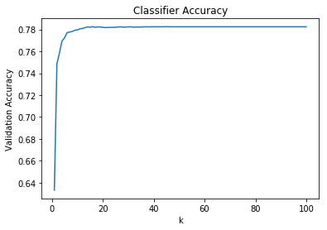
Graph of k
As k increases, accuracy increases and then levels off just before 20

Slide 19
Question 2
Upon running the model based on question 2, results for both regression and classification were very different
Both classification approaches were less accurate
Regression approaches stayed approximately the same but with much less mean absolute error
This is possibly due to the variance in location data as compared to the -1’s in the income data

Slide 20
Question 2 continued
 | Naïve Bayes | K-Nearest Class. | MLR | K-Nearest Regr.
Time to run | 0.1208 ms | 0.2852 ms | 0.0032 ms | 0.3049 ms
Accuracy | 52.58% | 50.16% | - | -
Precision | Similar for both with small variance |  | - | -
Recall | Similar for both with small variance |  | - | -
R² score | - | - | 0.0036 | -0.0876
Variance Score | - | - | 0.0036 | -0.0873
Mean Absolute Error | - | - | 9.0625 | 9.4021

Slide 21
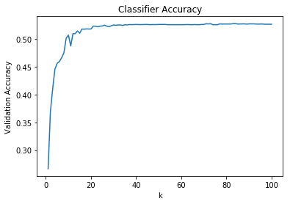
Question 2 continued
As k increases, accuracy also increases but dips down at around 15, and then levels off at around 20
Compared to question 1, the graph is not as smooth but has a similar curve

Slide 22
Conclusion / Next Steps
In conclusion:
Prediction of income is possible and can be accurate but due to lack of income data or majority of income being -1, we cannot say that the model performed well.
Upon scanning the job data, users with jobs have put -1 as their income and this indicates that the information is not correct. Therefore, we cannot predict income based on education and jobs for this dataset
Question:
Since job and location data seem to have better user inputs, perhaps I can predict which city (or state) has what kind of jobs
Ex: predict if tech-related jobs are in San Francisco
Ex: predict if entertainment jobs are in Los Angeles
Next Step:
I will try to create a ‘state’ column for each user and see if I can predict their job type (tech-related, entertainment, etc.) based on location or vice versa

