Slide 1
HR Analytics
CASE STUDY SUBMISSION
Group Name:
Abhishek Bansal
Puneet Tripathi
Melvin Vallully
Srishti Khanna

Slide 2
Abstract
XYZ, employs over 4000 employees
Their yearly attrition is around 15%, resulting in
  Delayed Projects
  Need for more backup resources
  More number of trainings and onboarding sessions for New employees
All the above factors is impacting their operational cost and brand value

Slide 3
Problem solving methodology
Data Preparation -
Test for duplicates
Fix NA values
Fix outliers
Create Segmented variables – like age group, overtime etc.
EDA -
Perform univariate and multivariate analysis
Modeling -
Create train/test data by spliting the data in 70:30 ratio
Run stepAIC on train data, run iteration to remove columns with High VIF and high p-value
Take final model and use it to predict attrition in test model
Evaluate model on sensitivity, specificity and accuracy of model
Create Gain/Lift charts to validate the model strength
Find KS-statistics to determine the discriminating power of model

Slide 4
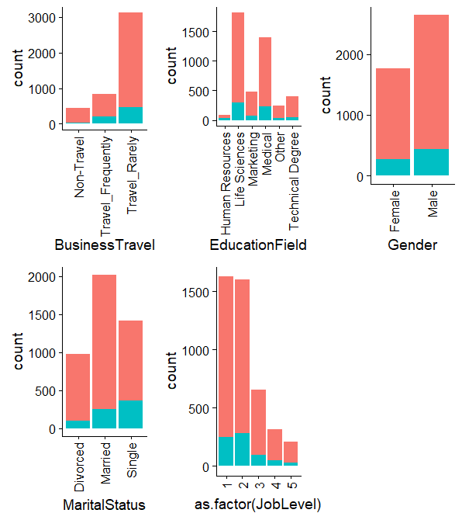
Variables across attrition
BusinessTravel has a clear impact on attrition
Other variables too are showing significant spread for attrition
Numberwise More Males leave job but percentagewise women leave more
Singles tend to quit jobs more than married and divorced

Slide 5
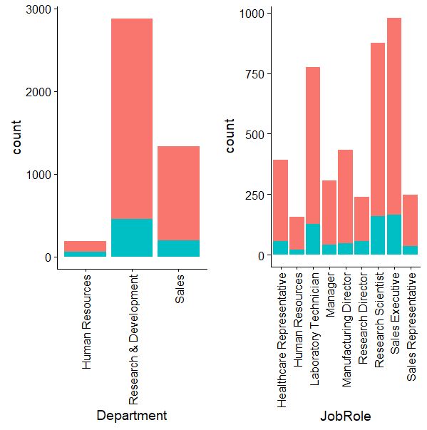
Variables across attrition
People working in Research be it Research Scientist or Lab Technician quits job more than others
Sales executives are also attrition prone more than others

Slide 6
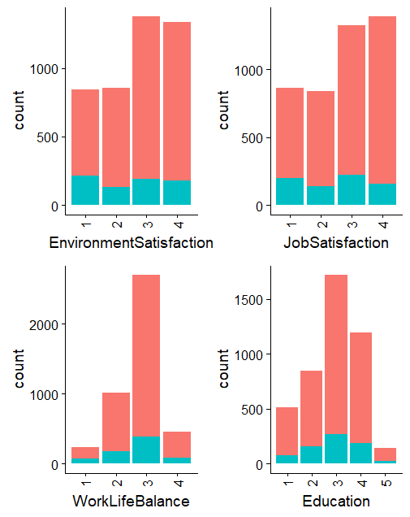
Factor (ordinal though) but have numerical value
WorkLifeBalance & Eduation is an important Factor
Looks like EnvironmentSatisfaction and JobSatisfaction explains variance in similar fashion

Slide 7
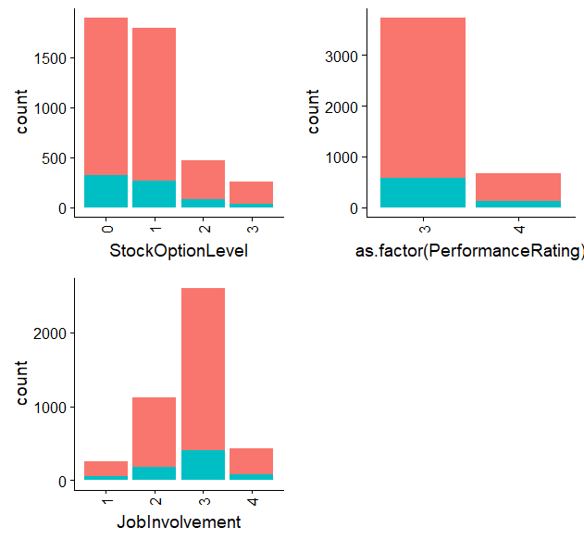
Variables categorical (ordinal) in nature
All of these variables looks important as they have significant attrition spread
StockOptionLevel and JobInvolvement looks like key

Slide 8
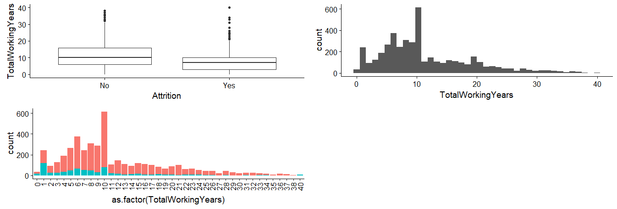
Total Work Experience
People leaving company have median 7 years of experience and have relatively lower overall experience
This might mean as people get more experienced they tend to stay at same company for longer time

Slide 9
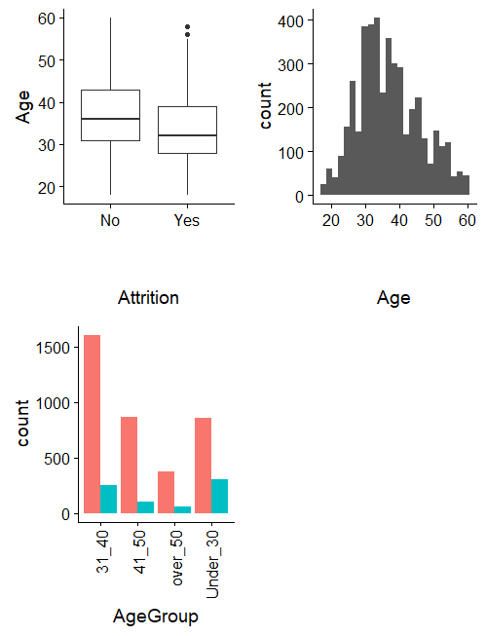
Age and AgeGroup
Mostly work force has age between 25 to 50
People resigning appears to be relatively younger ones
We will use AgeGourp for modeling as it gives a creaer picture, So dropping Age

Slide 10
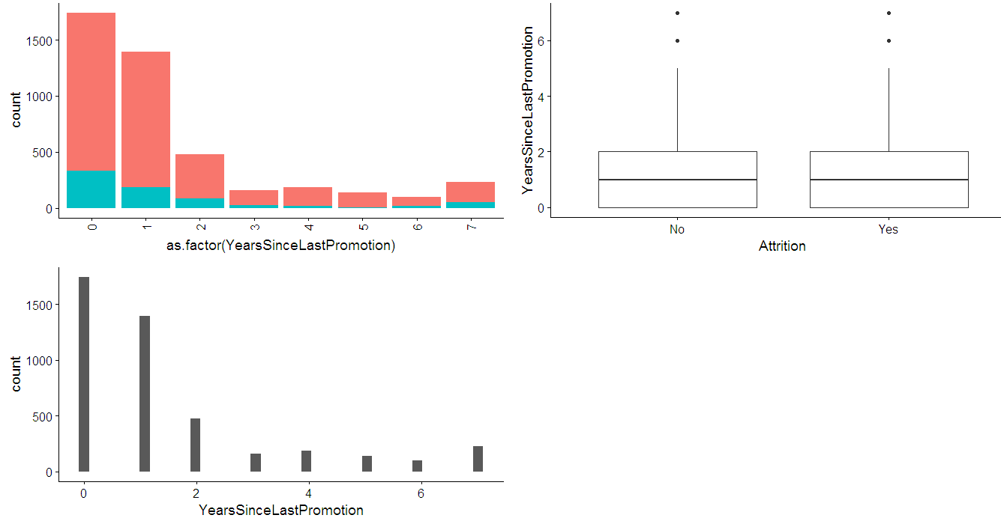
Years Since Last Promotion
people are trying to change job soon after getting promotion
that might make sense as well because that means reaching higher salary/ higher grade jump in relatively lower time span

Slide 11
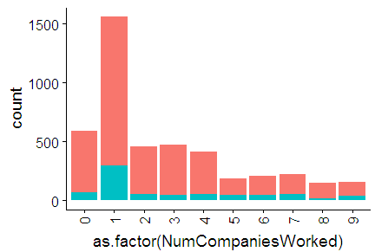
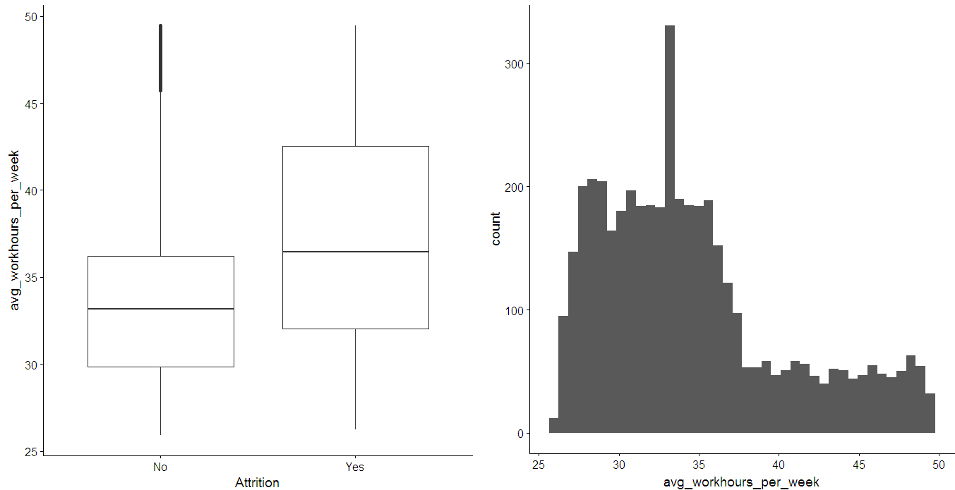
Other Variables having impact on Attrition
Most people leaving have worked in 1 company or if it is their 1st company
People resigning are those who are generally overworked

Slide 12
Model Creation
We did a 70-30 split for Training & Testing respectively
Post stepAIC and 29 Iterations over Train dataset, we reached a model that takes 13 input variables
AIC – 2226.1, Null deviance: 2747.7, Residual deviance: 2198.1
Final Model Equation –
model_29 <- glm(formula = Attrition ~ NumCompaniesWorked + TotalWorkingYears +
YearsAtCompany + YearsSinceLastPromotion +
avg_workhours_per_week + AgeGroup.xUnder_30 +
EnvironmentSatisfaction.x2 + EnvironmentSatisfaction.x3 +
EnvironmentSatisfaction.x4 + JobSatisfaction.x4 +
BusinessTravel.xTravel_Frequently + JobRole.xManufacturing.Director +
MaritalStatus.xSingle,
family = "binomial", data = train)

Slide 13
Model Evaluation
We predicted the Attrition on test dataset -
summary(test_pred)
Min. 1st Qu. Median Mean 3rd Qu. Max.
0.002391 0.046552 0.110468 0.171465 0.238789 0.862327
Then we plotted sensitivity, specificity and accuracy of model, and finalized a cutoff of 0.1775758
+------------------------------------------+
|Accuracy | Sensitivity | Specificity |
+------------------------------------------+
|0.733938 | 0.7294686 | 0.734767 |
+------------------------------------------+
Plot of sensitivity, specificity and accuracy on next page
KS-Statistics of our model is 0.4642356 – which is a satisfactory discrimination power

Slide 14
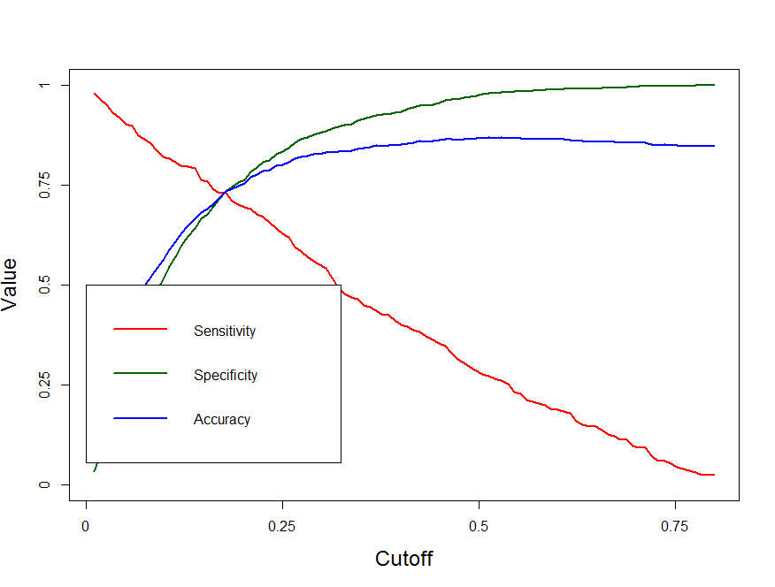
Model Evaluation – Contd.
Plot of sensitivity, specificity and accuracy

Slide 15
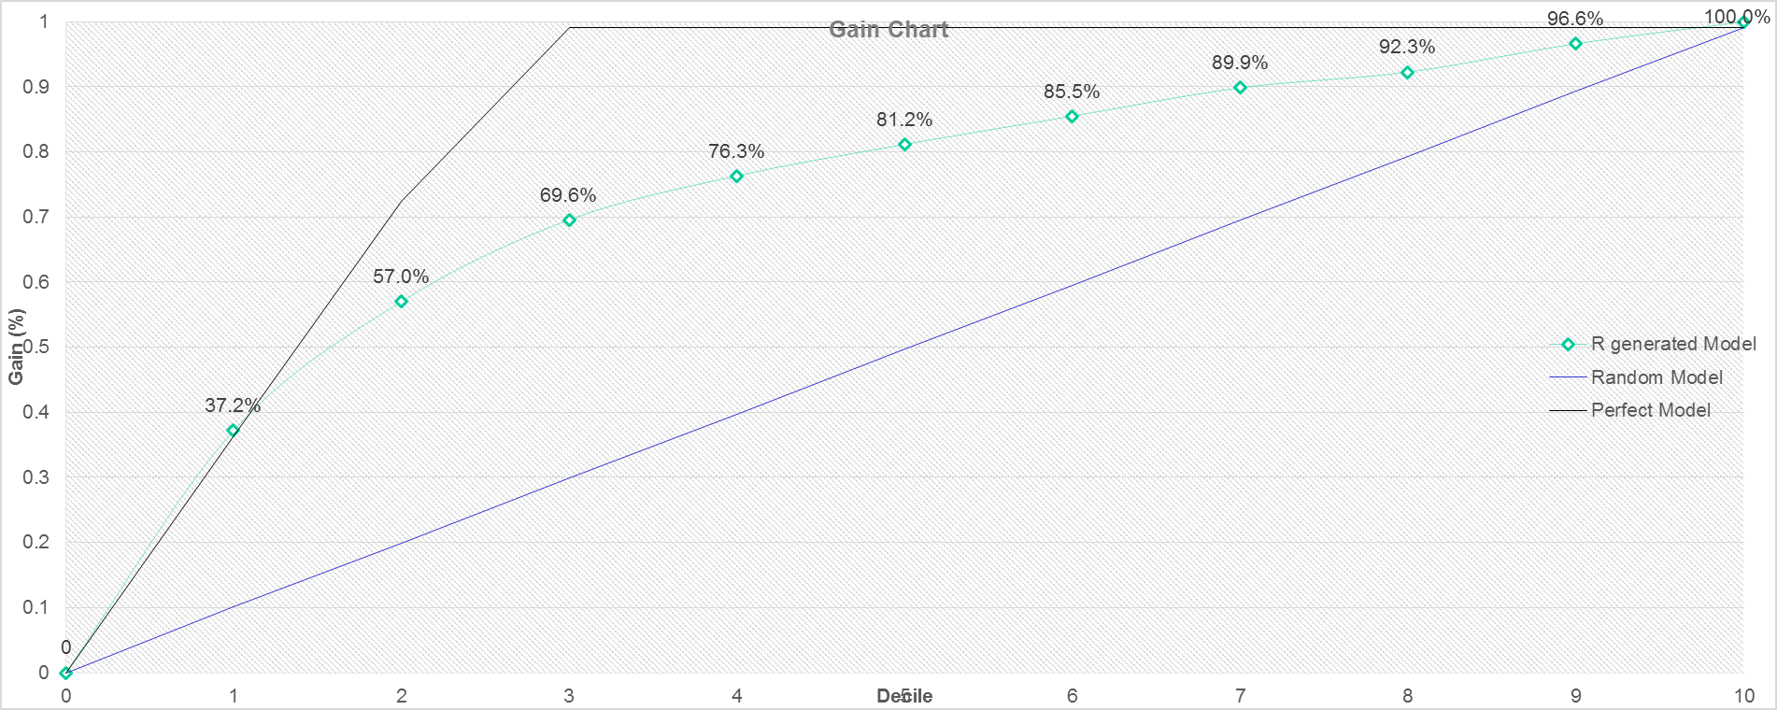
Model Evaluation – Gain Chart
From Gain Chart it is clearly visible that in 4th decile using our model we identify 76.3% of attrition.

Slide 16
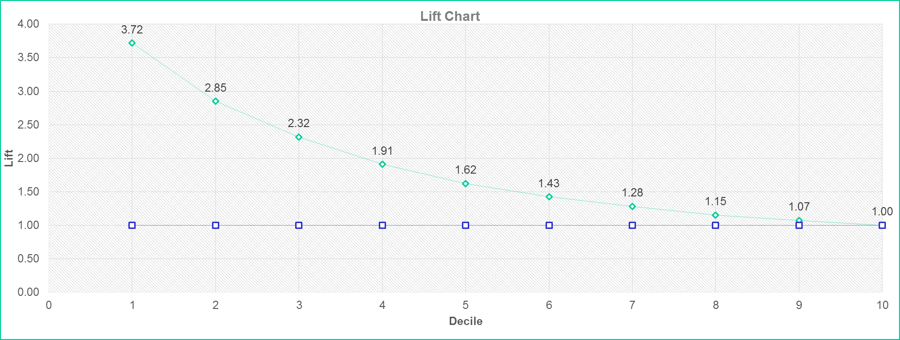
Model Evaluation – Lift Chart
From Lift Chart it is clearly visible that in 3rd decile our model is outperforming a random model by 2.32 and in 4th by 1.91

Slide 17
Conclusion
Factors that affect adversely and attribute to increase in attrition are:
NumCompaniesWorked – People who have worked in many companies before have higher chances of leaving.
YearsSinceLastPromotion – People who have not been promoted for a long time have higher chances of leaving.
avg_workhours_per_week – Has strong impact on attrition, people who are working more hours, i.e. overworked employee, are more likely to leave company.
AgeGroup.xUnder_30 – It tells that people with age under 30 are more likely to change job than others.
BusinessTravel.xTravel_Frequently – People traveling frequently is coming out a factor for attrition, as it may be affecting their work life balance.
MaritalStatus.xSingle – the employees who are single have higher chances of leaving than the ones married or divorced

Slide 18
Conclusion – contd.
Factors that keeps attrition in control:
TotalWorkingYears – This variable has a very low p-value and has stronger impact on attrition. The employees with higher work experience tend to stay longer at company.
YearsAtCompany – People who have spent more time at company tends to stay with the company.
EnvironmentSatisfaction.x2/ x3 / x4- People who rated work environment as Medium/ High/ Very High are happy with the company environment and do not leave.
JobSatisfaction.x4 –People only who are very highly satisfied with their job are going to stay with the organization.
JobRole.xManufacturing.Director – Employees who are Director in manufacturing are satisfied with their role and tend to stay with the organization

