Slide 1
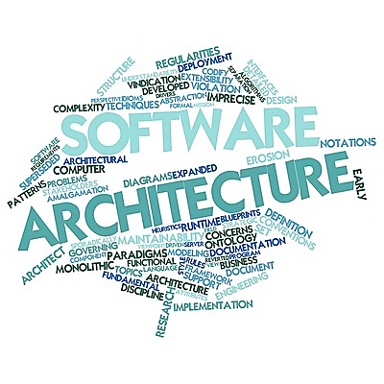
“Software Architecture Patterns”
1

Slide 2
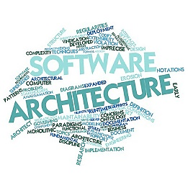
“Software Architecture Patterns”
# Agenda! We Are Going To Cover:-
Introduction.
What is Software architecture patterns?
Why Software architecture patterns?
When we follows Software architecture patterns?
Who follows software architecture patterns?
Discussion about Essentials Software Architectures?
2

Slide 3

# Introduction:- What is Software architecture patterns ?
Reusable predefined solutions.
Set of instructions, rules, specifications and guidelines.
Customizable and merged able.
3

Slide 4
# Introduction:- Why Software architecture patterns?
To give commonly occurring problems solutions, from previous listens and learns.
To avoid common problems, issues and mistakes, those are already fetched.
Helps in decision making, creating new design solutions that needs in applications.
4

Slide 5
# Introduction:- When, Who follows Software architecture patterns?
Before any Software Development need to know about those patterns clearly.
Before Develop any enterprise application need to know about those pattern.
When you want to know, how existing enterprise application overcome their critical salutation and how to solved those.
5

Slide 6
# Architectural Design Patterns
High-Level structural designs for organizing a software system.
Provide solutions to common problems related to system-level concerns such as scalability, maintainability, and performance.
Key Characteristics:
Scope: Applied at the system level, affecting the overall organization and structure.
Purpose: Define how components interact, how data flows, and how responsibilities are distributed.
Abstraction Level: High-level; focuses on the "big picture."
Implementation: Involves multiple subsystems, modules, or layers.

Slide 7
# Design Patterns
Reusable solutions to common problems in software design at the code level
Focus on object-oriented design principles and are more concerned with how specific components interact.
Key Characteristics:
Scope: Applied at the component or class level, often within a single module or layer.
Purpose: Solve recurring design problems such as object creation, communication, or behaviour.
Abstraction Level: Low-level; focuses on implementation details
Implementation: Often involves classes, interfaces, or objects.

Slide 8

# Introduction:- Discussion about essentials software architectures
Layered Architectural Pattern and MVC
Microkernel Architectural Pattern
CQRS Architectural Pattern
Event Sourcing Architectural Pattern
Microservices Architectural Pattern
6

Slide 9
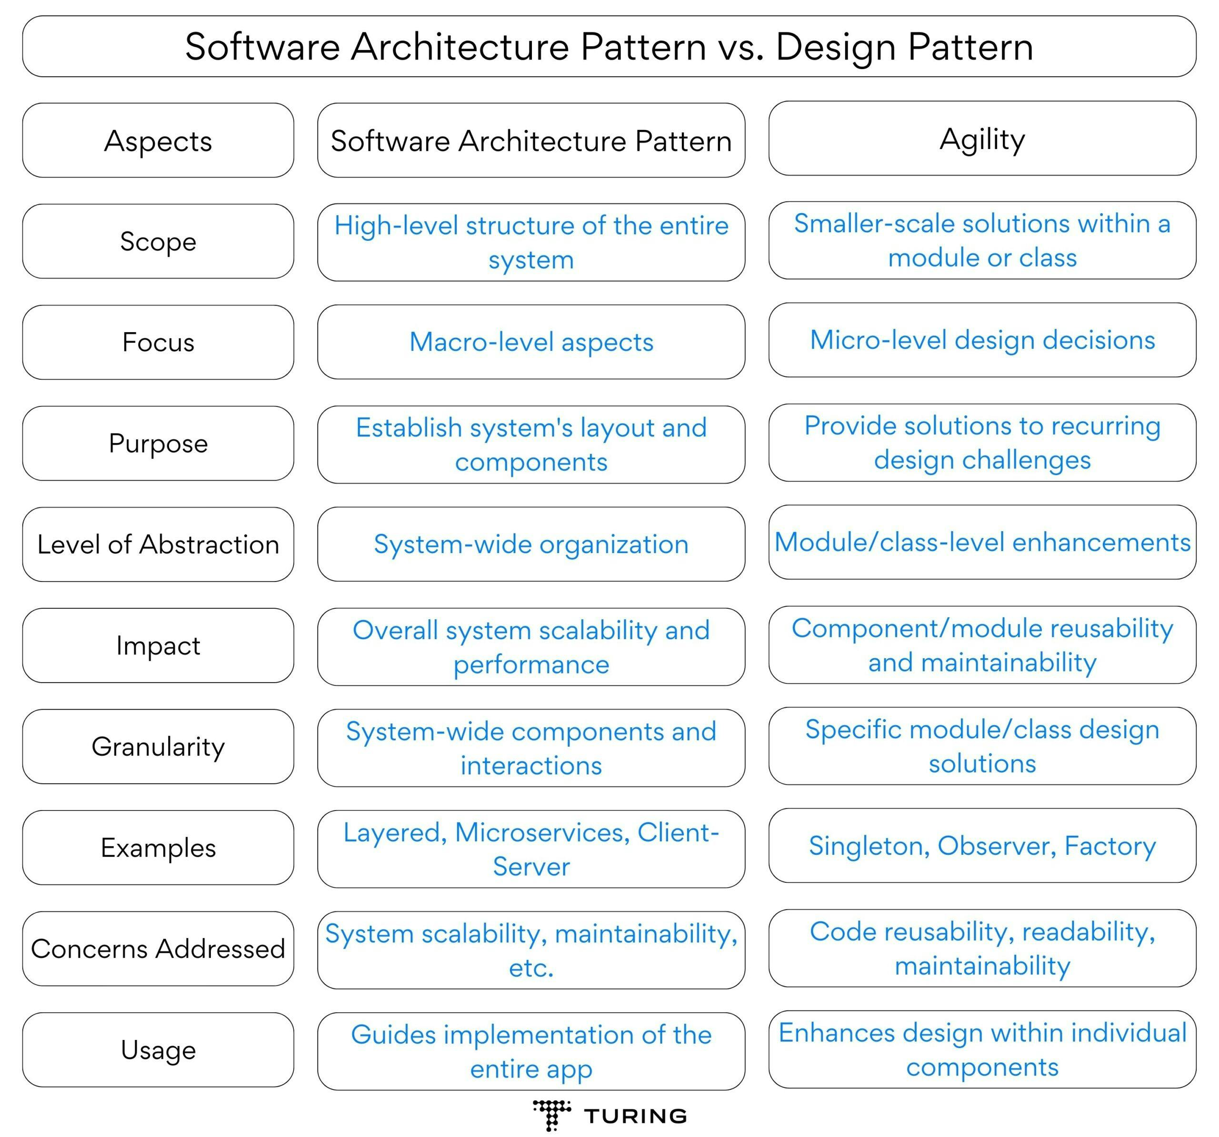

Slide 10
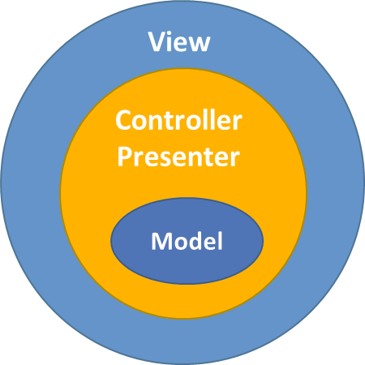
# Layered Architectural Pattern and MVC
Split up code into layers, they have different responsibly for higher layer.
Layer can be logical separation of code or physical separation of code.
Physical separation of code is know as tier.
Layer aren’t predefined. But most common flow
Presentation
MVC
Most Used Pattern
Application
Call between layers flow downward
Business
Persistence
Databases
Tiers may seem similar to the model-view-controller (MVC).
MVC architecture is triangular, the view sends updates to the controller, the controller updates the model, and the view gets updated directly from the model.
MVC components could talk to each other, layered architecture only allows message passing between layers. MVC architecture is mostly used for presentation, but layered architecture is focused on the entire system
Explanation:
User click a button from Presentation layer, then it call application layer
Now, Application layer call Business layer and process its logical operations
And finally store data through Persistence layer, then store it in Database
7

Slide 11
# Layered Architectural Pattern and MVC (Pros & Cons )
Pros:
Most developers are familiar with this pattern.
It provides an easy way of writing a well-organized and testable application.
Cons:
It tends to lead to monolithic applications that are hard to split up afterward.
If you are writing a simple CRUD application, without adding any value in these layers. Need to writing lot of code in different layers.
When Choose:
For small business. and small organizations
Individual Development
8

Slide 12
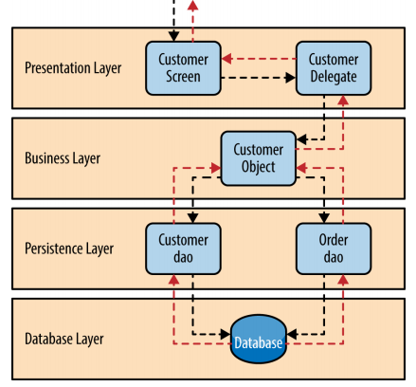
# Layered Architectural Pattern Example

Slide 13
# Layered Architectural Pattern Analysis
Overall Agility - Low
Ease of Deployment - Low
Testability - High
Performance - Low
Scalability - Low
Ease of Development - High

Slide 14
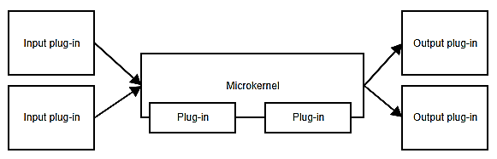
# Microkernel Architectural Pattern
Most of the application developed on this pattern
Limiting the features, so that application makes more light weight, functional and extensive.
Plug-in pattern, is useful when application has a core set of responsibilities and a collection of interchangeable parts on the side.
We are familiar with plugins or extensions
Explanation:
Like Chrome, Eclipse, Photoshop or other application we’re adding plugins for extended functionality.
Microkernel could contain all the logic for scheduling and triggering tasks, of plugins. Or they can share task and logic through APIs.
But application should run limited functional, without depends on plugins
9

Slide 15
# Microkernel Architectural Pattern (Pros & Cons )
Pros:
Provides great flexibility and extensibility.
Some implementations allow for adding plugins while the application is running.
Microkernel and plugins can be developed by separate teams.
Cons:
Difficult to decide what belongs in the microkernel and what doesn’t.
Predefined API might not be a good fit for future plugins development for separate teams.
When Choose:
For Workflow Applications.
Applications take data from different sources, transform that data and writes it to different destinations
10

Slide 16
# Microkernel Pattern Analysis
Overall Agility - Low
Ease of Deployment - Low
Testability - High
Performance - Low
Scalability - Low
Ease of Development - High

Slide 17
# CQRS Architectural Pattern
CQRS is an acronym for Command and Query Responsibility Segregation.
The central concept of this pattern is that an application has read operations and write operations that must be totally separated.
Implementations can be like below:
If use a relational database, this means there will be tables for the command model and tables for the read model.
Some implementations even store the different models in totally different databases, e.g. SQL Server for the command model and MongoDB for the read model. (Cause RDBMS faster for write and NOSQL faster for read)
11

Slide 18
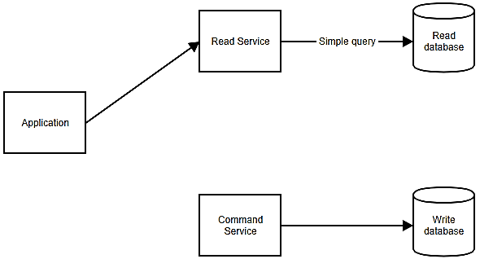
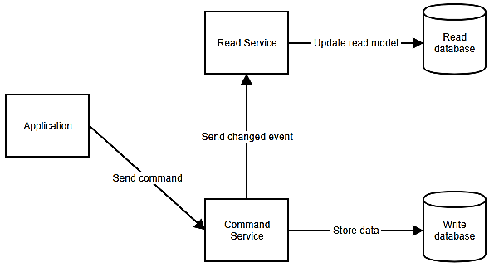
# CQRS Architectural Pattern Flow
How to read or fetch data from Databases
How to write data in Databases
After send command store data in write database then update changes in read database.
12

Slide 19
# CQRS Architectural Pattern (Pros & Cons )
Pros:
Command models can focus on business logic, other side read models can ensure validity of tailored.
You can avoid complex queries (e.g. joins in SQL). which makes the reads more performant.
Cons:
Keeping the command and the read models in sync can become complex.
When Choose:
Applications with complex domains like enterprise applications.
Need when High amount of reads.
13

Slide 20
# Event Sourcing Architectural Pattern
CQRS is closely related to Event Sourcing.
In this pattern we don’t just store current state of model in the database, but also the events that happened to the model. (e.g. if want to change the name of user then need to store ‘NameChanged’ event with new and possibly the old one too. Immutable
When need to retrieve a model, then retrieve all its stored events and reapply them on a new object. It’s knows as rehydrating an object.
A real-life analogy of event sourcing is accounting. When you add an expense, you don’t change the value of the total. In accounting, a new line or record is added with the operation to be performed.
If an error was made. Then just simply add a new line. To make your life easier, you could calculate the total every time and add a line. This total can be regarded as the read model.
14

Slide 21
# Event Sourcing Architectural Pattern: Example
Jobs | Amount | Event
… | … | …
Invoice 19_03_22 | 500 | generate_invoice
Buy Pen | - 10 | expense_add
Buy Pencil | - 5 | expense_add
Invoice 19_04_22 | 485 | generate_invoice
Buy Bangla Book | -200 | expense_add
Cancellation invoice 19_04_22 | - 485 | make_invoice_correction
Invoice 19_04_22 | 215 | generate_invoice
Total | 715 | <== Auto-updated read model
Total Expenses: 10+5+200 = 215
Total Expenses: 500 +215 = 715
15

Slide 22
# Event Sourcing Architectural Pattern (Pros & Cons )
Pros:
It can provide an audit log out of the box.
Each event represents a manipulation of the data at a certain point in time.
Cons:
Requires some discipline because you can’t just fix wrong data with a simple edit in the database.
Not trivial task to change the structure of an event. E.g. suppose need to add property, then still contains previous events without that property. Now manually need to handle this missing data in code.
When Choose:
Will be built with CQRS.
Need publish events to external systems.
Have complex domains.
Need an audit log of changes to the data.
16

Slide 23
# Event Sourcing Architectural Pattern: Typical Workflow
Event Generation
A customer places an order.
Instead of updating an "Orders" table, an "OrderPlaced" event is created,
with details like order ID, items, and timestamp.
Event Storage
The "OrderPlaced" event is stored in the event store.
Read Model Update
Event handlers consume the "OrderPlaced" event and update a read model
(e.g., a denormalized database optimized for querying).
State Reconstruction
If the system needs the current state of the order, it replays all events for that order
(e.g., "OrderPlaced," "PaymentReceived," "OrderShipped").
Event Propagation
The "OrderPlaced" event is published to other systems,
such as inventory management or notifications.

Slide 24

“Microservices”
Microservices is basically a Software Development Architecture.
Design application or services that can Independently deployable.
17

Slide 25
# What is microservices?
Need to know about Monolithic.
Monolithic Vs Microservices.
Why Monolithic to Microservices?
All the functionality and responsibility are separated.
All the functionality and responsibility into single application
User Registration
Service
User Registration
Order
Inventory
Inventory
Service
Payment
Application
API
Order
Service
E-Shop Monolithic Base Application
E-Shop Microservices Base Application
Payment
Service
18

Slide 26
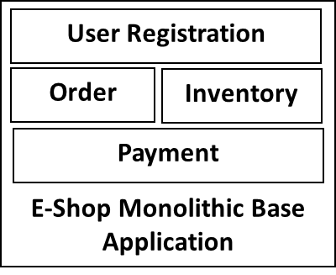
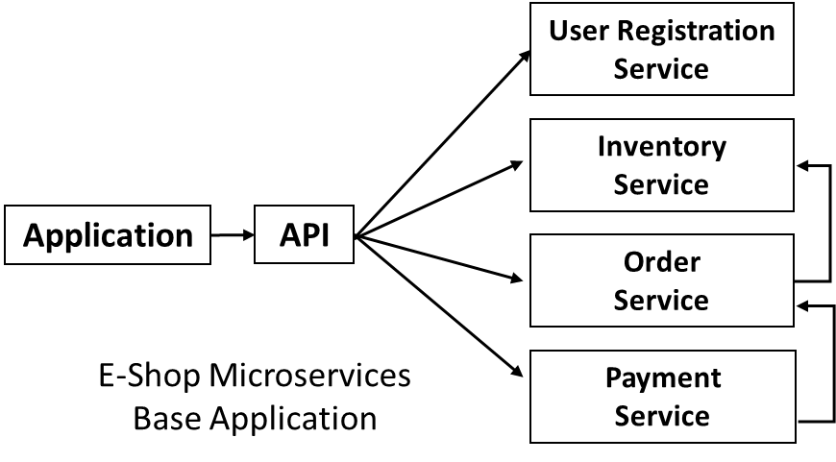
# Monolithic Vs microservices
To Scale Or replicate a Monolithic application need multiple servers. Legacy operations are complex.
Allocate more resources, so it’s increase costs.
Continuous features development, integrations and development are harder and slow.
To Scale Or replicate by distribute across servers as needed.
It’s easier to rewrite pieces of the application because they’re smaller and less coupled to other parts.
Need to handle communication, coordination, backward compatibility, logging, etc.
Hard to writing a good set of microservices.
19

Slide 27
# When Choose microservices?
Applications where certain parts will be used intensively and need to be scaled.
Services that provide functionality to several other applications.
Applications that would become very complex if combined into one monolith.
Where application need data and is responsible for its integrity and mutability.
20

Slide 28
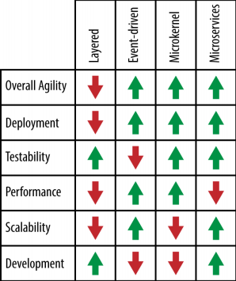
Comparison

