Slide 1
Presentation on:
Tim Hortons restaurant app for android platform.

Slide 2
Tim Hortons App
DEEPAK PUNIA (C0739472) Backend
PRABHJOT SINGH GILL (C0739416) Frontend
TEHAL SINGH SRAN (C0736348) Frontend

Slide 3
Contents:
Project Objective
Project Introduction
What we learned?
Requirements
End Users
Application Snapshots
Demonstration

Slide 4
Project Objective:
To develop an android interactive app which provides:-
Nearest store selection.
Order food online.
Manage order list.

Slide 5
Project Introduction:
More than half of people aged 25-29 now live in households with mobile phones but no traditional landline telephones. That encourage application development.
We are living in a busy world and every minute counts. Whether you are working from home, a businessman, or an office attendant, everyone is working in their way. However, one thing is universal when it comes to the modern man regardless of the profession. We are all too busy to have time for a delicious and well-balanced meal.
Tim Hortons app is here to make our lives comfortable.

Slide 6
What we learned and used?
Technical Leaning:
Android programming
Fragmentation and Tab Bar
WebView
Custom Adaptor
Database : SQLite
List View
Spinner
General Learning:
Team Work

Slide 7
Requirements:
Android version 2.2 and Higher versions.
Visual Studio
Database: SQLite
Xamarin
Programming language: C#

Slide 8
End User:
Anyone who is hungry.

Slide 9
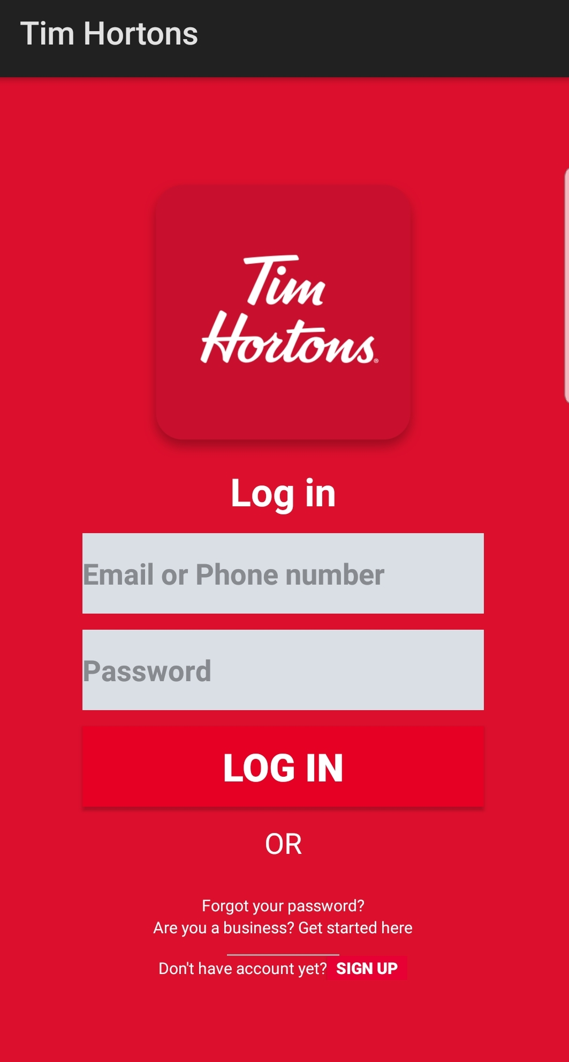
Application Snapshots:
When user open the application, main activity starts and this is the first page that appears, which is a LOGIN PAGE.
User can login with username and password.
Entered data is matched with database records.
Data validation is done.

Slide 10
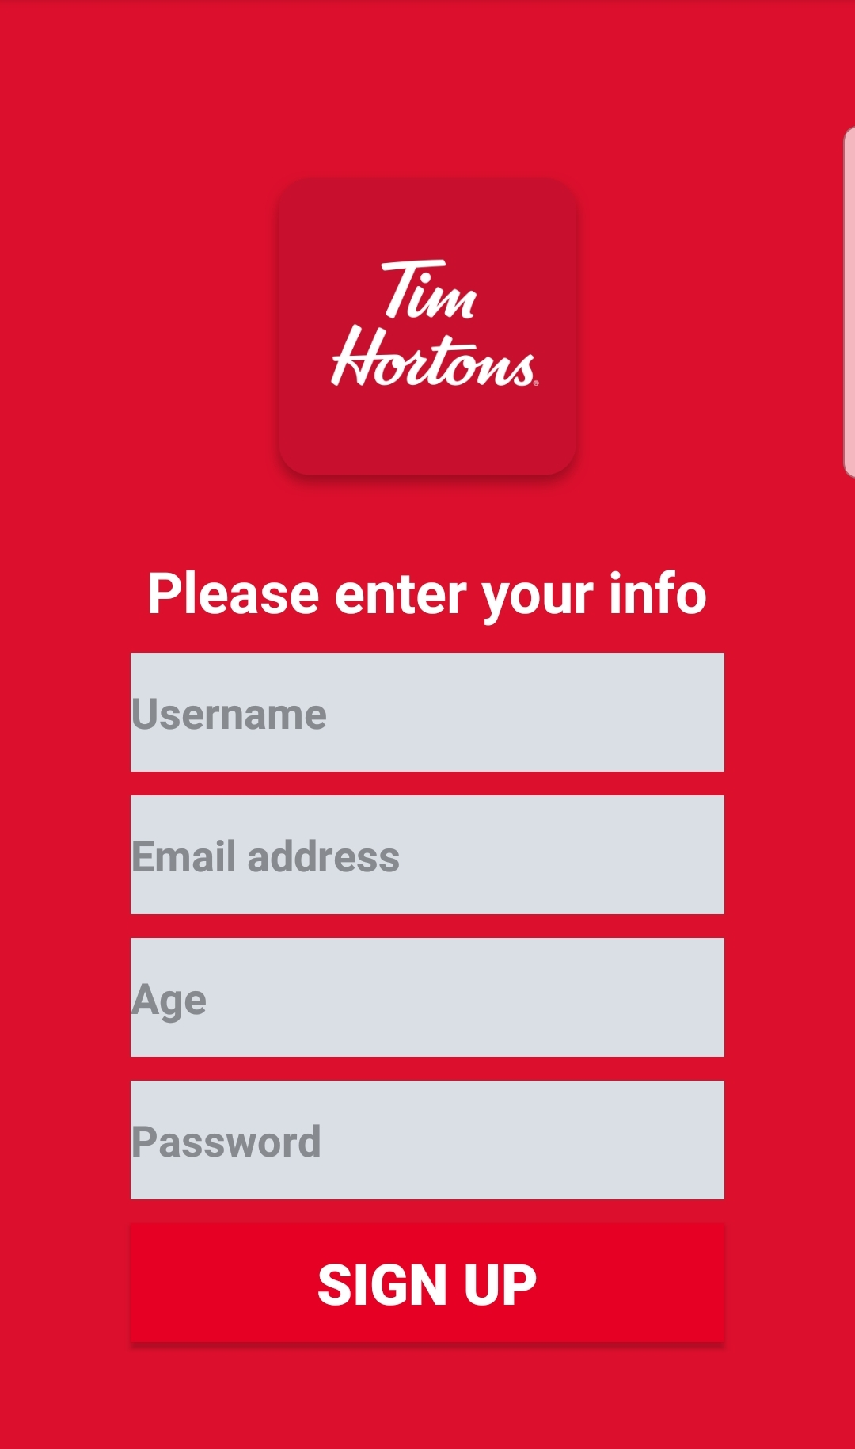
Application Snapshots:
This is signup page.
User can enter details create account for the application.
Database record is created for the user after clicking sign up button.

Slide 11
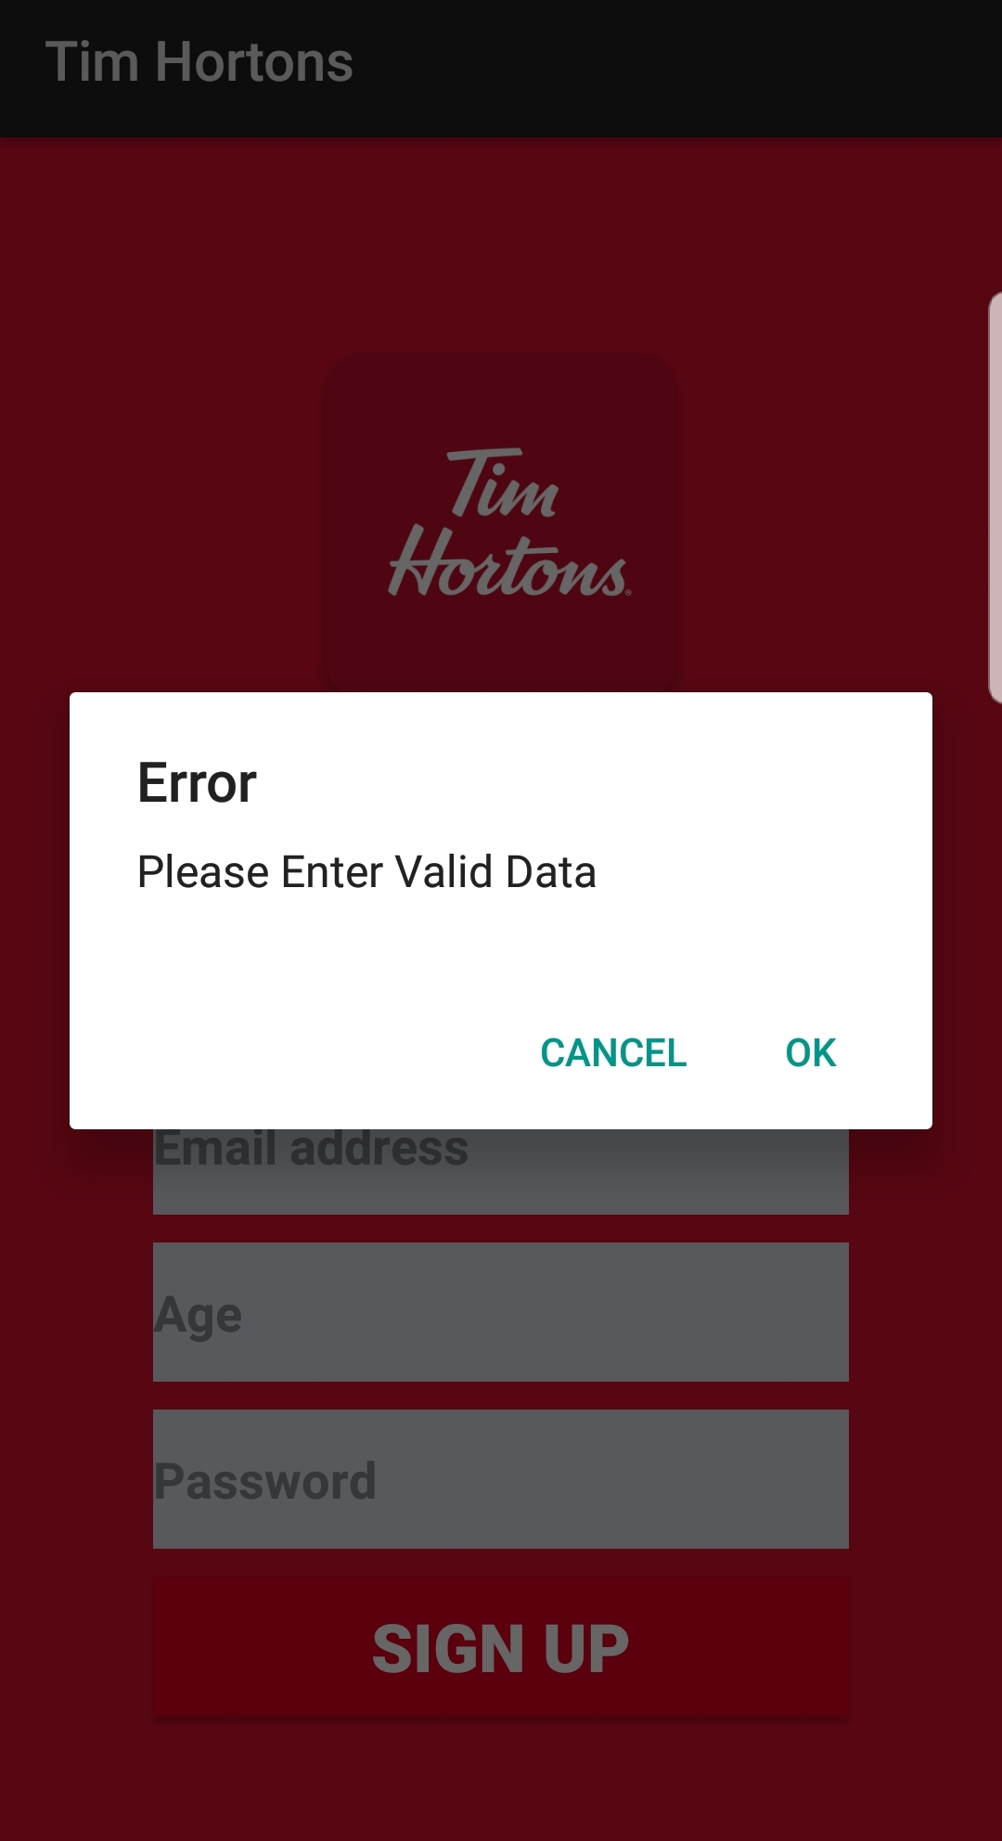
Application Snapshots:
Alert message is shown if data is entered incorrectly.
Data validation is performed before saving data into database.

Slide 12
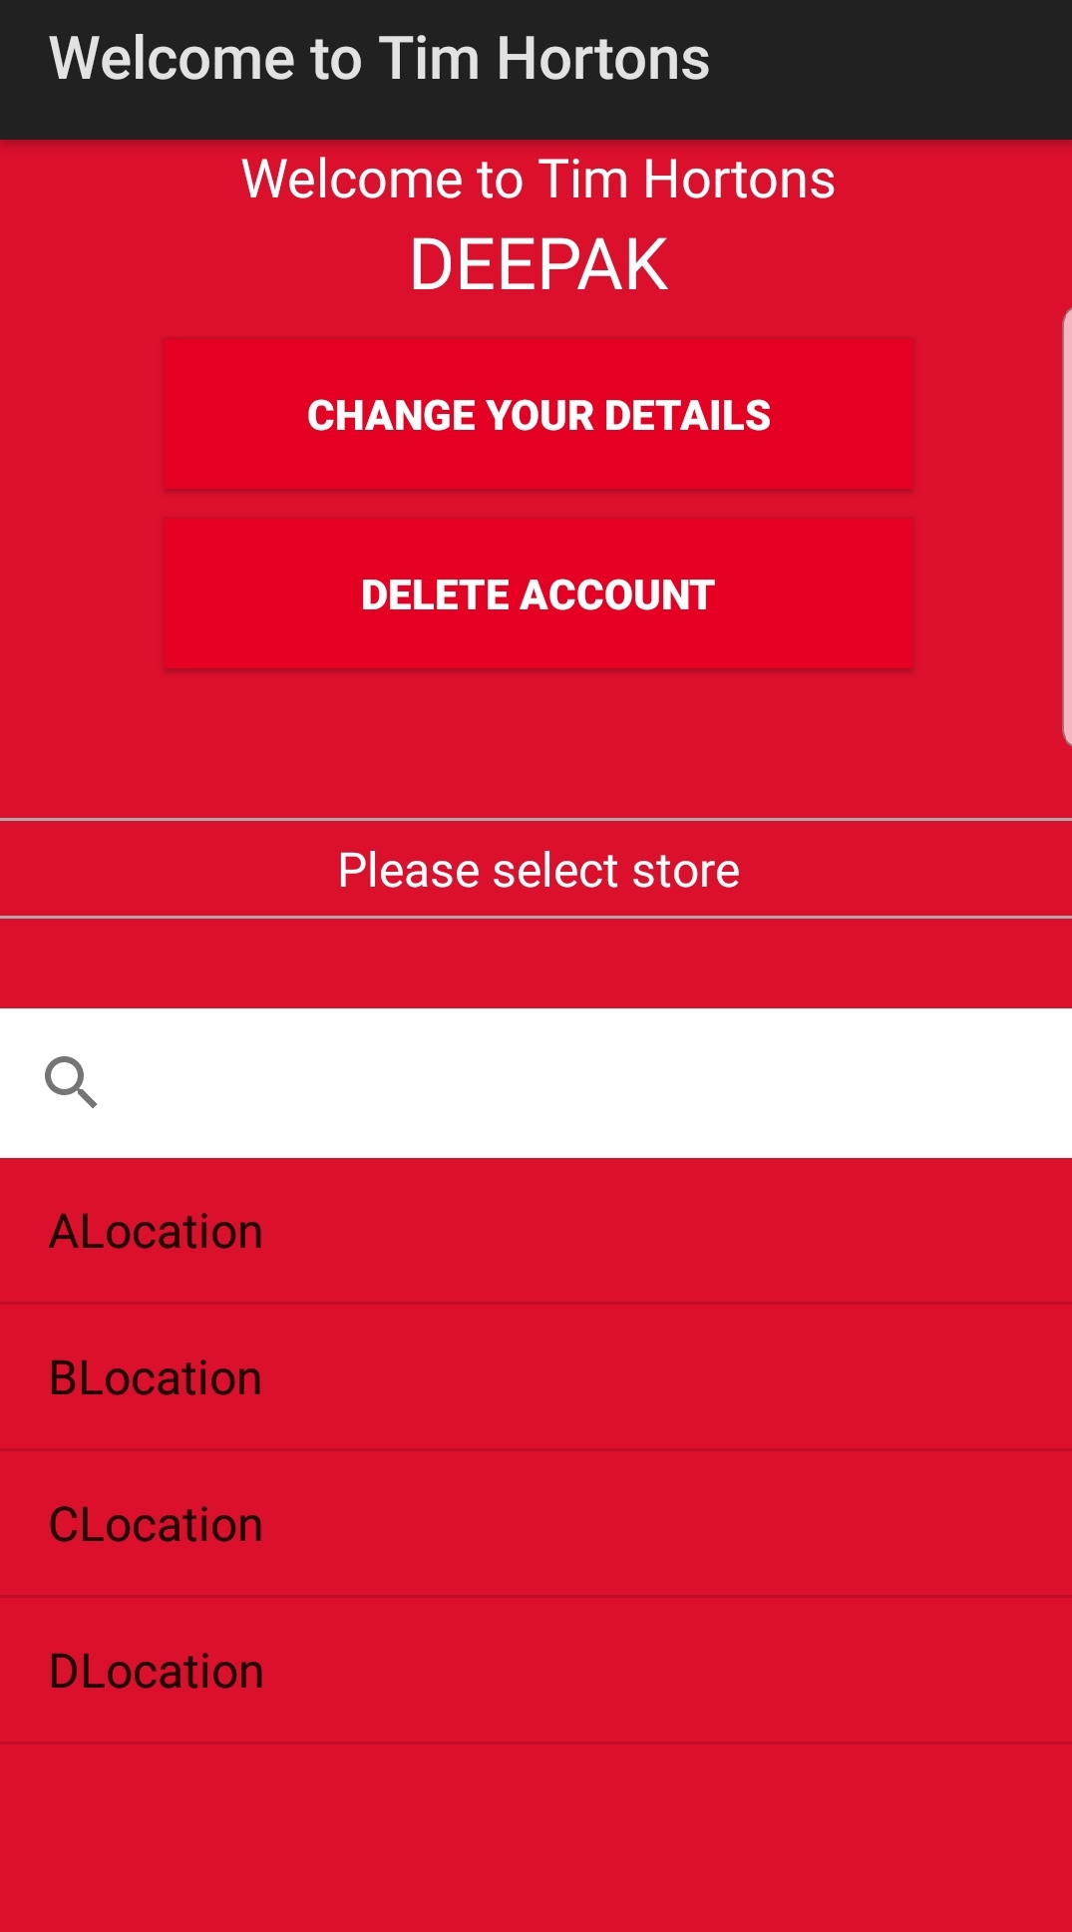
Application Snapshots:
This is Welcome page for user, after user successfully logged in.
Shows name of user.
Change your details – button allow user to change his details.

Slide 13
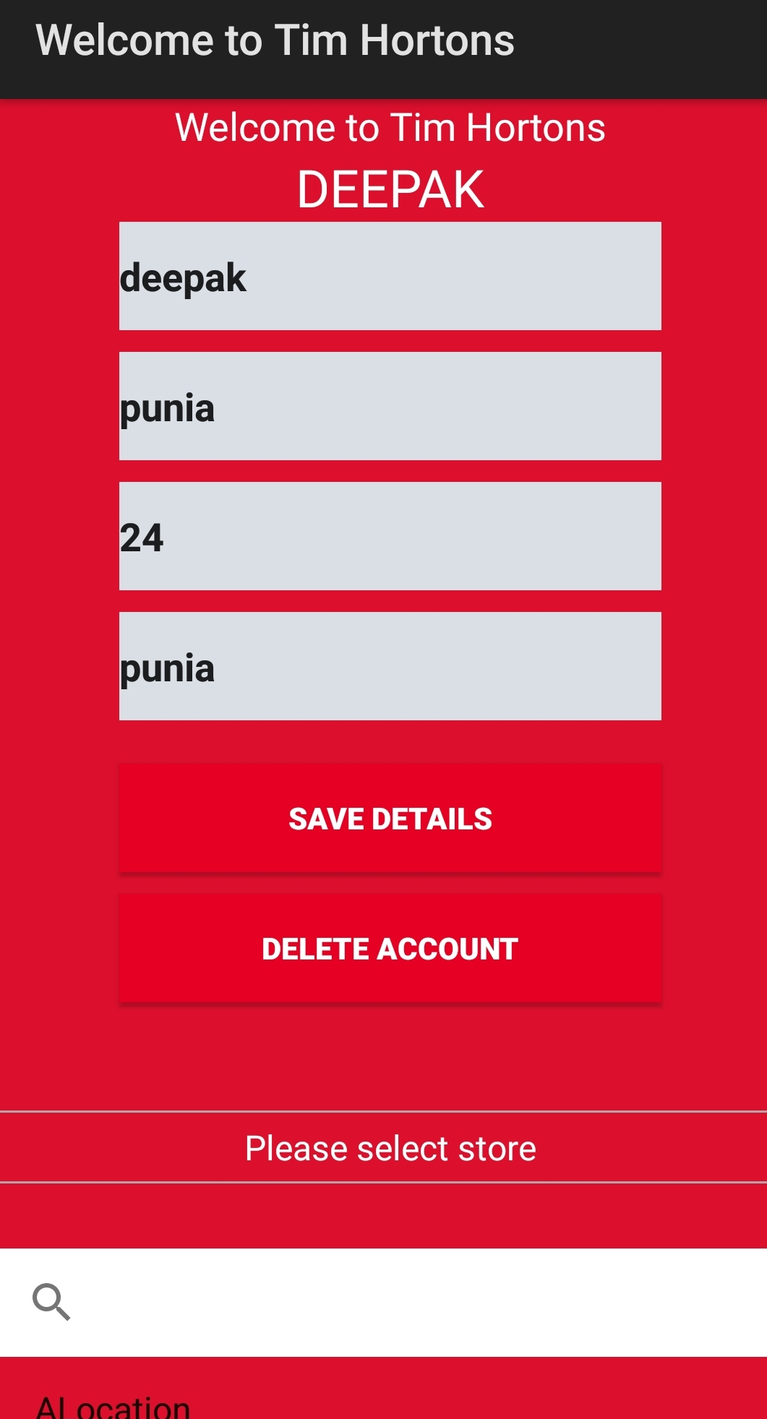
Application Snapshots:
Edit box is visible when user click on change your details button.
Delete account button will erase the user data from database.

Slide 14
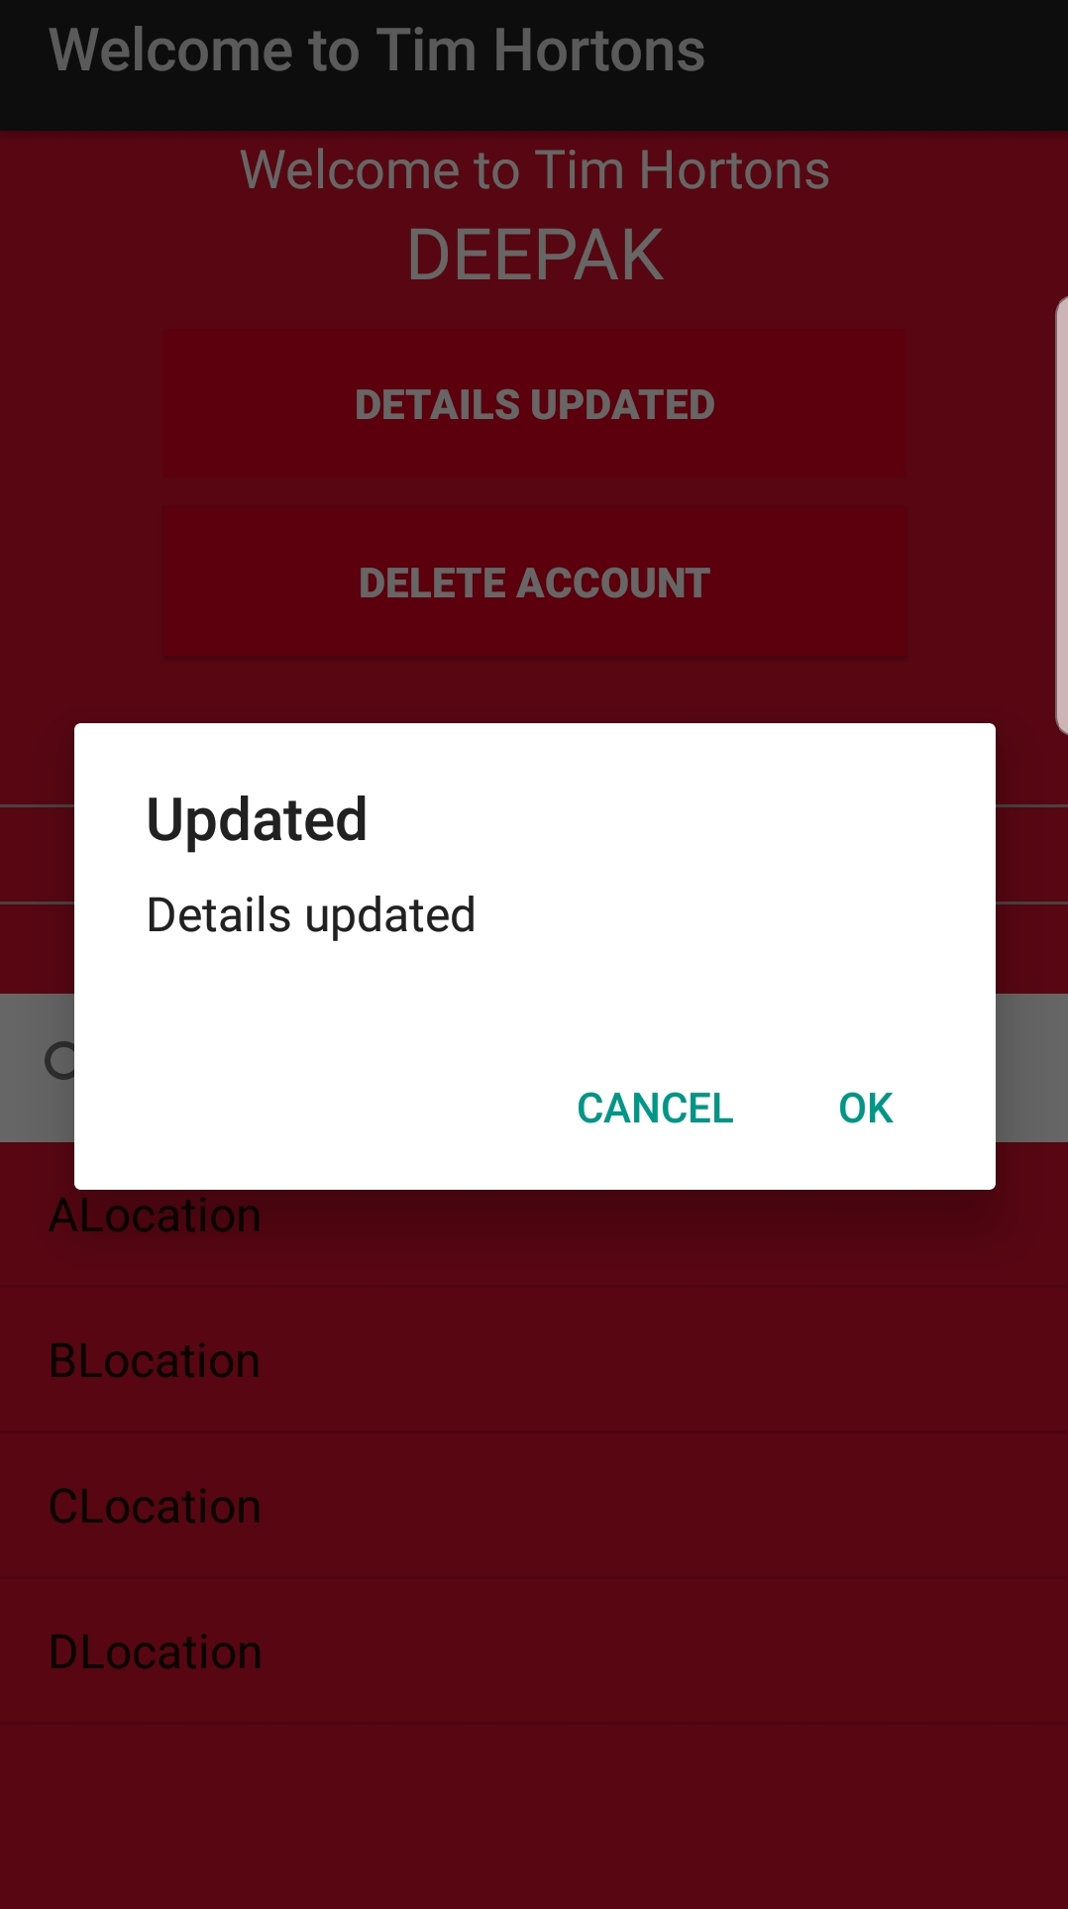
Application Snapshots:
After editing details, user can save details by clicking save details button.
Details are updated in database and message is displayed to the user.
Change your details button is changed to DETAILS UPDATED button and disabled for user till user log in again.

Slide 15
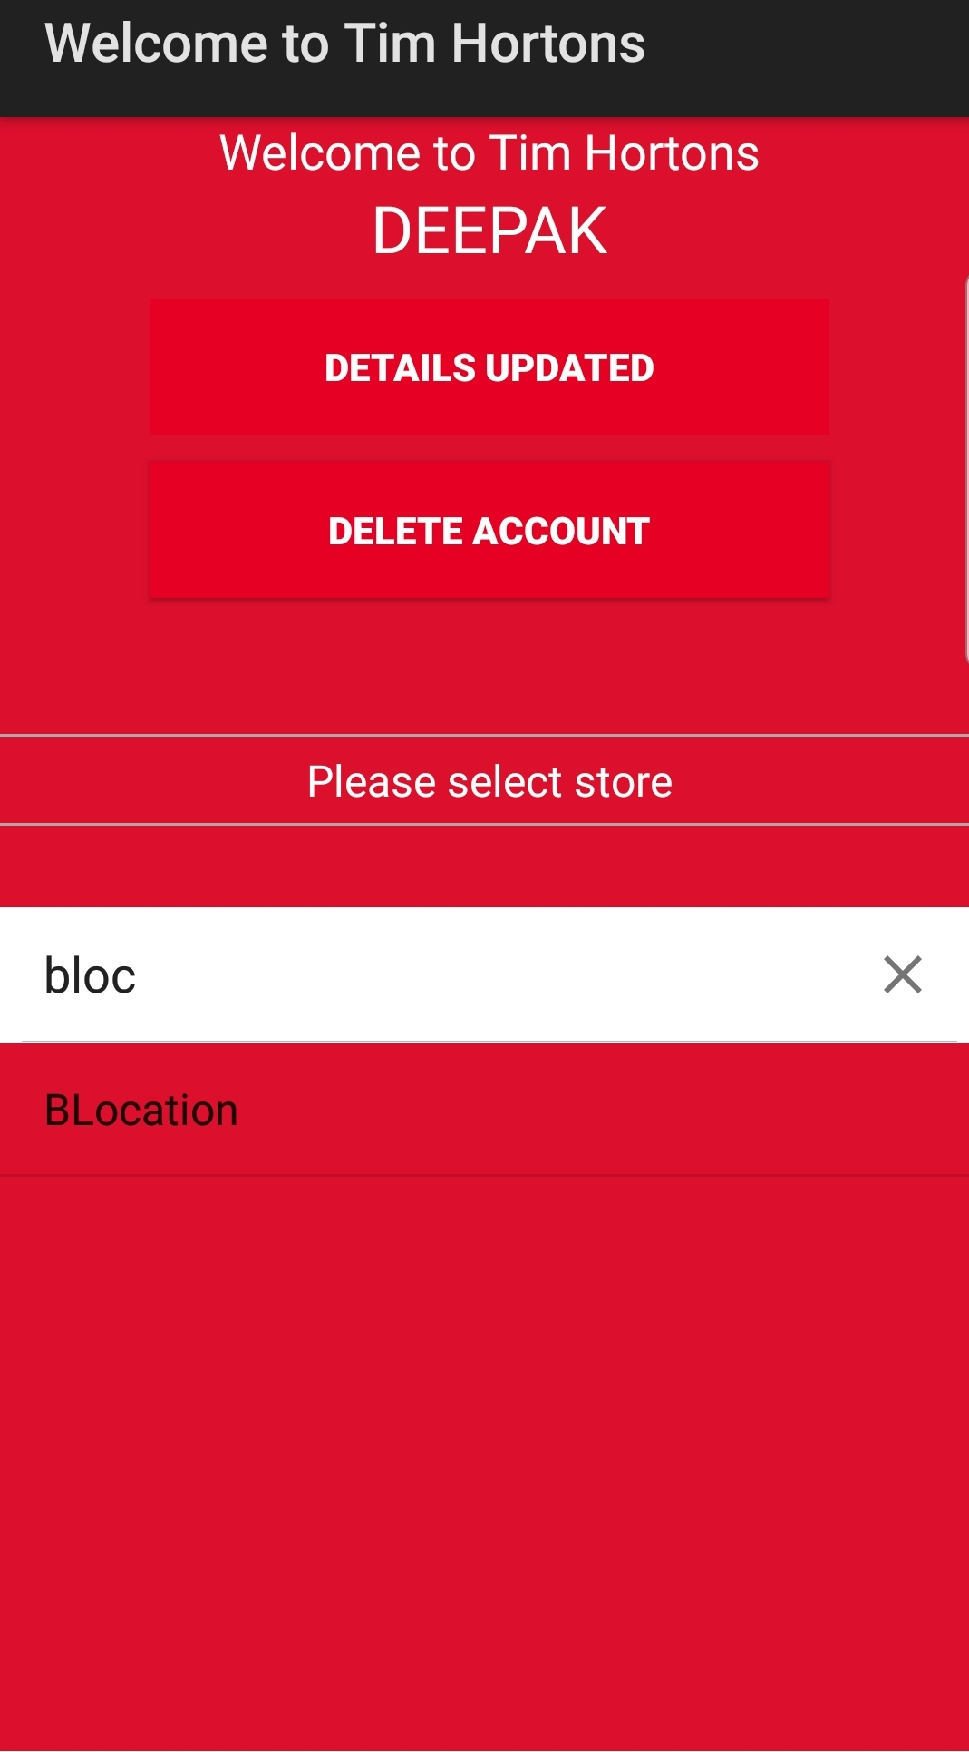
Application Snapshots:
Location list is displayed .
User can search the location.
User can proceed to order selection page by clicking on location.

Slide 16
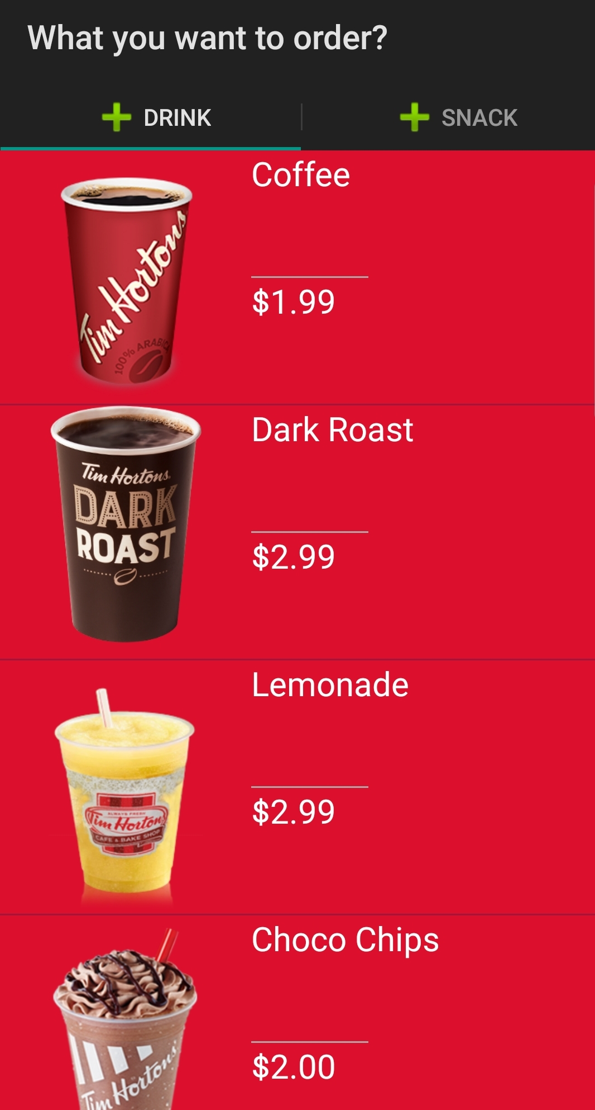
Application Snapshots:
This is the order selection page.
User can choose drinks from DRINK tab or snacks from SNACK tab.

Slide 17
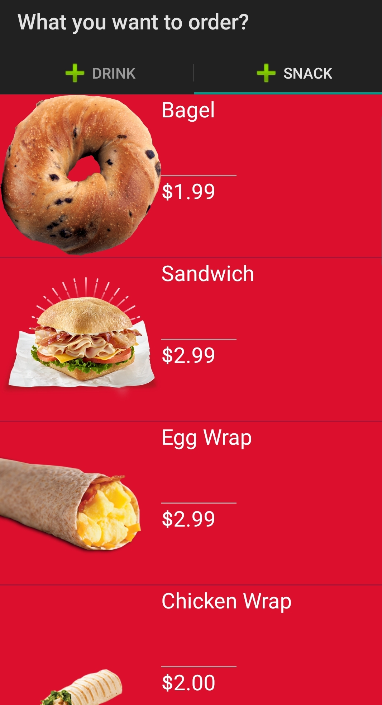
Application Snapshots:
Image of food with name and price is displayed to user.
User can click on any food item to see its details.

Slide 18
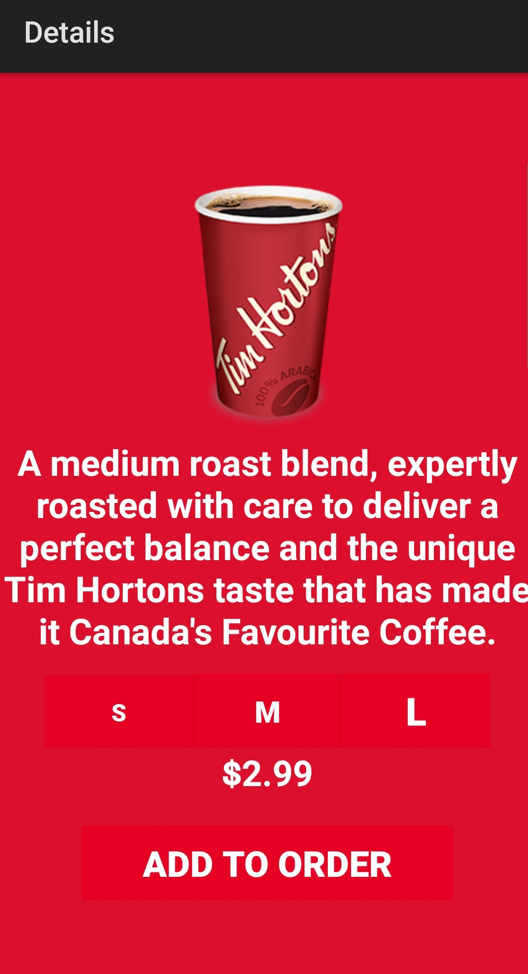
Application Snapshots:
Details of item is displayed to user.
User can select size from:
S: small
M: medium
L: large
Price of item is changed accordingly.
User can add item to order list by clicking ADD TO ORDER button.

Slide 19
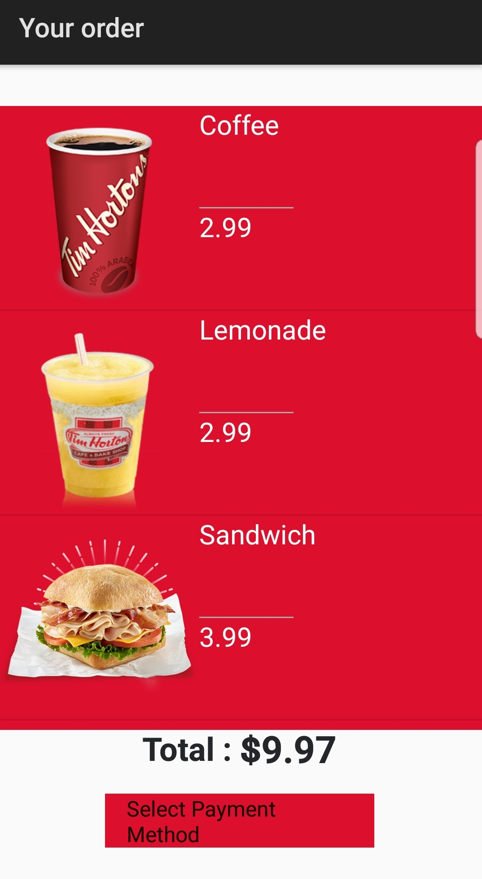
Application Snapshots:
On order list page, items are shown which are added to order list by user.
Total price is displayed.

Slide 20
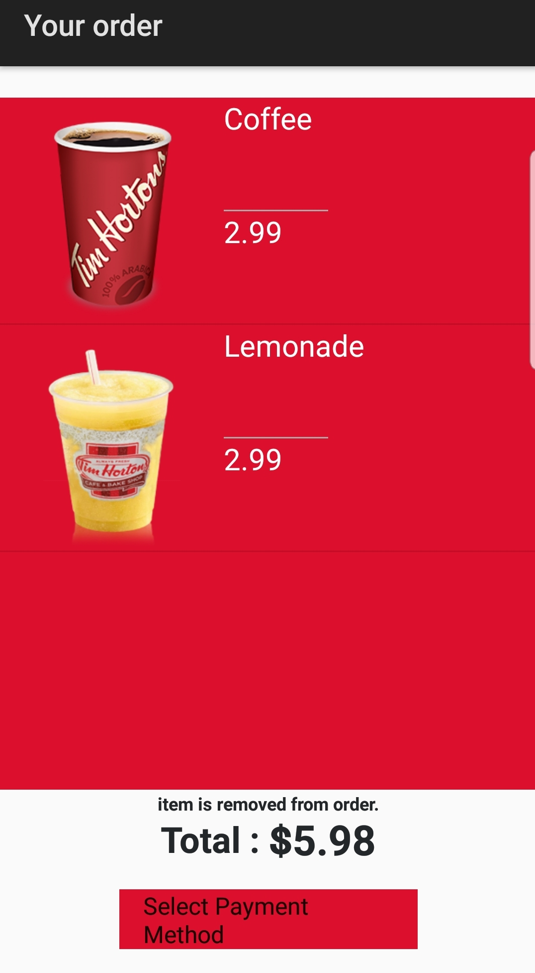
Application Snapshots:
User can click on item to remove it from order list.
When item is removed from list, list is updated and a message is displayed to user.
Total price changed accordingly.

Slide 21
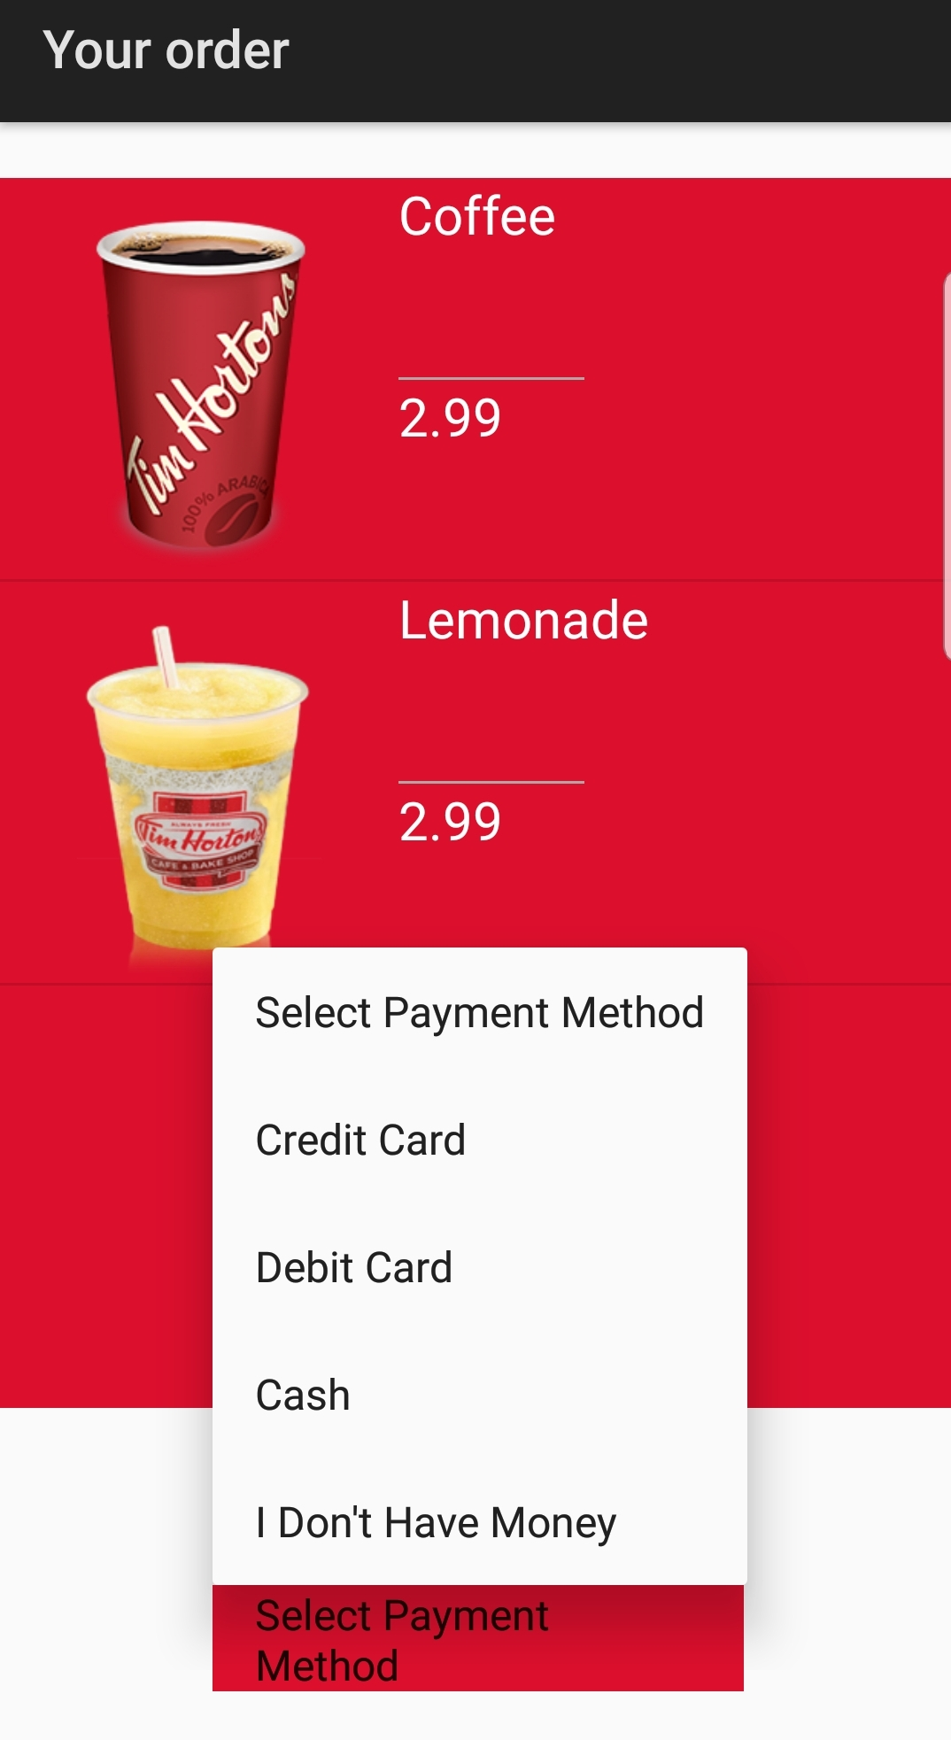
Application Snapshots:
Spinner is added.
User can select payment method from the dropdown menu.
I Don’t Have Money option leads to credits page.

Slide 22
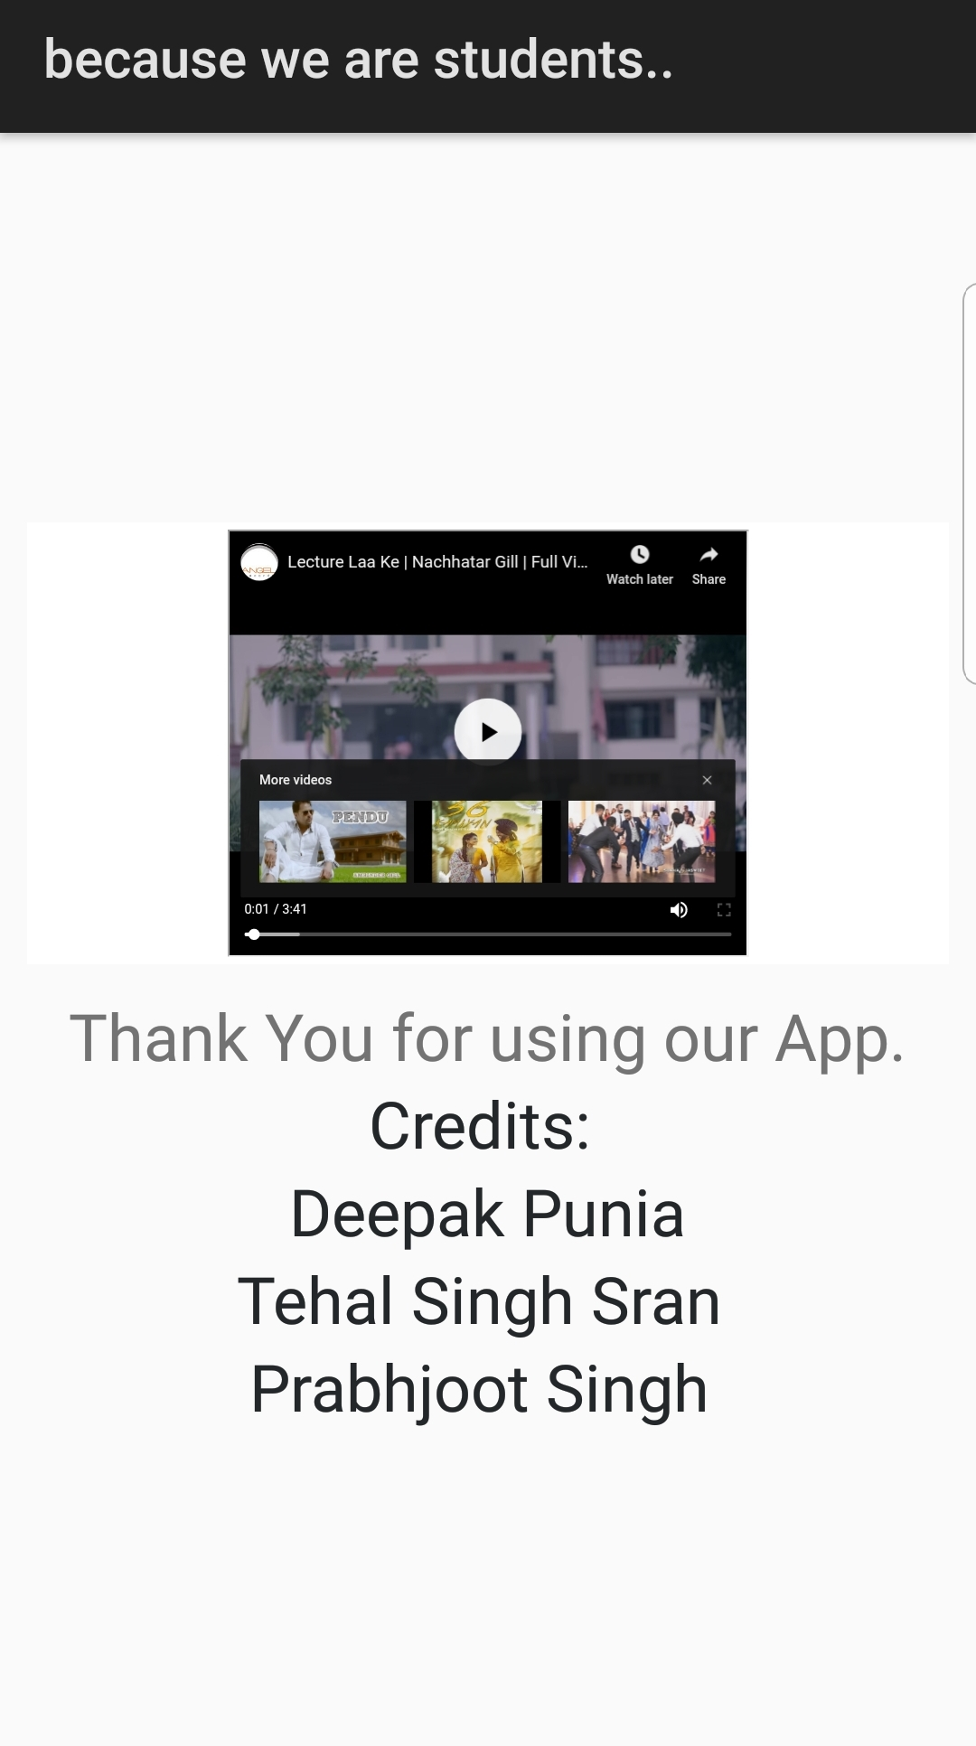
Application Snapshots:
This is the credit page.
Web View is used to displayed youtube video.

Slide 23
Demonstration

Slide 24
THANK YOU

