Slide 1
Introduction to PHP
Prepared By:
Pranjal Vyas

Slide 2
Introduction to PHP
1.1 Configuration of PHP, Apache web server, MySQL and Open source
1.2 Relationship between Apache, MySql and PHP
1.3 Installing PHP
1.4 PHP structure and syntax
1.5 Creating PHP pages.
1.6 Rules of PHP snytax
1.7 Integrating HTML with PHP
1.8 Constants, Variables, Static and Global variable.
1.9 Conditional structure and looping PHP Operators.
1.10 Arrays & Constructs.
1.11 User Define function, Argument Function, Variable Function, Return Function, default argument, variable length argument.

Slide 3
What you should already know??
Web Application
Web Application that is hosted in a browser control environment or coded in browser supported language, such as HTML.
Website
Website is a collection of Web files on a particular subjects.
E.g.. www.Google.com
Web Page
Web Pages are the pages stored on a server which are created using HTML.
Server
The machine were website actually resides is called Web Server. The web pages and the related resources are stored into the central computer called Web Server.
.E.g.: IIS, WAMP, XAMP, APACHE are example of Web servers.

Slide 4
Clients
Computers that offers the facilities to read information into the server are called Web Clients.
Web browser
Web browser is a software which request to the web server and accepts response to that request.
Internet Explorer, Google Chrome, Mozilla etc.
HTML
HTML stands of Hypertext Markup Language.
We can create static WebPages with the use of HTML.
Client-side scripting
With the Client-side scripting, the script on the web page are processed by individual web-browser that requests the page.
Client side coding is interpreted by browser and run on the client.
E.g.: JavaScript & VB script.

Slide 5
Server-side scripting
With the Server-side scripting all scripts are processed on the server before the requested page is ever sent to the browser.
Server side coding is used to when you want to display something on the web browser but the data, text etc comes from the server.
E.g.: PHP, JSP, ASP.net
Database
Database is used when we work with dynamic contents like Login, Registration, Message etc.
MySQL, SQL Server, Oracle etc are Database software.
Open source
Program’s source code is freely available to the public.
Anyone must be allowed to modify the source code and modified versions can be redistributed.
Open source software is free to download and use.
Funded by donors with an interest in the project and advertisement.

Slide 6
History of PHP
Founder of PHP is Rasmus Lerdorf.
PHP was Written by Rasmus Lerdorf in1994 for use in monitoring his online resume and related personal information.
Original meaning of PHP is “Personal Home Page” by Rasmus Lerdorf.
In 1995 he combined PHP with his own form interpreter, and mini SQL (mSQL).
This combination was released as PHP/FI (PHP 2.0).

Slide 7
Versions of PHP
Version | Release date | Supported until | Notes
1.0 | 8 June ‘95 |  | Officially called "Personal Home Page Tools (PHP Tools)". This is the first use of the name "PHP".
2.0 | 1 Nov ‘97 |  | Officially called "PHP/FI 2.0". This is the first release that could actually be characterized as PHP,
3.0 | 6 June ‘98 | 20 Oct 2000 | Development moves from one person to multiple developers.
4.0 | 22 May 2000 | 23 June ‘01 | Added more advanced two-stage parse/execute tag-parsing system called the Zend engine
4.1 | 10 Dec ‘01 | 12 Mar 02 | Introduced 'superglobals' ($_GET, $_POST, $_SESSION, etc.)
4.2 | 22 Apr ‘02 | 6 Sep ‘02 | Disabled register_globals by default.
4.3 | 27 Dec ‘02 | 31 March ‘05 | Introduced the command-line interface, to supplement the CGI.
4.4 | 11 July ‘05 | 7 Aug ‘08 | Fixed a memory corruption bug,
5.0 | 13 July ‘04 | 5 Sep ‘05 | Zend Engine II with a new object model.
5.1 | 24 Nov ‘05 | 24 Aug ‘06 | Performance improvements with introduction of compiler variables in re-engineered PHP Engine.

Slide 8
Versions of PHP
Version | Release date | Supported until | Notes
5.2 | 2 Nov 2006 | 6 Jan ‘11 | Enabled the filter extension, Native JSON support.
5.3 | 30 June ‘09 | 14 Aug ‘14 | Improved Windows support, MySqlnd as a replacement for libmysql.
5.4 | 1 Mar ‘12 | 3 Sept ‘15 | Built-in web server. Several improvements to existing features, performance and reduced memory requirements.
5.5 | 20 June ‘13 | 10 July ’16 | Support for generators, finally blocks for exceptions handling
5.6 | 28 Aug ’14 | 28 Aug ’17 | Extensions of the use statement for functions and constants, new phpdbg debugger as a SAPI module
6.x | Not released | N/A | Included native Unicode support.
7.0 | 3 Dec ‘15 | 3 Dec ‘18 | Zend Engine 3, simpler, more consistently available CSPRNG API, replacement of many remaining internal PHP "errors" with the more modern exceptions.
7.1 | 2016 | After 3 year | void return type, class constant visibility modifiers

Slide 9
What is PHP??
Full form of PHP is Hypertext Preprocessor.
PHP is a server scripting language, and a powerful tool for making dynamic and interactive Web pages.
PHP is HTML embedded scripting language.
PHP is an open source scripting language.
PHP scripts are executed on the server and result returned to the browser as plain HTML.
PHP is free to download and use.
PHP files can contain text, HTML, CSS, JavaScript, and PHP code.
PHP files have extension ".php”.

Slide 10
What Does PHP Can Do?
PHP offers web application creation, web site maintenance, web site designing, software development, online shopping stores, web portal development, face book application, ecommerce solution and Web directory development for the global businesses of various sizes.
PHP can create, open, read, write, delete, and close files on the server.
Set session, cookies for letter, send email and SMS and can run thread.
PHP can add, delete, modify data in database.
PHP can encrypt data.
PHP can authenticate and track users.
With PHP, you can output images, PDF files , Flash Movies and even Text such as XHTML, XML.

Slide 11
Why PHP ??
PHP runs on various platforms like Windows, Linux, Unix, Mac OS etc.
PHP is compatible with almost all servers used today Apache, IIS, etc.
PHP supports a wide range of databases.
PHP is free. Can download from the official PHP resource: www.php.net
PHP is easy to learn and runs efficiently on the server side.

Slide 12
Advantages of PHP
Open source
Free to download. So PHP application are much cheaper.
Cross Platform
Enables operation across various operating system.
Quick
PHP provides rapid application development, to develop ensures that there is a quick turnaround time.
Embedding with HTML
Very easy to convert an existing static website into a bold and new dynamic website
Powerful library support and other tools
So any one can easily find functional modules. And support web based tools like Google map, face book plug-ins etc..

Slide 13
Disadvantages of PHP
Security
As it is open source, it can be used by people to explore the weakness of PHP.
Not suitable for large applications
Hard to maintain since it is not very modular.
Weak type
E.g. string “1000” and “1e3” compare equal because they are implicitly cast to floating point numbers.

Slide 14
Difference Between PHP & ASP. Net
Open source : Free. | Microsoft product: Expensive.
Programming language. | Platform.
Server: Any kind of (Apache , IIS etc.). | IIS only (Microsoft Product).
Database: MySQL (Open source). | Ms-SQL (Microsoft Product).
Operating System: Linux (Open source). | Windows (Chargeable).
Execution: Faster because PHP uses in-built memory space. | Slower because it uses server space during execution.
Many useful tools are available free for PHP. | Tools that can be used with ASP.NET are not free.
Syntax similar to C and C++. | Syntax similar to Visual Basic.

Slide 15
Apache-MySQL
Apache
Apache is a free software, distributed by Apache software foundation.
The actual purpose of apache is to host PHP websites.
Apache is the engine which runs the PHP page in the server and displays the output in client browser.
The Apache run under many platforms like Windows, Linux etc..
MySQL
MySQL is an open source relational database management system that relies on SQL for processing the data in the database.
We can use MySQL in PHP using open-source tool PHPMyAdmin.

Slide 16
Relationship Between AMP
AMP Stands for Apache-MySQL-PHP.
When a web site visitor visits any web site, visitor requests a particular page or resource from their web browser.
The Apache takes those specific requirements process it and pass them off to PHP.
Then PHP goes to the MySQL to retrieve the particular data to prepare the output and presents the web page to the Apache.
Apache gives the output to visitor’s browser according to his request.

Slide 17
Installing PHP
Download Apache from http://httpd.apache.org/docs/2.2/paltform/windows.html
Download MySQL from
http://dev.mysql.com/downloads
Download PHP from
http://www.php.net/install.windows
Instead of all above we can directly use WAMP server , windows web development environment.
Download WAMP server from
http://www.wampserver.com
WAMP stands for Windows-Apache-MySQL-PHP/Perl/Python.

Slide 18
Download and Install WAMP
How to download WAMP Server
How to install WAMP Server

Slide 19
PHP Structure and Syntax
There are two methods to write php code
<?php (Start tag)
…………..
…………..
?> (End tag)
<? (Start tag)
…………..
…………..
?> (End tag)
Known as Short tags

Slide 20
Rules of PHP Syntax
PHP is denoted in the page with opening and closing tags.
<?php……………..?>
PHP lines ends with a semicolon. White spaces are ignored.
<?php
Echo “Hello” ;
?>
Comments in PHP.
  // - Single line comment.
  /*……*/ - Multiline comment.
  PHP uses “echo” or “print” statement to print something on screen.

Slide 21
Difference between echo and print
Echo | Print
Can accept multiple expression | Cannot accept multiple expression
Faster | Slower
Echo is not function | Print is a function
Void echo (string $arg1, string $arg2) | Int print (string $arg)
echo does not return any value | Print return 1 or 0 depending on success
e.g. echo “welcome” , “to” , “PHP” ; | e.g. print “welcome” ;

Slide 22
Integrating PHP with HTML
PHP in HTML | HTML in PHP
<html> <head> <title> PHP Page </title> </head> <body> <?php Echo “hello” ; ?> </body> </html> | <?php echo “<b> Hello </b>”; echo “<i> Hello </i> ; ?>

Slide 23
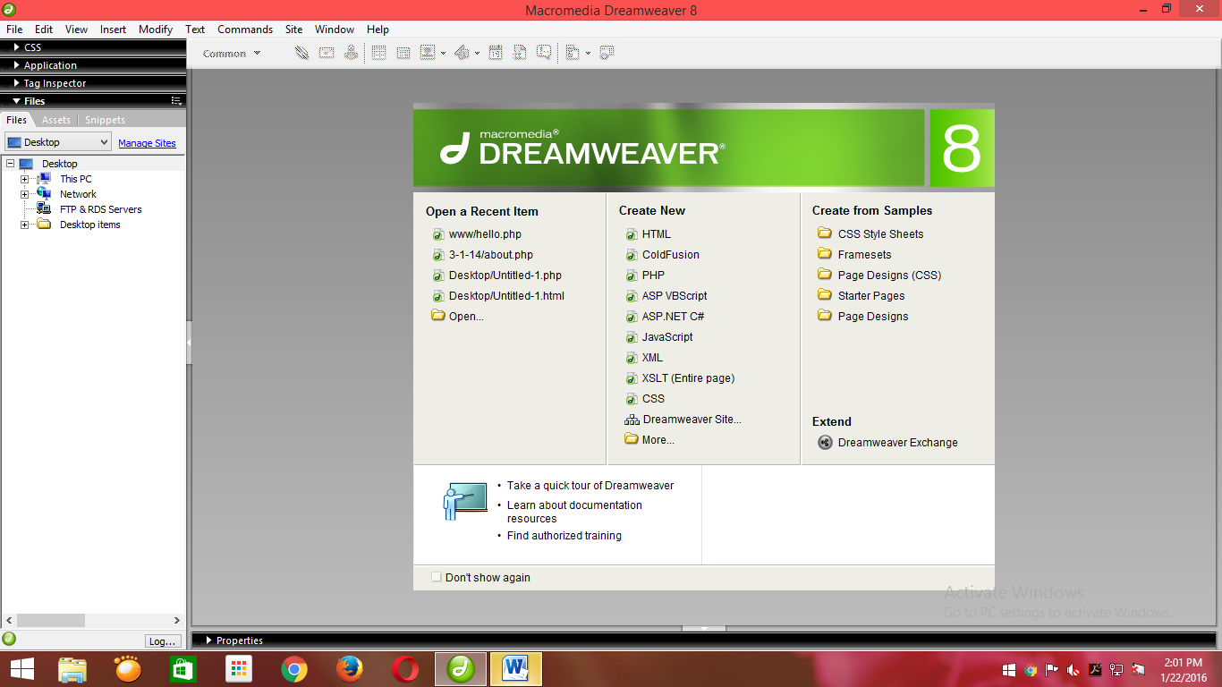
Creating PHP Pages
Open DreamWeaver → Select PHP

Slide 24
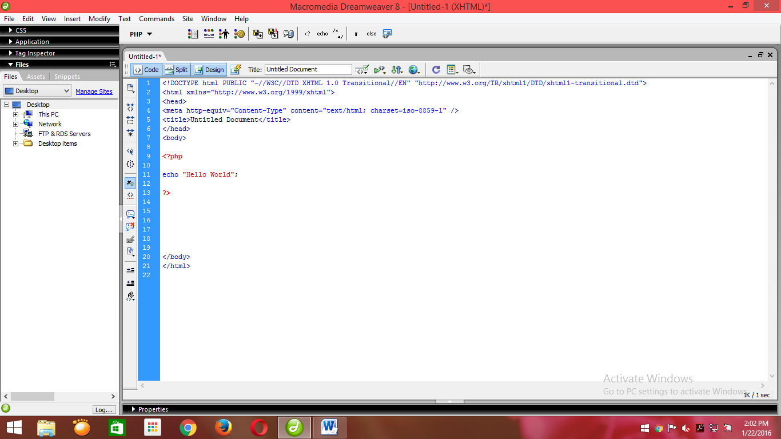
Write PHP Script Between HTML Body Tag
PHP uses echo or print statement to print

Slide 25
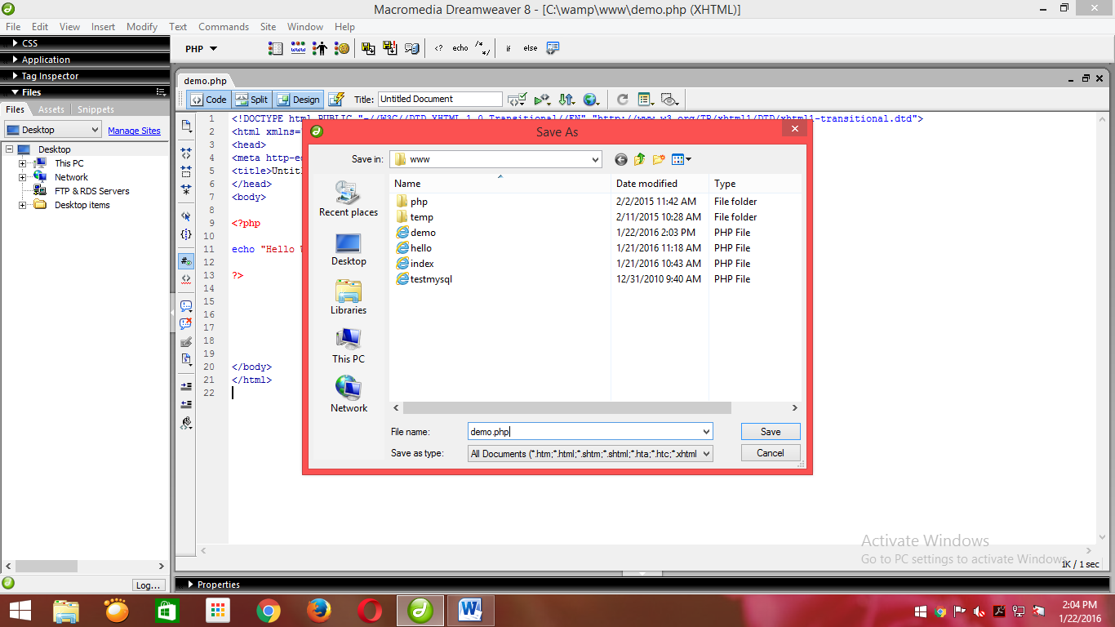
Save your file with extension .php at this location
Drive C → WAMP → www

Slide 26
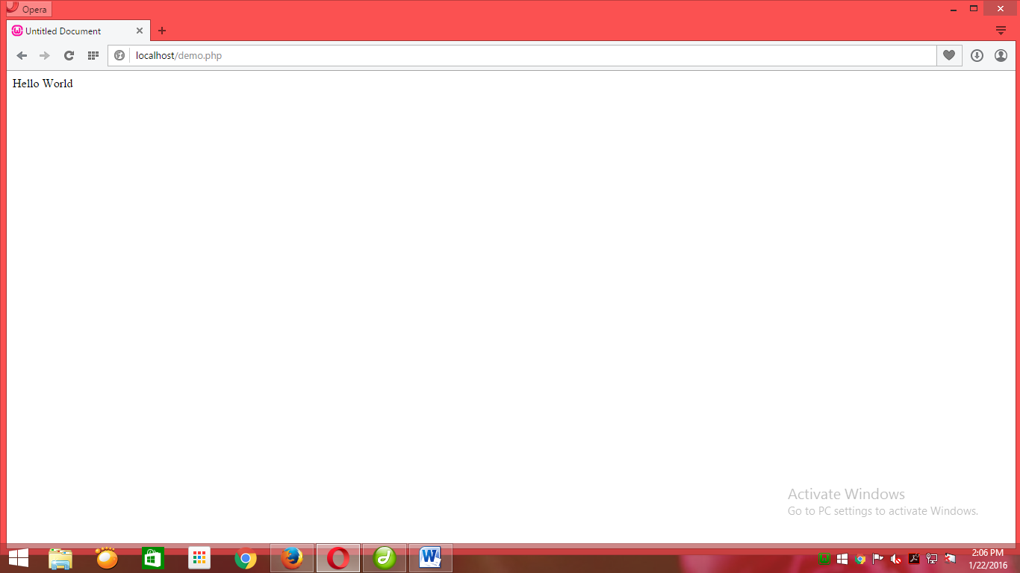
Open Your Browser and run your program
Localhost/filename.php

Slide 27
Constants in PHP
Constants holds values that don’t get changed during the runtime of a script.
There are two ways to define constants in PHP
define (“Contant_name” , “value”);
E.g. define ( “year” , “2010”) ;
2. const constantvariablename = value;
E.g. const PI = 3.14 ;
Once the constant have been set, may not be redefine or undefined.
By default scope of constant is global.

Slide 28
Variables in PHP
A variable is container that you can store data in, and every variable has a unique name.
In php variable does not need to be declared before adding a value to it.
PHP automatically converts the variable to the correct data type, depending on its value.
Variable in php starts with $ sign and start with letter or underscore and not with number.
A variable in php can have only numeric(0-9) , letter (a-z and A-Z) and underscore ( _ ) . Space and special character are not allowed accept underscore ( _ ) and dollar ( $ ).
Syntax: $ variable_name = value;

Slide 29
Data types in PHP
Data type | Stores | Function name
Integer | Whole number | Is_integer
Double | Floating point numbers | Is_double
Booleans | True and false | Is_bool
Null | No value | Is_null
Strings | Sequences of characters | Is_string
Arrays | Named and indexed collection | Is_array
Objects | Programmer define classes | Is_object
Resources | Special variables that holds referenced to resources external | Is_resource

Slide 30
Variables in PHP
Local
Global
Static

Slide 31
Local Variables
A variable declared within a function or parameter of function can be considered as a local.
<? Php
function add ($a, $b)
{
$c= $a+$b;
return $c;
}
$ans = add (45,22);
print “sum = $ans”;
?>
In above example. Variable a,b and c are local variable.

Slide 32
Global Variables
A variable declared outside a function has a GLOBAL SCOPE and can accessed outside from any part of the PHP coding.
PHP also stores all global variables in array called $GLOBALS[index] and the index holds the name of variable.
E.g.
global $a , $b ; // a and b are global variable.

Slide 33
Static Variables
When we want variable which will not lose its value after completion of function that type we can use variable as a static.
In class, static keyword used when we want value common for all the object.
If we declare a variable as static then we can access the method using class, without instantiating any object.
Syntax: static variable_name ;

Slide 34
Conditional Structure in PHP
Conditional statement is also known as decision making or branching statement.
There are two ways to check condition..
If – else
Switch – case
If - else
There are cases when we would like to execute some logic when a condition is TRUE and another logic when condition is FALSE.
We can write only if block. Else if and else clauses are optional.
We can also write nested if - else block.

Slide 35
Syntax of if – else
if (condition)
{
Statements
}
elseif (condition)
{
Statements
}
else
{
Statements
}

Slide 36
Switch Case
When we are comparing the same expression to several different values, we can use the switch case statements.
Switch block with a break statement at the end of each case.
Syntax:
switch (test_variable)
{
case expression1:
Logic..
break;
case expression2:
Logic..
break;
default:
}

Slide 37
Loops in PHP
Looping structures are used when a group of statements is to be executed repeatedly , until a condition is TRUE or until a condition is FALSE.
PHP supports the following
For loop
While loop
Do..while loop
For each loop
For loop
The for loop executes a block of statement a specified number of times.
Syntax:
For (Initialization ; condition ; increment/decrement)
{
Logic
}

Slide 38
While loop
While loop keeps executing until the condition against which it tests remain true.
The while statement always checks the condition before it begins.
Syntax:
while (up to condition)
{
Logic..
}
Do..while loop
Do while loop makes sure that the code block is always executed least once.
Syntax:
Do
{
Logic..;
} While (up to condition);

Slide 39
For each loop
For each pass the value of the current array element is assigned to $value and the array pointer is moved by one and in the next pass next element will be processed.
Syntax:
foreach ( $array as $value )
{
logic
}

Slide 40
Break
Sometimes we want to break out of , or end a loop before it is complete, usually when a certain condition is met.
Syntax:
break;
Continue
Sometimes we want to continue after break out loop.
Syntax:
continue;

Slide 41
Operators in PHP
Category | Operator
Assignment | = , += , -= , *= , /= , %= , .=
Arithmetic | + , - , * , / , %
Comparison | == , === , ! , != , < , > , <> , <= , >=
Concat | . (dot)
Logical | And , or , xor , && , || , !
Increment – Decrement | ++ , --
conditonal | ? , :

Slide 42
Arrays in PHP
Array is data structure whose capacity is store many data at single place whose data types must be same.
There are three types of array.
One dimensional array (Vector array)
Associative array
Multidimensional array

Slide 43
One Dimensional Array
In one dimensional array values are stored in sequential manner in starting with 0 index.
This array type has a numeric value.
Syntax:
$ arrayname[index]=value;
or
$ arrayname[]=value;
or
$ arrayname=array(“value1”,”value2”,”value3”);

Slide 44
Associative Array
In associative array use a unique id key , specified by the programmer , to reference each value stored in array.
We can use print_r function with associative array.
Syntax:
$ arrayname[‘keyname’]=value;
or
$arrayname=array (“keyname”=>”value1”,”keyname”=>“value2”);

Slide 45
Multidimensional Array
In multidimensional arrays are arrays that contains another array.
Values in the multi dimensional array are accessed using multiple index.
Syntax:
$arrayname = array (“keyname” => array (“value1” , “value2”));

Slide 46
Array Functions
Function Name | Syntax | Use
Count | Count (arrayname) | Counts total elements in array
List | List(var1,var2,…) | Split the values of array into var.
In_array | In_array (search , arname) | Search element in array
Current | Current (arrayname) | Fetch current element in array
Prev | Prev (arrayname) | Array value in previous place pointed by internal array
Next | Next (arrayname) | Array value in next place pointed by internal array
End | End (arrayname) | Last element of the array
Array_reverse | Array_reverse (arname) | Reverse element of array

Slide 47
Each | Each (arrayname) | Current key and value pair
Array_merge | Array_merge (a1,a2) | Merge two arrays
Array_search | Array_search (element , aranme , strict) | Return element and key
Sort | Sort (arrayname , sort type) | Sort array according to type
Explode | Explode (string operator , string str , int limit) | Breaks string into smaller pieces
Implode | Implode ( string separator , array) | Opposite of explode

Slide 48
User define function
Functions are most useful when you will be using the code than one place.
In PHP we can create a function.
Syntax:
Function function-name ($argument-1 , $argument-2)
{
statement-1;
statement-2;
……..
}

Slide 49
Argument function
PHP can pass argument to the function by two way..
Call by value
The default behavior for user-defined function in PHP is call by value.
This means that when you pass variable to a function call, PHP makes copies of the variable values to pass on to the function.
2. Call by reference
If you want to define a function to operate directly on a passed variable, simply put ampersand in front of the formal parameter in the definition.

Slide 50
Variable function
Use variables in place of the names of user define functions.
This allows us to use function as data.
Example:
function customized_greeting()
{
echo “Good Morning” ;
}
customized_greeting() ;
$my_greeting = customized_greeting ;
$my_greeting();

Slide 51
Return function
Values are returned by using return statement.
Any type may be returned including array and object.
Example:
<? php
function add ($a , $b)
{
$c= $a + $b ;
return $c;
}
$a=5;
$b=7;
$ans = add ($a , $b);
echo “$ans”;
?>

Slide 52
Default arguments
To define a function with default arguments , simply turn the formal parameter name into an assignment expression.
PHP will match actual with formal until the actual parameters are exhausted and then will use the default assignments to fill in the rest.
Example:
<?php
function setHeight($minheight = 50)
{
echo "The height is : $minheight <br>";
}
setHeight(350); // will use the value of height 350
setHeight(); // will use the default value of 50
?>

Slide 53
Variable length arguments
Function | Work
func_get_arg (position) | Returns the value of specified argument provides in the function call operation. Position is the index of argument.
func_num_args () | Returns the total number of arguments provided in the function call operation.
func_get_args() | It creates and returns an array which contains values of all arguments provided in the function call operation.

