Slide 1

Mastering Git & GitHub
First commit to collaboration
Practical, hands-on approach
Version control fundamentals
Team workflows & branching
VERSION CONTROL
GIT
GITHUB

Slide 2
What We'll Cover Today
01
02
Version Control Basics
Setting Up Git
Git, GitHub, why they matter
Install, configure, hands-on
03
04
Core Git Skills
GitHub & Teams
Branch, merge, stash, rebase
Remotes, Desktop, VS Code, workflows

Slide 3

Ever Lost Your Work?
Accidentally deleted a file
Overwrote working code
No way to go back
Version control is your safety net.

Slide 4
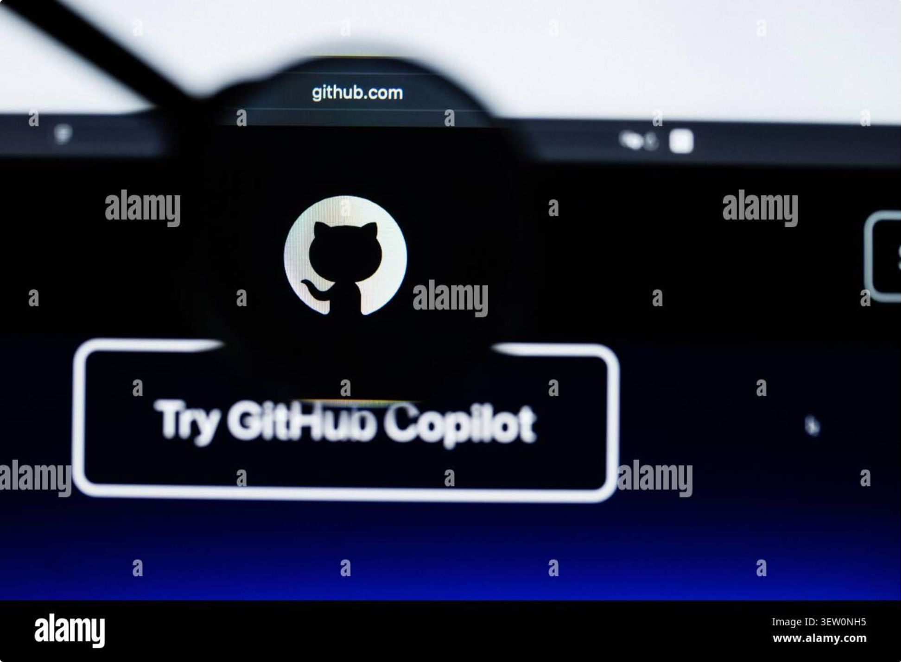
What is Git?
A distributed version control system by Linus Torvalds (2005).
Tracks every code change
Revert to any previous state
Works fully offline
Free and open source

Slide 5
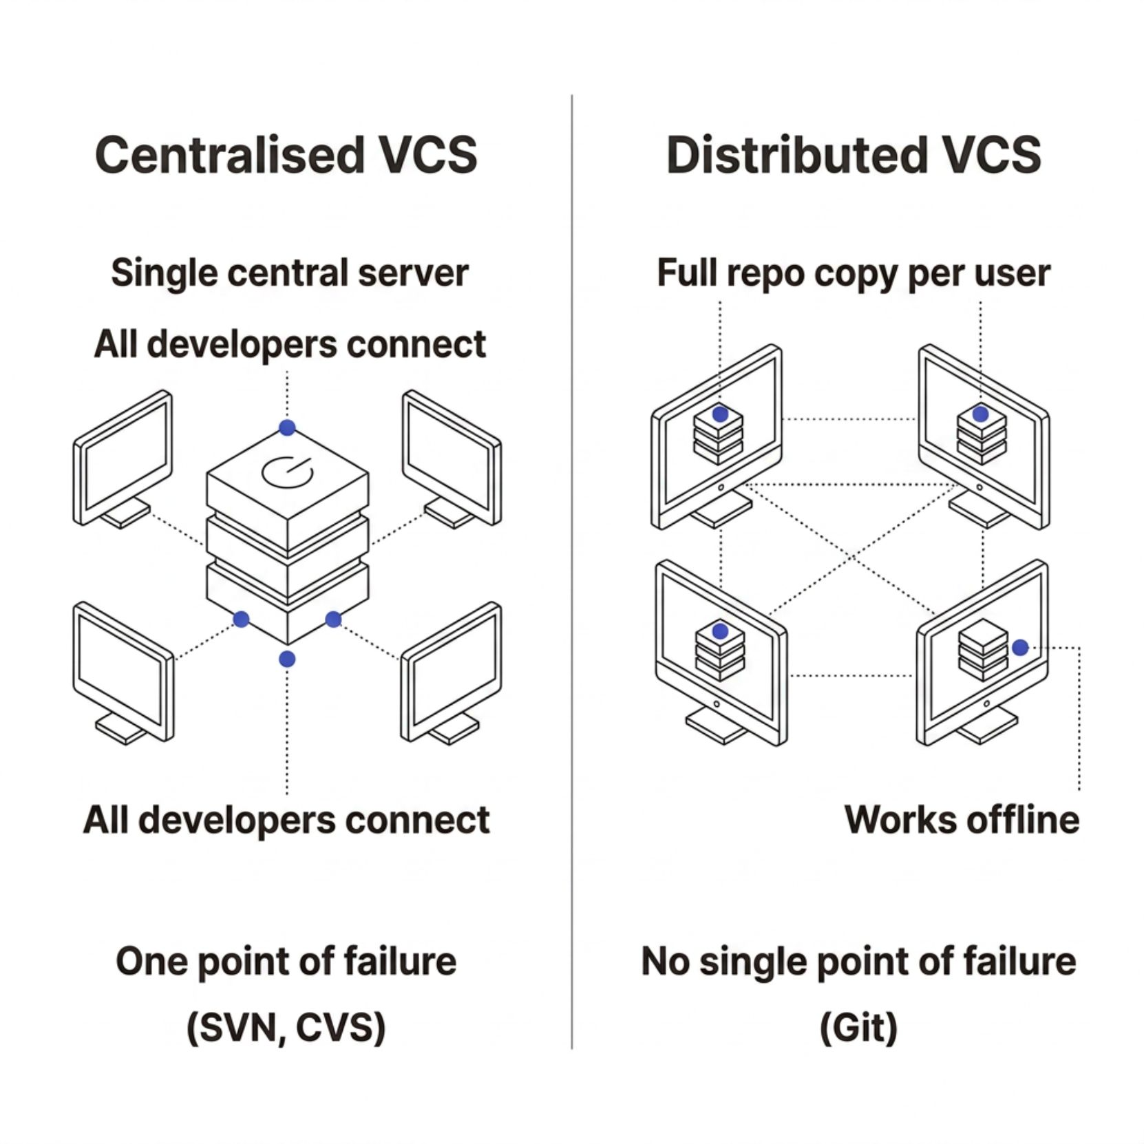
Centralised vs Distributed VCS
Centralised
Distributed
Single central server
Network always required
One point of failure
e.g. SVN, CVS
Full copy on every machine
Works fully offline
No single point of failure
e.g. Git

Slide 6

Git vs GitHub
Git
GitHub
Runs locally on your machine
Tracks file history
No internet required
Cloud hosting for repos
Team collaboration tools
Pull requests & Actions
Git = the engine. GitHub = the garage.

Slide 7

Installing Git
Windows
macOS
Download from git-scm.com
Includes Git Bash
brew install git
Or Xcode Command Line Tools
Install
Run & accept defaults
Download
Verify
Linux
git-scm.com
git --version
sudo apt install git
Ubuntu / Debian

Slide 8
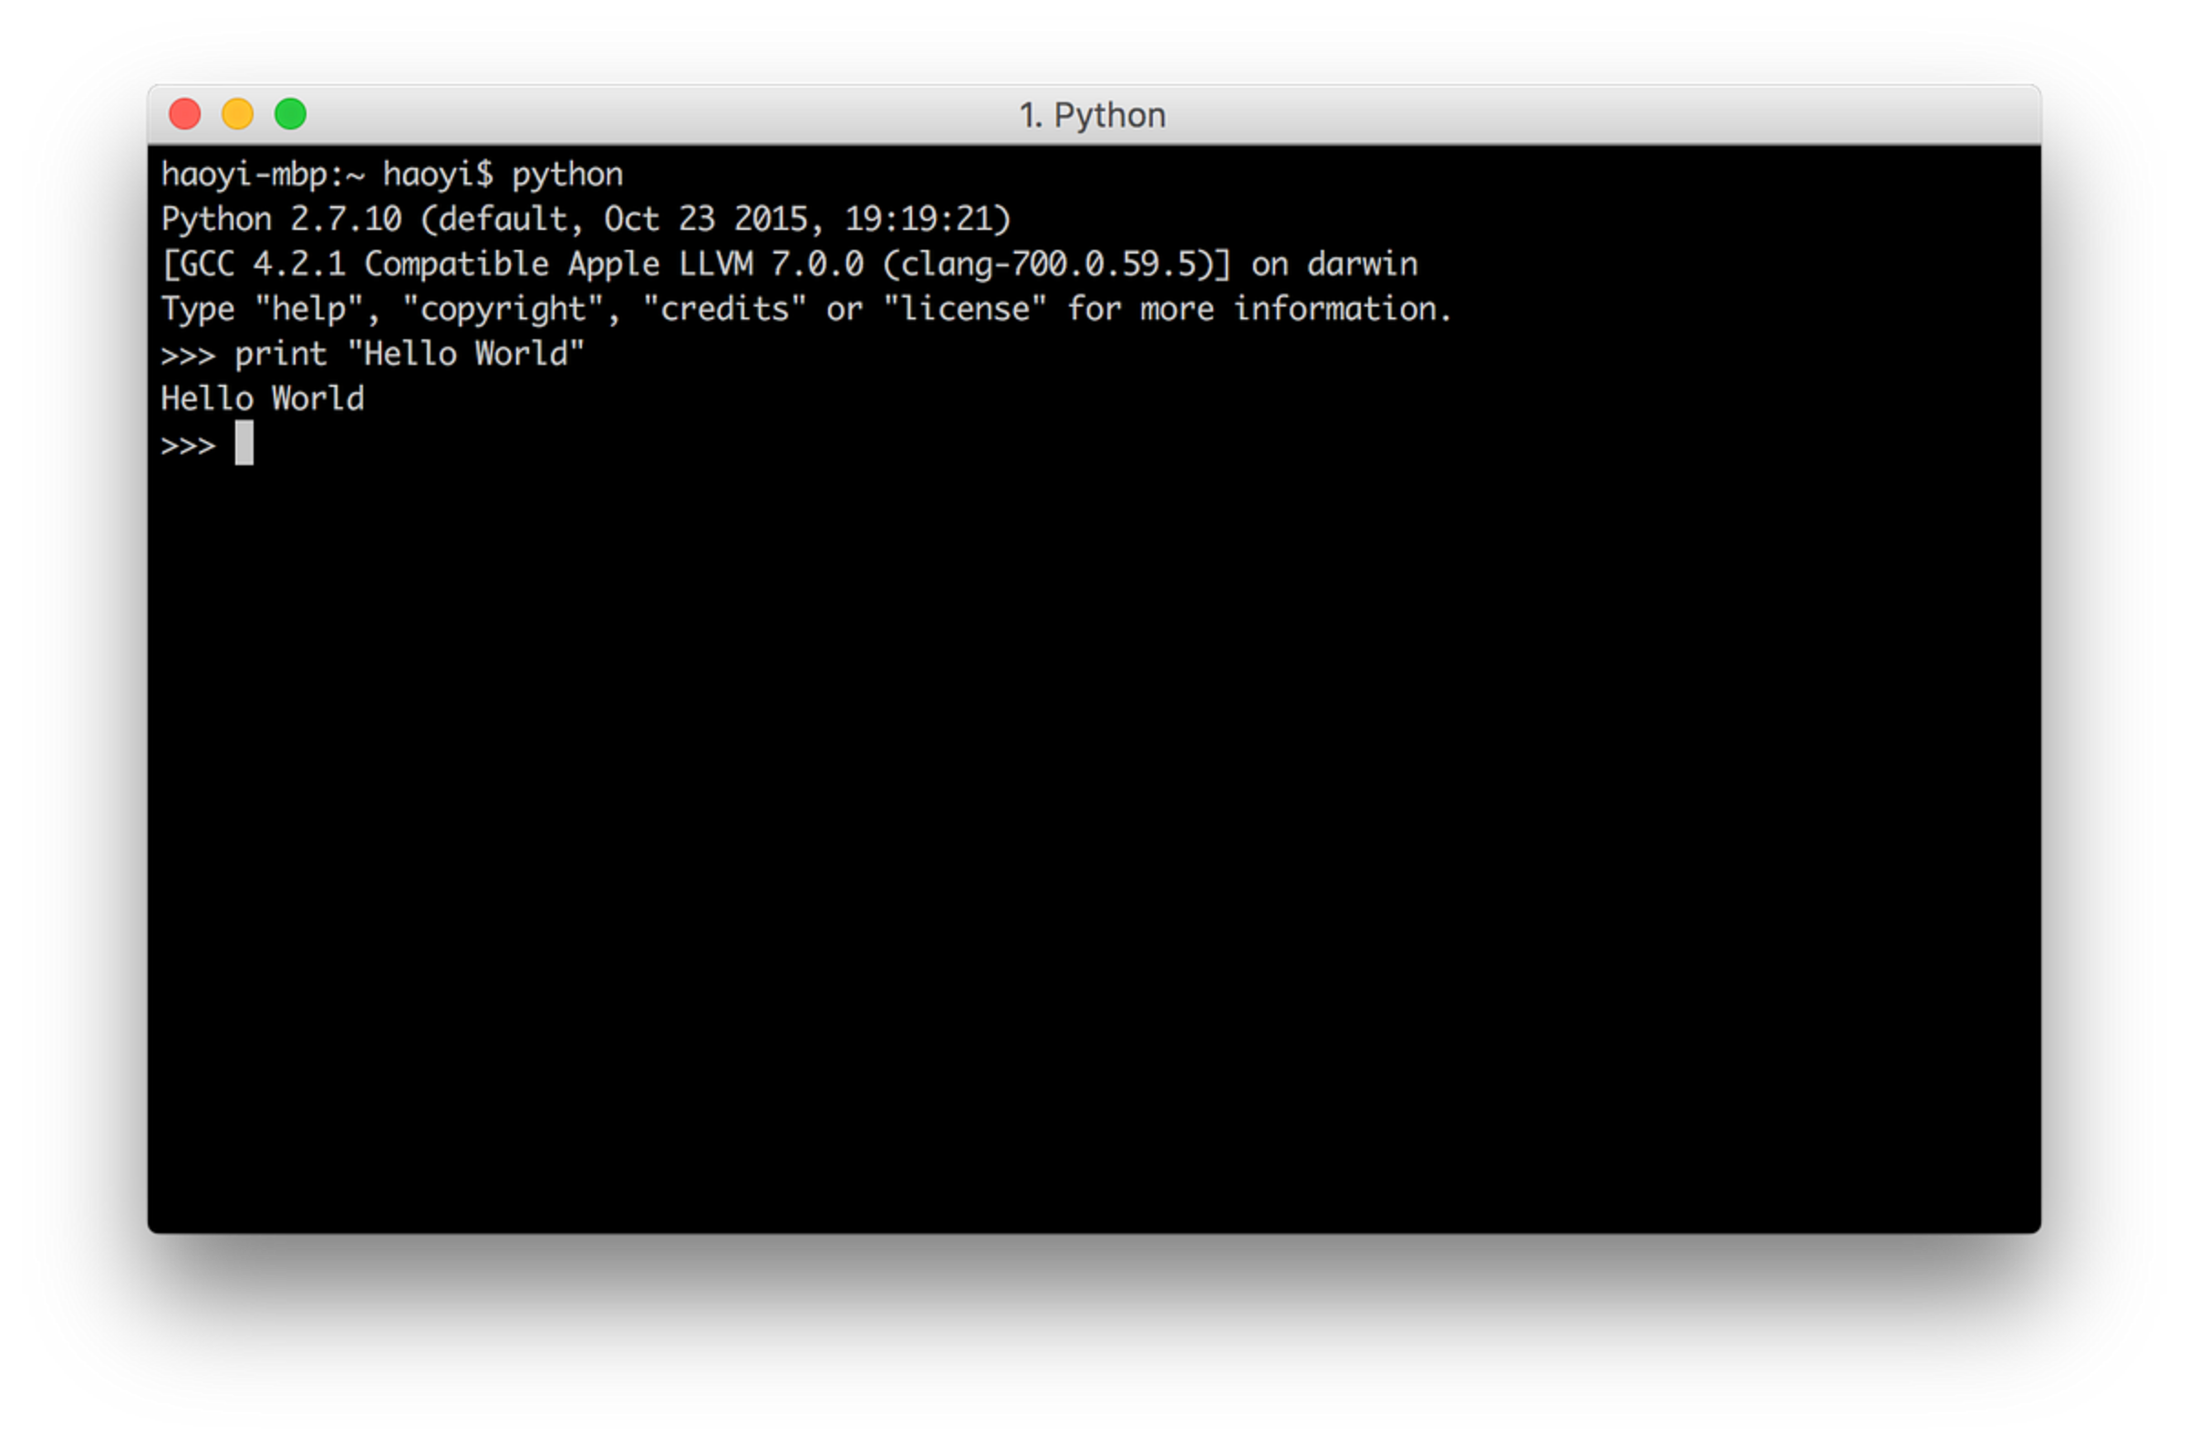
First-Time Git Configuration
git config --global user.name "Your Name"
git config --global user.email "you@example.com"
git config --global core.editor "code --wait"
Sets your identity for all commits
Stored globally — configure once
Editor opens for commit messages

Slide 9




How Git Works
Working Directory
Staging Area
Edit & write files
Files queued to commit
Local Repository
Remote Repository
Snapshots stored locally
Shared via GitHub
Git stores snapshots, not differences — each commit is a full project picture.

Slide 10
HANDS-ON GIT
Single User Setup
1
Initialise
mkdir my-project
cd my-project
git init
git add index.html
git commit -m "Initial commit"
git log --oneline
Creates hidden .git folder
2
Stage
Moves files to staging
3
Commit
Saves a snapshot locally

Slide 11
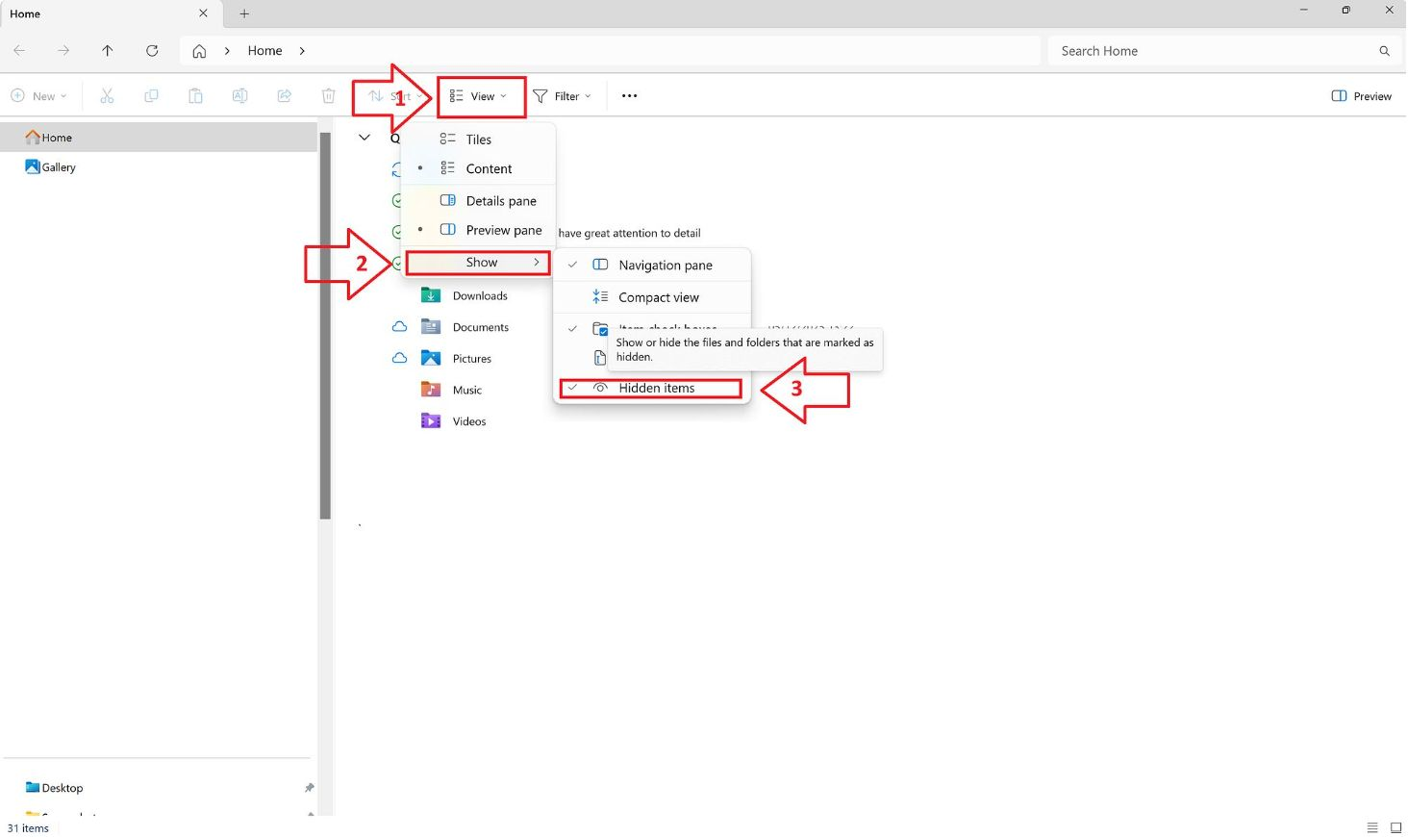
Ignoring Files
Files that should never be tracked:
API keys & secrets
Build outputs
OS & editor files
💡 Pro Tip
GitHub provides ready-made .gitignore templates for most languages & frameworks.
Create a .gitignore in your project root:
# Dependencies
node_modules/
# Build output
/dist
# Environment variables
.env
# macOS
.DS_Store

Slide 12
Tracking Empty Directories
Git tracks files, not folders — empty directories are invisible to Git.
The Problem
The Fix
Need logs/ or uploads/ in repo
Git ignores empty folders
Folder won't appear in commits
Add a .gitkeep file inside the folder
Convention only — not a Git feature
touch logs/.gitkeep
git add logs/.gitkeep

Slide 13

Branching in Git
Work without touching main codebase
Isolate features and bug fixes
Merge back when ready
git branch feature/login # create
git switch feature/login # switch
git switch -c feature/login # both

Slide 14
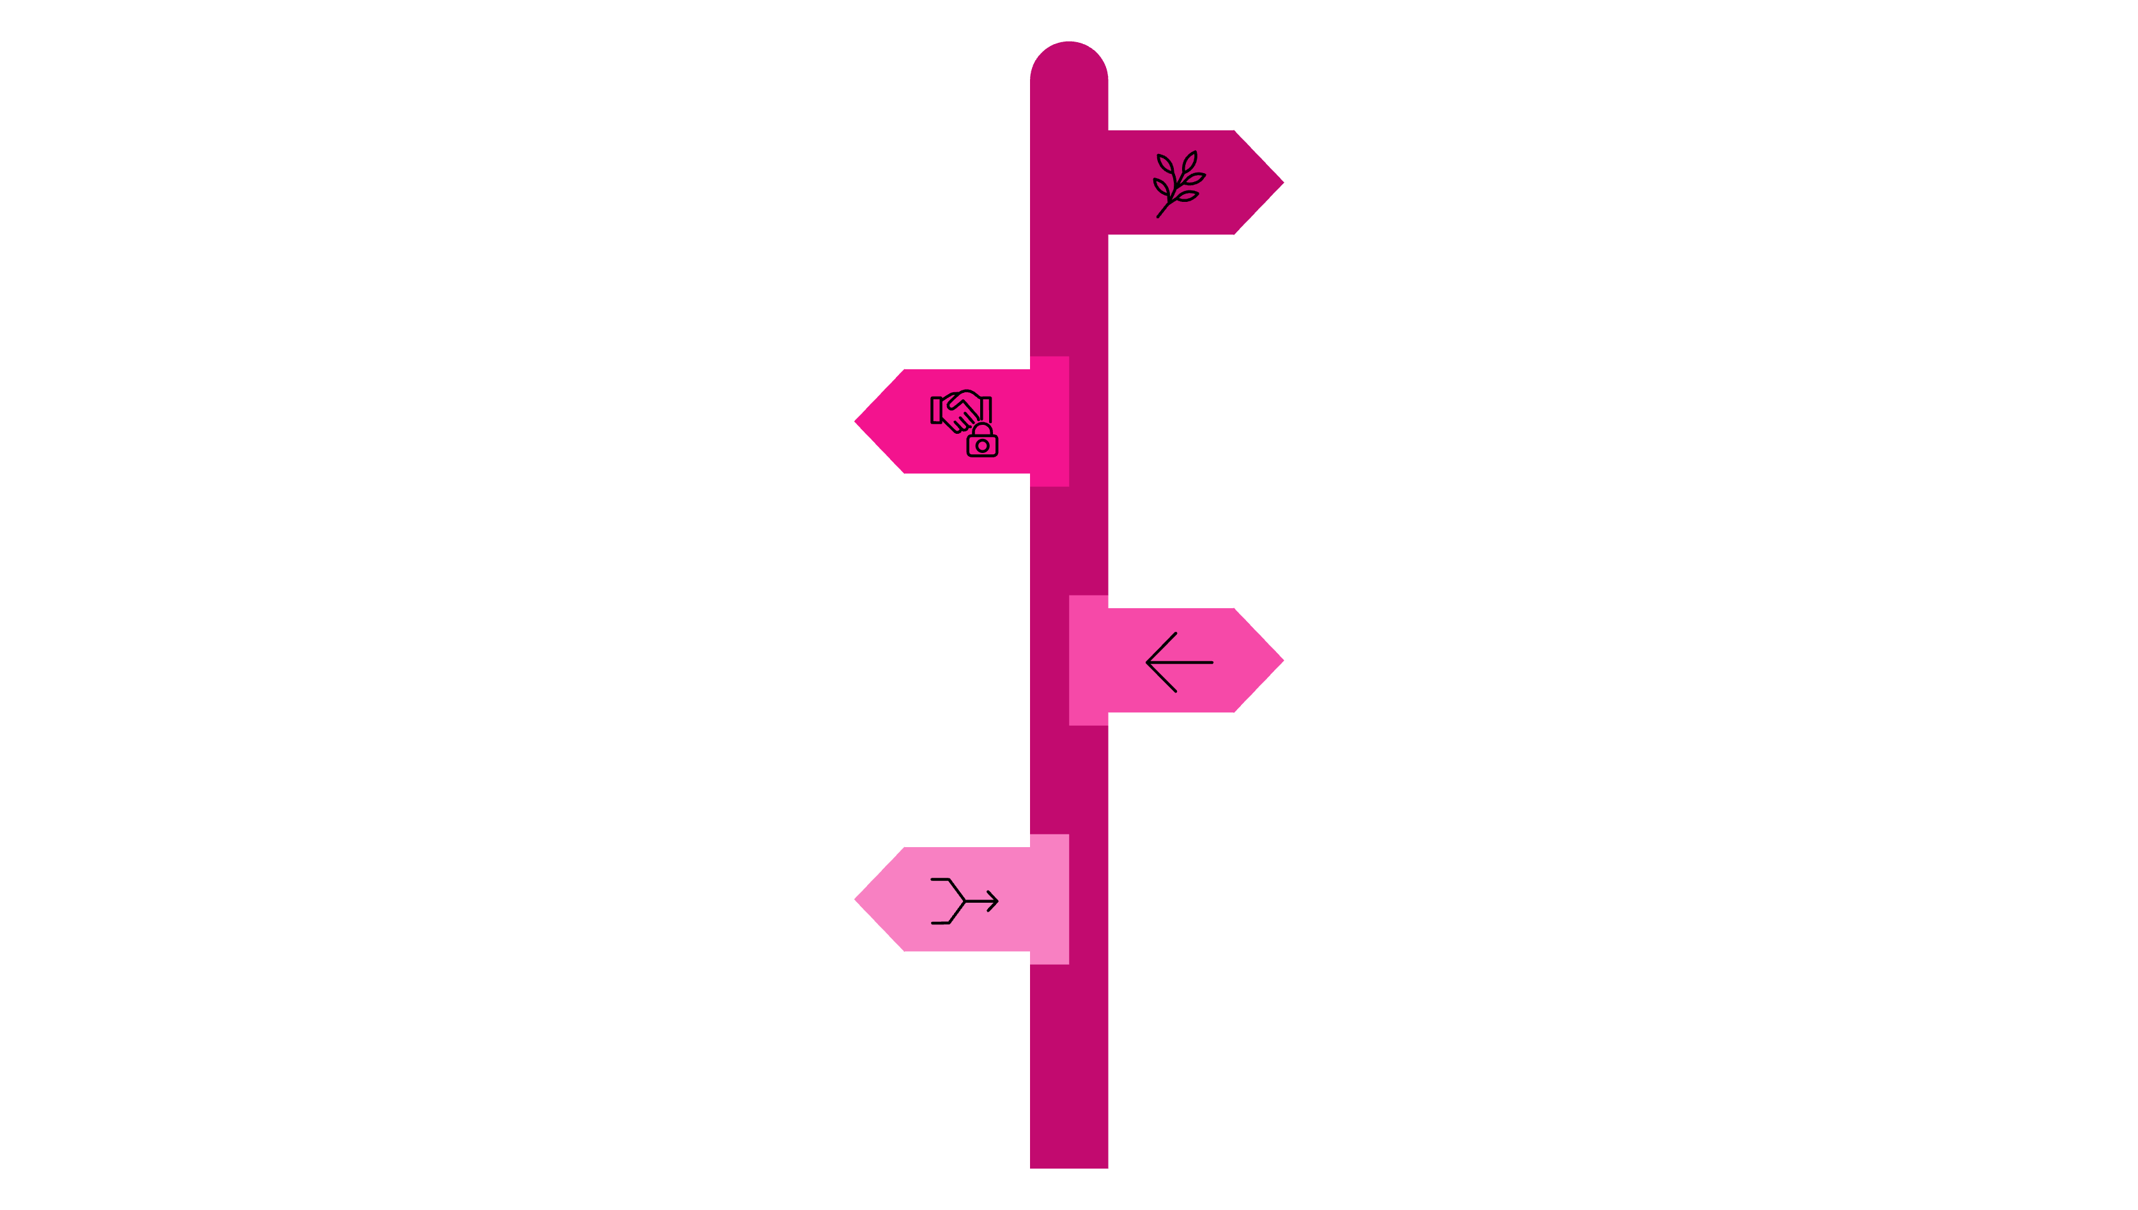
Working with Branches
Create Branch
New feature branch locally.
Commit Changes
Commits on feature branch.
Switch to Main
Return to main branch.
Merge Branch
Merge feature into main.
git switch main
git merge feature/login
git branch -d feature/login

Slide 15

Merge Conflicts
Occurs when two branches change the same line.
<<<<<<< HEAD
console.log("Hello");
=======
console.log("Hi there");
>>>>>>> feature/login
Edit file — keep desired change
Remove conflict markers
Stage and commit resolved file

Slide 16
Stashing in Git
Switch branches without committing — stash it.
Stash changes
Do other work
Restore stash
git stash
Switch branches, fix bugs
git stash pop
git stash # save current changes
git stash list # view all stashes
git stash pop # apply latest stash
git stash apply stash@{2} # apply specific

Slide 17

Git Tags
Tags mark specific points in history — typically release versions.
Lightweight Tag
Annotated Tag
git tag v1.0
git tag -a v1.0 -m "msg"
Push Tags
git push origin --tags

Slide 18
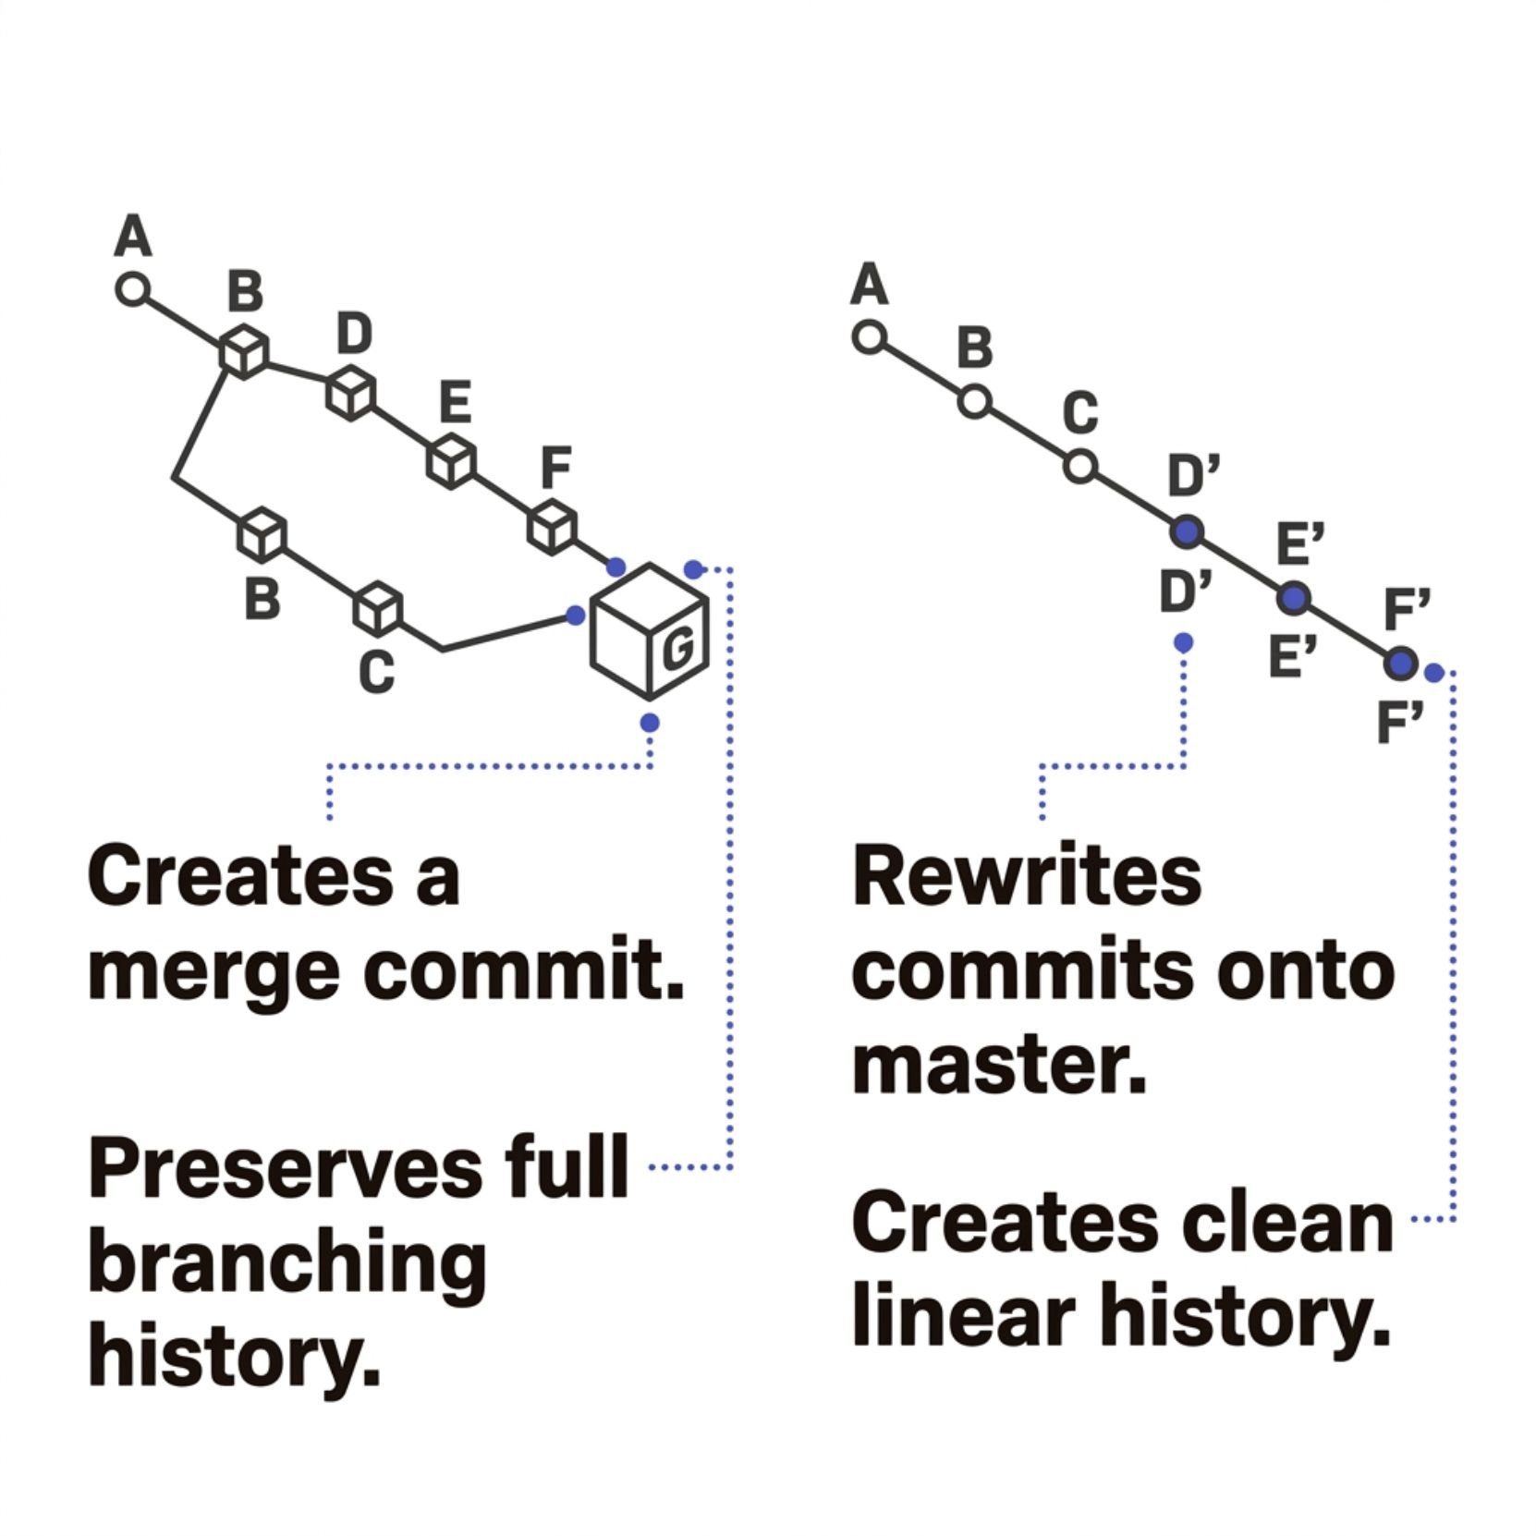

Git Rebase
git switch feature/login
git rebase main
Merge
Rebase
Preserves full history
Creates merge commit
Linear, cleaner log
Rewrites commit history
Never rebase already-pushed shared commits.

Slide 19
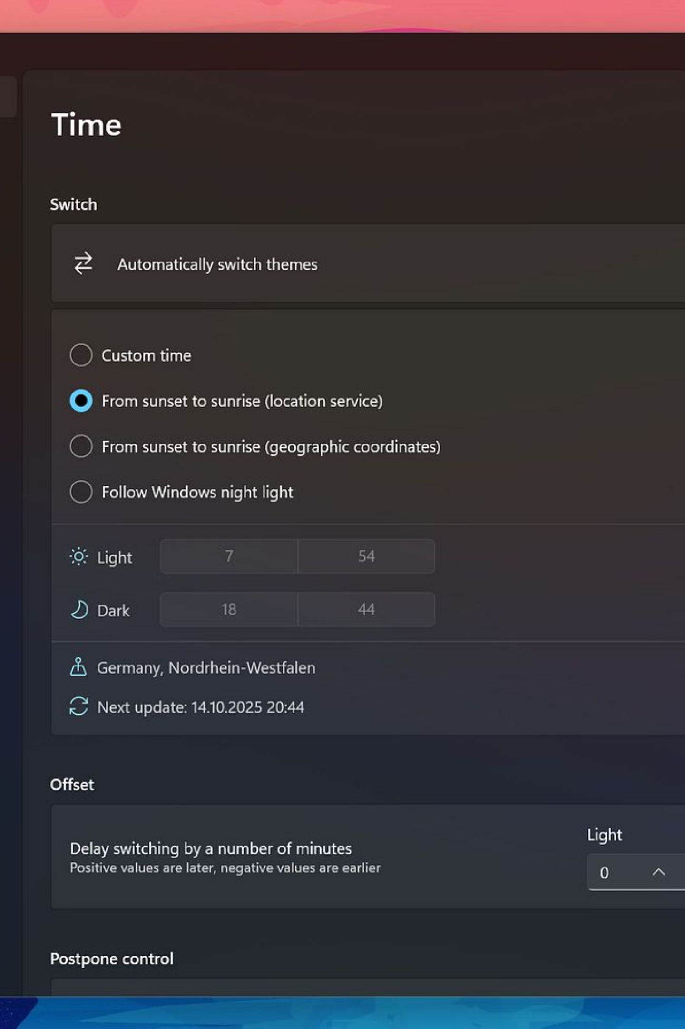
GITHUB
Hosting Your Repo on GitHub
Push local commits to the cloud
Share code with your team
Collaborate via pull requests
Keep an offsite backup

Slide 20

Connecting Local to GitHub
Create Repo
Copy URL
Add Remote
Push Commits
git remote add origin https://github.com/user/repo.git
git branch -M main
git push -u origin main

Slide 21
Essential Remote Commands
git push
git pull
Send commits to GitHub
Fetch & merge remote changes
git clone
git fetch
Download a full repo copy
Download changes, no merge

Slide 22
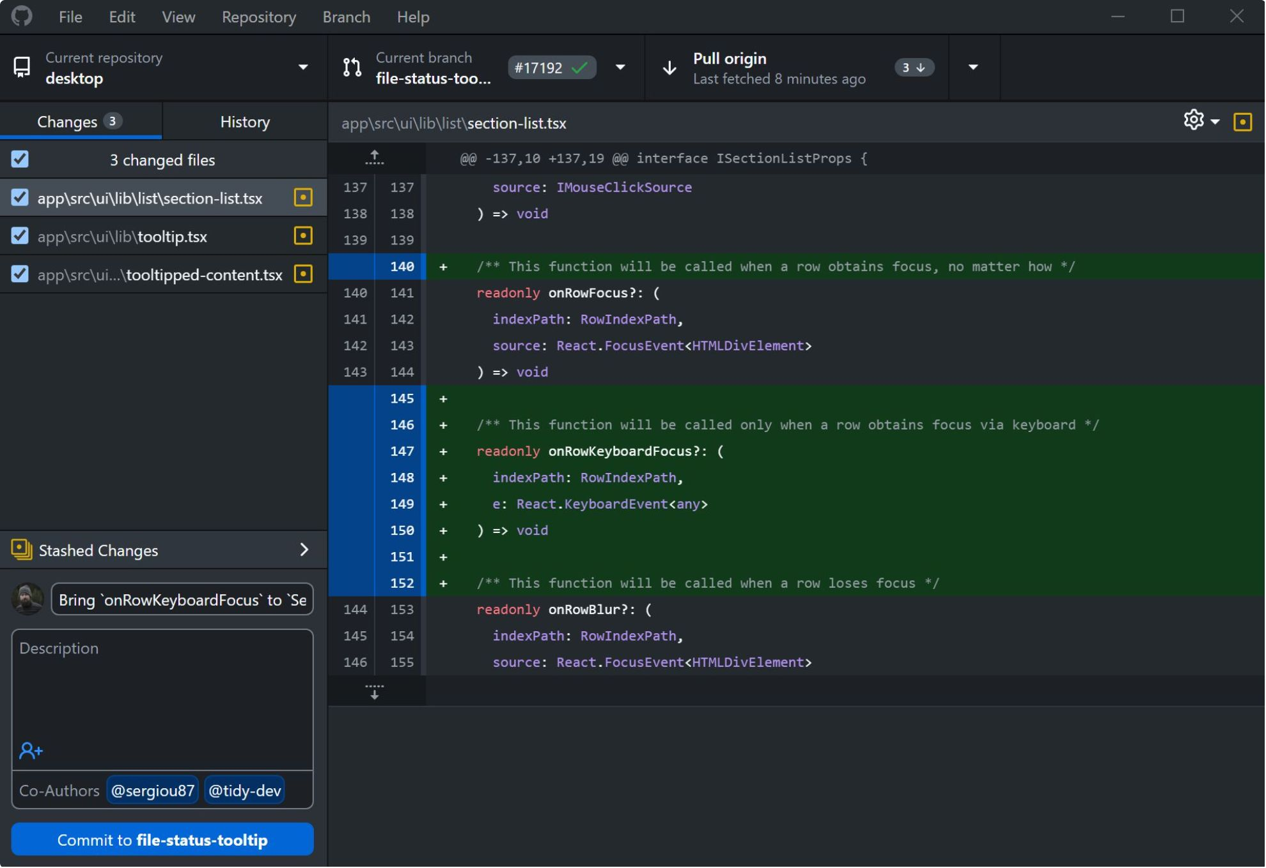
GitHub Desktop
Free GUI app — no terminal needed
Visual diff viewer
One-click commit, push, pull
Easy branch management
Beginner-friendly
Works alongside the CLI
Download: desktop.github.com

Slide 23
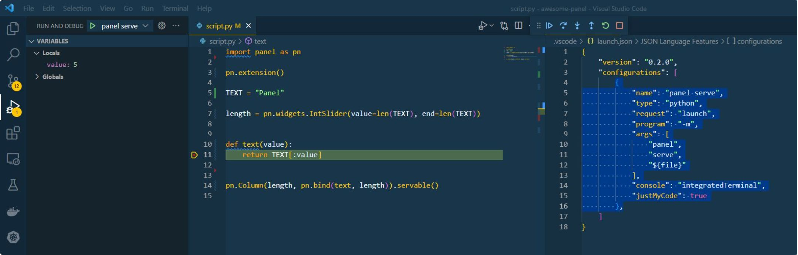
Using Git in VS Code
Git is built in — no extensions needed.
Stage & commit in sidebar
Inline diff highlighting
Branch management via UI
GitLens: blame & history per line

Slide 24

MULTI-USER SETUP
Working as a Team
One shared repository
Each dev on own branch
Merge via pull requests
Git resolves conflicts
Full history for all

Slide 25

Multi-User Setup
New Feature Branch
Make Commits
Clone Repo
Push Branch
Open PR
Each member works on own branch
Changes reviewed before merging

Slide 26
Pull Requests & Code Review
1
2
Open a PR
Review
Propose branch for merging
Comment, suggest, approve
3
4
CI Checks
Merge
Automated tests run
Approved PR merges to main

Slide 27
Modern Git Workflow
main
1
Stable, production-ready only
2
develop
Features integrate here first
feature/*
3
One branch per feature
4
release/*
Stabilise before production
hotfix/*
5
Emergency fixes off main
Git Flow — popular branching strategy for teams.

Slide 28
Quick Reference
Command
Purpose
git init
Initialise a new repo
git add .
Stage all changes
git commit -m ""
Snapshot with message
git switch -c name
Create & switch branch
git push / pull
Sync with remote
git log --oneline
View compact history

Slide 29
Common Beginner Mistakes
Committing to main directly
Vague commit messages
Always use a feature branch
Keep main clean & stable
Avoid "fixed stuff" messages
Be specific and descriptive
Forgetting .gitignore
Rebasing shared branches
Exclude node_modules, .env
Set up before first commit
Only rebase local branches
Never rewrite shared history

Slide 30

You're Ready to Git Going
Practice Daily
Use Branches
Commit small and often.
One feature, one branch.
Read the Docs
git-scm.com · docs.github.com
Questions? Open an issue — or raise your hand.

