Slide 1
ASAKAI · RAKATHON 2026
Rakathon: From Idea to D-Day
Submit your idea, get shortlisted, hack for a week, and demo live to the senior jury
Submission 15–31 Oct 2026 · Event Day 23 Nov 2026 · RIEPL India

Slide 2
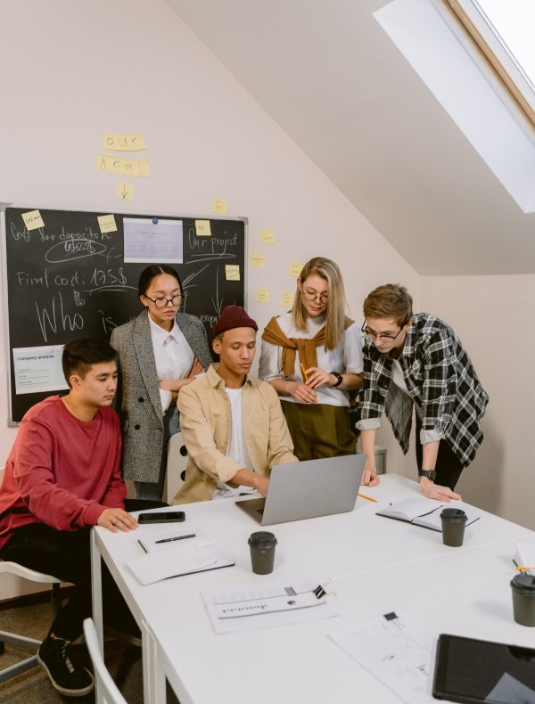
This Presentation Relates to…
Brand Concepts
  On a Mission: Empowerment
  Behave Ethically: Integrity
  Prepare to Succeed: Professionalism
  Complete Commitment: Get Things Done
  Solidarity: Succeed as a Team
5 Principles for Success
  Always Improve, Always Advance
  Be Passionately Professional
  Hypothesize → Practice → Validate → Shikumika
  Maximize Customer Satisfaction
  Speed!! Speed!! Speed!!
Notes:
“Our presentation will represent _____for brand concepts and ___ among our five principles of success.

Slide 3




PROGRAMME TIMELINE
Rakathon: From Idea to D-Day
Submit your idea, get shortlisted, hack for a week, and demo live to the senior Jury
01
02
03
04
15 to 31
OCT.
13 to 01
NOV.
16 to 22
NOV.
23 NOV.
2026
Submission
Shortlisting
Hack Week
Event Day
REGISTRATION
PANEL EVALUATION
TOP 10 TEAMS
LIVE DEMO TO JURY
Submit hack ideas in the prescribed format. Teams can have up to 4 members.
Panels shortlist ideas through a defined evaluation process, from N to 10 ideas
Each team is assigned a mentor to help them prepare against expectations
Each team presents and demos live. Top 3 win exciting, rewarding prizes
ALL IDEAS (N) → TOP 10 SHORTLISTED TEAMS → TOP 3 WINNERS

Slide 4
Rakathon 2026 — Background
Theme: Enterprise Agentic AI — build Super Agents that create real business impact
2025 Hack-a-Prompt (vibe coding) → 2026 Rakathon: production-ready agentic solutions
Aligned with RPC 2026 and Mikitani-san's Super Agent vision
Tagline contest coming soon — help us name Rakathon 2026
Reference: Super Agent at Rakuten AI Optimism 2026

Slide 5
What we need from you
Tagline contest — submit a creative tagline for Rakathon 2026
Idea submission — 1-page proposal, POC, and expected business impact (by 31 Oct)
Problem areas — prepare your pitch around leader-identified RIEPL focus areas
Teams — 1 to 4 members; cross-department collaboration encouraged
Recruit teammates and register during the submission window

Slide 6
What you get out of the event
Chance to attend a prominent AI conference — and more for top teams
India Agent Marketplace launch — host your agents for use across RIEPL
Impact on leader-identified problem areas with org-wide visibility
Mentorship during Hack Week and recognition for Top 3 winners

