Slide 1



UTSAV 2016
“Reason to Celebrate”
By
App Development Team, MCA
Department of Computer Applications,
Manipal Institute of Technology, Manipal
Department of Computer Applications, MIT, Manipal
1

Slide 2
Why UTSAV – 2016 APP?
Simple and Smart interface
Easy Information sharing
Quick access and reference
Instant reach to all MU members and students
Dynamic update of results and images
Technology-culture interconnect
Department of Computer Applications, MIT, Manipal
2

Slide 3
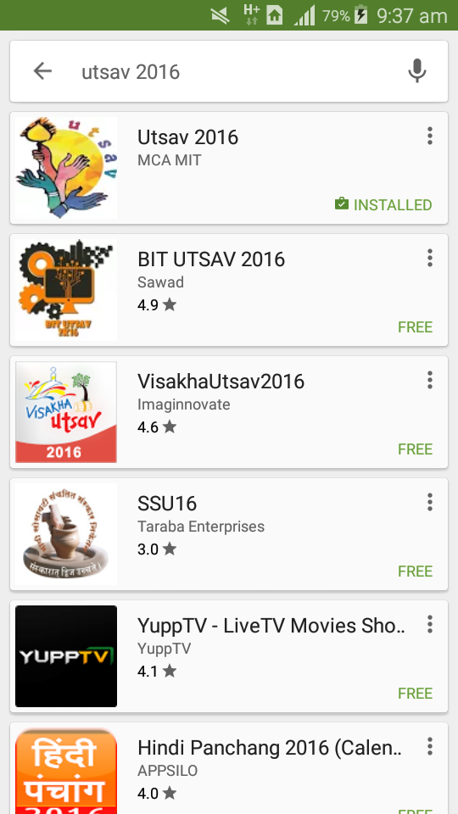
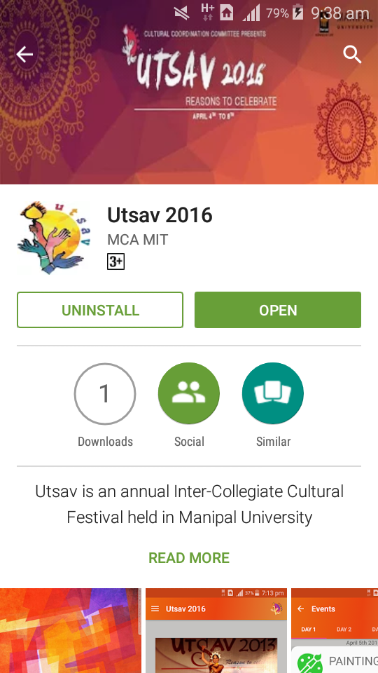
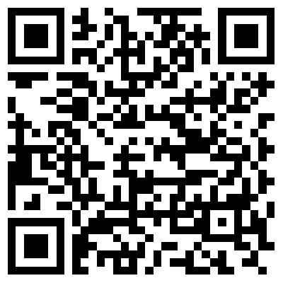
Downloading Utsav 2016 App
QR Code
Android application available on Play Store
Department of Computer Applications, MIT, Manipal
3

Slide 4
Features
Information about the events, schedules and venues
Contact information of the event coordinators
Photo-Gallery showing glimpses of Utsav
Venue search
Notifications of event results, alerts and status
Chart showing the ranking of top 5 institutions
Department of Computer Applications, MIT, Manipal
4

Slide 5

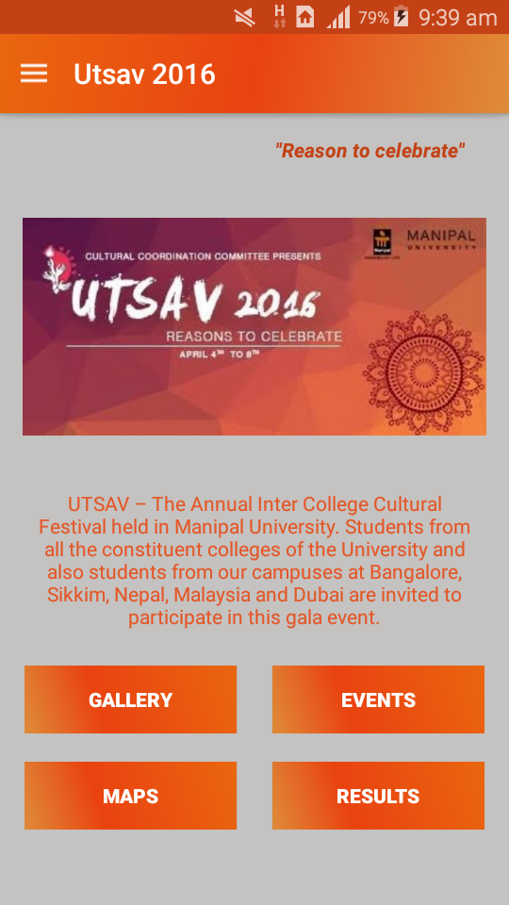
Screenshots
Splash Screen
Home Screen
Department of Computer Applications, MIT, Manipal
5

Slide 6
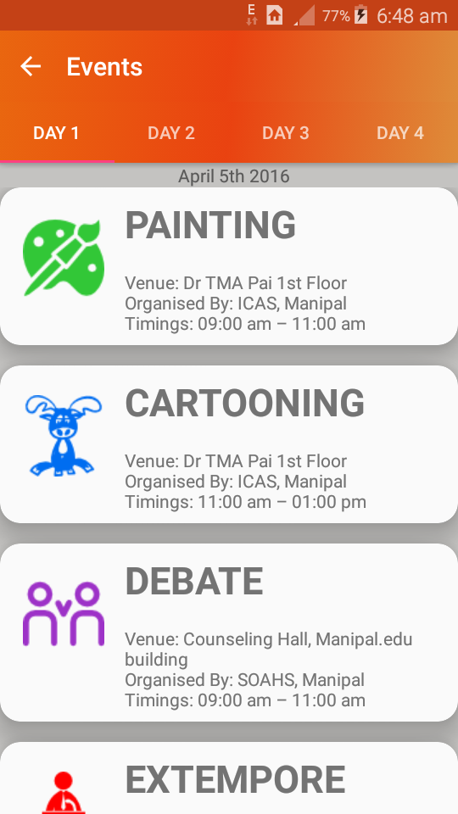
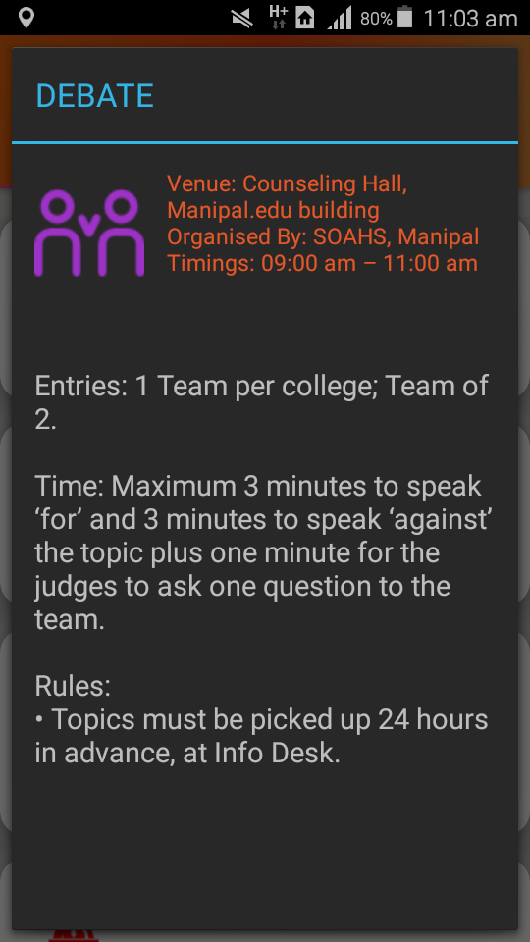
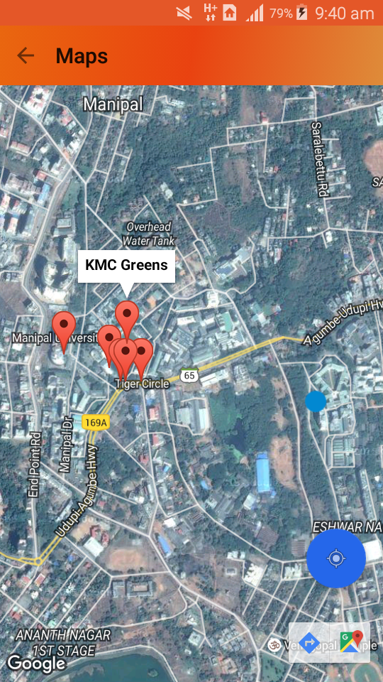
Screenshots
Events
Event Rules
Event Venues
Department of Computer Applications, MIT, Manipal
6

Slide 7
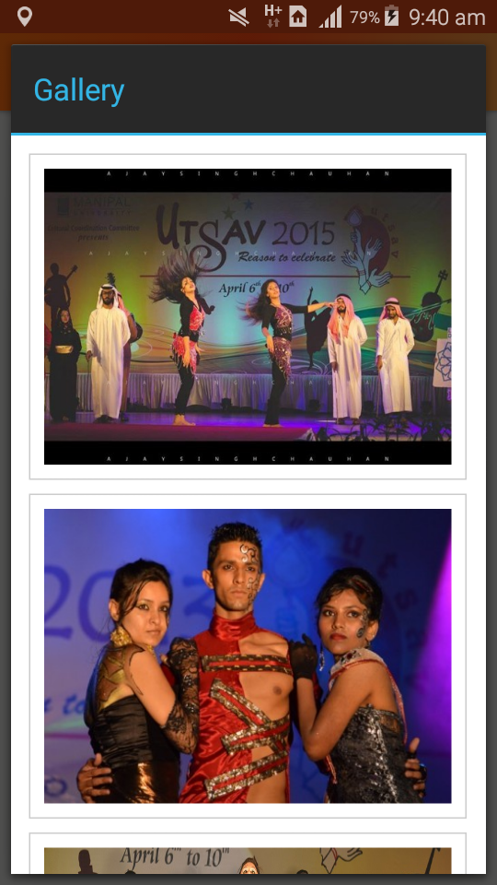
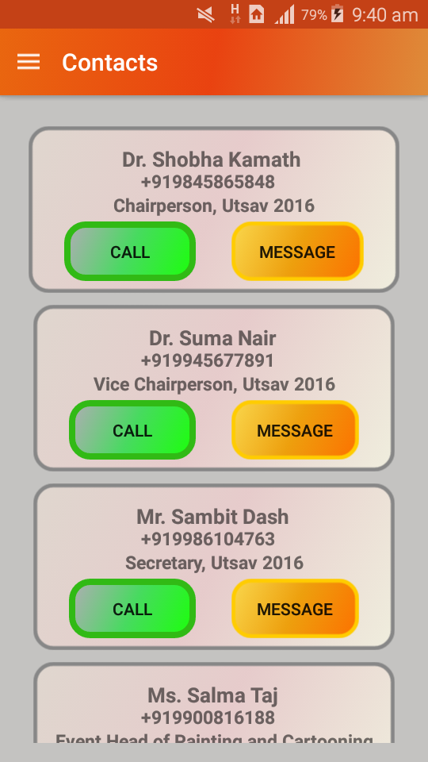
Screenshots
Image Gallery
Contacts
Department of Computer Applications, MIT, Manipal
7

Slide 8
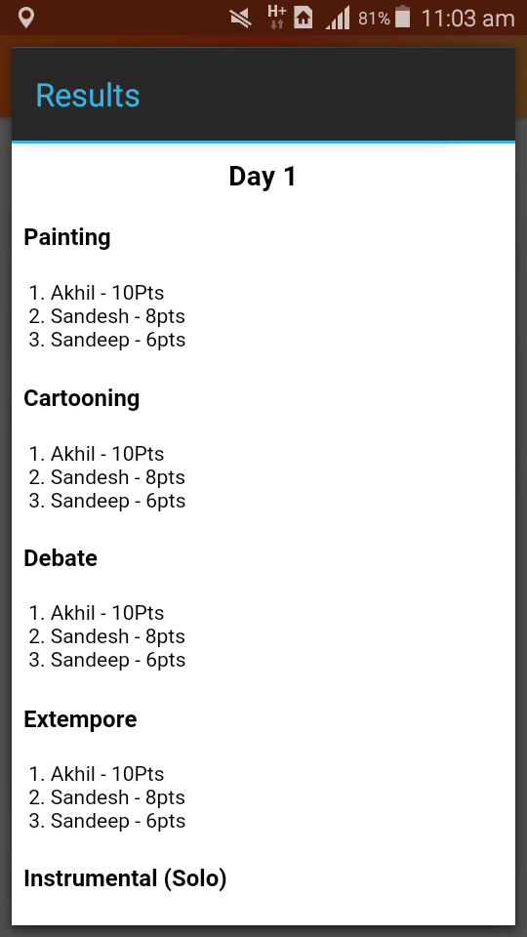
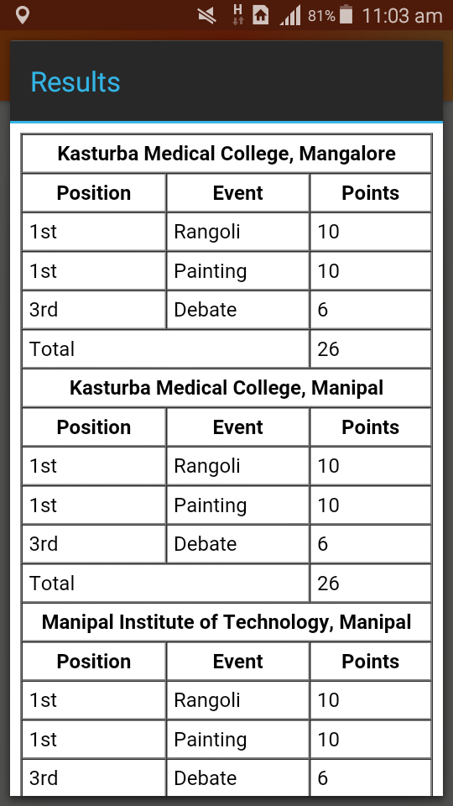
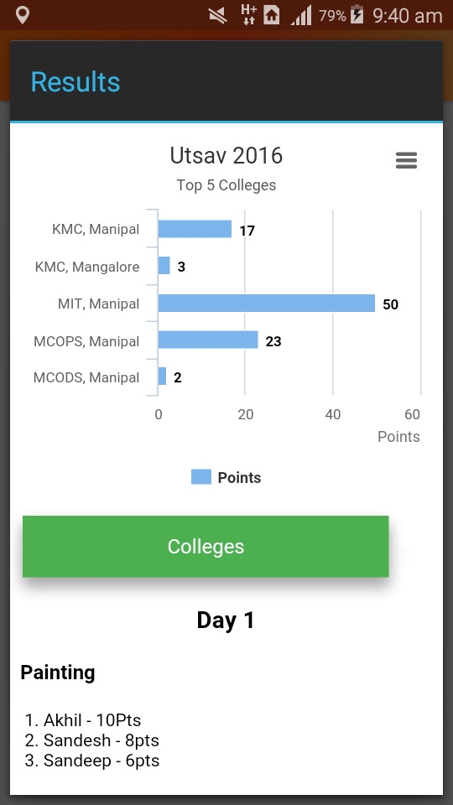
Screenshots
Results
Department of Computer Applications, MIT, Manipal
8

Slide 9
Publicity
Using University mail exchange server to send notifications to the users about the app
Mails to the different college coordinators and event coordinators
Hosting a message in facebook page
Informing different clubs
Putting pop-up message in website
Sharing with previous coordinators and alumni
Sending messages in whatsapp groups
Department of Computer Applications, MIT, Manipal
9

Slide 10
Requests
Server space- To host the app(University Information System Department)
Pictures and summary report – From Organizing team
Department of Computer Applications, MIT, Manipal
10

Slide 11
Acknowledgements
Manipal University officials for giving valuable time to launch beta version of the app
Cultural Coordination Committee chairperson and members team for giving a chance to merge technology with culture
Director, MIT, Faculty and staff of Department of Computer Applications, for giving the support, suggestions and guidance
Department of Computer Applications, MIT, Manipal
11

Slide 12
THANK YOU

