Slide 1
Module 5
The Applet Class

Slide 2
1. INTRODUCTION
Java Applet
Applet is a special type of JAVA program i.e embedded in the webpage to generate the dynamic content.
It runs inside the browser and works at client side.
Advantage of Applet
There are many advantages of applet. They are as follows:
It works at client side so less response time.
Secured
It can be executed by browsers running under many plateforms, including Linux, Windows, Mac Os etc.

Slide 3
2. Two Types of Applets
Two varieties of applets.
The first are those based directly on the Applet class.
The applets use the Abstract Window Toolkit (AWT) to provide the graphic user interface (or use no GUI at all).
This style of applet has been available since Java was first created.
The second type of applets are those based on the Swing class JApplet.
Swing applets use the Swing classes to provide the GUI.
Swing offers a richer and often easier-to-use user interface than does the AWT.
Thus, Swing-based applets are now the most popular.

Slide 4
However, traditional AWT-based applets are still used, especially when only a very simple user interface is required.
Thus, both AWT- and Swing-based applets are valid. Because JApplet inherits Applet, all the features of Applet are also available in JApplet, and most of the information applies to both types of applets.

Slide 5
Types of Applets:
Web pages can contain two types of applets which are named after the location at which they are stored.
1. Local Applet
2. Remote Applet
Local Applets:
A local applet is the one that is stored on our own computer system. When the Web-page has to find a local applet, it doesn't need to retrieve information from the Internet.
A local applet is specified by a path name and a file name as shown below in which the
codebase attribute specifies a path name, whereas the
code attribute specifies the name of the byte-code file that contains the applet's code.
<applet codebase="MyAppPath" code="MyApp.class" width=200 height=200> </applet>

Slide 6
2. Remote Applets
A remote applet is the one that is located on a remote computer system. (This computer system may be located in the building next door or it may be on the other side of the world).
No matter where the remote applet is located, it's downloaded onto our computer via the Internet.
The browser must be connected to the Internet at the time it needs to display the remote applet.
To reference a remote applet in Web page, we must know the applet's URL (where it's located on the Web) and any attributes and parameters that we need to supply.
A local applet is specified by a url and a file name as shown below.
<applet codebase="http://www.apoorvacollege.com" code="MyApp.class" width=200 height=200> </applet>

Slide 7
3. Applet basics
All applets are subclasses (either directly or indirectly) of Applet.
Applets are not stand-alone programs. Instead, they run within either a web browser or an applet viewer.
An applet is a Java program that runs in a Web browser.
An applet can be a fully functional Java application because it has the entire Java API.
Execution of an applet does not begin at main( ). Actually, few applets even have main( )methods. Instead, execution of an applet is started and controlled with an entirely different mechanism.

Slide 8
Output to your applet's window is not performed by System.out.println( ). Rather, in non-Swing applets, output is handled with various AWT methods, such as drawString( ), which outputs a string to a specified X,Y location.
Input is also handled differently than in a console application.
To use an applet, it is specified in an HTML file. One way to do this is by using the APPLET tag.
The applet will be executed by a Java-enabled web browser when it encounters the APPLET tag within the HTML file

Slide 9
To view and test an applet more conveniently, simply include a comment at the head of your Java source code file that contains the APPLET tag.
This way, your code is documented with the necessary HTML statements needed by your applet, and you can test the compiled applet by starting the appletviewer with your Java source code file specified as the target.
Here is an example of such a comment:
/*
<applet code="MyApplet" width=200 height=60></applet>
*/
This comment contains an APPLET tag that will run an applet called MyApplet in a window that is 200 pixels wide and 60 pixels high.
Because the inclusion of an APPLET command makes testing applets easier, all of the applets shown in this topic will contain the appropriate APPLET tag embedded in a comment

Slide 10
FEATURE | STAND ALONE APPLICATION | APPLET
main() method | Present | Not present
Execution | Requires JRE | Requires a browser like Chrome
Nature | Called as stand-alone application as application can be executed from command prompt | Requires some third party tool help like a browser to execute
Restrictions | Can access any data or software available on the system | cannot access any thing on the system except browser’s services
Security | Does not require any security | Requires highest security for the system as they are untrusted

Slide 11
Cont.. Of Applet basics
The Applet Class
Every applet is an extension of the java.applet.Applet class.
The base Applet class provides methods that a derived Applet class may call to obtain information and services from the browser context.
Applet provides all necessary support for applet execution,
such as starting and stopping.
Applet also provides methods that load and display images, and methods that load and play audio clips.
Applet extends the AWT class Panel. In turn, Panel extends Container, which extends Component
These classes provide support for Java's window based , graphical interface.
Applet provides the necessary support for window-based activities.

Slide 12
The Methods Defined by Applet do the following −
Get applet parameters
Get the network location of the HTML file that contains the applet
Get the network location of the applet class directory
Print a status message in the browser
Fetch an image
Fetch an audio clip
Play an audio clip
Resize the applet
Additionally, the Applet class provides an interface by which the viewer or browser obtains information about the applet and controls the applet's execution. The viewer may −
Request information about the author, version, and copyright of the applet
Request a description of the parameters the applet recognizes
Initialize the applet
Destroy the applet
Start the applet's execution
Stop the applet's execution

Slide 13
Some of The Methods Defined by Applet
void destroy( )
Called by the browser just before an applet is terminated. Your applet will override this method if it needs to per form any clean up prior to its destruction.
2. AccessibleContextReturns getAccessibleContext( )
Returns the accessibility context for the invoking object.
3. AppletContext getAppletContext( )
Returns the context associated with the applet.
4. String getAppletInfo( )
Returns a string that describes the applet.
5. AudioClip getAudioClip(URL url)
Returns an AudioClip object that encapsulates theaudio clip found at the location specified by url.

Slide 14
4. Applet Architecture
Java provides console based programming language environment and window based programming environment.
An applet is a window based programming environment. So applet architecture is different than console based program.
Java applets are essentially java window programs that can run within a web page.
Applet programs are java classes that extend that java.applet.Applet class and are enabled by reference with HTML page.

Slide 15
When applet are combined with HTML, that can make an interface more dynamic and powerful than with HTML alone.
Dynamic web page can be used in an enterprise application to view or manipulate data coming from some source on the server.
The Applet and there class files are distribute through standard HTTP request and therefore can be sent across firewall with the web page data.
Applet code is referenced automatically each time the user revisit the hosting website. Therefore keeps full application up to date on each client desktop on which it is running.

Slide 16
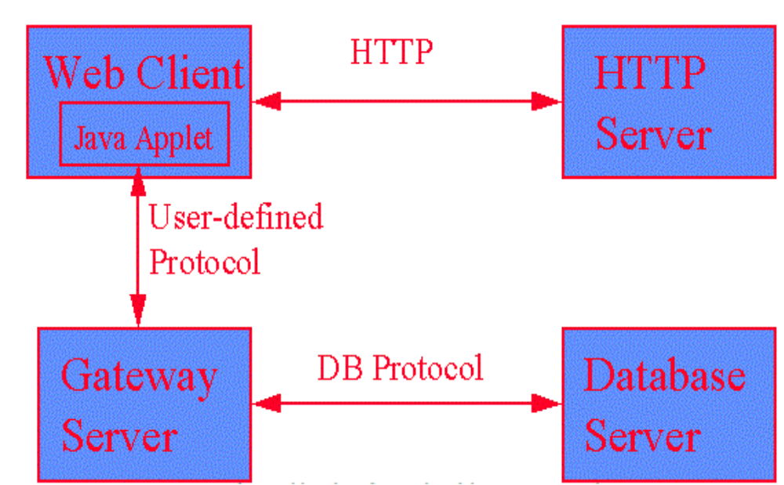
Applet Architecture:

Slide 17
5. An Applet Skeleton/Life Cycle of an Applet
Lifecycle of Java Applet
Applet is initialized.
Applet is started.
Applet is painted.
Applet is stopped.
Applet is destroyed.
Lifecycle methods for Applet:
The java.applet.Applet class 4 life cycle methods
and
The java.awt.Component class provides 1 life cycle methods for an applet

Slide 18
Life cycle of an Applet
Start state
Redraw Applet
Destroy Applet
init( )
Applet Born
start( )
paint( )
stop( )
destroy( )
Initialization state
Applet Working
Applet Displayed
Idle State
Applet Destroyed

Slide 19
java.applet (Applet class)
For creating any applet java.applet. Applet class must be inherited.
It provides 4 life cycle methods of applet.
public void init(): is used to initialized the Applet. It is invoked only once.
public void start(): is invoked after the init() method or browser is maximized. It is used to start the Applet.
public void stop(): is used to stop the Applet. It is invoked when Applet is stop or browser is minimized.
public void destroy(): is used to destroy the Applet. It is invoked only once.
java.awt (Component class)
The Component class provides 1 life cycle method of applet.
public void paint(Graphics g):
It is used to paint the Applet. It provides Graphics class object that can be used for drawing oval, rectangle, arc etc.

Slide 20
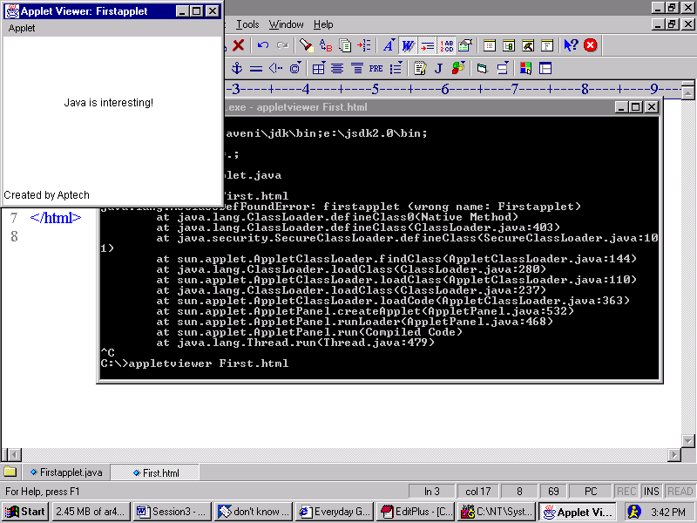
A simple Applet
import java.awt.*;
import java.applet.*;
public class FirstApplet extends Applet
{
String str;
public void init()
{
str = "Java is interesting!";
}
public void paint(Graphics g)
{
g.drawString(str, 70, 80);
}
}
Output

Slide 21
Creating an Applet
An Applet is compiled using the Java compiler: javac
  javac Firstapplet.java
Create an HTML page to display the Applet
  <html>
  <appletcode=Firstapplet width=200 height=200>
  </applet>
  </html>
Then type the following at command prompt:
  appletviewer abc.html where abc.html is the name of
  the html file.

Slide 22
// An Applet skeleton.
import java.awt.*;
import java.applet.*;
/*
<applet code="AppletSkel" width=300 height=100>
</applet>
*/
public class AppletSkel extends Applet
{ // Called first.
public void init()
{// initialization
}
/* Called second, after init(). Also called whenever the applet is restarted. */
public void start()
{
// start or resume execution
}

Slide 23
// Called when the applet is stopped.
public void stop()
{ // suspends execution
}
/* Called when applet is terminated. This is the last method executed. */
public void destroy()
{ // perform shutdown activities
}
// Called when an applet's window must be restored.
public void paint(Graphics g)
{ // redisplay contents of window
}
}

Slide 24
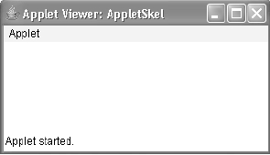
Although this skeleton does not do anything, it can be compiled and run. When run, it generates the following window when viewed with an applet viewer

Slide 25
6. Simple Applet Display Methods
Applets are displayed in a window, and AWT- based applets use the AWT to perform input and output.
To output a string to an applet, use drawString( ) , which is a member of the Graphics class.
Typically, it is called from within either
update( ) or paint( ).
It has the following general form:
void drawString(String message, int x, int y)
Here, message is the string to be output beginning at x,y. In a Java window, the upper-left corner is location 0,0.

Slide 26
The drawString( ) : method will not recognize newline characters.
If you want to start a line of text on another line, you must do so manually, specifying the precise X,Y location where you want the line to begin.
To set the background color of an applet's window, use
setBackground( ).
To set the foreground color (the color in which text is shown) setForeground( ).
These methods are defined by Component, and they have the following general forms:
void setBackground(Color newColor)
void setForeground(Color newColor)

Slide 27
Here newColor specifies the new color.
The class Color defines the constants shown here that can be used to specify colors:
Color.black
Color.magenta
Color.blue
Color.orange
Color.cyan
Color.pink
Color.darkGray
Color.red
Uppercase versions of the constants are also defined.
The following example sets the background color to green and the text color to red:
setBackground(Color.green); setForeground(Color.red);

Slide 28
A good place to set the foreground and background colors is in the init( ) method.
You can change these colors as often as necessary during the execution of your applet.
You can obtain the current settings for the background and foreground colors by calling getBackground( ) and getForeground( ), respectively.
They are also defined by Component and are shown here:
Color getBackground( )
Color getForeground( )

Slide 29
/*A simple applet that sets the foreground and background colors and outputs a string. */
import java.awt.*;
import java.applet.*;
/* <applet code="Sample" width=300 height=50> </applet> */
public class Sample extends Applet
{
String msg;
// set the foreground and background colors.
public void init()
{
setBackground(Color.cyan);
setForeground(Color.red);
msg = "Inside init( ) --";
}
// Initialize the string to be displayed.
public void start()
{
msg += " Inside start( ) --";
}
// Display msg in applet window.
public void paint(Graphics g)
{
msg += " Inside paint( ).";
g.drawString(msg, 10, 30);
}
} //Note ; The methods stop( ) and destroy( ) are not overridden, because they are not needed by
this simple applet.

Slide 30
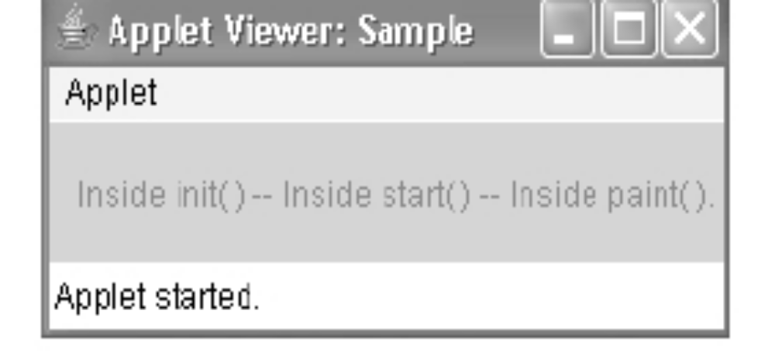

Slide 31
A "Hello, World" Applet
Following is a simple applet named HelloWorldApplet.java −
import java.applet.*;
import java.awt.*;
public class HelloWorldApplet extends Applet
{
public void paint (Graphics g)
{
g.drawString ("Hello World", 25, 50);
}
}

Slide 32
7. Requesting Repainting
The repaint( ) method is defined by the AWT.
It causes the AWT run-time system to execute a call to your applet's update( )
method, which, in its default implementation, calls paint( ).
The AWT will then execute a call to paint( ), which can display the stored information.
For example, if part of your applet needs to output a string, it can store this string in a String variable and then call repaint( ). Inside paint( ) , you will output the string using drawString( ).
The repaint( ) method has four forms.
Let's look at each one, in turn. The simplest version of repaint( ) is shown here:
1. void repaint( )
This version causes the entire window to be repainted. The following version specifies a region that will be repainted:
2. void repaint(int left, int top, int width, int height)
Here, the coordinates of the upper-left corner of the region are specified by left and top, and the width and height of the region are passed in width and height. These dimensions are specified in pixels.

Slide 33
Calling repaint( ) is essentially a request that your applet be repainted sometime soon.
However, if your system is slow or busy, update()
might not be called immediately.
Problem is to use the following forms of repaint( ):
1. void repaint(long maxDelay)
2. void repaint(long maxDelay, int x, int y, int width,
int height)
Here, maxDelay specifies the maximum number of milliseconds that can elapse before update( ) is called.

Slide 34
8. Using the Status Window
An applet can also output a message to the status window of the browser or applet viewer on which it is running.
To do so, call showStatus() with the string that you want displayed.
The status window is a good place to give
The user feedback about what is occurring in the applet,
Suggest options, or possibly report some types of errors.
The status window also makes an excellent debugging aid,
because it gives you an easy way to Output information
about your applet

Slide 35
//Using the Status Window.
import java.awt.*;
import java.applet.*;
/* <applet code="StatusWindow" width=300 height=50> </applet> */
public class StatusWindow extends Applet
{
public void init()
{
setBackground(Color.cyan);
}
// Display msg in applet window.
public void paint(Graphics g)
{
g.drawString("This is in the applet window.", 10, 20);
showStatus("This is shown in the status window.");
}
}

Slide 36
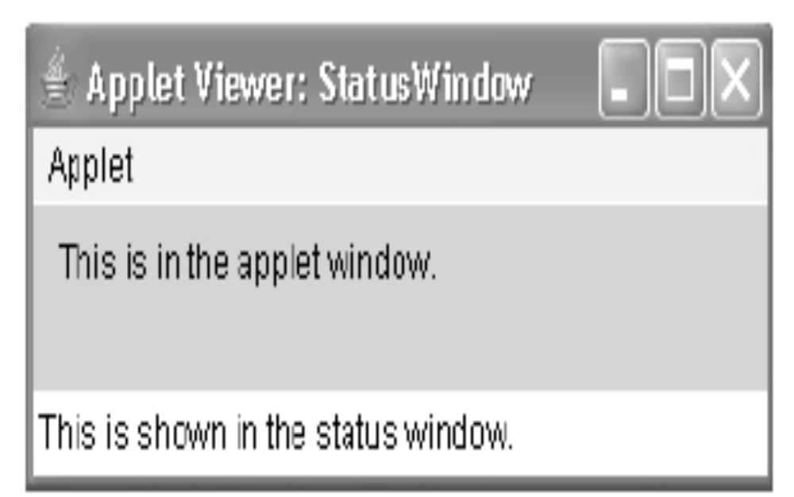

Slide 37
9.The HTML APPLET Tag
The APPLET tag be used to start an applet from both an HTML document and from an
applet viewer.
An applet viewer will execute each APPLET tag that it finds in a separate window, while web browsers will allow many applets on a single page.
The syntax for a fuller form of the APPLET tag is shown here.
Bracketed items are optional

Slide 38
Syntax
<APPLET
[CODEBASE = codebaseURL]
CODE = appletFile
[ALT = alternateText]
[NAME = appletInstanceName]
WIDTH = pixels HEIGHT = pixels
[ALIGN = alignment]
[VSPACE = pixels] [HSPACE = pixels]
>
[< PARAM NAME = AttributeName VALUE = AttributeValue>]
[< PARAM NAME = AttributeName2 VALUE = AttributeValue>]
...
[HTML Displayed in the absence of Java]
</APPLET>

Slide 39
CODEBASE
CODEBASE is an optional attribute
Specifies the base URL of the appletcode,
The HTML document's URL directory is used as the CODEBASE if this attribute is not specified. The CODEBASE does not have to be on the host from which the HTML document was read.
CODE
CODE is a required attribute
It gives the name of the file containing your applet's compiled .class file.
This file is relative to the code base URL of the applet, which is the directory that the HTML file was in or the directory indicated by CODEBASE if set.

Slide 40
ALT
The ALT tag is an optional attribute
It is used to specify a short text message that should be displayed if the browser recognizes the APPLET tag
It can't currently run Java applets.
This is distinct from the alternate HTML you provide for browsers that don't support applets.
NAME
NAME is an optional attribute
It is used to specify a name for the applet instance.
Applets must be named in order for other applets on the same page to find them by name and communicate with them.
To obtain an applet by name, use getApplet( ), which is defined by the AppletContext interface.
WIDTH and HEIGHT
WIDTH and HEIGHT are required attributes that give the size (in pixels)of the applet display area

Slide 41
ALIGN
ALIGN is an optional attribute
It specifies the alignment of the applet.
This attribute is treated the same as the HTML IMG tag with these possible values:
LEFT, RIGHT,TOP, BOTTOM, MIDDLE, BASELINE, TEXTTOP, ABSMIDDLE, and ABSBOTTOM.
VSPACE and HSPACE
These attributes are optional.
VSPACE specifies the space, in pixels,above and below the applet.
HSPACE specifies the space, in pixels, on each side of the applet.
They're treated the same as the IMG tag's VSPACE and HSPACE attributes.
PARAM NAME and VALUE
The PARAM tag allows you to specify applet-specific arguments in an HTML page.
Applets access their attributes with the getParameter( ) method

Slide 42
10.Passing Parameters to Applets
The APPLET tag in HTML allows you to pass parameters to your applet.
To retrieve a parameter,use thegetParameter() method.
It returns the value of the specified parameter in the form of a String object.
Syntax: public String getParameter(String parameterName)

Slide 43
import java.applet.Applet;
import java.awt.Graphics;
public class UseParam extends Applet
{
public void paint(Graphics g)
{
String str=getParameter("msg");
g.drawString(str,50, 50);
}
}
myapplet.html
<html>
<body>
<applet code="UseParam.class" width="300" height="300">
<param name="msg" value="Welcome to applet">
</applet>
</body>
</html>

Slide 44
11. getDocumentBase( ) and getCodeBase( )
We will create applets that will need to explicitly load media and text.
Java will allow the applet to load data from
The directory holding the HTML file that started the applet (the document base)
and
The directory from which the applet's class file was loaded(the code base).
These directories are returned as URL objects by getDocumentBase( ) and getCodeBase( ).
They can be concatenated with a string that names the file you want to load.

Slide 45
// Display code and document bases.
import java.awt.*;
import java.applet.*;
import java.net.*;
/*
<applet code="Bases" width=300 height=50>
</applet>
*/
public class Bases extends Applet
{ // Display code and document bases.
public void paint(Graphics g)
{
String msg;
URL url = getCodeBase(); // get code base
msg = "Code base: " + url.toString();
g.drawString(msg, 10, 20);
url = getDocumentBase(); // get document base
msg = "Document base: " + url.toString();
g.drawString(msg, 10, 40);
}
}

Slide 46
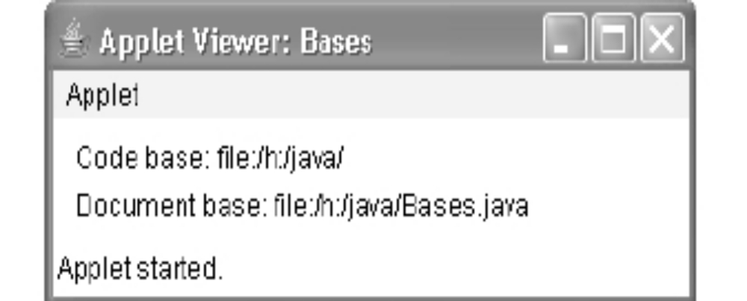
output

Slide 47
12. AppletContext and showDocument( )
Java allows the applet to transfer the control to another URL by using the showDocument () Method defined in the AppletContext interface.
For this, first of all, it is needed to obtain the Context of the currently executing applet by calling the getAppletContext () method defined by the Applet.
Once the context of the applet is obtained with in an applet, another document can be brought into view by calling showDocument () method.
There are two showDocument () methods which are as follows:
showDocument(URL url)
showDocument(URL url,string loc)
where,
url is the URL from where the document is to be brought into view.
loc is the location within the browser window where the specified document is to be displayed.

Slide 48
/* Using an applet context, getCodeBase(), and showDocument() to display an HTML file.*/
import java.awt.*;
import java.applet.*;
import java.net.*;
/*
<applet code="ACDemo" width=300 height=50>
</applet>
*/
public class ACDemo extends Applet
{
public void start()
{
AppletContext ac = getAppletContext();
URL url = getCodeBase(); // get url of this applet
try {
ac.showDocument(new URL(url+"Test.html"));
}
catch(MalformedURLException e)
{
showStatus("URL not found");
}
}
}

Slide 49
13.The AudioClip Interface
The AudioClip interface defines these methods: play( ) (play a clip from the beginning),
stop( ) (stop playing the clip), and
loop( ) (play the loop continuously).
After you have loaded an audio clip using getAudioClip(), you can use these methods to play it.
14. The AppletStub Interface
The AppletStub interface provides the means by which an applet and the browser (or appletviewer) communicate.
Your code will not typically implement this interface

Slide 50
15.Outputting to the Console
Although output to an applet's window must be accomplished through GUI-based methods, such as drawString( ), it is still possible to use console output in your applet, especially for debugging purposes.
In an applet, when you call a method such as System.out.println( ),the output is not sent to your applet's window. Instead, it appears either in the console session in which you launched the applet viewer or in the Java console that is available in some browsers.
Use of console output for purposes other than debugging is discouraged, since it violates the design principles of the graphical interface most users will expect

Slide 51
SWINGS

Slide 52
Introduction to Swing
We have learned how to build user interfaces with the AWT classes.
Although the AWT is still a crucial part of Java, its component set is no longer widely used to create graphic user interfaces.
Today, most programmers use Swing for this purpose.
Swing is a set of classes that provides more powerful and flexible GUI components than does the AWT.
Swing provides the look and feel of the modern Java GUI.
It is important to understand that the number of classes and interfaces in the Swing packages is quite large.

Slide 53
Java Swing is a part of Java Foundation Classes (JFC) that is used to create window-based applications.
It is built on the top of AWT (Abstract Windowing Toolkit) API and entirely written in java.
Java Swing provides platform-independent and lightweight components.
The javax.swing package provides classes for java swing API such as
JButton, JTextField,
JTextArea, JRadioButton,
JCheckbox, JMenu, JColorChooser etc.

Slide 54
1.The Origins of Swing
Swing did not exist in the early days of Java. Rather, it was a response to deficiencies present in Java's original GUI subsystem: the Abstract Window Toolkit.
The AWT defines a basic set of controls, windows, and dialog boxes that support a usable, but limited graphical interface.
AWT components use native code resources, they are referred to as heavyweight.
The use of native peers led to several problems.
First, because of variations between operating systems, a component might look, or even act, differently on different platforms. This potential variability threatened the overarching philosophy of Java: write once, run anywhere.
Second, the look and feel of each component was fixed (because it is defined by the platform) and could not be (easily) changed.
Third, the use of heavyweight components caused some frustrating restrictions.
For example, a heavyweight component is always rectangular and opaque
Not long after Java's original release, it became apparent that the limitations and restrictions present in the AWT were sufficiently serious that a better approach was needed.
The solution was Swing. Introduced in 1997, Swing was included as part of the Java Foundation Classes (JFC).
Swing was initially available for use with Java 1.1 as a separate library. However, beginning with Java 1.2, Swing (and the rest of the JFC) was fully integrated into Java.

Slide 55
2. Two Key Swing Features
Swing was created to address the limitations present in the AWT. It does this through two key features:
1. Lightweight components and 2. A pluggable look and feel.
1. Swing Components Are Lightweight
With very few exceptions, Swing components are lightweight. This means that they are written entirely in Java and do not map directly to platform-specific peers.
Because lightweight components are rendered using graphics primitives, they can be transparent, which enables nonrectangular shapes.
Thus, lightweight components are more efficient and more flexible.
Furthermore, because lightweight components do not translate into native peers, the look and feel of each component is determined by Swing, not by the underlying operating system. This means that each component will work in a consistent manner across all platforms.

Slide 56
2. Swing Supports a Pluggable Look and Feel(PLAF)
Swing supports a pluggable look and feel (PLAF).
Because each Swing component is rendered by Java code rather than by native peers, the look and feel of a component is under the control of Swing.
This fact means that it is possible to separate the look and feel of a component from the logic of the component, and this is what Swing does. Separating out the look and feel provides a significant advantage: it becomes possible to change the way that a component is rendered without affecting any of its other aspects.
In other words, it is possible to "plug in" a new look and feel for any given component without creating any side effects in the code that uses that component.
Moreover, it becomes possible to define entire sets of look-and-feels that represent different GUI styles.
To use a specific style, its look and feel is simply "plugged in." Once this is done, all components are automatically rendered using that style.

Slide 57
Pluggable look-and-feels offer several important advantages.
It is possible to define a look and feel that is consistent across all platforms.
For example, if you know that an application will be running only in a Windows environment, it is possible to specify the Windows look and feel. It is also possible to design a custom look and feel.
Finally, the look and feel can be changed dynamically at run time.
Java SE 6 provides look-and-feels, such as metal and Motif, that are available to all Swing users.
The metal look and feel is also called the Java look and feel.
It is platform-independent and available in all Java execution environments.
It is also the default look and feel. Windows environments also have access to the Windows and Windows Classic look and feel.

Slide 58
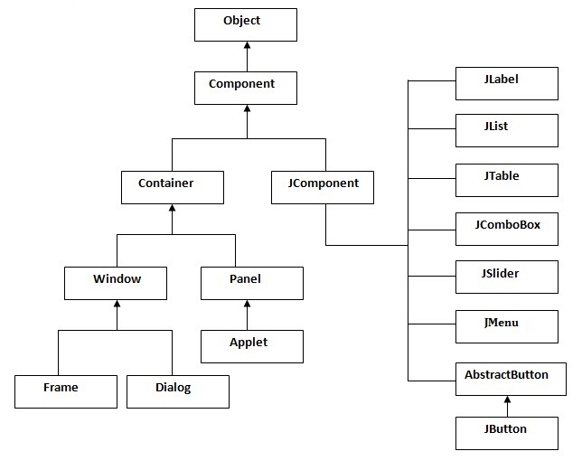
Hierarchy of Java Swing classes

Slide 59
Components and Containers
A Swing GUI consists of two key items:
1. components and 2. containers.
A component is an independent visual control, such as a push button or slider.
A container holds a group of components. Thus, a container is a special type of component that is designed to hold other components.
Furthermore, in order for a component to be displayed, it must be held within a container.
All Swing GUIs will have at least one container.
Because containers are components, a container can also hold other containers. This enables Swing to define what is called a containment hierarchy, at the top of which must be a top-level container.

Slide 60
1. Components
In general, Swing components are derived from the JComponent class.
JComponent provides the functionality that is common to all components.
For example, JComponent supports the pluggable look and feel.
JComponent inherits the AWT classes Container and Component.
A Swing component is built on and compatible with an AWT component.
All of Swing's components are represented by classes defined within the package javax.swing.
All component classes begin with the letter J.
For example, the class for a label is JLabel;
the class for a push button is JButton;
and the class for a scroll bar is JScrollBar

Slide 61
The following table shows the class names for Swing components (including those used as containers)
JApplet Jbutton JCheckBox JCheckBoxMenuItem
JColorChooser JComboBox Jcomponent JDesktopPane
Jdialog JEditorPane JFileChooser JFormattedTextField
Jframe JInternalFrame Jlabel JLayeredPane
Jlist Jmenu JMenuBar JMenuItem
JOptionPane Jpanel JPasswordField JPopupMenu
JProgressBar JRadioButton JRadioButtonMenuItem JRootPane
JScrollBar JScrollPane Jseparator JSlider
Jspinner JSplitPane JTabbedPane JTable
JTextArea JTextField JTextPane JTogglebutton
JToolBar JToolTip Jtree JViewpor t
JWindow

Slide 62
2. Containers
Swing defines two types of containers.
The first are top-level containers:
JFrame, JApplet, JWindow, and JDialog.
These containers do not inherit JComponent.
They do, however, inherit the AWT classes Component and Container.
Unlike Swing's other components, which are lightweight, the top-level containers are heavyweight. This makes the top-level containers a special case in the Swing component library.
As the name implies, a top-level container must be at the top of a containment hierarchy.
A top-level container is not contained within any other container.
Furthermore, every containment hierarchy must begin with a top-level container.
The one most commonly used for applications is JFrame.
The one used for applets is JApplet.

Slide 63
The second type of containers supported by Swing are lightweight containers.
Lightweight containers do inherit JComponent.
An example of a lightweight container is JPanel, which is a general-purpose container.
Lightweight containers are often used to organize and manage groups of related components because a lightweight container can be contained within another container.
Thus, you can use lightweight containers such as JPanel to create subgroups of related controls that are contained within an outer container.

Slide 64
Swing Packages
Swing is a very large subsystem and makes use of many packages. These are the packages used by Swing that are defined by Java SE 6
The main package is javax.swing.
This package must be imported into any program that uses Swing.
It contains the classes that implement the basic Swing components, such as push buttons, labels, and check boxes

Slide 65
javax.swing javax.swing.border
javax.swing.colorchooser javax.swing.event
javax.swing.filechooser javax.swing.plaf
javax.swing.plaf.basic javax.swing.plaf.metal
javax.swing.plaf.multi javax.swing.plaf.synth
javax.swing.table javax.swing.text
javax.swing.text.html
javax.swing.text.html.parser
javax.swing.text.rtf javax.swing.tree
javax.swing.undo

Slide 66
A Simple Swing Application
Swing programs differ from both the console-based programs and the AWT-based programs
For example, they use a different set of components and a different container hierarchy than does the AWT.
Swing programs also have special requirements that relate to threading.
The best way to understand the structure of a Swing program is to work through an example.
There are two types of Java programs in which Swing is typically used.
The first is a desktop application.
The second is the applet.
In the process, it demonstrates several key features of Swing.
It uses two Swing components: JFrame and JLabel. JFrame is the top-level container that is commonly used for Swing applications.
JLabel is the Swing component that creates a label, which is a component that displays information.
The label is Swing's simplest component because it is passive. That is, a label does not respond to user input. It just displays output.
The program uses a JFrame container to hold an instance of a JLabel.
The label displays a short text message

Slide 67
//A simple Swing application.
import javax.swing.*;
class SwingDemo
{
SwingDemo()
{
// Create a new JFrame container.
JFrame jfrm = new JFrame("A Simple Swing Application");
// Give the frame an initial size.
jfrm.setSize(275, 100);
// Terminate the program when the user closes the application.
jfrm.setDefaultCloseOperation(JFrame.EXIT_ON_CLOSE);
// Create a text-based label.
JLabel jlab = new JLabel(" Swing means powerful GUIs.");
// Add the label to the content pane.
jfrm.add(jlab);
// Display the frame.
jfrm.setVisible(true);
}
public static void main(String args[])
{
// Create the frame on the event dispatching thread.
SwingUtilities.invokeLater(new Runnable()
{
public void run()
{
new SwingDemo();
}
});
}
}

Slide 68
Swing programs are compiled and run in the same way as other Java applications. Thus, to compile this program, you can use this command line:
javac SwingDemo.java
To run the program, use this command line:
java SwingDemo
Because the SwingDemo program illustrates several core Swing concepts, we will examine it carefully, line by line.
The program begins by importing javax.swing. As mentioned, this package contains the components and models defined by Swing.
For example, javax.swing defines classes that implement labels, buttons, text controls, and menus. It will be included in all programs that use Swing.

Slide 69
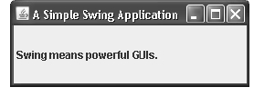
Next, the program declares the SwingDemo class and a constructor for that class.
The constructor is where most of the action of the program occurs. It begins by creating a JFrame,using this line of code:
JFrame jfrm = new JFrame("A Simple Swing Application");
This creates a container called jfrm that defines a rectangular window complete with a title bar; close, minimize, maximize, and restore buttons; and a system menu.
Thus, it creates a standard, top-level window. The title of the window is passed to the constructor.

Slide 70
Create a Swing Applet
The second type of program that commonly uses Swing is the applet. Swing-based applets
are similar to AWT-based applets, but with an important difference: A Swing applet extends
JApplet rather than Applet. JApplet is derived from Applet. Thus, JApplet includes all of
the functionality found in Applet and adds support for Swing. JApplet is a top-level Swing
container, which means that it is not derived from JComponent. Because JApplet is a
top-level container, it includes the various panes described earlier. This means that all
components are added to JApplet's content pane in the same way that components are
added to JFrame's content pane.
Swing applets use the same four lifecycle methods as described in Chapter 21: init( ),
start( ), stop( ), and destroy( ). Of course, you need override only those methods that are
needed by your applet. Painting is accomplished differently in Swing than it is in the AWT,
and a Swing applet will not normally override the paint( ) method. (Painting in Swing is
described later in this chapter.)
One other point: All interaction with components in a Swing applet must take place on
the event dispatching thread, as described in the previous section. This threading issue
applies to all Swing programs.

