Slide 1
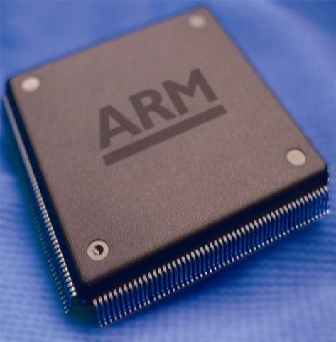
Module – 5
Microprocessor and Microcontroller
(15CS44)
By,
Mrs. Ashwini N
Assistant Professor
Dept. of Information Science & Engg.
BMS Institute of Technology, Bengaluru.

Slide 2
Introduction to the ARM Instruction Set
The ARM Architecture is a Load/Store architecture
  No direct manipulation of memory contents
  Memory must be loaded into the CPU to be modified, then written back out
Cores are either in ARM state or Thumb state
  This determines which instruction set is being executed
  An instruction must be executed to switch between states
The architecture allows programmers and compilation tools to reduce branching through the use of conditional execution
  Method differs between ARM and Thumb, but the principle is that most (ARM) or all (Thumb) instructions can be executed conditionally.

Slide 3


Introduction to the ARM Instruction Set
Each instruction set has the following format:
In the pre- and post-conditions, memory is denoted as
  mem<data_size>[address]
Example:

Slide 4
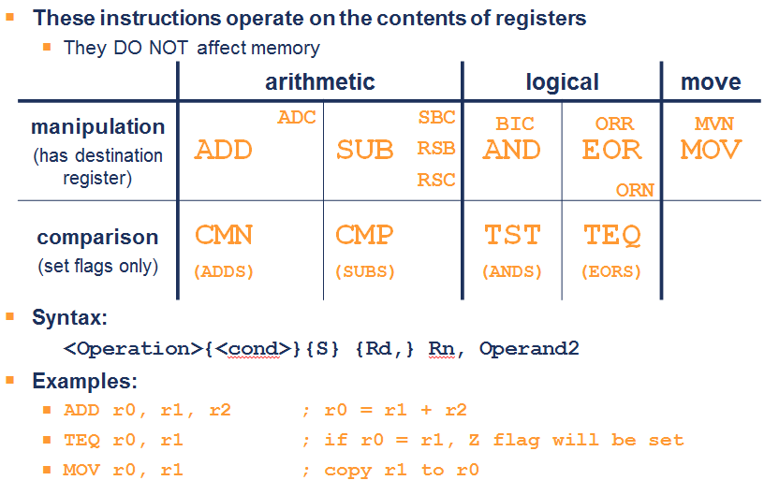
3.1 Data Processing Instructions

Slide 5
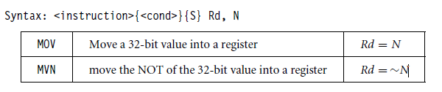
3.1.1 Move Instructions
Syntax:

Slide 6
Using a Barrel Shifter:The 2nd Operand
Operand 1
Operand 2
Register, optionally with shift operation
  Shift value can be either be:
    5 bit unsigned integer
    Specified in bottom byte of another register.
  Used for multiplication by constant
Immediate value
  8 bit number, with a range of 0-255.
    Rotated right through even number of positions
  Allows increased range of 32-bit constants to be loaded directly into registers
Barrel
Shifter
ALU
Result

Slide 7
Data Processing Exercise
1. How would you load the two’s complement representation of -1 into Register 3 using one instruction?
2. Implement an ABS (absolute value) function for a registered value using only two instructions.
3. Multiply a number by 35, guaranteeing that it executes in 2 core clock cycles.

Slide 8
Data Processing Solutions
1. MOVN r6, #0
2. MOVS r7,r7 ; set the flags
RSBMI r7,r7,#0 ; if neg, r7=0-r7
3. ADD r9,r8,r8,LSL #2 ; r9=r8*5
RSB r10,r9,r9,LSL #3 ; r10=r9*7

Slide 9
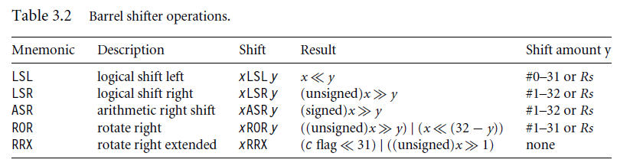

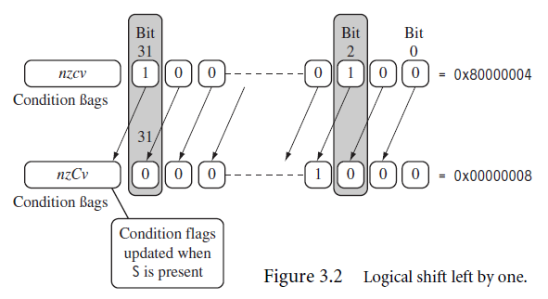
Barrel Shifter Operation

Slide 10
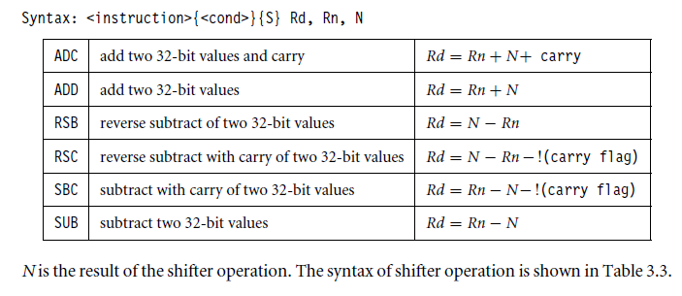
3.1.3 Arithmetic Instructions

Slide 11
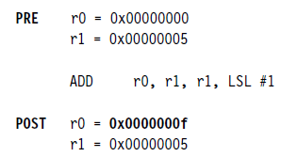
3.1.4 Using the Barrel Shifter with Arithmetic
Instructions
The wide range of second operand shifts available on arithmetic and logical instructions is a very powerful feature of the ARM instruction set.
The instruction multiplies the value stored in register r1 by three.

Slide 12
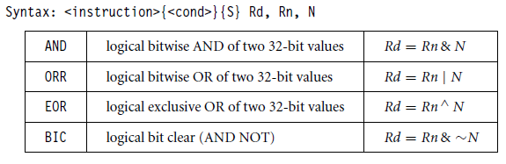
3.1.5 Logical Instructions
Logical instructions perform bitwise logical operations on the two source registers.

Slide 13
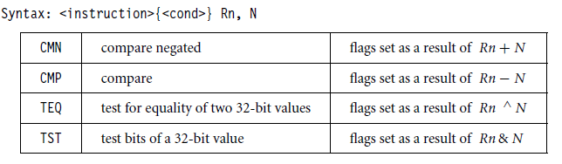
3.1.6 Comparison Instructions
Used to compare or test a register with a 32-bit value.
They update the cpsr flag bits according to the result, but do not affect other registers.

Slide 14
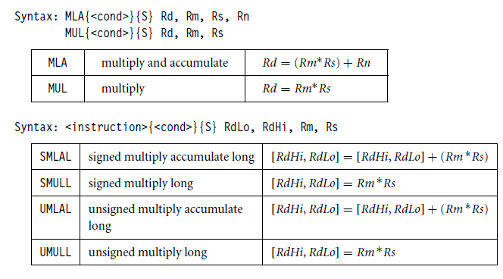
3.1.7 Multiply Instructions

Slide 15
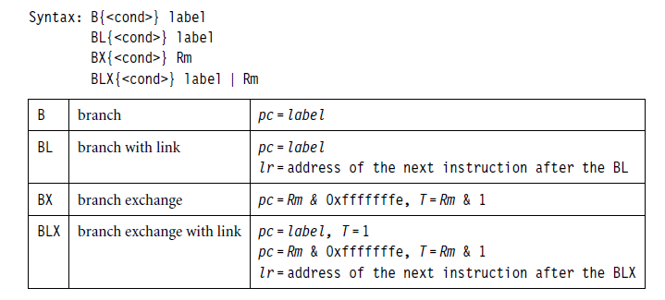
3.2 Branch Instructions

Slide 16
3.3 Load-Store Instructions
(3.3.1 Single-Register Transfer)
  LDR STR Word
  LDRB STRB Byte
  LDRH STRH Halfword
  LDRSB Signed byte load
  LDRSH Signed halfword load
Memory system must support all access sizes
Syntax:
  LDR{<cond>}{<size>} Rd, <address>
  STR{<cond>}{<size>} Rd, <address>
  e.g. LDREQB

Slide 17
3.3 Load-Store Instructions
(3.3.1 Single-Register Transfer)
Address accessed by LDR/STR is specified by a base register with an offset
For word and unsigned byte accesses, offset can be:
  An unsigned 12-bit immediate value (i.e. 0 - 4095 bytes)
  LDR r0, [r1, #8]
  A register, optionally shifted by an immediate value
  LDR r0, [r1, r2]
  LDR r0, [r1, r2, LSL#2]
This can be either added or subtracted from the base register:
LDR r0, [r1, #-8]
LDR r0, [r1, -r2, LSL#2]
For halfword and signed halfword / byte, offset can be:
  An unsigned 8 bit immediate value (i.e. 0 - 255 bytes)
  A register (unshifted)
Choice of pre-indexed or post-indexed addressing
Choice of whether to update the base pointer (pre-indexed only)
  LDR r0, [r1, #-8]!

Slide 18
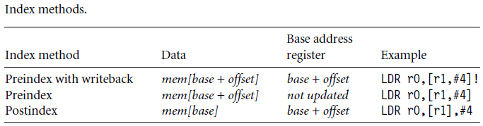
3.3.2 Single-Register Load-Store Addressing Modes
The ARM instruction set provides different modes for addressing memory.
These modes incorporate one of the indexing methods:
  Preindex with writeback,
  Preindex
  Postindex

Slide 19
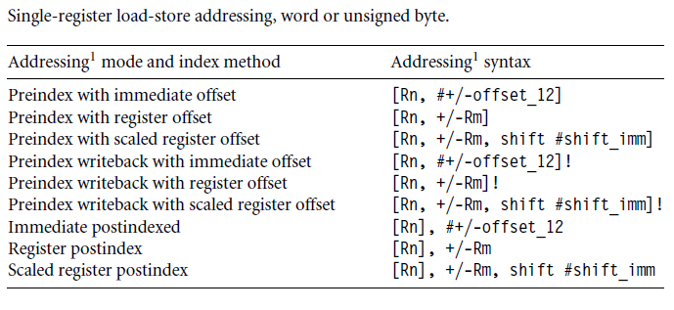
3.3.2 Single-Register Load-Store Addressing Modes

Slide 20
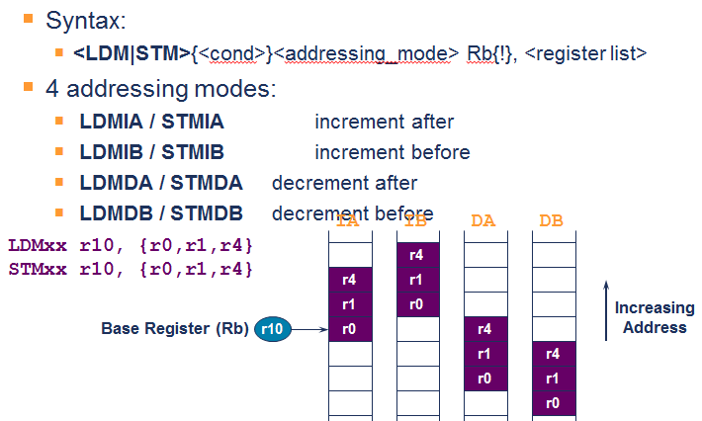
3.3.3 Multiple-Register Transfer

Slide 21
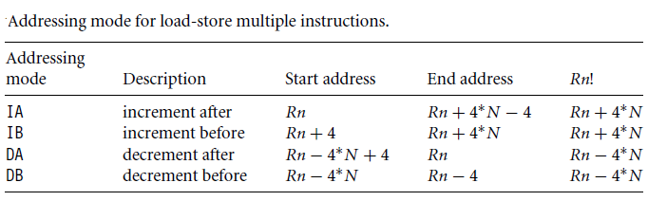
3.3.3 Multiple-Register Transfer

Slide 22
3.3.3.1 Stack Operations
The load-store multiple instructions to carry out stack operations.
  The pop operation (removing data from a stack) uses a load multiple instruction
  The push operation (placing data onto the stack) uses a store multiple instruction.
A stack is either ascending (A) or descending (D).
  Ascending stacks grow towards higher memory addresses
  Descending stacks grow towards lower memory addresses.
  full stack (F)
  empty stack (E)

Slide 23
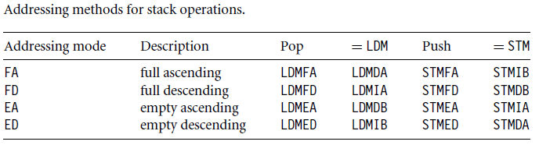
3.3.3.1 Stack Operations
(Addressing Modes)

Slide 24
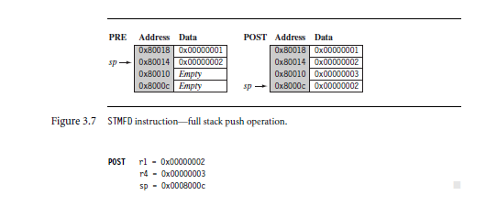

Slide 25
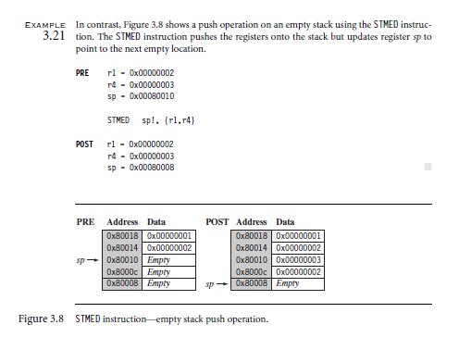

Slide 26
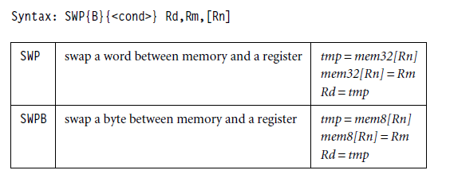
3.3.4 Swap Instruction

Slide 27
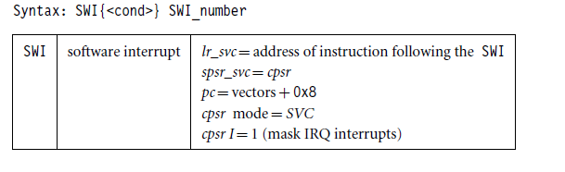
3.4 Software Interrupt Instruction
Causes a software interrupt exception
  which provides a mechanism for applications to call operating system routines.

Slide 28
3.5 Program Status Register Instructions
Two instructions to directly control a program status register (psr).
The MRS instruction transfers the contents of either the cpsr or spsr into a register
the MSR instruction transfers the contents of a register into the cpsr or spsr.

Slide 29
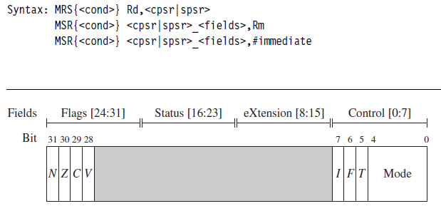
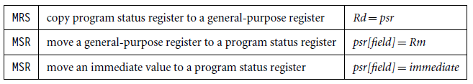
3.5 Program Status Register Instructions

Slide 30
3.5.1 Coprocessor Instructions
A coprocessor can either provide additional computation capability or be used to control the memory subsystem including caches and memory management.
The coprocessor instructions include data processing, register transfer, and memory transfer instructions.

Slide 31

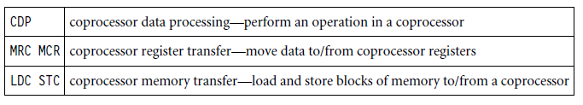
3.5.1 Coprocessor Instructions

Slide 32
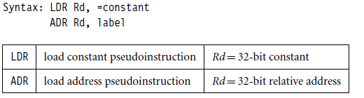
3.6 Loading Constants
There is no ARM instruction to move a 32-bit constant into a register.
Since ARM instructions are 32 bits in size, they obviously cannot specify a general 32-bit constant.

Slide 33
Mrs. Ashwini N
Assistant Professor
Dept.of.ISE
BMSIT&M, Bengaluru
Email: ashwinilaxman@bmsit.in

