Slide 1

Developing Single-Page Applications using Angular JS
Crisp Analytics

Slide 2
JQuery made web app development easier, much easier.
Developers no longer need to write code for different browsers. Traversing and painting the DOM became an easy task.

Slide 3
JQuery doesn’t scale because it doesn’t provide a way to structure or organize your code.
A typical flow in Jquery involves the following steps
Add event listener
request data
Add data to DOM
Show/hide DOM elements

Slide 4
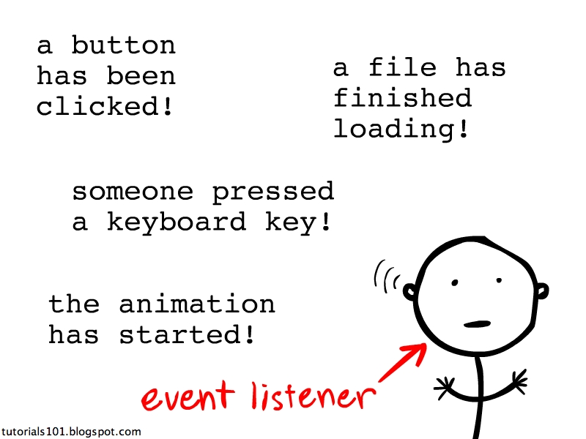
Add event listener
$(“#button”).click(buttonClicked);

Slide 5

Request data
$.ajax({
url: ‘mysite.com/data’,
type: ‘post’,
success: function(data) {
loadData(data);
}
});

Slide 6
Add data to the DOM
$(“#container”).html(data.dataPoint);
Show/Hide DOM elements
$(“#container”).show();

Slide 7
When everything is put together
$(“#button”).click(function(){
$.ajax({
url: ‘mysite.com/data’,
type: ‘post’,
success: function(data) { $(“#container”).html(data.dataPoint);
$(“#container”).show();
}
});

Slide 8
Maintaining consistency between UI and data
Update the data through api calls
Repaint the DOM using DOM manipulation code
OR
Get user input from DOM
Update data through api calls
Repaint DOM

Slide 9
The problem
After sometime, we end up with a tangled mess of callbacks, selectors, DOM manipulation, ajax calls all mixed up in one place.

Slide 10
The solution
Bind data to DOM elements during initialization.
Work only with data from then on. The DOM automatically updates itself.
Changing the DOM also changes the data automatically.
Maintain Separation of Concerns(SoC) and divide the code into different parts.

Slide 11


Enter Javascript frameworks
Model
View
Two-way binding
ViewModel

Slide 12
Why Angular.js
Angular JS allows us to do a lot without writing JavaScript code.
This means we can focus on putting our business rules to work while leaving angular to do the rest.

Slide 13
Hello World Program
What is your name?
<input type="text" ng-model="sometext" />
<h1>Hello {{ sometext }}</h1>
http://jsfiddle.net/viralpatel/vFcZ7/

Slide 14
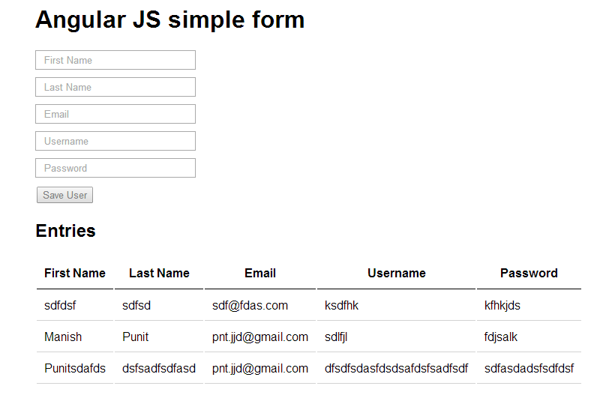
Learning Program – Basic form
Step-1
Angular JS in 60-ish minutes
http://www.youtube.com/watch?v=i9MHigUZKEM
Task: Implement a simple form for adding users.
At the bottom of the form, there should be a table that displays all the users.
Do everything in a single file for now.

Slide 15
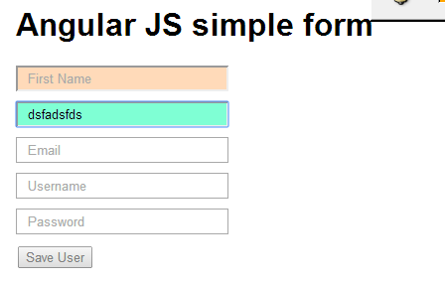
Learning Program – Form Validation
Step-2
Form Validation
http://scotch.io/tutorials/javascript/angularjs-form-validation
Task: Add form validation to the form created in Step-1
Username is required.
Email is required and should have correct format.
Firstname is required.
Password is required.
Save User button should be disabled

Slide 16
Learning Program – Keep data operations in a factory
Step-3
Factory Angular JS example
http://www.davidsalter.com/2013/08/using-angularjs-factories-to-get-remote.html
Task: Move the code that performs operations on the data into a separate js file using Angular js factory

Slide 17
Learning Program – Routes and Views
Step-4
Routes and Views
http://viralpatel.net/blogs/angularjs-routing-and-views-tutorial-with-example/
Task: Divide the page created in step-2 into two views – one for adding users and another for displaying them using the concepts in the above tutorial

Slide 18
Learning Program – Adding structure
Step-5
Folder structure
https://medium.com/opinionated-angularjs/9f01b594bf06
Organize the code written in the previous steps into the following structure
Index.html
App
user
user.html
user-controller.js
user-service.js
user-test.js
app.js
Vendor
angular.min.js
Assets
images
Common
directives
Styles
Services

Slide 19
Learning Program – Authentication
Step-6
User authentication
http://blog.auth0.com/2014/01/07/angularjs-authentication-with-cookies-vs-token/
Create a sample application using the code sample provided in the above example
Modify the existing user management system so that only authenticated users can add, edit and delete users but everyone can view them.

