Slide 1
Analysis and Forecasting of Power Factor for Optimum Electric Consumption in a Household
Manu Mishra Punit Lohani Shrikant Samarth Niraj Shah
Advanced Data Mining
Team M

Slide 2
Agenda
Introduction and Motivation
Research Question
Methodology
Conclusion
Future work

Slide 3
Introduction and Motivation
Reactive load of household appliances have mixture of both capacitance and inductance.
Phase difference exists between the source voltage and current.
Practically, the value for power factor lies in the range of (0,1)
Cosine (Ø) = (Active Power)/(Apparent Power)

Slide 4
Introduction and Motivation
Lower power factor must be avoided as it may lead to poor performance of electrical appliances.
Regular check on the value is considerably important.
Due to imbalance in reactive load, variation occurs in power factor’s value.
With an accurate forecasting ability of machine learning methods, trend of power factor can be predicted for the maintenance of best operating condition.

Slide 5
Research Question
What can be the best short-term range of forecast for power factor patterns, so that optimum energy consumption can be achieved for a household?

Slide 6
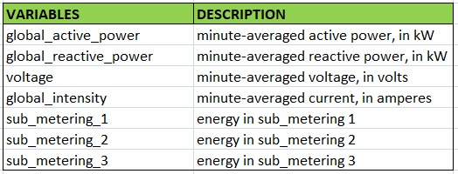
Methodology
Business Understanding
Data understanding
Individual household electric power
consumption of Sceaux city
located near Paris, France.
Dataset contains approximately
2 million measurements,
as a combination of the given indicators.

Slide 7
Methodology
3) Data Preparation and Transformation:
Missing values were removed.
New column for power factor has been introduced by using the formulae shown below
Root Mean Square Voltage, V_{rms} =1.11× voltage
Apparent Power = V_{rms ×} current
Power Factor = Active Power ÷ Apparent Power
Anomaly of Power factor greater than 1 have been removed.

Slide 8
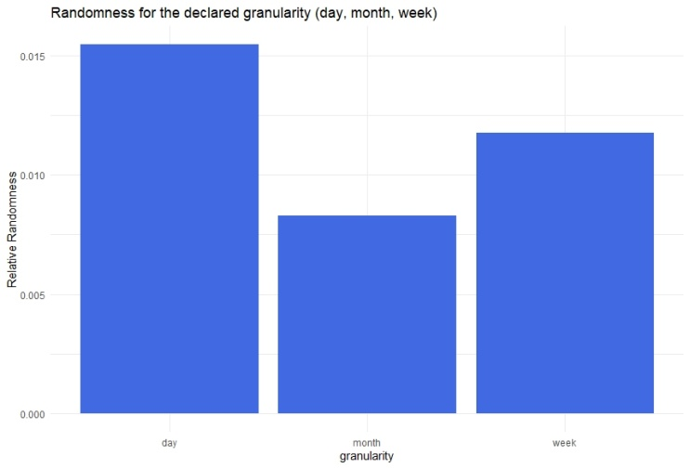
Methodology: Modeling
4) Modeling:
Randomness in terms of three levels:
Day
Week
Month
Lowest value has been obtained for Month
Models are provided with monthly aggregated data

Slide 9
Methodology : Modeling
ETS method
Holt-Winters method
ARIMA model

Slide 10
Methodology: Evaluation
Mean Absolute Percentage Error (MAPE)
Root Mean Squared Error (RMSE)
Mean Absolute Error (MAE)

Slide 11
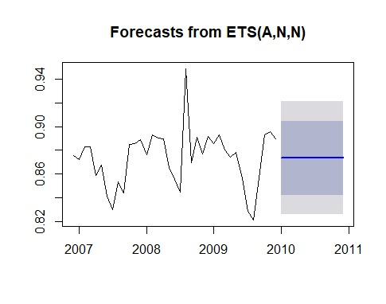
Methodology: Evaluation
Performance metrics for ETS method
The forecast of the power factor for the next 12 months

Slide 12
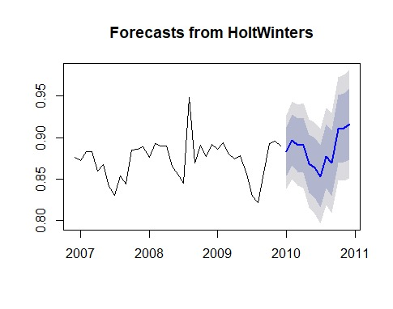
Methodology: Evaluation
Performance metrics for Holt-Winters method
The forecast of the power factor for the next 12 months

Slide 13
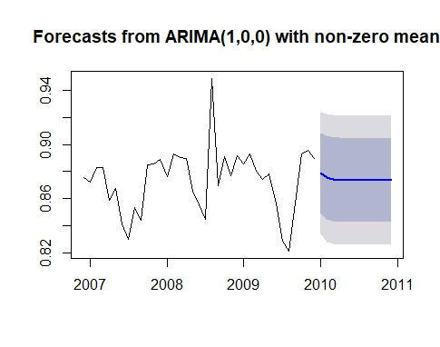
Methodology: Evaluation
Performance metrics for ARIMA model
The forecast of the power factor for the next 12 months

Slide 14
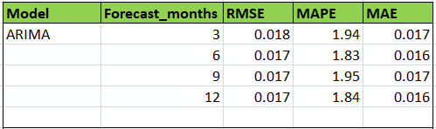
Methodology: Evaluation
Table representing ARIMA model and forecast months, along with the RMSE, MAPE and MAE values.

Slide 15
Results
For forecasting the data that contains seasonality, Holts-Winter presented a significant result with the RMSE value of 0.014
Best short-term range of forecast for power-factor values and patterns has been achieved through ARIMA model with 6 and 12 months forecast period.

Slide 16
Future Work
Hybrid model can be useful for enhancing the performance and the work can be extended by applying the hybrid model to the same dataset to check the forecasting accuracy.
In addition, different combinations of resistive and reactive load can be used for checking the ability of ARIMA and hybrid model for forecasting the power factor patterns, so that optimum energy consumption can be achieved for a household.

Slide 17

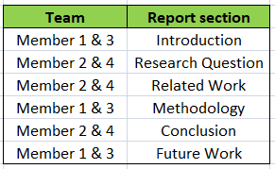
Distribution of work
Part-1: Coding
Entire team was involved together
for the coding process.
Part-2: Reporting section

Slide 18

“Forecasts create the mirage that the future is knowable.” - Peter L. Bernstein, Financial Historian

