Slide 1

Analysis of factors affecting ratings of restaurants
Punit Lohani
Msc in Data Analytics
National college of Ireland

Slide 2
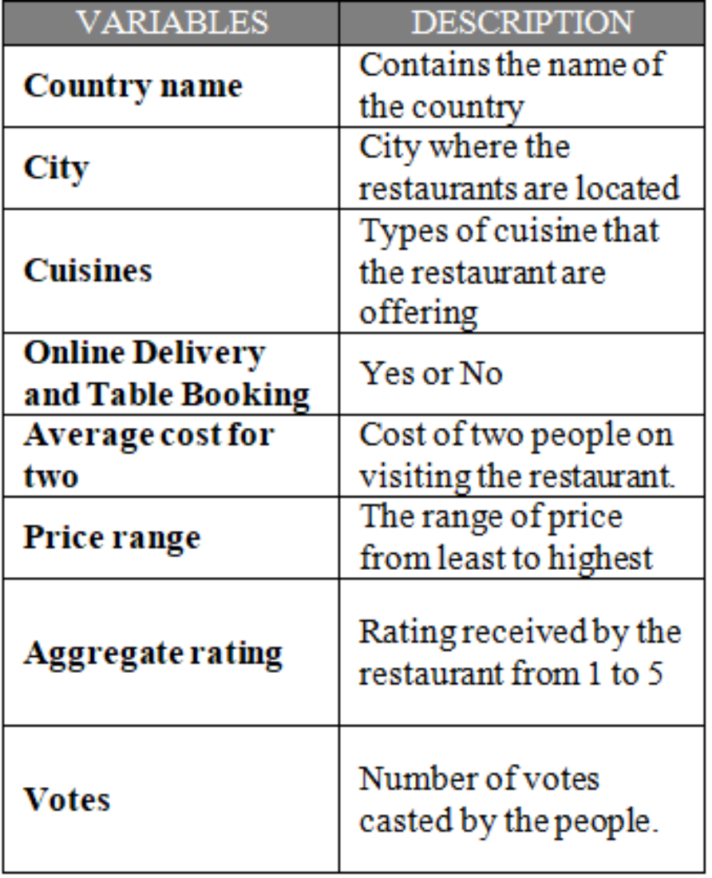
Overview of Dataset
  The Dataset has been taken from Kaggle.
  Represents the information about the restaurants associated with leading online food aggregator of India i.e. Zomato.

Slide 3
Hypothesis
Aggregate rating of the restaurant is depended on the Votes, Average cost for two and price range.

Slide 4
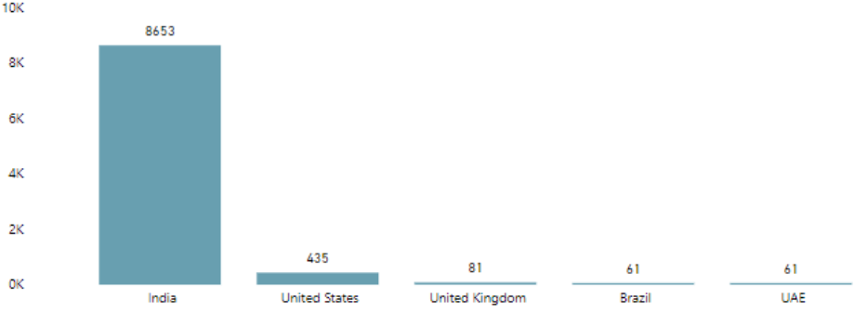
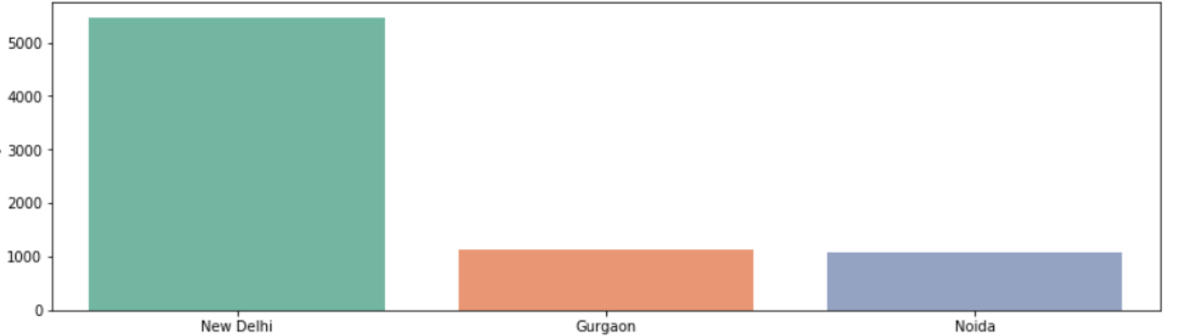
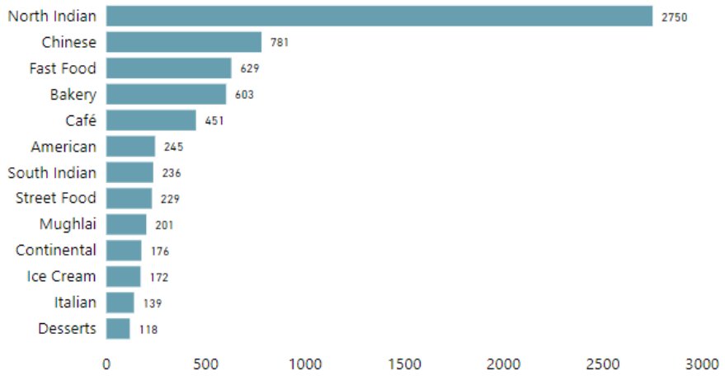
Initial Analysis
  Major countries and cities of business operation and customer preferences.

Slide 5
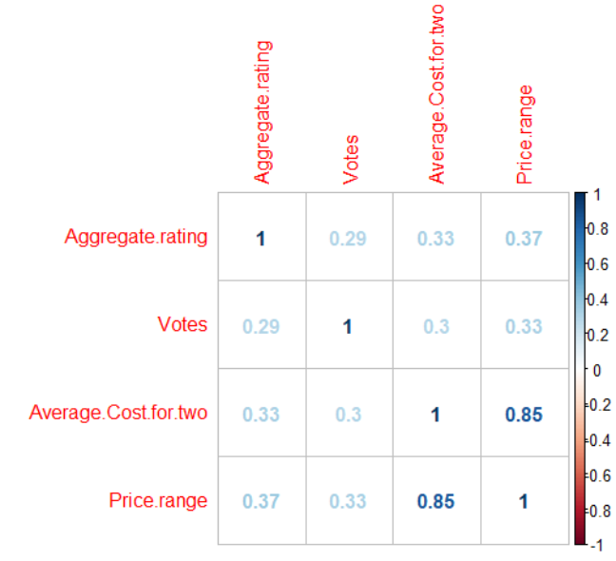
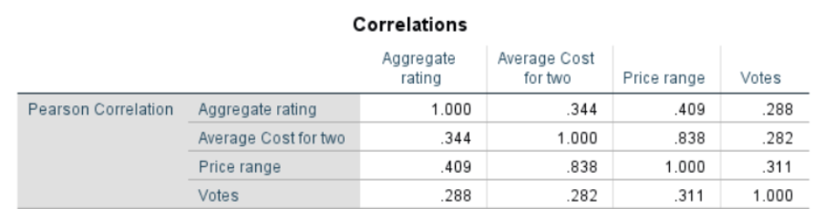
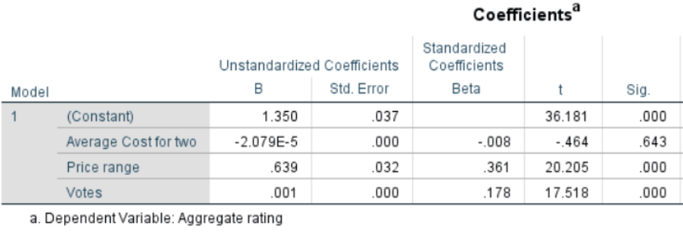
Correlation between the variables
Correlation matrix using R
SPSS Outputs
Correlation between the Aggregate rating, votes, Average cost for two and Price range.

Slide 6
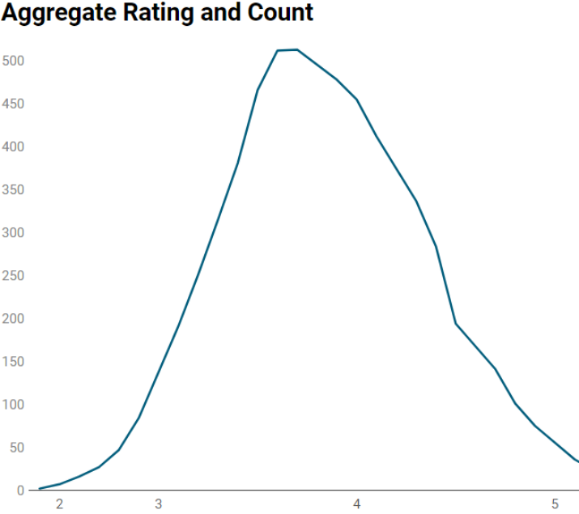
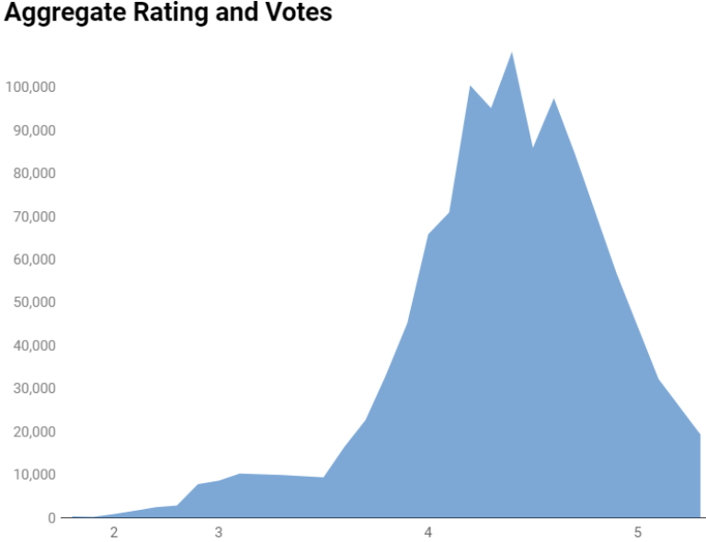
Comparison of Aggregate rating and Votes
Restaurants with higher votes also have higher aggregate rating

Slide 7
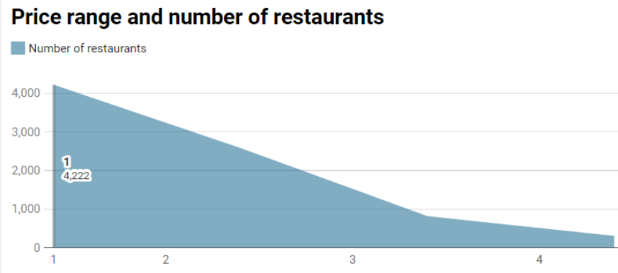
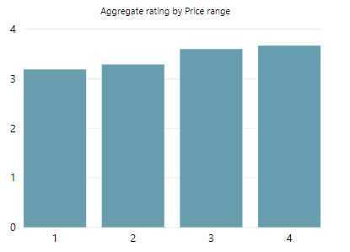
Comparison of Aggregate rating and Price range
Aggregate rating of the restaurants depends upon the Price range.

Slide 8
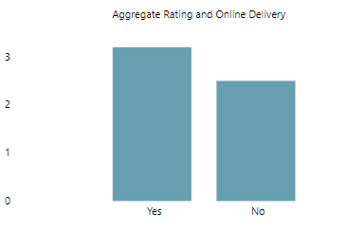
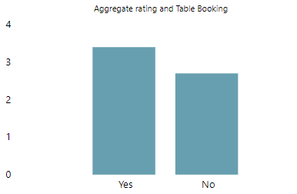
Aggregate rating, Online Delivery, Table Booking
Aggregate rating is dependent on whether the restaurants are having facilities like online delivery and Table booking.

Slide 9
Conclusion
  Aggregate rating of the restaurants depends majorly on Votes, Price range than average price for two.
  In addition, Online delivery and Table booking also affects Aggregate rating.

Slide 10
Business Insight
  Helpful for restaurants to retain and attract new customers.
  Food aggregator can retain their tie ups with the restaurants.

Slide 11
Thank You!!!!

