Slide 1

MahApps & Co
MahApps.Metro MahApps.Metro.IconPacks ControlzEx GongSolutions.WPF.DragDrop
http://mahapps.com

Slide 2
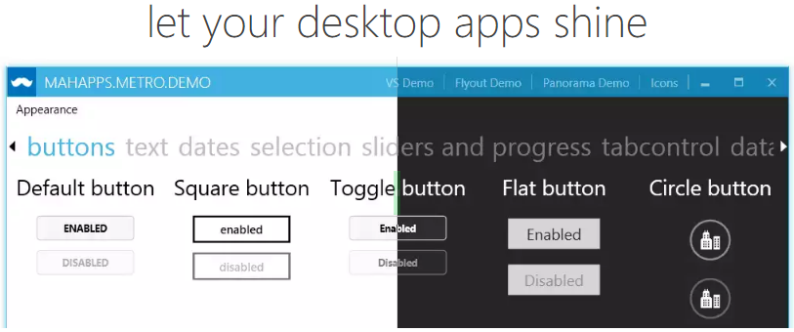
MahApps.Metro
Was ist MahApps.Metro?
UI Toolkit / Bibliothek
Metro- / Modern-Style für alle Standard Controls von WPF
Farb-Akzente bzw. ein helles und dunkles Design
2011 von Paul Jenkins aus dem Projekt MahTweets (MyTweets) enstanden
Microsoft bietet kein Metro-Style bzw. Moderner Look für WPF an

Slide 3
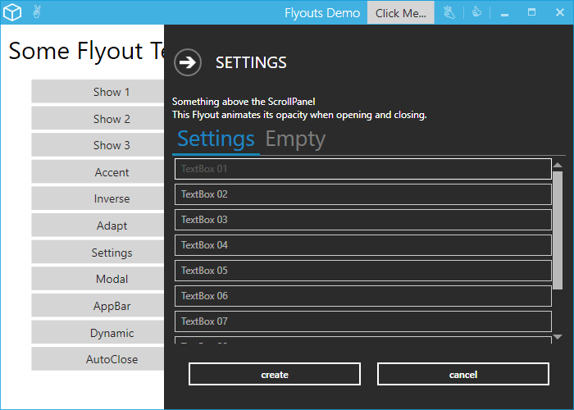



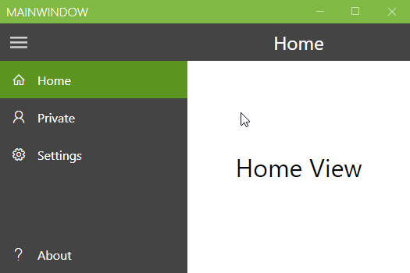
MahApps.Metro
Zusätzliche Controls
MetroWindow
Flyouts
Dialogs
ToggleSwitch
HamburgerMenu
Badged
TimePicker / DateTimePicker
TransitioningContentControl
RangeSlider
NumericUpDown
SplitButton / DropDownButton
FlipView

Slide 4
MahApps.Metro
Einbinden in die eigene WPF App
Installation via NuGet Package-Manager /-Konsole oder Paket-Manager
https://www.nuget.org/packages/MahApps.Metro/
MahApps.Metro Resourcen in die App.xaml eintragen
Basisklasse des Fensters ändern (MetroWindow)
Quick-Guide auf mahapps.com

Slide 5
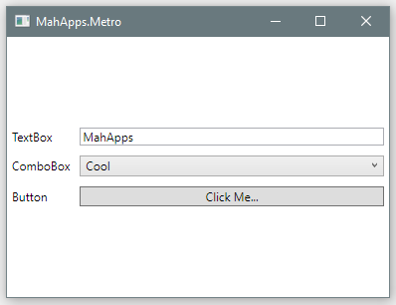
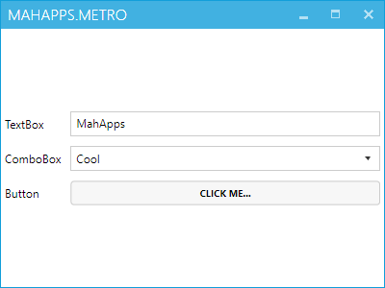
MahApps.Metro
Normale WPF App
Mit MahApps.Metro

Slide 6
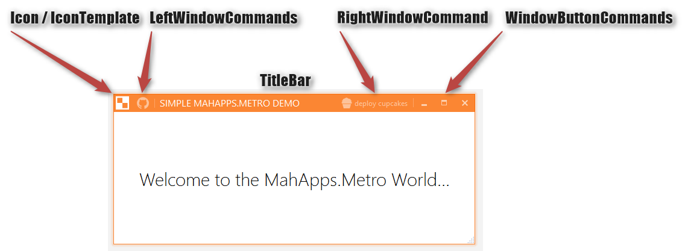
MahApps.Metro

Slide 7
MahApps.Metro
Hilfe
Dokumentation auf http://mahapps.com
Gitter Channel https://gitter.im/MahApps/MahApps.Metro
Demo App https://github.com/MahApps/MahApps.Metro/releases
code-samples https://github.com/punker76/code-samples
Sonstiges
"Metro-Look für WPF" in der dotnetpro 7/15 von Fabian Deitelhoff
"Creating Modern WPF Apps with MahApps.Metro" von Mark Heath
http://markheath.net/post/mahapps-metro-pluralsight
https://www.pluralsight.com/courses/mahappsdotmetro-creating-modern-wpf-apps
http://markheath.net/post/mahapps-metro-getting-started
"XAML-Tipp: Windows-10-Design für WPF-Anwendungen" von Gregor Biswanger
https://entwickler.de/online/windowsdeveloper/xaml-tipp-windows-10-wpf-579749009.html

Slide 8
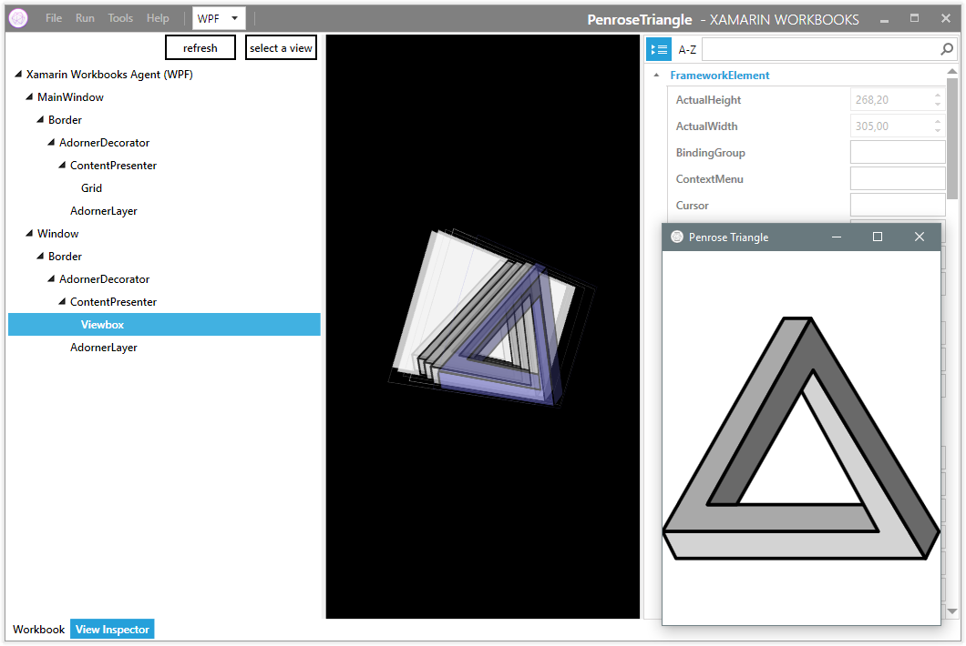
MahApps.Metro Beispiele
Xamarin Inspector / Workbooks
https://developer.xamarin.com/guides/cross-platform/inspector/

Slide 9
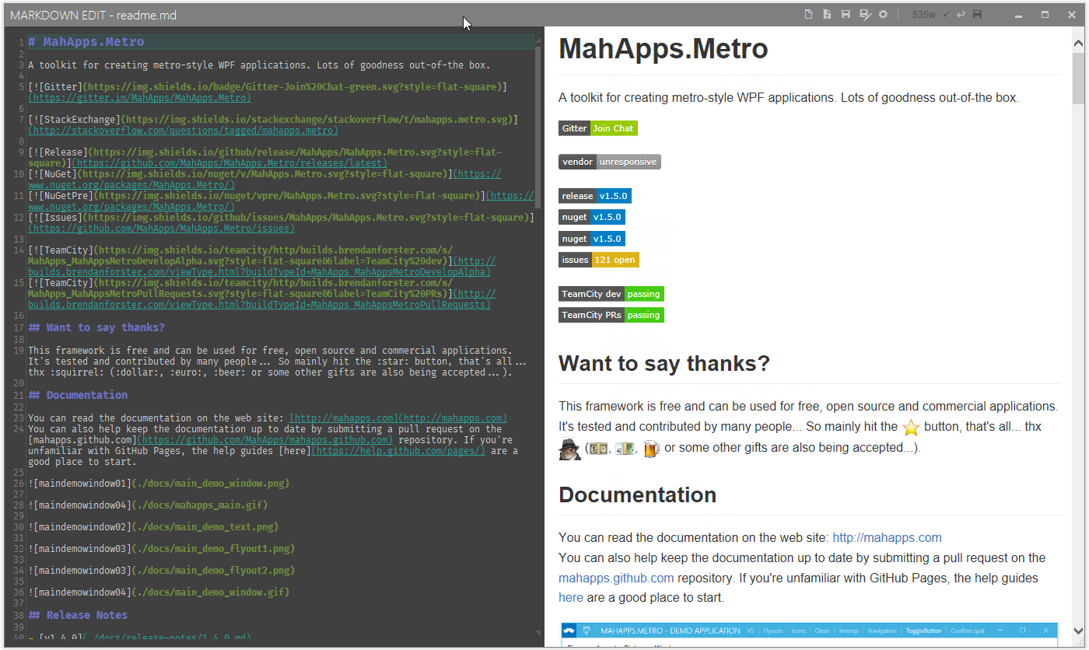
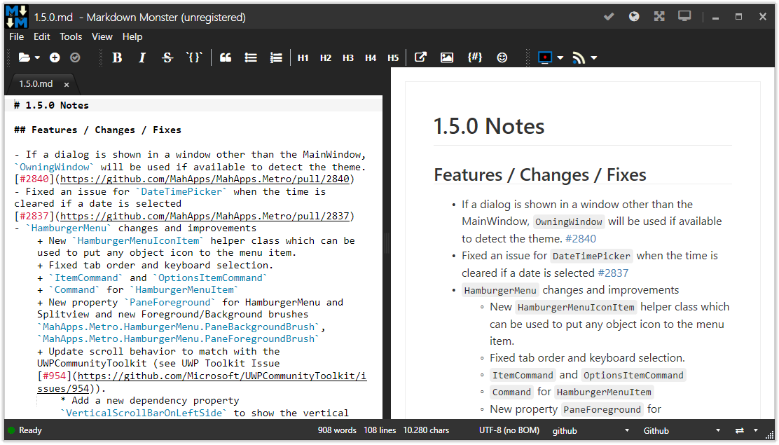
MahApps.Metro Beispiele
Markdown Edit von Mike Ward
http://markdownedit.com
MarkdownMonster von Rick Strahl
https://markdownmonster.west-wind.com

Slide 10
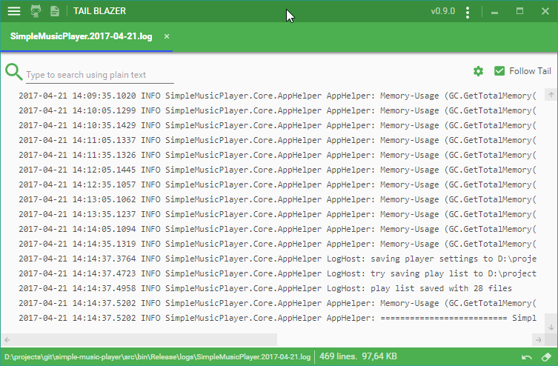
MahApps.Metro Beispiele
TailBlazer von Roland Pheasant
https://github.com/RolandPheasant/TailBlazer

Slide 11
MahApps.Metro Beispiele
Simple Music Player
https://github.com/punker76/simple-music-player
myEcho: iOS Dictation for Windows
von Scott Hanselman und Greg Shackles http://myechoapp.com
Solutionizer
von Thomas Freudenberg https://github.com/thoemmi/Solutionizer
Papercut Simple Desktop SMTP Server
https://github.com/ChangemakerStudios/Papercut
ChocolateyGUI
A delicious GUI for chocolatey https://github.com/chocolatey/ChocolateyGUI
Codetrack
A versatile profiler with some extra tricks up its sleeve. http://www.getcodetrack.com
Popcorn
An application which aims to provide a simple interface to watch any movie. https://github.com/bbougot/Popcorn

Slide 12
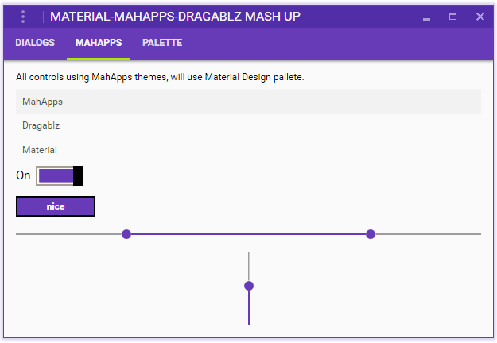
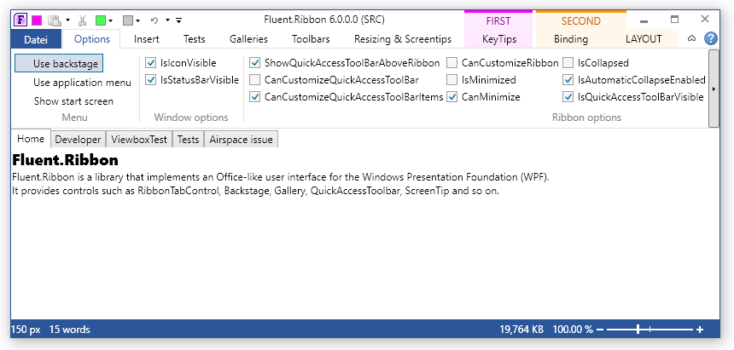
& Co
ControlzEx
Entstanden aus MahApps, MaterialDesignInXamlToolkit und Fluent.Ribbon
https://github.com/ControlzEx/ControlzEx
https://github.com/ButchersBoy/MaterialDesignInXamlToolkit von James Willock @ButchersBoy
https://github.com/fluentribbon/Fluent.Ribbon von Bastian Schmidt @batzen

Slide 13
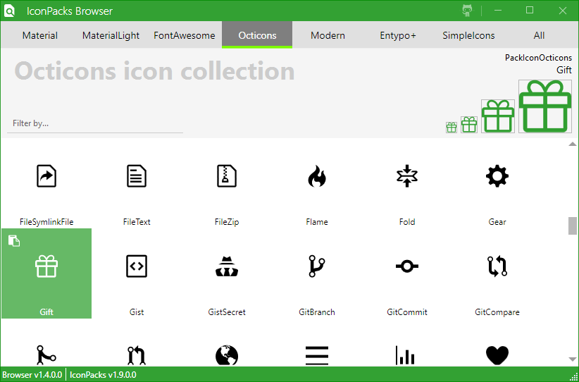
& Co
MahApps.Metro.IconPacks
Icon Sammlung für WPF und UWP
https://github.com/MahApps/MahApps.Metro.IconPacks
Material Design, Material Design Light
Font Awesome
GitHub Octicons
Modern
Entypo+
Simple Icons
Auch ohne MahApps nutzbar

Slide 14
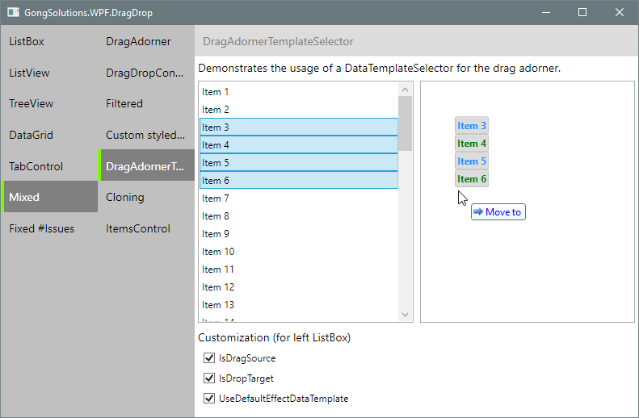

& Co
GongSolutions.WPF.DragDrop
https://github.com/punker76/gong-wpf-dragdrop
Drag&Drop Toolkit für WPF
MVVM Support
ListBox, ListView, TreeView, DataGrid

Slide 15

Alles klar?
Kontakt
Jan Karger
http://jkarger.de
Twitter: @punker76
GitHub: https://github.com/punker76
Mail: punkerat76@gmail.com

