Slide 1

Individual Contribution Scores in Federated Learning
w w w . c r y s y s . h u
Azra Avci
BSc Project
Supervisor: Balázs Pejó

Slide 2
Background and motivation
Federated Learning (FL) allows decentralized data sources to train models collectively without explicitly sharing data.
Move the computation to the data
Evaluating individual contributions in FL while preserving privacy is challenging
Not sharing individual gradients limits ways of calculating individual contribution
Existing scoring mechanisms are too demanding, not privacy-preserving
Notes:
Examples where centralized machine learning does not work include:
Sensitive healthcare records from multiple hospitals to train cancer detection models
Financial information from different organizations to detect financial fraud
Location data from your electric car to make better range prediction
End-to-end encrypted messages to train better auto-complete models
---https://flower.ai/docs/framework/tutorial-series-what-is-federated-learning.html

Slide 3
Problem statement and objectives
How to evaluate individual FL participants’ contributions without compromising their privacy?
Implementing alternative scores as privacy-preserving metrics
Leave-One-Out
Include-One-In
Integrating these metrics into the Flower framework with Secure Aggregation (SecAgg)

Slide 4
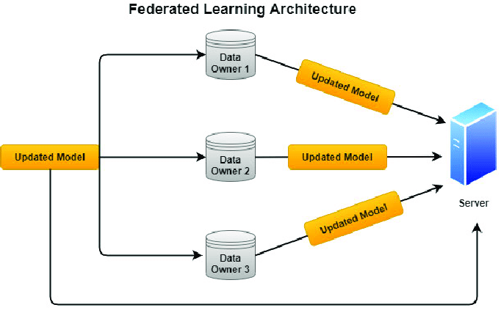
Results
SecAgg conceals individual contributions
Utilizing Federated Evaluation
I1I Score: Measures the impact of including a participant’s update
Local improvement
Leave-One-Out Score: Measures the impact of excluding a participant
Global improvement – global improvement except client i
Notes:
Instead of every possible subset of participants, you get two: only member, only member out
Local improvement: Eval of Locally trained machine – the received model
Global improvement: received model – previous model
Global model except client i_: (received, already trained model – the impact of the local model) – prev model

Slide 5
Results
Key steps:
Client initializes global model
Clients train local models and compute I1I scores
Server aggregates updates to form a new global model
Clients compute L1O scores
Evaluation using global or local test sets.

Slide 6
Evaluation
Global Evaluation:
Initial Accuracy: 0.0957
Final Accuracy: 0.9803
L1O Scores: -0.0089 to 0.0086
I1I Scores: -0.0167 to 0.795
Local Evaluation:
Initial Accuracy: 0.1032
Final Accuracy: 0.9795
L1O Scores: -0.0013 to 0.0137
I1I Scores: -0.0017 to 0.8283

Slide 7
Related work
The Shapley value computation
Computationally infeasible
Incompatible with privacy-preserving technologies
Shapley value computation approximations
Incompatible with privacy-preserving technologies

Slide 8
Conclusion and future work
Implemented L1O and I1I scores for FL participant evaluation using Flower and SecAgg
Demonstrated that these metrics provide a way of evaluating individual contributions while maintaining privacy.
Self-evaluation of contributions can be falsely reported
Verifiable computation

