Slide 1
E-Commerce Analysis
By Punkit Verma

Slide 2





Contents
Customer Trend
Revenue Growth
Logistics View
Dashboard

Slide 3

Problem Statement
Revenue YoY
Product Returns Impact
Product Specific Revenue Loss
Less Revenue Months
Region Wise Impact
Rating impact on Sales

Slide 4

Methodologies Used
Multiple DAX functions were used to compute the results, few of them listed below:
Related
Sum
DistinctCount
Calculate
Average
Countrows
Filter
SamePeriodLastYear

Slide 5
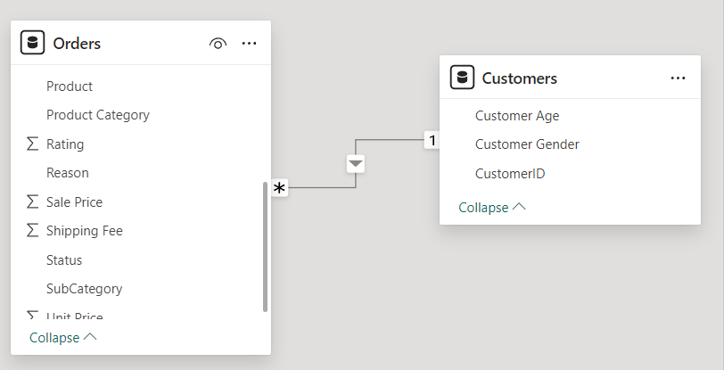
Data Overview
There are 2 tables – Orders & Customers.
For Data Cleaning – I removed Null from Location, ProductCategory & Unit Price column in Orders table

Slide 6
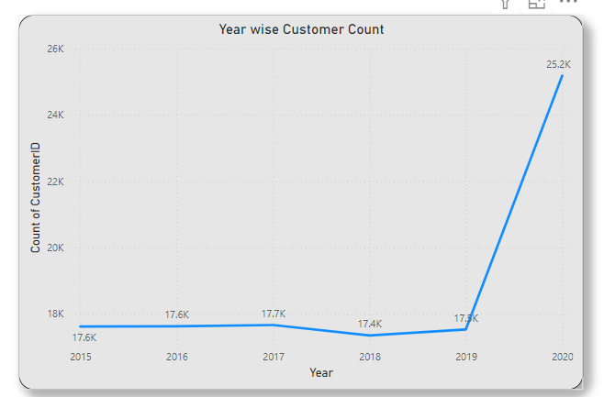
Customer’s Trend
The year 2020 recorded the highest customer count.
Customer count increased by 42% from 2015 to 2020.

Slide 7
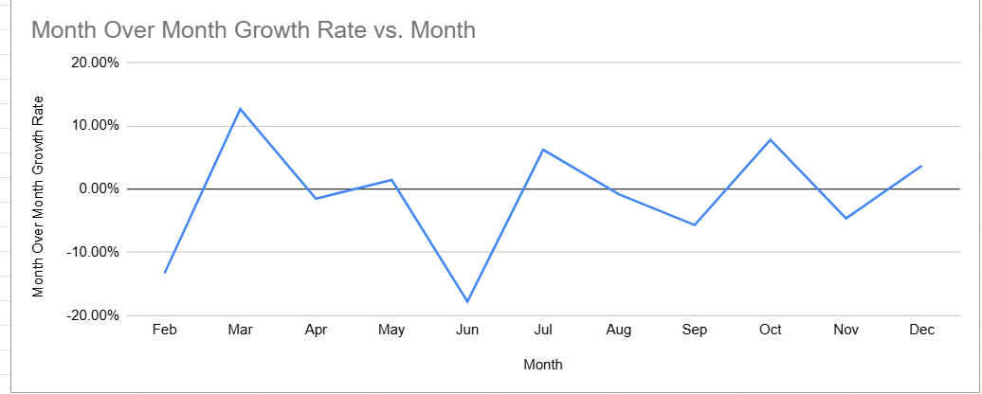
Revenue Growth
Most Revenue Growth is seen in the month of March
Least Impact seen in the month of June

Slide 8
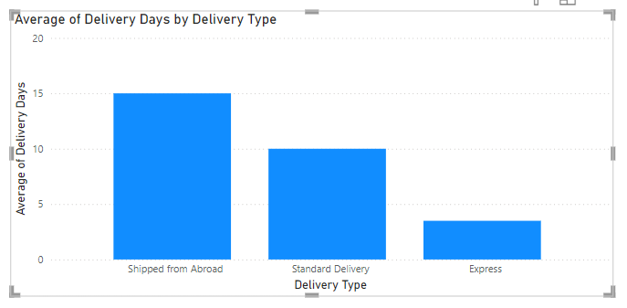
Logistics View
Most delivery time is taken for the category “Shipped from Abroad”
Least delivery time is taken by the Express

Slide 9
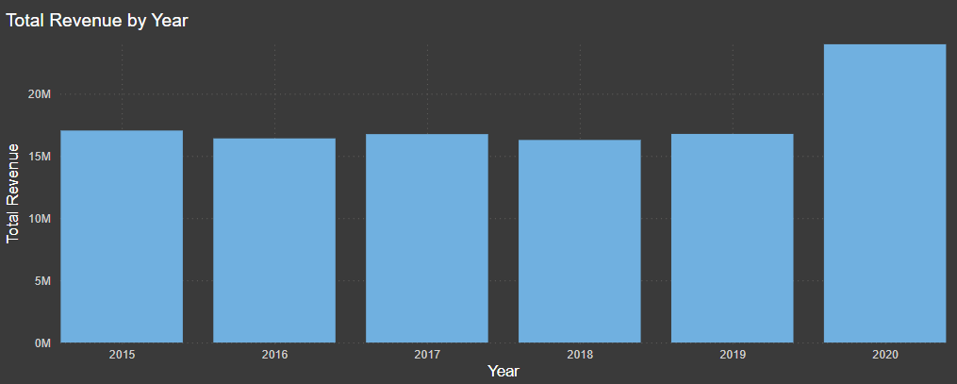
Revenue YoY
Best Revenue year has been 2020
2016 & 2018 has seen the least revenue

Slide 10
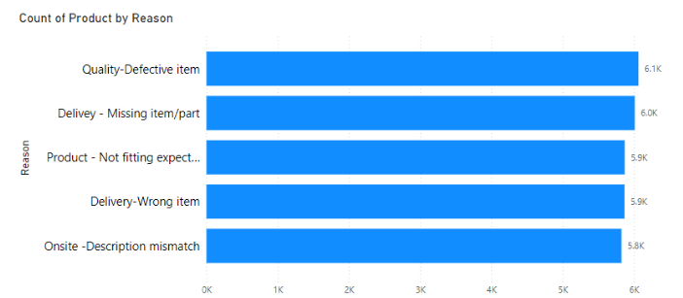
Product Return Impact
Missing, wrong, and defective items account for 18K returned products, making up 58% of total returns
By providing accurate product descriptions, returns could be reduced by 42%.

Slide 11
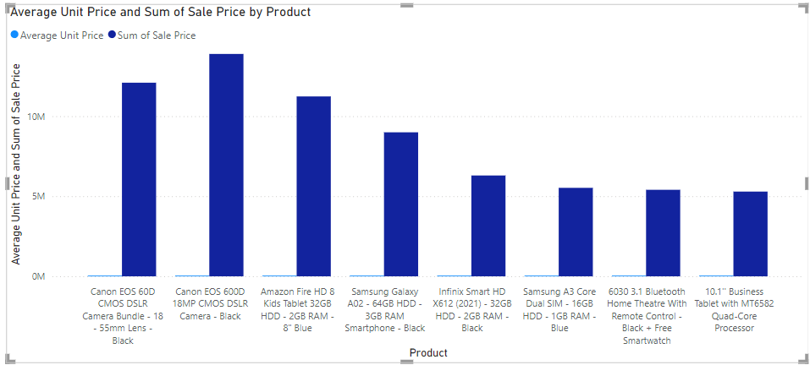
Product Specific Revenue Impact
These products have the less share in overall revenue.
To increase their sales, we will have to implement offers like Trade-in Discounts, EMI Offers, free Extended Warranties, etc

Slide 12
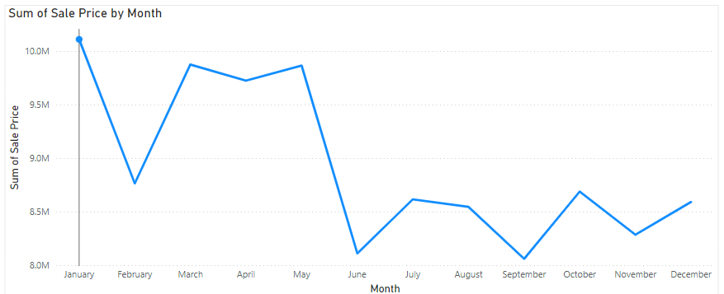
Less Revenue Months
June, September and November are the months with less revenue so we should plan promotional offers in this period

Slide 13
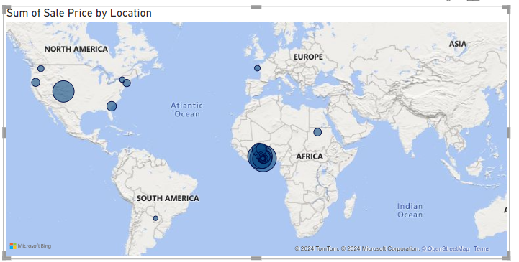
Region Wise Impact
Major business is from Africa continent – focus should be more towards Asian and European continent

Slide 14
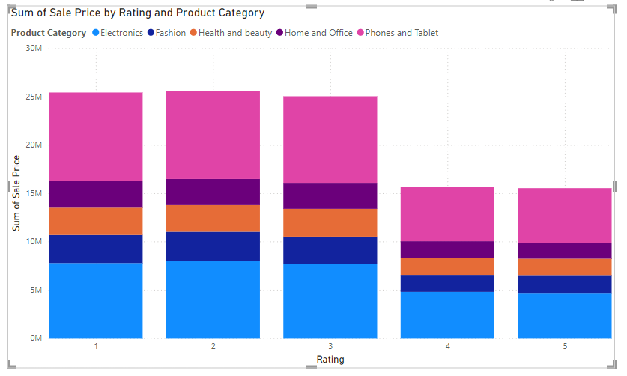
Rating Impact on Sales
Ratings have shown no direct impact on sales.
Low-rated items recorded the highest sales across all categories.

Slide 15
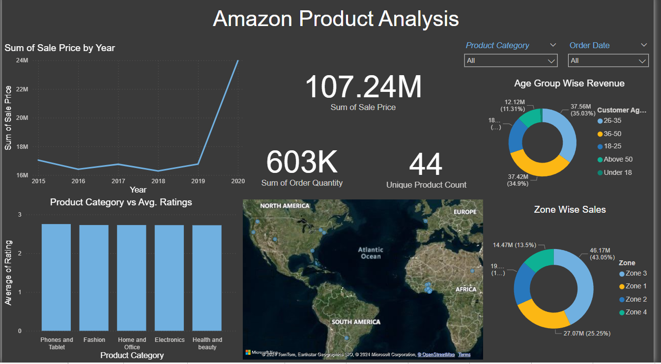

Slide 16
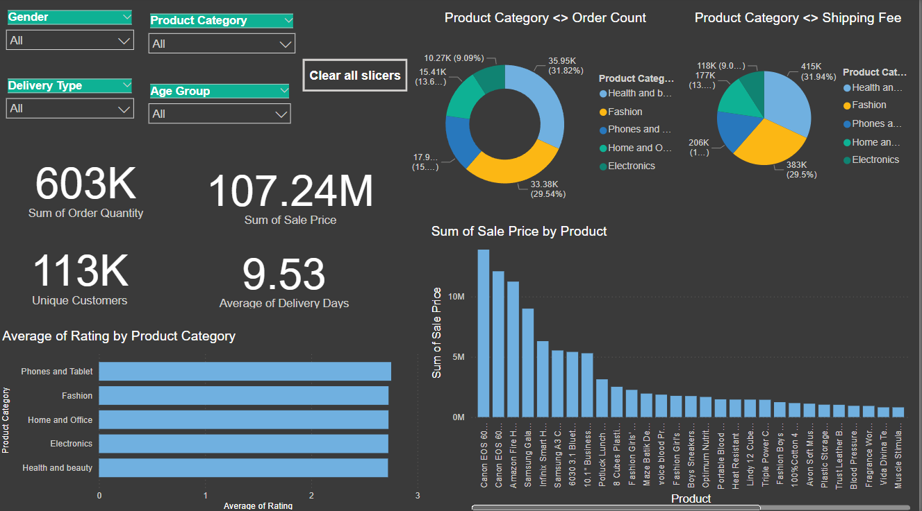

Slide 17
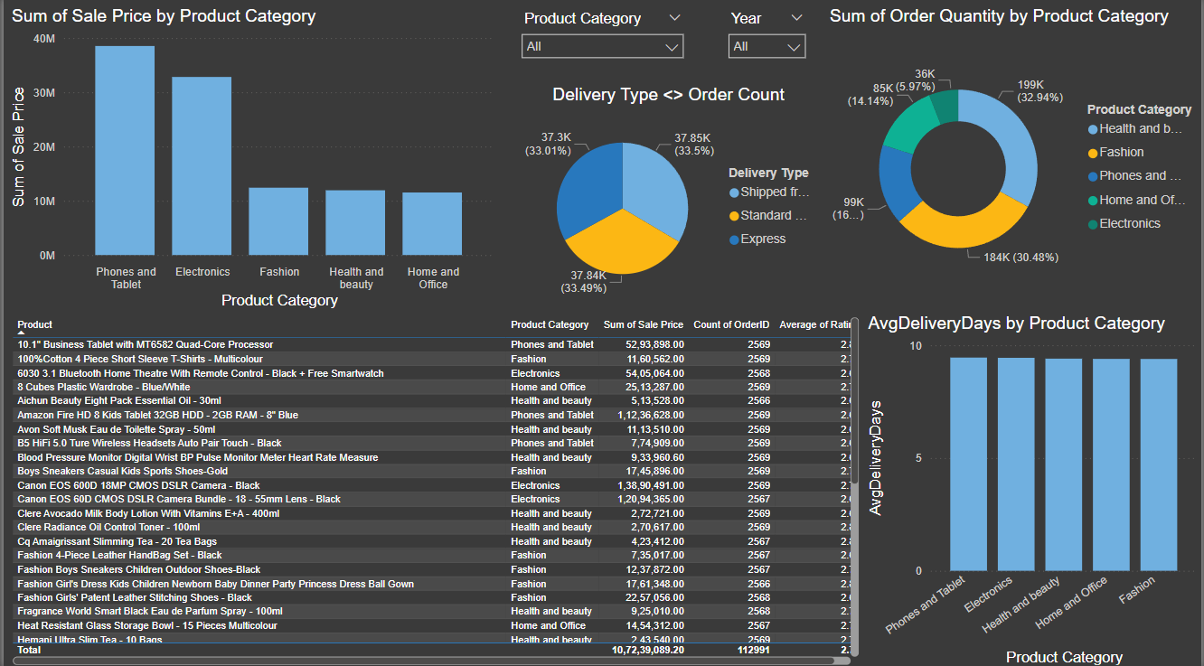

Slide 18

Sales Focus: Target specific months like June, September, and November to boost sales.
Delivery Efficiency: Express is identified as the fastest delivery mode.
Product Targeting: Introduce new schemes for specific products to enhance overall revenue.
Return Reduction: Minimize returns by improving product quality and providing accurate product descriptions on the website.

Slide 19
THANK YOU

