Slide 1
Predicting Construction Accident Severity Using Classification Techniques
Under the guidance of
Dr.Lu Gao Professor
Presented by: Surya Punna PS ID: 2348592

Slide 2
CONTENTS
Introduction
Problem Statement
Literature Review
Objectives
Dataset and Data Preprocessing
Exploratory Data Analysis (EDA)
Methodology
Results and Evaluation
Conclusion
Future Scope
References

Slide 3
Introduction
Overview: The importance of enhancing safety on construction sites through accident severity prediction.
Context: Machine learning techniques can help classify accidents into fatal or non-fatal based on risk factors such as environmental, task-related, human, and project characteristics.
Safety Concerns: Construction sites remain prone to serious accidents leading to injury or death.
Challenges: Difficulty in predicting accidents due to complex interactions between environmental, task-specific, and human factors.
Goal: Develop a predictive model that classifies accident severity and provides insights for proactive safety measures.

Slide 4
Problem Statement
Construction sites are inherently hazardous environments where accidents can result in serious harm
or even fatalities . Despite current protective measures, predicting and preventing the severity of construction
accidents remains a challenge due to the variety of factors involved

Slide 5

Literature Review
Traditional Methods:
Reliance on expert opinions and simple statistical models for evaluating safety risks.
Limitations in handling non-linear relationships between variables.
Machine Learning Applications:
Random Forest, XGBoost, and LightGBM provide improved predictive capabilities.
Key Studies:
Breiman (2001): Developed Random Forest for classifying data.
Chen et al.: Applied Random Forest to assess the impact of tasks, context, and behaviors on accident severity.

Slide 6
Objectives
Classify construction accidents based on severity (fatal or non-fatal) using factors such as event type,
task assigned, human factors, and environmental conditions.
Develop a predictive model that offers preventive measures to construction managers, safety officers, or policymakers
helping them to avoid severe accidents.
Enhance safety planning and resource allocation by providing actionable insights into high-risk areas and tasks on construction sites.
Improve risk management by predicting accident outcomes and offering recommendations for mitigating safety hazards.

Slide 7

DATASET AND Data Preprocessing
Dataset Overview: Construction accident dataset with 4,847 records and 25 features.
Key Features: Event type, fall height, human factor, environmental factors, task assigned, project cost, building stories, year of incident, and injury type.
Preprocessing Steps:
Handling Missing Values: Mean or mode imputation for numerical and categorical features.
Encoding Categorical Features: One-Hot Encoding and Frequency Encoding applied.
Feature Scaling: Standard scaling for numerical features (e.g., fall height, project cost).
Outlier Handling: Boxplot analysis to detect and treat outliers.

Slide 8
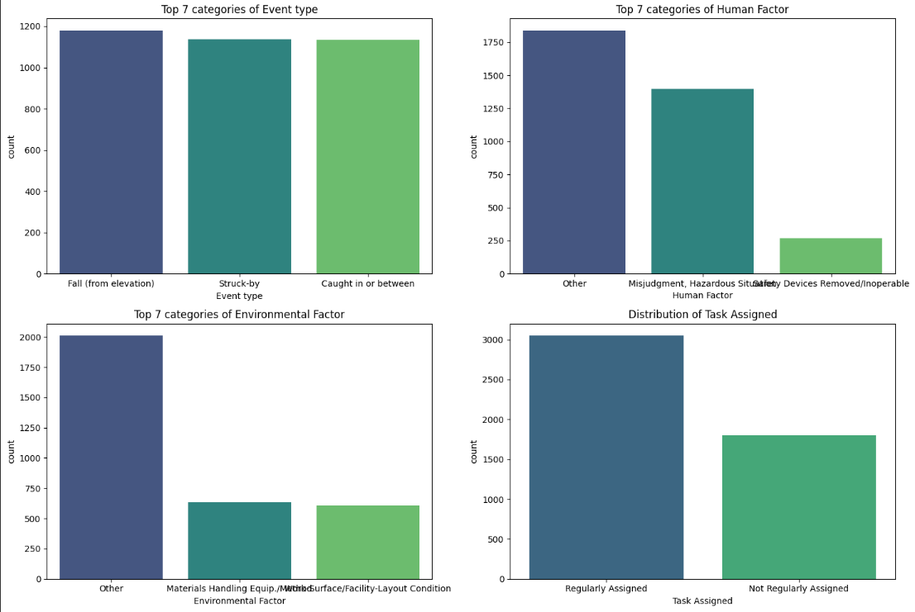
Exploratory Data Analysis (EDA)
Distribution of Categorical fields
The Distribution of Categorical fields like event type, human factor , Environmental factors and Task Assigned below

Slide 9
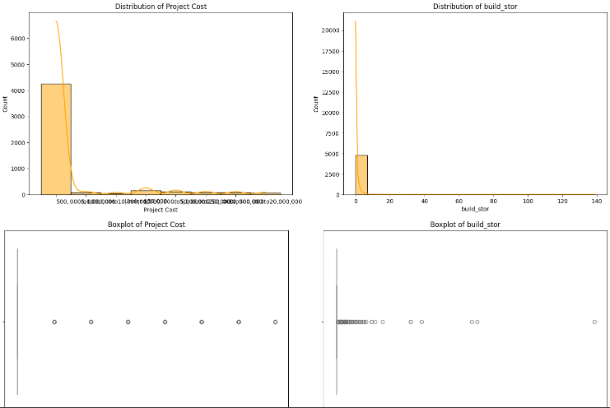
Distribution of numerical fields

Slide 10
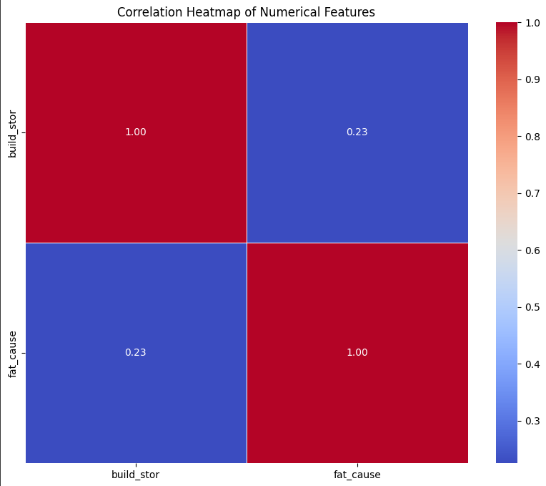
Correlation of numerical fields

Slide 11
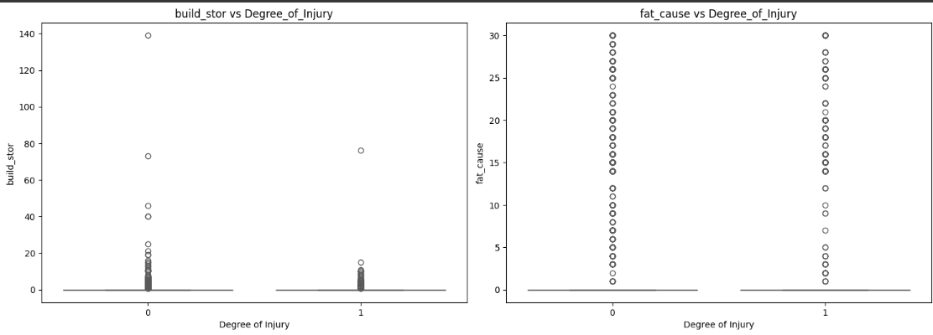
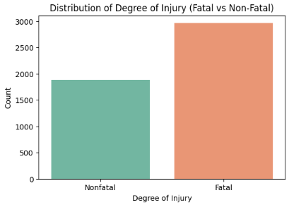
Distribution of target feature against numerical features
Distribution of target feature

Slide 12
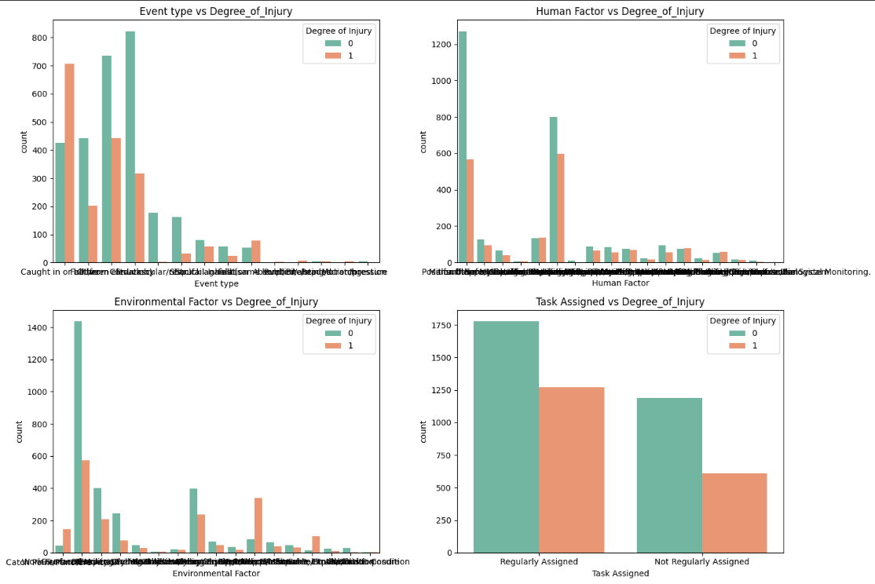
Distribution of target feature against categorical features

Slide 13
METHODS
Model Architecture: Ensemble of classifiers to predict accident outcomes, focusing on both numerical and categorical data.
Models Used:
Here are the top 10 models you have used in your project:
Logistic Regression (L2 and L1 Regularization)
Random Forest Classifier
Decision Tree Classifier
Support Vector Machine (SVM)
K-Nearest Neighbors (KNN)
Naive Bayes
XGBoost
LightGBM
CatBoost
Neural Networks (MLP or Deep Learning Models)

Slide 14
Model Comparison Table
Model | Accuracy | Key Features | Strengths | Limitations
Logistic Regression | 89% | Task type, environmental aspects | Simple, good for benchmarking | Not effective for complex relationships
Random Forest | 90% | Orientation height, task, fall environment, human environment | Handles mixed data well, avoids overfitting | May require tuning for optimal performance
Decision Tree | 88% | Task, worker activity, conditions | Interpretable model | Prone to overfitting without pruning

Slide 15
Model Comparison Table (cont.)
Model | Accuracy | Key Features | Strengths | Limitations
Support Vector Machine (SVM) | 89% | Environmental condition, job title, worker's attitude | Effective for non-linear relationships | Sensitive to parameter selection
K-Nearest Neighbors (KNN) | 83% | Fall height, task assigned, human factors | Simple, effective for smaller datasets | Sensitive to feature scaling, presence of outliers
Naive Bayes | 84% | Job description, people-related issues, physical characteristics | Works well with large datasets | Assumes independence between features

Slide 16
Model Comparison Table (cont.)
Model | Accuracy | Key Features | Strengths | Limitations
XGBoost | 92% | Task type, fall height, worker behavior | Handles complex data well, high efficiency | Computationally intensive
LightGBM | 92% | Task performed, worker interaction, environment | Fast training, good for high-dimensional data | Sensitive to overfitting if not tuned properly
CatBoost | 92% | Tasks, circumstances, worker behavior | Handles categorical data effectively | May require substantial computational resources

Slide 17
Model Evaluation Metrics
Model | Accuracy | Precision (Class 0) | Precision (Class 1) | Recall (Class 0) | Recall (Class 1) | F1-Score (Class 0) | F1-Score (Class 1)
Logistic Regression | 89% | 0.91 | 0.85 | 0.9 | 0.86 | 0.91 | 0.86
Random Forest | 90% | 0.92 | 0.88 | 0.92 | 0.87 | 0.92 | 0.88
Decision Tree | 88% | 0.9 | 0.85 | 0.9 | 0.85 | 0.9 | 0.85
SVM | 89% | 0.9 | 0.87 | 0.92 | 0.84 | 0.91 | 0.85
KNN | 83% | 0.83 | 0.83 | 0.91 | 0.72 | 0.87 | 0.77
Naive Bayes | 84% | 0.84 | 0.84 | 0.91 | 0.73 | 0.87 | 0.78
XGBoost | 92% | 0.93 | 0.89 | 0.93 | 0.9 | 0.93 | 0.89
LightGBM | 92% | 0.93 | 0.89 | 0.93 | 0.9 | 0.93 | 0.89
CatBoost | 92% | 0.93 | 0.89 | 0.93 | 0.89 | 0.93 | 0.89

Slide 18
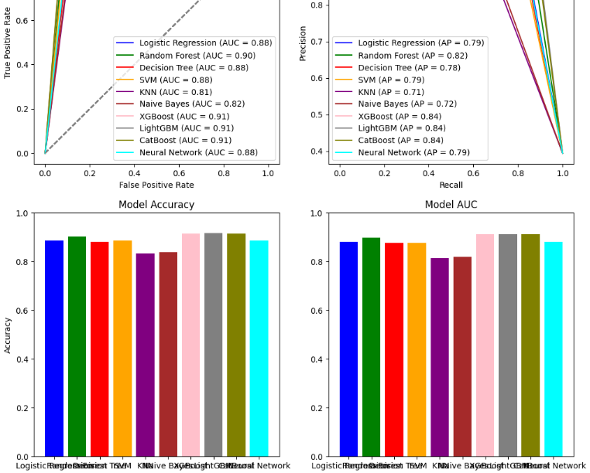
ROC , AUC and PR curves

Slide 19
Applications :
Improved safety conditions and resource control on construction sites by predicting accident severity.
Prioritization of safety efforts by focusing on high-risk activities, such as the use of large equipment and working on high-rise structures.
Enhancement of worker training plans by targeting safety training for workers in risky positions.
Reduction in safety inspections by focusing on high-risk areas based on model predictions.
Support for improved safety policies by providing actionable data for decision-makers.
Contribution to risk management, saving lives and enhancing public safety on construction sites.
Improved resource allocation by identifying areas that require more attention and safety measures.

Slide 20
Conclusion
Machine learning models like Random Forest, XGBoost, LightGBM, and CatBoost effectively predicted construction
accident severity, categorizing accidents as fatal or non-fatal while improving accuracy through complex pattern recognition.
The use of feature selection and dataset balancing helped fine-tune the models to handle class imbalances
enhancing prediction reliability.
Visual tools such as ROC curves, AUC, and precision-recall curves were used to evaluate and interpret the model’s performance clearly.
With further development, this model could support real-time monitoring and contribute to smart city initiatives
improving construction site safety and making resource allocation more data-driven and efficient.

Slide 21
Future work
Incorporate real-time information such as time of day, weather conditions, traffic loads, and technological
environment to enhance the model's predictive capabilities.
Improve algorithms like Gradient Boosting and Neural Networks to better handle imbalanced data and increase
prediction accuracy.
Implement real-time monitoring with sensor data to provide continuous alerts about potential accidents and
offer solutions to mitigate risks.
Support smart city projects by integrating the model into urban infrastructure, enhancing safety through
data-driven decisions for construction workers and the public.

Slide 22
References
Zhang, L., & Tam, V. W. (2008). "A review of accident modeling and prediction techniques in construction industry." Journal of Safety Research, 39(5), 463-469.
Chien, S., Ding, Y., Wei, C., & Lee, C. (2018). "Application of machine learning algorithms for predicting construction accident severity." Automation in Construction, 96, 164-177.
Breiman, L. (2001). "Random forests." Machine Learning, 45(1), 5-32.
Chen, T., & Guestrin, C. (2016). "XGBoost: A scalable tree boosting system." Proceedings of the 22nd ACM SIGKDD International Conference on Knowledge Discovery and Data Mining, 785-794.
Vasquez, A., & Liu, M. (2019). "Data-driven approaches for safety risk assessment in construction projects." Automation in Construction, 107, 102904.
Kuhn, M., & Johnson, K. (2013). Applied Predictive Modeling. Springer.
Zhang, Z. (2016). "A survey on multi-class classification methods." IEEE Access, 4, 1-10.
Yang, Y., & Wang, X. (2019). "Real-time construction site monitoring and accident prediction with IoT and machine learning." Automation in Construction, 107, 102904.

Slide 23
Thank you 😊

