Slide 1

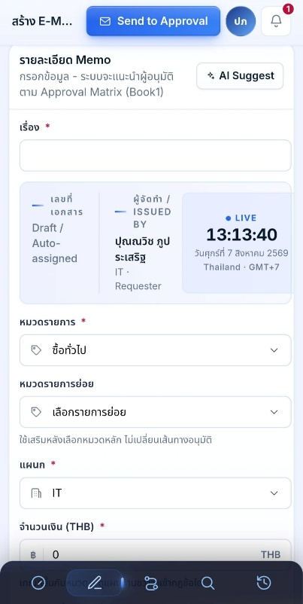
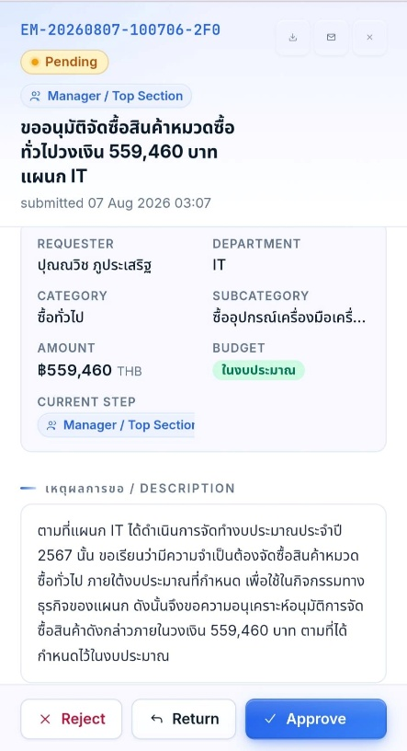
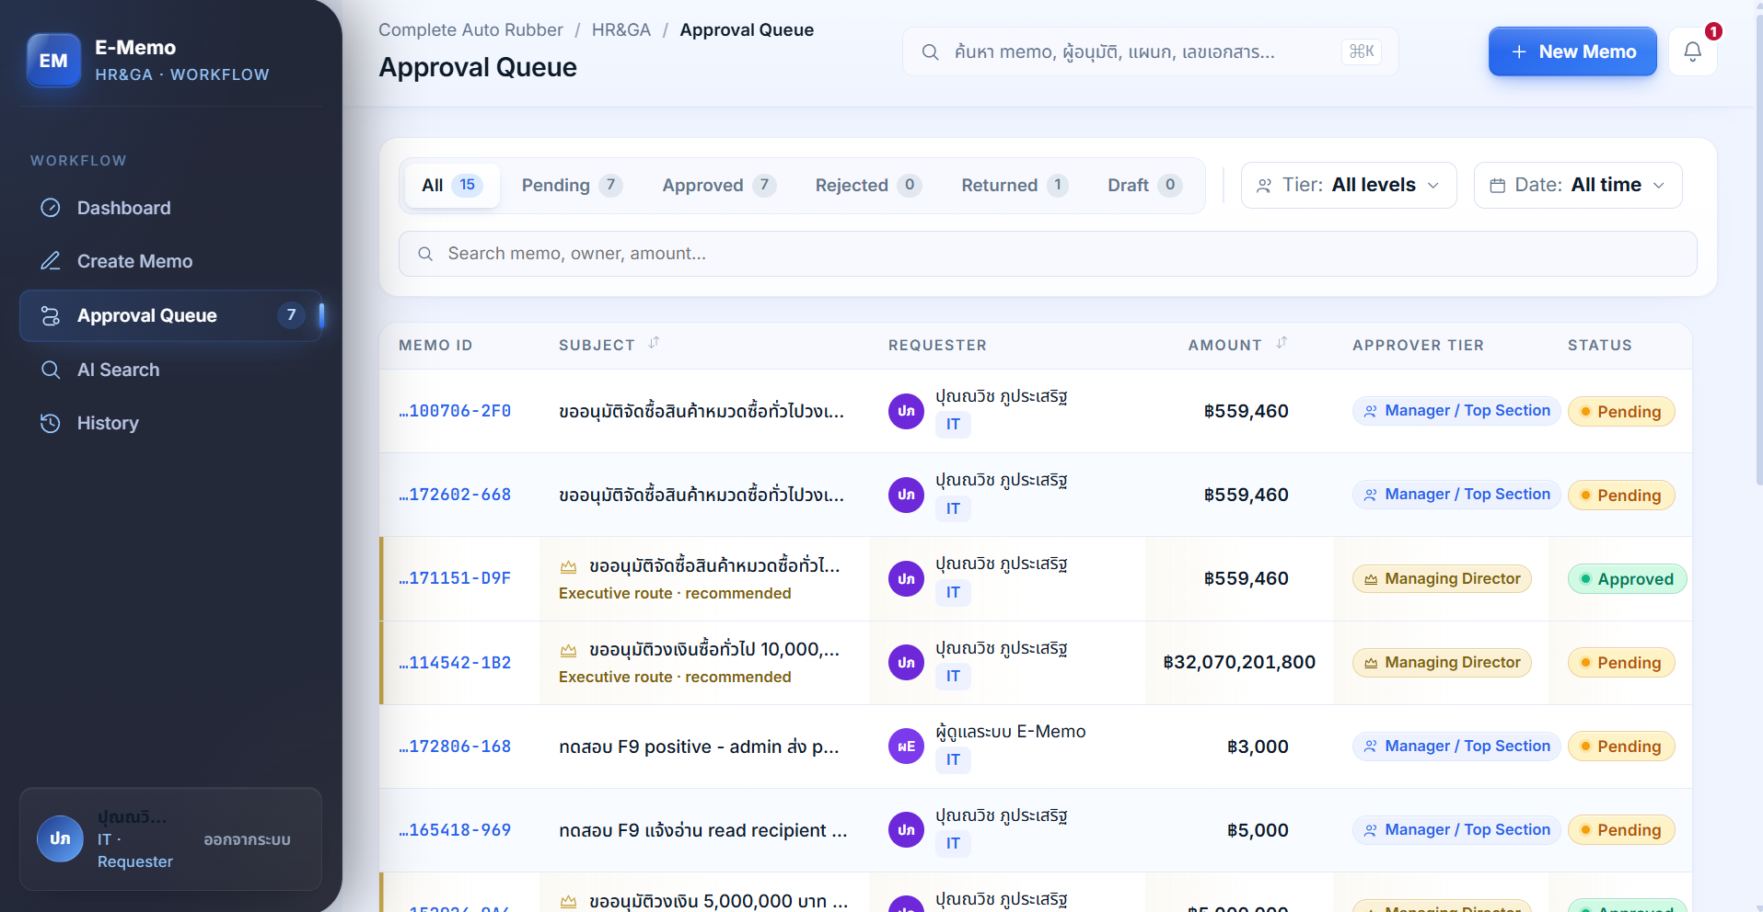
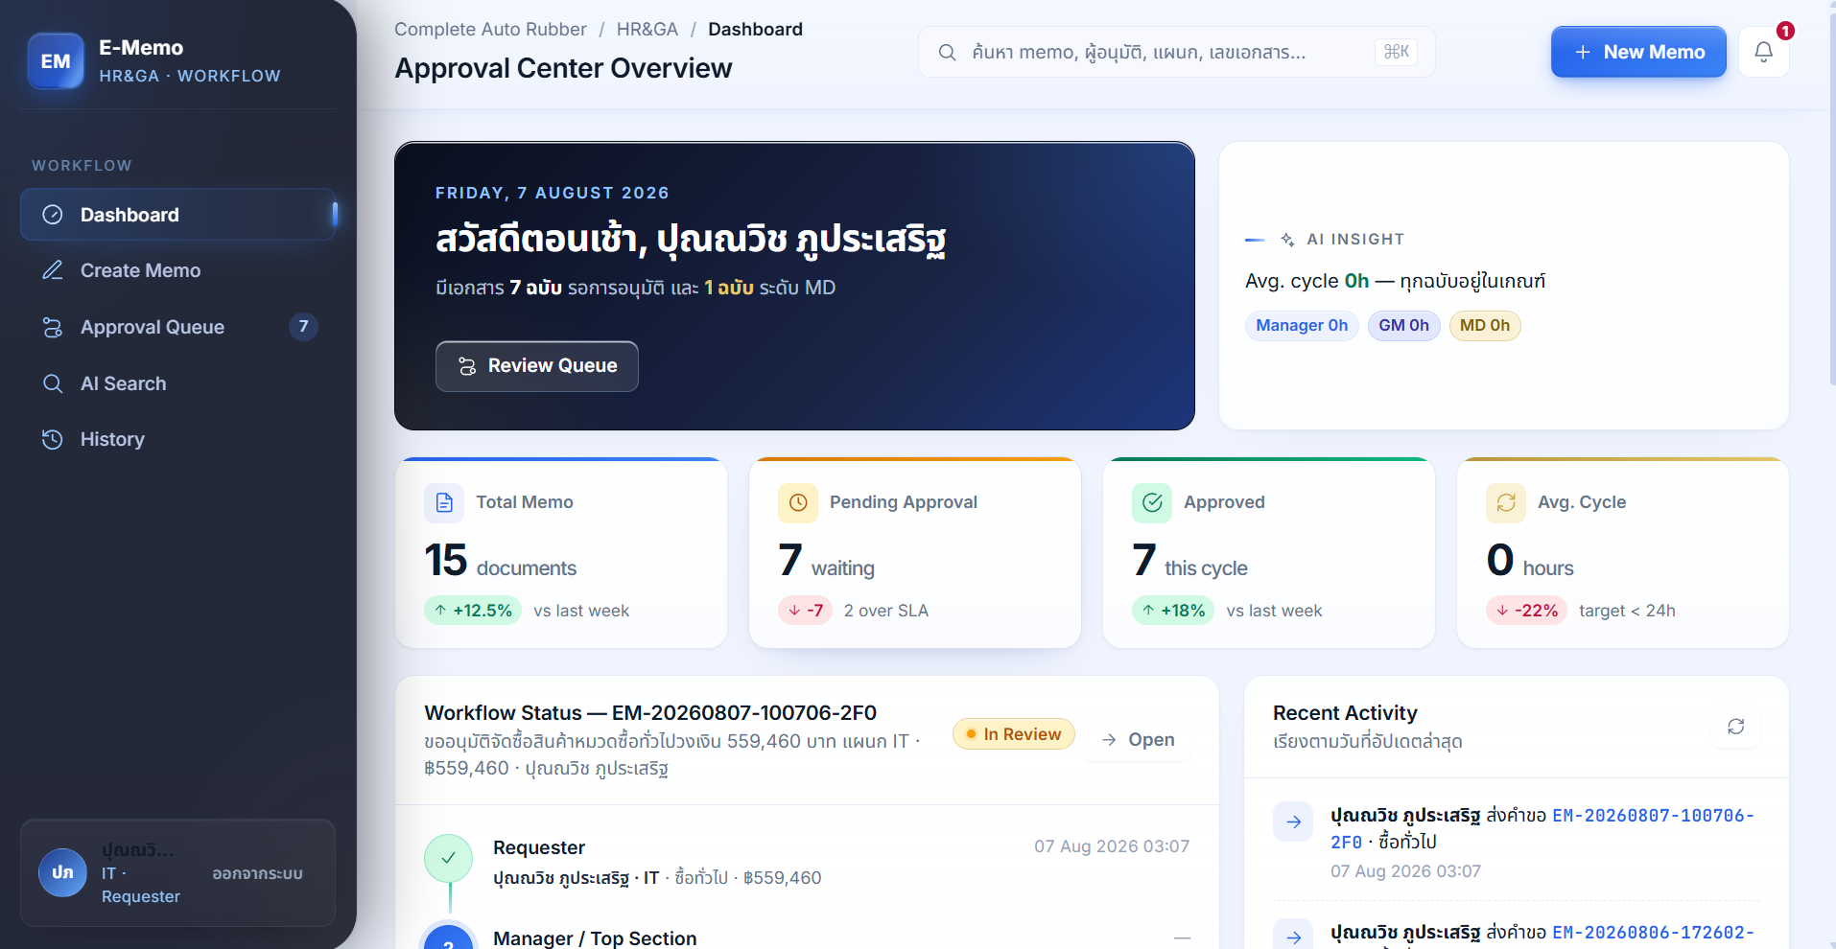
4. HR&GA IT Activity : E-MEMO
📈 Results
• 60–80% faster process
• 50,000–150,000 THB annual cost savings
• 60–70% fewer administrative errors
• 100% Paperless
• Real-time monitoring and reporting
Tagline: 🚀 From Paper-Based Approvals to Real-Time Digital Management

