Slide 1
Blood and Organ Donation Management System - “LifeShare”
punnya.p.s
mca b batch

Slide 2
INTRODUCTION
The scarcity and exigency for blood and organs has created many discrepancies in current approaches. These have created the criteria for malpractices such as organ trafficking and black market selling. This presents a solution with a secured-smart blood and organ donation web developed system, allowing both patients and healthcare providers to access information about the blood and organ processing records. Over 5 lakh people in our country face death due to lack of organs, this is due to lack of awareness and connection between the donors and seekers. , it’s an application which is meant for the life saving purpose and will be a revolutionary step for saving the lives of our people.

Slide 3
RELEVANCE
The Manual donation system has many disadvantages which includes, it is too time consuming , often leads to error prone results, consumes lot of manpower, lacks donor information, retrieval of data takes a lot of time, percentage of accuracy is less. . This Life Share presents a solution with a secured-smart blood and organ donation web developed system, allowing both patients and healthcare providers to access information about the blood and organ processing records. The database would be managed using the Blockchain technology which could be only accessed by authorized users . Finally, tracking all registered donors, the proposed system generates a smart identity developed by Ethereum Smart Contract (ESC).

Slide 4
DESCRIPTION
This presents a solution with a secured-smart blood and organ donation web developed system, allowing both patients and healthcare providers to access information about the blood and organ processing records.it is a web application. The database would be accessed by authorized users. using global positioning system, system finds the best matches among donors and seekers according to the nearest location. Further, the system will automatically collect feedback from user.

Slide 5
OBJECTIVE
Main objective of this research is to provide unique platform for both blood and organ donation management with advanced security features. also, to minimize death rates associated with organ donations.
->Blockchain-based tracking and generating a smart ID
-> The system finds the best matches among donors and seekers according to the nearest location.
->The system will automatically collect feedback from user.

Slide 6
EXISTING SYSTEM
Blood and organ donation is required during an accidents, cancer treatment etc. For blood donation, one needs to check for a donation camp or needs to visit blood bank. The Manual donation system has many disadvantages which includes, it is too time consuming, often leads to error prone results, consumes lot of manpower, lacks donor information, retrieval of data takes a lot of time, percentage of accuracy is less. In the time of emergency, it becomes difficult to approach the right donor. Rare blood groups are not available all the time at all blood banks and recipients find difficulties to track the right blood donor.

Slide 7
PROPOSED SYSTEM
This project is aimed to developing an online Blood/Organ Donation Information. ‘Life Share’ system is a web application through which registered users can check accessibility/availability of their blood requirement. The system finds the best matches among donors and seekers according to the nearest location. The system will collect feedback from user.The user part is done in android studio.

Slide 8
MODULES
1)Block chain creation
2)Finding nearest donor using GPS

Slide 9
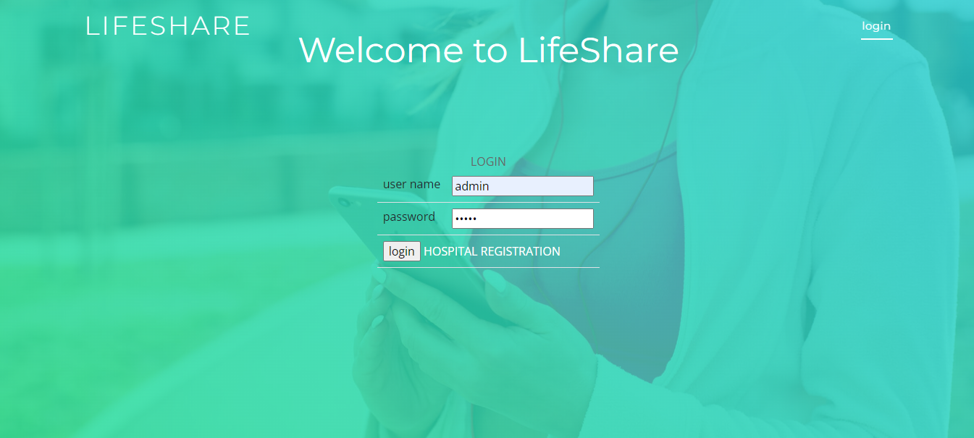
screenshots

Slide 10
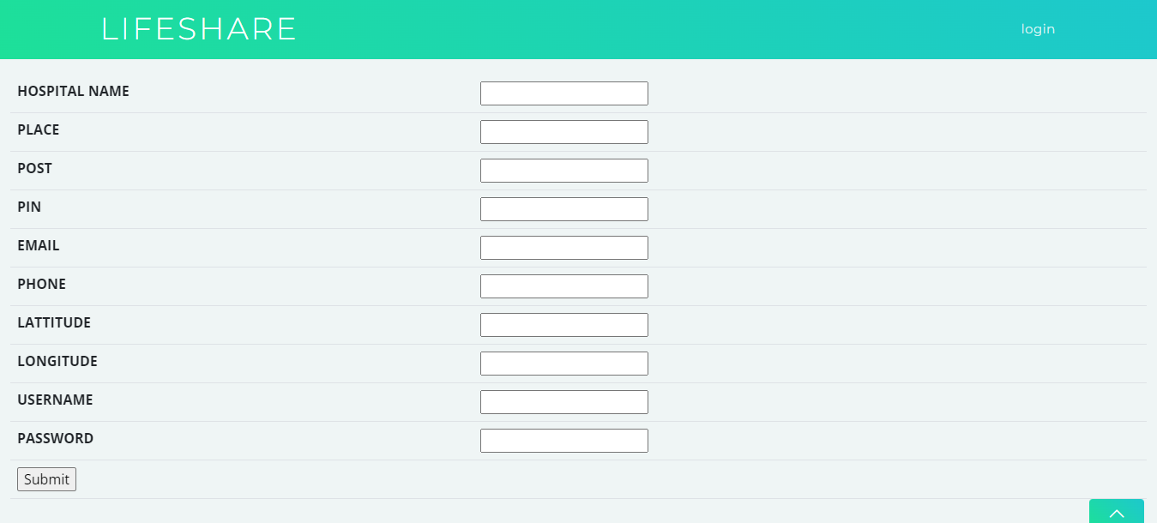

Slide 11
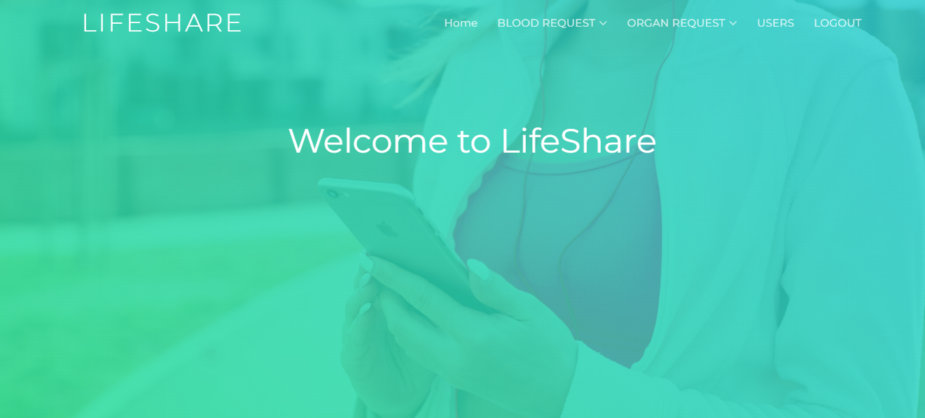

Slide 12
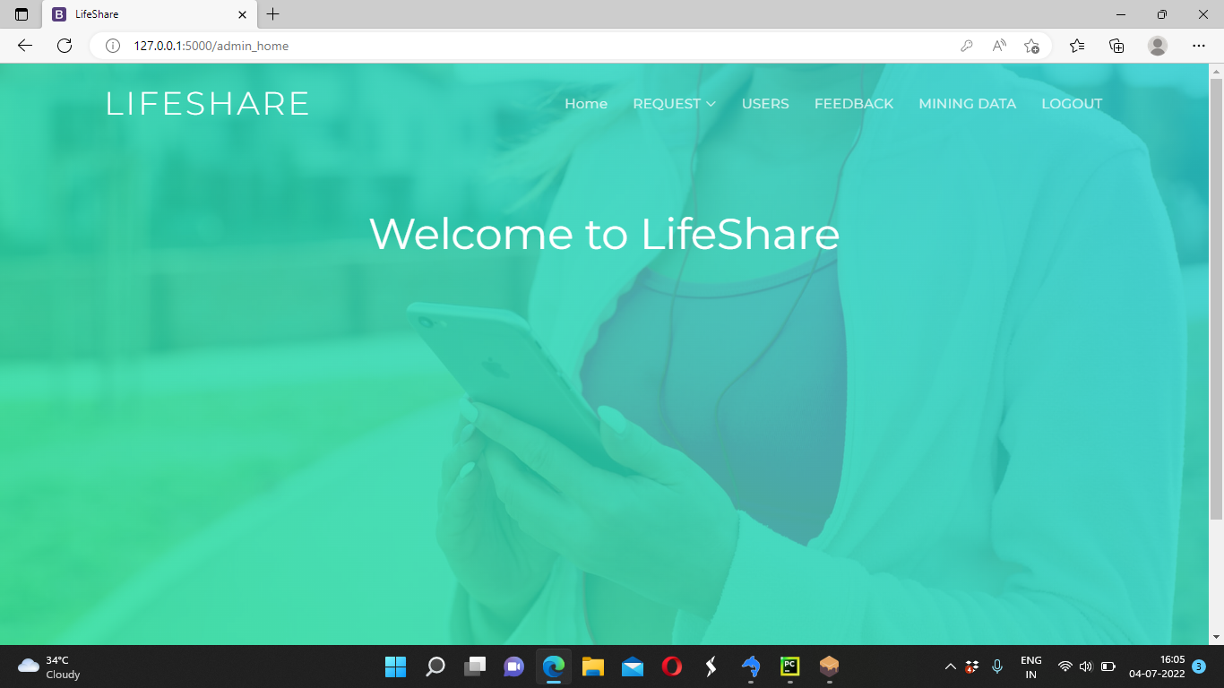

Slide 13
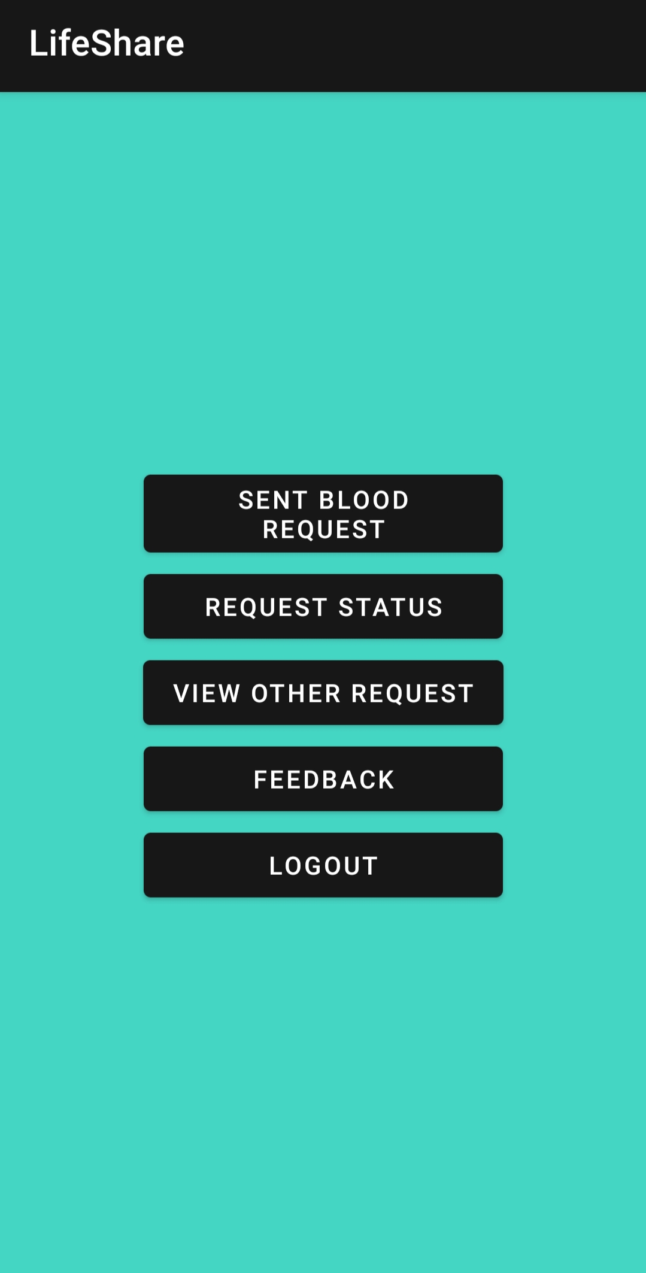

Slide 14
THANK YOU

