Slide 1




Employees who feel a sense of belonging are more engaged
GROUP - KND_08
Student Number | Name
IT23580176 | K A G T N Waidyarathne
IT23642232 | S R M P T Rathnayake
IT23728844 | M D A K Mahagamage
IT23599154 | P A Tennakoon

Slide 2




PROBLEM STATEMENT
Do employees who feel a stronger sense of belonging become more engaged?’
Many organisations struggle with low employee engagement and employee turnover.
A sense of belonging in the workplace may influence how engaged employees feel.
This study investigates whether employees who feel a stronger sense of belonging are more engaged.
Yet it's unclear whether belonging directly predicts engagement or if both are symptoms of broader dissatisfaction

Slide 3

OBJECTIVES
To analyse the relationship between employee belonging and engagement.
To identify patterns in belonging and engagement scores across employee groups using Descriptive analysis.
To determine whether differences in engagement and belonging are statistically significant using Inferential Analysis.
To evaluate whether belonging can help explain employee engagement using Predictive Analysis.

Slide 4
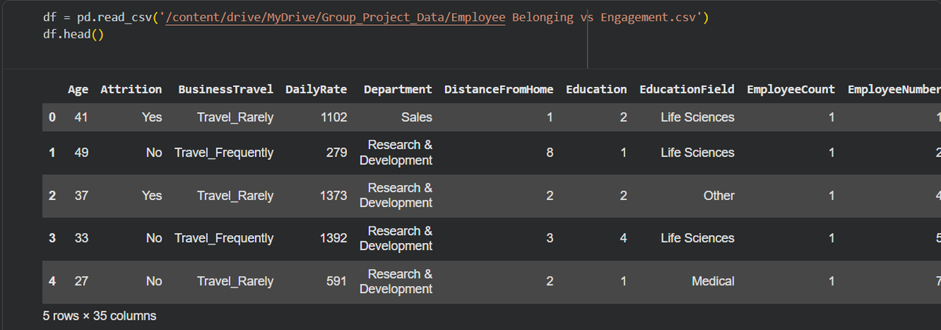
DATA COLLECTION
Dataset obtained from Kaggle
Secondary dataset related to employee workplace satisfaction and engagement.
Dataset includes 35 columns, with employee attributes such as:
- Job Involvment, Attrition, Job Satisfaction, Relationship Satisfaction, and Environment Satisfaction
The dataset contains survey style responses from 1470 employees.

Slide 5
DATA PREPROCESSING
Data cleaning means finding and fixing problems in a dataset so that the data is
accurate, consistent, and ready to be analysed.
Cleaning steps performed
Step | Finding | Action
Missing value | 0 found | no action needed
Duplicate Rows | 0 found | no action needed
Constant columns | 3 found | Removed (EmployeeCount, Over18, StandardHours)
Data types | 2 text columns | Converted Yes/No → 1/0

Slide 6
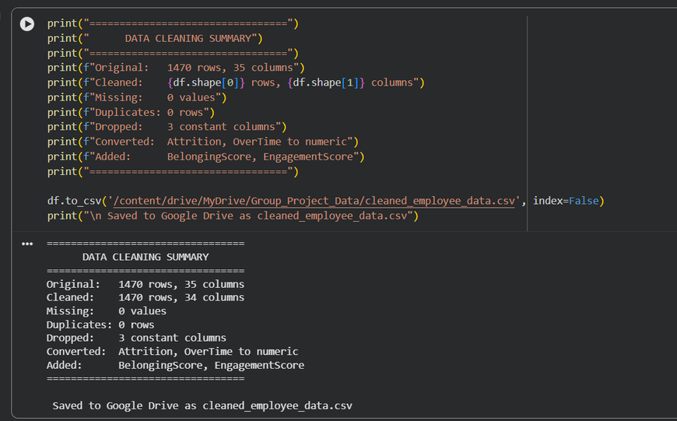
FEATURE ENGINEERING
Why Feature Engineering?
The dataset had no direct "Belonging" or "Engagement" column, so we created them.
Two New Scores Created:
BelongingScore
(RelationshipSatisfaction + EnvironmentSatisfaction) ÷ 2 Measures how included and valued an employee feels
EngagementScore
(JobInvolvement + JobSatisfaction) ÷ 2
Measures how dedicated and satisfied an employee is with their job
Final output

Slide 7
DESCRIPTIVE ANALYSIS
Descriptive analysis helps us understand patterns, distributions, and
initial relationships between Belonging Score and Engagement Score.
Average belonging and engagement scores were moderate across employees.
Mean and median values were similar, suggesting balanced distributions.
Value | Mean | Median | Std Value
Belonging Score | 2.72 | 2.50 | 0.77
Engagement Score | 2.73 | 3.00 | 0.65

Slide 8
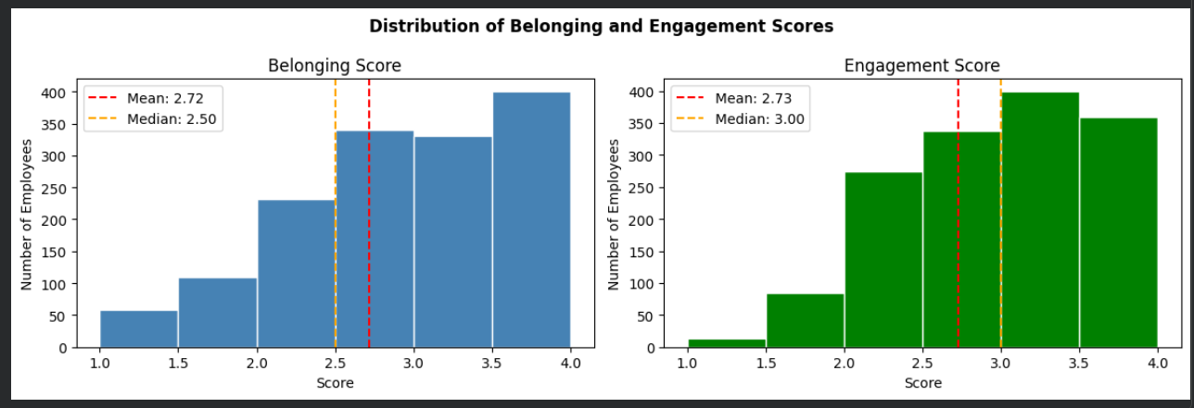
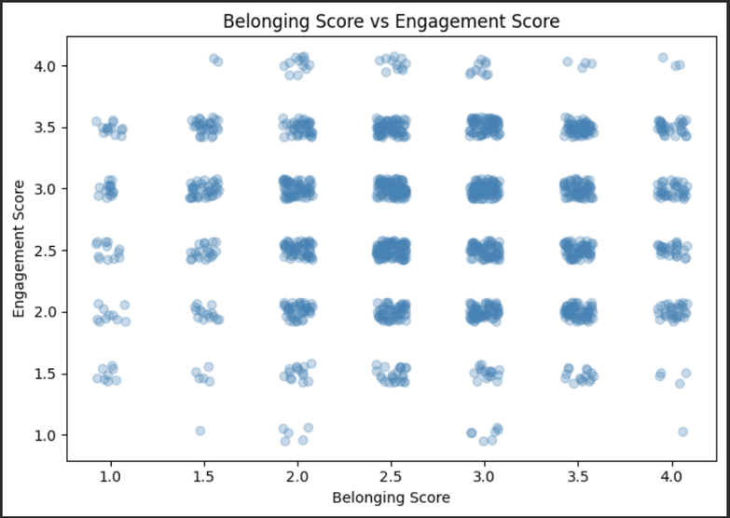
DESCRIPTIVE ANALYSIS
Distribution & Relationship Between Variables
As seen in the two histograms, score distributions were relatively centered around the middle values.
The scatter plot showed no clear linear relationship between belonging and engagement scores at independent level.
Pearson correlation coefficient was -0.002, indicating almost no linear correlation.

Slide 9
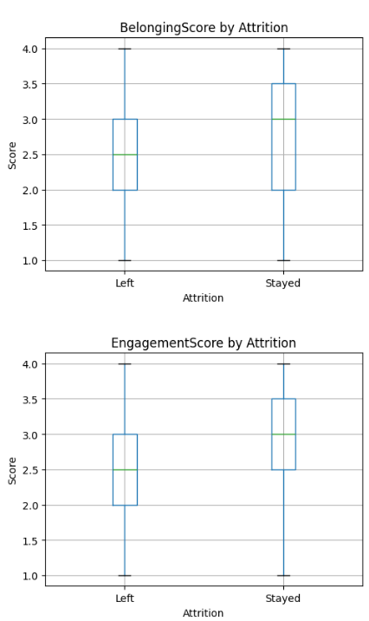
DESCRIPTIVE ANALYSIS
Group-Level Findings & Conclusion
Group | Belonging mean | Engagement mean
Stayed (Attrition- 0) | 2.75 | 2.78
Left (Attrition - 1) | 2.53 | 2.49
Employees who left the organisation had lower belonging and engagement scores.
This suggests both factors decline together among disengaged employees.
Descriptive analysis provides indirect support for the statement.
Inferential analysis is needed to determine statistical significance.

Slide 10
INFERENTIAL ANALYSIS
What is Inferential Analysis?
Inferential Analysis uses statistical tests to check if observed patterns are real or just by chance. Significance level used: α = 0.05
TEST 1 — Pearson Correlation Test
TEST 2,3 — Two Sample T-Test
Used to measure the strength and direction of relationship between BelongingScore and EngagementScore.
Two numerical variables → Pearson Correlation is the correct test.
Used to compare means of two independent groups - Stayed vs Left. Tests whether the difference between groups is real or just by chance.

Slide 11
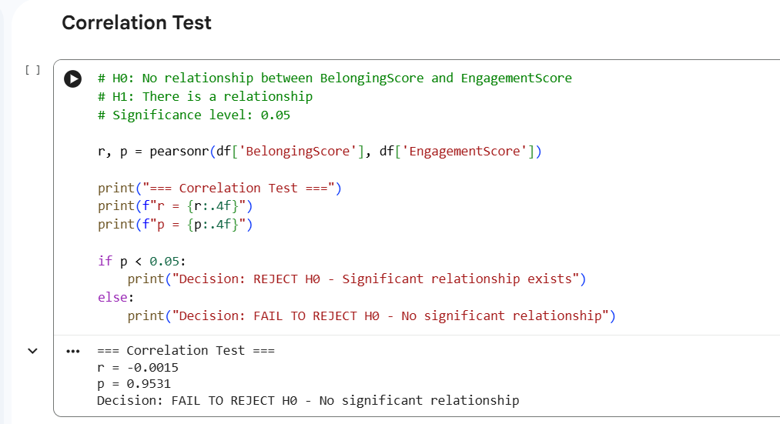
INFERENTIAL ANALYSIS
TEST 1 — Pearson Correlation Test
Tested the relationship between BelongingScore and EngagementScore.
H0:No relationship between BelongingScore and EngagementScore
H1: There is a relationship
r = -0.0015 | p = 0.9531
p > 0.05 → FAIL TO REJECT H0
✖ No significant relationship found at individual level

Slide 12
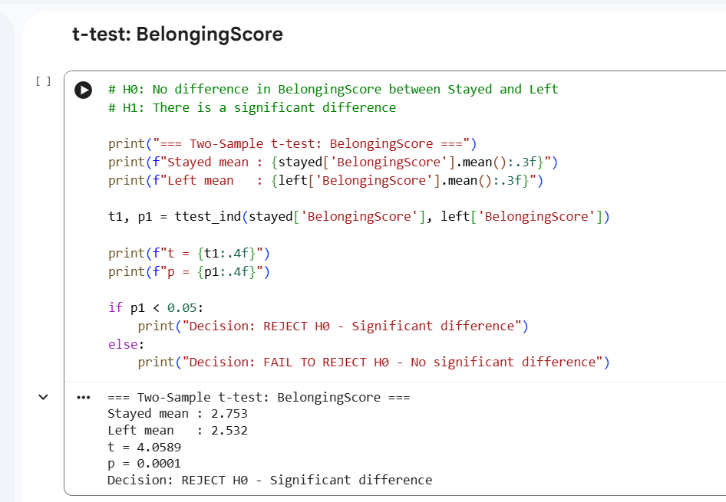
INFERENTIAL ANALYSIS
TEST 2 — Two Sample t-test: BelongingScore
Compare the BelongingScore between employees who stayed and those who left.
H0: No difference between Stayed and Left groups
H1: There is a significant difference
Stayed mean = 2.753 | Left mean = 2.532
t = 4.06 | p = 0.0001
p < 0.05 → REJECT H0
✔ Significant difference exists

Slide 13
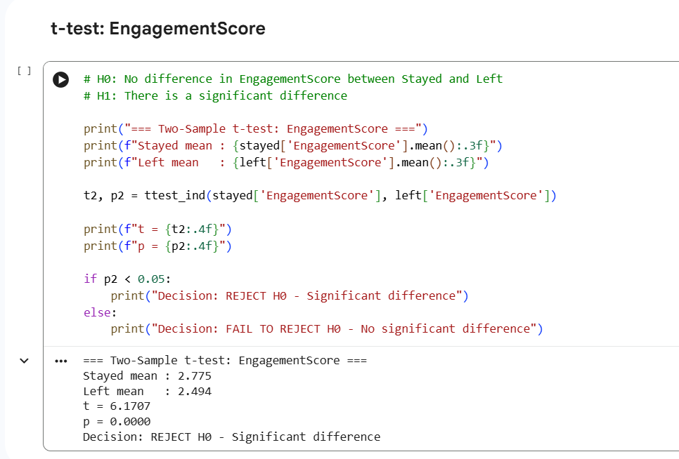
INFERENTIAL ANALYSIS
TEST 3 — Two Sample t-test: EngagementScore
Compare the EngagementScore between employees who stayed and those who left.
H0: No difference between Stayed and Left groups
H1: There is a significant difference
Stayed mean = 2.775 | Left mean = 2.494
t = 6.17 | p = 0.0000
p < 0.05 → REJECT H0
✔ Significant difference exists

Slide 14
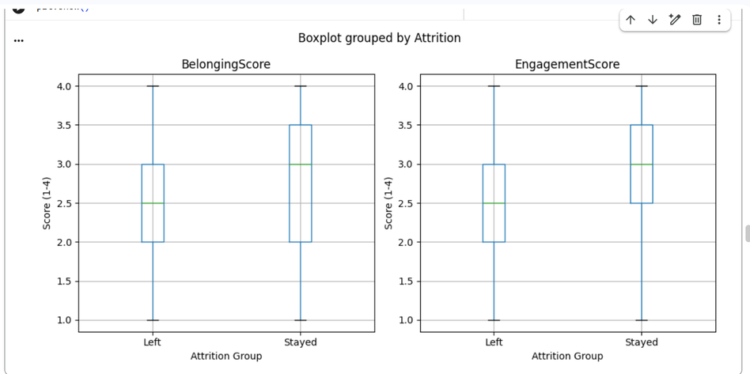
INFERENTIAL ANALYSIS
Box Plot
Stayed group has higher scores than Left group for both BelongingScore and EngagementScore. This visually supports the t-test results.
CONCLUSION
✖ Correlation → No direct relationship individually
✔ t-test Belonging → Significantly lower in Left group
✔ t-test Engagement → Significantly lower in Left group
📌 Result → No direct relationship individually, but both scores significantly lower in employees who left — PARTIAL SUPPORT for the statement.

Slide 15
PREDICTIVE MODEL
Can belonging and engagement predict whether an employee will leave?
We built a predictive model that determines whether an employee will leave the organisation (Attrition) based on their BelongingScore, EngagementScore and other workplace factors.
Predictive modelling uses historical data to forecast future outcomes
Models used: Logistic Regression, Decision Tree
Target variable: Attrition — whether an employee left (1) or stayed (0)

Slide 16
PREDICTIVE MODEL
Data Preparation — Defining X and y
(Independant)
X - clues we give the model
BelongingScore
EngagementScore
WorkLifeBalance
OverTime
JobLevel
YearsAtCompany
(Dependant)
y - the answer we want to predict
Attrition
Train / Test Split:
80% → Training set — 1,176 employees (model learns from these)
20% → Test set — 294 employees (model is tested on these)

Slide 17
PREDICTIVE MODEL
Building the Model
Model — Logistic Regression
Why Logistic Regression ? Attrition is not a number on a scale , That is why Logistic Regression is the right choice here. It gives each employee a probability of leaving and makes a final yes or no decision
Why not Linear Regression - Linear Regression is designed to predict continuous numerical outcomes. But Attrition is not a number. An employee either left or they didn't. Linear Regression cannot make a yes or no decision.

Slide 18
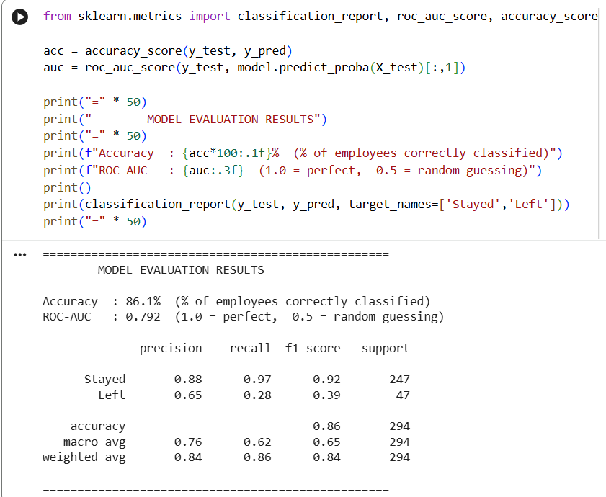
PREDICTIVE MODEL
Model Evaluation & Results
Accuracy of 86% - the model correctly identified 249 out
of 294 test employees
ROC-AUC of 0.79 - the model has genuinely learned real patterns
(ROC-AUC measures how well the model separates employees who left from employees who stayed)

Slide 19
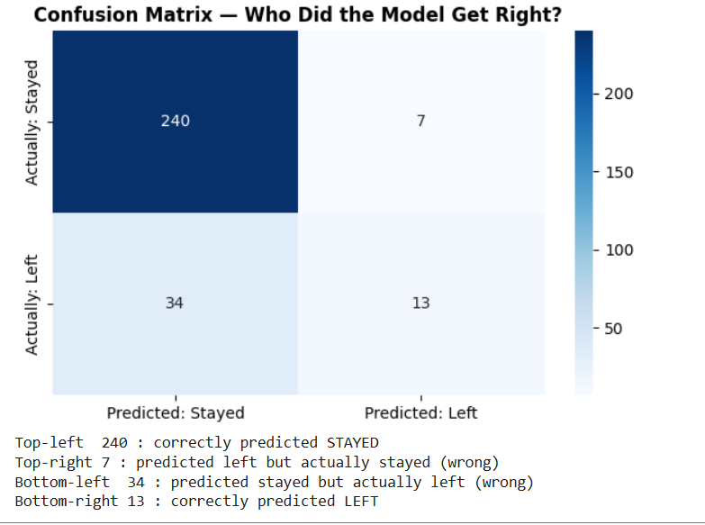
PREDICTIVE MODEL
What is a Confusion Matrix?
A scoreboard showing exactly where the model was correct and where it made mistakes

Slide 20
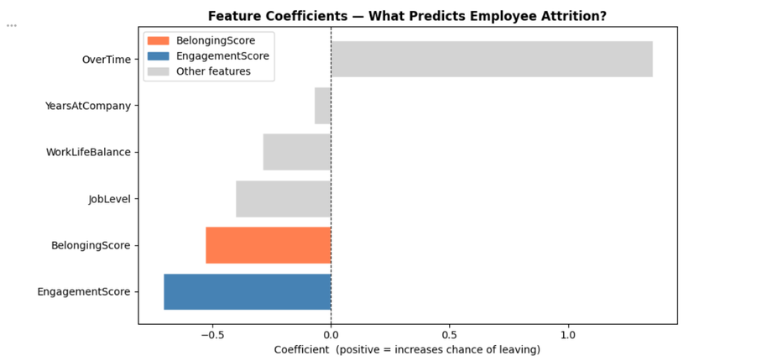
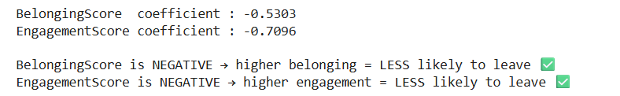
PREDICTIVE MODEL
Key Finding & Conclusion
Key Finding — Importance of BelongingScore & EngagementScore
BelongingScore → negative coefficient → higher belonging = less likely to leave
EngagementScore → negative coefficient → higher engagement = less likely to leave
Attrition is the strongest signal overall

Slide 21
PREDICTIVE MODEL
Decision Tree — Model & Results
What is a Decision Tree?
Makes predictions through a series of yes/no questions — like a flowchart
Simple, transparent and easy to interpret
Example:
"Is BelongingScore < 2.5?" → Yes → "Does employee work OverTime?" → Yes → Likely to leave
Why Decision Tree alongside Logistic Regression?
To validate findings — if both models agree, the conclusion is stronger
Decision Tree shows feature importance scores

Slide 22
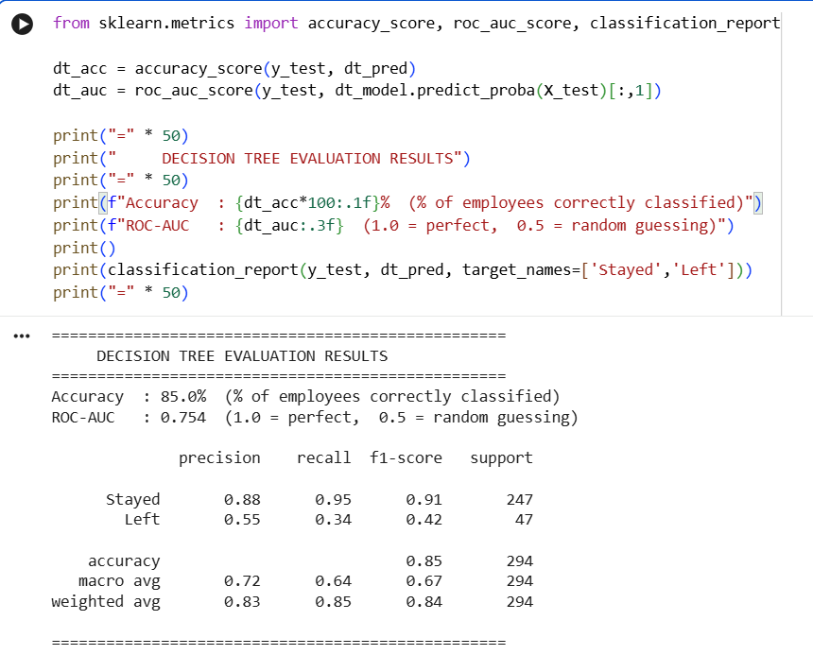
PREDICTIVE MODEL

Slide 23
PREDICTIVE MODEL
Model Comparison
Model | Accuracy | ROC-AUC
Logistic Regression | 86.1% | 0.792
Decision Tree | 85.0% | 0.754

Slide 24
RESULTS
DESCRIPTIVE RESULTS
Belonging & Engagement do not
correlate at individual level.
r = -0.002
Employees who LEFT:
- BelongingScore = 2.532
- EngagementScore = 2.494
Employees who STAYED:
- BelongingScore = 2.753
- EngagementScore = 2.775
Both scores lower in employees
who left the organisation.
INFERENTIAL RESULTS
Correlation Test:
r = -0.0015, p = 0.9531
✖ No significant relationship
t-test BelongingScore:
t = 4.06, p = 0.0001
✔ Significant difference found
t-test EngagementScore:
t = 6.17, p = 0.0000
✔ Significant difference found
PREDICTIVE RESULTS
Model: Logistic Regression
Accuracy = 86.1%
ROC-AUC = 0.792
Model: Decision Tree
Accuracy = 85%
ROC-AUC = 0.754
✔ Higher belonging = less attrition

Slide 25
FINAL DECISION
Claim: "Employees who experience a sense of belonging are more engaged"
Employees who left scored significantly lower on both BelongingScore and EngagementScore
The differences are statistically significant not due to chance (p < 0.001)
Logistic Regression model predicted attrition with 86% accuracy BelongingScore and EngagementScore were among the strongest predictors
Belonging and engagement are two dimensions of the same workplace wellbeing

Slide 26
CONCLUSION
The statement, "Employees who feel a sense of belonging are more engaged" is partially true by this analysis.
The statement holds at the organisational level, where employees low on belonging and low on engagement are significantly more likely to leave, and both scores independently predict attrition.
But it is not true at the individual level, because belonging does not directly predict engagement score-to-score
Belonging and engagement are two dimensions of the same workplace wellbeing

Slide 27
THANK
YOU

