Slide 1

LEVEL – I : BEGINNER

Slide 2
1)Introduction
2)Installing Node
3) Understanding Node.js
4) Node PackageManager(NPM)
5)Modules
6) Frame Works(Express and Jade)
7) Creating a Sample Todo App using Express, Jade and local storage.

Slide 3
“Node.js is many things, but mostly it’s a way of running JavaScript outside the web browser.”

Slide 4
Introduction
Chapter 1
Node Introduction
• About Node & V8
• Why Node ?

Slide 5
Background
Lightweight and Fast
Based on V8
Server Side Javascript
40% JS and 60% C++ Code
Open Source
Created by Ryan Dahl in 2009
Beta Phase : Latest version – 0.6.11
Notes:
Is still in Beta phase. Latest version is 0.6.11
Is Open Source. It runs well on Linux systems, can also run on Windows systems.
In simple words Node.js is ‘server-side JavaScript’.
It’s a command line tool.
In ‘Node.js’ , ‘.js’ doesn’t mean that its solely written JavaScript. It is 40% JS and 60% C++.
It is not a web framework and it is not a language.
From the official site:
- ‘Node's goal is to provide an easy way to build scalable network programs’ - (from nodejs.org!)

Slide 6
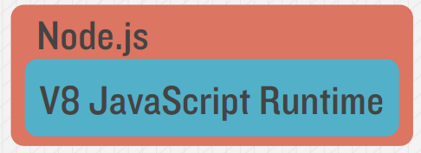
V8 JavaScript Engine
The V8 JavaScript Engine is an open source JavaScript engine developed by Google for the Google Chrome web browser.
V8 is used both in a browser (notably in Chrome and Chromium browsers) and as a standalone high-performance engine that can be integrated into independent projects, for example server-side JavaScript in Node.js.
Node.js is a wrapper around the V8 Engine. So, basically, our V8 Engine is capable of doing low level Network Communication and we are leveraging its capabilities, using Node.js.

Slide 7
Installation
02
Chapter 2
Node Installation
• Windows & Mac
• Running Node

Slide 8

Installing Node.js : Windows & Mac
Windows :
It’s easy to install node.js on Windows, just go to node.js official site (http://nodejs.org/download/) and download Windows installer, then execute the installer.
Macintosh :
Similarly download the Mac installer, then execute the installer.
Try some commands on the Interactive Shell

Slide 9
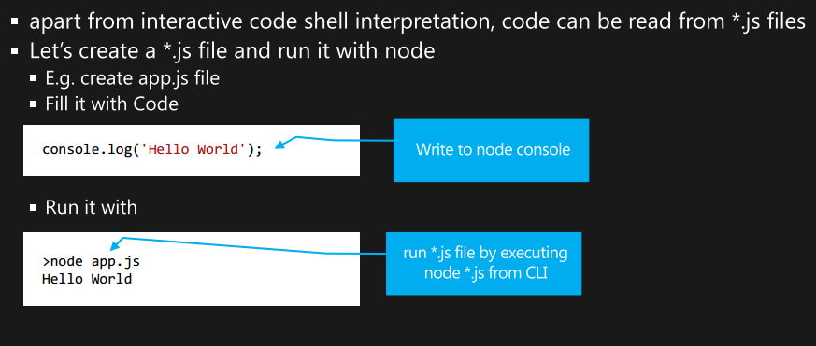
Running Node.js

Slide 10
Understanding Node.js
02
Chapter 2
• How it works & Comparisons
• Node Pros
• Why Node?
• Node Concepts – Event Loop and Event Emitter Pattern

Slide 11
Why is Node.js so fast?
Traditional Execution Techniques :
C Code -> Assembly Language -> Binaries -> Machine Code -> .exe file
The .exe file is to be executed from the file system.
Java Code -> Compiled Java Class(Byte Code) -> Byte code
Byte Code is input to the Java Virtual Machine and hence machine code is generated by interpreting byte code.
V8 compiles JavaScript to native machine code before executing it, hence the compiled code is additionally optimized (and re-optimized) dynamically at runtime, based on probability of the code's execution profile.
These runtime optimizations make Node.js faster .
Notes:
Include the code as well.

Slide 12
Why Node?
Easy to configure.
It runs JavaScript, so you can use the same language on server and client, and even share some code between them (e.g. for form validation, or to render views at either end.)
The event-driven system is fast, compared to traditional Java when handling lots of requests at once.
The ever-growing pool of packages, most of which are conveniently hosted on github.
Node.js is ideal for application that serve a lot of requests but don’t use and need lots of computational power per request.

Slide 13
How it works?
Event Looping
Client
Clients send HTTP requests
to Node.js server
Event loop returns
result to client
Event loop
(main thread)
An Event-loop is woken up by OS,
passes request and response objects
to the thread-pool
Long-running jobs run
on worker threads
Response is sent
back to main thread
via callback
C++ Threadpool
(worker threads)

Slide 14
Event Looping
Node.js has a single threaded server , i.e. , it is one process.
Keep slow operations from blocking other operations.
Even with Single process, we write Non Blocking Code : We write code in the form of callbacks.
Node is going to register an event for when the request comes, and then the request goes to web worker threads where the long jobs are running. As soon as the result is returned, we execute the callback function.

Slide 15
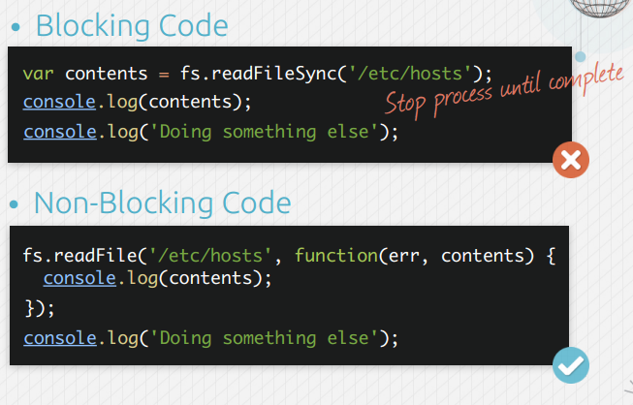
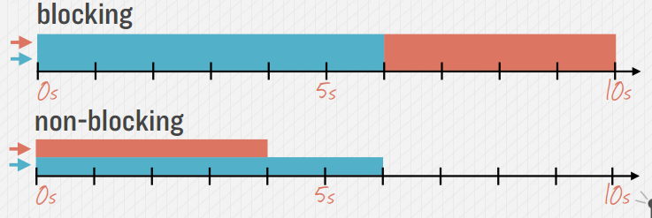
Blocking V/S Non Blocking Code
Notes:
It is not Return values based I/O. This is a callback style.
In traditional programming : It is blocking users when doing I/O operations. In those systems, a user would typically need to finish 1 operation before even deciding what the next operation will be.

Slide 16
Event Emitter Pattern
Standard Callback Pattern : When you want the client to be notified when a function completes.
If you are being interested in being notified everytime data is available on a socket, the standard callback is not very helpful.
Event Emitter –
Action that will cause an event to emit : Event Emitter
Listeners which are listening to those particular events
Foreg : the response object of an HTTP Request is an event emitter. It emits “data” and “end” events.
response.on(“data”,function(data){
console.log(data received.);
});

Slide 17

“JavaScript has certain characteristics that make it very different than other dynamic languages , namely that it has no concept of threads. Its model of concurrency is completely based around events.”
– Ryan Dahl

Slide 18
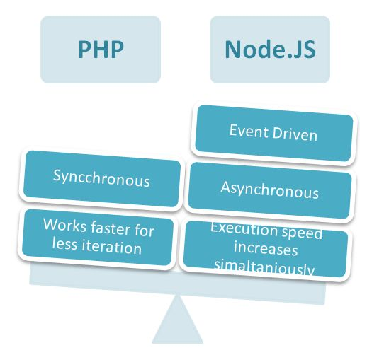
Comparison with others!
Node.js is 15-20% faster than any other scripting language.
#ZingProject Review- “We use node.js to power the back end of our real-time collaboration software between its superb scalability and performance, Node.js is the only logical choice for our current and future applications.” - Pete Fredricks [Co-Founder, CEO]

Slide 19
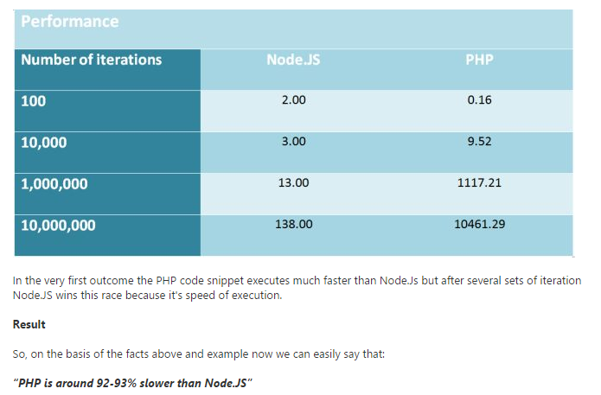
Performance
Notes:
Now as we can see the chart, PHP code executes much faster in the first instance, but when the no of iterations are much higher, then nodejs taking advantage of its callback pattern, executes much faster.

Slide 20
Who is using Node.js in Production?
Yahoo! : iPad App Livestand uses Yahoo! Manhattan framework which is based on Node.js.
LinkedIn : LinkedIn uses a combination of Node.js and MongoDB for its mobile platform. iOS and Android apps are based on it.
eBay : Uses Node.js along with ql.io to help application developers in improving eBay’s end user experience.
Dow Jones : The WSJ Social front-end is written completely in Node.js, using Express.js, and many other modules.
Complete list can be found at:
https://github.com/joyent/node/wiki/Projects,-Applications,-and-Companies-Using-Node

Slide 21
Node Package Manager and Git
02
Chapter 2
• Understanding package.json
• Github
- Git Installation
- Checkout or Clone repo

Slide 22
Node Package Manager (npm)
NPM is basically a system in place that allows you to download , install and manage 3rd party modules.
NPM is —
a third-party package repository,
a standard to define dependencies on other packages.
It provides a public registry service that contains all the packages that programmers publish in NPM.
It also provides a command-line tool to download, install, and manage these packages.
Notes:
Most programming languages have a system in place that allows you to download, install and manage 3rd party modules.
In Node, you have NPM!
The philosophy of global and local modules is that each project can have their own versions of packages and can install and keep them seperately.
While this does takes up extra disk space, since the node modules are typically not that large, the disk space requirement is trivial.
NPM is also capable of starting the application by using package.json start – script.

Slide 23
Node Package Manager (npm)
Windows: Open Node Command Prompt
Mac: Open Terminal
Type npm. You should see a bunch of commands
Npm install package_name
Npm install package_name@version
Npm install is most commonly used command to resolve dependencies.It looks in your package.json file to make sure you have what you need. Whenever you have potentially different package.json, do npm install.

Slide 24
Npm - > Package.json
A set of ‘instructions’ that assist your app.
All npm packages contain a file, usually in the project root, called package.json - this file holds various metadata relevant to the project.
This file is used to give information to npm that allows it to identify the project as well as handle the project's dependencies.
It can also contain other metadata such as a project description, the version of the project in a particular distribution, license information, even configuration data - all of which can be vital to both npm and to the end users of the package.
Notes:
Now coming to package.json, To start a new project, the best way is to create the package.json.
Create a folder on the desktop named airline. And cd to it and then do a npm init.
This is a step by step process to create your package.json file and give the necessary details.

Slide 25
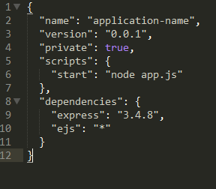
How does it look?
Npm supports the Scripts field for parameters like preinstall, start. If there is a app.js file in the root of your package, then npm will default the start command to node server.js.
Dependencies field is used to list all the dependencies of your project that are available on npm. When someone installs your project through npm, all the dependencies listed will be installed as well. Additionally, if someone runs npm install in the root directory of your project, it will install all the dependencies to ./node_modules
Notes:
This allows people who find your project understand what it is in just a few words. The author, contributors, homepage and repository fields can all be used to credit the people who contributed to the project, show how to contact the author/maintainer, and give links for additional references.
The file listed in the main field is the main entry point for the libary; when someone runs require(&lt;library name>), require resolves this call torequire(&lt;package.json:main>).
Finally, the dependencies field is used to list all the dependencies of your project that are available on npm. When someone installs your project through npm, all the dependencies listed will be installed as well. Additionally, if someone runs npm install in the root directory of your project, it will install all the dependencies to ./node_modules.
It is also possible to add a devDependencies field to your package.json - these are dependencies not required for normal operation, but required/recommended if you want to patch or modify the project. If you built your unit tests using a testing framework, for example, it would be appropriate to put the testing framework you used in yourdevDependencies field. To install a project's devDependencies, simply pass the --dev option when you use npm install.
For even more options, you can look through the online docs or run npm help json

Slide 26
GIT is a Distributed version control that focuses on sharing changes.
GITHUB is a web page on which you can publish your git repositories and collaborate with other people.

Slide 27
Git & Github
Git is a version control system; think of it as a series of snapshots (commits) of your code. You see a path of these snapshots, in which order they where created. You can make branches to experiment and come back to snapshots you took.
GitHub, is a web-page on which you can publish your Git repositories and collaborate with other people.
Installation :
Windows : Download the setup from the https://windows.github.com/ and run the installer.
Mac : http://git-scm.com/downloads -> Download the Mac installer and run it.

Slide 28

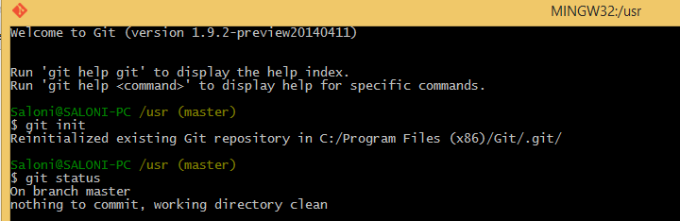
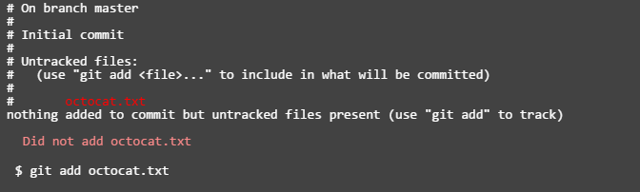
Git : Commands
Initializing a Git repository
Current state of our project
Adding a file

Slide 29
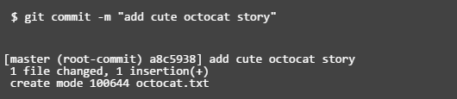
Git : Simple Commands
Git add command basically adds the files to the staging area, We could add or remove files from the stage before we store them in the repository.
Now, to commit the file, we have to run
git commit –m “meaningful message for the commit”
Advice : Run git status command regularly to keep a check on the repository.
It tells you the number of changes and the number of the changed files.

Slide 30

Git : Commands
We can also use commands like :
git add ‘*.txt’
git log : Git's log as a journal that remembers all the changes we've committed so far, in the order we committed them.
By following these steps, we have created a new local repo, but to push the local repo to the server, we need to push it using a remote name and a remote repo URL.
Most Important : Pushing our files to the server
The push command tells Git where to put our commits when we're ready. The name of our remote is origin and the default local branch name is master.
Notes:
The -u tells Git to remember the parameters, so that next time we can simply run git push and Git will know what to do. Go ahead and push it!

Slide 31

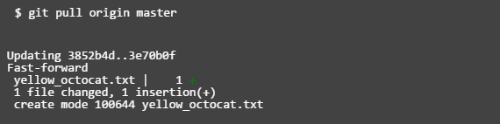
Git : The Final Push!!
After pushing the files to the server :
After several commits by other people : We can check for changes on our GitHub repository and pull down any new changes by running:
After some additions and deletions to the code, you can check the most recent commit differences by using the command :
git diff HEAD
Notes:
The -u tells Git to remember the parameters, so that next time we can simply run git push and Git will know what to do. Go ahead and push it!

Slide 32
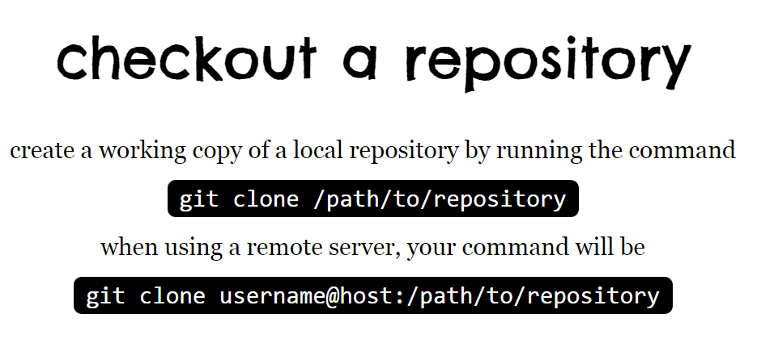

Slide 33
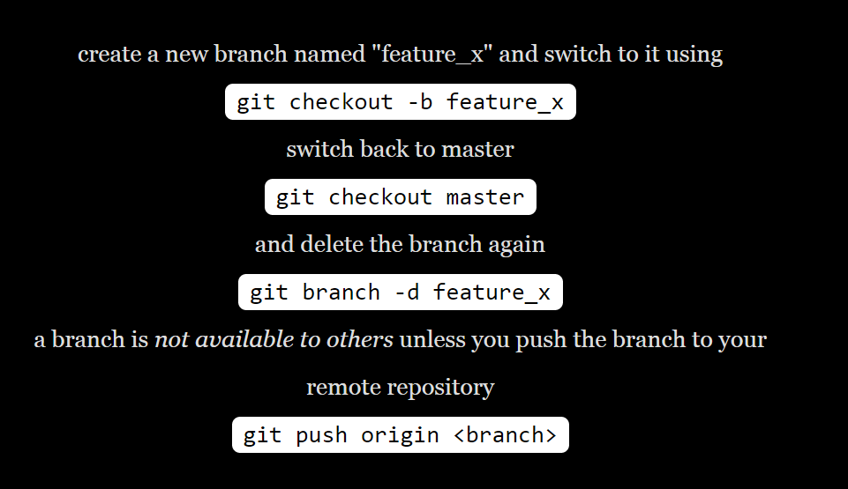

Slide 34
Modules
03
Chapter 3
Node Modules & Frame Works
• Talk about Node Modules
• Modules and Frameworks

Slide 35

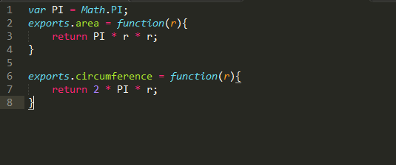
Node Modules
Node has a simple module loading system.
In Node, files and modules are in one-to-one correspondence. As an example, foo.js loads the module circle.js in the same directory.
Require() is used for loading the modules.
The module circle.js has exported the functions area() and circumference.
Notes:
To add functions and objects to the root of the module, you can add them to the special exports object.
Variables local to the module will be private, as though the module was wrapped in a function. In this example, the variable PI is private to circle.js
http://openmymind.net/2012/2/3/Node-Require-and-Exports/

Slide 36
Node Modules Demo

Slide 37
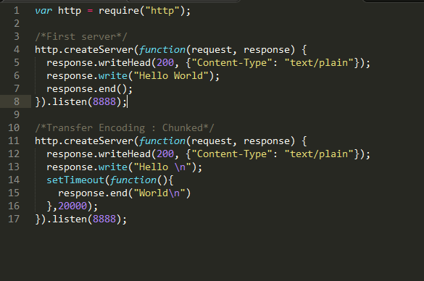
Http Server - Sample

Slide 38
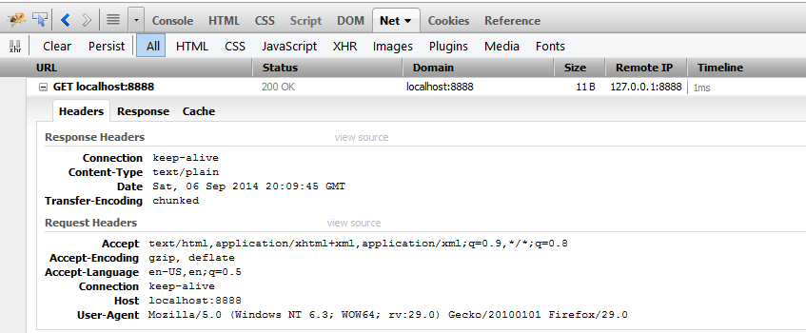
Node.js - > Http Server -> Request
Persistent connections to the web server.
Node does not force you to give the whole body response upfront but you can give the pauses in between.
Notes:
-In old HTTP, you make a request, you get a response and your TCP connection will be killed.
-But in modern HTTP, you can send request and another number of requests and you can get response, response, response, all on the same connection without going down and tearing down that TCP connection.

Slide 39
HTTP Server Demo

Slide 40
Node Frameworks : Express Introduction
Express is one of the most popular web frameworks used to build HTML-based websites. It builds up on the middleware functionality provided by Connect and allows you to view rendering and routing on top of that.
Express.js is based on the connect middleware engine.
Structure the development of HTML applications
Routing the HTTP requests to the correct controller code - It allows us to set up middleware to respond to HTTP requests, it allows us to perform different actions based on the HTTP method and URL – by letting us define a routing table.
Render HTML Templates - It also allows us to dynamically render HTML documents based on supplying arguments to templates.
Notes:
We mostly need frameworks that simplify the job of crafting an HTTP based application.
Most have the goal of simplifying and structuring the development of HTML applications and solving some common problems like routing the HTTP request to the correct controller code, serving static assets, and rendering HTML templates.

Slide 41
Install Express
Install Express with npm
npm install –g express
Installed into local node_modules folder
Loaded with require()
var express = require(‘express’); // all the exported functions will come in the variable express
Three Steps of creating an express application :
configure app
use middleware
define routes
Notes:
Reason for using express : In Node, we have 1 function, http.createServer which is requiring http,(protocol for implementing server side communication), Now there is this function that has to know everything about all our routes and our whole implementation, which will hard to track. So, that is why we need a framework to manage a structure for our app
Before requiring a module, we have to make sure that that module is present in our directory/ present in node_modules folder and then we have to load it by requiring it.

Slide 42
Generate Express App
JADE as HTML preprocessor template engine for HTML .It comes as a default with express.
C:\nodegetstart>express myapp

Slide 43
Directory Structure – Express app
Now can see APP directory Structure generated by Express Generator :
/myapp
/package.json
/app.js
/public
/javascripts
/images
/routes
/stylesheets
/style.css
/routes
/index.js
/users.js
/views
/index.jade
/layout.jade
/error.jade
/bin
/www
Structure the development of HTML applications
Notes:
Express creates a directory named my_app, followed by a set of files on which you can base your new application.
Package.json : This manifest file’s main purpose is to contain the module dependency list that NPM can use to install dependencies.

Slide 44
Express Start Demo

Slide 45
Setting Environment Variable
You can change the environment by setting the NODE_ENV environment variable. For instance, set the environment to production when you start your Node process in this way:
$ NODE_ENV=production node my_app In Express, the environment defaults to development.

Slide 46
Routes
Different parts of our application will trigger different server behaviors.
Routing Table : It maps HTTP Protocols and URL patterns into actions.
For eg :
GET /users — To show a list of users or to search for users. GET /users/:username — To show the profile of the user with the given username

Slide 47
Jade Templating Engine
Jade is a templating language for Node.js. It is a simplified way of writing HTML.
Indentation defines tag levels. - We can nest tags within each other just by indenting them.
There is no need to close tags and helps to catch the syntax errors up front.
It allows you to render HTML blocks, render dynamic values, perform loops, and include other templates.
Please refer : http://jade-lang.com/
Notes:
https://www.youtube.com/watch?v=xNoWTLsZbaU

Slide 48
Jade Templating Engine
In Jade we divide markups into “Reusable blocks”.
Extendable : Some of the Jade Views can extend other Jade Views.

Slide 49
Express
app.set() is used to write the configuration settings for your application.
The main features of express are routing and render() function.
Express does not have its own view engine but it has support for pretty much all the view engines available.
In a post request, if I try to do a req.body.newItem/if I try to parse the body, I am not allowed to do it, I would need a body parser to do that for me.
Bower is kind of like npm but is geared for installing frontend components like bootstrap and npm is used for installing node modules that are basically backend components.
Express comes with only 1 middleware that is express.static(). The static middleware will parse a folder and find the files for you.
Notes:
Reason for using express : In Node, we have 1 function, http.createServer which is requiring http,(protocol for implementing server side communication), Now there is this function that has to know everything about all our routes and our whole implementation, which will hard to track. So, that is why we need a framework to manage a structure for our app
Before requiring a module, we have to make sure that that module is present in our directory/ present in node_modules folder and then we have to load it by requiring it.
https://www.youtube.com/watch?v=QseHOX-5nJQ

Slide 50
LEVEL – II : ADVANCED
-Prasanna Venkatesh

Slide 51
Authentication using Passport
What is Passport
Configure Passport
Authentication Providers and Schemes
Create HTTP and HTTPS server and where they are used for the TODO application
Working example with Express/Jade on Register/Login and Logout functionality

Slide 52
What is Passport?
Passport is an authentication middleware for Node designed to serve authentication requests.
By providing itself as a middleware, Passport does an excellent job at separating the other concerns of a web application from its authentication needs.
Passport can be easily configured in to an Express based application
Easy to install $ npm install passport
Authentication is performed by calling passport.authenticate() and need to the specify the authentication strategy to be used.

Slide 53
What is Passport?
The function signature of authenticate makes it easy to configure as a route middleware using applications like Express.
Simple Usage:
app.post('/login', passport.authenticate('local', { successRedirect: '/’, failureRedirect: '/login' }));
Failed authentication by default is returned a 401 unauthorized status.
After successful authentication a redirect is issued and we move on to the next stage.
Additionally We can disable sessions and also use custom callbacks.

Slide 54
Configuring Passport
Authentication strategies
Passport uses strategies to authenticate requests. Different strategies are basic username/password check $ npm install passport-local, authentication using Oauth $ npm install passport-oauth and federated login using OpenID $ npm install passport-openid.
2. The strategy configuration is supplied via use() function. A typical way to configure is provided below:
var passport = require('passport’) , LocalStrategy = require('passport-local').Strategy;
passport.use(new LocalStrategy(function(username, password, done) {} ));

Slide 55
Configuring Passport
Authentication strategies
3. Strategies needs a verify callback. The purpose of a verify callback is to find the user that possesses a set of credentials
4. Application middleware & Sessions
Using an Express based application, we can initialize a passport something like this - passport.initialize().
Configure Passport something like this app.configure(function() { });
For Persistent login sessions use passport.session().
Passport will serialize and deserialize user instances to and from the session.

Slide 56
Authentication Providers
Different authentication providers
Facebook : $ npm install passport-facebook. Uses Facebook strategy to authenticate requests using facebook account. It uses the OAuth 2.0 Principle.
Twitter: $ npm install passport-twitter. Uses Twitter strategy to authenticate requests using twitter account. It uses the OAuth 1.0a Principle.
Google: $ npm install passport-google. Uses Google strategy to authenticate requests using google account. The authentication works using OpenID
So many other providers are available of which notable are Amazon, Dropbox, Bitbucket etc. and most of them use OAuth Principle.
Operations which we can perform on Passport:
Log In : login()
Logout: logout()
Authorize: passport.authorize()

Slide 57
Authentication Schemes
Different authentication schemes
The HTTP authentication framework defines the Basic and Digest authentication schemes.
$ npm install passport-http
These schemes authenticate users and protect API end points.
3. The Basic scheme uses a username and password to authenticate a user. These credentials are transported in plain text, so it is advised to use HTTPS when implementing this scheme.
4. The Digest scheme uses a username and password to authenticate a user. Its primary benefit over Basic is that it uses a challenge-response paradigm to avoid sending the password in the clear.

Slide 58
Authenticating Tokens
Oauthorize and OAuth2orize,, provides a toolkit for implementing OAuth and Oauth 2.0 service providers respectively.
2. OAuth tokens can be authenticated using the passport-http-oauth module.
$ npm install passport-http-oauth.
Bearer tokens are the most widely issued type of token in OAuth 2.0. Bearer tokens can be authenticated using the passport-http-bearer module.
$ npm install passport-http-bearer.

Slide 59
Create a basic HTTPS Server
We need 2 things to create an https server an SSL certificate and node’s https module
There are two types of certificate, one signed by a ‘Certificate Authority’ and a self signed Certificate.
// Show how to generate self signed certificate.
Server setup code
var https = require('https');
var fs = require('fs');
var options = { key: fs.readFileSync('key.pem'), cert: fs.readFileSync('cert.pem') };
var a = https.createServer(options, function (req, res) { res.writeHead(200); res.end(”test\n"); }).listen(8000);
The Register and login requests will use this.

Slide 60
Working Application - Express/Jade
App Demo – Passport. Register/Login

Slide 61
Working with Files
Interacting with Files – fs module
Read/Write/Open and other functions.
Common file system operations
Working with Directories
Working example with Express/Jade on Create a TODO list and save it in a JSON file. Read the saved files and do update/delete operations.

Slide 62
Interacting with Files – fs module
The file system functions consists of file I/O functions and Directory I/O functions.
The fs module is created like this var fs = require('fs');
Both synchronous and asynchronous operations can be done. Synchronous is usually preferred for reading configurations file from server. Besides that all scenarios use async mode.
Sample Synchronous function code:
var fs = require('fs');
var data = fs.readFileSync('file.html', 'utf8');
// Hold on till it is processed and then use the data
console.log(data);
Sample Asynchronous function code: Uses a callback function
var fs = require('fs');
fs.readFile('file.html', 'utf8', function(err, data) {
// the data is passed to the callback in the second argument
console.log(data);
});

Slide 63
Read/Write/Open and other file related functions
Read a file :
The file is read into the buffer using the read() function. The buffer now contains the raw data read from the file. In order to display the data, we must first convert it to a UTF-8 encoded string
fs.readFile('file.html', 'utf8', function(err, data) {console.log(data); });
Writing a file:
fs.writeFile(’test.json', ’Json Sample', function(err) {if(err) throw err;});
Open a File: fs.open(path, flags, [mode], [callback]) (Different flags options provided below in notes section)
Notes:
Flags Options :
'r' - Open file for reading. An exception occurs if the file does not exist.
'r+' - Open file for reading and writing. An exception occurs if the file does not exist.
'w' - Open file for writing. The file is created (if it does not exist) or truncated (if it exists).
'w+' - Open file for reading and writing. The file is created (if it does not exist) or truncated (if it exists).
'a' - Open file for appending. The file is created if it does not exist.
'a+' - Open file for reading and appending. The file is created if it does not exist.

Slide 64
Read/Write/Open and other file related functions
Watching a file:
The file system module allows programs to watch for modifications to specific files.
fs.watch(fileName, {persistent: true}, function(event, filename) {});
Check if a file is present: exists()
fs.exists(fileName, function(exists) {});
Opening, writing to a file and closing it (in parts):
fs.write(fd, buf, 0, buf.length, null, function(err, written, buffer) {fs.close(fd, function() {}); });
fs.stat() gives us more information about each item

Slide 65
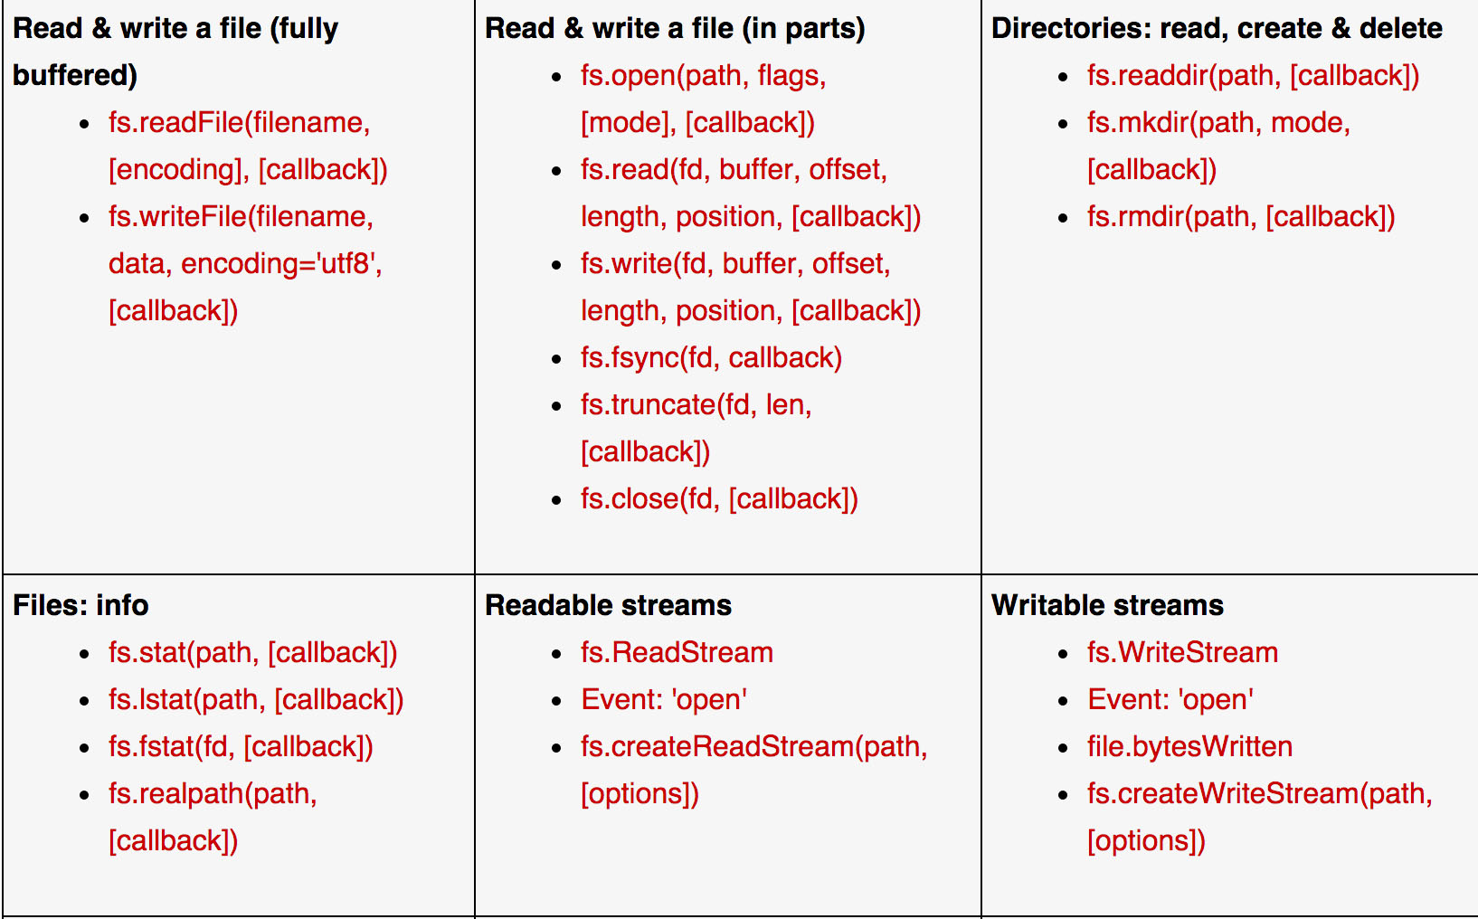
Common File system functions
Notes:
Different functions of stat object:
stats.isFile()
stats.isDirectory()
stats.isBlockDevice()
stats.isCharacterDevice()
stats.isSymbolicLink() (only valid with fs.lstat())
stats.isFIFO()
stats.isSocket()

Slide 66
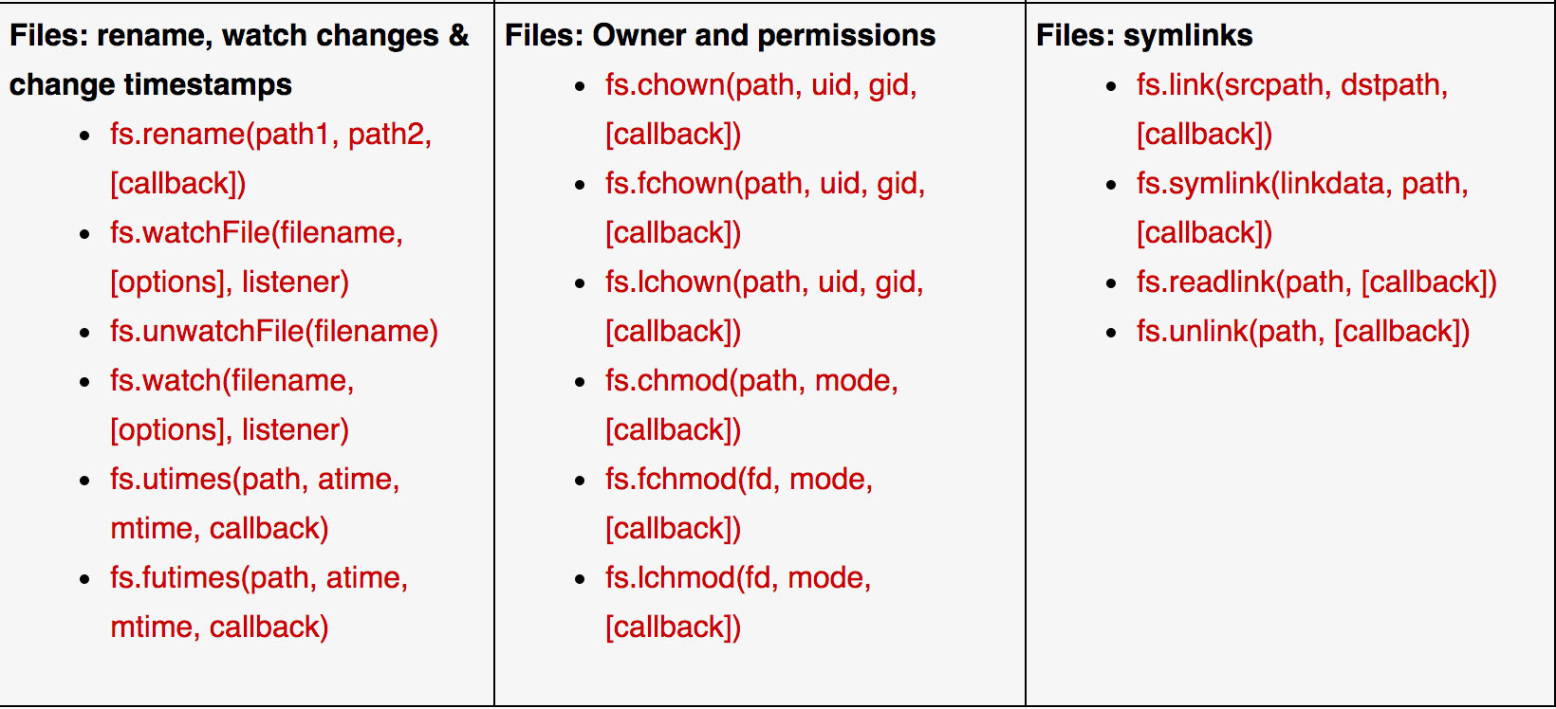
Common File system functions

Slide 67
Working with Directories and other file operations
Reading a Directory:Read a directory from a path and then print all the files
var path = './folder/';
fs.readdir(path, function (err, files) {});
Creating and Deleting a directory
fs.mkdir('./newdir', 0666, function(err) {});
fs.rmdir('./newdir', function(err) {});
Using pipe to read from one file and write to another file.
var file = fs.createReadStream(’json1.txt', {flags: 'r'} );
var out = fs.createWriteStream(’json2.txt', {flags: 'w'});
file.pipe(out);

Slide 68
Working with Directories and other file operations
Appending to an existing file:
var file = fs.createWriteStream(’json.txt', {flags: 'a'} );
file.write(’Test Json!\n'); file.end(function() {//Do something });

Slide 69
Sample Exercises – Demo file operations
TODO : Sample File Exercises – Showcase some examples

Slide 70
Working Application - Express/Jade
Demo the TODO app – Reading/writing and deleting json files

Slide 71
Other Advanced Topics
How to Create a streaming proxy server
Use Node Js to create APIs and communicate server-to-server.
What is UDP and when to use it

Slide 72
LEVEL – III : Expert
-Mahesh Talada

Slide 73
Mongo DB
01
Chapter 1
Introduction to Mongo DB
Installation to Mongo DB – Windows & OSX
Mongo DB operations
Node.js with Mongo DB
Performance & handling Load using Clusters
Best Practices and Guide

Slide 74
What is Mongo DB?
Developed
& supported by :
10gen
MongoDB
Open Source
Document Oriented Database
Is

Slide 75
Definition of MongoDB (by manufacturer)
MongoDB
“Scalable , Open Source ,
high performance ,
document oriented
database”
Is

Slide 76
Document Oriented Databases
Document Oriented
Databases
MongoDB

Slide 77
NoSQL Databases
No
NoSQL Databases
Document Oriented Databases
MongoDB

Slide 78
NoSQL Databases
Relational Database
Problem: Not able/hard to handle Big data
NoSQL Databases Introduced

Slide 79
NoSQL Database Objective
Scalability
NoSQL
Offers
Performance
High Availability

Slide 80
NoSQL Database Types
Key Value Store
Tabular
Document Oriented
Examples:
Memcached
Coherence
Redis
Examples:
BigTable
Hbase
Accumulo
Examples:
MongoDB
CouchDB
Cloudant

Slide 81
NoSQL - What is Missing?
No Joins Support
No Complex Transaction Support
No Constraints Support

Slide 82
NoSQL Attributes
NoSQL
Performance
RDBMS
Functionality

Slide 83
Storage NoSQL Vs RDBMS
RDBMS
MongoDB
Tables
Collections

Slide 84
Data Storage
Table : Employee
FIRSTNAME | LASTNAME | AGE
Steve | Jobs | 30
Bill | Gates | 50
Collection : Employee
{
"_id":ObjectId("1avt382df98jz28i1dt2r3d1"),
“Firtsname":"Steve",
“Lastname":"Jobs",
"Age" : 30
},
{
"_id":ObjectId("1avt382df98jz28i1dt2r3d1"),
“Firstname":“Bill",
“Lastname":“Gates",
"Age" : 50,
"Designation": "CEO"
}

Slide 85
Collections (BSON Format)
JSON like
format
{
"_id":ObjectId("1avt382df98jz28i1dt2r3d1"),
“Firstname":"Steve",
“Lastname": “Jobs",
"Age" : 30
},
{
"_id":ObjectId(“2avt382df98jz28i1dt2r7zx"),
“Firstname":“Bill",
“Lastname":“Gates",
"Age" : 50,
"Designation": "CEO"
}
Document/
Object
Mandatory
Field
Key Value
Pairs

Slide 86
Array Structured & Nested Structured
{
"_id":ObjectId("1avt382df98jz28i1dt2r3d1"),
"name":"Steve Jobs",
"project":["project 1 " , "project 2"]
},
{
"_id":ObjectId("1avt382df98jz28i1dt2r3d1"),
"name":“Bill Gates",
"project":["project 1 "],
"address":[ {
city: "city1"
state: "state1"
postal: "12345"
},
{
city: "city2"
state: "state2"
postal: "12345"
}
]
}

Slide 87
Document Oriented Query Language
db.employee.find({_id:5});
db.employee.find({name:"Steve Jobs"});
db.employee.find().sort({name:1});
Find record
With id 5
Find record where
Name is Steve Jobs
Find all records
Sort by name

Slide 88
Features
Ad hoc Queries
Search by field , range queries and regular expression searches

Slide 89
Features
Indexing
Any field in a document can be indexed

Slide 90
Features
Replication
Supports Master-Slave replication.
A master can perform reads & writes.
Slaves copies data from master & used for reads & backup.

Slide 91
Features
Duplication of Data
Runs over multiple servers.
Data is duplicated to make sure system is up & running in case of hardware failure.

Slide 92
Features
Load Balancing
Automatic load balancing configurations are easy to deploy.

Slide 93
Features
Scalability
Scales Horizontally.
New machines can be added as data grows on running database.

Slide 94
Features
File Storage
Could be used to store files using special feature GridFS

Slide 95
Features
Server-side
JavaScript Execution
JavaScript functions can be used in queries

Slide 96
When to use NoSQL
To Store & Retrieve huge amount of data
Data is not structured & dynamic structure changes
If relationships not required to use between elements
If fast applications needed to developed
Growing list of elements
Blogs , twitter posts ,log files
If constraints & business validation not required at data base level

Slide 97
When not to use NoSQL
Complex transactions need be handled
Joins must be handled by database
Validations must be handled by databases

Slide 98
Install MongoDB on Windows
Install MongoDB
There are three builds of MongoDB for Windows:
MongoDB for Windows Server 2008 R2 edition (i.e. 2008R2) runs only on Windows Server 2008 R2, Windows 7 64-bit, and newer versions of Windows. This build takes advantage of recent enhancements to the Windows Platform and cannot operate on older versions of Windows.
MongoDB for Windows 64-bit runs on any 64-bit version of Windows newer than Windows XP, including Windows Server 2008 R2 and Windows 7 64-bit.
MongoDB for Windows 32-bit runs on any 32-bit version of Windows newer than Windows XP. 32-bit versions of MongoDB are only intended for older systems and for use in testing and development systems. 32-bit versions of MongoDB only support databases smaller than 2GB.

Slide 99
Install MongoDB on Windows
Download MongoDB for Windows
Download the latest production release of MongoDB from the MongoDB downloads page. Ensure you download the correct version of MongoDB for your Windows system. The 64-bit versions of MongoDB does not work with 32-bit Windows.
Install the downloaded file
In Windows Explorer, locate the downloaded MongoDB msi file, which typically is located in the default Downloads folder. Double-click the msi file. A set of screens will appear to guide you through the installation process.
Move the MongoDB folder to another location (optional)
To move the MongoDB folder, you must issue the move command as an Administrator. For example, to move the folder to C:\mongodb:
Select Start Menu > All Programs > Accessories.
Right-click Command Prompt and select Run as Administrator from the popup menu.
Issue the following commands:
cd \
move c:\mongodb-win64 c:\mongodb

Slide 100
Install MongoDB on Windows
Run MongoDB
Set up the MongoDB environment.
MongoDB requires a data directory to store all data. MongoDB’s default data directory path is\data\db. Create this folder using the following commands from a Command Prompt:
md \data\db
You can specify an alternate path for data files using the --dbpath option to mongod.exe, for example:
C:\mongodb\bin\mongod.exe --dbpath d:\test\mongodb\data
If your path includes spaces, enclose the entire path in double quotes, for example:
C:\mongodb\bin\mongod.exe --dbpath "d:\test\mongo db data"

Slide 101
Install MongoDB on Windows
Run MongoDB
Set up the MongoDB environment.
MongoDB requires a data directory to store all data. MongoDB’s default data directory path is\data\db. Create this folder using the following commands from a Command Prompt:
md \data\db
You can specify an alternate path for data files using the --dbpath option to mongod.exe, for example:
C:\mongodb\bin\mongod.exe --dbpath d:\test\mongodb\data
If your path includes spaces, enclose the entire path in double quotes, for example:
C:\mongodb\bin\mongod.exe --dbpath "d:\test\mongo db data"

Slide 102
Install MongoDB on Windows
Start MongoDB
To start MongoDB, run mongod.exe. For example, from the Command Prompt:
C:\Program Files\MongoDB\bin\mongod.exe
Connect to MongoDB
To connect to MongoDB through the mongo.exe shell, open another Command Prompt. When connecting, specify the data directory if necessary. This step provides several example connection commands.
If your MongoDB installation uses the default data directory, connect without specifying the data directory:
C:\mongodb\bin\mongo.exe
If you installation uses a different data directory, specify the directory when connecting, as in this example:

Slide 103
Installing Mongo DB
Now install the dependencies through NPM -
C:\nodegetstart\myapp>npm install
Once NPM has run its course, you should have a node_modules directory which contains all of our dependencies for this tutorial.
Also we have “mongoose” as a other alternative for MongoDB driver instead “monk” but as beginner level will monk db wrapper

Slide 104
References
Watch this video at Youtube: http://www.youtube.com/watch?v=jo_B4LTHi3I
Read the free O’reilly Book ‘Up and Running with Node.js’ @ http://ofps.oreilly.com/titles/9781449398583/
Visit www.nodejs.org for Info/News about Node.js
Watch Node.js tutorials @ http://nodetuts.com/
http://nodejs.org/
http://www.zdnet.com/the-rewards-of-running-server-side-javascript-revealed-7000027060/
http://readwrite.com/2013/11/21/how-nodejs-got-big
http://www.clevertech.biz/services/node-js-backbone-js-raphael-js.html
https://www.youtube.com/watch?v=eqlZD21DME0
http://www.codeschool.com
http://www.udemy.com
http://www.c-sharpcorner.com/UploadFile/2072a9/node-js-vs-traditional-scripting-languages/
http://www.haneycodes.net/to-node-js-or-not-to-node-js/
http://gitimmersion.com/
http://stackoverflow.com/questions/11816424/understanding-the-basics-of-git-and-github
https://try.github.io/levels/1/challenges/1
http://rogerdudler.github.io/git-guide/
http://openmymind.net/2012/2/3/Node-Require-and-Exports/

Slide 105
Cons of Nodejs
When you are doing heavy and CPU intensive calculations on server side, because event-loops are CPU hungry.
Node.js API is still in beta, it keeps on changing a lot from one revision to another and there is a very little backward compatibility. Most of the packages are also unstable. Therefore is not yet production ready.
Node.js is a no match for enterprise level application frameworks like Spring(java), Django(python), Symfony(php) etc. Applications written on such platforms are meant to be highly user interactive and involve complex business logic.
Read further on disadvantages of Node.js on Quora: http://www.quora.com/What-are-the-disadvantages-of-using-Node-js

