Slide 1
Tato
Walter Koch Rothach (1886-1966)
My grandfather from my mother’s side
By Jorge (George) Soini Koch
May, 2006
Notes:
The information about Tato’s genealogy was given to me by my first cousin Pedro Koch who is currently living in Zurich, Switzerland.
The history of Puntiagudo farm was taken from the magazine Gaceta del Lago Todos los Santos, Dec. 2004.
Maps were obtained using the search engine Google.
Pictures were sent to me by my sister since she has the family photo albums.
As a result of the assignment given by our teacher (kumu) E. Kalani Flores for the Hawaii Culture 231 course in Fall 2005 I was able to get more informed about the significant life of my grandfather as well to know more about myself, my name and the incredibly beautiful mystery of Life. I hope to pass on this information to my children and eventually complement it with data from my father as well as from my wife’s side of the family.
It reinforces what was presented to us at the Kahilu Theater on May, 2005 by the students of Kanu o ka “Aina. Ho’i ka piko a malama i ke kahua…..Return to the source and maintain the foundation.

Slide 2
Genealogy/ Family History
Walter Franz Koch, born in St. Gallen, Switzerland on Dec. 14,1887; son of Franz Josef Koch, born on Jan. 20,1855 and Maria Barbara Rothach, born on Dec. 10,1852.
After completing his studies at the business school in St. Gallen, he goes to Paris for his first job. There he is contacted by W.R. Grace & Co. and spends a few years at their headquarters in New York.
In 1911 he arrives at Valparaiso, Chile being hired as the secretary of Mr. Inglehart, Vice President of W.R.Grace & Co.
He meets Marta Muller Corday and marries her in 1913. They have 4 children: Ruth, Walter, Irma (Bibi) and Marta (Musi).
Musi was born the 8th of June, 1920 in Valparaiso. Lincoln Crocker, close friend of Tato from New Bedford, Massachusetts, becomes Marta’s godfather.
After completing her school studies in 1938, Marta goes to Pembrook College in Providence, Rhode Island and studies in English Literature for one year.
In 1940, Hector Soini visited Chile while working for Nestle Co. assigned in Lima, Peru. He was invited to have lunch by Walter and he there first met Marta.
Marta Koch Muller marries Hector Soini Bertoli on May 1941 in Santiago and moves to Lima, Peru. Jorge (George) Soini Koch is born on Sept. 5, 1946 in Lima. Fred and Dorly Marmillod, originally from Lausanne, Switzerland become George’s godparents.
On May 1, 1962 Walter Franz Koch passes away as consequence from an operation. He is buried in Santiago. After August 16, 1991 when his wife Marta passed away, both were buried in Puntiagudo.

Slide 3
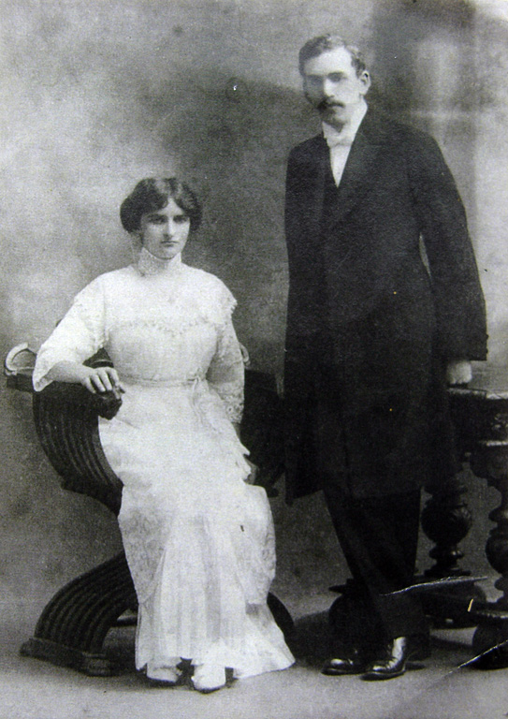
Tato and Mamita
Photo taken prior
Their wedding in 1913.

Slide 4
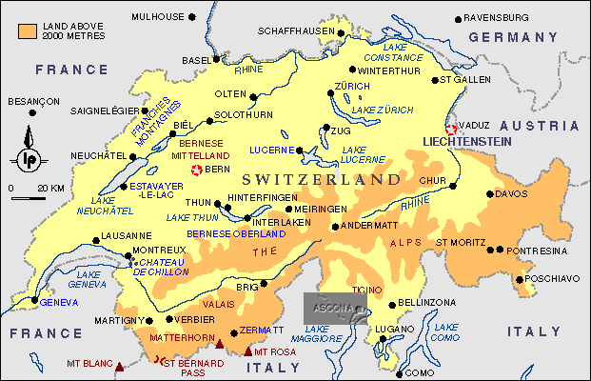
Map of Switzerland

Slide 5
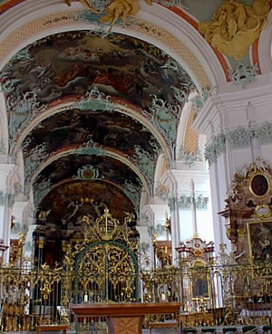
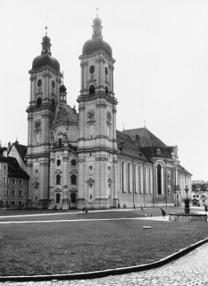
St. Gallen’s Cathedral
Tato,as a young boy, used to sing in the choir of the Cathedral

Slide 6
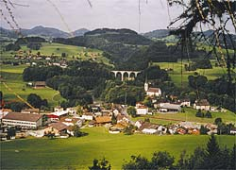
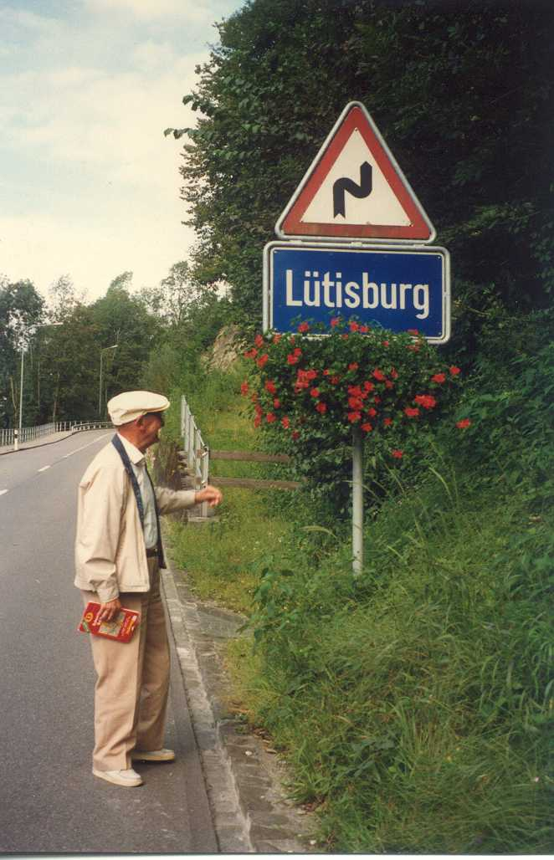
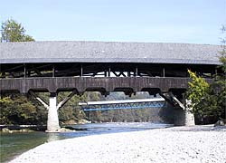
Lutisburg, St. Gallen, Switzerland
In this town is where the Koch family name is registered.
In the picture appears my father Hector Soini. Although he was born in Vevey Switzerland, he was only able to obtain his first Swiss passport when he became 90 years old!
Prior to this he was not considered Swiss but Italian since he was born form Italian parents.
In spite of that, he always considered himself to be Swiss!

Slide 7
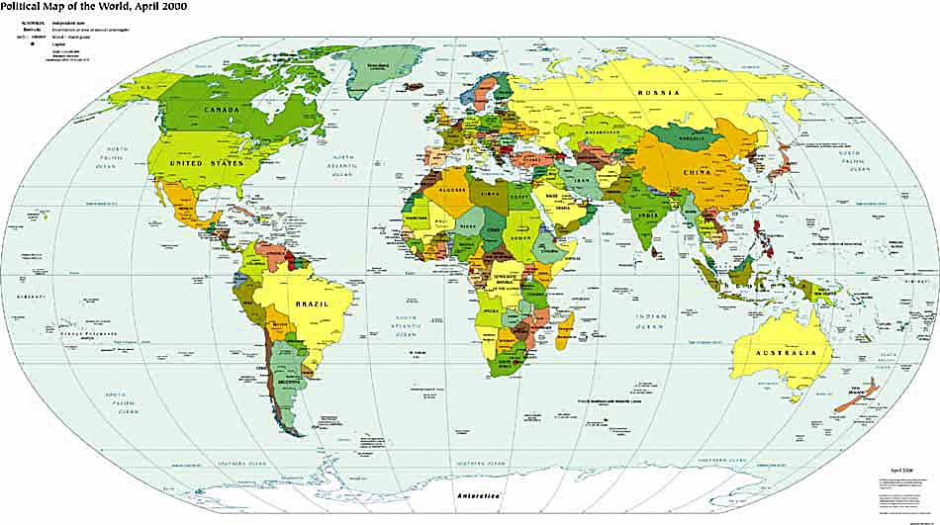
Tato’s migration from St. Gallen, Switzerland to Valparaiso, Chile via New York, USA

Slide 8
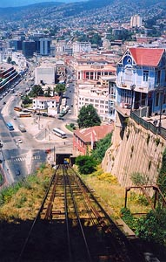
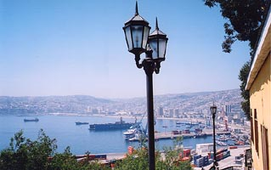
Valparaiso, Chile
Second biggest city in Chile and second most important sea port in the Pacific.
This is where Tato first arrived to work for W. R. Grace & Co.

Slide 9
Tato acquires land in the south of Chile, in the lake region.
Puntiagudo, lake Todos los Santos,
During a business trip to Buenos Aires, Walter Koch returns to Chile via Bariloche, crossing the border to Chile into the lake of Todos los Santos. He becomes enamored with the area and starts negotiations with the owner of the land adjacent to the Puntiagudo volcano. He eventually buys the farm in 1914.
At that time, it was necessary to take a two-day train trip to travel from Valparaiso to the farm. After an overnight stay in Puerto Varas, it was a boat trip across lake Llanquihue to Ensenada. From there it was by horse cart to Petrohue, the port at lake Todos los Santos. Then it was necessary to take another boat trip, going from Petrohue to Peulla, which was on the other side of the lake. This is one of the ways to reach Bariloche, Argentina via the pass Vicente Rosales. From this boat, crossing the lake Todos los Santos, it was required to transfer to a row boat in order to eventually reach Puntiagudo. The total traveling time used to be 4 days. Now, if you take a plane ride from Santiago to Pto. Montt it can be reached in 1 day.
Walter then realizes the negative impact of transportation costs in any economic activity deriving from the land he bought. He concludes that one possible solution could be the production of slow maturing cheeses. In order to produce cheese you require milking cows and good pastures. Therefore he started by preparing the land for pastures. He hired a crew of transient workers who helped clearing the land, then tilling it and seeding it with wheat, oats, and grass seeds. They also fenced the pastures.
In the 1920’s, he hired a Swiss superintendent to handle the cheese production. He associated himself with Mr. Lincoln Crocker from Rhode Island. With his capital they invest into a saw mill, the cheese vats imported from Switzerland, etc. They produced Edam cheese.
Mr. Crocker also became Marta’s godfather and hence my middle name Linc.
In May 22nd, 1960 there is the worst earthquake disaster (*). In Puntiagudo there is a landslide that buries houses and 31 persons! This tragedy affected very much my grandfather. This was compounded with a fire that destroyed the main house. All photos and documents recording the development of the farm were also destroyed.
(*) note: the tsunami that affected Hilo, HI was originated from the same earthquake.
At the present time, the farm of Puntiagudo is leased to Carlos Winkler, husband of Cristina Koch, my cousin. In 2004 the farm ceased to produce cheese due to economies of scale and the high impact of transport costs.

Slide 10
The 1960 Tsunami, Hilo
Thirty-four years ago, on May 23, 1960, a tsunami destroyed much of downtown Hilo. Tsunami, or seismic sea waves, are generated in several ways, including by large submarine explosive eruptions, by landslides where rock slides into or beneath the sea surface, and by large earthquakes that displace rocks below sea level. The waves generated spread outward in all directions and travel across the oceans at speeds between 425 and 500 miles per hour. Most tsunami that cause widespread damage are produced by large earthquakes that cause fault movements of the sea floor, including the one in 1960. These giant waves wreak their havoc first near to, and then far from, the site of the original earthquake.
The earthquake that caused the 1960 tsunami occurred off the west coast of South America and had a magnitude between 8.25 and 8.5. The waves reached the Hawaiian Islands in about 15 hours. This tsunami caused little damage elsewhere in the islands, but the Hilo Bay area was hard hit. Sixty-one people lost their lives and about 540 homes and businesses were destroyed or severely damaged. The wave heights in Hilo Bay reached 35 feet compared to only 3-17 feet elsewhere. The water washed as far inland as Kilauea Avenue/Keawe Street through the entire present downtown area and to Kekuanaoa Street near Kilauea Avenue.
Each tsunami consists of a succession of waves that arrive from 12 to 20 minutes apart. The 1960 tsunami had eight separate waves that crested between 4 and 14 feet above sea level at the Wailuku River bridge. The first wave is not necessarily the largest, and each wave may crest higher at different locations. Each tsunami may also have its maximum crest at a different location. This fact contributed to many deaths in Hilo in 1960, because people remained in the Waiakea peninsula area, which had minimal damage during the even larger 1946 tsunami.

Slide 11
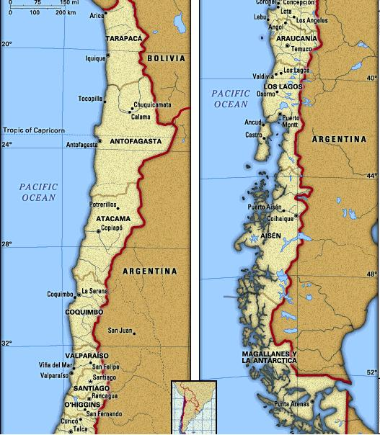
Trip from Santiago to Lake Todos los Santos
see details
next slide

Slide 12
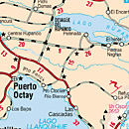
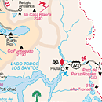
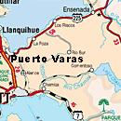
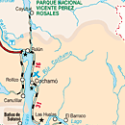
Volcan Puntiagudo
Argentina
Lake Todos los Santos

Slide 13
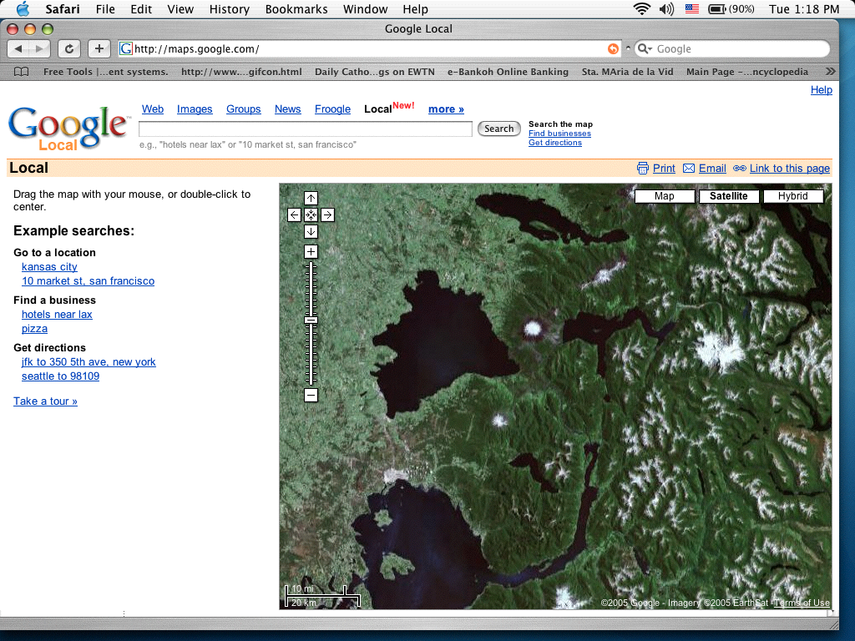
Satelite view including the lakes as well as the bay of Reloncavi
Lake Todos los Santos

Slide 14
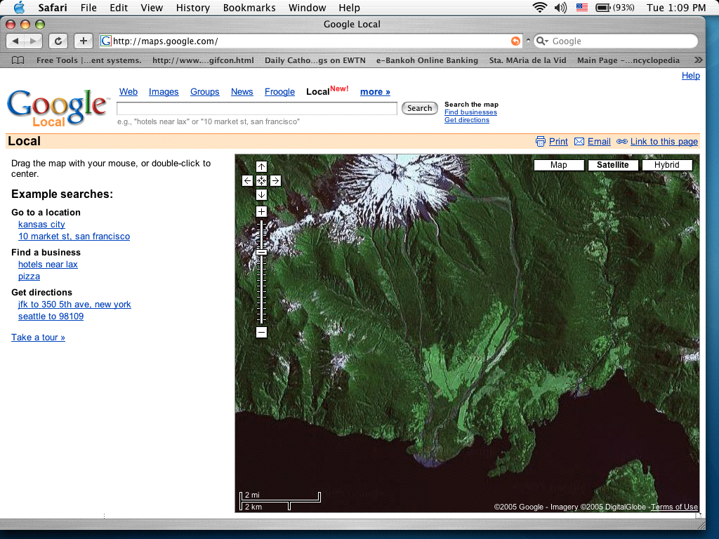
Satelite View of Puntiagudo, the farm and lake shore

Slide 15
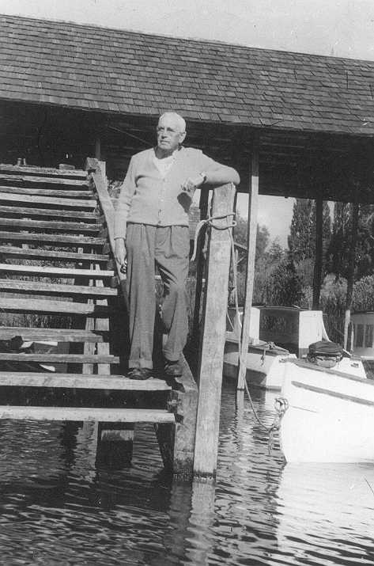
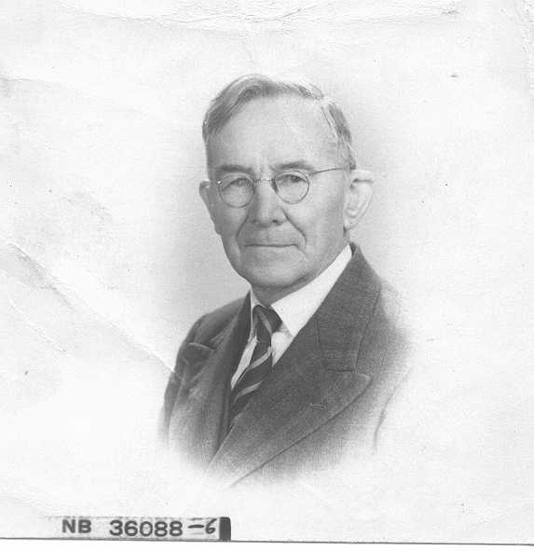
Lincoln Crocker, his good friend from Rhode Island and my mother’s godfather,circa 1950
Tato at the lake Todos los Santos, circa 1950

Slide 16
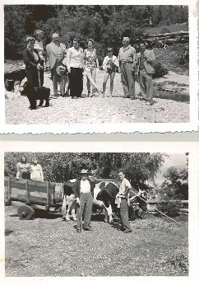
Old pictures taken at Lago Todos Los Santos

Slide 17
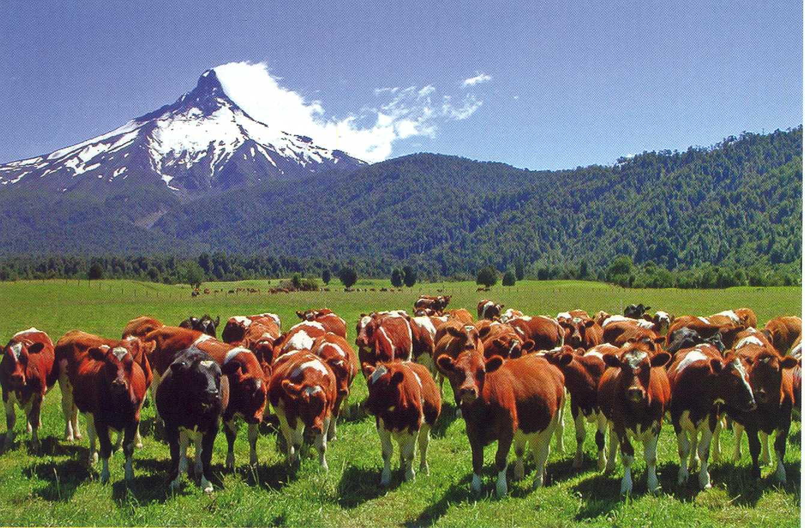
View showing cows in a pasture at the foothills of volcano Puntiagudo

Slide 18
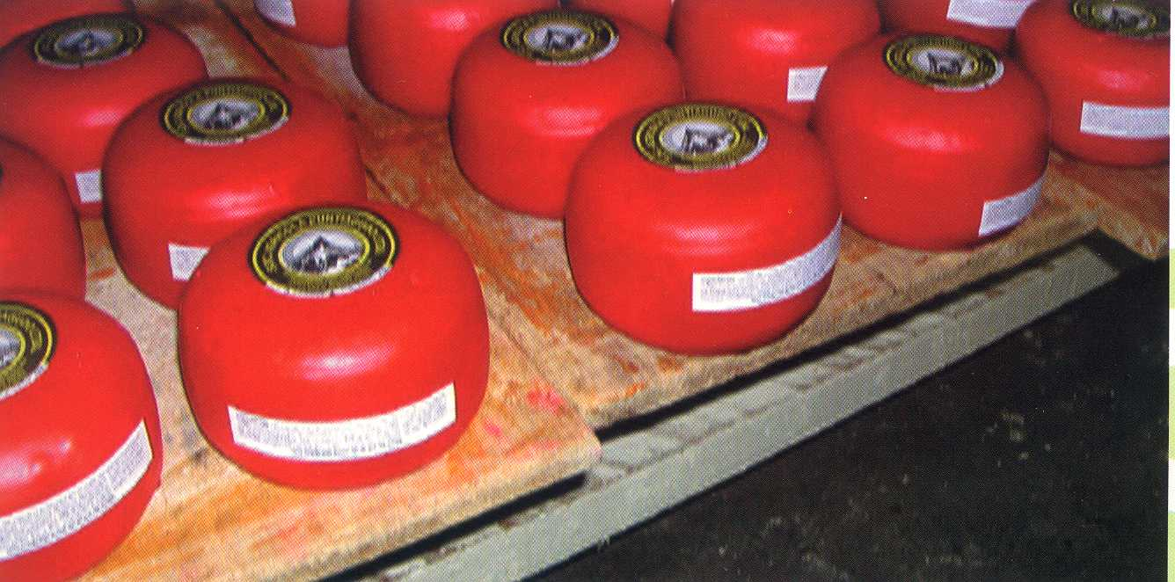
Picture showing Puntiagudo edam cheese.
The label depicts the Puntiagudo volcano

Slide 19
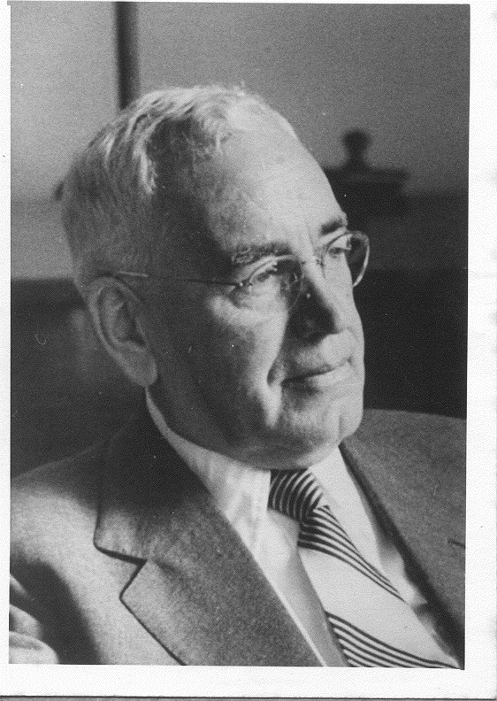
Tato y su escritorio al fondo

Slide 20
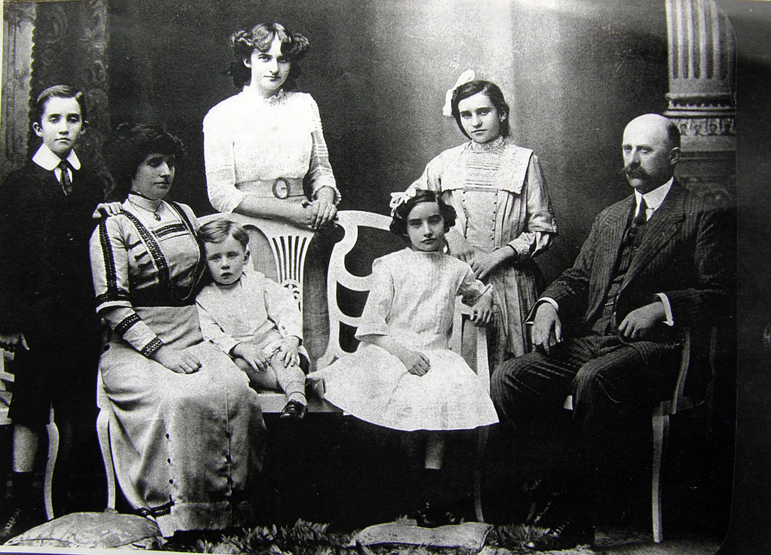
Muller-Corday family
Mamita con sus padres, hermanas y hermanos

Slide 21
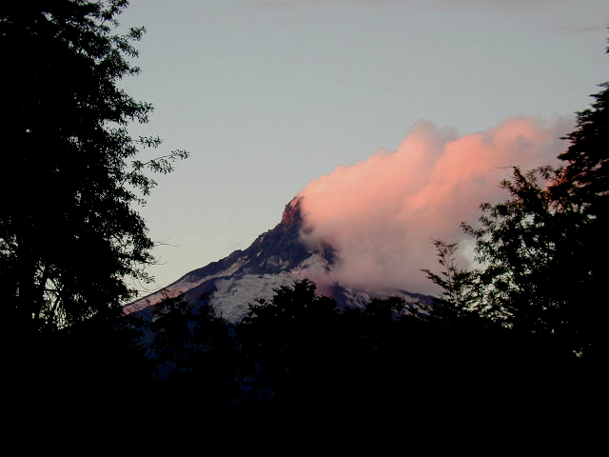
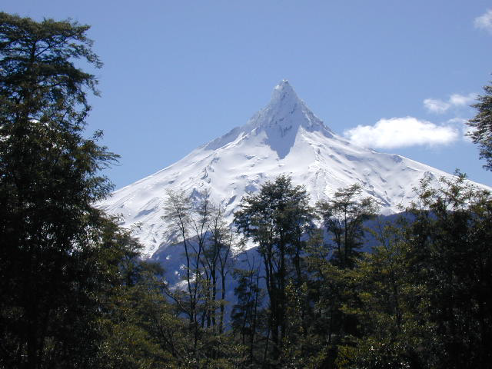
Puntiagudo in summer
Puntiagudo in winter

