Slide 1
Server Details Demo project

Slide 2
API CASES

Slide 3
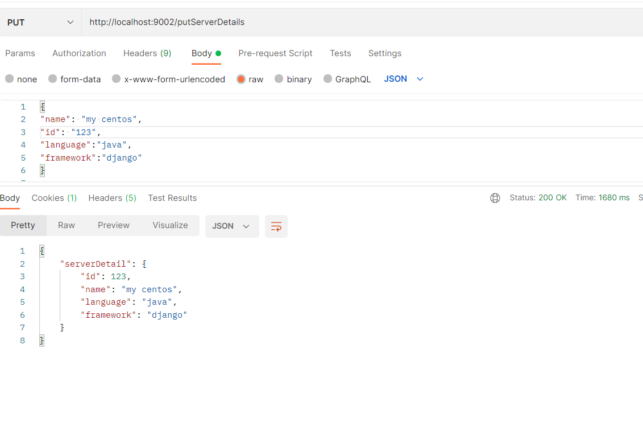
PUT a server. The server object is passed as a json-encoded message body.

Slide 4
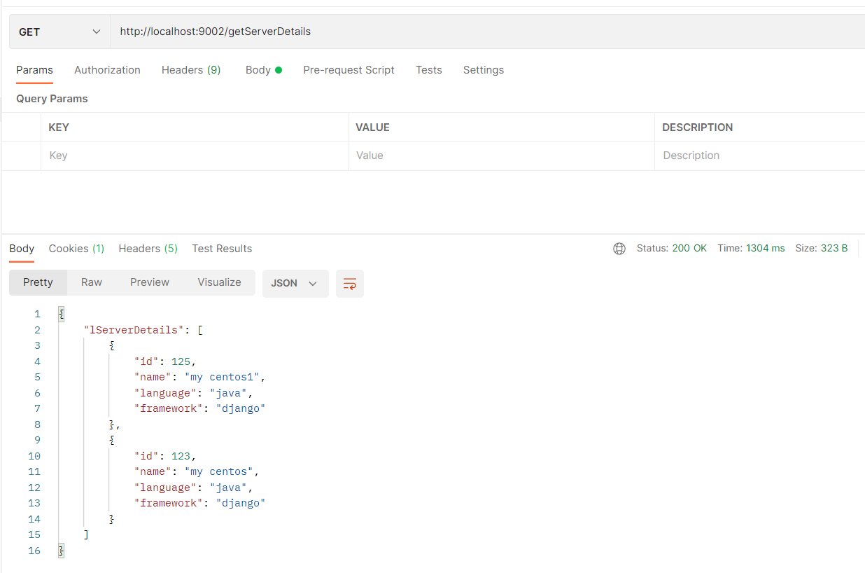
GET servers. Should return all the servers if no parameters are passed

Slide 5
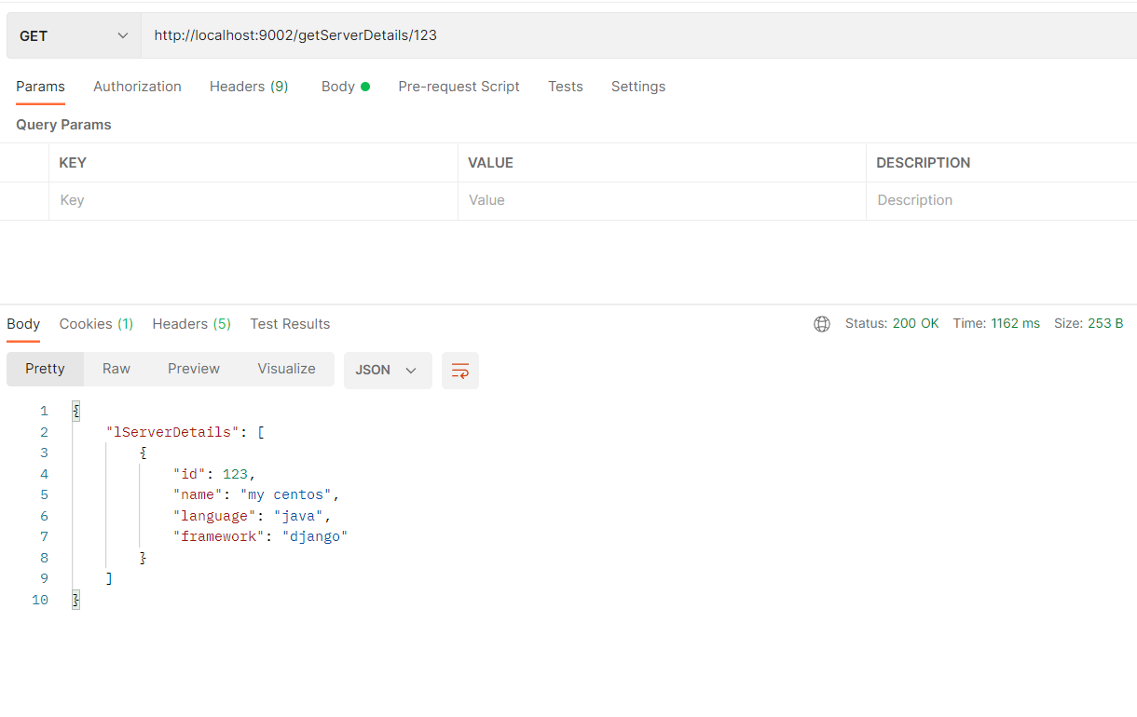
When server id is passed as a parameter - return a single server

Slide 6
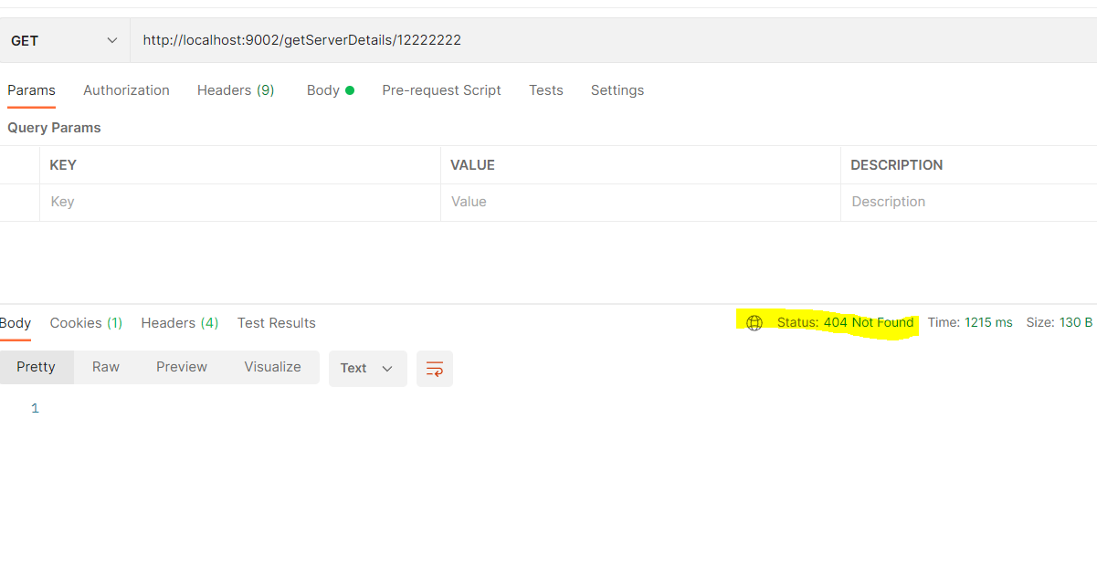
404 if there’s no such a server.

Slide 7
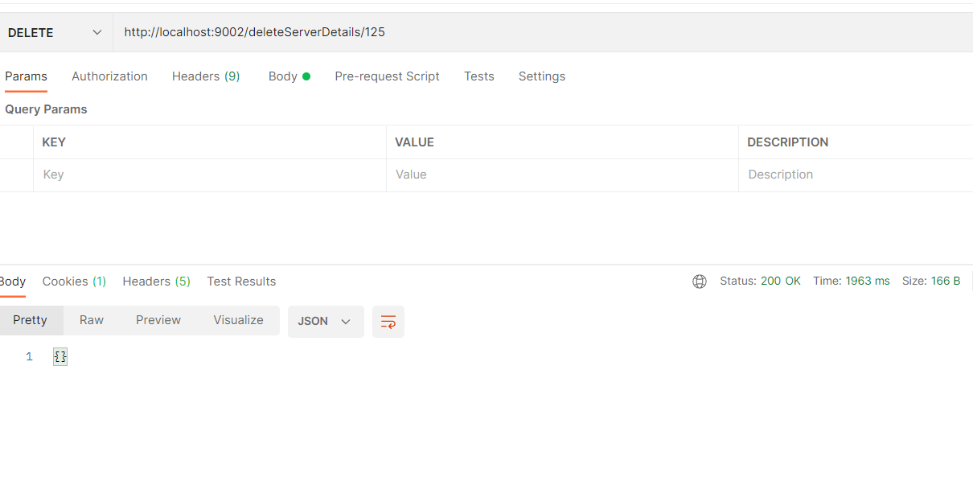
DELETE a server. The parameter is a server ID.

Slide 8
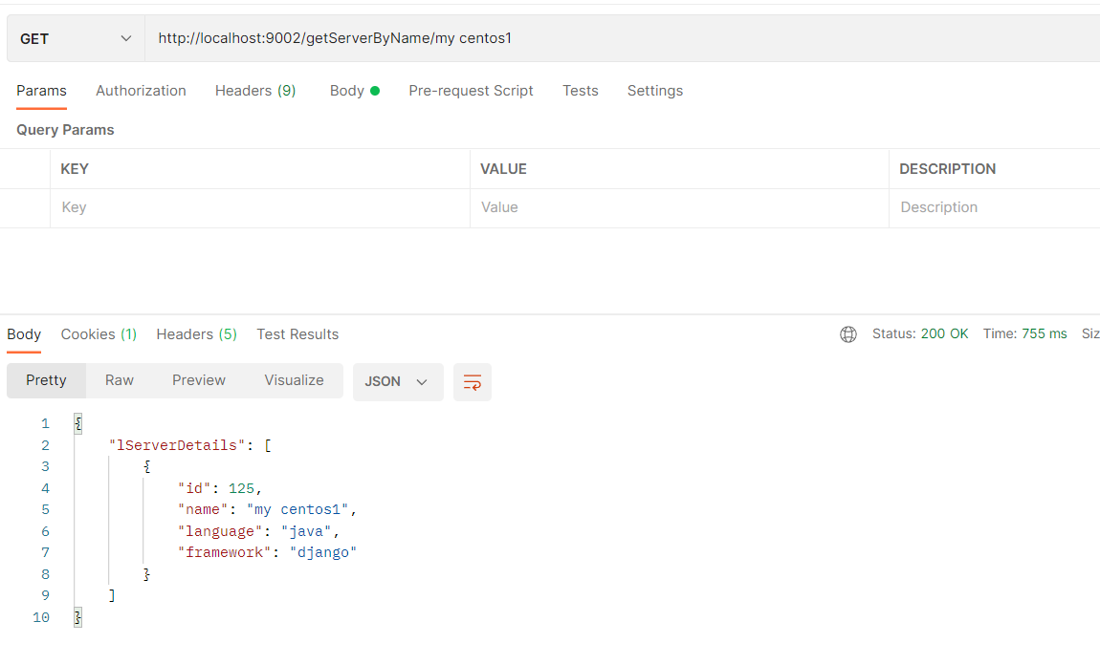
GET (find) servers by name. The parameter is a string. Must check if a server name contains this string and return one or more servers found

Slide 9
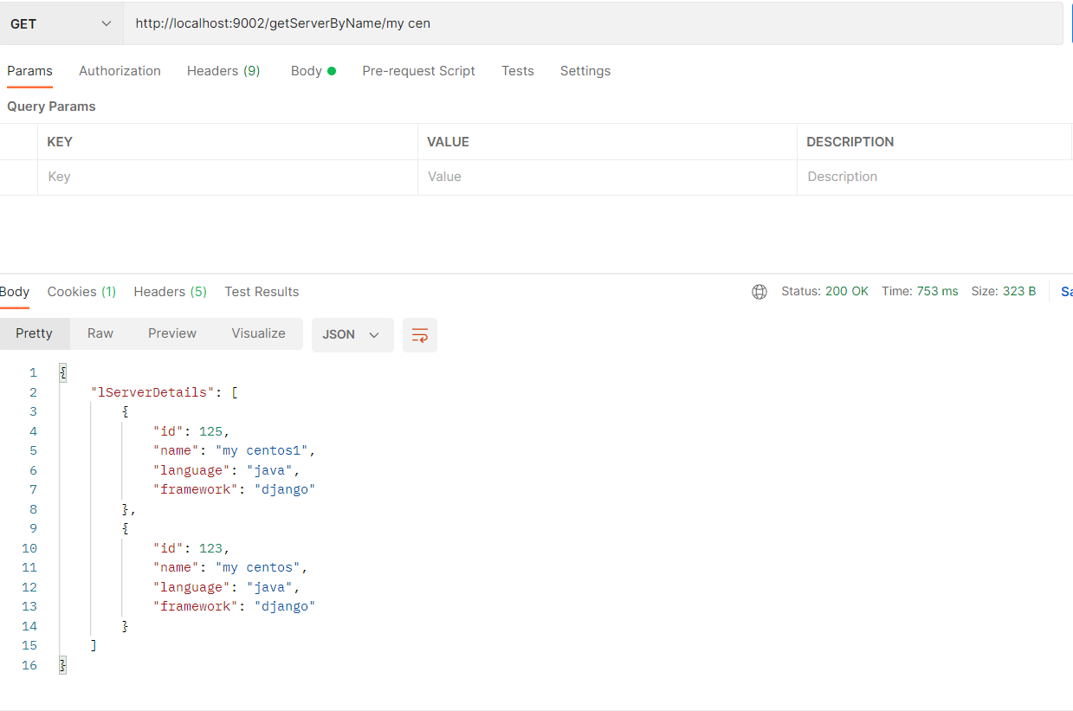
GET (find) servers by name. The parameter is a string. Must check if a server name contains this string and return one or more servers found

Slide 10
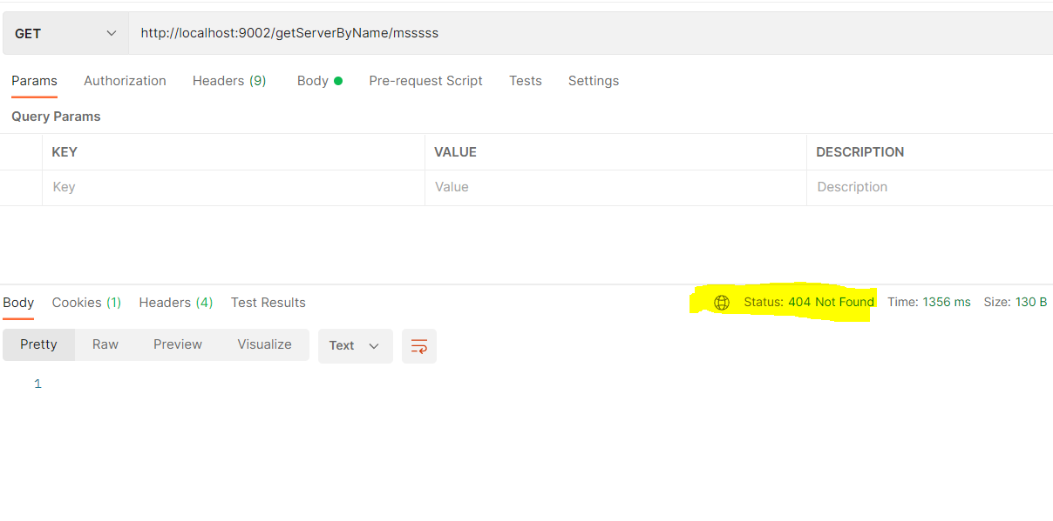
Return 404 if nothing is found.

Slide 11
Web UI

Slide 12
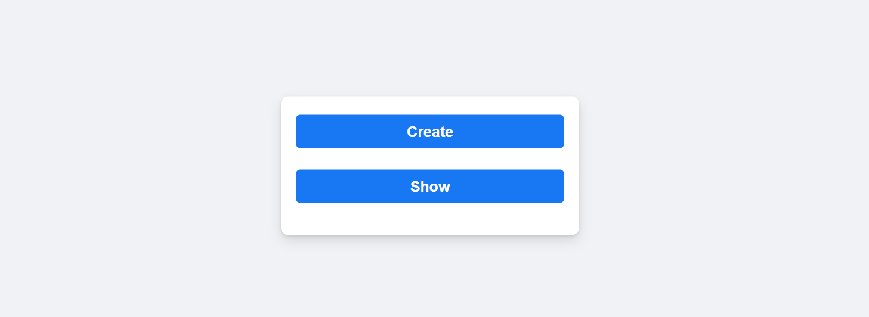

Slide 13
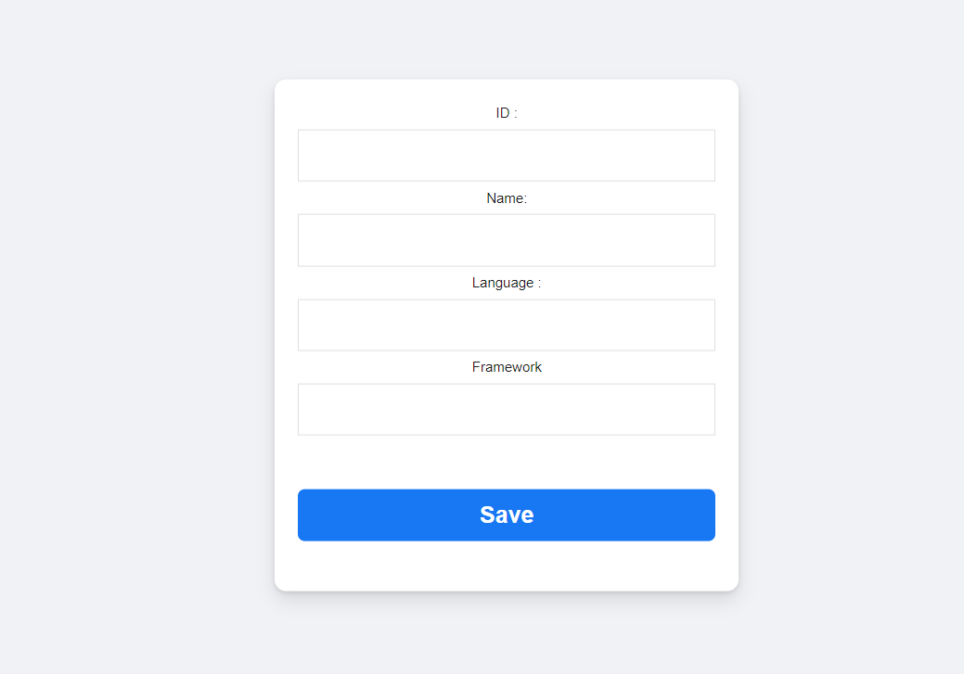

Slide 14
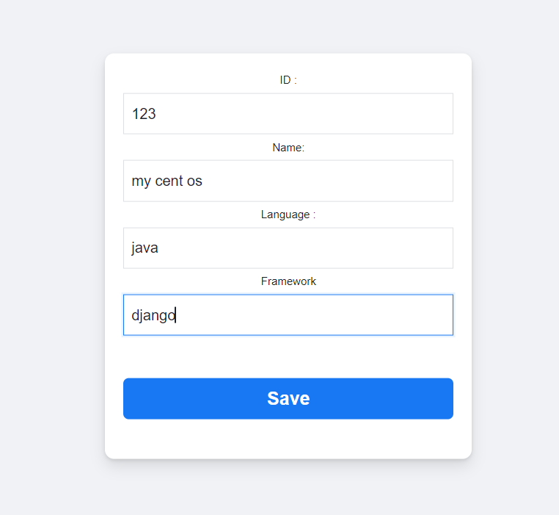

Slide 15
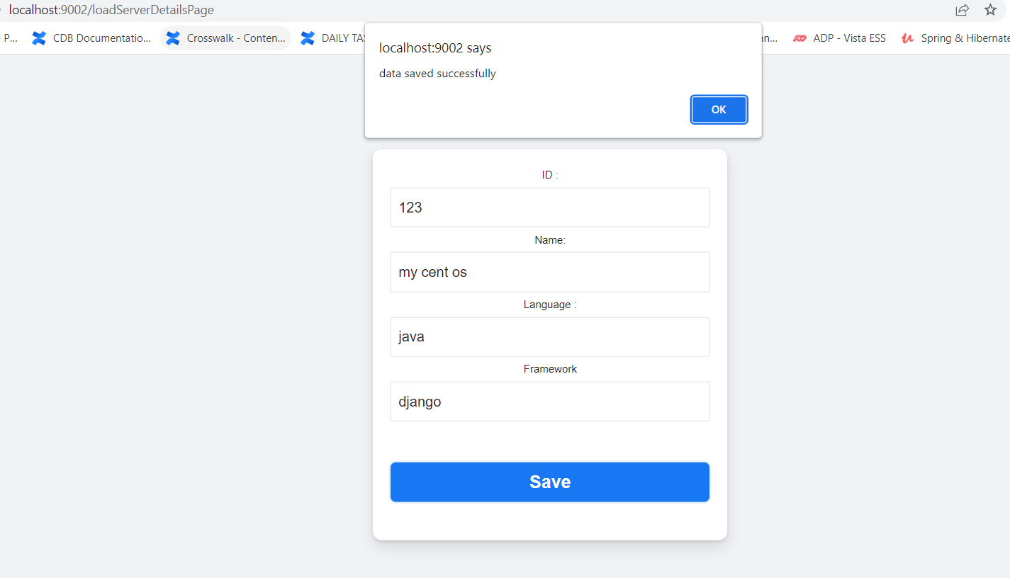

Slide 16
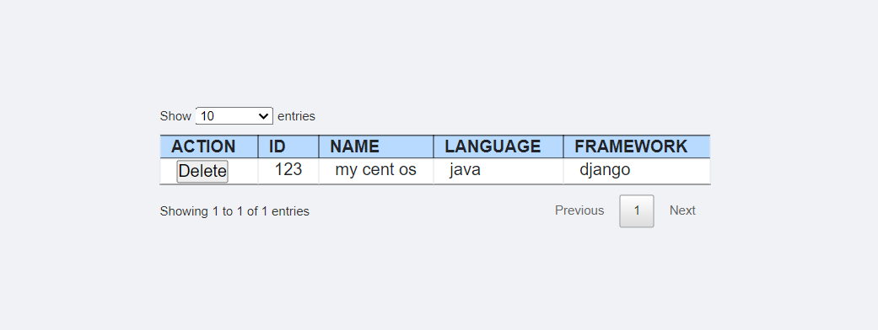

Slide 17
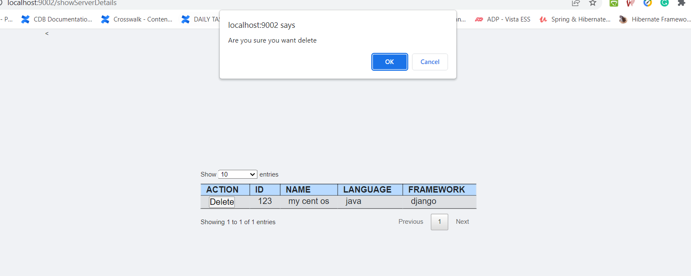

Slide 18
