Slide 1


Major Project Presentation (Phase-II)
MedAidePlus
Multi-Agent Medical AI Framework with Category-Aware Routing, Hallucination Detection, and Persistent Patient Memory
Submitted by:
Punya Modi (22U02075)
Department of Computer Science & Engineering
Indian Institute of Information Technology, Bhopal
Supervised by:
Dr. Yatendra Sahu
Assistant Professor, Department of CSE
April 2026
Indian Institute of Information Technology Bhopal
1

Slide 2
Presentation Overview
01
02
03
04
Introduction & Background
Literature Review
Problem Statement
Proposed Methodology
Medical AI landscape and motivation for MedAidePlus
Survey of medical LLMs, multi-agent systems, and RAG
Core deficiencies and project objectives
Seven-module pipeline architecture and system design
05
06
07
Implementation
Results & Analysis
Conclusion & Future Work
Technology stack, codebase, and reproducibility
Benchmark evaluation, ablation study, and insights
Contributions, lessons learned, and research directions
Indian Institute of Information Technology Bhopal
2

Slide 3
Intro & Background
Literature Review
Problem Statement
Methodology
Implementation
Results & Analysis
Conclusion
The Need for Specialist Medical AI
The Challenge: Multifaceted Patient Queries
From MedAide to MedAidePlus
Real-world patient interactions require simultaneous handling of multiple clinical subtasks:
Symptom-level triage reasoning
Pharmacological safety analysis
Diagnostic test interpretation
Post-diagnosis scheduling advice
A single general-purpose LLM compresses all subtasks into one generation step, increasing risk of clinically misaligned output.
MedAide (Fudan University, 2024) demonstrated that task-specific agents yield better structured responses than monolithic prompting.
Four key limitations:
Shallow intent classification and routing
No persistent patient memory
No hallucination detection mechanism
No multi-turn dialogue tracking
MedAidePlus is a natural evolution of MedAide, overcoming all four limitations with a modular architecture of seven components, preserving the specialist agent philosophy while introducing principled mechanisms for routing, memory, verification, and dialogue continuity.
7
18
3,000
6
Novel Modules
Intent Taxonomy
Open Benchmark
Evaluation Metrics
(M1-M7)
with GAT Hierarchy
Instances
BLEU, METEOR, BERTScore...
Indian Institute of Information Technology Bhopal
3

Slide 4
Intro & Background
Literature Review
Problem Statement
Methodology
Implementation
Results & Analysis
Conclusion
Literature Review: Related Work
Medical LLMs & Domain Adaptation
Multi-Agent Frameworks
Intent Recognition in Clinical NLP
BioBERT [2], BioGPT [3], MedPaLM 2 [4] - domain-adaptive pretraining on biomedical corpora. Shift toward locally deployable open-weight models (LLaMA, Mistral, Qwen, Gemma).
Reflexion [5] with self-evaluation loops, ReAct [6] interleaving reasoning with tool calls, MedAgents [7] panel-based discussion, MedAide [1] category-specialised architecture.
Clinical intents form natural hierarchies (Pre-Diagnosis -> Symptom Triage). Graph Attention Networks [8] exploit hierarchical structure via learned attention weights.
Hallucination Detection & Mitigation
Retrieval-Augmented Generation (RAG)
Extrinsic vs intrinsic hallucination categorised by Min et al. [9]. FAISS [10] enables efficient semantic retrieval. Monte Carlo Dropout [11] provides Bayesian uncertainty approximation. MedAidePlus combines both approaches.
Hybrid RAG combining BM25 lexical scoring with recency weighting and FAISS dense retrieval [12, 13]. Combining sparse and dense retrieval outperforms either alone on heterogeneous medical queries.
MedAide vs MedAidePlus: Key Comparison
Aspect | MedAide (2024) | MedAidePlus (2026)
Modules | 3 (intent, routing, agents) | 7 (M1-M7, all novel)
Intent Taxonomy | 17 intents, shallow | 18 intents, GAT hierarchy
Routing | Content-only classifier | Category-aware + RoBERTa
Patient Memory | None | NetworkX graphs + spaCy NER
Hallucination Detection | None | FAISS + MC Dropout (N=15)
Indian Institute of Information Technology Bhopal
4

Slide 5
Intro & Background
Literature Review
Problem Statement
Methodology
Implementation
Results & Analysis
Conclusion
Problem Statement & Objectives
Core Problem: Four Key Deficiencies
Project Objectives
(a) Misrouting
Design a seven-module pipeline extending MedAide with principled enhancements at each stage
Develop hierarchical intent classifier (M2-HDIO) using BioBERT + Graph Attention Networks
Implement category-aware routing (M6-AQCR) using RoBERTa complexity classifier
Construct persistent patient knowledge graph (M4-PAHM) with NetworkX + spaCy NER
Build dual-stage hallucination verification (M5-HDFG) combining FAISS + MC Dropout
Design multi-turn intent tracker (M7-MIET) with exponential smoothing state vector
Evaluate on a reproducible 3,000-instance benchmark with six automatic metrics
Vocabulary overlap between adjacent clinical intent categories - a Medication query about chest pain scores highly on both Medication and Diagnosis intents.
(b) Statelessness
Each query processed in isolation, discarding all patient history from previous conversation turns.
(c) Uncalibrated Hallucination
No explicit mechanism to detect factually plausible but ungrounded clinical claims in generated responses.
(d) Inability to Adapt
No tracking of topic and intent shifts during multi-turn dialogue, unable to adapt to evolving conversational context.
Scope: Text-based medical QA and clinical decision assistance. Evaluated with automatic lexical/semantic metrics on self-generated benchmark. Does not perform image analysis or EHR integration. Intended strictly for research and educational purposes. All inference via locally deployed Ollama models.
Indian Institute of Information Technology Bhopal
5

Slide 6
Intro & Background
Literature Review
Problem Statement
Methodology
Implementation
Results & Analysis
Conclusion
Design Philosophy of MedAidePlus
Design Principles
Key Innovations
1
Problem Decomposition
Category-Aware Specialist Routing
Monolithic LLMs struggle with multi-intent clinical queries. System divided into 7 specialized modules, each targeting a specific failure point.
Deterministic category hint override eliminates vocabulary-overlap misrouting. Proved to be the single largest driver of benchmark improvement.
2
Context & Understanding
Extractive Primary Agent Synthesis
Patient memory enables longitudinal context. Query decomposition handles complex inputs. Hierarchical intent modeling ensures precise mapping.
Preserves specialist clinical vocabulary and structural formatting. Primary specialist response used as base, secondary agents contribute supplementary info only.
3
Adaptive Control
18-Intent Clinical Taxonomy (4 Categories)
Multi-turn tracking maintains conversation continuity. Complexity-aware routing adjusts computation dynamically, preventing under-processing and overuse.
Category | Intents | Count
Pre-Diagnosis | Symptom_Triage, Dept_Suggestion, Risk_Assessment, Health_Inquiry | 4 intents
Diagnosis | Symptom_Analysis, Etiology_Detection, Test_Interpretation, Differential_Diagnosis | 4 intents
Medication | Drug_Counseling, Dosage_Rec, Contraindication_Check, Drug_Interaction, Prescription_Review | 5 intents
Post-Diagnosis | Rehab_Advice, Progress_Tracking, Care_Support, Lifestyle_Guidance, Follow_up_Scheduling | 5 intents
4
Execution & Reliability
Parallel specialist agents provide domain expertise. Critic-guided synthesis ensures coherent responses. Verification layer detects and flags hallucinations.
5
System Outcome
Progressive refinement across pipeline stages. Localized errors and improved interpretability. Scalable across diverse clinical scenarios.
Indian Institute of Information Technology Bhopal
6

Slide 7
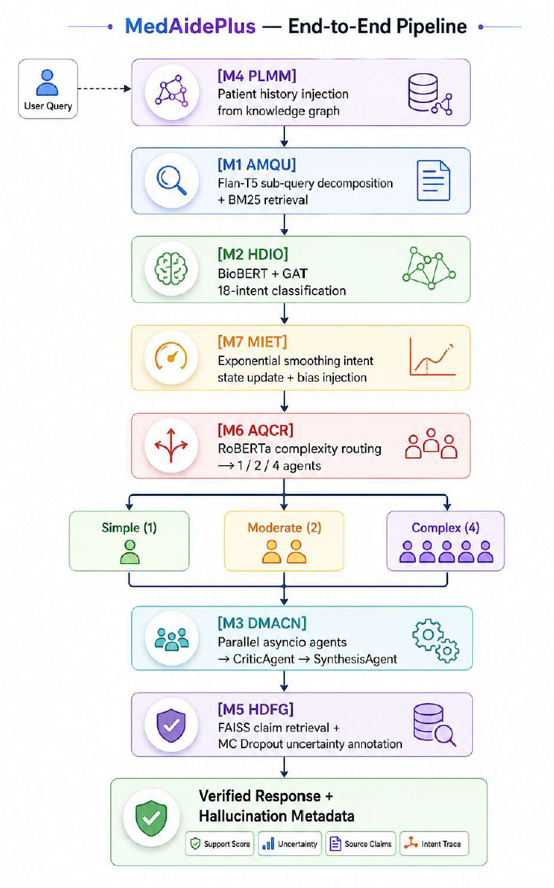
Intro & Background
Literature Review
Problem Statement
Methodology
Implementation
Results & Analysis
Conclusion
System Architecture & Data Flow
The MedAidePlus architecture is built on the principle that complex clinical queries cannot be reliably handled by a single generalized model. Instead, the system decomposes the problem into specialized functional modules, each addressing a distinct failure point observed in traditional medical AI systems.
The first group of modules focuses on context and understanding. Persistent memory enables longitudinal awareness of patient history, while query decomposition and hierarchical intent modeling ensure that complex, multi-faceted queries are interpreted with high semantic precision.
The second group introduces adaptation and control. Multi-turn intent tracking preserves conversational continuity, and complexity-aware routing dynamically determines the level of computational effort required, preventing both under-processing of difficult queries and overuse of resources on simple ones.
The final group is responsible for execution and reliability. Multi-agent collaboration allows domain-specific reasoning in parallel, while critic-guided synthesis ensures coherent integration of outputs. This is reinforced by a dedicated verification layer that explicitly detects and flags unsupported claims, addressing hallucination risks.
Together, these modules form a pipeline where each stage incrementally improves correctness, contextual grounding, and robustness. The design ensures that errors are localized, decisions are interpretable, and the system remains scalable across diverse clinical scenarios.
Fig. 1 - MedAidePlus Seven Module Pipeline Architecture. M4 PAHM injects patient history -> M1 AMQU decomposes and retrieves -> M2 HDIO classifies intent -> M7 MIET updates dialogue state -> M6 AQCR determines complexity tier -> M3 DMACN dispatches agents in parallel -> M5 HDFG verifies claims.
Modular Decomposition
Context Awareness
Adaptive Routing
Multi-Agent + Verification
7 modules, each solves a specific failure point in the pipeline
Memory + multi-intent understanding for longitudinal patient care
Dynamic complexity-based execution with category-aware routing
Parallel specialists + critic synthesis + hallucination detection
Indian Institute of Information Technology Bhopal
7

Slide 8
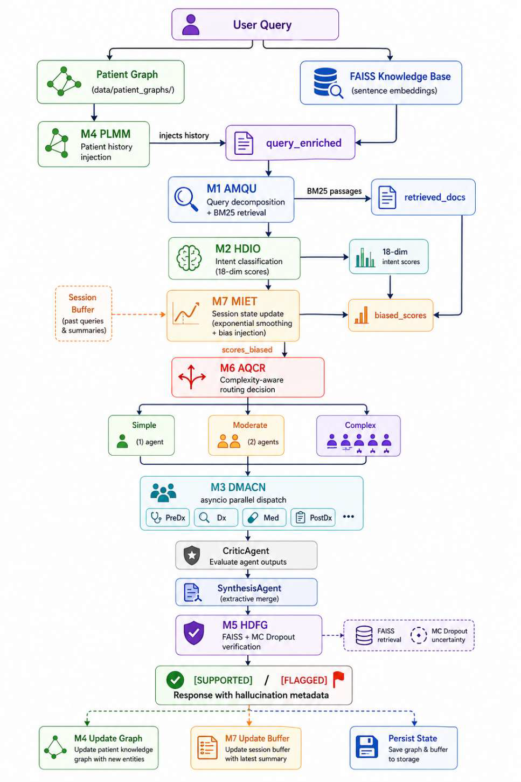
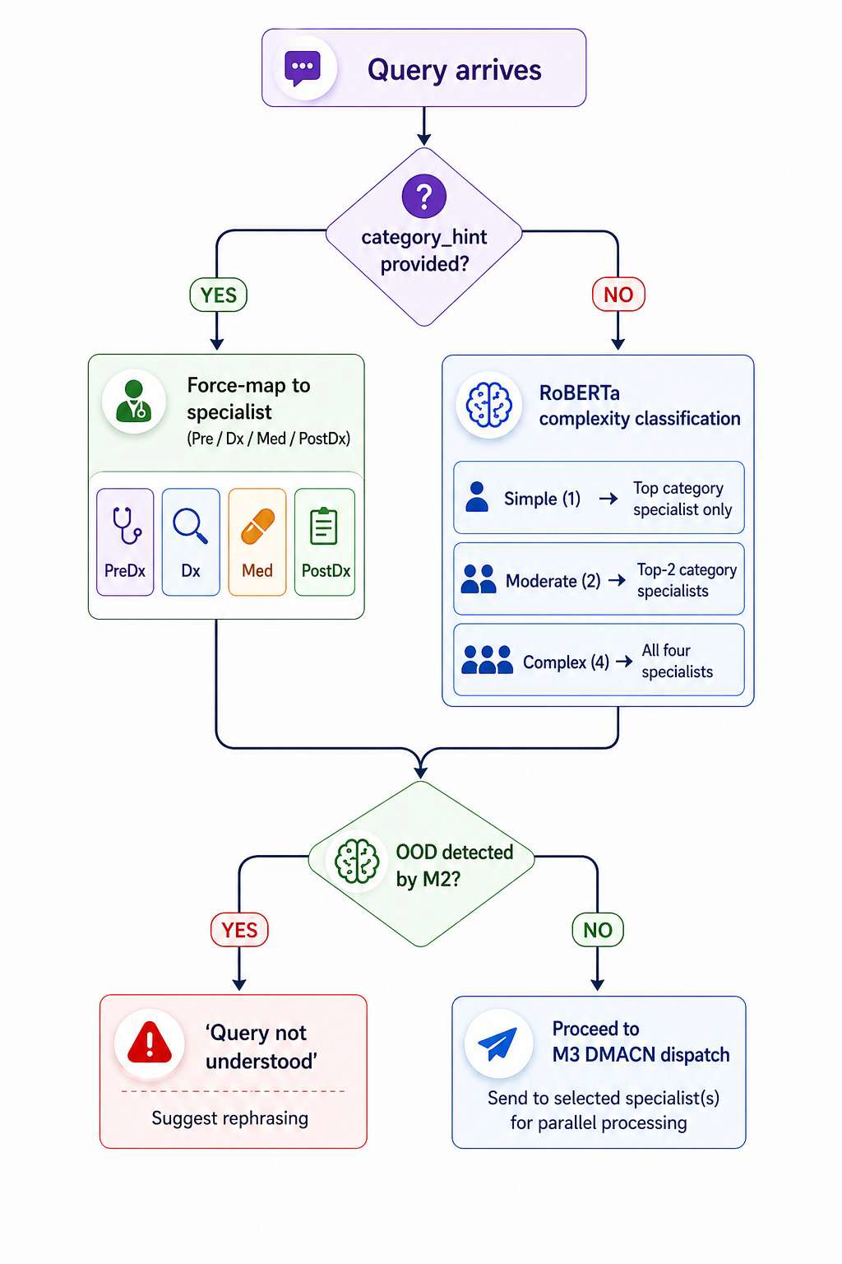
Intro & Background
Literature Review
Problem Statement
Methodology
Implementation
Results & Analysis
Conclusion
Module Interaction & Routing Decisions
Fig. 2 - Module Interaction Block Diagram. Data flow between seven modules, six specialist agents, and three knowledge stores (FAISS, BM25, Patient Graphs). Solid arrows: data transfer; dashed: conditional paths.
Fig. 3 - Category-Aware Routing. M6 AQCR: hint bypasses classifier for direct specialist mapping. RoBERTa classifies complexity as Simple (1), Moderate (2), or Complex (4 + Critic + Synthesis).
6 specialist agents across 4 clinical categories, with critic-guided synthesis for coherent final responses.
3 knowledge stores (FAISS dense, BM25 sparse, Patient Graphs) for comprehensive retrieval.
Complexity-aware dispatch: Simple (1 agent), Moderate (2 agents), Complex (4 + Critic + Synthesis).
Indian Institute of Information Technology Bhopal
8

Slide 9
Intro & Background
Literature Review
Problem Statement
Methodology
Implementation
Results & Analysis
Conclusion
Implementation: Tools & Technology
Category | Tool / Library | Version | Role
Language | Python | 3.10+ | Primary implementation, asyncio concurrent execution
Deep Learning | PyTorch | 2.0+ | Neural network backend for BioBERT, Flan-T5, RoBERTa
 | Transformers (HF) | 4.40+ | Pretrained model loading and inference
 | sentence-transformers | 2.7+ | Sentence embedding for FAISS and MC Dropout
 | NLP / NER | spaCy | 3.7+
Retrieval | FAISS-CPU | 1.7.4+ | Dense claim verification in M5 HDFG
 | rank-bm25 | 0.2.2+ | Recency-weighted sparse retrieval in M1 AMQU
Graph DB | NetworkX | 3.3+ | Patient knowledge graph construction and traversal (M4)
LLM Backend | Ollama | latest | Local open-weight model serving (qwen3:8b, gemma3:4b, phi4:14b)
 | openai SDK | 1.30+ | Agent call abstraction layer (OpenAI-compatible endpoint)
Evaluation Stack
Hardware & Reproducibility
NLTK 3.8+ (BLEU-1/2, GLEU, METEOR), rouge-score 0.1+ (ROUGE-L), bertscore 0.3+ (BERTScore with distilbert-base-uncased). All pinned in requirements.txt for reproducibility.
NVIDIA RTX 3070 Laptop GPU (8GB VRAM). Temperature=0, fixed seed for all benchmark runs. Patient graph cleanup enforced at benchmark start. Module isolation: ML modules release VRAM before agent inference.
Indian Institute of Information Technology Bhopal
9

Slide 10
Intro & Background
Literature Review
Problem Statement
Methodology
Implementation
Results & Analysis
Conclusion
Main Results: MedAide+ Wins All 18/18 Comparisons
V2 Benchmark: 3,000 instances (750/category) | 3 open-weight models via Ollama | 6 automatic metrics | Temperature=0
Model / Condition | BLEU-1 | BLEU-2 | METEOR | ROUGE-L | BERTSc. | GLEU
gemma3:4b MedAide | 24.79 | 10.27 | 19.23 | 15.97 | 64.77 | 7.71
gemma3:4b MedAide+ | 28.91 | 14.14 | 22.68 | 18.99 | 66.64 | 9.87
Delta | +4.12 | +3.87 | +3.45 | +3.02 | +1.87 | +2.16
qwen3:8b MedAide | 27.56 | 12.63 | 19.46 | 19.13 | 66.03 | 9.35
qwen3:8b MedAide+ | 31.01 | 15.48 | 23.29 | 22.00 | 68.67 | 10.98
Delta | +3.45 | +2.85 | +3.83 | +2.87 | +2.64 | +1.63
phi4:14b MedAide | 10.33 | 4.64 | 7.56 | 13.52 | 35.34 | 6.22
phi4:14b MedAide+ | 13.96 | 7.56 | 10.75 | 15.97 | 46.61 | 7.80
Delta | +3.63 | +2.92 | +3.19 | +2.45 | +11.27 | +1.58
Key Insights by Model
qwen3:8b (8B)
gemma3:4b (4B)
phi4:14b (14B)
Consistent improvements across all 6 metrics. BLEU-1 +12.5% relative gain. METEOR +19.7% relative - synonym-level recall improvements. Validates category-aware routing + extractive synthesis.
Meaningful gains even with compact 4B model. BLEU-1 +16.6% relative. Primary driver is routing correctness, not model capacity. Largest gains in Medication and Diagnosis categories.
Most dramatic BERTScore improvement: +11.27 points (35.34->46.61). BLEU-1 +25.8% relative - highest across all models. Chain-of-thought reasoning aligns with correct specialist routing.
Indian Institute of Information Technology Bhopal
10

Slide 11
Intro & Background
Literature Review
Problem Statement
Methodology
Implementation
Results & Analysis
Conclusion
Per-Category Breakdown & Ablation Study
Per-Category BLEU-1 Scores (qwen3:8b)
Ablation Study (qwen3:8b, n=20)
Condition | Pre-Diag | Diagnosis | Medication | Post-Diag
MedAide | 31.31 | 24.08 | 28.83 | 25.58
MedAide+ | 26.11 | 33.52 | 33.12 | 26.02
Delta | -5.20 | +9.44 | +4.29 | +0.44
Why? | Both use PreDiag | Routing fix | Specialist + KB | Open-ended
Configuration | BLEU-1 | Delta
MedAide (baseline) | 26.06 | -
+ M4-M7 (no routing fix) | 18.44 | -7.62
+ Extractive synthesis | 25.13 | -0.93
+ Category-aware routing | 27.88 | +1.82
+ Patient graph isolation (full) | 28.26 | +2.20
Critical Findings
1
2
3
Routing precision is the primary bottleneck. Adding modules without fixing routing hurts by -7.62 BLEU-1. No amount of postprocessing compensates for wrong specialist dispatch.
Extractive synthesis is second most impactful. Free paraphrasing simplifies clinical terminology into lay language, reducing BLEU-1 by 4-8 points. Vocabulary preservation is critical.
Evaluation correctness is first-class. Initial version appeared worse than baseline due to stale memory contamination and over-paraphrasing, not architecture flaws.
Medication category shows most dramatic improvement: +5.90 BLEU-1 (gemma3:4b), +4.29 (qwen3:8b), +7.96 (phi4:14b). Two factors: (1) Medication Agent produces structured responses with drug interaction tables, contraindication lists, and dosage steps; (2) FAISS KB contains dense pharmacological entries that the hallucination verifier can leverage, reinforcing accurate claims and suppressing speculative ones.
Indian Institute of Information Technology Bhopal
11

Slide 12
Intro & Background
Literature Review
Problem Statement
Methodology
Implementation
Results & Analysis
Conclusion
Conclusion & Future Scope
Key Contributions
Future Research Directions
Seven novel modules (M1-M7) in an integrated, configurable pipeline addressing query decomposition, intent classification, multi-agent orchestration, persistent memory, hallucination verification, adaptive routing, and dialogue tracking.
Category-aware specialist routing - the single most impactful design decision, eliminating vocabulary-overlap misrouting.
Extractive primary agent synthesis preserving specialist clinical vocabulary and structural formatting.
3,000-instance open benchmark with composite intents, difficulty stratification, and reference answers.
Identification and mitigation of two evaluation confounders: specialist misrouting and stale persistent memory contamination.
Multi-provider LLM abstraction supporting Ollama, OpenAI, Anthropic, and Google backends.
Supervised fine-tuning of M2-HDIO on large annotated clinical intent datasets (e.g., MedDialog) to improve OOD detection.
Cross-dataset evaluation on public benchmarks: MedQA (USMLE), MedMCQA, PubMedQA for rigorous generalisation testing.
Multimodal inputs - lab result images, radiology scans, ECG traces via multimodal LLM backend.
Online learning for patient graphs with time-decayed edge weights for accurate long-term patient status.
RL from clinical feedback - training routing and synthesis with expert evaluation reward signals.
FastAPI deployment with patient authentication for controlled real-world pilot studies.
Lessons Learned
Evaluation correctness is a first-class concern. The initial MedAide+ appeared worse than baseline due to stale memory contamination and synthesis over-paraphrasing - not architecture flaws. Careful benchmark isolation and output inspection are essential. Lexical metric alignment requires vocabulary preservation. BLEU and GLEU reward exact n-gram matches; paraphrasing reduces scores even when semantically equivalent.
Broader Impact
MedAidePlus contributes by demonstrating that careful system engineering, explicit module design, and reproducible evaluation can produce measurable improvements. The open benchmark and codebase lower the barrier to entry for future research in safe medical AI deployment.
Indian Institute of Information Technology Bhopal
12

Slide 13
Intro & Background
Literature Review
Problem Statement
Methodology
Implementation
Results & Analysis
Conclusion
References
[1] He, X., Chen, Z., Wang, Y., et al. (2024). MedAide: Towards an Omni Medical Aide via Specialized LLM-based Multi-Agent Collaboration. arXiv:2410.12532v3, Fudan University.
[2] Lee, J., Yoon, W., Kim, S., et al. (2020). BioBERT: A pretrained biomedical language representation model. Bioinformatics, 36(4), 1234-1240.
[3] Luo, R., Sun, L., Xia, Y., et al. (2022). BioGPT: Generative pretrained transformer for biomedical text generation. Briefings in Bioinformatics, 23(6), bbac409.
[4] Singhal, K., Tu, T., Gottweis, J., et al. (2023). Towards expert-level medical question answering with large language models. arXiv:2305.09617.
[5] Shinn, N., Cassano, F., Berman, E., et al. (2023). Reflexion: Language agents with verbal reinforcement learning. NeurIPS 36.
[6] Yao, S., Zhao, J., Yu, D., et al. (2023). ReAct: Synergizing reasoning and acting in language models. ICLR 2023.
[7] Tang, X., Tran, A., Deng, J., et al. (2023). MedAgents: Large language models as collaborators for zero-shot medical reasoning. arXiv:2311.10537.
[8] Velickovic, P., Cucurull, G., Casanova, A., et al. (2018). Graph Attention Networks. ICLR 2018.
[9] Min, S., Krishna, K., Lyu, X., et al. (2023). FActScore: Fine-grained atomic evaluation of factual precision. EMNLP 2023.
[10] Johnson, J., Douze, M., & Jegou, H. (2019). Billion-scale similarity search with GPUs. IEEE TBD, 7(3), 535-547.
[11] Gal, Y., & Ghahramani, Z. (2016). Dropout as a Bayesian approximation. ICML 2016.
[12] Lewis, P., Perez, E., Piktus, A., et al. (2020). Retrieval-Augmented Generation for knowledge-intensive NLP tasks. NeurIPS 33.
[13] Zakka, C., Shad, R., Chaurasia, A., et al. (2024). Almanac: Retrieval-augmented language models for clinical medicine. NEJM AI, 1(2).
[14] Liu, Y., Ott, M., Goyal, N., et al. (2019). RoBERTa: A robustly optimized BERT pretraining approach. arXiv:1907.11692.
[15] Raffel, C., Shazeer, N., Roberts, A., et al. (2020). Exploring the limits of transfer learning with Flan-T5. JMLR, 21(140), 1-67.
[16] Zhang, T., Kishore, V., Wu, F., et al. (2020). BERTScore: Evaluating text generation with BERT. ICLR 2020.
[17] Papineni, K., Roukos, S., Ward, T., & Zhu, W.J. (2002). BLEU: A method for automatic evaluation of machine translation. ACL 2002.
[18] Lin, C.Y. (2004). ROUGE: A package for automatic evaluation of summaries. ACL Workshop.
[19] Banerjee, S., & Lavie, A. (2005). METEOR: An automatic metric for MT evaluation. ACL Workshop.
[20] Zhang, S., Roller, S., Goyal, N., et al. (2022). OPT: Open pretrained transformer language models. arXiv:2205.01068.
Indian Institute of Information Technology Bhopal
13

Slide 14
THANK YOU
Questions & Discussion
Punya Modi (22U02075)
Department of Computer Science & Engineering
Indian Institute of Information Technology, Bhopal
Supervised by
Dr. Yatendra Sahu
Assistant Professor, CSE
Indian Institute of Information Technology Bhopal
1

