Slide 1
Chapter # 4: Programmable and
Steering Logic
Contemporary Logic Design
Randy H. Katz
University of California, Berkeley
June 1993

Slide 2
Chapter Overview
• PALs and PLAs
• Non-Gate Logic
Switch Logic
Multiplexers/Selecters and Decoders
Tri-State Gates/Open Collector Gates
ROM
• Combinational Logic Design Problems
Seven Segment Display Decoder
Process Line Controller
Logical Function Unit

Slide 3
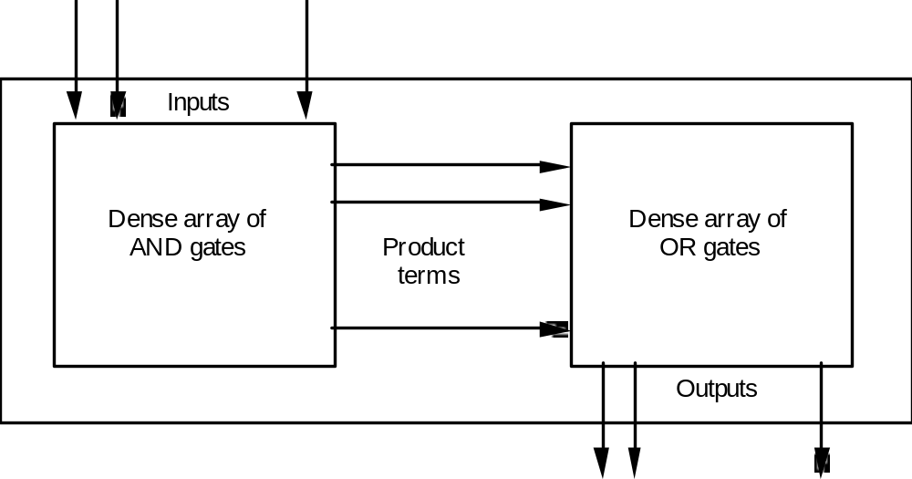
PALs and PLAs
Pre-fabricated building block of many AND/OR gates (or NOR, NAND)
"Personalized" by making or breaking connections among the gates
Programmable Array Block Diagram for Sum of Products Form

Slide 4
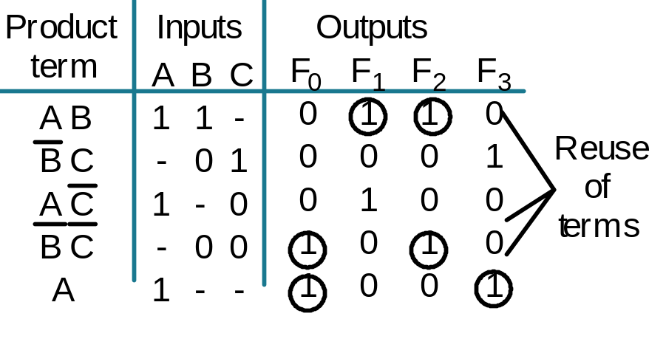
PALs and PLAs
Key to Success: Shared Product Terms
Equations
F0 = A + B' C'
F1 = A C' + A B
F2 = B' C' + A B
F3 = B' C + A
Example:
Input Side:
Personality Matrix
1 = asserted in term
0 = negated in term
- = does not participate
Output Side:
1 = term connected to output
0 = no connection to output

Slide 5
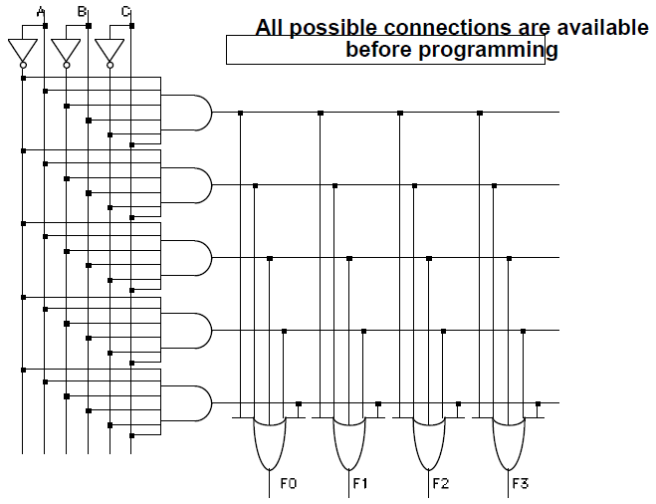
PALs and PLAs
Example Continued

Slide 6
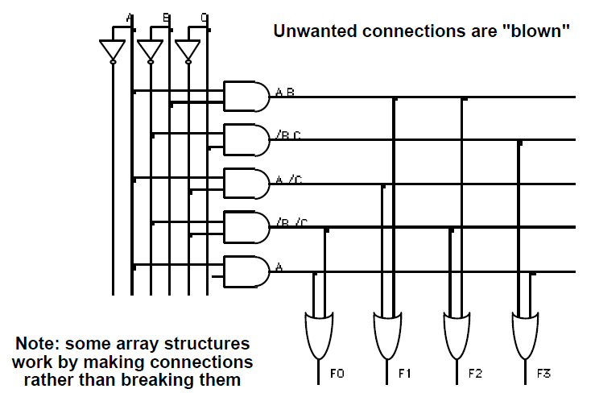
PALs and PLAs
Example Continued

Slide 7
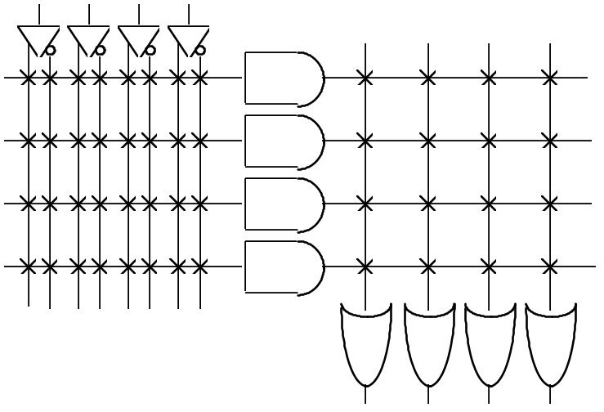
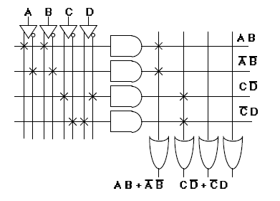
PALs and PLAs
Alternative representation for high fan-in structures
Short-hand notation
so we don't have to
draw all the wires!
Notation for implementing
F0 = A B + A' B'
F1 = C D' + C' D

Slide 8
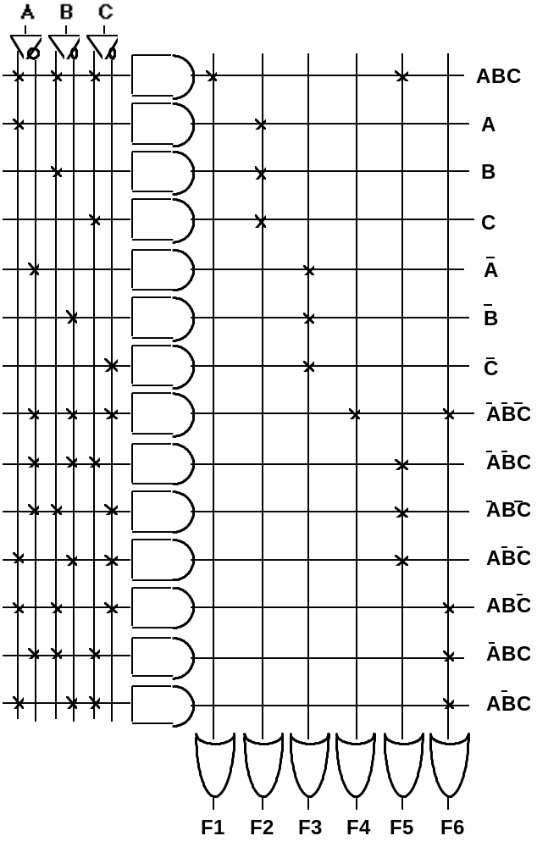
PALs and PLAs
Design Example
Multiple functions of A, B, C
F1 = A B C
F2 = A + B + C
F3 = A B C
F4 = A + B + C
F5 = A xor B xor C
F6 = A xnor B xnor C

Slide 9
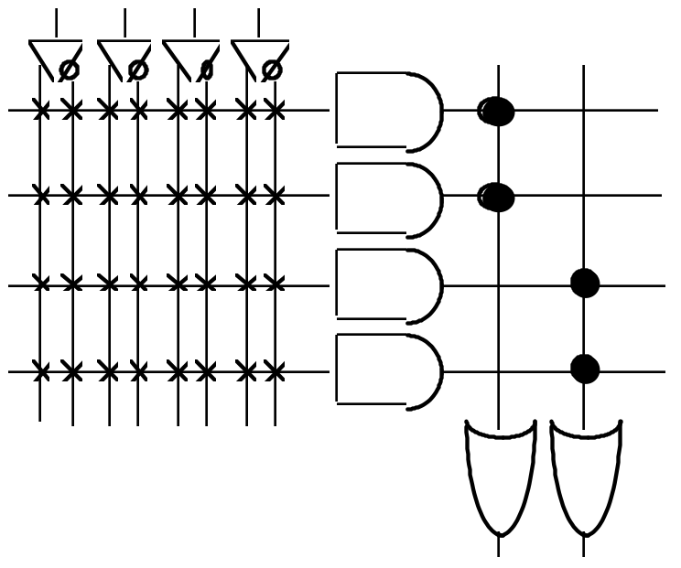
PALs and PLAs
What is difference between Programmable Array Logic (PAL) and
Programmable Logic Array (PLA)?
PAL concept — implemented by Monolithic Memories
constrained topology of the OR Array
A given column of the OR array
has access to only a subset of
the possible product terms
PLA concept — generalized topologies in AND and OR planes

Slide 10
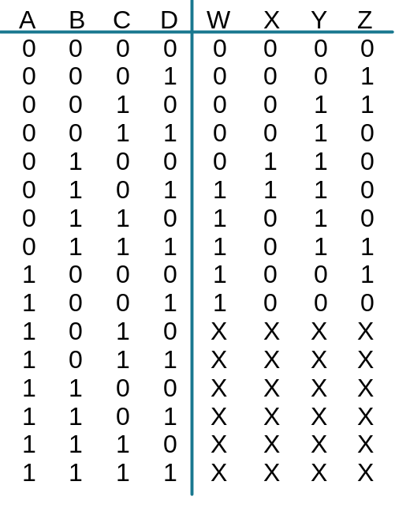
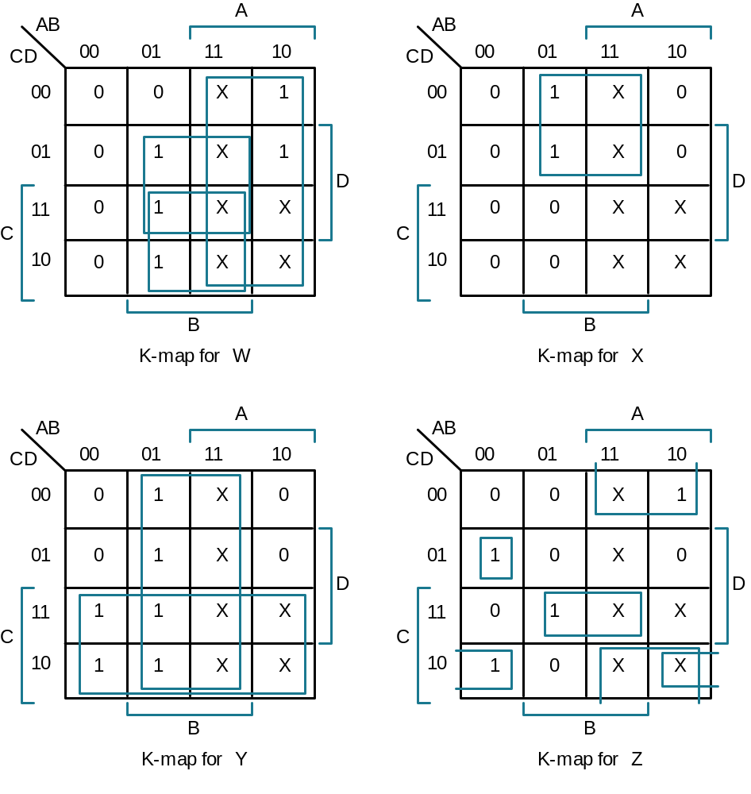
PALs and PLAs
Design Example: BCD to Gray Code Converter
Truth Table
K-maps
Minimized Functions:
W = A + B D + B C
X = B C'
Y = B + C
Z = A'B'C'D + B C D + A D' + B' C D'

Slide 11
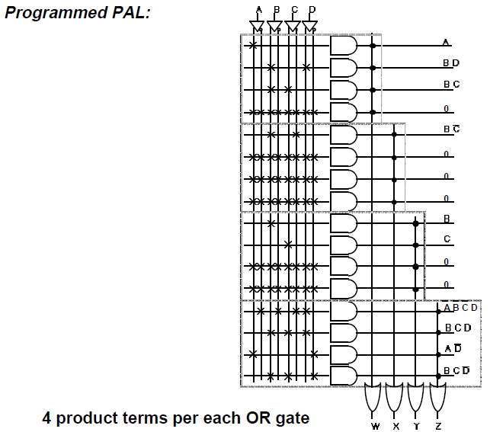
PALs and PLAs
W = A + B D + B C
X = B C'
Y = B + C
Z = A'B'C'D + B C D + A D' + B' C D'

Slide 12
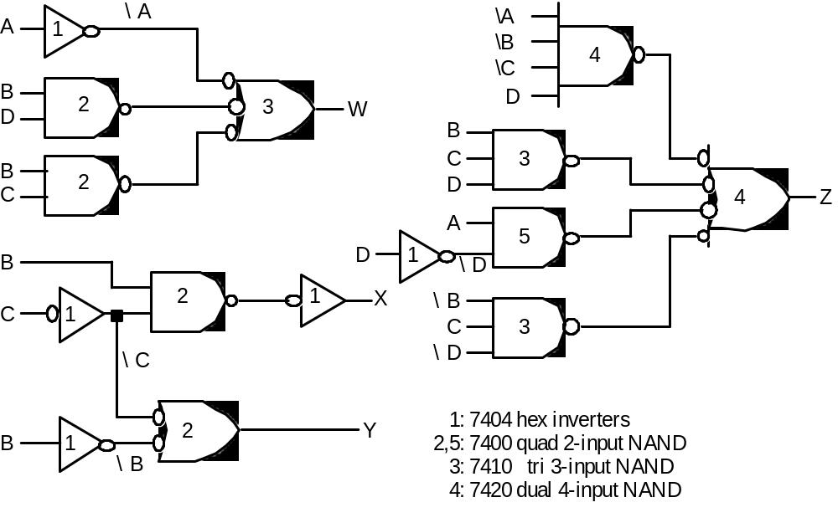
PALs and PLAs
Code Converter Discrete Gate Implementation
4 SSI Packages vs. 1 PLA/PAL Package!

Slide 13
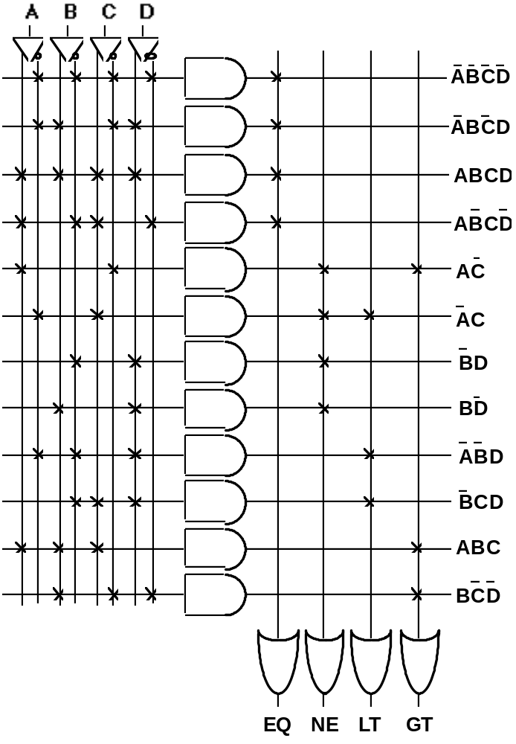
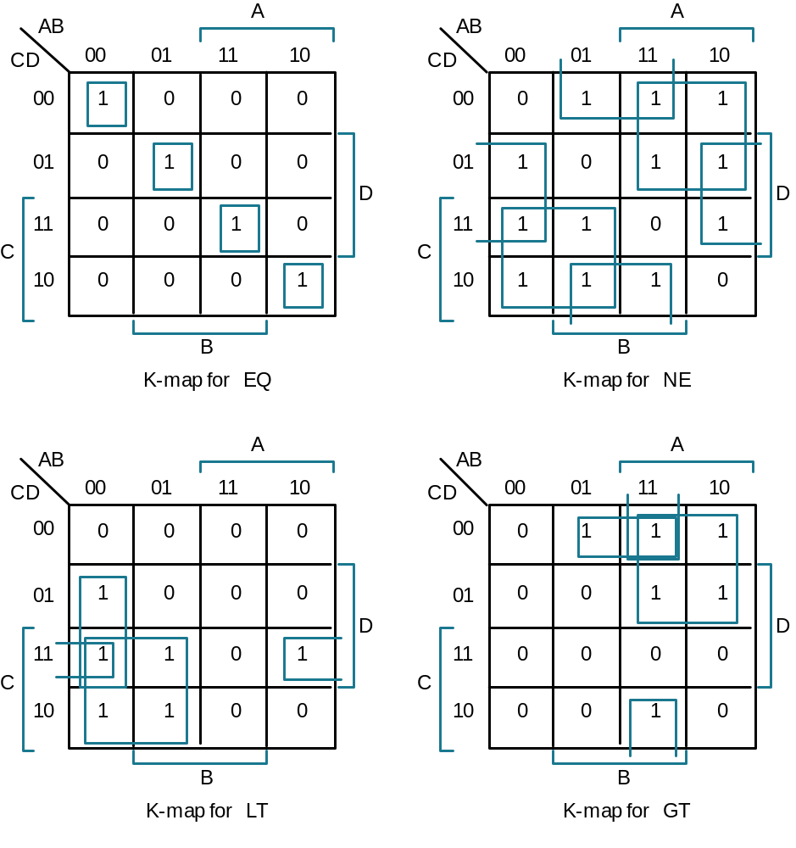
PALs and PLAs
Another Example: Magnitude Comparator

Slide 14
Non-Gate Logic
Introduction
AND-OR-Invert
PAL/PLA
Generalized Building Blocks
Beyond Simple Gates
Kinds of "Non-gate logic":
• switching circuits built from CMOS transmission gates (not cover)
• multiplexer/selecter functions
• decoders
• tri-state and open collector gates
• read-only memories

Slide 15
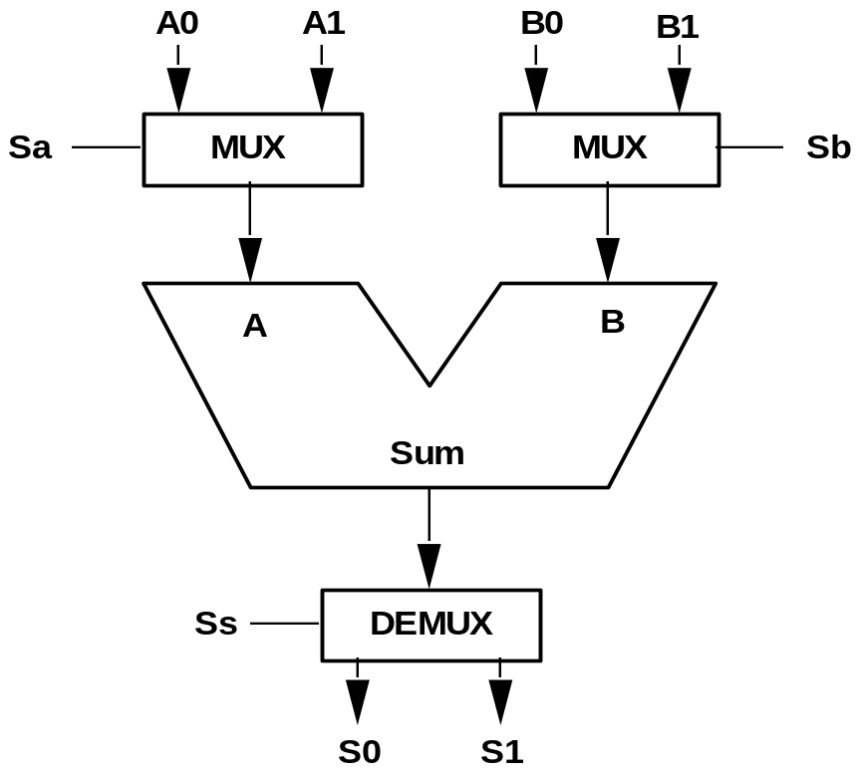
Multiplexers/Selectors
Use of Multiplexers/Selectors
Multi-point connections
Multiple input sources
Multiple output destinations

Slide 16
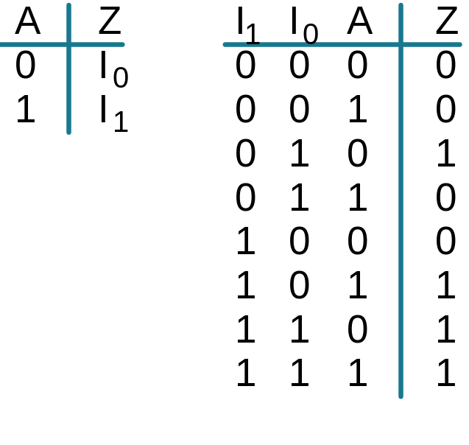
Multiplexers/Selectors
General Concept
n
2 data inputs, n control inputs, 1 output
used to connect 2 points to a single point
control signal pattern form binary index of input connected to output
n
Z = A' I + A I
0
1
Functional form
Logical form
Two alternative forms
for a 2:1 Mux Truth Table

Slide 17
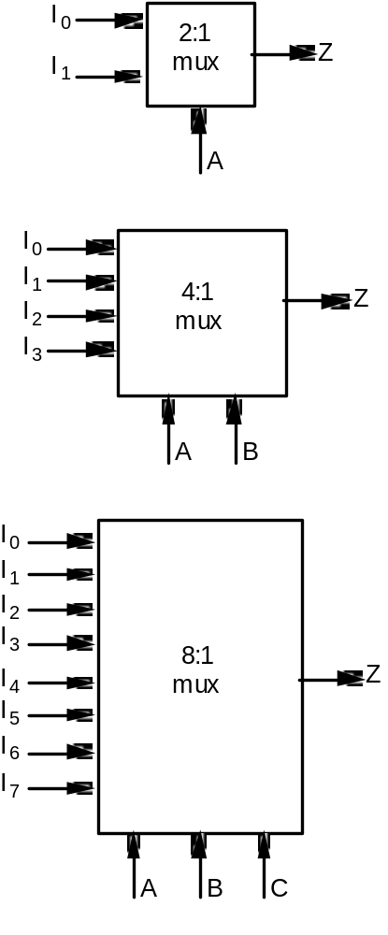
Multiplexers/Selectors
Z = A' I + A I
0
1
Z = A' B' I0 + A' B I1 + A B' I2 + A B I3
Z = A' B' C' I0 + A' B' C I1 + A' B C' I2 + A' B C I3 +
A B' C' I4 + A B' C I5 + A B C' I6 + A B C I7
n
2 -1
In general, Z = Σ m I
k=0
k
k
n
in minterm shorthand form for a 2 :1 Mux

Slide 18
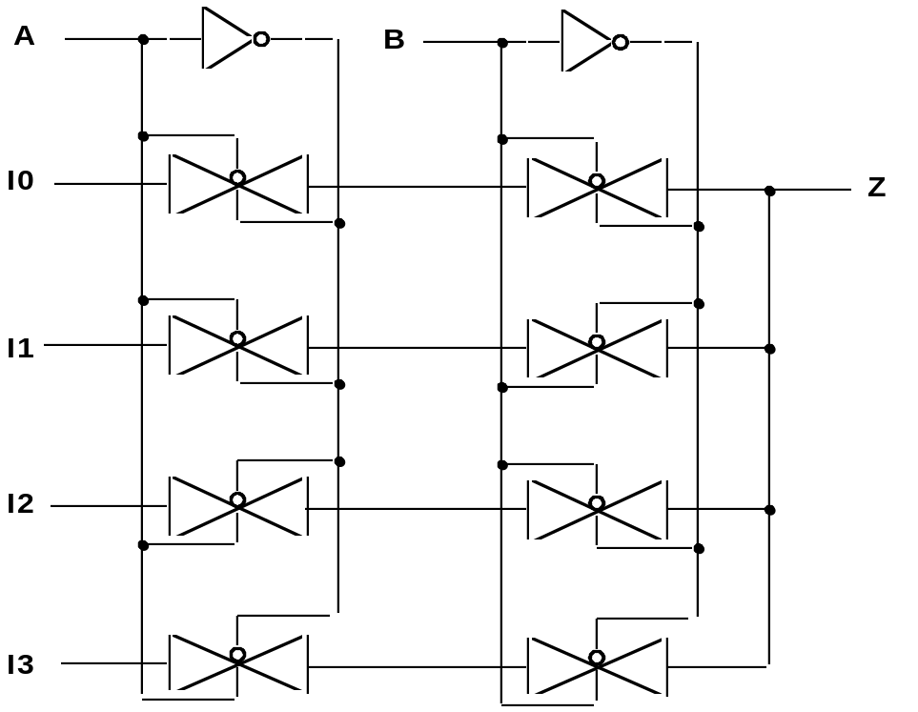
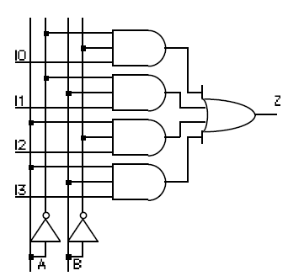
Multiplexers/Selectors
Alternative Implementations
Gate Level
Implementation
of 4:1 Mux
Transmission Gate
Implementation of
4:1 Mux
thirty six transistors
twenty transistors

Slide 19
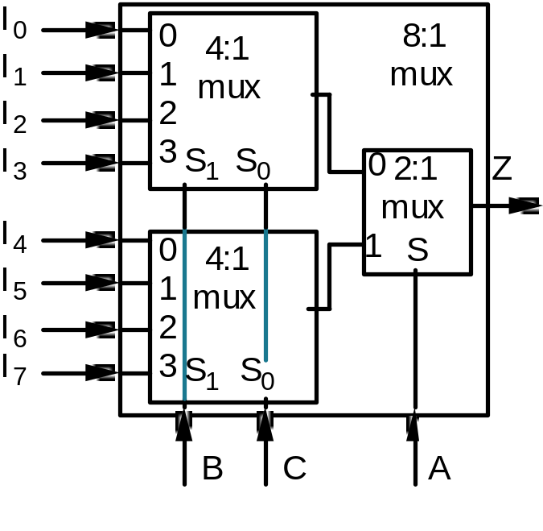
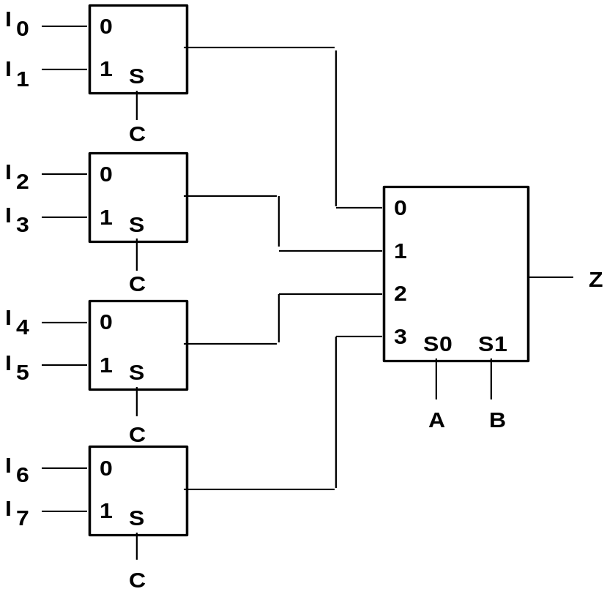
Multiplexer/Selector
Large multiplexers can be implemented by cascaded smaller ones
Control signals B and C simultaneously
choose one of I0-I3 and I4-I7
Control signal A chooses which of the
upper or lower MUX's output to gate to Z
Alternative 8:1 Mux Implementation

Slide 20
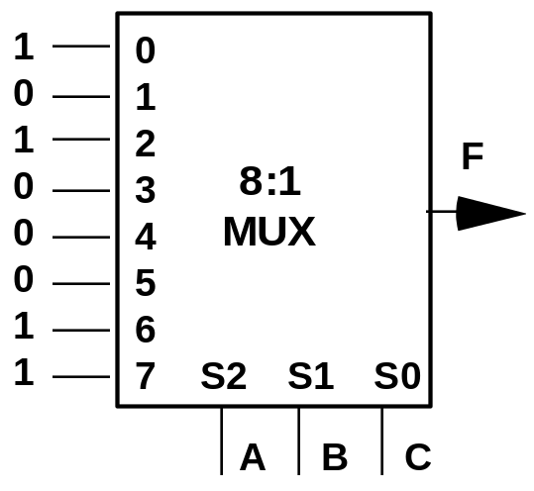
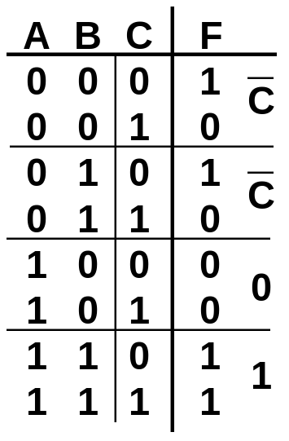
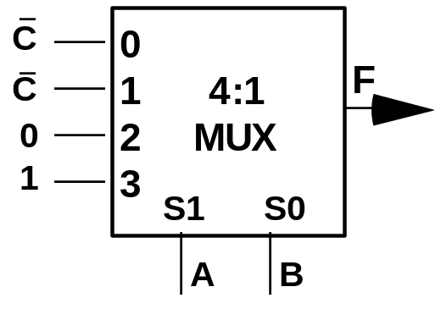
Multiplexer/Selector
Multiplexers/selectors as a general purpose logic block
n-1
2 :1 multiplexer can implement any function of n variables
n-1 control variables; remaining variable is a data input to the mux
Example:
F(A,B,C) = m0 + m2 + m6 + m7
= A' B' C' + A' B C' + A B C' + A B C
= A' B' (C') + A' B (C') + A B' (0) + A B (1)
"Lookup Table"

Slide 21
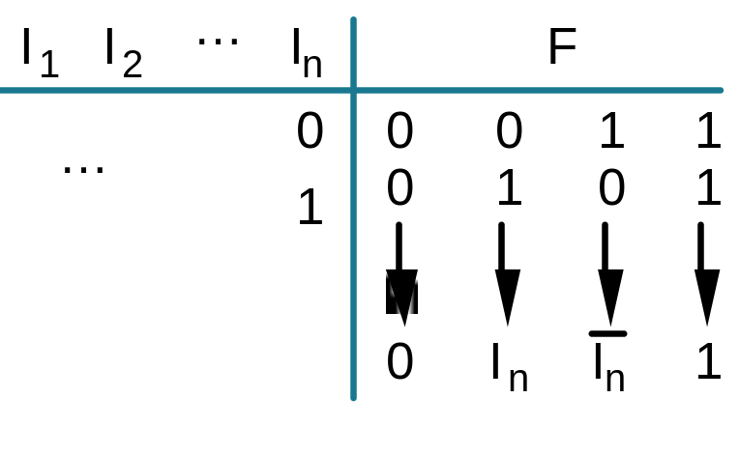
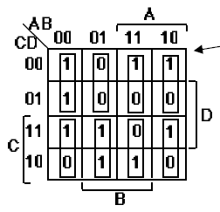
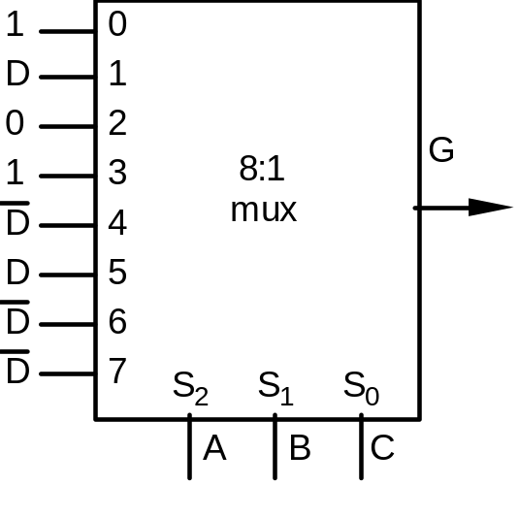
Multiplexer/Selector
Generalization
Four possible
configurations
of the truth table rows
n-1 Mux
control variables
single Mux
data variable
Can be expressed as
a function of In, 0, 1
Example:
G(A,B,C,D) can be implemented by an 8:1 MUX:
K-map
Choose A,B,C
as control variables
Multiplexer
Implementation
TTL package efficient
May be gate inefficient

Slide 22
Decoders/Demultiplexers
n
Decoder: single data input, n control inputs, 2 outputs
control inputs (called select S) represent Binary index of output to which
the input is connected
data input usually called "enable" (G)
1:2 Decoder:
3:8 Decoder:
O0 = G • S; O1 = G • S
O0 = G • S0 • S1 • S2
O1 = G • S0 • S1 • S2
O2 = G • S0 • S1 • S2
O3 = G • S0 • S1 • S2
O4 = G • S0 • S1 • S2
O5 = G • S0 • S1 • S2
O6 = G • S0 • S1 • S2
O7 = G • S0 • S1 • S2
2:4 Decoder:
O0 = G • S0 • S1
O1 = G • S0 • S1
O2 = G • S0 • S1
O3 = G • S0 • S1

Slide 23
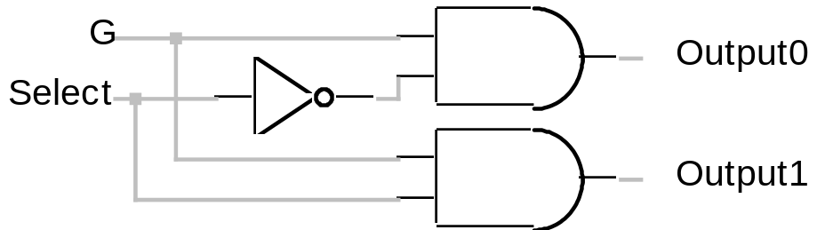
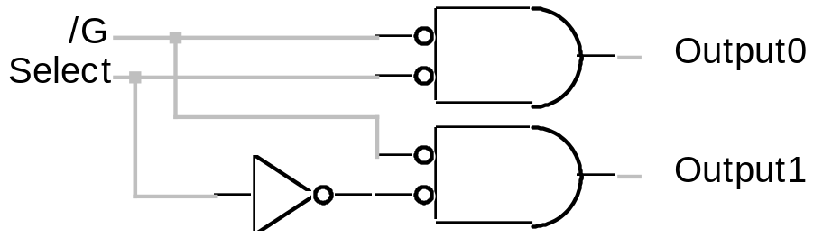
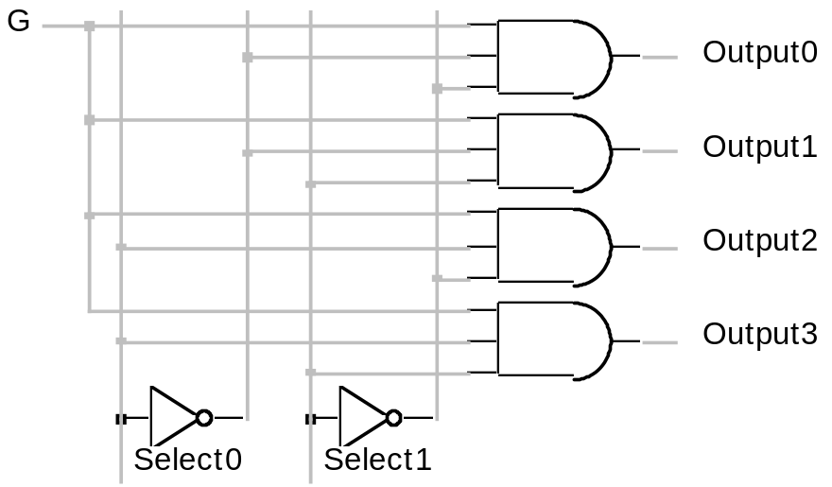
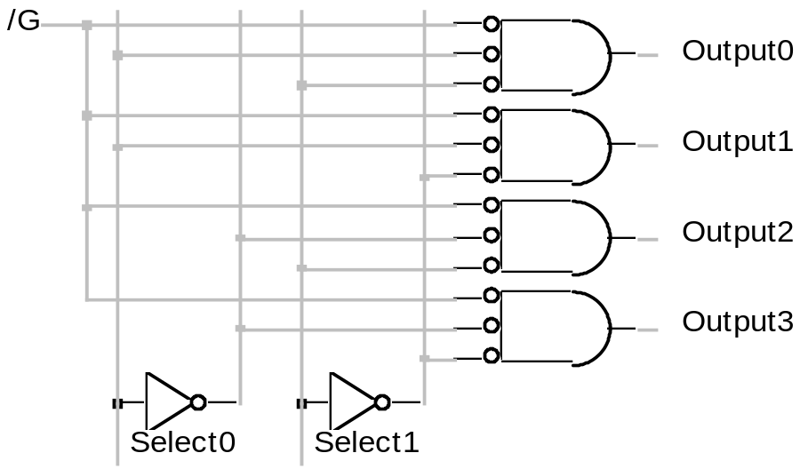
Decoders/Demultiplexers
Alternative Implementations
1:2 Decoder, Active High Enable
1:2 Decoder, Active Low Enable
2:4 Decoder, Active High Enable
2:4 Decoder, Active Low Enable

Slide 24
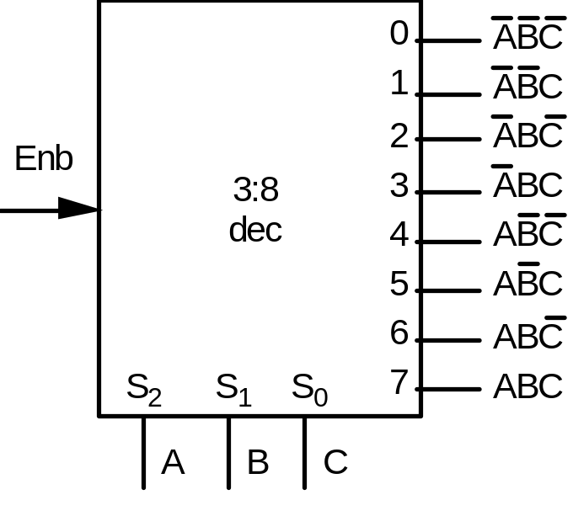
Decoder/Demultiplexer
Decoder as a Logic Building Block
Decoder Generates Appropriate
Minterm based on Control Signals
Example Function:
F1 = A' B C' D + A' B' C D + A B C D
F2 = A B C' D' + A B C
F3 = (A' + B' + C' + D')

Slide 25
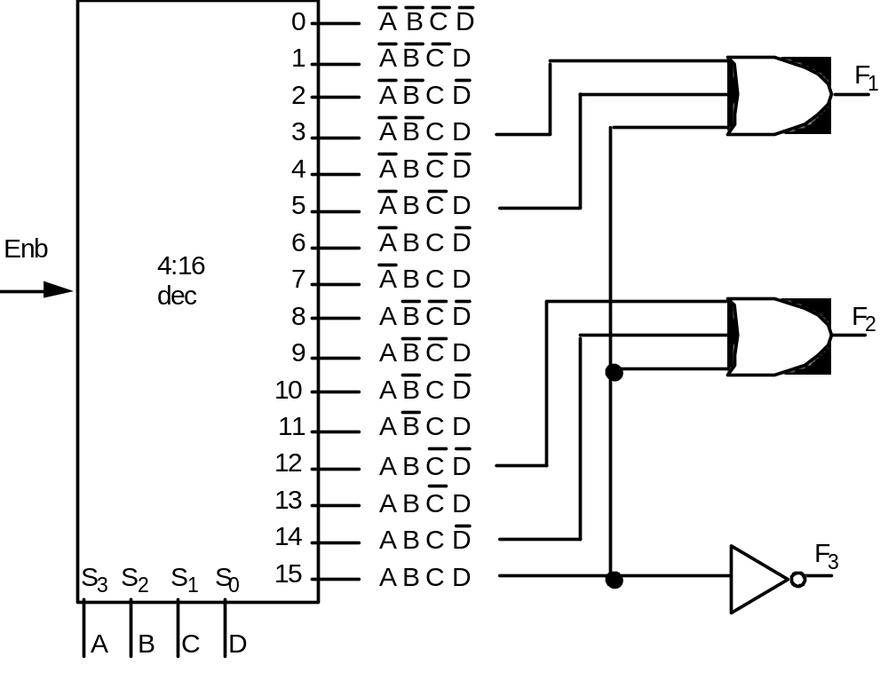
Decoder/Demultiplexer
Decoder as a Logic Building Block
F1 = A' B C' D + A' B' C D + A B C D
F2 = A B C' D' + A B C
F3 = (A' + B' + C' + D')
If active low enable, then use NAND gates!

Slide 26
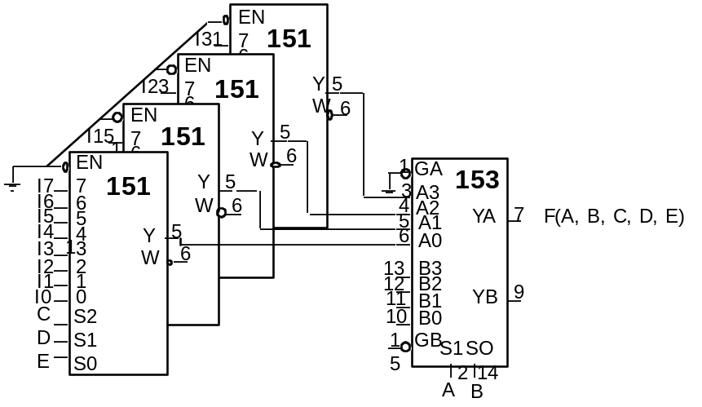
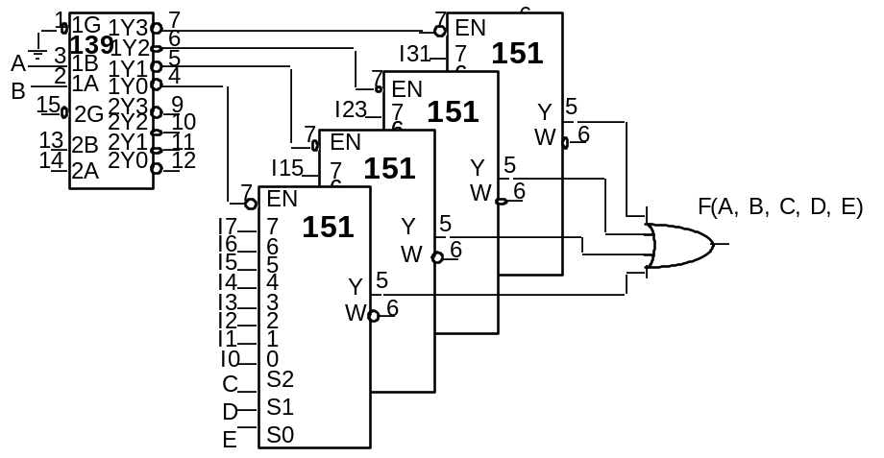
Multiplexers/Decoders
Alternative Implementations of 32:1 Mux
2:4 demux
Multiplexer Only
Multiplexer + Decoder
74151 – 8:1 Mux
74153 – 4:1 Mux
74138 – 3:8 Demux
74139 – 2:4 Demux

Slide 27
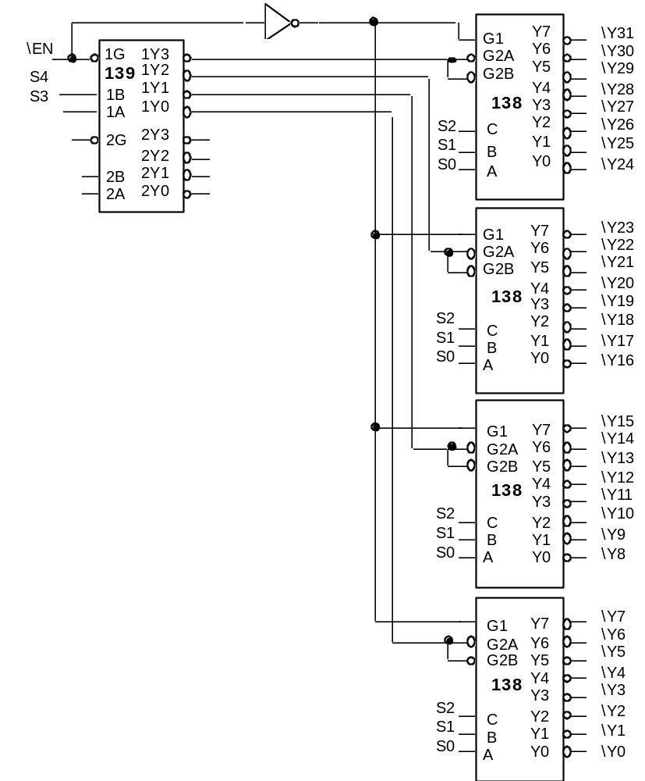
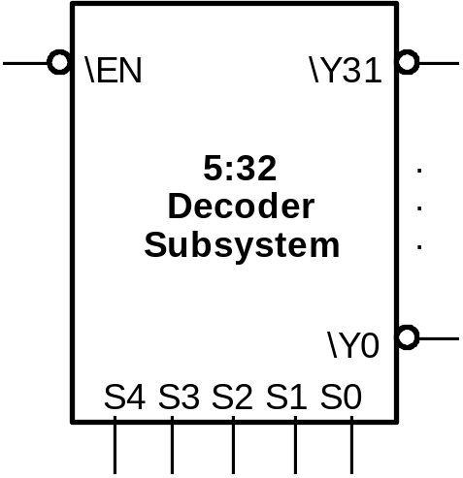
Multiplexers/Decoders
5:32 Decoder
74151 – 8:1 Mux
74153 – 4:1 Mux
4139 – 2:4 Demux

Slide 28
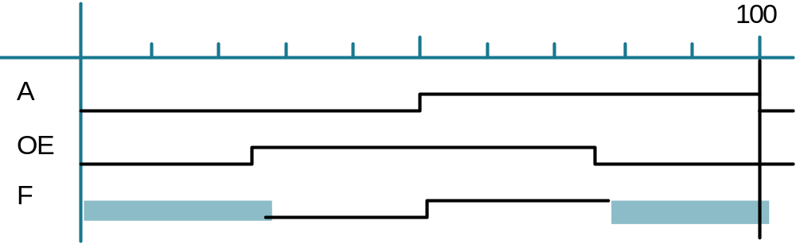
Tri-State and Open-Collector
The Third State
Logic States: "0", "1"
Don't Care/Don't Know State: "X" (must be some value in real circuit!)
Third State: "Z" — high impedance — infinite resistance, no connection
Tri-state gates: output values are "0", "1", and "Z"
additional input: output enable (OE)
A
X
0
1
OE
0
1
1
F
Z
0
1
When OE is high, this gate is a non-inverting "buffer"
When OE is low, it is as though the gate was
disconnected from the output!
This allows more than one gate to be connected to the
same output wire, as long as only one has its
output enabled at the same time
Non-inverting buffer's
timing waveform
"Z"
"Z"

Slide 29
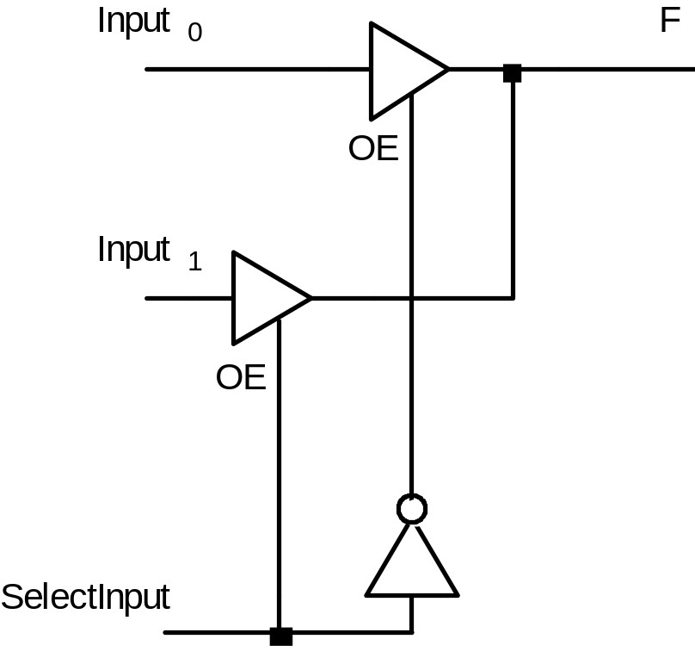
Tri-state and Open Collector
Using tri-state gates to implement an economical multiplexer:
When SelectInput is asserted high
Input1 is connected to F
When SelectInput is driven low
Input0 is connected to F
This is essentially a 2:1 Mux

Slide 30
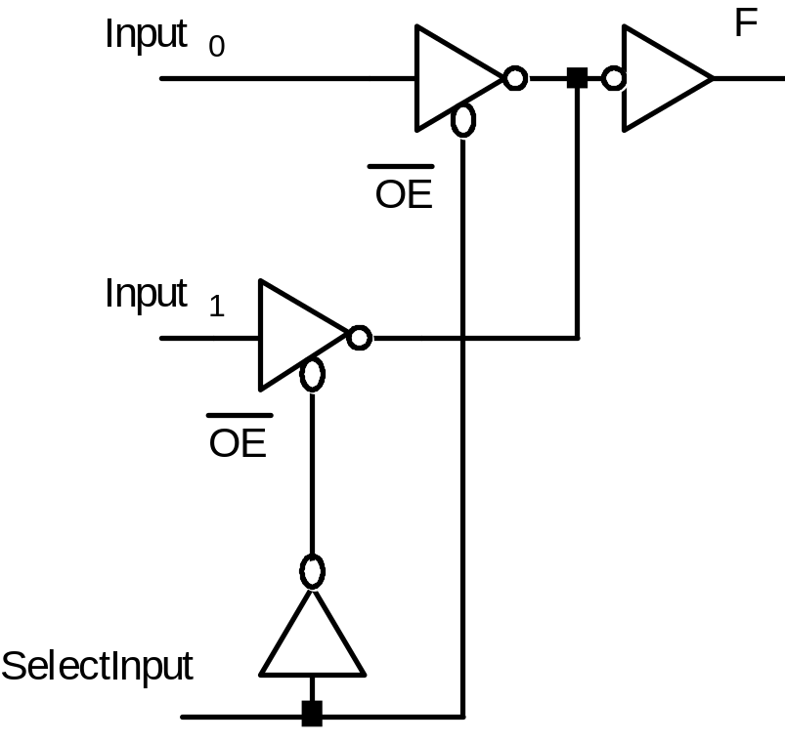
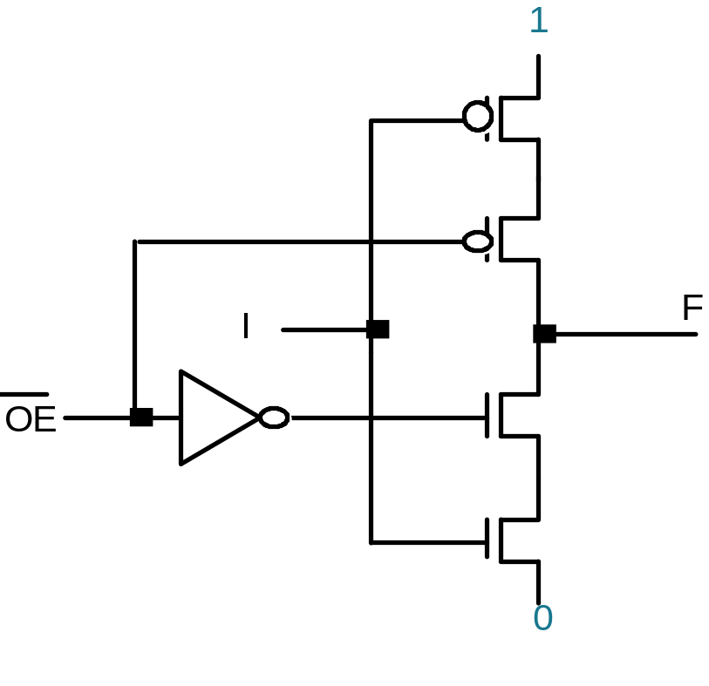
Tri-state and Open Collector
Alternative Tri-state Fragment
Active low tri-state enables
plus inverting tri-state buffers
Switch Level Implementation
of tri-state gate

Slide 31
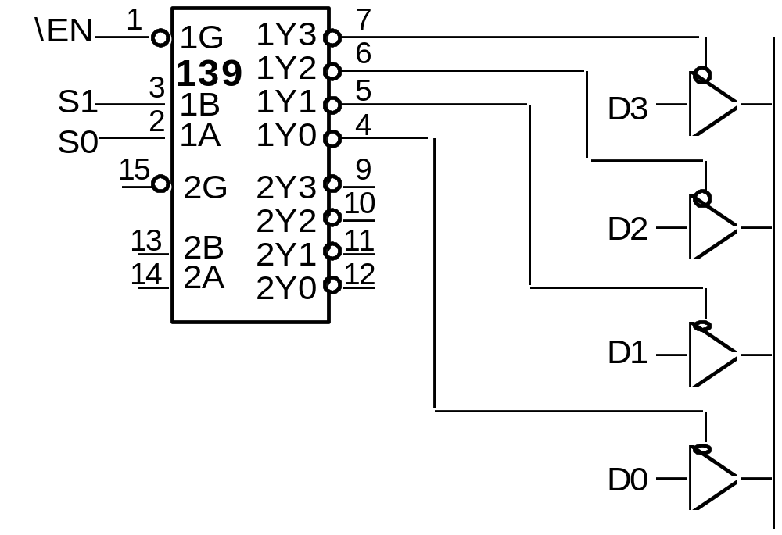
Tri-State and Open Collector
4:1 Multiplexer, Revisited
Decoder + 4 tri-state Gates

Slide 32
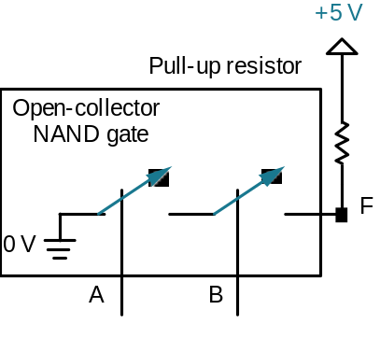
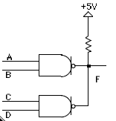
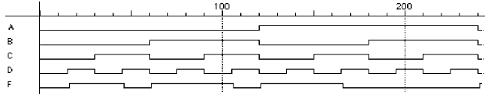
Tri-State and Open Collector
Open Collector
another way to connect multiple gates to the same output wire
gate only has the ability to pull its output low; it cannot actively
drive the wire high
this is done by pulling the wire up to a logic 1 voltage through a
resistor
OC NAND gates
Wired AND:
If A and B are "1", output is actively pulled low
if C and D are "1", output is actively pulled low
if one gate is low, the other high, then low wins
if both gates are "1", the output floats, pulled
high by resistor
Hence, the two NAND functions are AND'd
together!

Slide 33
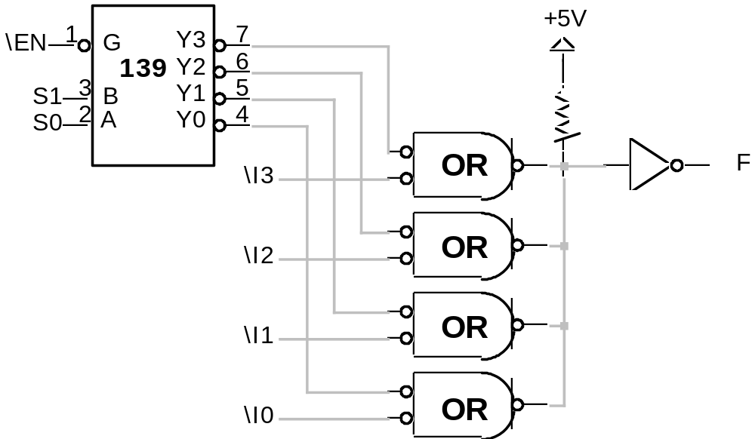
Tri-State and Open Collector
4:1 Multiplexer
Decoder + 4 Open Collector Gates

Slide 34
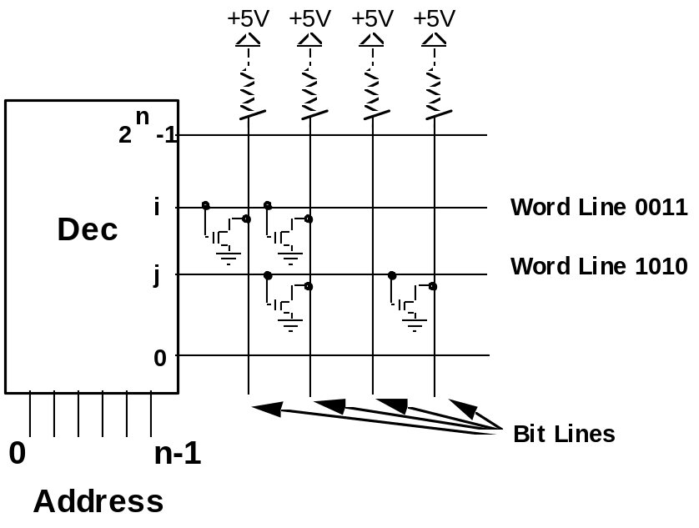
Read-Only Memories
ROM: Two dimensional array of 1's and 0's
Row is called a "word"; index is called an "address"
Width of row is called bit-width or wordsize
Address is input, selected word is output
Internal Organization

Slide 35
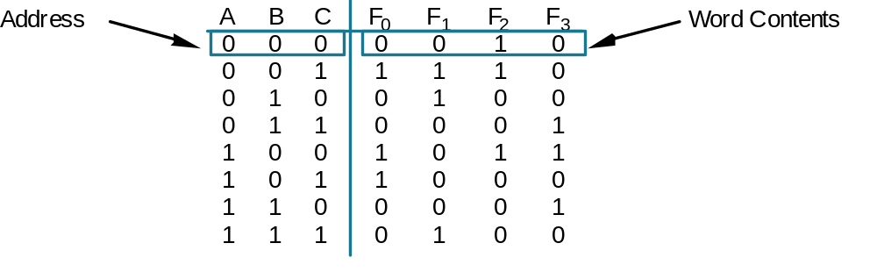
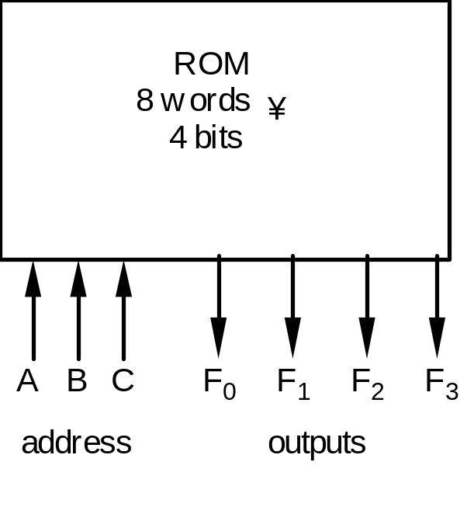
Read-Only Memories
Example: Combination Logic Implementation
F0 = A' B' C + A B' C' + A B' C
F1 = A' B' C + A' B C' + A B C
F2 = A' B' C' + A' B' C + A B' C'
F3 = A' B C + A B' C' + A B C'
by

Slide 36
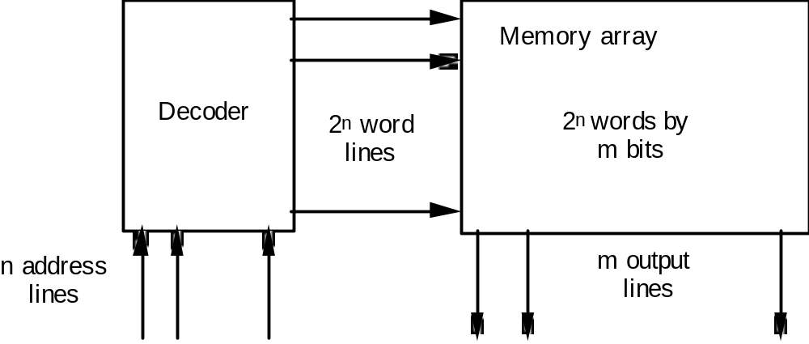
Read-Only Memories
Not unlike a PLA
structure with a
fully decoded
AND array!
ROM vs. PLA:
ROM approach advantageous when
(1) design time is short (no need to minimize output functions)
(2) most input combinations are needed (e.g., code converters)
(3) little sharing of product terms among output functions
ROM problem: size doubles for each additional input, can't use don't cares
PLA approach advantangeous when
(1) design tool like espresso is available
(2) there are relatively few unique minterm combinations
(3) many minterms are shared among the output functions
PAL problem: constrained fan-ins on OR planes

Slide 37


Read-Only Memories
2764 EPROM
8K x 8
16K x 16
Subsystem

Slide 38
Combinational Logic Word Problems
General Design Procedure
1. Understand the Problem
what is the circuit supposed to do?
write down inputs (data, control) and outputs
draw block diagram or other picture
2. Formulate the Problem in terms of a truth table or other suitable
design representation
truth table or waveform diagram
3. Choose Implementation Target
ROM, PAL, PLA, Mux, Decoder + OR, Discrete Gates
4. Follow Implementation Procedure
K-maps, espresso, misII

Slide 39
Combinational Logic Word Problems
Process Line Control Problem
Statement of the Problem
Rods of varying length (+/-10%) travel on conveyor belt
Mechanical arm pushes rods within spec (+/-5%) to one side
Second arm pushes rods too long to other side
Rods too short stay on belt
3 light barriers (light source + photocell) as sensors
Design combinational logic to activate the arms
Understanding the Problem
Inputs are three sensors, outputs are two arm control signals
Assume sensor reads "1" when tripped, "0" otherwise
Call sensors A, B, C
Draw a picture!

Slide 40

Combinational Logic Word Problems
Process Control Problem
Where to place the light sensors A, B, and C to distinguish among
the three cases?
Assume that A detects the leading edge of the rod on the conveyor

Slide 41

Combinational Logic Word Problems
Process Control Problem
A to B distance place apart at specification - 5%
A to C distance placed apart at specification +5%

Slide 42

Combinational Logic Word Problems
Process Control Problem
Truth table and logic implementation
now straightforward
"too long" = A B C
(all three sensors tripped)
"in spec" = A B C'
(first two sensors tripped)

Slide 43


Combinational Logic Word Problems
BCD to 7 Segment Display Controller
Understanding the problem:
input is a 4 bit bcd digit
output is the control signals for the display
4 inputs A, B, C, D
7 outputs C0 — C6
Block Diagram

Slide 44

Combinational Logic Word Problems
BCD to 7 Segment Display Controller
Formulate the problem in terms of a
truth table
Choose implementation target:
if ROM, we are done
don't cares imply PAL/PLA may be
attractive
Follow implementation procedure:
hand reduced K-maps
vs.
espresso

Slide 45



Combinational Logic Word Problems
BCD to 7 Segment Display Controller
C0 = A + B D + C + B' D'
C1 = A + C' D' + C D + B'
C2 = A + B + C' + D
C3 = B' D' + C D' + B C' D + B' C
C4 = B' D' + C D
C5 = A + C' D' + B D' + B C'
C6 = A + C D' + B C' + B' C
14 Unique Product Terms

Slide 46

Combinational Logic Word Problems
BCD to 7 Segment
Display Controller
16H8PAL
Can Implement
the function

Slide 47

Combinational Logic Word Problems
BCD to 7 Segment
Display Controller
14H8PAL
Cannot Implement
the function

Slide 48
Combinational Logic Word Problems
BCD to7 Segment Display Controller
.i 4
.o 7
.ilb a b c d
.ob c0 c1 c2 c3 c4 c5 c6
.p 16
0000 1111110
0001 0110000
0010 1101101
0011 1111001
0100 0110011
0101 1011011
0110 1011111
0111 1110000
1000 1111111
1001 1110011
1010 -------
1011 -------
1100 -------
1101 -------
1110 -------
1111 -------
.e
.i 4
.o 7
.ilb a b c d
.ob c0 c1 c2 c3 c4 c5 c6
.p 9
-10- 0000001
-01- 0001001
-0-1 0110000
-101 1011010
--00 0110010
--11 1110000
-0-0 1101100
1--- 1000011
-110 1011111
.e
C0 = B C' D + C D + B' D' + B C D' + A
C1 = B' D + C' D' + C D + B' D'
C2 = B' D + B C' D + C' D' + C D + B C D'
C3 = B C' D + B' D + B' D' + B C D'
C4 = B' D' + B C D'
C5 = B C' D + C' D' + A + B C D'
C6 = B' C + B C' + B C D' + A
9 Unique Product Terms!
espresso
output
63 Literals, 20 Gates
espresso
input

Slide 49

Combinational Logic Word Problems
BCD to 7 Segment Display Controller
PLA Implementation
C0 = B C' D + C D + B' D' + B C D' + A
C1 = B' D + C' D' + C D + B' D'
C2 = B' D + B C' D + C' D' + C D + B C D'
C3 = B C' D + B' D + B' D' + B C D'
C4 = B' D' + B C D'
C5 = B C' D + C' D' + A + B C D'
C6 = B' C + B C' + B C D' + A
9 Unique Product Terms!

Slide 50
Combinational Logic Word Problems
BCD to7 Segment Display Controller
Multilevel Implementation
X = C' + D'
Y = B' C'
C0 = C3 + A' B X' + A D Y
C1 = Y + A' C5' + C' D' C6
C2 = C5 + A' B' D + A' C D
C3 = C4 + B D C5 + A' B' X'
C4 = D' Y + A' C D'
C5 = C' C4 + A Y + A' B X
C6 = A C4 + C C5 + C4' C5 + A' B' C
52 literals
33 gates
Ineffective use of don't cares

Slide 51

Combinational Logic Word Problems
Logical Function Unit
Statement of the Problem:
3 control inputs: C0, C1, C2
2 data inputs: A, B
1 output: F

Slide 52


Combinational Logic Word Problems
Logical Function Unit
Formulate as a truth table
Choose implementation technology
5-variable K-map
espresso
multiplexor implementation
4 TTL packages:
4 x 2-input NAND
4 x 2-input NOR
2 x 2-input XOR
8:1 MUX

Slide 53

Combinational Logic Word Problems
Logical Function Unit
Follow implementation procedure
F = C2' A' B' + C0' A B'
+ C0' A' B + C1' A B
5 gates, 5 inverters
Also four packages:
4 x 3-input NAND
1 x 4-input NAND
Alternative: 32 x 1-bit ROM
single package

Slide 54
Chapter Review
• Non-Simple Gate Logic Building Blocks:
• Combinational Word Problems:
PALs/PLAs
Multiplexers/Selecters
Decoders
ROMs
Tri-state, Open Collector
Understand the Problem
Formulate in terms of a Truth Table
Choose implementation technology
Implement by following the design procedure

