Slide 1



Apache Maven
PunyaShloka M

Slide 2
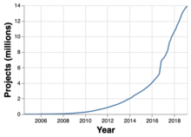


Introduction
Maven, created by Takari's Jason van Zyl, begain as a subproject of Apache Turbine in 2002. In 2003, it was voted on and accepted as a top level Apache Software Foundation project.
In July 2004, Maven's release was the critical first milestone, v1.0. Current version 3.6.1.
14.6 Million and growing…

Slide 3
Maven has ~70% of the build tool market for Java applications
• ~20% of marketshare : Gradle
• ~10% of marketshare : Ant
• Very common in large companies
• Started in 2002, became top level Apache project in 2004
• Supported by all major IDEs
• Commonly used by large Open Source Projects (ie Spring Framework, Spring Boot, etc)

Slide 4
Apache Maven - De Facto Standard
• Apache Maven has established ‘standards’ used by other build tools
• Maven Standard Directory Layout - In most part adapted by other tools such as Gradle
• Artifact Naming - Apache Maven helped establish how Java artifacts are named.
• Artifact Repositories - Apache Maven established the structure of artifact repositories
• Prior to Maven these ‘standards’ did not exist
• New build tools are compatible with these ‘standards’

Slide 5
Artifact Naming
Project Naming Convention:
Example - 3.2.1-987-beta
• Major Version - first number - 3
• Minor Version - second number - 2
• Incremental Version (patch) - third number - 1
• Build Number - from CI Build - 987
• Qualifier - String Qualifier - ‘beta’
• Most common in use is just major.minor.incremental (3.2.1)

Slide 6
Maven Coordinates
Maven Coordinates are used to identify artifacts
• Together, they identify a ‘location’ in a Maven repository.
• groupId - Typically unique to an organization. Often the organization’s reverse domain is used.
But not always. Can be just ‘junit’.
• artifactId - typically the project name. A descriptor for the artifact
• version - refers to a specific version of the project.
• groupId and version can be inherited from a parent POM.

Slide 7
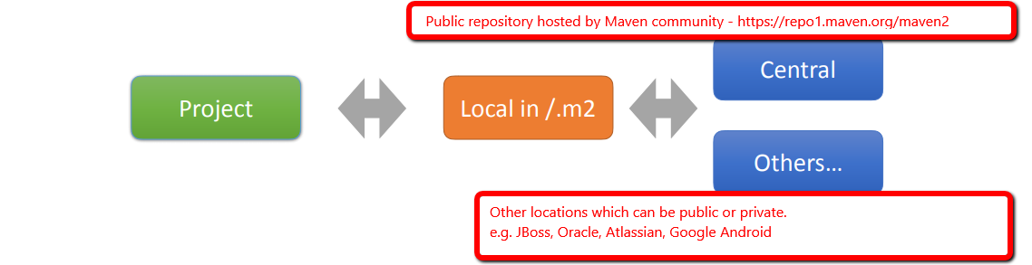
Snapshot vs Stable version
Snapshot : dev version. Check remote repository once/day. Can be configurable
Stable : Once pull, sit back & relax. Can be configurable.

Slide 8
Resolving an artifact
First: Check in the local repository
Next: Maven Central
Next: any additional repositories conf
Search order of additional repositorie
Typically not important
Is Alphabetical by repository id value

Slide 9
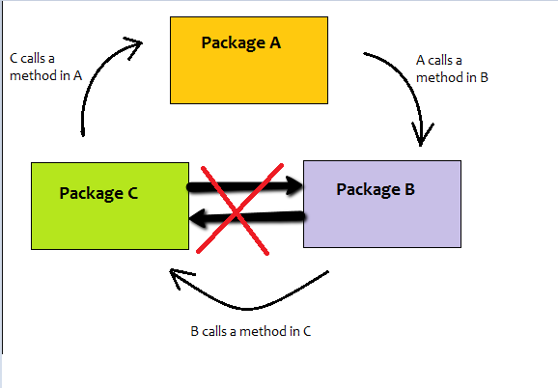
POM & Effective POM
Maven POM
POM - Project Object Model
Must comply with the maven-4.0.0.xsd
‘Effective POM’ - is the POM complete with inherited properties • mvn help:effective-pom
Pom : what developer understands
Effective POM : What maven understands
Maven Dependencies

Slide 10
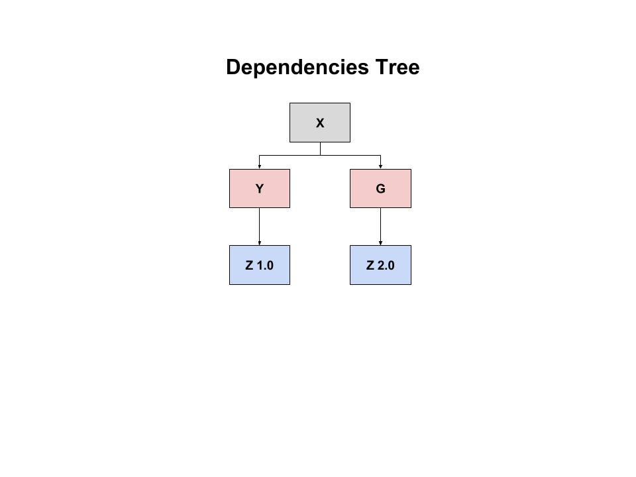
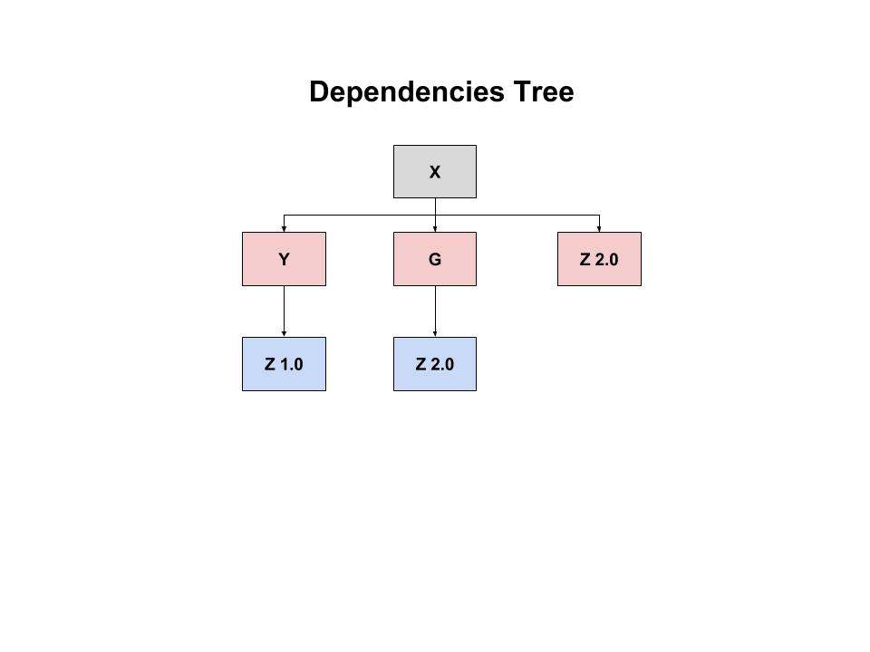
Dependency Conflict
X -> Y; W -> Y, Y->Z 1.0;
X -> G 2.0

Slide 11
Dependency Scope
compile
provided
runtime
test
system
import

Slide 12
Maven Mirror & Repositories
Mirror
Private Repository
JBoss
Atlasian
Global setting

Slide 13
Maven Build Lifecycles
Life Cycle
Plugins
Maven Site Plugin
maven resource Plugin
Maven Wrapper

Slide 14
Multi Module
Maven Refactor
Maven Revision (from 3.5) Maven CI
Maven change version

Slide 15
Spring Boot
Starter parent POM
Dependency Tree
Original Jar
manifest-MF
Actuator
Git with Actuator

Slide 16
Optional
Package Cloud
Nexus

