Slide 1



Big Data Analytics and Visualization Project IMSE586
GROUP MEMBERS: SUCHITHRA RAMACHANDRAN
PUNYA SRIDHARAN
ALKA

Slide 2
Data Sets
Project is based on two data sets: 1. 1.8 Million US Wildfire 2.Airbnb

Slide 3
1.88 Million US Wildfire
Found this data on Kaggle.com:
https://www.kaggle.com/rtatman/188-million-us-wildfires
Database of wildfires that occurred in the United States from 1992 to 2015, includes 1.88 million geo-referenced wildfire records, representing a total of 140 million acres burned during the 24-year period.

Slide 4
Research Questions (Hypothesis)
Have wildfires become more frequent over time ?
Which state had the highest number of fires
Do we have a peak season for fire?
Can we predict the number of fires given a year?

Slide 5
Methods
Wildfire was a huge dataset with date and time.
Used Time Series Analysis to analyse the data and answer the hypothesis questions using AR Model.

Slide 6
Data Cleaning
Checked for null values
Convert data time attribute to Data type DateTime and set that as index for the data frame.
Performed resampling

Slide 7
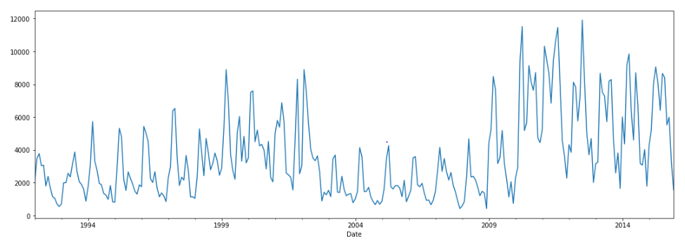
Initial checks
Created a line plot for the attribute that is going to be predicted. We chose FIRE_SIZE and below is the line plot.

Slide 8
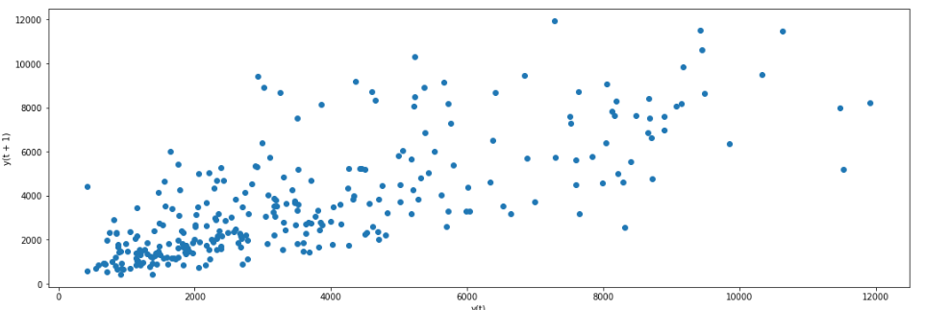
Initial checks
Check if the data set has autocorrelation ,We can plot the observation at the previous time step (t-1) with the observation at the next time step (t+1) as a scatter plot. It does shows a relationship or some correlation.

Slide 9
Analysis (AR Model)
Built a model to predict last 12 month fire size using AR model.
Removed the data inconsistency, variations and seasonality in order to make the mean constant.
Removed the variations through log and differencing to make the mean constant.

Slide 10
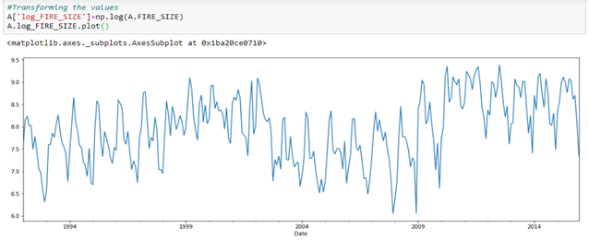
Transformation

Slide 11
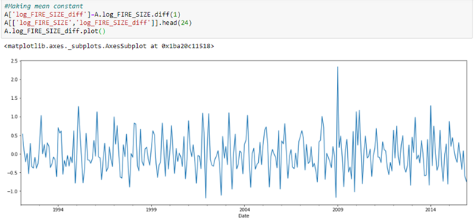
Mean Constant

Slide 12
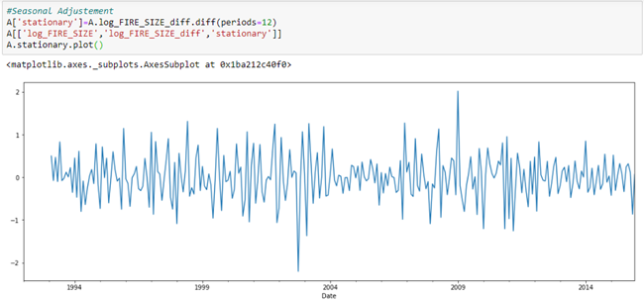
Seasonality Adjustment
Removed the seasonality variations to have constant mean to perform the time series analysis.

Slide 13
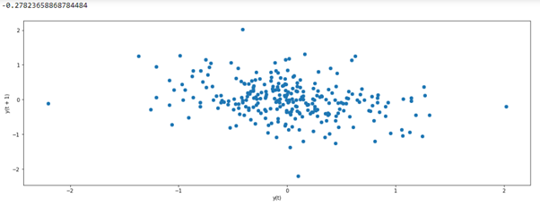
Correlation
Finding the correlation value and plotting a scatter plot for lag value=1

Slide 14
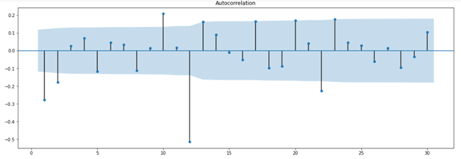
Autocorrelation
Autocorrelation plot to determine the coefficient value for 30 lag values

Slide 15
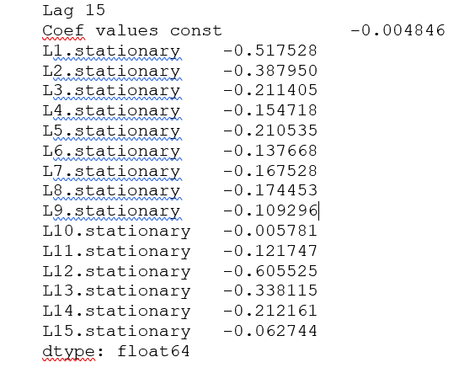
Coefficient values
Built an AR model for Frequency=’MS’. The model picked lag value=15 and below was the coefficient value for the 15 lags

Slide 16
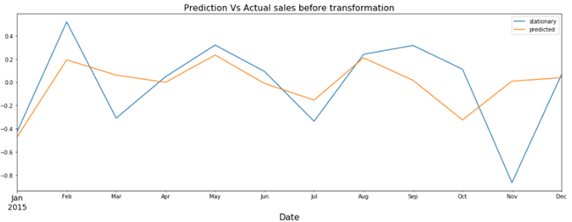
Prediction vs Actual
Built the prediction to have last 12 months of value into test which has values of the year 2015 and the train value has the value from 1992 to 2014 and below was the actual vs prediction before transformation.

Slide 17
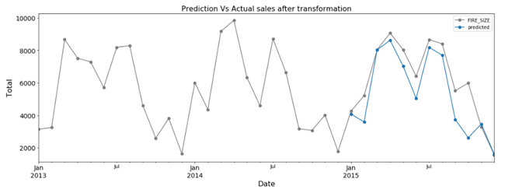
RMSE
The RMSE value is 1321.4

Slide 18
Conclusions
The statsmodels API does not make it easy to update the model as new observations become available.
Way it can be done is re-training the AR model each day as new observations become available, and that may be a valid approach, if not computationally expensive.
Alternative would be to use the learned coefficients and manually make predictions.

Slide 19
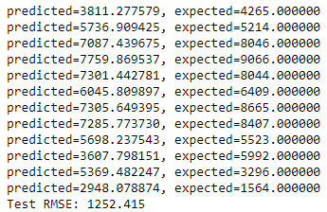
Manually calculates RMSE
When we calculate it manually we could see some drop in the RMSE value:

Slide 20
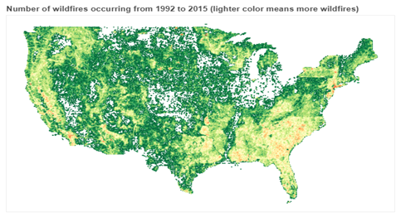
Heat Map of USA Wildfires

Slide 21
Visualization
Looking at the trend of total number of fires:
The count of the fire incident was highest in 2006 with some ups and downs.
Looking at the sum of the acres of forest burnt every year there is vast variation.
Conclusion that there are more number of small sized fires than large size.
But in 2015 there were large size fires.
To support our conclusion , we plotted the fire incidents for each class of fire, from A till G. A being the smallest and G being the largest

Slide 22
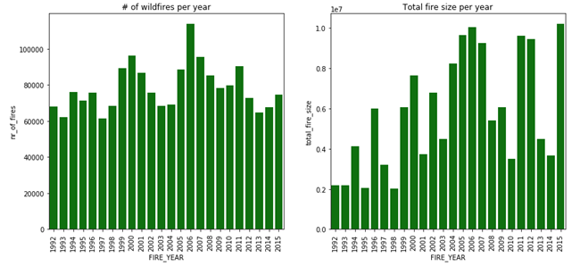

Slide 23
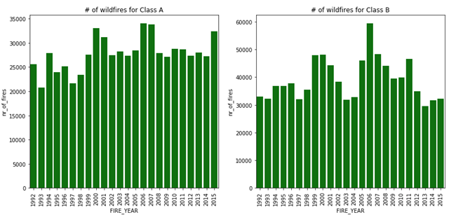
Class A and B

Slide 24
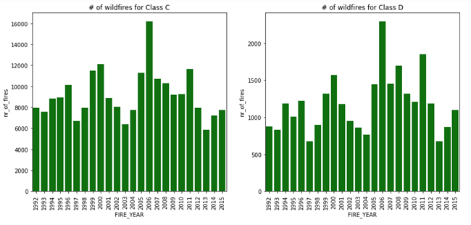
Class C and D

Slide 25
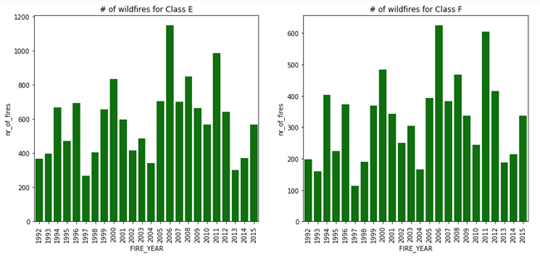
Class E and F

Slide 26
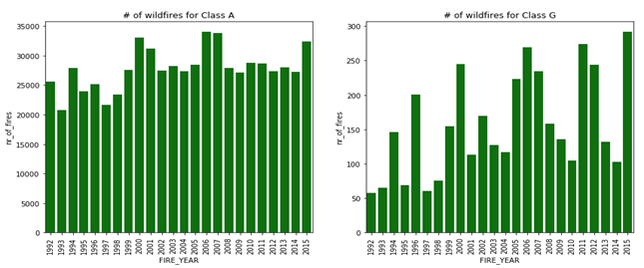
Class A and G

Slide 27
Small Fires >Large Fires
Looking at the count of fire for each class -A, B, C, D, E, F, G of fire, it can be concluded that there is rise in small size fire than larger fire.
Thus from the above graphs, we have solid evidence that small size fires are more frequent in occurrence than the larger ones.

Slide 28
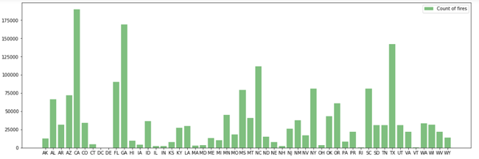
State with Highest Wildfire
We know california is more prone to forest fires due to its weather, populations and other factors.
The next graph justifies our assumption with CA having the highest number of wildfires

Slide 29
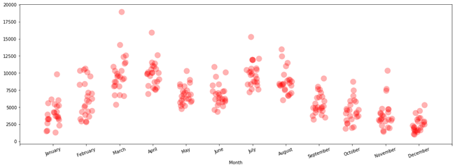
Peak Months for Wildfire

Slide 30
Conclusion
We know california is more prone to forest fires due to its weather, populations and other factors.
The graph justifies our assumption with CA having the highest number of wildfires.

Slide 31
Conclusion
Ideally the peak season of the fire should be in summer (June-August).
From the year 1992 to 2000 the peak season was during March-April, however from 2003 -2008 the number of fires were less around 4K range but from 2009-2015 ( on and off) there has been a spike with peak season from March to July/August

