Slide 1

CE7454 Project: Simultaneous Prediction of Box-ofﬁce and Movie Rating using Multimodal Neural Network
Group 26: Li Jie, Shen Meng, Wang Ruihang
School of Computer Science and Engineering
Nov 2019

Slide 2
Outline of This Slides
Project Introduction
Data Acquisition
Data Cleaning
Deep Learning Network
Results Analysis

Slide 3
Project Introduction
Notes:
The world’s movie industry has witnessed an unprecedented boom in recent years. With heavy investments in today’s movie industry, reliable predictions of a movie’s box-ofﬁce revenue before its theatrical release is essential for producers to reduce ﬁnancial risk. From the perspective of viewers, however, movie rating is an important factor to measure the quality of a movie.
In this project, we are interested in predicting both box-ofﬁce revenue and movie rating in an early stage, aiming to provide useful information for producers, distributors and viewers.

Slide 4
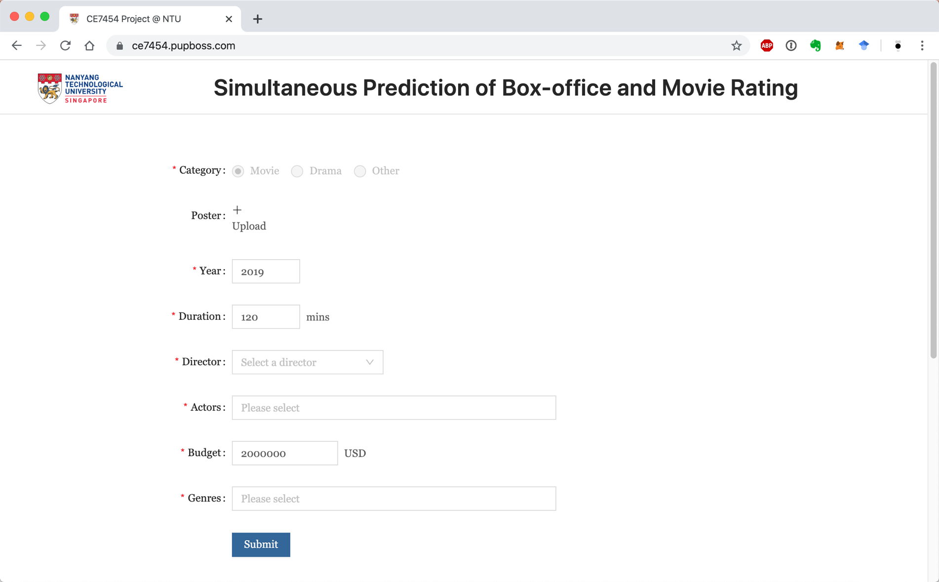
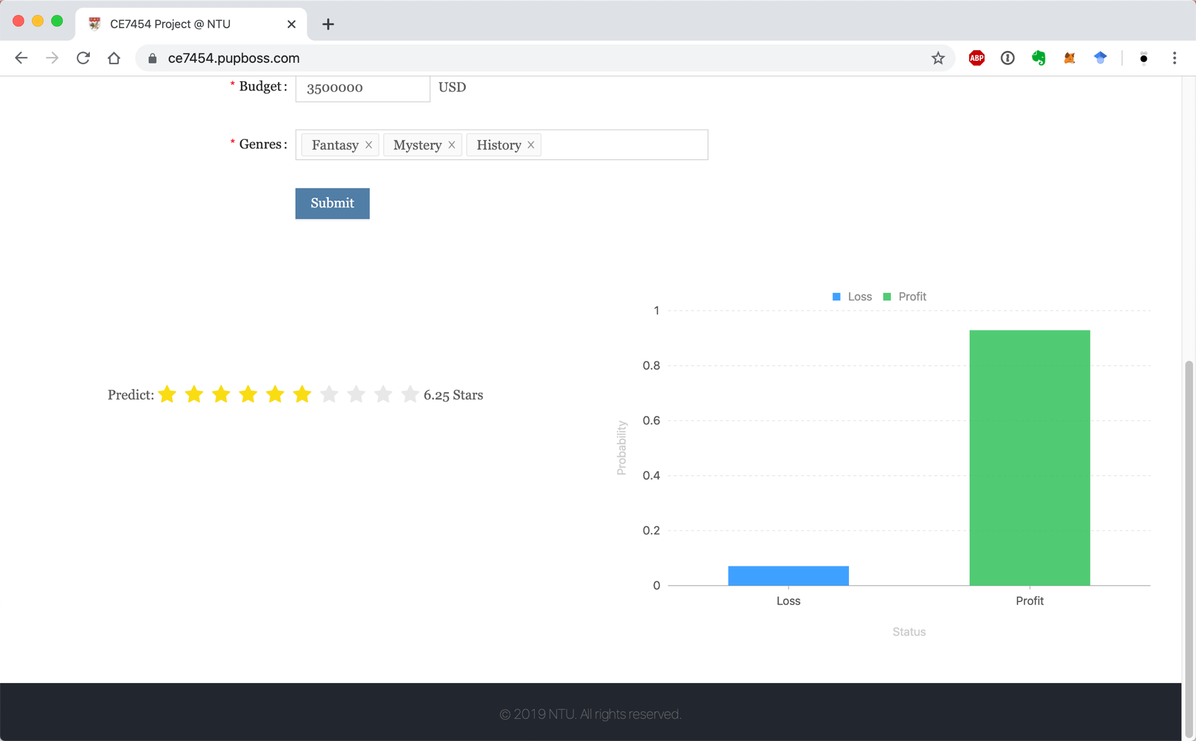
An Online Demo for Box-office Prediction
Website URL: https://ce7454.pupboss.com

Slide 5
Data Acquisition
Data Source:
IMDb official website
Crawler
Technologies in use
Python, Pandas, PyQuery, requests
Data Acquisition
Collected 8278 records including:
Titles, Budgets, Box Offices, Years, Directors, Actors, Ratings and etc.
Notes:
IMDb provides xxxx, so xxx, but xxxxx, we have to develop our own crawler
Python is a well known programming language, Pandas is used for data filtering and xxx, PyQuery is for parsing HTML doms, requests will be used in images downloading
Finally, we collected xxxx

Slide 6
Data Cleaning

Slide 7
Deep Learning Network

Slide 8
Results Analysis

Slide 9
Everyone’s Contribution
Project Proposal: Li Jie, Wang Ruihang, Shen Meng
Crawler Development: Shen Meng, Li Jie
Data Cleaning: Shen Meng, Li Jie, Wang Ruihang
Network Design: Wang Ruihang, Shen Meng
Data Analytics: Wang Ruihang
Online Demo and backend: Li Jie

Slide 10

THANKS

