Slide 1
CONTENT PRESERVING
WATERMARKING THROUGH
UNICODE HOMOGLYPH
SUBSTITUTION
-Abhishek Kumar (1406004)
-Prashant Kumar Singh (1406011)
-Sanjli Kumari (1406080)

Slide 2
OUTLINE
What is watermarking
Why watermarking
Cryptography vs. Steganography vs. watermarking
Category of Watermarking
Property of Watermarking
Watermarking on different media types
Text watermarking
Text watermarking techniques
Feature of technique used
Unicode confusable
Watermark Generation
Algorithm for embedding watermark
Algorithm for extraction of watermark
Authorship verification
Output
Drawback
Future Work

Slide 3
WHAT IS WATERMARKING
Message that can be embedded into the digital data like video, pictures, text and databases and the embedded data can be extracted later
insertion of imperceptible and inseparable information into data for data integrity

Slide 4
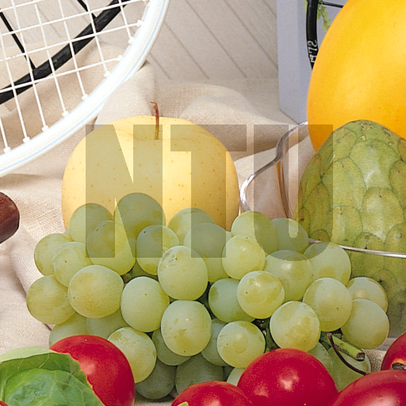

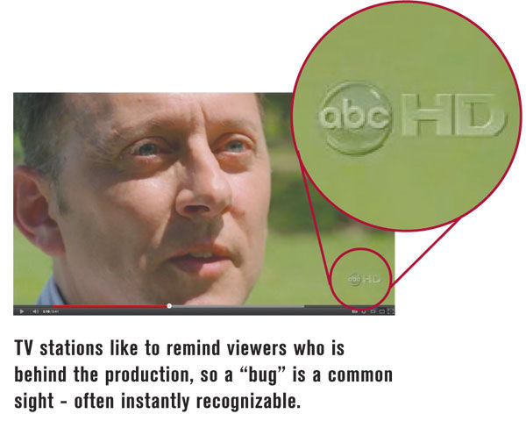
EXAMPLES

Slide 5
WHY WATERMARKING
for proof of ownership
copyrights protection
for tamper proofing
data integrity

Slide 6
CRYPTOGRAPHY VS.
STEGANOGRAPHY VS.
WATERMARKING

Slide 7
Cryptography algorithms make the document unreadable.
Steganography algorithms provide techniques to hide new information into the carrier, that is a readable document.
Watermarking algorithms ensure the authentication and the copyright protection by applying a watermark to the digital content.

Slide 8
CATEGORY OF
WATERMARKING

Slide 9
Invisible- Hidden in the carrier, does not appear to user.
Visible- Noticeable to the user.
Fragile- Detectable and can be easily altered and erased.
Distortion Based- Marking produces distortion to the underlying data.

Slide 10
Distortion Free- Does not produce any distortion to the data.
Robust- Detectable but not erasable.
Blind- No need of original document while extracting.
Non Blind- Requires original document while extracting.

Slide 11
PROPERTY OF WATERMARKING
Robustness
Security
Verifiability
Detectability
Cost
Data Payload

Slide 12
WATERMARKING FOR
DIFFERENT MEDIA TYPES
Text watermarking
Audio watermarking
Image watermarking
Video watermarking
Database watermarking

Slide 13
OUR WORK FOCUSES
ON
TEXT WATERMARKING

Slide 14
WHY TEXT WATERMARKING
Immense amount of textual knowledge is increasing daily
like- short text messages used for government, micro blogging
post, social media etc.
One of the largest bunch of digital contents that people can explore online.
Text watermarking is most difficult task among in comparison to other media watermarking.

Slide 15
TEXT WATERMARKING
TECHNIQUES
Image-based Techniques
Syntactic Techniques
Semantic Techniques
Structural Techniques

Slide 16
FEATURES
OF
OUR WORK

Slide 17
Belongs to Structural watermarking techniques.
Content preserving in nature
Password based watermark
Invisible
Detectable
Blind class

Slide 18
UNICODE CONFUSABLE
Among 120k of Unicode symbols some symbols are totally or partially indistinguishable from others with different hex codes.
Similarity between symbols represents security problem
These duplicates are being exploited to encode the bits of hidden payload.

Slide 19
 | Bit ‘ 0’ | Bit ‘1’
Symbol | Original Code | Duplicate Code
- | 0x002d | 0x2010
; | 0x003b | 0x037e
C | 0x0043 | 0x216d
D | 0x0044 | 0x216e
K | 0x004b | 0x212a
L | 0x004c | 0x216c
M | 0x004d | 0x216f
V | 0x0056 | 0x2164
X | 0x0058 | 0x2169
c | 0x0063 | 0x217d
d | 0x0064 | 0x217e
i | 0x0069 | 0x2170
j | 0x006a | 0x0458
l | 0x006c | 0x217c
v | 0x0076 | 0x2174
x | 0x0078 | 0x2179
Table 1.
Subset of confusable symbols used to encode the watermark. Original and Duplicate code for each symbol is shown.

Slide 20
White space | Bits | Unicode
Space | 000 | 0x0020
En Quad | 001 | 0x2000
Three-per-em Space | 010 | 0x2004
Four-per-em-Space | 010 | 0x2005
Punctuation Space | 011 | 0x2008
Thin Space | 100 | 0x2009
Narrow No-break Space | 110 | 0x202f
Medium Mathematical space | 111 | 0x205f
Table 2.
Encoding for white space symbols. In order to encode 3 bits in a single whitespace 8 different whitespace are used in total

Slide 21
FLOWCHART
Watermark
Generation
Embedding
of
Watermark
Extraction
of
Watermark
Authorship
Verification

Slide 22
WATERMARK GENERATION WITH PASSWORD
Text, t
All the world’s a stage and all the man and woman are merely players…
Hash(t,k)
Watermark, w
b9460a86157731eb
Password, k
***************
Given the original text ‘t’ and a password ‘k’, the Siphash function generates a cryptographic hash, representing the watermark w to be embedded.

Slide 23
UNICODE WATERMARK EMBEDDING
A the wor
Text
l
l
l
d
1 0 1 1 1 0 0 1 0 1
Watermark
Only the symbols with a related duplicate in Table 1 and 2 are used to embed the watermark.

Slide 24
ALGORITHM FOR EMBEDDING
1: T= {c1,….,c2} /*Text string of n Unicode characters */
2:Originals= {U+002c,U+002d,U+002e,…} /*List of confusable original symbols */
3:Duplicates={U+a4f9,U+2010,U+a4f8,…} /*List of confusable duplicate symbols*/
4:Space={U+0020,U+2002,U+2005,…} /*List of confusable white space*/
5:Confusables = Originals & Spaces /*List of all confusable*/
6: W = [b1,……,b64] /*Watermark bit array*/
7:GetDuplicate : Originals ->Duplicates
8:GetSpace : {000,……,111} -> Spaces
9: WT = [] /*watermarked text*/
10: for all c <- T do
11: if c <- Confusables /\ |W| !=0 then
12: if c <- Spaces then
13: bits = Pop(W,3)
14: lshift(bits,3-len(bits))
15: c= GetSpace(bits)
16: else
17: bit= Pop(W,1)
18: if bit = 1 then
19: c= GetDuplicate(c)
20: endif
21: endif
22: endif
23: Append(WT,c)
24:end for
35:return WT

Slide 25
ALGORITHM FOR EXTRACTION
1: /*Text string of n Unicode characters c*/
2: T= {c1,….,c2}
3: /*List of confusable original symbols */
4:Originals= {U+002c,U+002d,U+002e,…}
5:/*List of confusable duplicate symbols*/
6:Duplicates={U+a4f9,U+2010,U+a4f8,…}
7:/*List of confusable white space*/
8:Space={U+0020,U+2002,U+2005,…}
9: WT = [] /*Watermark bit array*/
10:SpaceMap : Space -> {000,……,111} /*Reverse mapping function*/
11: for all c <- T do
12: if c <- Spaces then
13: Append(W, SpaceMap(c))
14: else if c <- Originals then
15: Append(W,0)
16: else if c <- Duplicates then
17: Append(W,1)
18: endif
19: if |W| >= 64 then
20: break
21: endif
22: end for
23: return W[:64]

Slide 26
AUTHORSHIP VERIFICATION
Author
Hash(t,k)
w’ w
Text t with extracted Watermark w
Attacker
Hash(t,k’)
w’’ w
The password k is a proof of authorship. Once the watermark is extracted, only the author with the original password k is able to reproduce it.

Slide 27
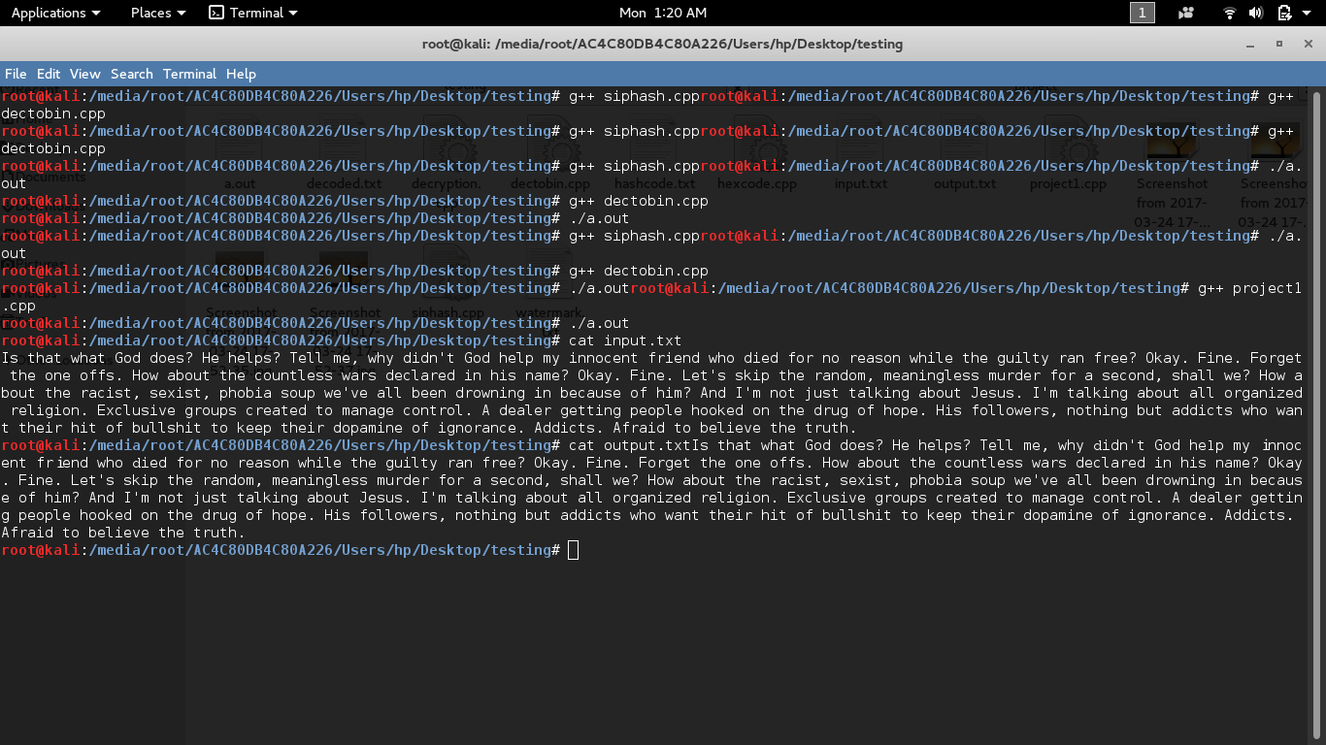
OUTPUT

Slide 28
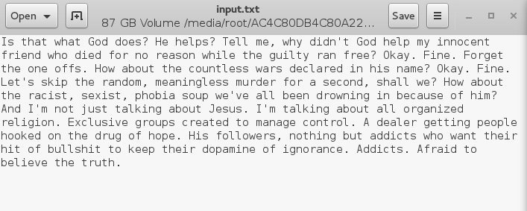
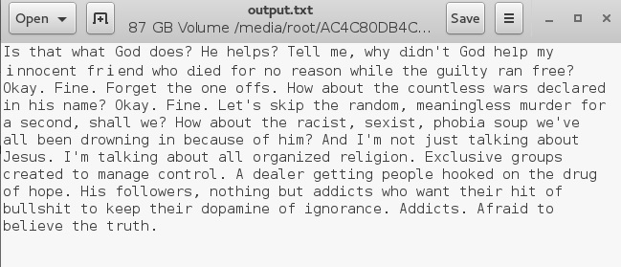
0x0064
0x006c
0x0069
0x217e
0x217c
0x2170

Slide 29
DRAWBACKS
Rewriting of the text manually.
Using OCR(Optical Character Recognition) Tool.

Slide 30
FUTURE WORK
Applying watermarking techniques to XML documents.
Most of the data now, like of Facebook, twitter, etc. are managed in XML form.
It becomes necessary to watermark them.

Slide 31
REFRENCES
http://dl.acm.org/citation.cfm
ftp://ftp.unicode.org/Public/security/revision-02/confusables.txt
https://en.wikipedia.org/wiki/SipHash
https://github.com/majek/csiphash
https://www.slideshare.net/ankushkr007/digital-watermarking-15450118
https://en.wikipedia.org/wiki/Digital_watermarking

Slide 32
THANK YOU
QUESTIONS??

