Slide 1
...TGTATATGAGAAATATCATTGTCGCGTGAA...
...TAATACCCATATCGCCGAGGGAAAAGCCGA...
...TGTATCTCATAATACCCATTGACGCGCGGA...
...TGAATATGAATGAATATCATCATCGCGTGA...
...TGTCTCCGAGAAATATCATTGTCGCGTGAA...
...TGTATATGAGAAATATCATTGTCGCGTGAA...

Slide 2
...TGTATATGAGAAATATCATTGTCGCGTGAA...
...TAATACCCATATCGCCGAGGGAAAAGCCGA...
...TGTATCTCATAATACCCATTGACGCGCGGA...
...TGAATATGAATGAATATCATCATCGCGTGA...
...TGTCTCCGAGAAATATCATTGTCGCGTGAA...
...TGTATATGAGAAATATCATTGTCGCGTGAA...

Slide 3
...TGTATATGAGAAATATCATTGTCGCGTGAA...
...TAATACCCATATCGCCGAGGGAAAAGCCGA...
...TGTATCTCATAATACCCATTGACGCGCGGA...
...TGAATATGAATGAATATCATCATCGCGTGA...
...TGTCTCCGAGAAATATCATTGTCGCGTGAA...
...TGTATATGAGAAATATCATTGTCGCGTGAA...

Slide 4
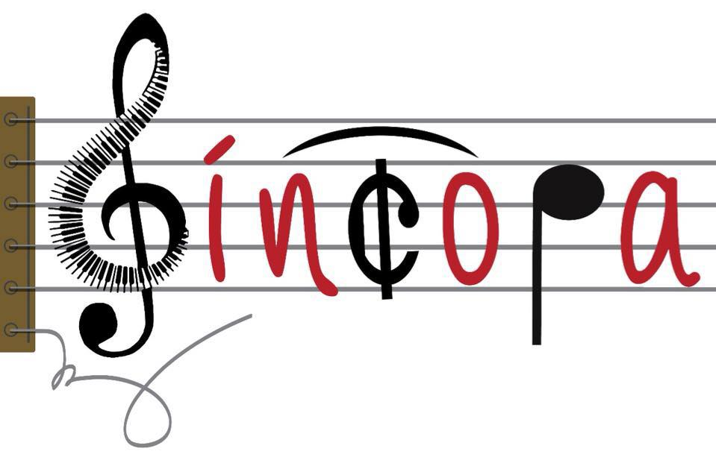
...TAATACCCATACATCGCGCGGAGTCTCCGAGGGAAAAGCCGA...
...TGTATCTCATTCATCGCCTCGAAATACCCATTGACGCGCGGA...
...TGAATATCATTCATCGCGTGAATGAATATCATCATCGCGTGA...
...TGTCTCCGAGAGAAAAAGCCGAGAATATCATTGTCGCGTGAA...
...TGTATATGAGAGAAAAAGTGAAGAATATCATTGTCGCGTGAA...

Slide 5
