Slide 1
Secure Data Hiding in Image using Steganography
CAPSTONE PROJECT
Presented By: Puppala Deepika
College Name: Marri Laxman Reddy Institute of Technology and Management
Department: Cyber Security

Slide 2
OUTLINE
Problem Statement
Technology used
Wow factor
End users
Result
Conclusion
Git-hub Link
Future scope

Slide 3
Problem Statement
In today's digital age, safeguarding sensitive information is essential. Conventional encryption techniques can draw undesired attention, complicating covert communication.
This project tackles the necessity for secure and stealthy message transmission by embedding secret messages within images through the use of image steganography.
It guarantees confidentiality by mandating a password for both encoding and decoding, ensuring that only authorized users can access the concealed data.
Moreover, the project features an intuitive GUI that facilitates effortless encryption and decryption, enhancing accessibility and user-friendliness.

Slide 4
Technology used
Python – The primary programming language utilized in this project.
OpenCV – Employed for processing images.
Tkinter – Serves as the GUI framework for user interface.
NumPy – Facilitates efficient management of image pixel data.
PIL (Pillow) – Provides image manipulation capabilities to ensure format compatibility.

Slide 5
Wow factors
Stealthy Message Embedding: The message is concealed within the image with no visible alterations.
Secure Access: Only authorized users can access the message due to password protection.
User-Friendly GUI: Provides an intuitive graphical interface for easy interaction.
Dynamic Pixel Allocation: The system automatically adjusts pixel storage to prevent errors.
Adaptable for Future Tech: Can be enhanced for AI-based steganography or blockchain security.

Slide 6
End users
Cybersecurity Experts: Utilize for secure data transmission.
Journalists & Whistleblowers: Send sensitive information discreetly.
Government & Intelligence Operatives: Engage in confidential communication.
Researchers & Academicians: Explore and experiment with steganography techniques.
General Users: Safeguard private messages from unauthorized access.

Slide 7
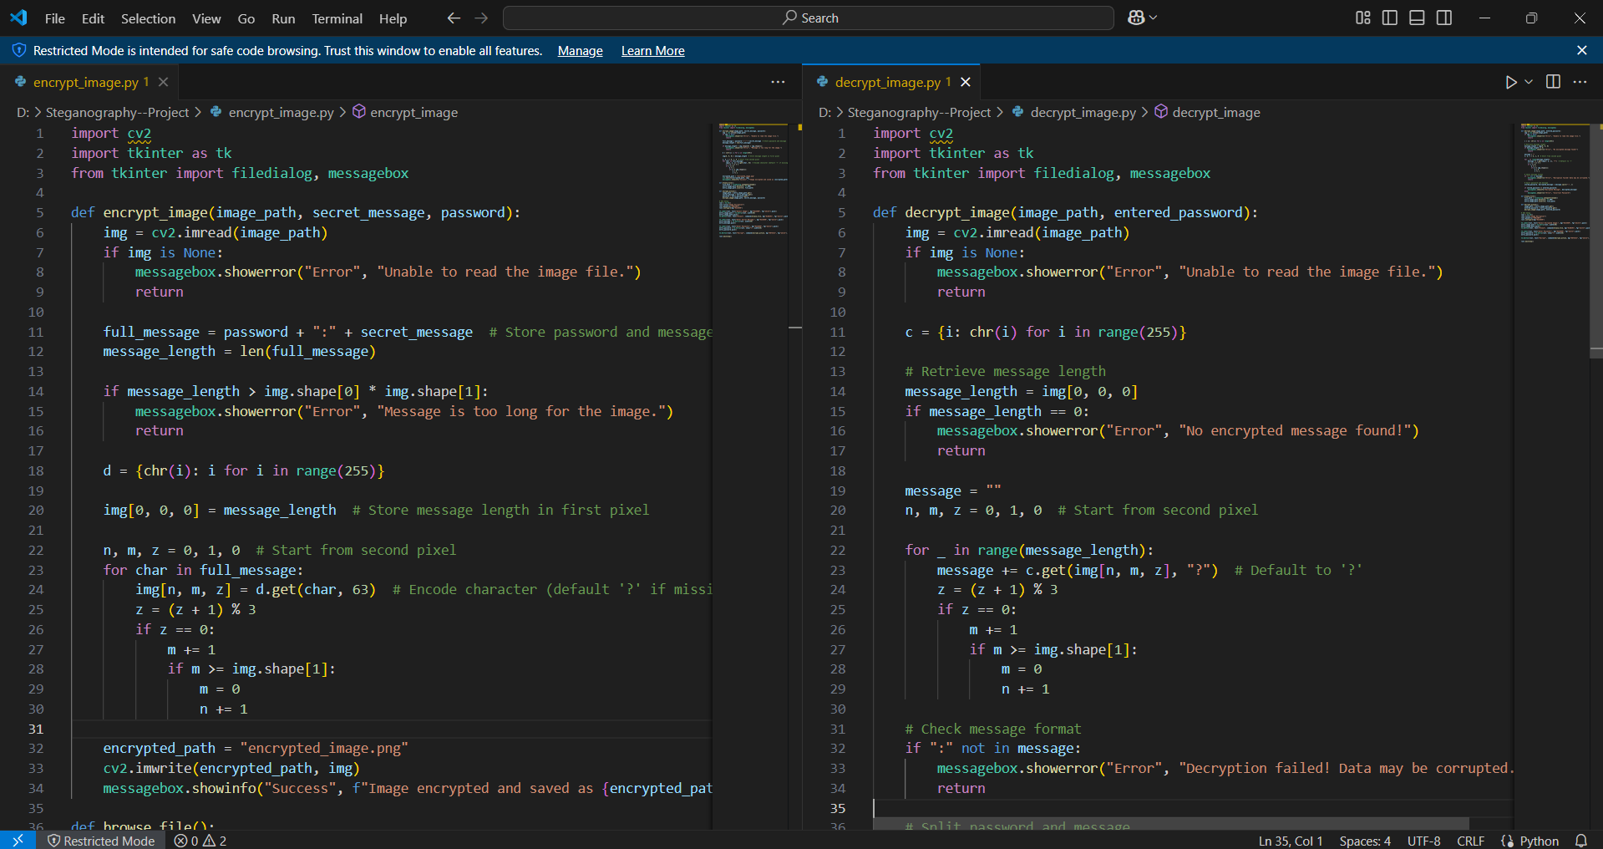
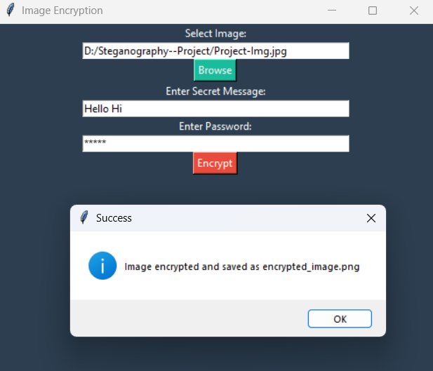
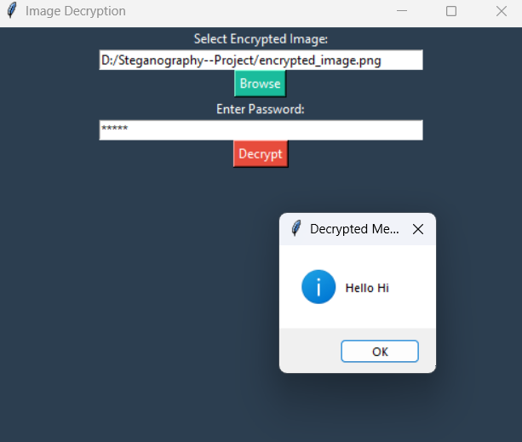

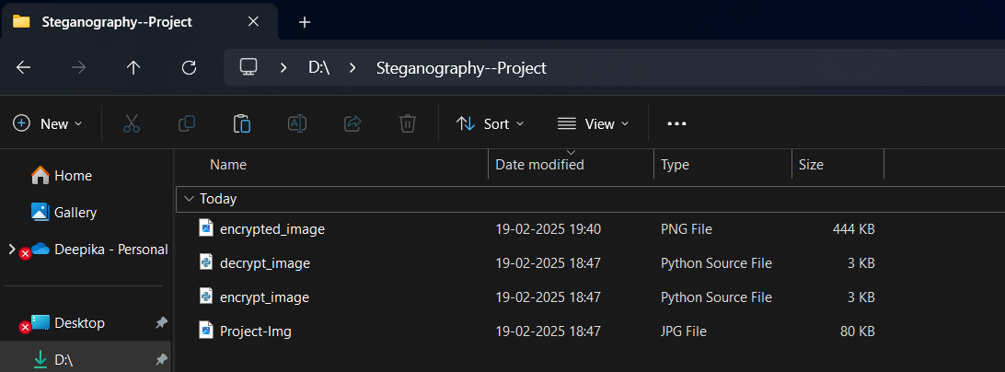
Results

Slide 8
Conclusion
The project effectively utilizes image-based steganography for secure communication.
It offers an intuitive, password-protected method for embedding and extracting messages.
The system maintains data confidentiality while preserving the original image's appearance.
It has potential for enhancement with advanced encryption algorithms and AI-driven detection resistance.

Slide 9
GitHub Link
https://github.com/puppaladeepika/Steganography

Slide 10
Future scope
Enhanced Encryption: Incorporate AES or RSA encryption prior to data embedding.
Multi-Format Compatibility: Expand support to include PNG, BMP, and GIF images.
AI-Driven Security: Implement AI to counteract detection by steganalysis tools.
Mobile & Web Integration: Create Android/iOS applications for broader access.
Cloud Storage Integration: Enable secure message embedding with remote cloud access.

Slide 11
THANK YOU

