Slide 1

Status:
Setup
Lab1 (structure, $.get, view)

Slide 2
Coming Up
Lab2 (small, id='kontainer', animation, CRUD)
Lab3 (classes, controller, template)
Wrap up
Hack

Slide 3
Next Lab:
Break up index.html 'middle'
Animate a view/DIV
Animation in a view
No back end resources

Slide 4
Inspiration?
What is an example of a good app?
  Famo.us
  IntoTheArtic.gp (demo)

Slide 5
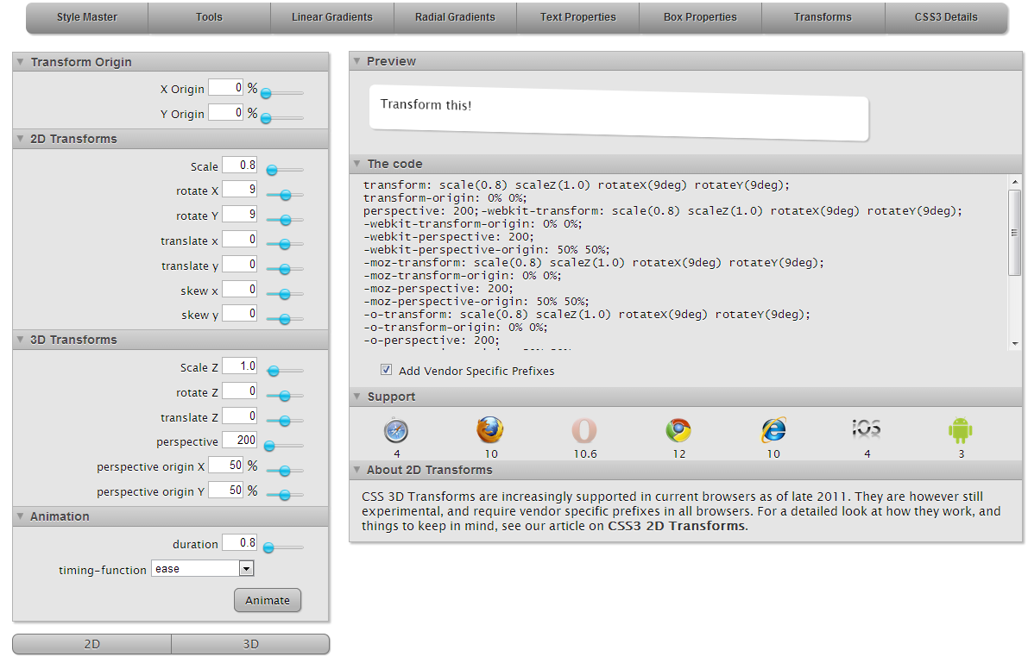

Slide 6
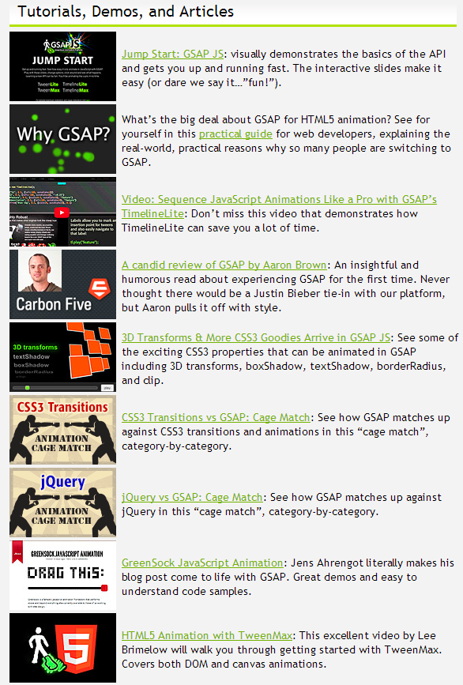

Slide 7
$.get Forward
Forward( ) function (helper)
  Ajax and insert in kontainer
  Arg 1. ht – filename
  Arg 2. id – id of the div to be forwarded
  Arg 3. callback function

Slide 8
And now... A word from our sponsor
Yeah!! Primus API rules.
API
  Like a database BUT
  No back end resources
  Security, Scalability, Speed, And all the rest!

Slide 9
Lab2
Index.html
  Topcoat
  Load Zepto or JQ

Slide 10
Lets go! Up Next:
Animation (tween) Lab
CRUD Lab
  D3 (in div animation) demo
Labs
  2.a: forward and animate
  2.b: api
  2.c: Obfuscate
  2.d: optional: D3.

Slide 11
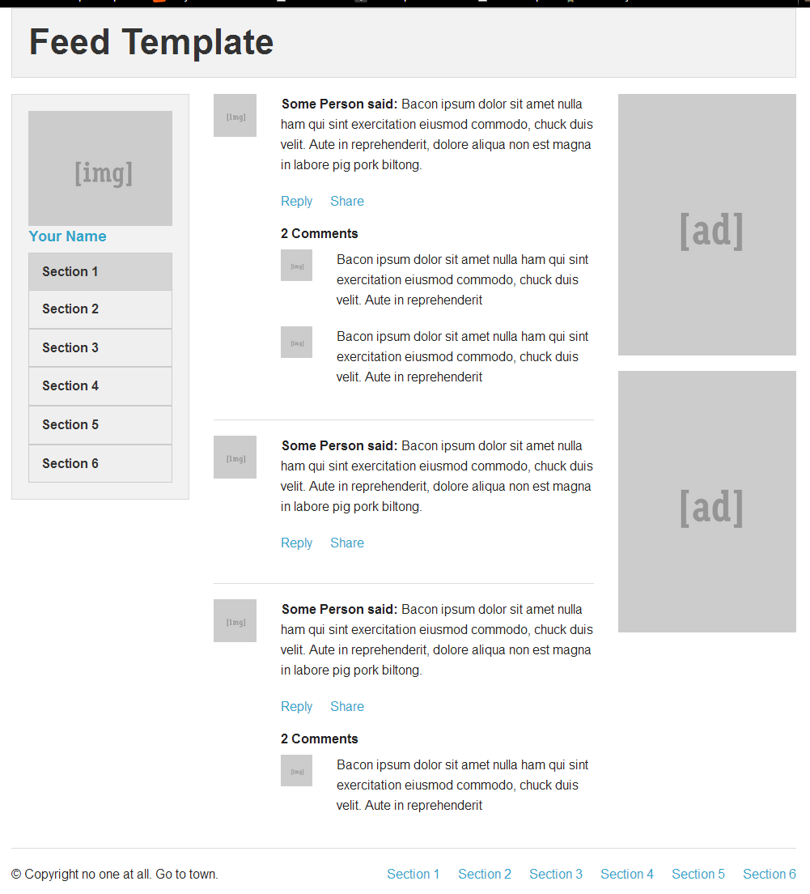
Lab3

Slide 12
Index
Foundation Example
Ripped out middle to be opened as a view

Slide 13
“Templates”
Whaaa?
Take a subview + .js data, mostly N times.
Which One? Who cares!
Google: List.js
  <li id="hacker-item">
<h3 class="name"></h3>
<p class="city"></p>
</li>
Ex: toDo.html

Slide 14
Lab 3.a
Template
What row got clicked?
  Ex: ToDo.html

Slide 15
We now have lots of views
Oh yeah!
  I see, SPA.

Slide 16
Advanced: Classes
Why classes in ES6(typescript)?
  Larger projects, second developer
  Group of related functions
'Patterns' and interfaces
  Interface (The I in API)
How to organize?
  Around a view, ie a class per view

Slide 17
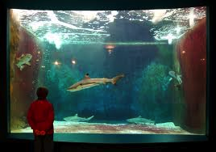
Classes Hint
Think fish swim in an aquarium -
Its not the aquarium moving fish around

Slide 18
A View (Manager) Class
Key to complex animations (aka cool, magic, stunning apps) is to divide
Should encapsulate animation inside the class
“Controlling complexity is the essence of computer programming” - Kernighan

Slide 19
Lets do a 2nd 'class'
Without a SPA, I can bookmark a document!
  How do I bookmark in WebApp | SPA?
  Or SEO?
  Or hold user state?

Slide 20
A type of a class to do that:
Controller
  AKA Action, Aka Router
  It waits on a user.
    And dispatches an event to a view;
    direct or better yet to a class that manages views that will load the view called
  Demo
Controller is key to SPA
What are derivative use of AppController:
  Game Loop (or resize dispatch)

Slide 21
Views
Controller
User acts (url change)
Controller selects the correct view
(or visa versa)

Slide 22
Views
Game loop
(or resize event)
Controller runs Game Loop and emits an event
60 x per sec move a DIV

Slide 23
What controller should I use?
Who cares.
  Google:
    Hasher.js
    Etc.
Mobile is small
Big .js framework may mean less UX
Hint: Focus on the CSS framework!

Slide 24
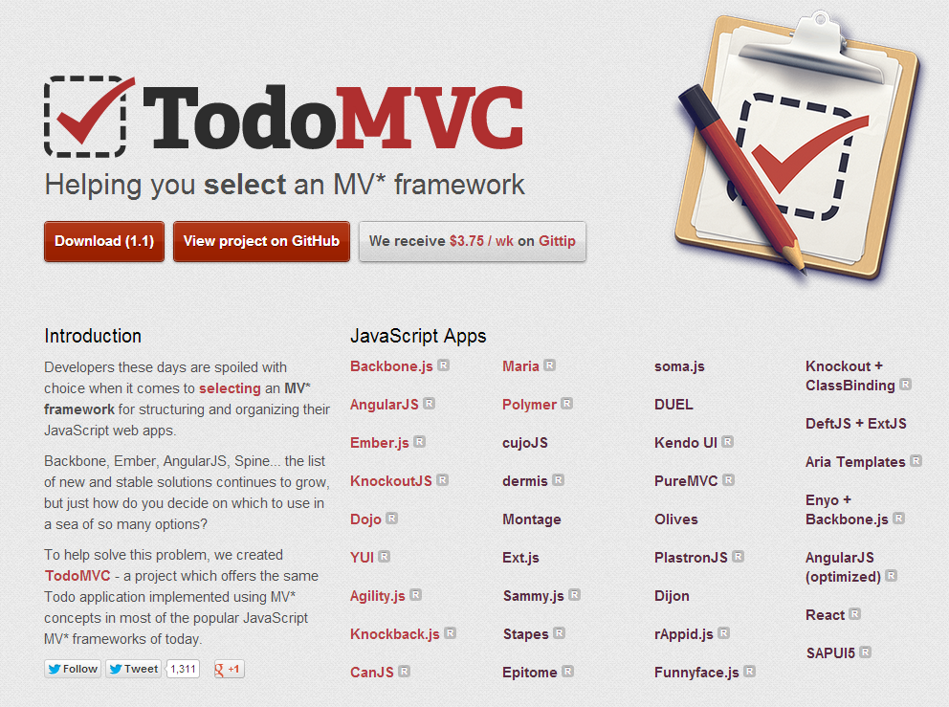

Slide 25
Controller Lab
Make another view class

Slide 26
*** BONUS LAB ***
CMS
Multi Slice
  Snap.js and BootStreap

Slide 27
LAB
Insert and retrieve content in CMS
  Hint:
  $('#id').text(someVar)

Slide 28
HTML 4 | HTML 5
JavaScript | ECMAScript 6
Canvas | CSS
Typography | Animation
PSD | Prototype
px | Rem, em, percent
Jpg/png | Svg ( | D3)
Degrading IE8 | Evergreen IE10
Document | SPA
View Source | Obfuscate
Native (Objective C, Java) | Cordova (PhoneGap)
Heavy | Minimal
Hosted | CDN
MV* js, JS | CSS Lib (Dreamweaver)
Ruby, PHP, Python, JSP, ASP | API

Slide 29
TL;DR
Recipe:
  Take a prototype or a layout
  Cut out 'main' div
  Ajax load that div
  Animate that div
  Don't work in landing page (index)
Use our Cloud API
  What is a Cloud API?

Slide 30
Student review time!
Let us know how we did!
Twitter! Blog! (Video, Github)
  How was the content?
  How was the presentation?

Slide 31
Keep In Touch
Follow us! Use us! Talk to us!
  @primusapi
  Meetup Group: /PrimusAPIMeetups
  PrimusAPI.com
Hack time!

