Slide 1

Sponsored by Primus API Corp.
Intro to cross platform HTML5 magic and stunning UX
  SPA
  Animations
  Mobile first
Targeting art directors, graphic designers, product managers

Slide 2
Tl/Dr
Recipe:
  Take a prototype or a layout
  Cut out 'main' div
  Ajax load that div
  Animate that div
  Don't work in landing page
Promote use of our Cloud API
  What is an API?

Slide 3
Training
Culture:
  Laptops/cellphones closed during in progress lecture
  Labs are required
    Learn by watching, please excuse self
  Breaks are during labs

Slide 4
Schedule:
  Labs are required
Setup
Lab1 (structure, $.get, view)
Lab2 (small, kontainer, animation, CRUD)
Lab3 (classes, controller, template)
Wrap up (before 1PM)
Hack or split

Slide 5
Quick (student) intro:
Write down your twitter ID and fold in 3
Represent:
  I'm from one of:
    Country/State born in
    Company
    Years pro.
Learn from each other

Slide 6
What is Proprietary?
HTML5 and UX is not
When using Select, Insert – it's us
  Ex: Save name, select name

Slide 7
What is 3rd party in training?
Greensock
Hasher.js
Bikesheding.js
WebStorm
TypeScript (like CoffeScript except ES6)
  Will get to that

Slide 8
Why Cloud API in UX?
Company mission!
Less resource (No Ruby, Python, PHP, Java devs)
Easier
  Can a product manager write an app?
Side effect: Both eyes on front end!

Slide 9
Setup Lab! (yes, it takes time)
Node, Python, Webstorm, PrimusAPI account
npm -g install less
npm -g install typescript
Unzip class files
Restart Webstorm
In folder:
python -m SimpleHTTPServer
Open chrome w/ console showing

Slide 10
Less
Use by libs
  Ex: bootstrap

Slide 11
TypeScript / ECMAscript 6
function foo() {
bar(1)
}
function bar(arg) {
console.log('yes, ' + arg)
}
foo()

Slide 12
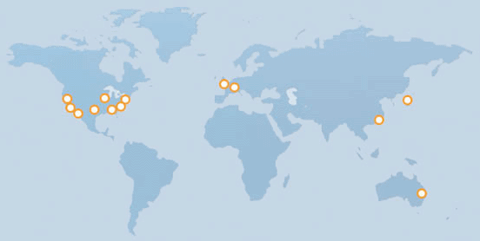
CDN:
What is a CDN?

Slide 13
Structure
ROOT
  Landing page, or Layout (ex: header/footer)
CDN
  Assets
  Libs
  App code
  View(*)

Slide 14
$.get
Look up docs in Zepto.js
Loads a *DIV File*
  AKA: View!

Slide 15
open()
View directory
Arguments to open
Teacher's pet: This is 90% of what you'll learn today.

Slide 16
Ex: Dreamweaver
Ex of view WYSWIG

Slide 17
Callback?
What is callback?
What is async?
What is a lock / mutli threading?

Slide 18
Index.html
Header
  Load style
Body/Container
  Header/Nav/etc.
  Divs
  Footer/Nav/etc.
Scripts (load)

Slide 19
Which CSS Lib?
Who cares/be balanced
Google:
  Foundation
  BootStrap
  TopCoat
  Groundwork, Gumby, ...
Mobile means small (so it loads fast)
  I judge them based on Forms
  Subjective, based on team

Slide 20
CSS Lib pg2
Polyglot
Be deep.
  Deep!

Slide 21
CDN:
What is a CDN?

Slide 22
Lab 1:
Touch a file. Did it compile?
Open!

