Slide 1

Status:
Setup
Lab1 (structure, $.get, view)
  Next up:
Lab2 (small, id='kontainer', animation, CRUD)
Lab3 (classes, controller, template)
Wrap up
Hack

Slide 2
So far?
Break up index.html 'middle'
Animate a view/DIV
Animation in a view
No back end resources

Slide 3
And now... a word from our sponsor
Yeah, Primus

Slide 4
Inspiration?
What is an example of a good app?
  Famo.us
  IntoTheArtic .gp (demo)

Slide 5
Lab2
Index.html
  Topcoat
  Load Zepto or JQ

Slide 6
Lets go! Up Next:
Animation(tween) Lab
CRUD Lab
D3 demo
Obfuscate page

Slide 7
Lab3

Slide 8
Index
Foundation Ex.
Ripped out middle

Slide 9
“Templates”
Wha?
Take a subview + .js data, mostly N times.
Which One? Who cares.
Google: List.js
  <li id="hacker-item">
<h3 class="name"></h3>
<p class="city"></p>
</li>
Ex: toDo.html

Slide 10
Lab
Template

Slide 11
We now have lots of views
Oh yeah!
  I see, SPA.

Slide 12
Advanced: classes
Why classes in ES6?
  Larger projects, second developer
'Patterns'
  Interface (The I in API)
How to organize?
  Around a view, ie a class per view
Teacher Hint: Think fish swim in aquarium
  (not aquarium moving fish)

Slide 13
A View (manager) class
Key to complex animations (aka cool, magic, stunning apps) is to divide
Should encapsulate animation inside the class

Slide 14
Lets do a 2nd 'class'
W/o SPA, I can bookmark a document!
  How do I bookmark in WebApp | SPA?
  Or SEO.
  Or hold user state.

Slide 15
A type of a class to do that:
Controller
  AKA Action, Aka Router
  It waits on user and dispatches
    to a view; direct or better to a class that manages the view the loads said view
  Demo
Controller is key to SPA
Derivative use of AppController:
  Game Loop (or resize dispatch)

Slide 16
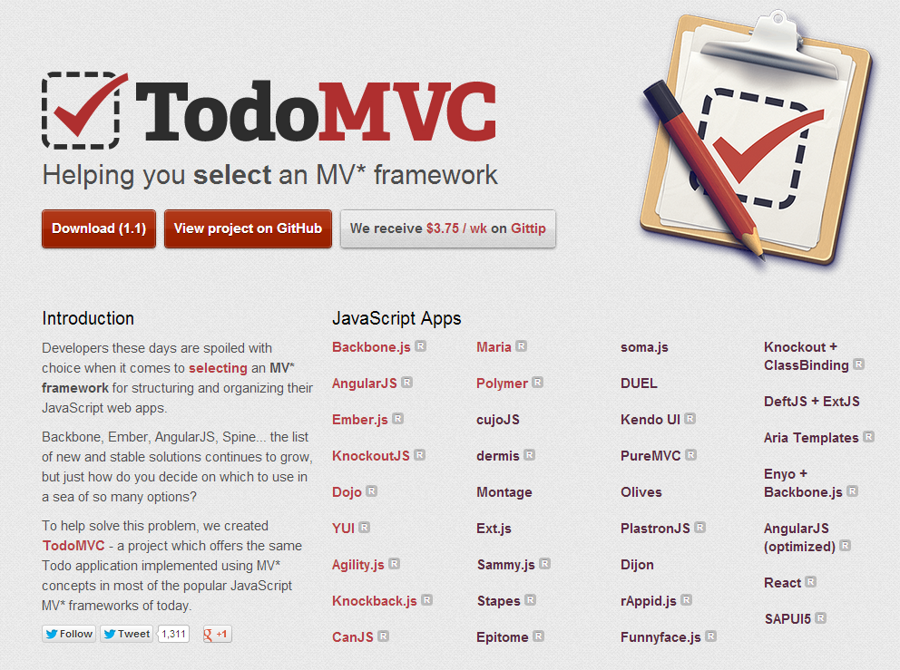

Slide 17
What controller should I use?
Who cares.
  Google:
    Hasher.js
    Etc.
Mobile is small
Big .js framework may mean less UX

Slide 18
Controller Lab
Set hash

Slide 19
*** BONUS LAB ***
CMS
Multi slice
  Snap.js and BootStreap

Slide 20
LAB
Insert and retrieve content in CMS

Slide 21
Wrap up

Slide 22
Tl/Dr
Recipe:
  Take a prototype or a layout
  Cut out 'main' div
  Ajax load that div
  Animate that div
  Don't work in landing page
Promote use of our Cloud API
  What is an API?

Slide 23
Student review time!
Twitter!
Blog!
Video, Github
Use Primus
  How was the content?
  How was the presentation?

Slide 24
KIT
Hack time!
  Git clone?

