Slide 1
DNS-as-a-Service in VPC
Milestone-2 Updated and Milestone-3 Presentation
By: Team 7

Slide 2
Introduction to DNS
Domain Name system is a system which provides translation of domain names to IP addresses.
DNS is designed to be a hierarchy of name servers maintained in a distributed manner.
DNS maintains a database of hostname - IP address mapping and defines the protocol to exchange this information.
DNS system in the cloud should be designed in such a way that it provides the end-users a route to the applications deployed in the cloud by translating names into numeric IP addresses.

Slide 3
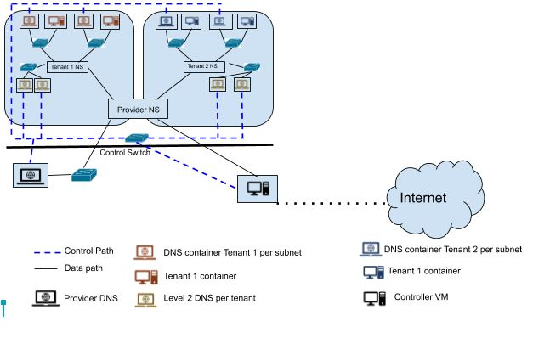
Cloud Infrastructure

Slide 4
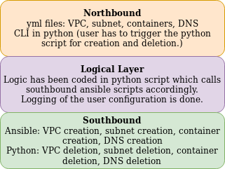
DNS Functional diagram

Slide 5
Northbound Explanation.
In Northbound, we take inputs from the tenant.
We need inputs from the tenant to create tenant namespaces, tenant subnets, and tenant containers.
We are asking the user to upload yaml files and to run the commands given in the readme.md which would take care of the required configurations.
The user has to upload the files vpc_variable.yml , subnet_vars.yml, ten_cont_vars.yml and run the commands specified in the readme.
The user has to upload l2dns_vars.yml and L3dns_vars.yml run the command as specified in readme for creation of DNS_VM’s levelwise.
The user has to edit the named.conf and forward.db templates provided by us
The user then has to run the script DNSconfig.py which takes care of DNS configuration.

Slide 6
Logical Layer and Southbound Layer
The logical layer has logic in the python scripts. Based on the input given the user, the logical layer python script calls the southbound layer(ansible).
The logical layer also does the logging the configuration provided by the user.
The southbound layer takes care of creation of all containers, subnets, and namespaces.
We have used these logs to create a script DNSconf.py to retrieve IPs of both the container instances and the DNS servers and displays them to the user which would assist him in DNS configurations.

Slide 7
Features Implemented
High Availability & Failover Mechanism
Firewall to prevent DOS attacks
Load-Balancing at subnet level
Content Based Routing
Kubernetes self healing feature.
Tools/Packages used: Docker, Ansible, Python, Bind9, Keepalived,IPtables.

Slide 8
High-Availability & Failover mechanism
The VRRP or Virtual Router Redundancy Protocol helps you create a reliable network by using multiple routers in a master/backup configuration. If the primary router fails, the backup router takes over almost seamlessly. A similar implementation has been made to provide high availability of DNS servers.
The same was tried for containers as well. We were able to built the docker image for keepalived but we were not able to configure the keepalive daemon for High-availability in this containerised architecture.

Slide 9
Firewall to prevent DOS attacks
We have given the capability to user to specify whether he wants security as a feature. Based on the user choice, our script DNSconfig.py takes care of configuration of firewall rules.
The script implements iptable rules to drop bogus DNS queries which have some of the common hex strings. This is to protect DNS from analysing any sort of random queries and thus saving DNS cycles.
The DNS server also provides security against multiple ping requests.
All the DNS servers are also performing logging to various queries being made to the DNS server. This has been implemented in the bind daemon itself. This is to make sure that auditing of queries made to the DNS server can be done.
We have iptables rule added to protect DNS server from any other traffic by allowing only UDP traffic over port 53.

Slide 10
Load balancing
We have implemented load-balancing at subnet level. Since DNS is the most important and the basic part of the network, we will have many DNS requests coming to the DNS servers at Level 3 DNS servers.
To manage these and make sure the performance of the network does not go down, we have used the DNS round robin load-balancer to load balance the traffic.
Round Robin DNS is a technique in which load balancing is performed by a DNS server instead of a strictly dedicated machine although a strictly dedicated machine provides more flexibility.

Slide 11
Content based Routing
The service provides content routing feature such that a client can reach an application which is running using the DNS queries.
For an example: a query to project.ece792.CSC.NCSU.com would point to CSC container using hierarchical DNS query responses. Provider DNS (NCSU.com) would provide the details of Level 2 DNS (CSC) server by looking up its entries, Level 2 DNS would then respond with the details of authoritative name server which is L3 DNS server for a specific subnet (ece792) by looking up its entries. L3 DNS server would then provide the response of application IP (project) by looking up its entries in the zones created.
The client would then be able to access the container through the data path provided by the cloud infrastructure.

Slide 12
Kubernetes self healing feature.
We have implemented kubernetes self healing feature in docker containers using python script.
The python script needs to be scheduled in a cron tab by the user so that it runs in the background.
Our script does the following two main tasks:
If a container is exited, our script detects that the container has exited and restarts the container.
If a container is deleted(and the instance was running previously), our script detects this and creates the container again and restarts the container. This is done from the latest committed image of the container when it was in running phase.

Slide 13
Challenges we have faced
We were able to place the templates(named.conf and forward.db) filled by the user in the DNS container specified by the user. This was done with the help of python script DNSconfig.py which has to be triggered by the user with correct arguments. This was the major challenge we faced.
There is no ansible module for BIND9 for creating zones and and for creating forward files.
We had to create separate volumes in hypervisor for each container for mounting named configuration files specific to each container.
To achieve High-availability on containers, we were able to build the keepalived docker image but we were not able to make the configuration work in the container based architecture.

Slide 14
Thank You

