Slide 1
ENGINEERING PORTFOLIO
Rigoberto
Cortez
Electrical Engineering
University of California San Diego
Embedded systems, computer vision, and physical prototypes
Notes:
Profile from user-provided context. First-year EE student at UC San Diego, October 2026. Projects on later slides distinguish completed work, team contributions, and concepts.

Slide 2
Chess move tracking camera
SPIS 2026 · Working team project
Camera image
Visual changes
Square geometry
Candidate move
Recorded move
Prior board state
Chess constraints
Conceptual overview based on the project description
Notes:
Source: user’s earlier SPIS chess-camera description. Approximately 98% and one error were reported for informal testing. Trial size and logs are unavailable. No code repository was supplied. Personal contribution: team development, testing, and tuning; sole code authorship is not claimed.

Slide 3
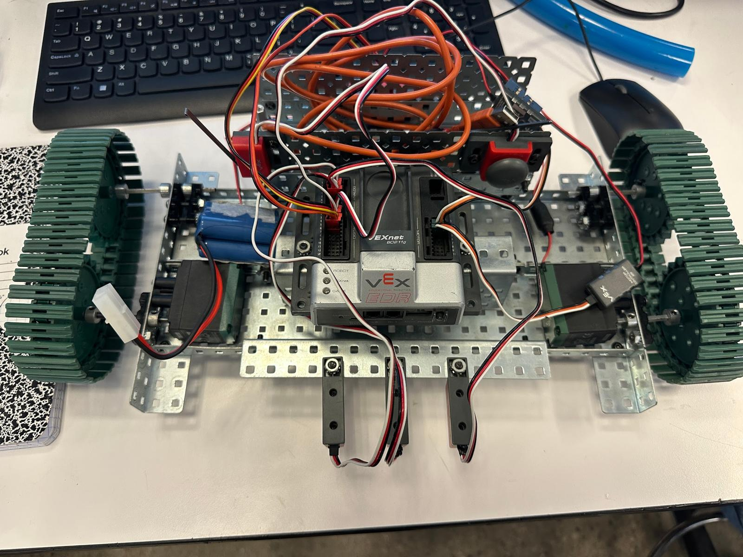
Tracked line-following robot
PLTW 2024 · Team hardware prototype
Hardware
VEX Cortex, two motors, tracks, three line trackers, and ultrasonic sensing.
Integration
Built the chassis and integrated sensors, switching, and wiring. RobotC control work remained incomplete.
Lesson
Start software trials before the mechanical build is finished.
Notes:
Source: engineering/Engineering_WrittenReport_Template.docx, Automated Guided Vehicle Project Tank Edition. Team: Nayeli Leyva, Rigoberto Cortez, Emiliano Banuelos. Photos from report. Report states code was unfinished. Assignment required a ¼-inch line, a 6-second intersection stop, cargo, manual start, emergency stop, and obstacle sensing.

Slide 4
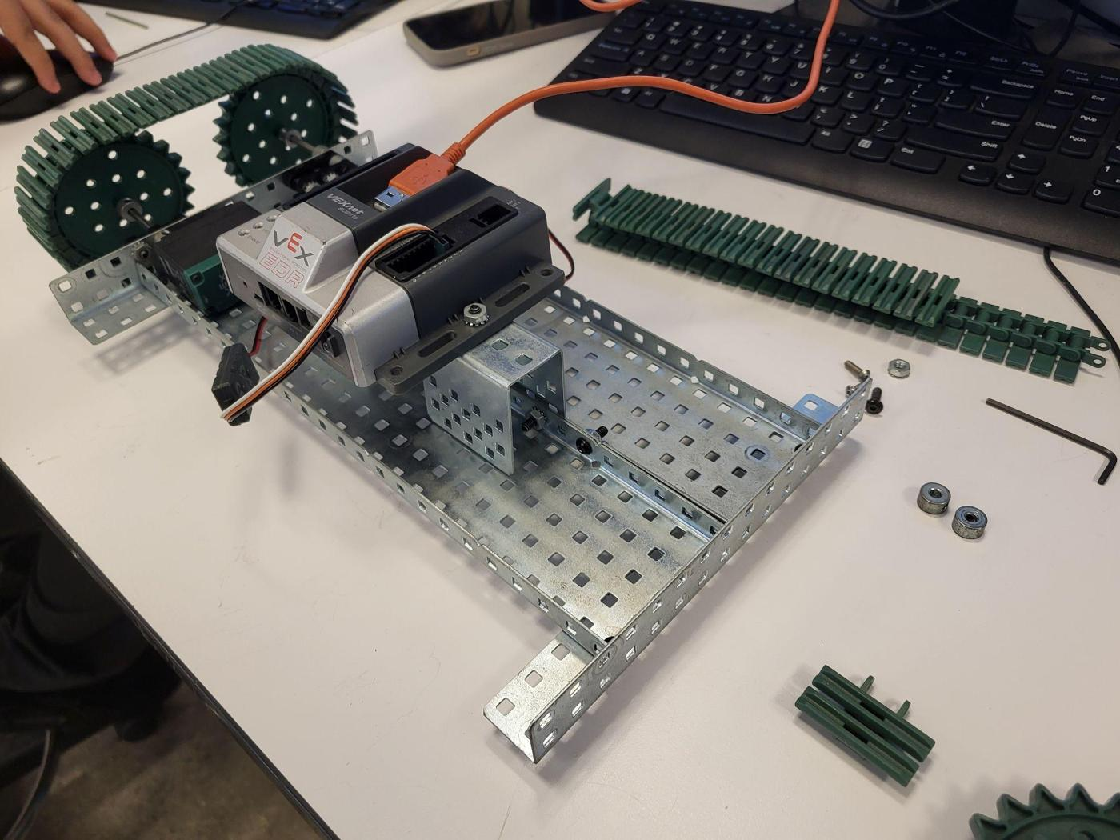
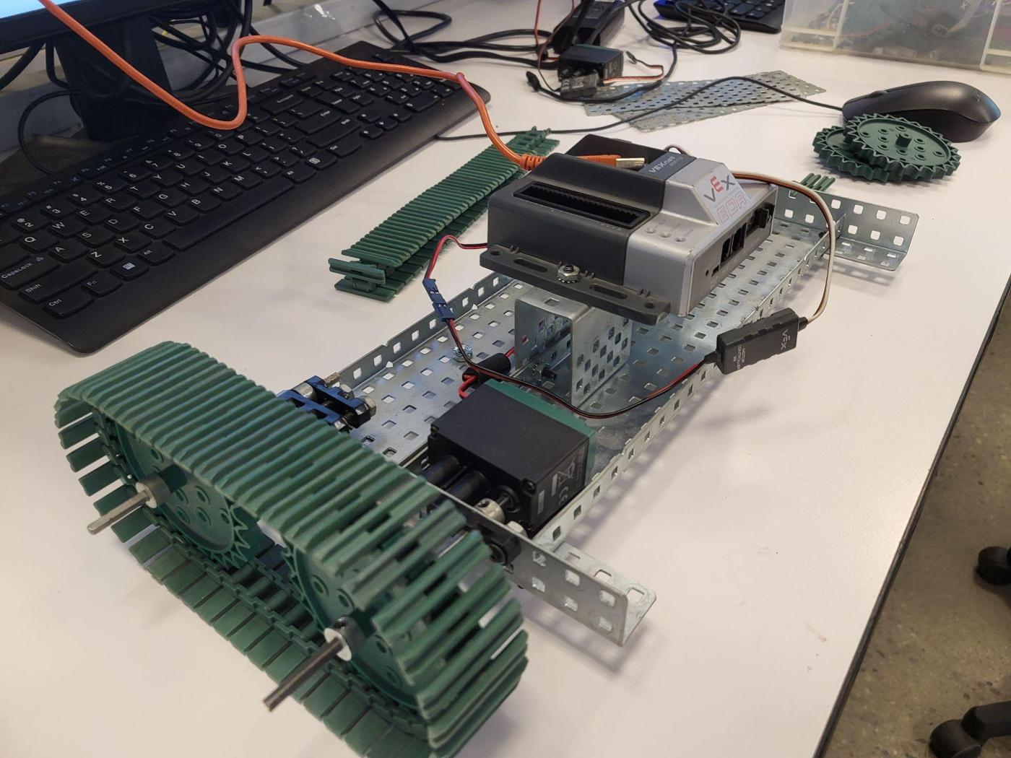
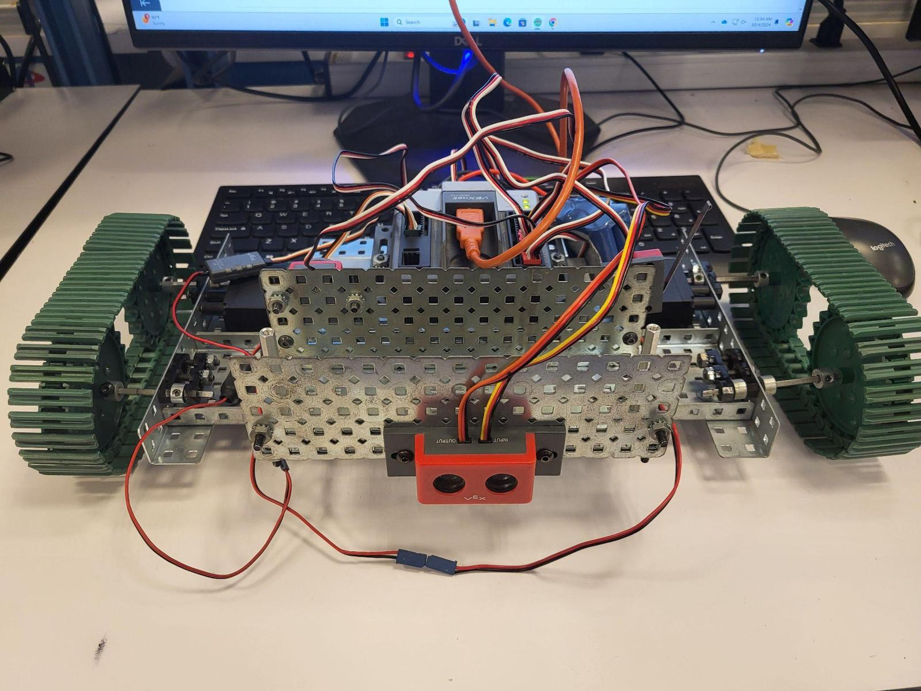
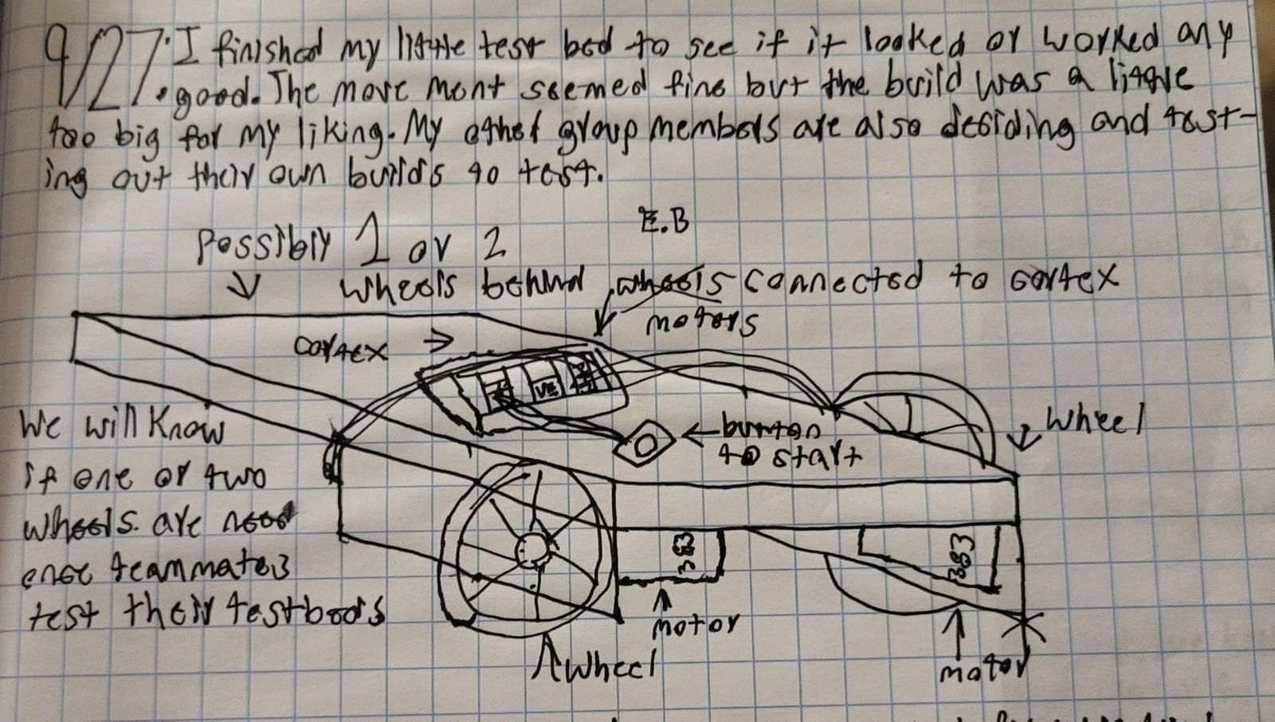
Robot build progression
Original build photographs and notebook sketch
Chassis and drivetrain
Assembly stage
Sensor-facing view
Early concept sketch
Notes:
Photos and sketch from Engineering_WrittenReport_Template.docx. Team project. Image evidence does not establish fully completed RobotC control software.

Slide 5
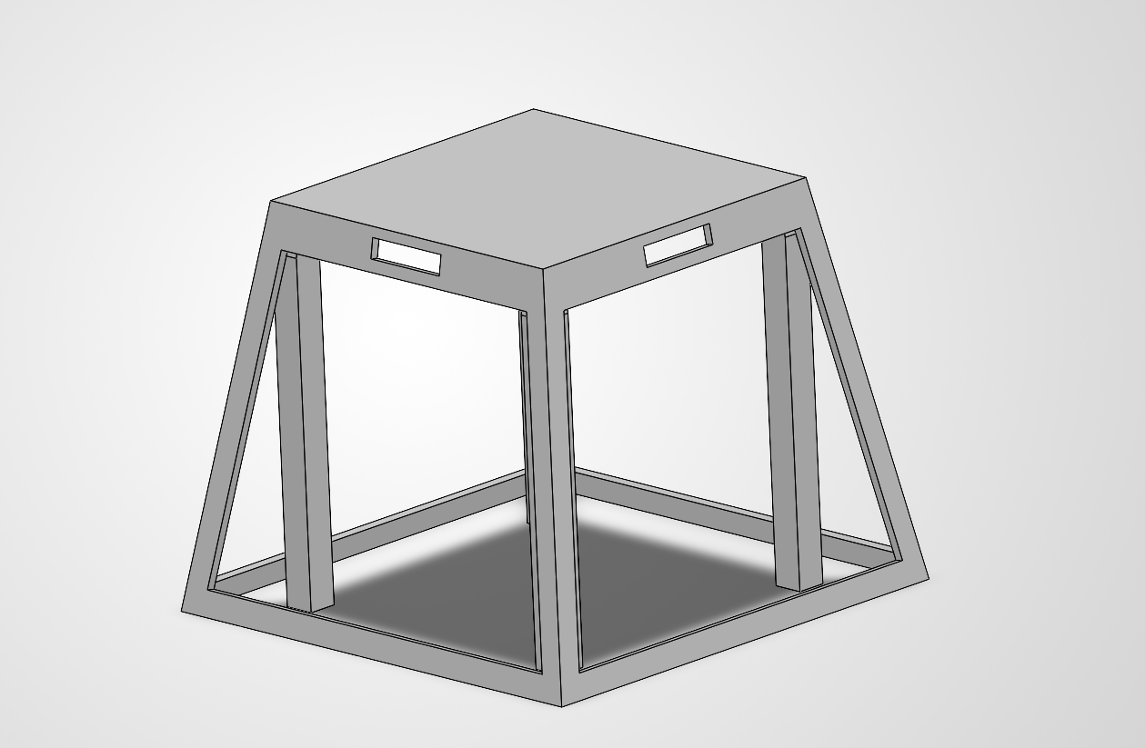
Environment-adaptive speaker
ECE Makerspace 2026 · Individual design proposal
Enclosure concept
A 6 × 6 in base and 4.5 in height. Four posts support the truncated pyramid frame.
Adaptive behavior
Each face would sense nearby obstructions and reduce its corresponding driver output.
Completed work
Frame CAD, bottom fastener locations, and a construction plan.
Notes:
Source: Speaker construction(1).pdf, sections 1–5 and 7–9. CAD image extracted from page 13. Dimensions from proposal. Partial enclosure CAD, not a physically built speaker. Proposed ESP32 and four ToF sensors.

Slide 6
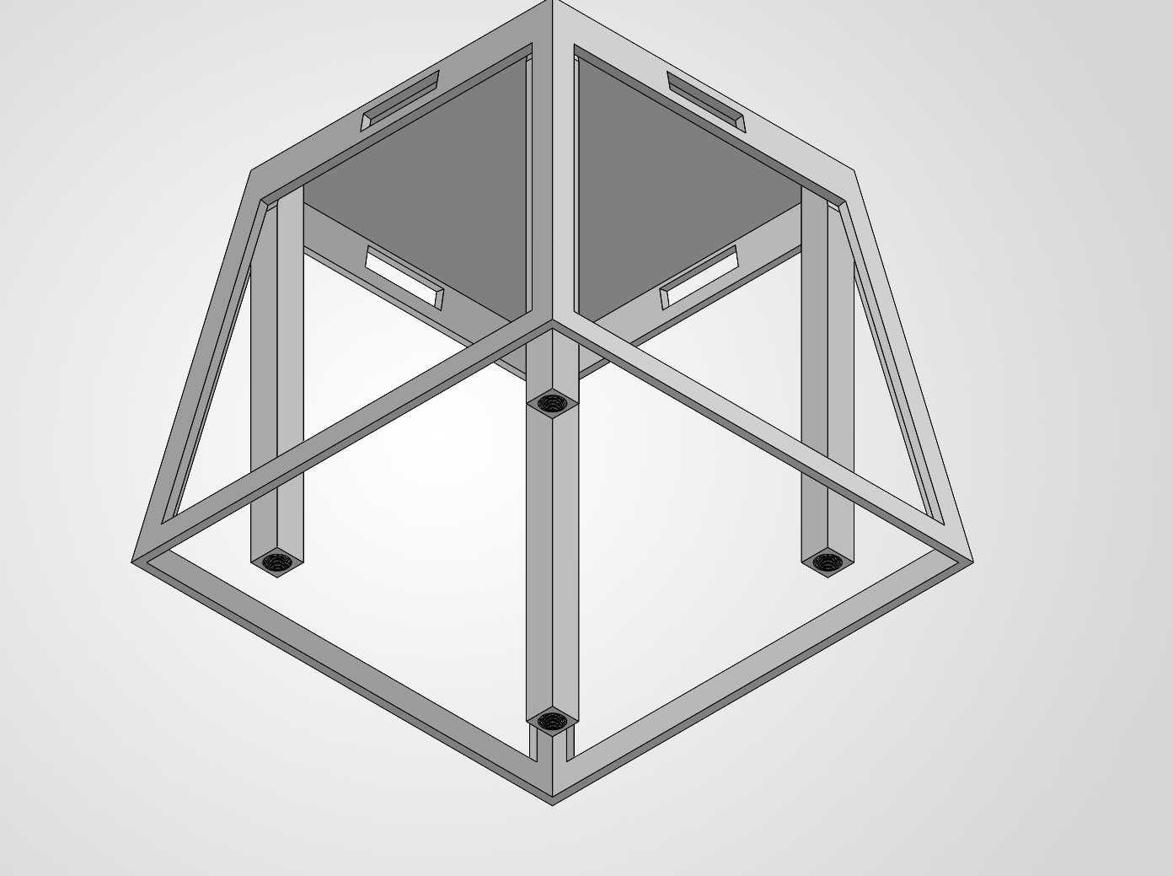
Speaker architecture and testing
Four independent outputs remain a design requirement
Audio control
The listed stereo amplifier needs revision or added channel control for four independent outputs.
Test plan
Compare adaptive mode on and off near walls and corners. Measure power and audible effects.
Design questions
Sensor thresholds, driver interaction, and internal volume still need testing.
Notes:
Source: Speaker construction(1).pdf. Proposed 2.0-channel module does not establish four independent outputs. Next steps here are editorial synthesis of the proposal’s requirements and unresolved decisions, not completed implementation. No measured power or acoustic benefits. CAD image from page 18.

Slide 7
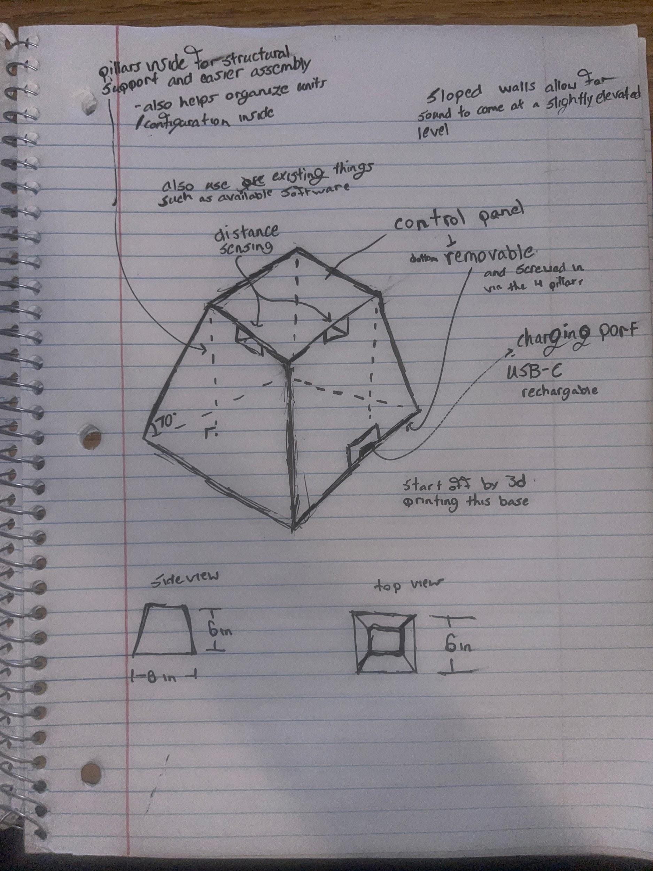
Speaker concept sketch
Original notebook drawing
Structure
Four internal posts support the enclosure and provide mounting locations.
Access and controls
Top controls and bottom service access appear in the original sketch.
Early concept sketch. Final proposal dimensions appear on the enclosure slide.
Notes:
Original concept sketch extracted from page 4 of Speaker construction(1).pdf. This is an early concept. The final proposal specifies 4.5-inch height even though the early notebook dimensions differ.

Slide 8
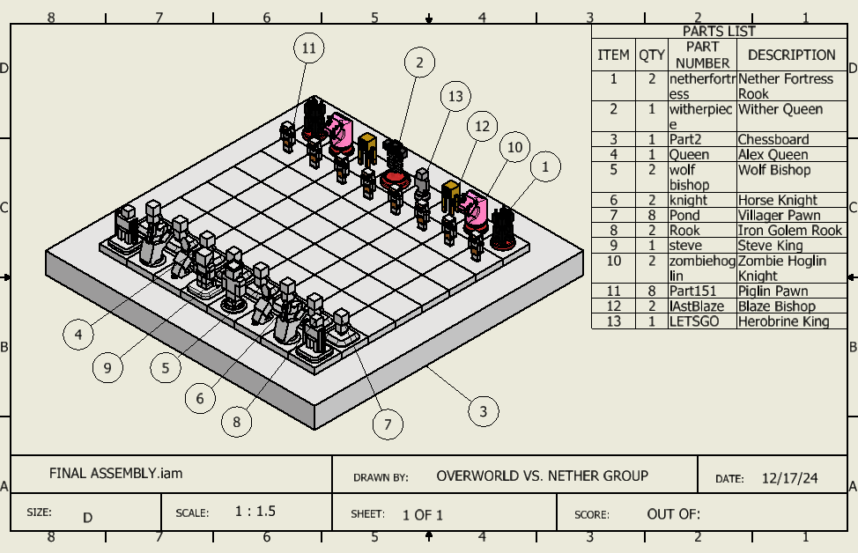
Minecraft chess set
PLTW 2024 · Individual parts in a team assembly
My parts
Knight, Steve piece, and wolf bishop. Drawing title blocks identify my contribution.
Documentation
Dimensioned views and neutral STEP geometry preserve the designs.
Next iteration
Check manufacturability and base consistency with a physical test print.
Notes:
Source: Group Chess Board Assembly archive. Knight, Steve pawn, and wolf bishop title blocks credit Rigoberto Cortez Cadenas. Other drawings credit Natalie Munoz, Stephanie Garcia Solis, and Emiliano Banuelos. Assembly is shared. STEP files from engineering archive; physical printing not established.

Slide 9
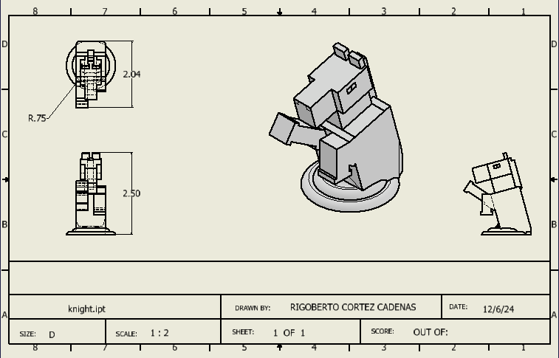
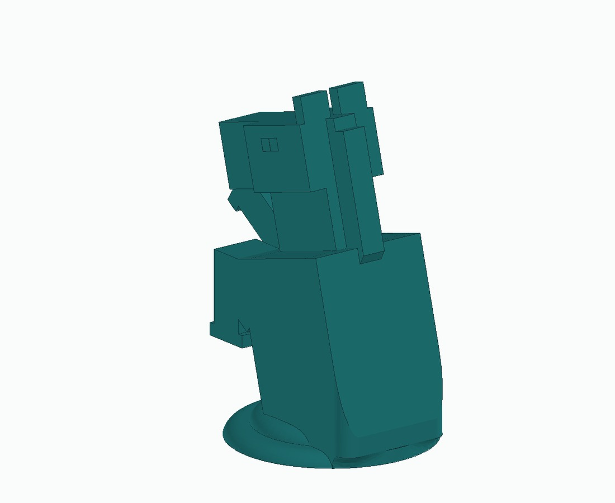
Knight
My Minecraft chess design
CAD geometry
Original engineering drawing
Notes:
Original STEP geometry from engineering archive. Model view renders source geometry in a presentation display color. Original dimensioned drawing title block credits Rigoberto Cortez Cadenas. No physical print is claimed.

Slide 10
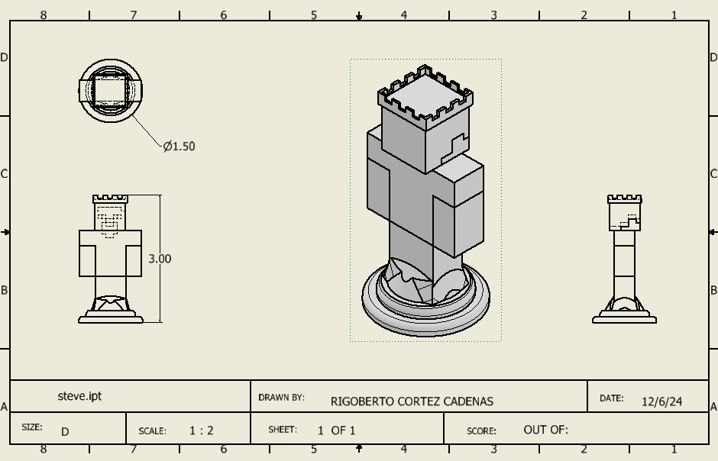
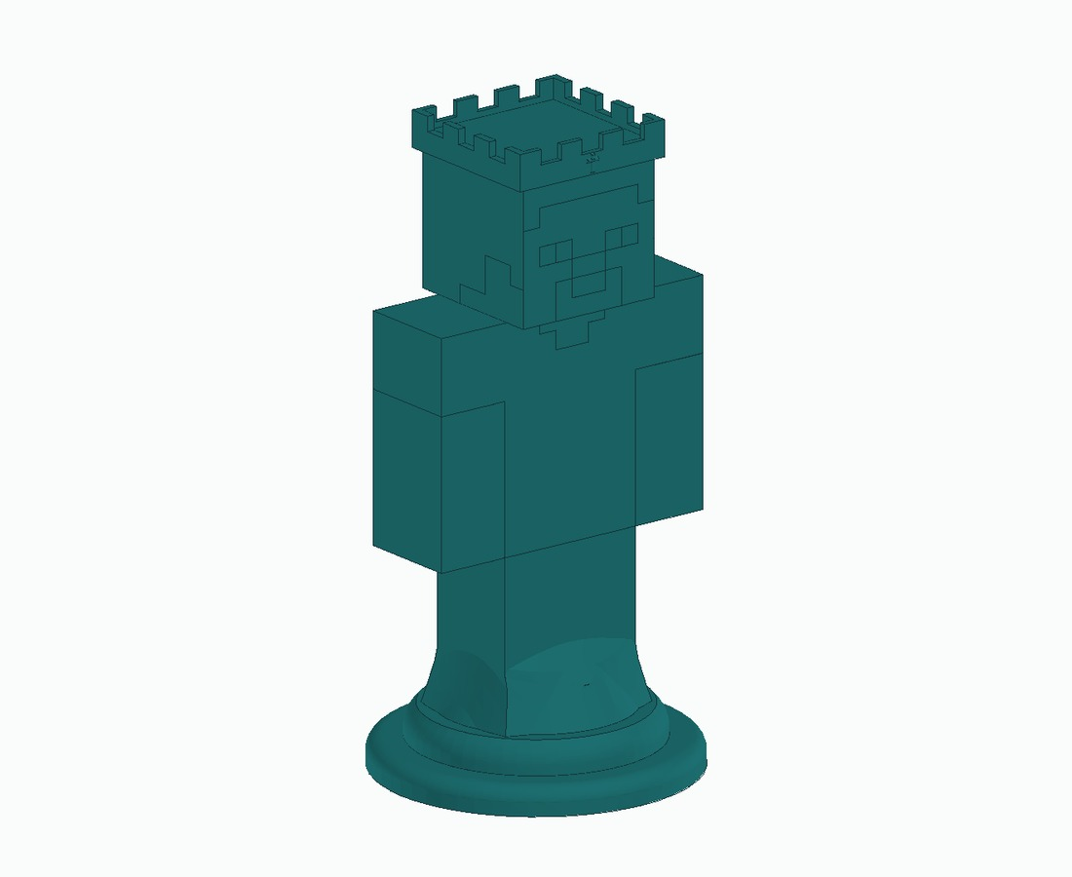
Steve piece
My Minecraft chess design
CAD geometry
Original engineering drawing
Notes:
Original STEP geometry from engineering archive. Model view renders source geometry in a presentation display color. Original dimensioned drawing title block credits Rigoberto Cortez Cadenas. No physical print is claimed.

Slide 11
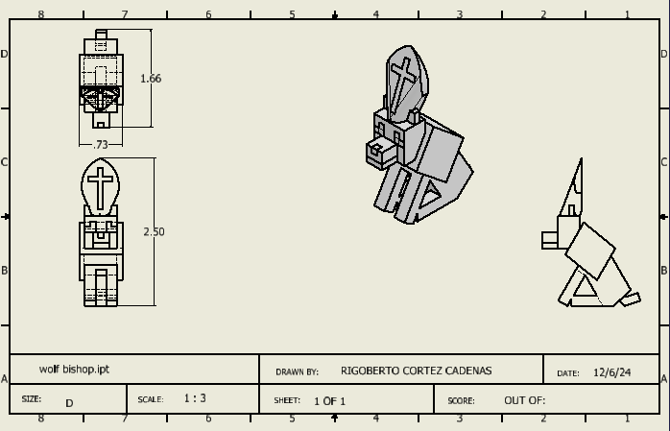
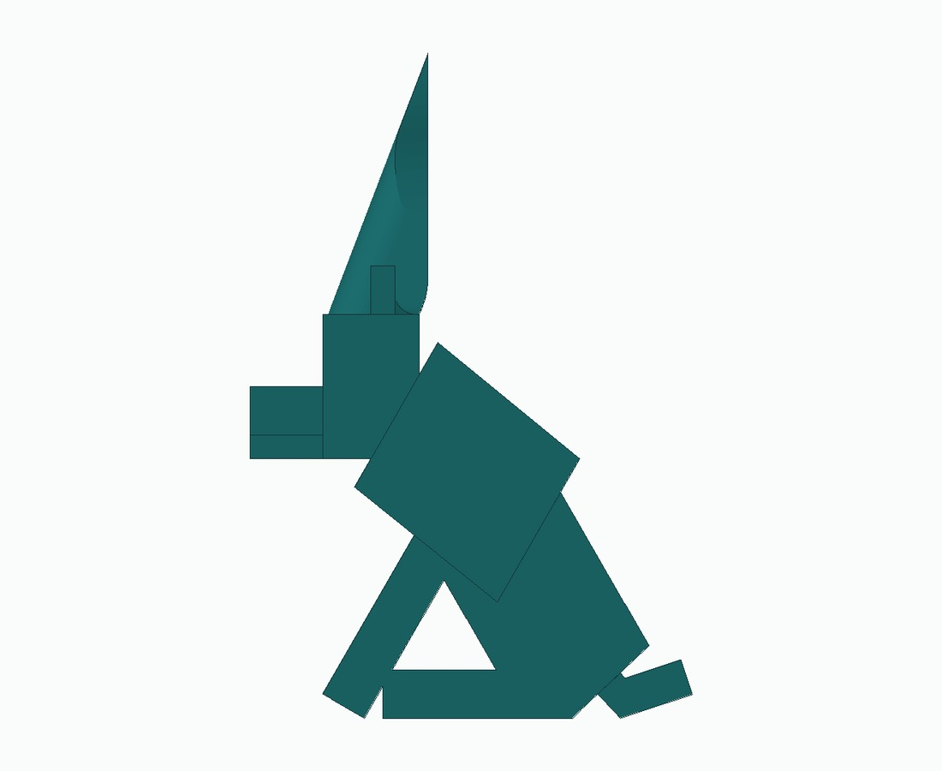
Wolf bishop
My Minecraft chess design
CAD geometry
Original engineering drawing
Notes:
Original STEP geometry from engineering archive. Model view renders source geometry in a presentation display color. Original dimensioned drawing title block credits Rigoberto Cortez Cadenas. No physical print is claimed.

Slide 12
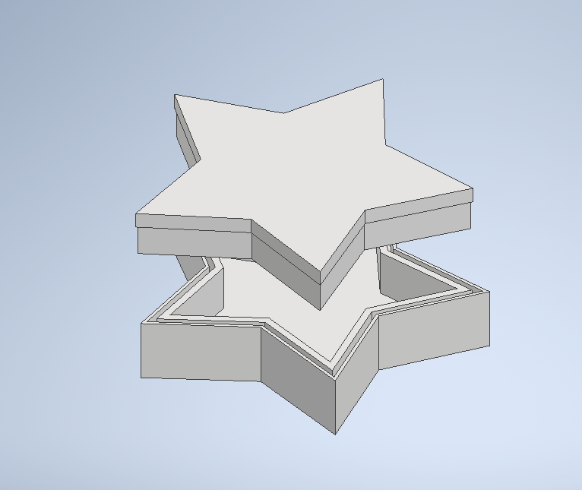
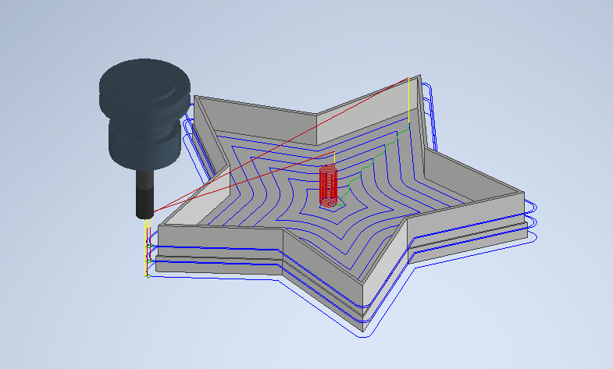
Star container and CAM studies
PLTW 2025 · CAD models and toolpath simulations
Part geometry
A star-shaped base and fitted lid. Sketches examine the fit between the opening and the lid.
CAM work
2D pockets and contours, with related studies in facing, slotting, drilling, and surface machining.
Lesson
Plan tool access while modeling. Reduce unnecessary tool travel.
Notes:
Sources: Copy of 2.3.7 Container Design Documentation.docx, dated 4/22/25; Copy of 2.3.4.A CAMStrategyPracticePart1 .docx; Copy of 2.3.6 CAMStrategyPractice_.docx. No finished machined-part photo or verified run. STEP files in Chest Cool Assembly archive; authorship not independently established by filename.

Slide 13
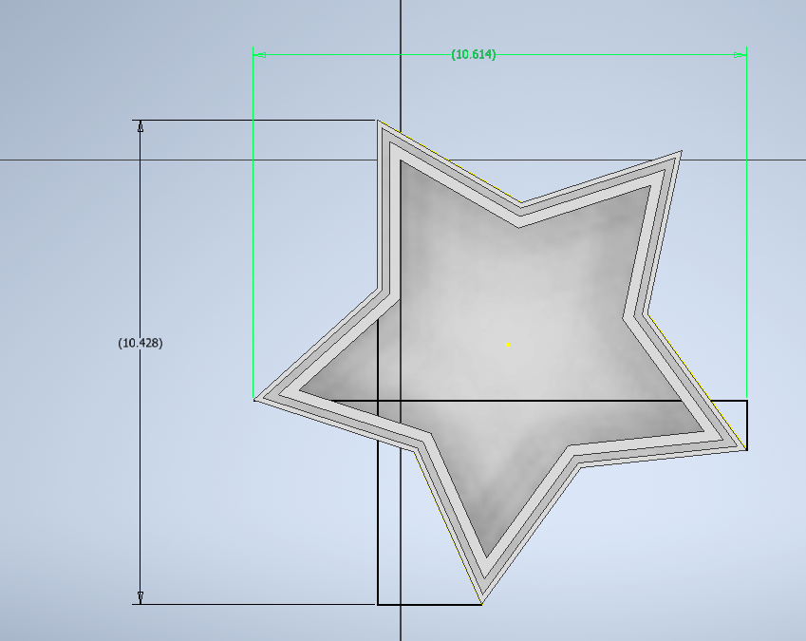
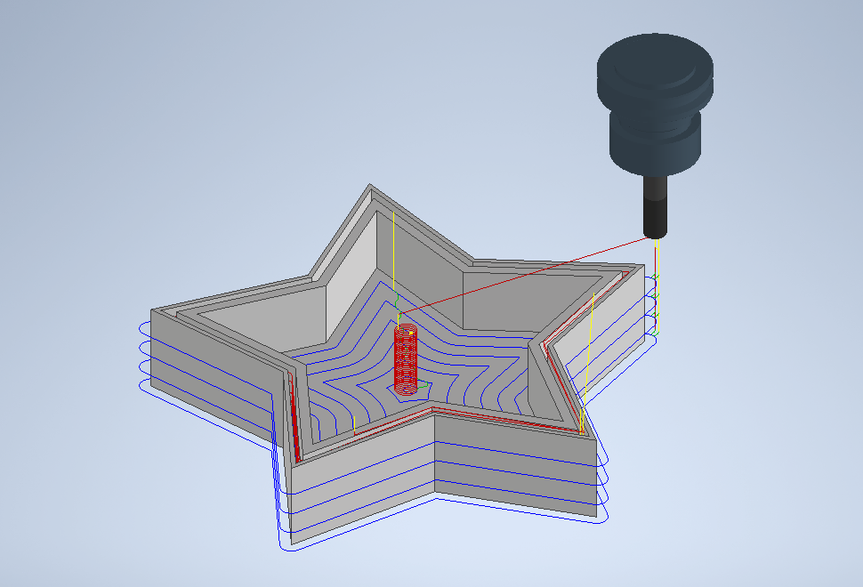
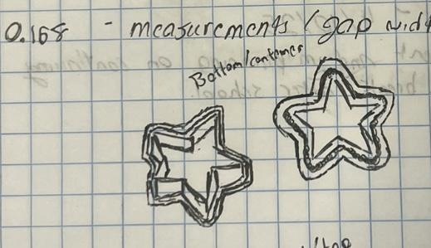
Container sketches and CAM evidence
Original design record and machining simulations
Lid fit sketch
Dimensioned top view
Lid toolpath
Notes:
Source: Copy of 2.3.7 Container Design Documentation.docx and CAM practice worksheets. Images preserve sketches and machining simulations. No completed machining run is claimed.

Slide 14
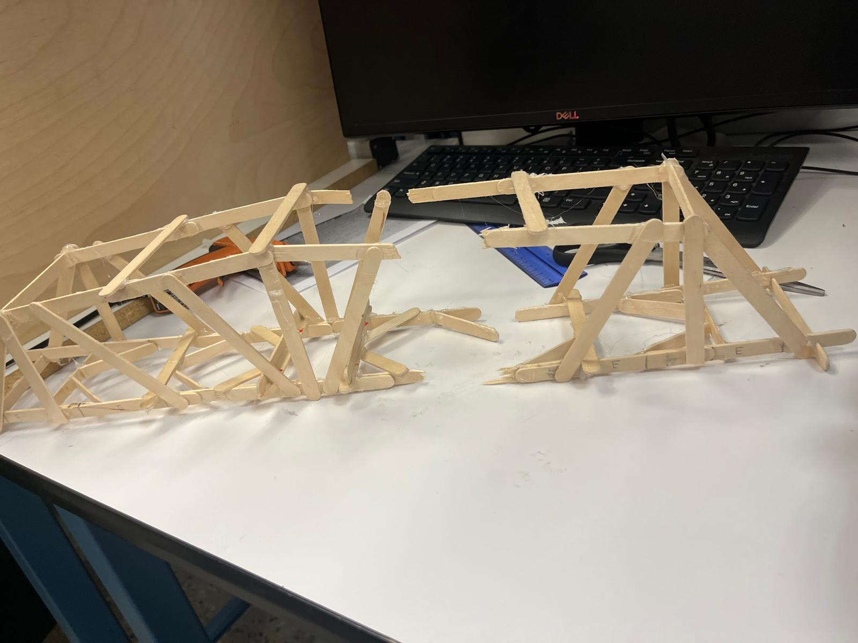
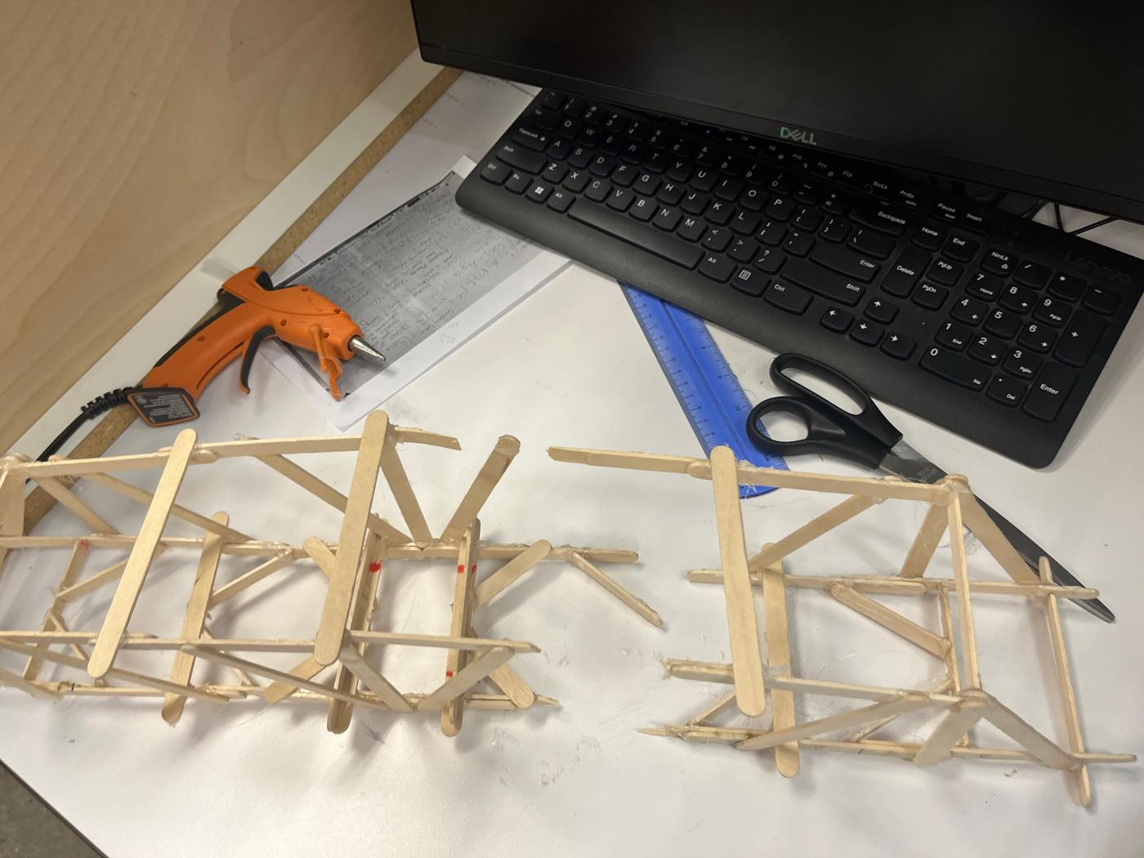
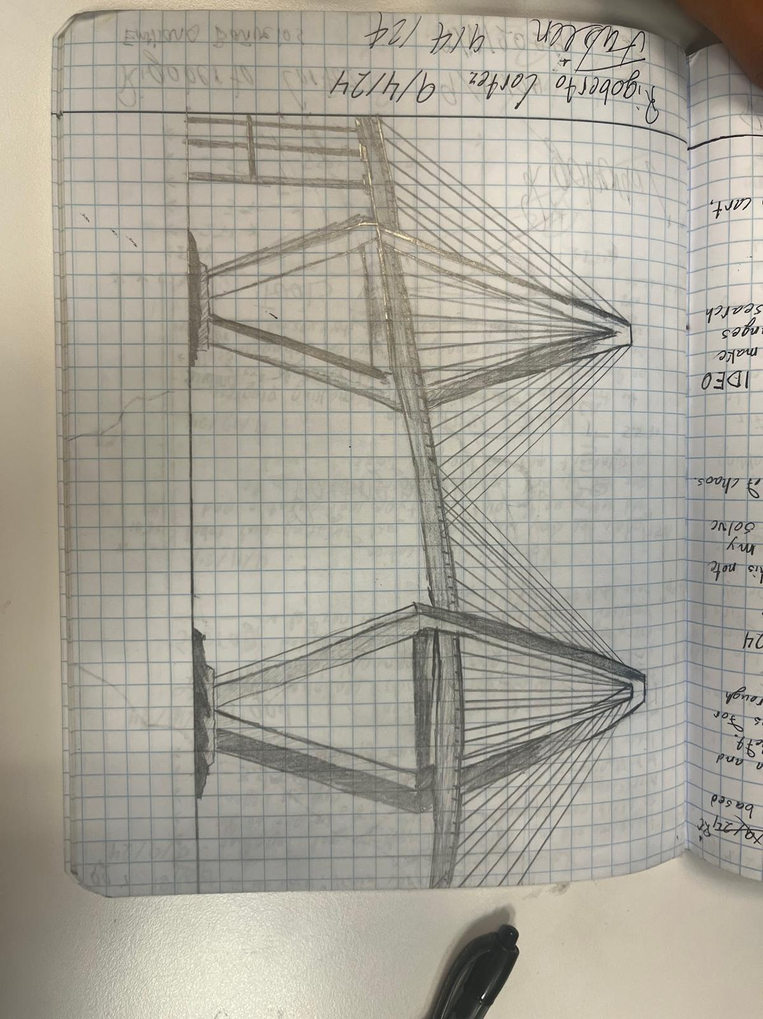
Bridge build and design reflection
PLTW 2024 · Individual physical build
Constraints
At most 60 popsicle sticks and a required 24-inch span.
Outcome
The bridge carried a load but fell about four inches short of the required span.
Lesson
Verify dimensions before bracing. A stronger structure still has to meet its original requirements.
Notes:
Source: building bridges reflection.docx, dated 12/19/24. Constraints: max 60 sticks, 24-inch span. Report says build fell approximately 4 inches short and gives no measured maximum load. This is separate from the balsa tower. Photograph from report.

Slide 15
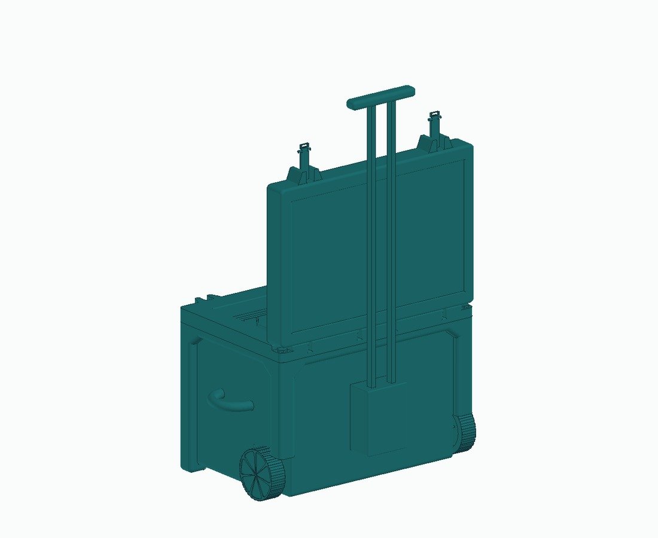
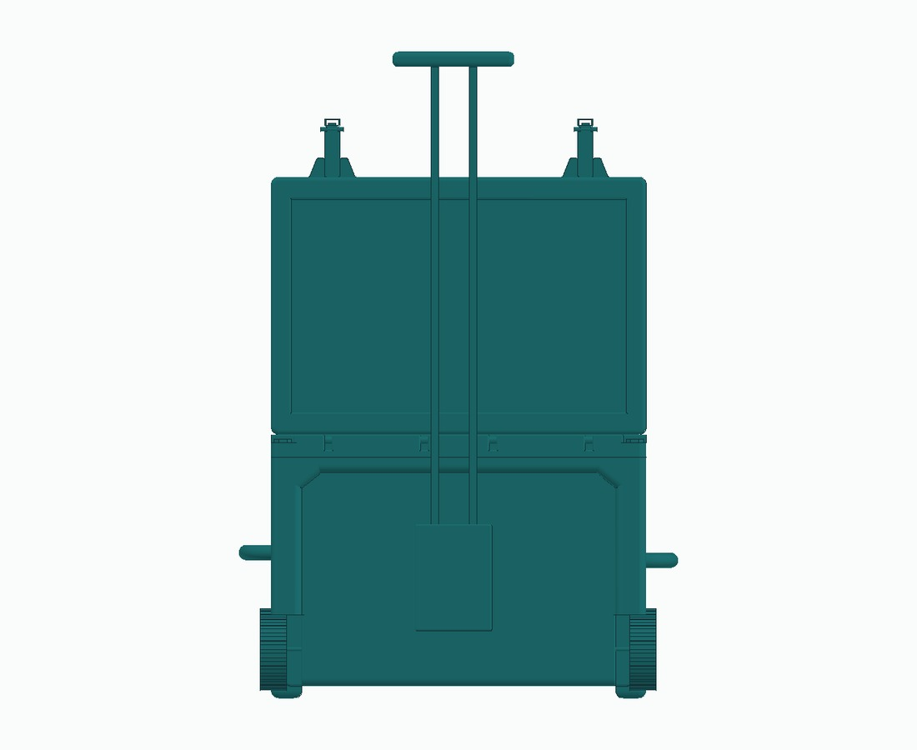
Chest cooler team CAD archive
Shared assembly context
Team assembly geometry. My specific contribution still needs documentation.
Notes:
Source: Chest Cool Assembly/emili folder/Assembly1cooler.stp. Views render the supplied assembly geometry. Rigoberto’s specific cooler geometry and role are not established by the archive. Team context only.

Slide 16
What I want to build next
Embedded systems that sense the physical world
and respond reliably.
I’m developing my C and embedded programming skills.
I’m looking for robotics, hardware, and research teams
where I can contribute while continuing to learn.
rcortezcadenas@ucsd.edu
github.com/pur35t/Brief-Projects-
Notes:
Interests and current learning from user-provided context. Repository is private unless owner changes access. Contact email provided in user history.

