Slide 1
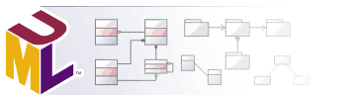
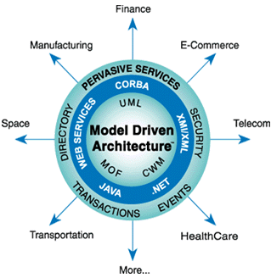
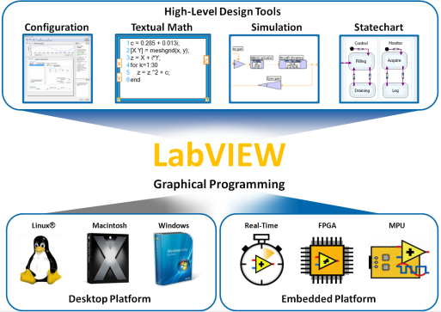
UML
Unified Modeling Language

Slide 2
Agenda
Introduction to UML diagrams
Modeling types
Types of Diagrams
Structural Diagrams
Behavioural Diagrams
Interaction Diagrams
Scenarios & Case Studies

Slide 3
Introduction
UML is a standard language for specifying, visualizing, constructing, and documenting the artifacts of software systems.
UML was created by Object Management Group (OMG) and UML 1.0 specification draft was proposed to the OMG in January 1997.
OMG is continuously putting effort to make a truly industry standard.
UML stands for Unified Modeling Language.
UML is different from the other common programming languages like C++, Java, COBOL etc.
UML is a pictorial language used to make software blue prints.

Slide 4
So UML can be described as a general purpose visual modeling language to visualize, specify, construct and document software system
UML is not a programming language but tools can be used to generate code in various languages using UML diagrams. UML has a direct relation with object oriented analysis and design. After some standardization UML is become an OMG (Object Management Group) standard.

Slide 5
Goals of UML:
A picture is worth a thousand words, this absolutely fits while discussing about UML. Object oriented concepts were introduced much earlier than UML. So at that time there were no standard methodologies to organize and consolidate the object oriented development. At that point of time UML came into picture.
UML diagrams are not only made for developers but also for business users, common people and anybody interested to understand the system. The system can be a software or non software. So it must be clear that UML is not a development method rather it accompanies with processes to make a successful system.

Slide 6
Object oriented concepts:
UML can be described as the successor of object oriented analysis and design.
The objects are the real world entities that exist around us and the basic concepts like abstraction, encapsulation, inheritance, polymorphism all can be represented using UML.
Following are some fundamental concepts of object oriented world:
Objects: Objects represent an entity and the basic building block.
Class: Class is the blue print of an object.
Abstraction: Abstraction represents the behavior of an real world entity.
Encapsulation: Encapsulation is the mechanism of binding the data together and hiding them from outside world.
Inheritance: Inheritance is the mechanism of making new classes from existing one.
Polymorphism: It defines the mechanism to exists in different forms.

Slide 7
OO Analysis and Design

Slide 8
Object Oriented analysis can be defined as investigation and to be more specific it is the investigation of objects. Design means collaboration of identified objects.
So the purpose of OO analysis and design can described as:
Identifying the objects of a system.
Identify their relationships.
Make a design which can be converted to executables using OO languages.
OO Analysis --> OO Design --> OO implementation using OO languages

Slide 9
UML Building Blocks

Slide 10
The building blocks of UML can be defined as
Things
Relationships
Diagrams

Slide 11
Things:
Things are the most important building blocks of UML. Things can be:
Structural
Behavioral
Grouping
Annotational

Slide 12

Structural things:
The Structural things define the static part of the model. They represent physical and conceptual elements. Following are the brief descriptions of the structural things.
Class:
Class represents set of objects having similar responsibilities.

Slide 13

Interface:
Interface defines a set of operations which specify the responsibility of a class.

Slide 14

Collaboration:
Collaboration defines interaction between elements.

Slide 15

Use case:
Use case represents a set of actions performed by a system for a specific goal.

Slide 16

Component:
Component describes physical part of a system.
Component diagrams are different in terms of nature and behaviour. Component diagrams are used to model physical aspects of a system.
Now the question is what are these physical aspects? Physical aspects are the elements like executables, libraries, files, documents etc which resides in a system.
So component diagrams are used to visualize the organization and relationships among components in a system. These diagrams are also used to make executable systems.

Slide 17

Node:
A node can be defined as a physical element that exists at run time.
A single node in a deployment diagram may conceptually represent multiple physical nodes, such as a cluster of database servers.
There are two types of Nodes:
Device Node
Execution Environment Node
Device nodes are physical computing resources with processing memory and services to execute software, such as typical computers or mobile phones.
An execution environment node (EEN) is a software computing resource that runs within an outer node and which itself provides a service to host and execute other executable software elements

Slide 18
Behavioral things:

Slide 19

A behavioral thing consists of the dynamic parts of UML models. Following are the behavioral things:
Interaction:
Interaction is defined as a behavior that consists of a group of messages exchanged among elements to accomplish a specific task.

Slide 20

State machine:
State machine is useful when the state of an object in its life cycle is important. It defines the sequence of states an object goes through in response to events. Events are external factors responsible for state change.

Slide 21
Grouping things:

Slide 22

Grouping things can be defined as a mechanism to group elements of a UML model together. There is only one grouping thing available:
Package:
Package is the only one grouping thing available for gathering structural and behavioral things.

Slide 23

Annotational things:
Annotational things can be defined as a mechanism to capture remarks, descriptions, and comments of UML model elements. Note is the only one Annotational thing available.
Note:
A note is used to render comments, constraints etc of an UML element.

Slide 24
Relationship

Slide 25

Relationship is another most important building block of UML. It shows how elements are associated with each other and this association describes the functionality of an application.
There are four kinds of relationships available.
Dependency
Dependency is a relationship between two things in which change in one element also affects the other one.

Slide 26

Association:
Association is basically a set of links that connects elements of an UML model. It also describes how many objects are taking part in that relationship.

Slide 27

Generalization:
Generalization can be defined as a relationship which connects a specialized element with a generalized element. It basically describes inheritance relationship in the world of objects.

Slide 28

Realization:
Realization can be defined as a relationship in which two elements are connected. One element describes some responsibility which is not implemented and the other one implements them. This relationship exists in case of interfaces.

Slide 29
UML Diagrams:
UML includes the following nine diagrams and the details are described in the following chapters.
Class diagram
Object diagram
Use case diagram
Sequence diagram
Collaboration diagram
Activity diagram
Statechart diagram
Deployment diagram
Component diagram

Slide 30
Diagram classifications
Structural Modeling(Structural diagrams)
Class Diagram,
Object Diagram,
Component Diagram,
Package Diagram, and
Deployment Diagram.
Behavioral Modeling(Behavioral diagrams)
Use Case Diagram,
Activity Diagram, and
State Machine Diagram.
Interaction Modeling (Interaction Diagrams -all derived from the more general Behavior Diagram)
Sequence Diagram.
Excludes - Composite Structure Diagram, Communication Diagram, Interaction Overview Diagram & Timing Diagram .

Slide 31
Structural Modeling(Structural diagrams)
Emphasize what things must be in the system being modeled
Define the static architecture of a model.
They are used to model the “things” that make up a model – the classes, objects, interfaces and physical components.
In addition they are used to model the relationships and dependencies between elements

Slide 32
Behavioral Modeling(Behavioral diagrams)
Behavior diagrams emphasize what must happen in the system being modeled
Since behavior diagrams illustrate the behavior of system
They are used extensively to describe the functionality of software systems.

Slide 33
Interaction Diagram
Interaction diagrams, a subset of behavior diagrams, emphasize the flow of control and data among the things in the system being modeled

Slide 34
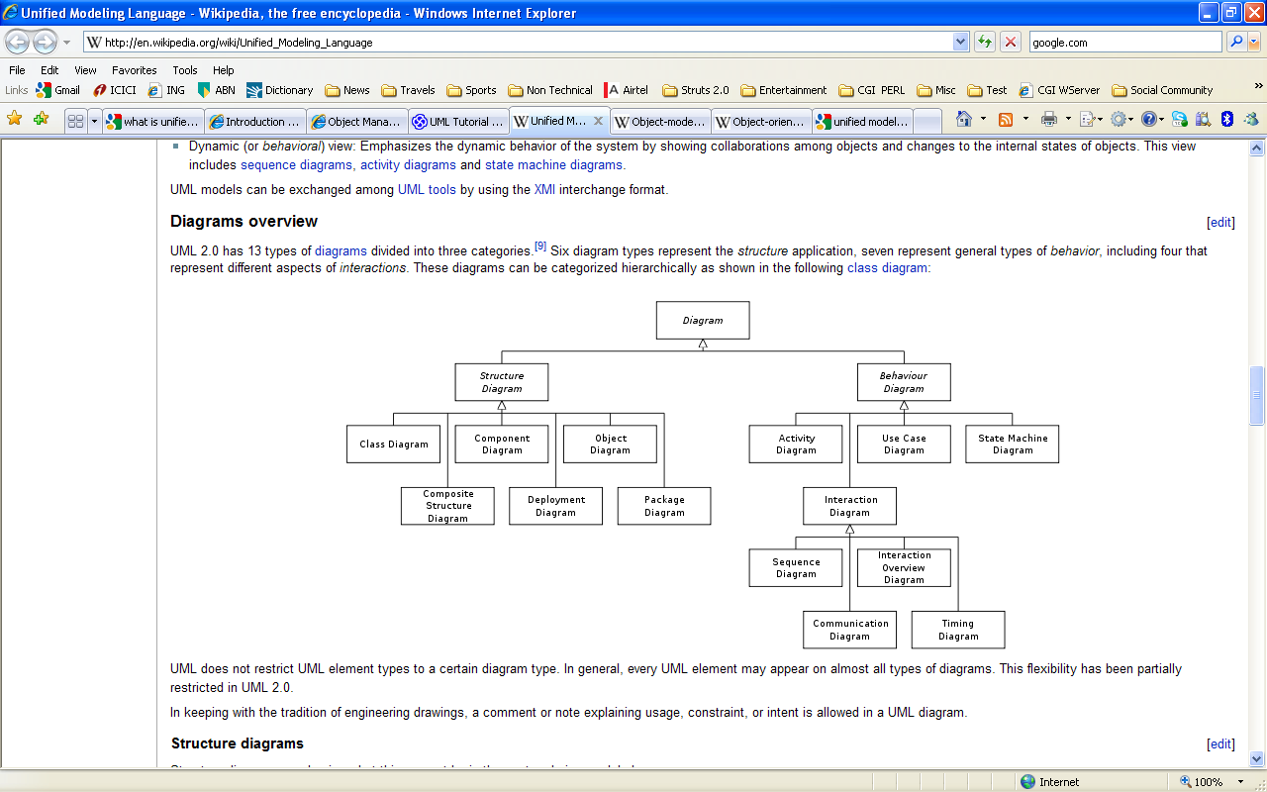
How they stand

Slide 35
Structural Modeling(diagrams)
Class diagram: describes the structure of a system by showing the system's classes, their attributes, and the relationships among the classes.
Object diagram: shows a complete or partial view of the structure of a modeled system at a specific time.
Component diagram: depicts how a software system is split up into components and shows the dependencies among these components.
Package diagram: depicts how a system is split up into logical groupings by showing the dependencies among these groupings.
Deployment diagram: serves to model the hardware used in system implementations, and the execution environments and artifacts deployed on the hardware.

Slide 36
Behavioral Modeling(diagrams)
Activity diagram: represents the business and operational step-by-step workflows of components in a system. An activity diagram shows the overall flow of control.
State machine diagram: standardized notation to describe many systems, from computer programs to business processes.
Use case diagram: shows the functionality provided by a system in terms of actors, their goals represented as use cases, and any dependencies among those use cases

Slide 37
Interaction Modeling(diagrams)
Sequence diagram: shows how objects communicate with each other in terms of a sequence of messages. Also indicates the life spans of objects relative to those messages.

Slide 38
Diagram classifications
Structural Modeling(Structural diagrams)
Class Diagram
Object Diagram
Component Diagram
Package Diagram
Deployment Diagram
Behavioral Modeling(Behavioral diagrams)
Use Case Diagram
Activity Diagram
State Machine Diagram
Interaction Modeling (Interaction Diagrams -all derived from the more general Behavior Diagram)
Sequence Diagram
Excludes - Composite Structure Diagram, Communication Diagram, Interaction Overview Diagram & Timing Diagram .

Slide 39
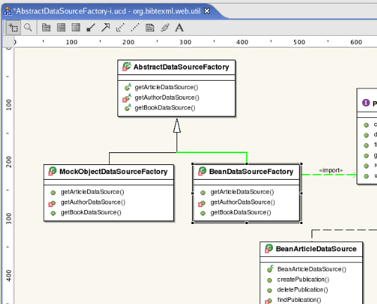
Class Diagram
Class diagram in the Unified Modeling Language (UML), is a type of static structure diagram that describes the structure of a system by showing the system's classes, their attributes, and the relationships between the classes.

Slide 40
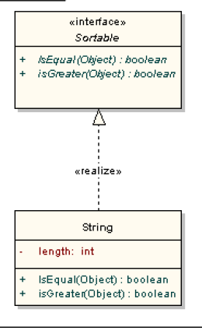
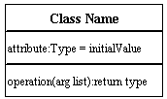
Class diagram Symbols & Notations(1)
Classes Illustrate classes with rectangles divided into compartments. Place the name of the class in the first partition ,list the attributes in the second partition, and write operations into the third
Interfaces
Represented by << >>

Slide 41
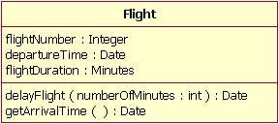
Class diagram Symbols & Notations

Slide 42
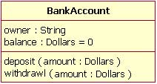
Showing a default value for attributes is optional; shows a Bank Account class with an attribute called balance, which has a default value of 0.

Slide 43
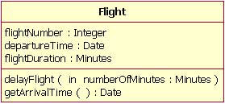

Slide 44
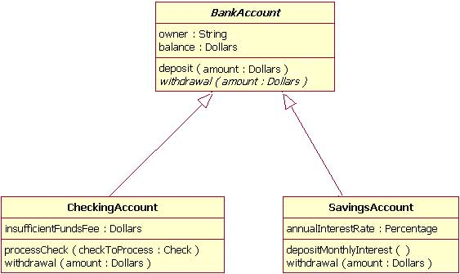
Inheritance
Inheritance is indicated by a solid line with a closed, unfilled arrowhead pointing at the super class

Slide 45
Associations
When you model a system, certain objects will be related to each other, and these relationships themselves need to be modeled for clarity. There are 2 types of associations. I will discuss two of them -- bi-directional and uni-directional associations

Slide 46
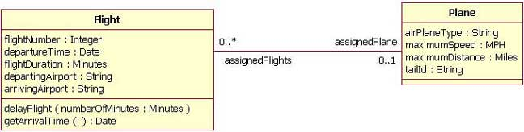
Bi-directional (standard) association
An association is a linkage between two classes. Associations are always assumed to be bi-directional; this means that both classes are aware of each other and their relationship

Slide 47
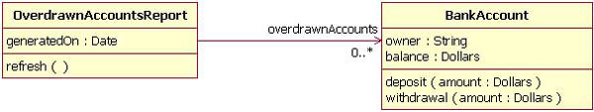
Uni-directional association
An example of a uni-directional association: The OverdrawnAccountsReport class knows about the BankAccount class, but the BankAccount class does not know about the association.

Slide 48
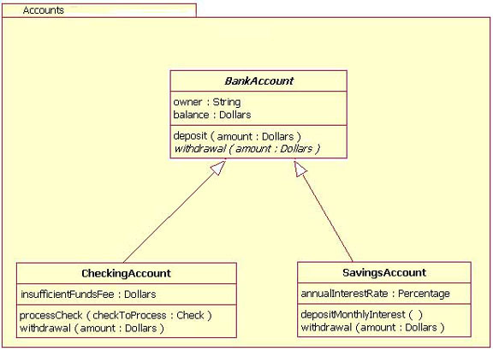
Packages

Slide 49
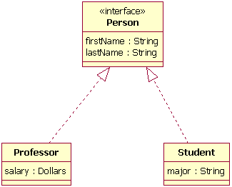
Interfaces

Slide 50
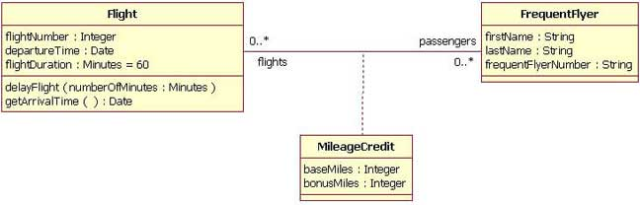
Association class

Slide 51
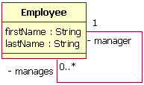
Reflexive association

Slide 52
Marks for UML-supported visibility type
Mark Visibility type
+Public
#Protected
-Private

Slide 53
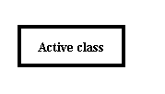
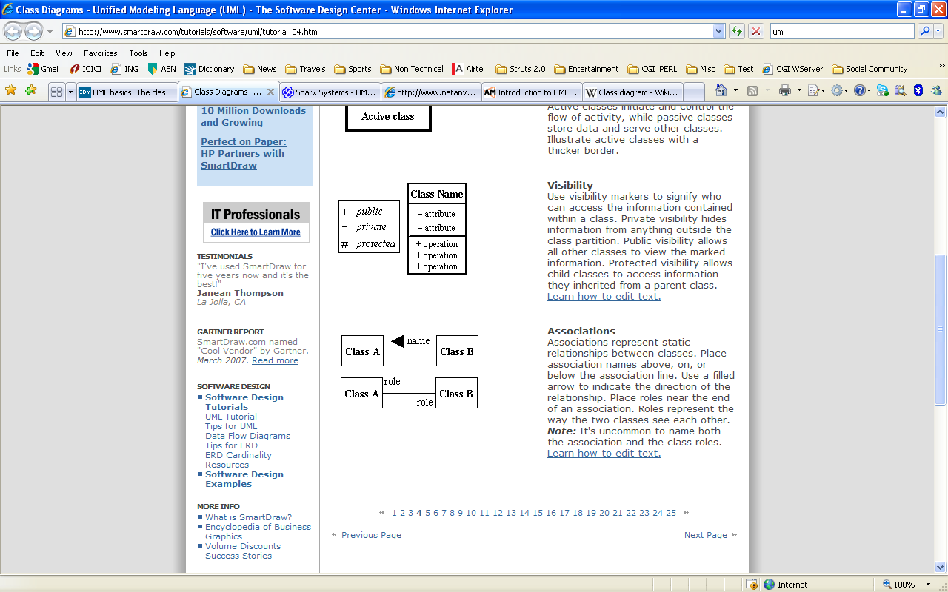
Class diagram Symbols & Notations(2)
Active Class Active classes initiate and control the flow of activity, while passive classes store data and serve other classes. Illustrate active classes with a thicker border.
Visibility Use visibility markers to signify who can access the information contained within a class.

Slide 54
Class diagram Symbols & Notations(3)
Associations Associations represent static relationships between classes. Place association names above, on, or below the association line. Use a filled arrow to indicate the direction of the relationship.
Place roles near the end of an association. Roles represent the way the two classes see each other.

Slide 55
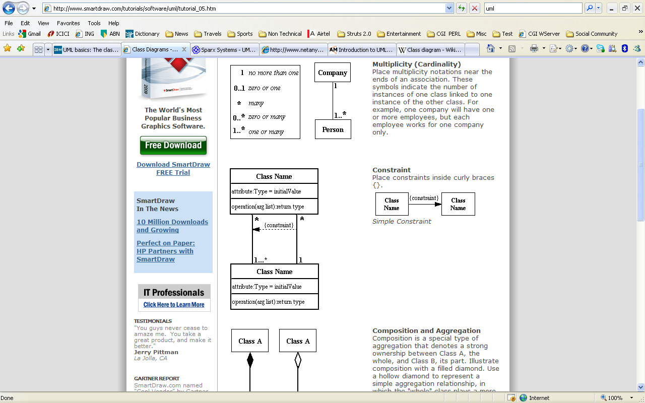
Class diagram Symbols & Notations(4)
Multiplicity (Cardinality) Place multiplicity notations near the ends of an association. These symbols indicate the number of instances of one class linked to one instance of the other class.
For example, one company will have one or more employees, but each employee works for one company only.

Slide 56
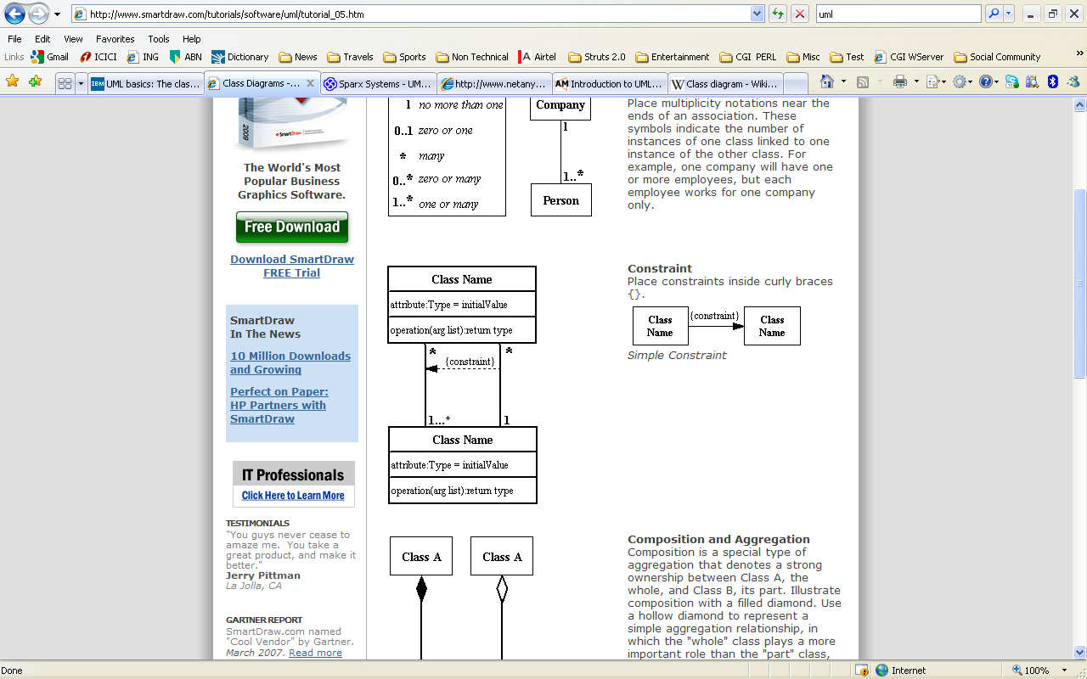
Class diagram Symbols & Notations(5)
Constraint Place constraints inside curly braces {}.

Slide 57
Class diagram Symbols & Notations(6)
Relationships
Instance –level relationships
Association
Aggregation
Composition
Class-level relationships
Generalization
Realization
General relationships
Dependency
Multiplicity

Slide 58
Class diagram Symbols & Notations(7)
Instance –level relationships
Association
Represents a family of links. Binary associations (with two ends) are normally represented as a line, with each end connected to a class box.
An association can be named, and the ends of an association can be adorned with role names, ownership indicators, multiplicity, visibility, and other properties
Example
A flight class is associated with a plane class
Department offers courses

Slide 59
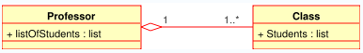
Class diagram Relationships(8)
Aggregation
Is a variant of the association relationship.
Aggregation is more specific than association
Association that represents part-whole or part-of relationship.
An Aggregation may not involve more than two classes.
Aggregation can occur when a class is a collection or container of other classes.
Hollow diamond shape

Slide 60
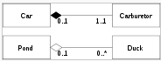
Class diagram Relationships(9)
Composition
is a stronger variant of the association relationship
composition is more specific than aggregation.
Composition usually has a strong life cycle dependency between instances of the container class and instances of the contained class(es):
If the container is destroyed, normally every instance that it contains is destroyed as well.
filled diamond shape

Slide 61
Class diagram Relationships(10)
Differences between Composition and Aggregation
The whole of a composition must have a multiplicity of 0..1 or 1(indicating that a part must be for only one whole).
The whole of an aggregation may have any multiplicity
E.g.,
An engine is part of a car, the composition relationship is most appropriate.
A car model engine
ENG01 is part of a car model CM01, an aggregation relationship is best, as the engine, ENG01 may be also part of a different car model.

Slide 62
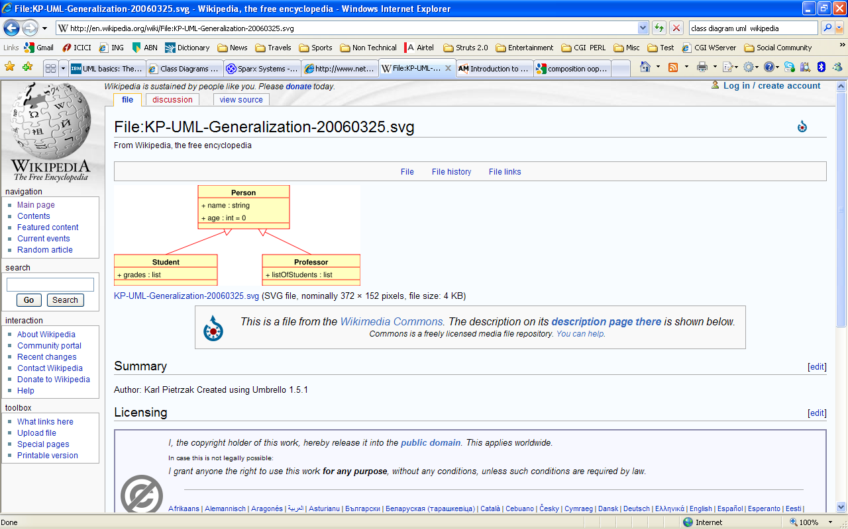
Class diagram Relationships(11)
Class –level relationships
Generalization
The Generalization relationship indicates that one of the two related classes (the subtype) is considered to be a specialized form of the other (the supertype) and supertype is considered as 'Generalization' of subtype
In practice, this means that any instance of the subtype is also an instance of the super type.

Slide 63
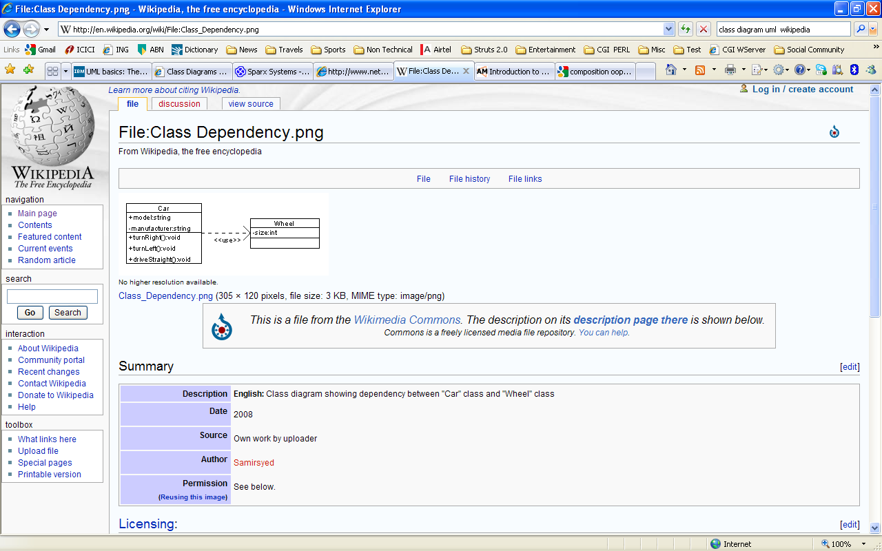
Class diagram Relationships(12)
Realization
Is a relationship between two model elements, in which one model element (the client) realizes the behavior that the other model element (the supplier) specifies.
Indicated by a dashed line with an unfilled arrowhead towards the supplier.
Realizations can only be shown on class diagrams
Realization is a relationship between classes,
interfaces, components, and
packages that connects a client
element with a supplier element

Slide 64
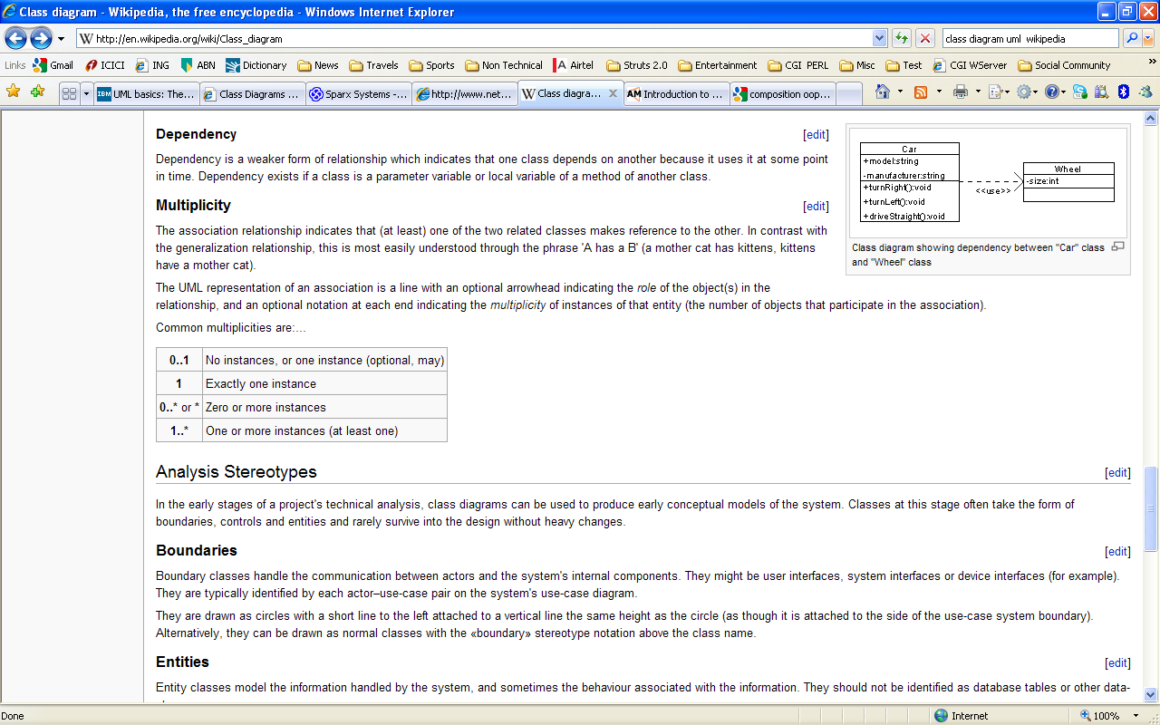
Class diagram Relationships(13)
General–level relationships
Dependency
Dependency is a weaker form of relationship
Indicates that one class depends on another because it uses it at some point in time.
Dependency exists if a class is a parameter variable or local variable of a method of another class.
Multiplicity
The association relationship indicates that (at least) one of the two related classes makes reference to the other
'A has a B' (a mother cat has kittens, kittens have a mother cat).

Slide 65
Scenario / Case Study Shopping Cart
Shopping Cart - Specifications
A Customer can be associated with zero(intially) or one Shopping Cart.
A Preferred Customer is a Subtype of Customer.
A Preferred Customer can be associated with many Credit Cards.
A Credit Card can be associated with one, and only one, Preferred Customer.
A Shopping Cart can be associated with one, and only one, Credit Card.
A Shopping Cart can be associated with many Items to Purchase.
An Item to Purchase can be associated with one and only one Product.
A Product can be associated with many Items to Purchase.

Slide 66
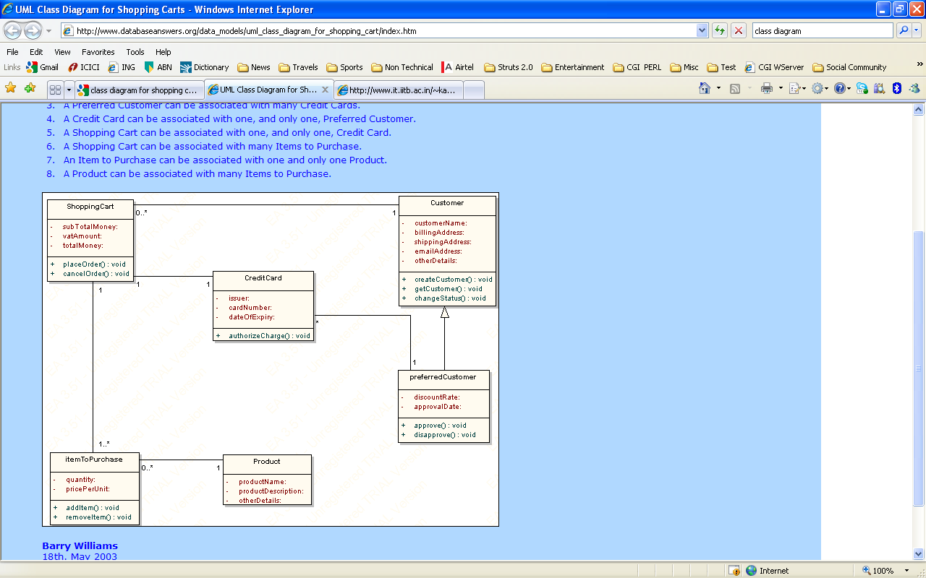
Shopping Cart – Solution

Slide 67
Scenario /Case Study : Text Document Processing
Suppose that you're writing a document in some of famous text processing tools, like Microsoft Word for example. You can start typing a new document, or open an existing one. You type a text by using your keyboard.
Every document consists of several pages, and every page consists of header, document's body or/and footer. In header and footer you may add date, time, page number, file location e.t.c.
Document's body has sentences. Sentences are made up of words and punctual signs. Words consists of letters, numbers and/or special characters. Also in the text you may insert pictures and tables. Table consists of rows and columns. Every cell from table may hold up text or pictures.
After finishing the document, user can choose to save or to print the document.

Slide 68
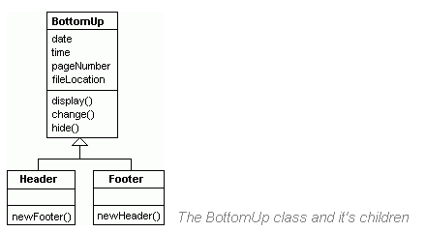
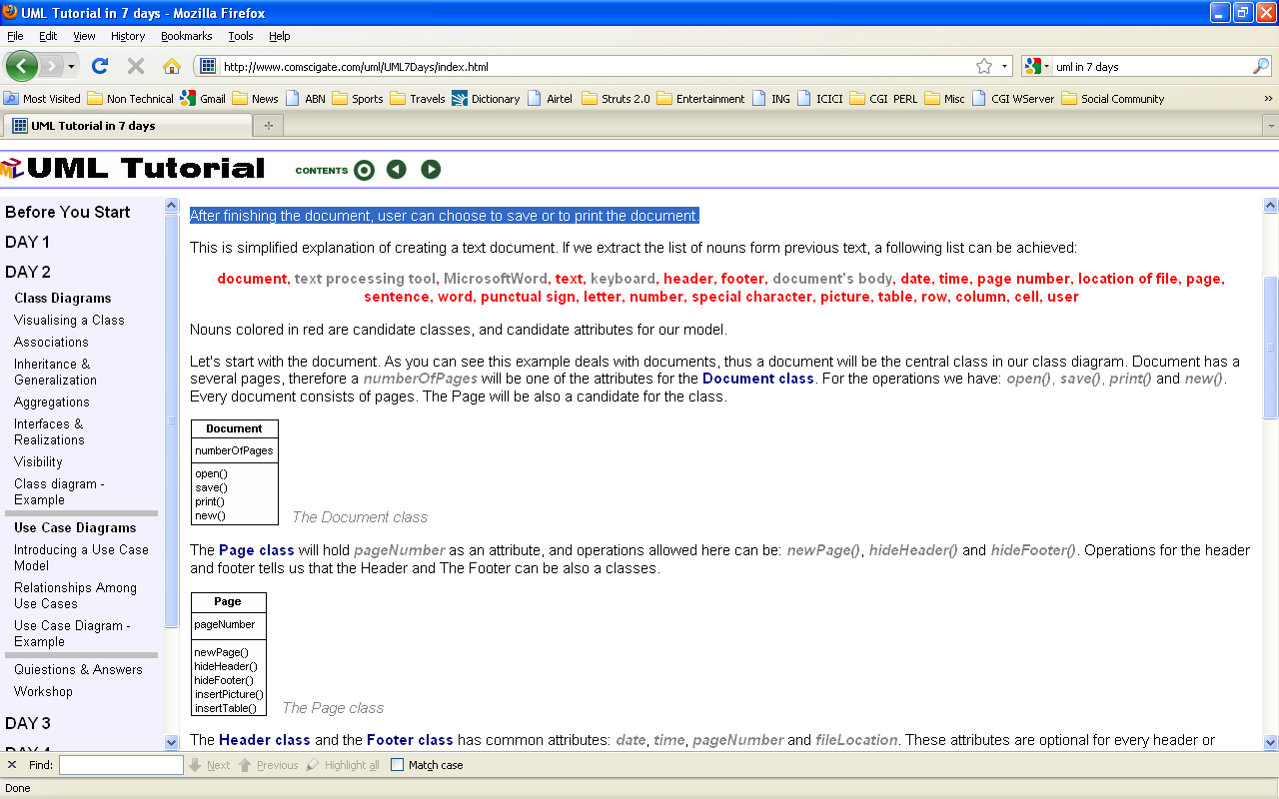
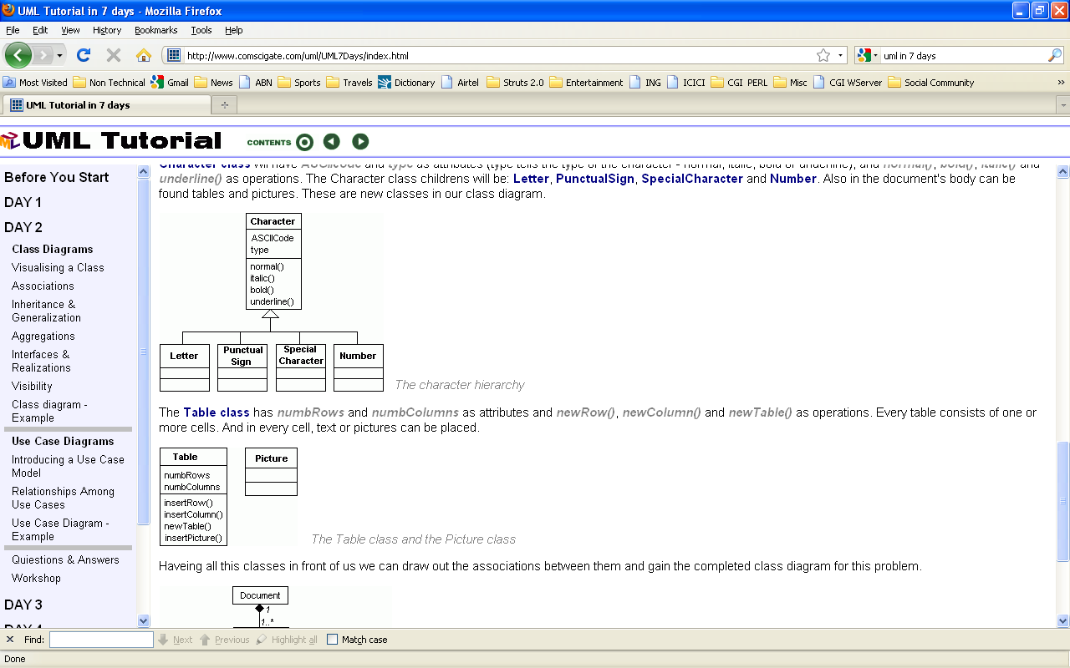
Classes / Attributes/Operations

Slide 69
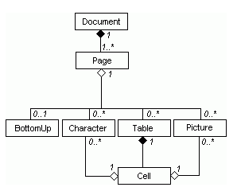
Complete Class Diagram

Slide 70
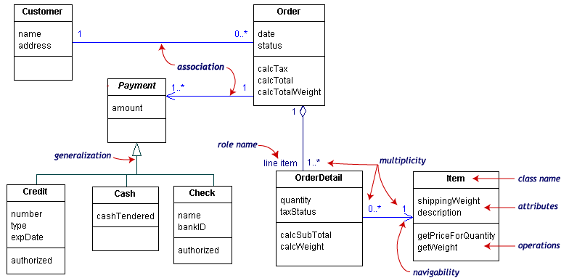
Scenario: Product Payment

Slide 71
Scenario: ATM System
Message - used to represent a message to the bank.
Receipt - used to encapsulate information to be printed on a receipt.
Status - used to represent return value from message to the bank.
Balances - used to record balance information returned by the bank.
Money - used to represent money amounts, in numerous places.
AccountInformation - contains names of various types of accounts customer can choose from

Slide 72
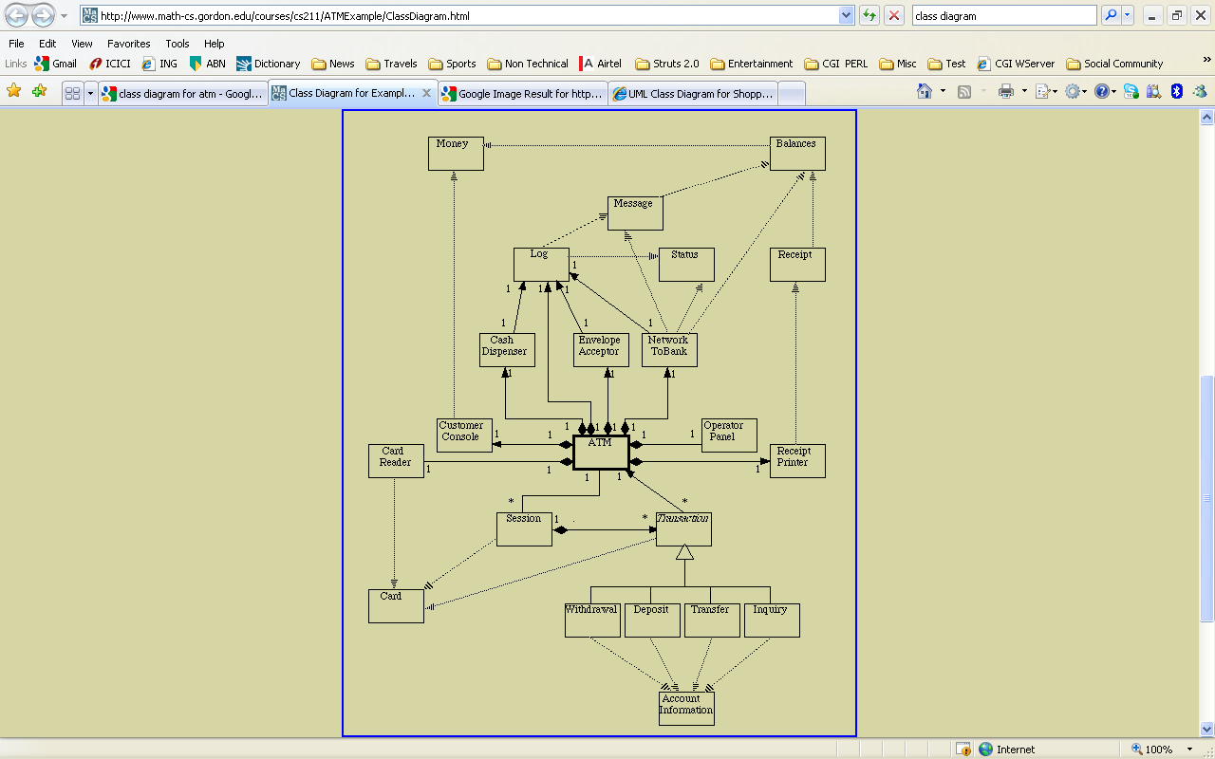
Scenario : ATM System

Slide 73
Diagram classifications
Structural Modeling(Structural diagrams)
Class Diagram
Object Diagram
Component Diagram
Package Diagram
Deployment Diagram
Behavioral Modeling(Behavioral diagrams)
Use Case Diagram
Activity Diagram
State Machine Diagram
Interaction Modeling (Interaction Diagrams -all derived from the more general Behavior Diagram)
Sequence Diagram
Excludes - Composite Structure Diagram, Communication Diagram, Interaction Overview Diagram & Timing Diagram .

