Slide 1

Global Electronics Retail Analysis
Power BI Dashboard
Puram Teja
Batch No :436
Innomatics Research
Labs Dilshuknagar

Slide 2
About me
I am Puram Teja.
I completed my B.Tech in Computer Science and Engineering (Data Science) from Kommuri Pratap Reddy Institute of Technology, Hyderabad.
LinkedIn :https://www.linkedin.com/in/puramteja
GitHub :https://github.com/puramteja131

Slide 3
AGENDA :
Business Problem
Business Objective
Dataset Overview
Data Cleaning & Transformation
Data Modeling
DAX Measures Created
Dashboard Highlights
Key Insights
Challenges Faced
Conclusion

Slide 4
Business Problem :
A global electronics retailer wants to understand why its overall revenue growth is slowing down. The business needs to identify where the slowdown is happening and whether it is related to order volume, order value, country performance, product categories, or outside factors such as the 2020 pandemic period.
Key questions:
How is revenue changing across years?
Which countries are performing better or worse?
Which product categories are increasing or decreasing revenue?
What happened to revenue during 2020?

Slide 5
Business Objective :
To analyze global electronics retail sales using Power BI and DAX and identify the main factors behind revenue growth and decline.
Key goals:
Analyze revenue and order trends across years.
Compare revenue performance across countries.
Compare category performance and identify strong/weak categories.
Measure YoY revenue growth and average order value.
Analyze the separate impact of the 2020 decline.
Build an interactive Power BI dashboard for business analysis.

Slide 6
Dataset Overview :
Total Rows : 62,884
Total Columns : 37
Source : Maven Analytics — Global Electronics Retailer
Related tables : Sales, Products, Customers, Stores, Exchange Rates
Coverage : 9 countries/channels | 2016–2021
Important note : 2021 was excluded from the main year comparison because it contains only 51 days of records.

Slide 7
Data Cleaning & Transformation :
Imported and cleaned the source tables using Power Query.
Fixed the Order Date locale/format error using Change Type with Locale (English UK), reducing errors from 61% to 0%.
Investigated missing Delivery Date values; around 79% were blank, so the blanks were retained.
Verified the data types of the required columns.
Checked and validated the cleaned data before building the data model and dashboard.

Slide 8
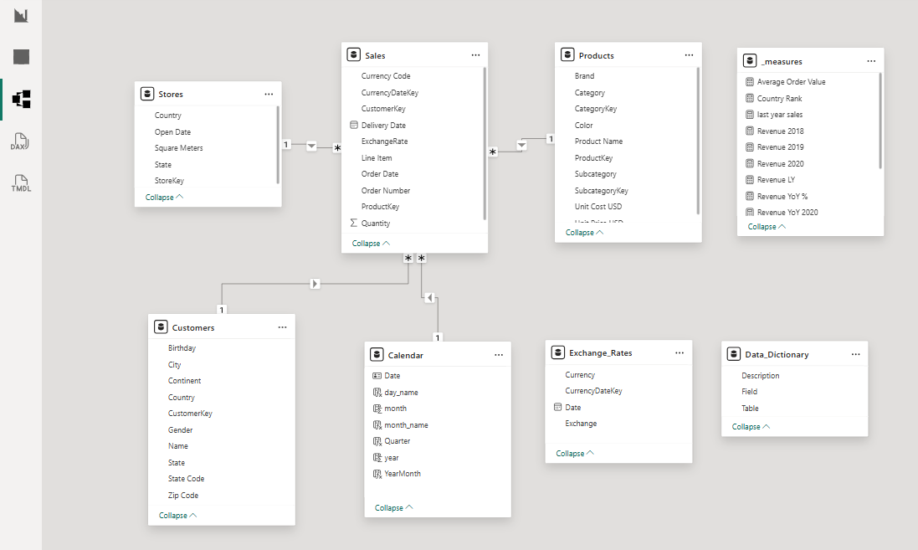
Data Modeling:
Built a star-schema data model with Sales as the main fact table.
Connected Sales with Customers, Products, Stores, and Calendar tables.
Created a separate Calendar table for time-based analysis.
Created a separate _measures table to organize DAX measures.

Slide 9
DAX Measures Created :
Total Revenue — calculates revenue using SUMX and RELATED.
Total Orders — counts the distinct orders using DISTINCTCOUNT.
Total Customers — counts distinct customers using DISTINCTCOUNT.
Average Order Value — calculates the average revenue per order using DIVIDE.
Revenue LY — calculates revenue for the same period in the previous year using SAMEPERIODLASTYEAR.
Revenue YoY % — measures the percentage change in revenue compared with the previous year.
Revenue YoY 2020 — measures the year-over-year revenue change specifically for 2020.
Country Rank — ranks countries based on their revenue performance using RANKX.

Slide 10
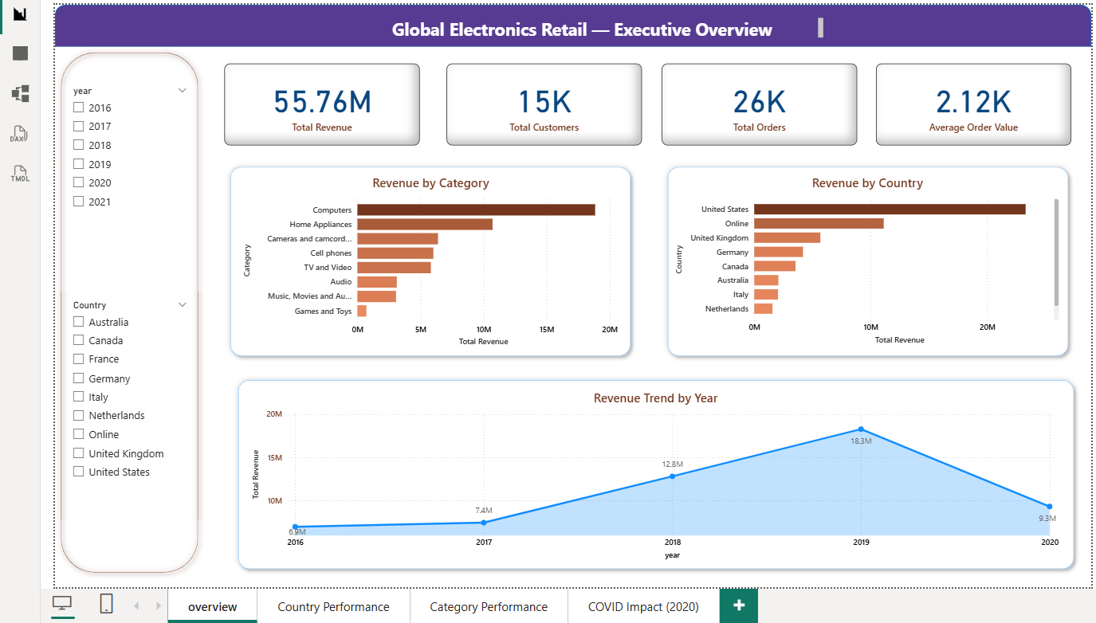
Dashboard Highlights – Overview:

Slide 11
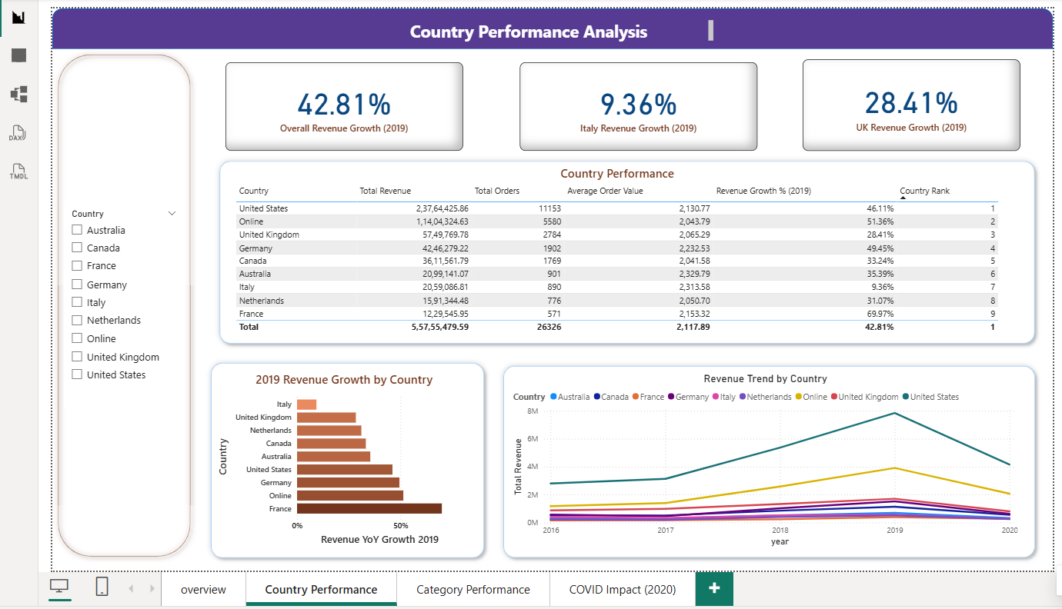
Dashboard Highlights – Country Performance:

Slide 12
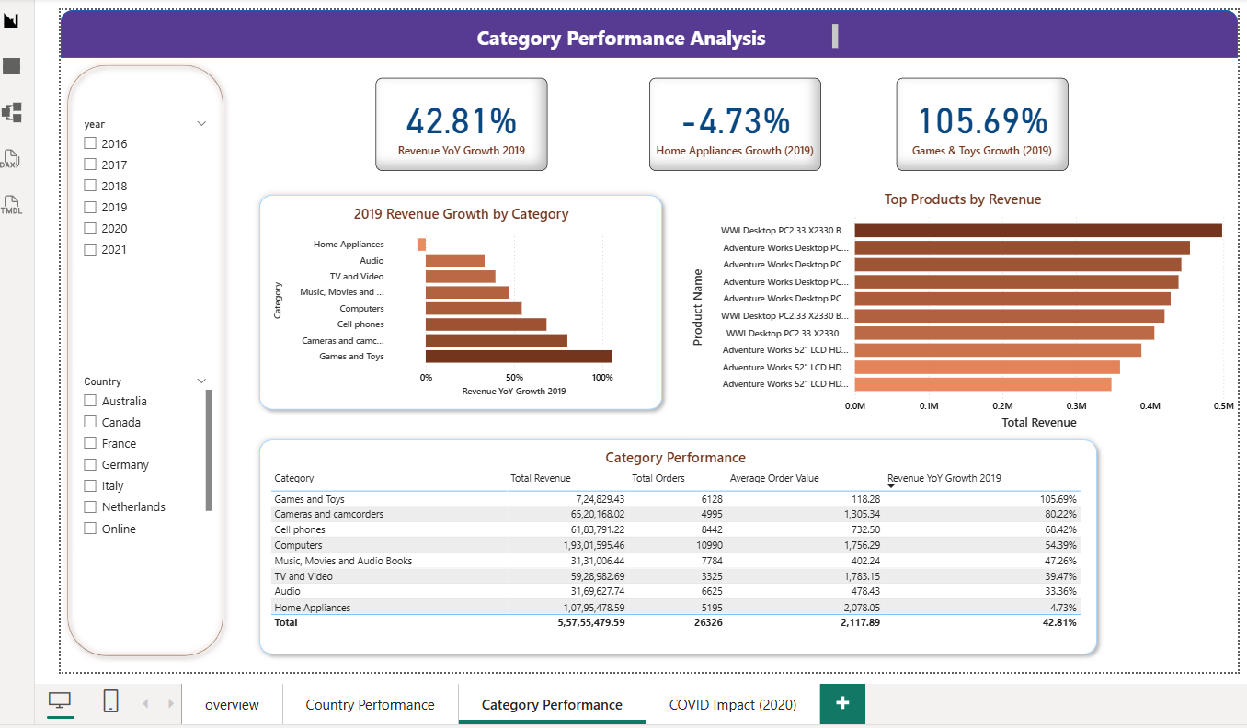
Dashboard Highlights – Category Performance:

Slide 13
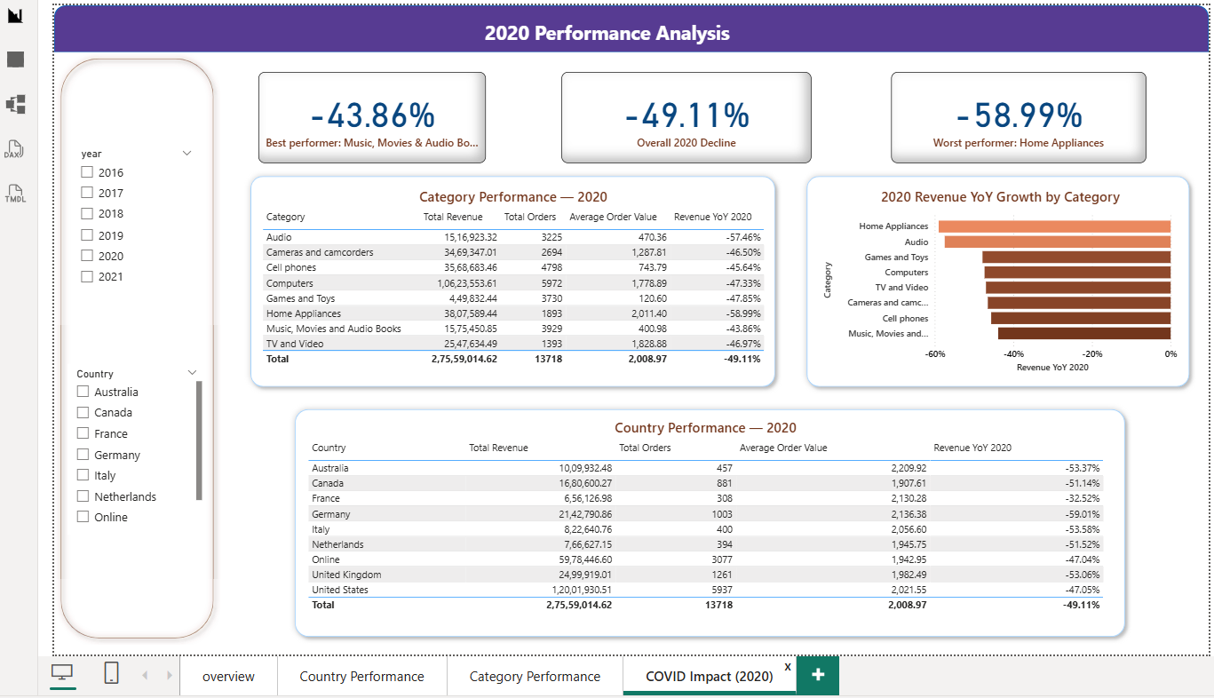
Dashboard Highlights – 2020 Impact:

Slide 14
Key Insights :
Overall revenue growth slowed from 72% in 2018 to 43% in 2019.
Italy recorded the lowest revenue growth in 2019 at 9.36%.
Games & Toys was the strongest-growing category, with 105.69% growth.
Home Appliances was the only category to decline in 2019, by 4.73%.
Revenue fell by approximately 49% in 2020.
The 2020 decline was analyzed separately because the sharp decline around March coincided with the COVID period.
2021 was excluded from the main trend analysis because it contained only 51 days of data.

Slide 15
Challenges Faced :
Handling the Order Date locale/format issue, which initially caused 61% errors.
Investigating the high number of missing Delivery Date values, with around 79% blanks.
Identifying the incomplete 2021 data and excluding it from the main year-over-year trend analysis.
Separating the 2020 revenue decline from the normal business trend and analyzing the month-by-month impact.

Slide 16
Conclusion :
The project successfully analyzed global electronics sales data using Power BI, Power Query, and DAX.
The dashboard helps us understand revenue and order trends across years, countries, and product categories.
The analysis helps identify areas of strong performance and areas that need improvement.
The interactive dashboard allows users to filter and explore the data based on their requirements.
Overall, the project shows how data analysis and visualization can support better business decisions.

Slide 17

THANK YOU

