Slide 1
Introduction to Guidewire Configuration
31 March 2011
Notes:
Introduction to Guidewire Configuration - <number>
Guidewire training materials contain Guidewire proprietary information that is subject to confidentiality and non-disclosure agreements. You agree to use the information in this manual solely for the purpose of training to implement Guidewire software solutions. You also agree not to disclose the information in this manual to third parties or copy this manual without prior written consent from Guidewire. Guidewire training may be given only by Guidewire employees or certified Guidewire partners under the appropriate agreement with Guidewire.

Slide 2
Lesson objectives
By the end of this lesson, you should be able to:
  List the areas of functionality in the Guidewire platform
  Explain the basic functionality of TrainingApp
  Describe the product architecture for Guidewire products
  Start a development instance of a Guidewire application
  Describe the purpose of Guidewire Studio
  This lesson uses the notes section for additional explanation and information.
  To view the notes in PowerPoint, choose View→Normal or View→Notes Page.
  If you choose to print the notes for the lesson, be sure to select “Print hidden slides.”
Notes:
Introduction to Guidewire Configuration - <number>

Slide 3
Lesson outline
Guidewire configuration technology
Training application data model
Guidewire product architecture
Starting Guidewire applications
Guidewire Studio
Documentation and support
Notes:
Introduction to Guidewire Configuration - <number>

Slide 4

Guidewire suite
ClaimCenter
PolicyCenter
BillingCenter
Three primary products to meet the core needs of property and casualty insurance carriers
  ClaimCenter: Processing claims for covered losses
  PolicyCenter: Underwriting policies
  BillingCenter: Managing billing for policies and accounts
Notes:
Introduction to Guidewire Configuration - <number>
Guidewire offers a set of applications designed to help property and casualty insurance companies expedite their policies, billing, and claim requirements:
ClaimCenter is an application designed to manage the process of reporting, verifying, and making payments on claims against a policy.
PolicyCenter is an application designed to issue, modify, and maintain data about policies.
BillingCenter is an application designed to issue and track the premium payments for policies and associated account charges.
Each application can function by itself, and each can be integrated with the other applications.
PolicyCenter can be integrated with BillingCenter, so that the two applications can share information about the payment expected, the payment schedule, and the possible cancellation of a policy if payments are not received.
PolicyCenter can be integrated with ClaimCenter, as ClaimCenter needs information about what was on the policy to determine if a loss is covered, and PolicyCenter needs to know what claims were filed to determine if the policy should be renewed and at what rate.
Although less common, BillingCenter can be integrated with ClaimCenter. This is typically done for business situations like subrogation in which the insured suffers a loss that a third party's insurance should pay for. ClaimCenter identifies that subrogation is expected, and BillingCenter manages the invoices sent to the third party's insurance provider.
There is a fourth application, ContactManager, which is used to manage information for contacts (such as auto repair, doctor, and legal vendors who participate in claims adjudication) and can be integrated with the other Guidewire applications.

Slide 5
The Guidewire platform
ClaimCenter
PolicyCenter
BillingCenter
Data
Model
User
Inter.
Data
Model
User
Inter.
Data
Model
User
Inter.
Bus.
Logic
Int.
APIs
Bus.
Logic
Int.
APIs
Bus.
Logic
Int.
APIs
Guidewire Platform,
with a common technology for configuring...
Data
Model
User
Interface
Business
Logic
Integration
APIs
Notes:
Introduction to Guidewire Configuration - <number>
The Guidewire platform includes four main areas of technology. There is one area for configuring:
The data model, which defines the structure of the data.
The user interface, which defines the forms and fields the end user interacts with.
The business logic, which defines and enforces business logic that must be captured in scriptable code.
The integration APIs, which connect a given application to external applications, such as a reporting system or check printing system.
Every application uses this common technology to define its own data model, user interface, business logic, and integration APIs. Each application is distinct, but every application shares common abilities and configuration techniques with all the other applications.

Slide 6
Application-specific functionality
ClaimCenter
PolicyCenter
BillingCenter
Finan-
cials
Group
Access
Product
Model
Job-
flow
Billing
Plan
Payment
Plan
Fraud Detection
Claim
Maturity
Role
Assign.
Policy
Validation
Charge
Pattern
Delinq.
Workflow
Data
Model
User
Inter.
Data
Model
User
Inter.
Data
Model
User
Inter.
Bus.
Logic
Int.
APIs
Bus.
Logic
Int.
APIs
Bus.
Logic
Int.
APIs
Guidewire Platform,
with a common technology for configuring...
Data
Model
User
Interface
Business
Logic
Integration
APIs
Notes:
Introduction to Guidewire Configuration - <number>
Each application has application-specific functionality. The application-specific functionality is created by implementations of the various platform-level technologies. For example:
The PolicyCenter-specific functionality includes:
The product model, which defines products, the policy lines assigned to each product, the coverages and coverables for the product, and the coverage terms for those coverages.
Jobflow, which defines how policy transactions (such as submissions, renewals, changes, and cancellations) are executed.
Role assignment, which defines how users are assigned responsibility for a given account, policy, or policy transaction.
Policy validation, which validates that a given policy is valid, quotable, bindable, or issuable.
The BillingCenter-specific functionality includes:
The management of invoices over the billing cycle from planned to billed to due and ultimately to paid.
The production of provider commission statements for business collected directly from the client and the production and reconciliation of account statements where the provider collects monies due.
The management of processing exceptions and events such as account statement queries. These are known as trouble tickets within BillingCenter.
The management of the escalation cycle invoked when a payment becomes overdue and the account becomes delinquent.
(continued)

Slide 7

(Notes only slide)
Notes:
The ClaimCenter-specific functionality includes:
Claim financials, which includes the ability to set aside money for expected payments (reserves), the ability to issue payments (checks), the ability to track recovery opportunities, and the ability to require approval for financial activity in excess of a given user's authority.
Claim maturity, which is a set of rules that automatically manage the claim's maturity level, with particular attention paid to whether the claim can be paid out or not and whether activities should be prevented if the claim is not yet payable.
Group access, which is enforced by "Access Control Lists", that can make a claim and its subobjects viewable or editable to only its owner, or its owner and anyone in that group, or its owner and anyone in the same security zone.
Fraud detection, which periodically checks claims for certain conditions and flags them for special investigation if the number and severity of the conditions it meets exceeds a given threshold.

Slide 8
Configuration courses
ClaimCenter
PolicyCenter
BillingCenter
Finan-
cials
Claim
Validation
Product
Model
Job-
flow
Billing
Plan
Payment
Plan
Claim
Maturity
AB
Integration
Role
Assign.
Policy
Validation
Charge
Pattern
Delinq.
Workflow
Application
Configuration
Data
Model
User
Inter.
Data
Model
User
Inter.
Data
Model
User
Inter.
Bus.
Logic
Int.
APIs
Bus.
Logic
Int.
APIs
Bus.
Logic
Int.
APIs
Guidewire Platform,
with a common technology for configuring...
"Fundamental"
Configuration
Data
Model
User
Interface
Business
Logic
Integration
APIs
Notes:
Introduction to Guidewire Configuration - <number>
Guidewire Education divides configuration technology into two categories: "fundamental" and "application-specific".
The "fundamental" configuration technology is the technology common to all Guidewire applications. One could think of it as the technology embedded within the Guidewire platform. This courses focuses on the fundamental configuration technology.
The "application-specific" technology is the technology added to each Guidewire application to enable it to do policy-specific, billing-specific, or claim-specific processing.

Slide 9
Lesson outline
Guidewire configuration technology
Training application data model
Guidewire product architecture
Starting Guidewire applications
Guidewire Studio
Documentation and support
Notes:
Introduction to Guidewire Configuration - <number>

Slide 10
Fundamentals training application
TrainingApp
Simplifies learning of fundamentals because it has:
  Simple examples of each "fundamental" configuration feature
  Smaller number of entities and screens
  Faster start-up time
  Excludes complex functionality designed for policy, billing, and claims processing
Data
Model
User
Inter.
Bus.
Logic
Int.
APIs
Guidewire Platform,
with a common technology for configuring...
Data
Model
User
Interface
Business
Logic
Integration
APIs
Notes:
Introduction to Guidewire Configuration - <number>
The training application also has the capability of being integrated with other systems. This course does not discuss integration, however.

Slide 11
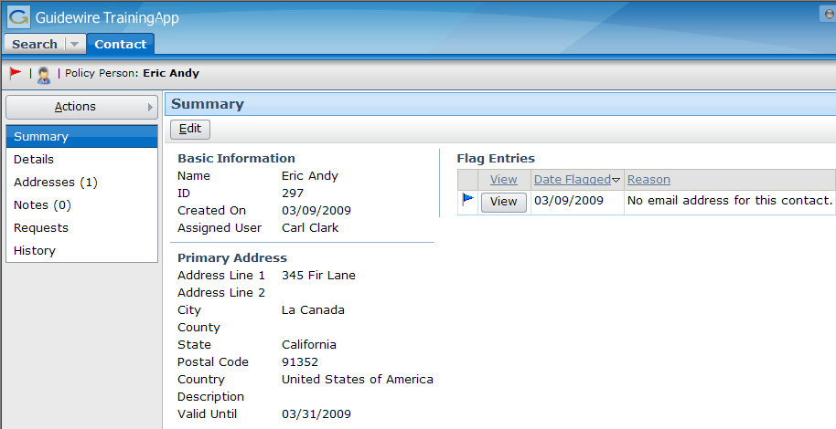
TrainingApp
Simple application for storing contact information
  Not sold as genuine Guidewire product
  Used exclusively by Guidewire Education
Notes:
Introduction to Guidewire Configuration - <number>

Slide 12
TrainingApp data model
FinanceManager
ABContact
AllAddresses
Address
History
History
Entry
AssignedUser
FlagEntries
Flag
Entry
FinancialSummary
ContactNotes
Contact
Note
User
BankAccounts
Bank
Account
Financial
Summary
ServiceEvaluations
Service
Evaluation
Notes:
Introduction to Guidewire Configuration - <number>
The core of the TrainingApp data model consists of nine entities and a small number of relationships which all center around ABContact.
The ABContact entity stores contacts. ("AB" stands for "Address Book". Many insurance carriers refer to their contact application as an Address Book.) The ABContact entity is subtyped, which is represented in the diagram above by the three small rectangles inside the ABContact rectangle. This is discussed in more detail on the following slide.
The Address entity stores addresses. An ABContact has one to many addresses.
Each contact has a history, which is a list of important occurrences in the life of that contact. The HistoryEntry entity stores a single entry in the ABContact's history. Given that a history entry is created to note the creation of the contact, every ABContact has one to many history entries.
The FlagEntry entity stores a flag entry. A flag entry is an issue pertaining to the ABContact which someone should attend to. An ABContact is "flagged" when it has one or more open flag entries. An ABContact can have zero to many flag entries.
The ContactNote entity stores notes about the ABContact. A contact note is a free-form text entry used to capture miscellaneous information about the contact. An ABContact can have zero to many contact notes.
The BankAccount entity stores bank account information. An ABContact can have zero to many bank accounts.
The Service Evaluation entity stores information about a service evaluation, which evaluates the quality of the service provided by the contact and is most appropriate for vendor contacts such as doctors, lawyers, and auto repair shops. An ABContact can have zero to many service evaluations.
The User entity stores information about TrainingApp users. An ABContact may have zero or one assigned users.
The FinancialSummary entity stores information about an ABContact's financial summary. An ABContact may have zero or one financial summaries.

Slide 13
(Notes only slide)
Notes:
Entities in a Guidewire data model can have one of four possible relationships. The four types of relationships are illustrated above.
A foreign key creates a many-to-one (M:1) relationship. In the example above, ABContact has a foreign key relationship to User. Each ABContact can be associated to a User (who is the assigned user). Many ABContacts can be associated to the same User.
A one-to-one relationship creates a one-to-one (1:1) relationship. In the example above, ABContact has a one-to-one relationship to FinancialSummary. Each ABContact can be associated to up to one FinancialSummary, and each FinancialSummary can be associated to up to one ABContact.
An edge-foreign key creates a foreign key relationship with one or more entities that reference each other in a cyclical fashion. This includes either:
An entity that references itself, or:
Two or more entities with references to one another in a circular fashion.
The edge foreign key is necessary because it provides additional information to Guidewire so that it can write rows to the database in the correct order (and can avoid writing one row to the database that references a row yet to be written). In the example above, ABContact has an edge foreign key to itself. (The ABCompany subtype of ABContact has a "FinanceManager" edge foreign key to the ABPerson subtype.)
An array can be thought of as creating a one-to-many (1:M) relationship. In the example above, ABContact has several arrays, including the BankAccounts array. Each ABContact can be associated to many bank accounts. Each bank account is associated to up to one ABContact. (Every array relationship requires a foreign key relationship in the opposite direction. For example, the array of BankAccounts on ABContact requires a foreign key from BankAccount to ABContact.)

Slide 14
ABContact is subtyped
ABContact
primary subtypes
ABPerson
ABCompany
ABPlace
ABAdjud-
icator
ABPerson
Vendor
ABPolicy
Person
ABCompany Vendor
ABPolicy
Company
ABLegal
Venue
AB
Attorney
AB
Doctor
AB
LawFirm
ABMedical
CareOrg
ABAuto
TowingAgcy
ABAuto
RepairShop
Notes:
Introduction to Guidewire Configuration - <number>
ABContacts are organized into a set of subtypes. The organization of the hierarchy helps to model information about contacts. Information common to all contacts can be established at the ABContact level. It is automatically inherited by all of its subtypes. Information specific to an ABPerson can be put at the ABPerson level. It will be inherited by all of its subtypes, but information on the ABPerson subtype is not available to ABCompany or ABPlace.
In the ABContact hierarchy, an ABPolicyPerson is a person who owns a policy issued by the carrier (such as an individual with a personal auto policy). An ABPolicyCompany is a company that owns a policy issued by the carrier (such as a construction company with a workers' compensation policy).
There is one entity that participates in the hierarchy that does not appear in the diagram above: ABUserContact. This type of contact represents a TrainingApp user and is used to store his or her contact information (such as home phone numbers). It has been excluded because it is not relevant to the configuration work to be done with TrainingApp.
Subtyping is also used within the three primary applications. For example:
BillingCenter's Activity, Plan, and Contact entities
ClaimCenter's Transaction, Incident, and Contact entities
PolicyCenter's Job and Contact entities

Slide 15
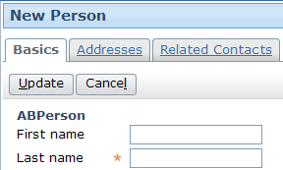
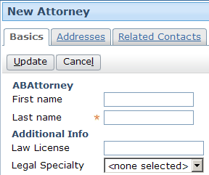
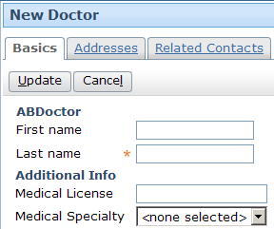
Fields at subtype level
First Name
Last Name
ABPerson
ABPerson
Vendor
AttorneyLicense
AttorneySpecialty
ABAttorney
DoctorSpecialty
MedicalLicense
ABDoctor
Notes:
Introduction to Guidewire Configuration - <number>
Any field declared at a given level is available to contacts of that type and all types below it. For example:
If First Name is declared at the ABPerson level, then it is available to contacts of type ABPerson, ABPersonVendor, ABAttorney, and ABDoctor.
If AttorneyLicense is declared at the ABAttorney level (and there are no levels below it), it is only available at that level.

Slide 16
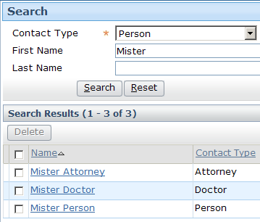
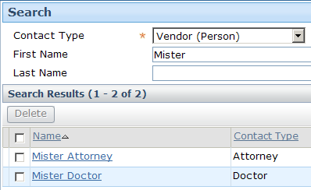
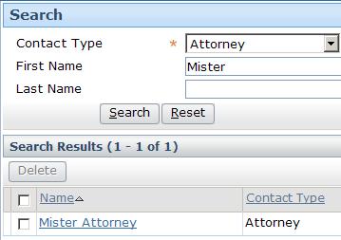
Search results within subtypes
ABPerson
ABPerson
Vendor
ABAttorney
ABDoctor
Notes:
Introduction to Guidewire Configuration - <number>
Any search conducted at a given level returns contacts whose subtype is at or below that level. For example:
A search for ABPersons returns ABPersons, ABPersonVendors, ABAttorneys, and ABDoctors.
A search for ABPersonVendors returns ABPersonVendors, ABAttorneys, and ABDoctors.
A search for ABAttorneys returns only ABAttorneys.

Slide 17
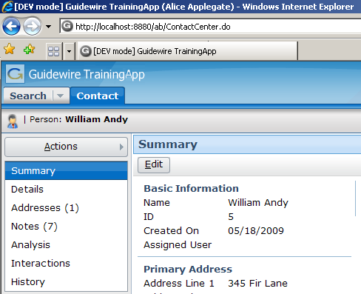
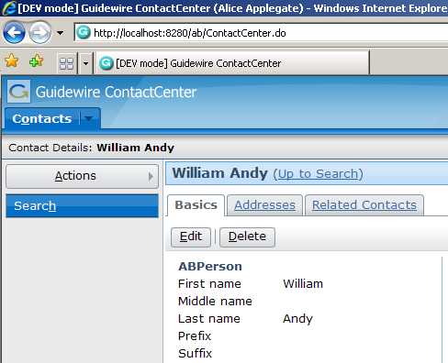
TrainingApp and ContactManager
TrainingApp is built on top of ContactManager
  Includes functionality not found in ContactManager
  Lacks ContactManager functionality not needed for training
Some references to ContactManager are hard-coded and appear in TrainingApp
Notes:
Introduction to Guidewire Configuration - <number>

Slide 18
Lesson outline
Guidewire configuration technology
Training application data model
Guidewire product architecture
Starting Guidewire applications
Guidewire Studio
Documentation and support
Notes:
Introduction to Guidewire Configuration - <number>

Slide 19
Platform Matrix
Most accurate resource for information on supported products and environments
Do the following:
  Access http://guidewire.hivelive.com/pages/home
  Select "Resources > Documentation"
  Click "Platform Matrix"
Notes:
Introduction to Guidewire Configuration - <number>

Slide 20

The application server
Supported application servers:
  Apache
  Tomcat
  JBoss EAP
  Jetty (development)
App. Server Machine
J2EE Application Server
Guidewire
Application
Supported
operating
systems:
  Vendor-supported operating systems
    Refer to your application server vendor
    For Apache Tomcat, review the Platform Matrix
Notes:
Introduction to Guidewire Configuration - <number>
All Guidewire applications are run within an application server. This is a robust piece of software that can run enterprise-wide applications. There are several different types of application servers. The type of application server used by Guidewire applications is a Java Enterprise Edition (Java EE) server. The platform was known as Java 2 Platform, Enterprise Edition or J2EE until the name was changed to Java EE in version 5.
Each Guidewire application is built and deployed as an Web Application Archive (WAR) or Enterprise Application Archive (EAR) file to the application server. It contains all the configuration, operational data and data definition files necessary to execute the application.
The application server is typically installed on a dedicated machine that does not host any other aspects of the architecture, such as the database. This machine must use an operating system supported by your third party application server vendor (or Guidewire, in the case of Apache Tomcat).
Guidewire supports the operating systems for which application servers provide customer support. For details, review the customer-viewable document Platform Matrix.
The Guidewire application (the center box) consists of a set of business rules, a user interface, a set of integration APIs, and a data model. The technology for configuring these application elements is platform-level (and common to all Guidewire applications), but the specific rules, UI, APIs, and data model for each application are distinct.

Slide 21
The application database
App. Server Machine
J2EE Application Server
Supported RDBMS:
  Oracle
  Enterprise
  Microsoft
  SQL Server
  H2 (development)
Database
Machine
Application DB
Notes:
Introduction to Guidewire Configuration - <number>
A relational database is a collection of data structure named tables that are linked (or related) to each other. The operational data for the Guidewire application is stored inside a relational database. This database is typically hosted on a machine other than the machine hosting the Java EE application server.
The war file contains a file named config.xml that specifies which database to connect to and how to establish the connection.

Slide 22

The user machines
App. Server Machine
Supported web browsers:
  Internet Explorer 7.0 or 8.0
J2EE Application Server
User Machine
Database
Machine
Application DB
Notes:
Introduction to Guidewire Configuration - <number>
End-users connect to the application using a web browser. Each application generates a collection of standard HTML pages that are rendered by the browser. Each application is a server-side application. It dynamically generates the HTML pages and data within those pages. It makes only a minimal use of functionality in the client (the web browser). Because there are no static HTML files, you cannot use the browser's Back button. All navigation is controlled on the server side.
In a development environment, you do not have to stop the application to deploy configuration changes to the business rules or the user interface. You must stop the application to deploy configuration changes to the data model. You may or may not need to stop the application to deploy configuration changes to integration APIs, depending on the nature of the change.
In a production environment, configuration changes are typically made by rebuilding and redeploying the application's war file. This always involve stopping and restarting the application.

Slide 23

The external systems
Policy
Admin.
App. Server Machine
J2EE Application Server
Address
Book
User Machine
Authen-
tication
Check
Printing
Reporting
Database
Machine
Application DB
Notes:
Introduction to Guidewire Configuration - <number>
Each application is typically integrated with a number of external systems. The connections to these systems are configured through the application APIs.

Slide 24
Gosu
Policy
Admin.
App. Server Machine
J2EE Application Server
Address
Book
User Machine
Authen-
tication
Check
Printing
Reporting
Database
Machine
Application DB
Notes:
Introduction to Guidewire Configuration - <number>
Gosu is an open-source, publicly-available programming language created by Guidewire. It has elements of both procedural and object-oriented programming languages. It is similar to JavaScript. Gosu is used to specify runtime business logic that:
Executes fundamental application behavior
Manages complex business processes
Specifies dynamic client-side behavior
Gosu can be used to affect behavior throughout the product architecture. This includes:
Application behavior (such as specifying business rule behavior, methods, and entity enhancements)
Client-side behavior in the web browser (such as reflecting the change of the value in one field in some other field)
Data model behavior (such as specifying which fields to concatenate for the "display name" of a given object)
Integration behavior (such as defining the behavior of a web service that responds to requests from external applications)
Guidewire developed Gosu for several reasons. First, there was a desire to have a single syntax that could be used to work with all of the elements relevant to Guidewire products (such as entities, display keys, classes, class enhancements, Java classes, permissions, and script parameters) even though these items have fundamentally distinct internal implementations. There was no existing language that provided this ability. Second, there was a desire to have a code auto-complete feature in Guidewire Studio, the primary tool used to complete Guidewire configuration tasks. This is possible only with a statically-typed language. Most scripting languages, such as JavaScript, Perl, Python, and Ruby, are dynamically-typed.

Slide 25
Lesson outline
Guidewire configuration technology
Training application data model
Guidewire product architecture
Starting Guidewire applications
Guidewire Studio
Documentation and support
Notes:
Introduction to Guidewire Configuration - <number>

Slide 26
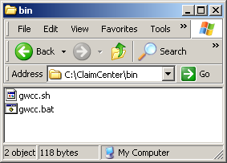
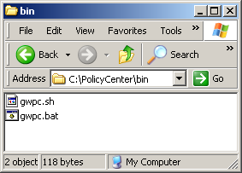
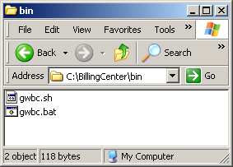
Parallel structure of Guidewire applications
All Guidewire end-user applications have a similar directory structure and are started using same basic tasks
Notes:
Introduction to Guidewire Configuration - <number>

Slide 27
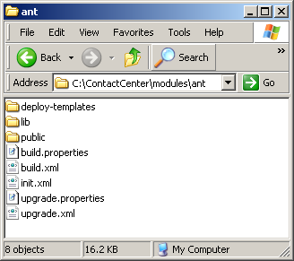

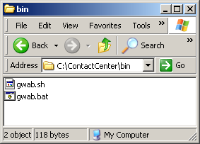
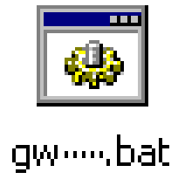
Files used to start application
build.xml defines administration tasks:
  Starting application
  Building web application archive (WAR) files
  Generating data and security dictionaries
"gw" batch file used to launch tasks defined in build.xml
  Located in <install>\bin
Notes:
Introduction to Guidewire Configuration - <number>
Every application's build.xml file is in <installDirectory>\modules\ant.
Every application's gw--.bat file is in <installDirectory>\bin. The name of the gw batch files varies from application to application.
TrainingApp: gwta.bat
BillingCenter: gwbc.bat
ClaimCenter: gwcc.bat
ContactManager (Address Book): gwab.bat
PolicyCenter: gwpc.bat

Slide 28
Commonly performed tasks
 | Start Application in Dev Mode | Regenerate Dictionaries | Stop Application
TrainingApp | gwta dev-start | gwta regen-dictionary | gwta dev-stop
BillingCenter | gwbc dev-start | gwbc regen-dictionary | gwbc dev-stop
ClaimCenter | gwcc dev-start | gwcc regen-dictionary | gwcc dev-stop
ContactManager (AddressBook) | gwab dev-start | gwab regen-dictionary | gwab dev-stop
PolicyCenter | gwpc dev-start | gwpc regen-dictionary | gwpc dev-stop
Notes:
Introduction to Guidewire Configuration - <number>
Every gw batch file and build task it references is prefixed by two-letter codes. The code for each product appears above in red. The code for ContactManager is "ab", which represents "Address Book".
Commonly PerformedTasks:
dev-start starts the given application in development mode.
regen-dictionary regenerates the data dictionary and the security dictionary.
dev-stop stops the application.
Note that—with the exception of the two-letter application code—the method for executing tasks is identical across all applications.

Slide 29
Applications can be run in one of two modes
Behavior | Development mode | Production mode
Available in QuickStart instance? | Yes | No
Contents of browser title bar | "DEV mode" + build number + application name + user name | Application name + user name
Access to internal tools | Unrestricted | Restricted by permissions
Running dev commands from QuickJump box | Enabled | Disabled
Database exceptions logged at... | Error level | Warning level
Notes:
For every Guidewire application, there is a QuickStart instance that can be run using a Jetty application server and an H2 database. These instances are useful for learning, demo, and development. A QuickStart instance cannot be run in production mode, however.
The Internal Tools interface contains controls for developing and administering Guidewire applications. It can be accessed only if:
The EnableInternalDebugTools parameter in config.xml is set to true.
The server is running in development mode.
To access Internal Tools, enter ALT + SHIFT + T. (It does not matter which user you are logged in as.)
The QuickJump box appears in the upper right-hand corner of the user interface. By default, it contains the text "Go to (Alt+/)". Typically, end users use this box to quickly navigate to various claims, policies, accounts, producers, or contacts. In development mode, however, more powerful commands can be executed. For example, the "run ImportSampleData" command loads sample data into a Guidewire application.
There is no obvious performance overhead to running in development mode—the performance characteristics of a running development server should closely resemble those of the same server in production mode.
Keep in mind that the information on this slide is not exhaustive. There are additional behavior differences that are either more technical in nature or are application-specific. For more information, refer to the Guidewire documentation.

Slide 30

Starting Guidewire in development mode
All Guidewire applications display " **** ready **** " message when started
  TrainingApp "ready" message references ContactManager
Notes:
Introduction to Guidewire Configuration - <number>
To start any Guidewire end-user application in development mode:
At a command prompt, navigate to the bin directory of the installation.
Enter gwxx dev-start, where xx is the application's two-letter code.
When the message "***** application ready *****" appears, the application has started.
The command prompt window must remain open while the application is running. You can minimize it, however.
For more information on how to start a Guidewire end-user application in production mode, refer to the Installation Guide for the appropriate application.

Slide 31
Accessing application logon page
URL syntax:
http://hostName:port/appCode
Example:
Application | Port | App Code | App Name
TrainingApp | 8880 | AB | ContactManager
BillingCenter | 8580 | BC | BillingCenter
ClaimCenter | 8080 | CC | ClaimCenter
ContactManager | 8280 | AB | ContactManager
PolicyCenter | 8180 | PC | PolicyCenter
Notes:
Introduction to Guidewire Configuration - <number>
TrainingApp's official application code and application name are "ab" and "ContactManager". This is a hard-coded aspect of Guidewire applications that cannot be customized.

Slide 32
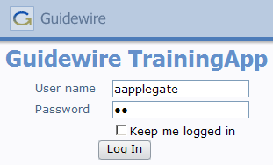
Logging on to the Guidewire applications
"su" (super user) account
  Only account in default installation
  Has all permissions, and special capabilities above what can be granted through permissions
    Because "su" has unique permissions behavior, use of "su" should be avoided during testing
"aapplegate" account
  Not in default installation,
  but in sample data for
  every application
  Represents basic end user
  with permissions typical to
  contact manager, adjuster,
  underwriter, or billing manager
Notes:
"su" and all user accounts in Guidewire sample data have an initial password of "gw".
If a user checks the "Keep me logged in" field and logs in, then for the next seven days the user is logged in automatically whenever they navigate to the login page. (This works only if the application is hosted by the same application server.) An explicit logout will clear the "keep me logged in" state.
Note that the "Keep me logged in" functionality writes a cookies to the user's machine. As is the case with all Internet Explorer cookies, this may expose a security risk if other people get access to the cookie. (For example, someone could copy the cookie to another machine and then log in without entering a user name or password.) If there is a concern about browser cookie theft, administrators should remove this checkbox from the login page.

Slide 33
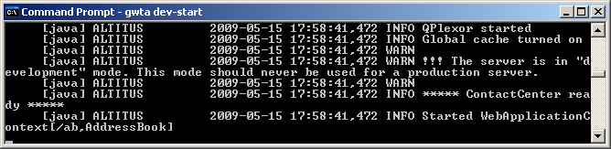
Stopping Guidewire applications
Application is running in development mode:
  Terminate the batch job (CTRL + C, y), or
  Close command prompt window
Application is running in production mode:
  Execute gwXX dev-stop
    Cleaner shutdown process that should be used for applications running in production mode
    Also useful in dev mode if server does not release port
Notes:
Introduction to Guidewire Configuration - <number>
Terminating the batch job has the advantage of keeping the command prompt window open and retaining the history of previously executed commands. This is useful if you need to stop and later restart the application.
The gwXX dev-stop command executes a more elegant shutdown. For example, if the application is in the middle of writing to a file, dev-stop would allow the process to complete, whereas terminating the batch job or closing the command prompt window may not. It also allows a script to stop the server. To execute dev-stop manually, you must open a second command prompt window, navigate to the bin directory, and enter "gwXX dev-stop", where XX is the two-letter application code.
In a development environment, there is virtually no harm in stopping the application by terminating the batch job or closing the command prompt window. In a small number of cases, the server may not release the port number. In this situation, executing a gwXX dev-stop should release the port.
The command prompt window must remain open while the application is running. You can minimize it, however.

Slide 34
Lesson outline
Guidewire configuration technology
Training application data model
Guidewire product architecture
Starting Guidewire applications
Guidewire Studio
Documentation and support
Notes:
Introduction to Guidewire Configuration - <number>

Slide 35
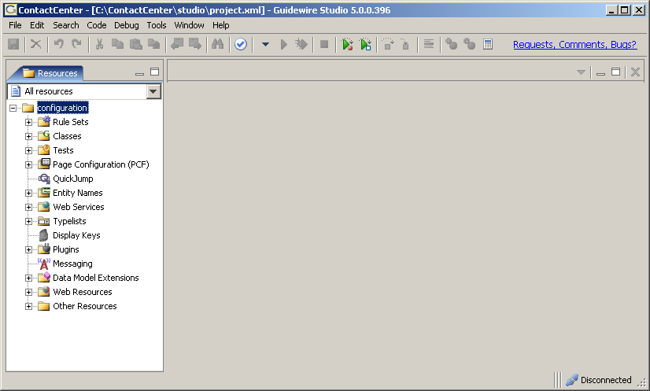
Guidewire Studio
Each Guidewire application has its own Studio
  Studio is used to configure:
    Data model
    User interface
    Business rules (and other scriptable logic)
    Integration APIs
Notes:
Introduction to Guidewire Configuration - <number>

Slide 36
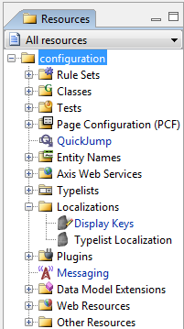
Studio resources
Most resources in Studio tie to one of the primary areas of functionality
business logic
user interface
data model
integration APIs
Notes:
Introduction to Guidewire Configuration - <number>
The various data model, user interface, and business rules resources are discussed throughout the course.
The integration API resources are discussed in the BillingCenter Application Integration, ClaimCenter Application Integration, and PolicyCenter Application Integration courses.
Plugins are blocks of code called at pre-defined points. Some plugins (such as ClaimCenter's claim number generator plugin or BillingCenter's commission calculator plugin) execute business logic entirely within the Guidewire application. Other plugins (such as ClaimCenter's policy search plugin or PolicyCenter's authentication plugin) manage interactions with external systems. Plugins, therefore, fall into both the business logic and integration APIs category.
The Web Resources node contains look-and-feel of the user interface as well as some JavaScript files.
The Other Resources node is a collection of templates, text files, and XML files that do not readily fall into any of the above categories.

Slide 37
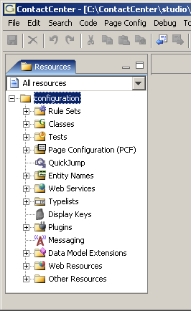
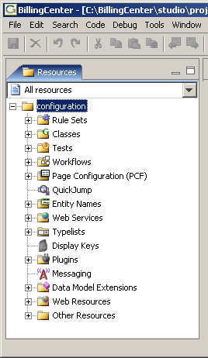
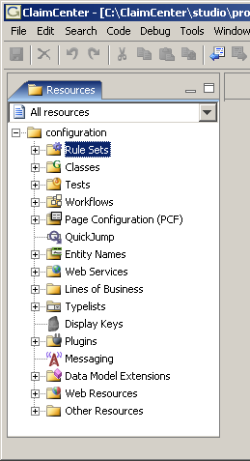
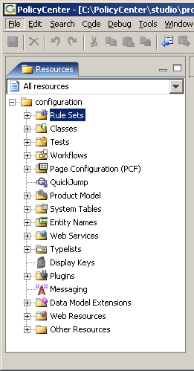
Variations in each application's Studio
Notes:
Introduction to Guidewire Configuration - <number>
Every feature in Studio is common to every application, except for the following:
The Workflow editor is found only in BillingCenter, ClaimCenter, and PolicyCenter. The Workflow editor is used to modify workflows, which are complex and potentially asynchronous processes that execute business processes.
The Line of Business editor is found only in ClaimCenter. It is used to modify the line of business model that determines how policies and coverages are mapped to sets of claim-related information known as exposure types.
The Product Model editor and System Tables editor are found only in PolicyCenter. The Product Model editor is used to configure the product model, which determines for a given type of policy what types of things can be covered on the policy, what coverages it can have, and what coverage terms are available for those coverages (such as limits and deductibles). The System Tables editor manages system tables, which are lookup tables used to manage tabular policy data such as workers' compensation parameters.

Slide 38
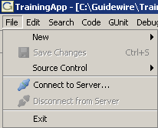

Starting and stopping Studio
To start:
  Open new command prompt
  Navigate to bin
  Execute gwXX studio
To stop, select File -> Exit
Notes:
Introduction to Guidewire Configuration - <number>
You can also start Guidewire Studio by double-clicking the studio.bat file. This opens a command prompt that executes the studio task. The command prompt window will be named "cmd.exe"; it is not unusual to have multiple command prompt windows open when configuring a Guidewire application, and it can be useful to have a meaningful name for each window.
The studio.bat file contains the following code:
@echo off
cd bin
call ant -f build.xml studio
This suppresses messages to the console (@echo off), changes to the bin directory, and then calls the studio ant task in the build.xml file.
The command prompt window must remain open while Studio is running. You can minimize it, however.

Slide 39
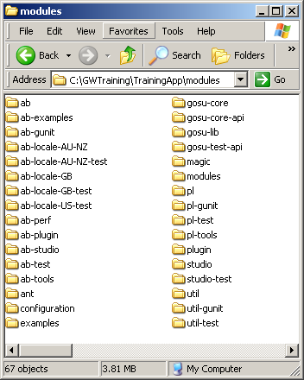
The modules directory
modules directory stores base and customized files
  base files in all subdirectories (except for configuration)
  customized files in configuration subdirectory
base
application
files
Notes:
Introduction to Guidewire Configuration - <number>

Slide 40

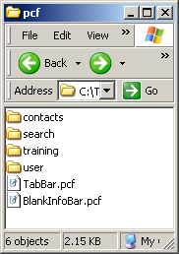
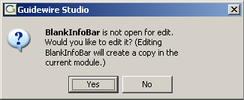

Editing base files
When you modify a base file, Studio:
  Copies it into configuration directory
  Makes changes to that copy
attempt to edit file
Notes:
Introduction to Guidewire Configuration - <number>
Whenever you attempt to edit a base file, Studio displays a "would you like to edit it" dialog box. If you click yes, Studio makes a copy of the file in the configuration directory. This copy then takes precedence over the original base copy. Studio also modifies the file name as displayed in the resource tree by changing the name to blue text and adding a pencil icon onto the file icon.
You have different levels of control over deleting resources depending on whether you select a base resource or one that you have created:
If you select a resource you created, you can select "Delete" from a right-click context menu or "Delete/Revert To Base" from the edit menu to delete the resource permanently
If you select a resource that you created as an extension of a base resource, you can select "Revert To Base" from a right-click context menu or "Delete/Revert To Base" from the edit menu to delete the extension and restore the base resource as the one that will be used by the system
If you select a base resource, the "Delete" and "Revert To Base" options are not displayed in menus, as base resources are required by the system and are therefore protected from manipulation
Note: Deleting or reverting resources will affect resources in the system that make reference to the removed resource. For example, deleting an entity will make any array key or foreign key references to that entity invalid, so you will have to modify any resources that make such references. Make sure you understand the implications of deleting or reverting a resource before doing so.

Slide 41
Lesson outline
Guidewire configuration technology
Training application data model
Guidewire product architecture
Starting Guidewire applications
Guidewire Studio
Documentation and support
Notes:
Introduction to Guidewire Configuration - <number>

Slide 42
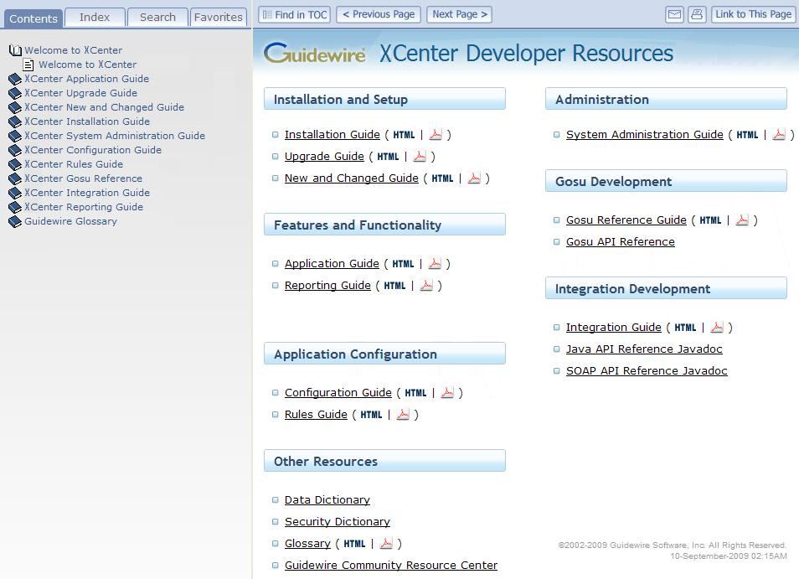
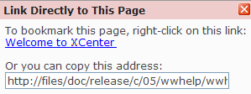
Guidewire documentation welcome page
Table of contents
Documentation set
Publication date
Notes:
Introduction to ClaimCenter - <number>
The documentation structure for every application (except ContactManager) follows the same structure. For a given application, there are two types of documentation that you can access from the Welcome page:
Books that are immediately available in both HTML and PDF format
Dynamic documents that need to be generated
Four tabs are provided for searching and navigating the documentation:
The Contents tab displays the table of contents for all books.
The Index tab allows you to select a letter and view all the index entries that start with that letter.
The Search tab allows you to perform a simple word search within the HTML documents. You can select a specific book or choose "All Available Books" to include in your search.
The Favorites tab helps you manage your documentation bookmarks.
The following buttons are available:
"Find in TOC" displays the table of contents with the current topic highlighted.
"Previous Page" and "Next Page" help you navigate sequentially through a document. Note the difference in behavior between "Previous Page" and the back button in your browser: "Previous Page" takes you to the page that immediately precedes the current page whereas the back button redisplays the most recent page you visited.
E-mail opens a new email that includes a link to the current topic.
Print allows you to print the current page.
"Link to This Page" provides a URL for you to copy or bookmark in your browser.
The ContactManager documentation does not live with the ContactManager application. Instead, it is located in the same directory as the ClaimCenter documentation.

Slide 43
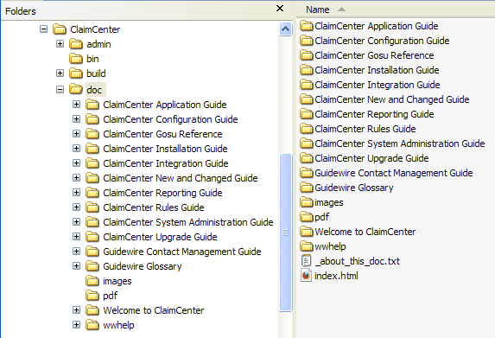
Guidewire documentation
Available from <XCenter home>\doc directory
  For example, in ClaimCenter...
API references are also available but must be generated
Documentation set in PDF
Always open this file to access full documentation set
Notes:
Introduction to ClaimCenter - <number>
Each application is shipped with a full set of documentation in both HTML and PDF formats. The recommended way to access the full documentation set is to open the file named index.html. You can then bookmark the URL in your browser.
In addition, there are three API references, which you need to generate before you can use them:
Gosu API reference is accessible from the Help menu in Guidewire Studio.
Java API reference is located in <XCenter>\java-api\doc\api. Open index.html
SOAP API reference is located in <XCenter>\soap-api\doc\api. Open index.html

Slide 44
Using the documentation
For this task … | Use …
Simple, whole-word search | Search tab to perform a search of all HTML books or of a single book
Comprehensive search | Open a PDF and use the Find facility
Print the current page | Click
Print multiple pages | Open the PDF and print selected pages
Send a link | Click
Bookmark a page in your browser | Click , right-click the link, and select Add to Favorites
Add an entry to the Favorites tab | On the Favorites tab, click Add button to create a link to the current page
Use these facilities for copying and bookmarking instead of using the URL in the address field
Notes:
Introduction to ClaimCenter - <number>
When bookmarking a page or copying the link to a page, do not use the URL in the address bar of your browser. Depending on the version of the documentation, the browser URL points either to the root directory of the documentation or to a file name, which is subject to change when topics are added to the documentation. The URLs that are available when you click the E-mail and "Link to This Page" buttons include the topic name instead of the file name so are less likely to change when the documentation is updated. Be sure to use the correct link when sending comments or questions to Guidewire Customer Support.
A search facility is provided for HTML documents. This mechanism is especially useful for searching across all HTML documents, but it does not support the use of quotation marks, wild cards, or partial words. For a more comprehensive search, open the PDF version of the document and use the Find facility.
You can perform a cross-book search of the PDF documents, though not from the browser:
Open Adobe Reader.
Select Edit → Search.
Select "All PDF Documents in" and then select the directory that contains the PDF files, such as C:\XCenter\doc\pdf.
Click Search.

Slide 45
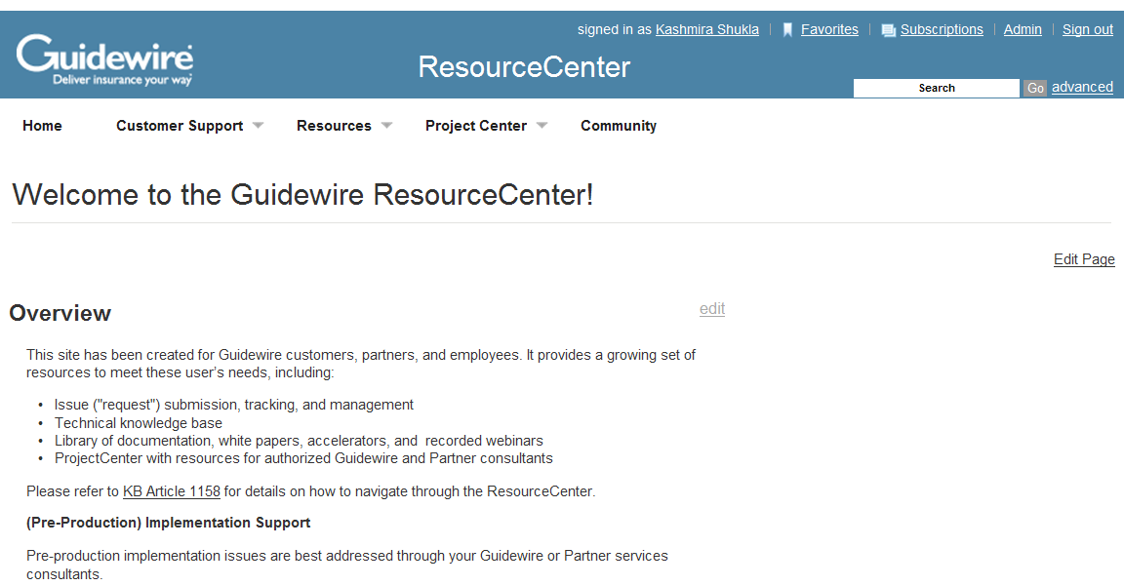
Guidewire ResourceCenter
The Guidewire ResourceCenter is a web site for support and information about Guidewire products
Notes:
Introduction to PolicyCenter - <number>
The ResourceCenter is at http://guidewire.hivelive.com/pages/home.
Accounts are automatically created for Guidewire employees and members of the customer implementation team.
The support and information functionality includes:
Issue management
Product documentation
Infrastructure and methodology white papers
Knowledge base
Implementation highlights
Company events
Users can create and update issues related to their project or organization. Customers can view and submit issues only once they are in production.

Slide 46
Lesson objectives review
You should now be able to:
  List the areas of functionality in the Guidewire platform
  Explain the basic functionality of TrainingApp
  Describe the product architecture for Guidewire products
  Start a development instance of a Guidewire application
  Describe the purpose of Guidewire Studio
Notes:
Introduction to Guidewire Configuration - <number>

Slide 47
Review questions
What are the four fundamental areas of Guidewire configuration technology?
ABLawFirm is a subtype of ABCompany.
  Does an ABLawFirm have all the fields declared on ABCompany?
  Will a search for an ABCompany return ABLawFirms?
How do you start a Guidewire application?
How do you stop a Guidewire application?
Notes:
Introduction to Guidewire Configuration - <number>
Answers
1. Data model, user interface, business rules, integration APIs
2. a) Yes. Any fields declared at the supertype level are available to its subtypes.
b) Yes. Any search at the supertype level returns instances of the supertype and instances of any of its subtypes.
3. Open a command prompt, navigate to the application \bin directory, and execute the start command ("gwXX dev-start" or "gwXX studio").
4. Close the command prompt (or, in the case of Studio, the application window)

Slide 48
Notices
Copyright © 2001-2011 Guidewire Software, Inc. All Rights Reserved.
Guidewire, Guidewire Software, Guidewire ClaimCenter, Guidewire PolicyCenter, Guidewire BillingCenter, Guidewire Reinsurance Management, Guidewire ContactManager, Guidewire Vendor Data Management, Guidewire Client Data Management, Guidewire InsuranceSuite, Guidewire ContactCenter, Guidewire Studio, Gosu, Deliver Insurance Your Way, and the Guidewire logo are trademarks or registered trademarks of Guidewire Software, Inc. in the United States and/or other countries.
This material is Guidewire proprietary and confidential. The contents of this material, including product architecture details and APIs, are considered confidential and are fully protected by customer licensing confidentiality agreements and signed Non-Disclosure Agreements (NDAs).
This file and the contents herein are the property of Guidewire Software, Inc. Use of this course material is restricted to students officially registered in this specific Guidewire-instructed course, or for other use expressly authorized by Guidewire. Replication or distribution of this course material in electronic, paper, or other format is prohibited without express permission from Guidewire.
    Guidewire products are protected by one or more of the following patents: U.S. Patent No. 7,885,831; U.S. Patent No. 7,788,296.
Notes:
Introduction to Guidewire Configuration - <number>

