Slide 1
FY2024 Meta Campaign Analysis
Lead Generation Campaign Performance Report
December 2024

Slide 2
Executive Summary
Key Findings:
• Total Leads Generated: 619
• Total Spend: $205,449
• Overall Click-to-Submit Rate: 1.51%
• Overall LPV-to-Submit Rate: 2.81%
• Average CPL: $98.94
• Programs Analyzed: 7

Slide 3
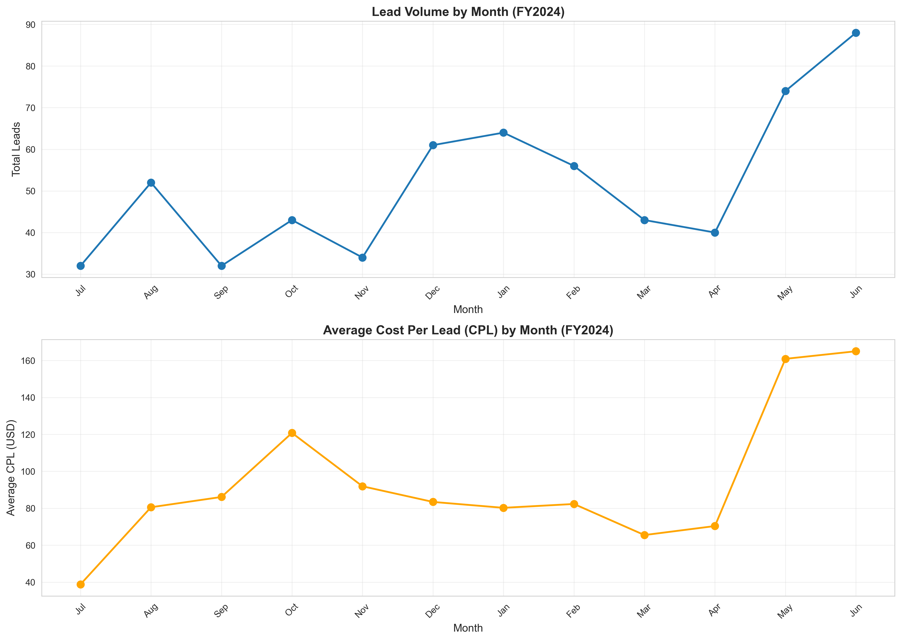
Seasonality Analysis: CPL and Lead Volume
Key Insights:
• Peak Lead Month: Jun (88 leads)
• Lowest Lead Month: Jul (32 leads)
• Highest CPL Month: Jun ($165.01)
• Lowest CPL Month: Jul ($38.82)
Recommendation: Increase budget allocation during peak months (May-June) and optimize campaigns during high CPL periods.

Slide 4
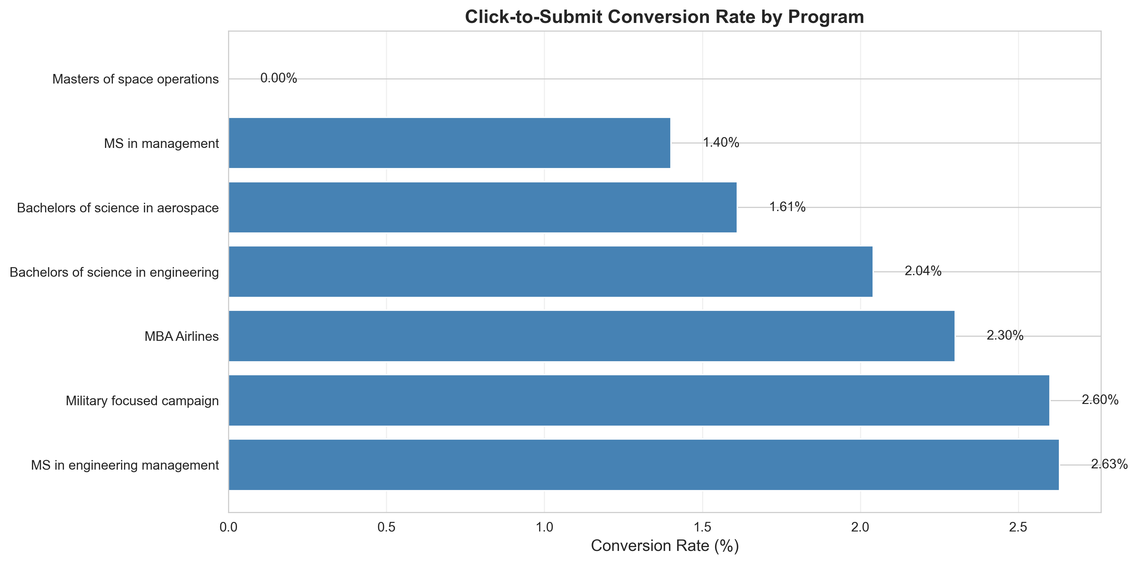
Click-to-Submit Conversion Rate
Overall Rate: 1.51%
Total Clicks: 41,108
Total Submits: 619
Top Performing Programs:
  • MS in engineering management: 2.63%
  • Military focused campaign: 2.60%
  • MBA Airlines: 2.30%

Slide 5
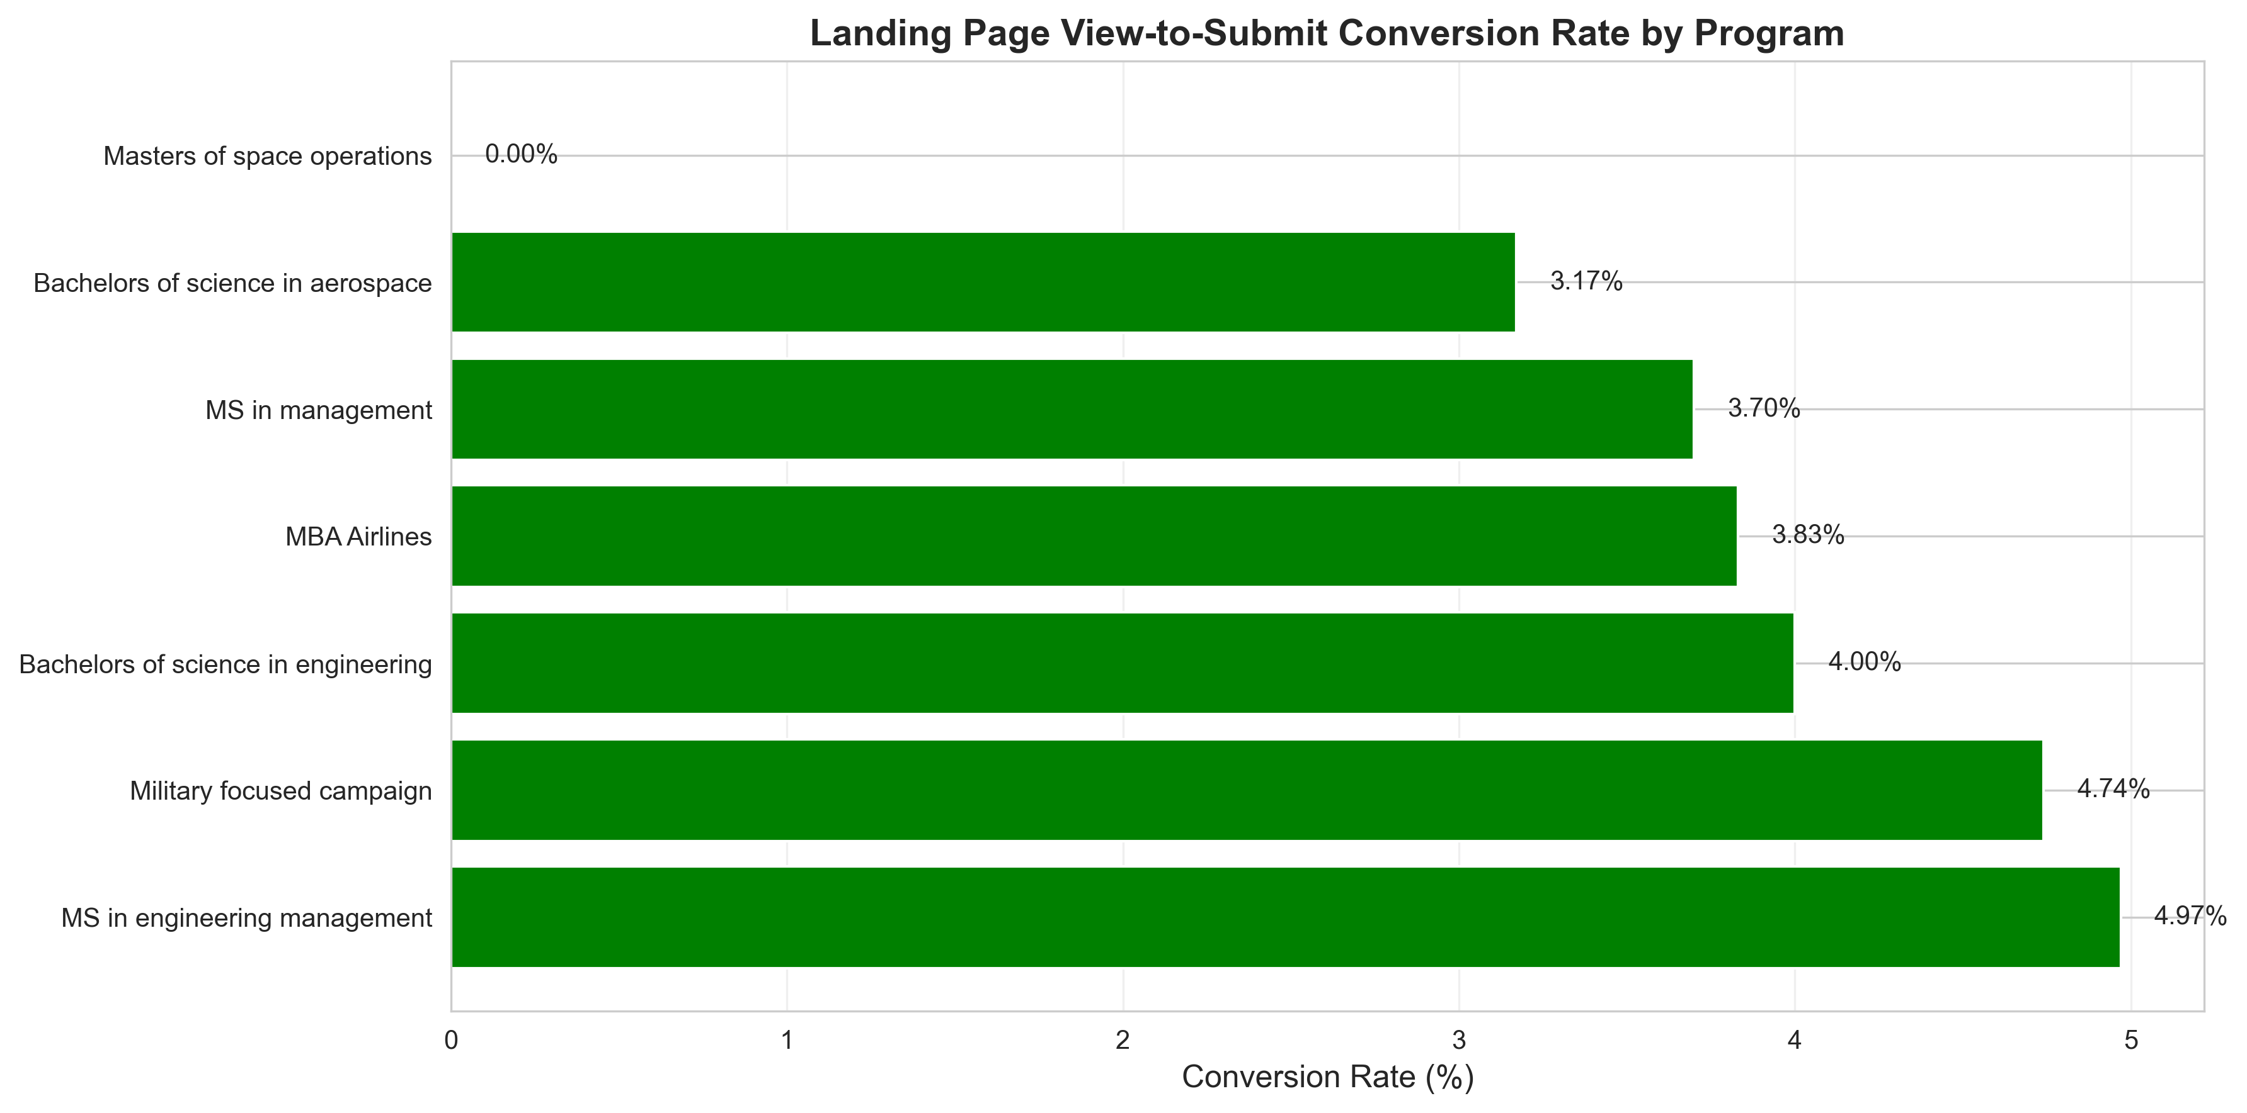
Landing Page View-to-Submit Conversion Rate
Overall Rate: 2.81%
Total Landing Page Views: 22,015
Total Submits: 619
Insight: Landing page optimization shows higher conversion potential than ad clicks alone.

Slide 6
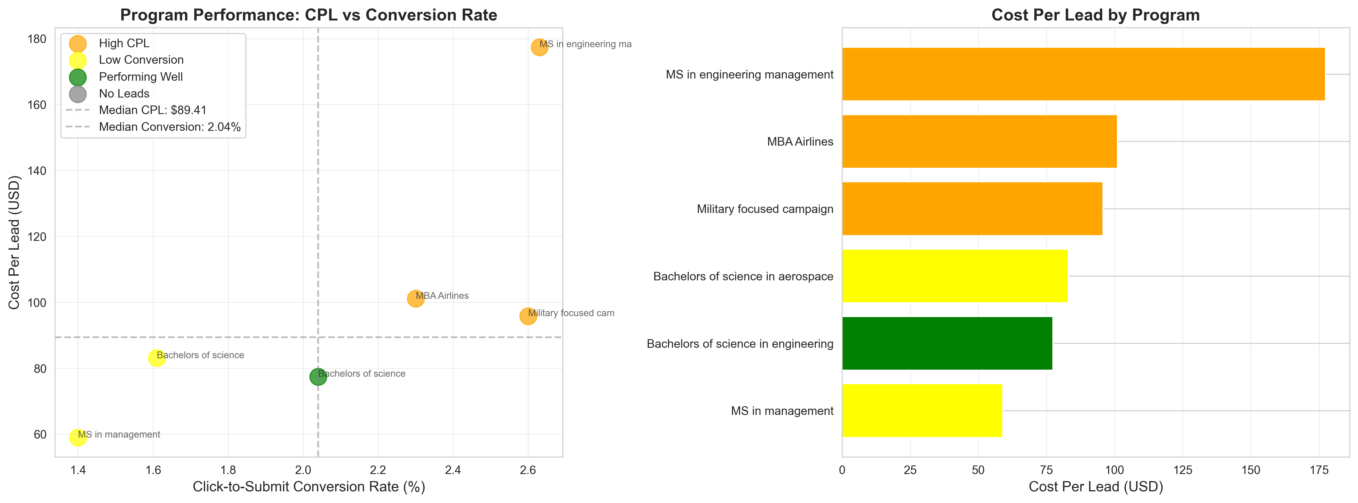
Underperforming Programs Analysis
Programs Requiring Attention:
• MS in engineering management
  Category: High CPL | CPL: $177.39 | Conversion: 2.63%
• MBA Airlines
  Category: High CPL | CPL: $101.09 | Conversion: 2.30%
• Military focused campaign
  Category: High CPL | CPL: $95.77 | Conversion: 2.60%
• Bachelors of science in aerospace
  Category: Low Conversion | CPL: $83.06 | Conversion: 1.61%
• MS in management
  Category: Low Conversion | CPL: $58.97 | Conversion: 1.40%
• Masters of space operations
  Category: No Leads | CPL: $nan | Conversion: 0.00%
Recommendation: Review targeting, ad creative, and landing page experience for underperforming programs.

Slide 7
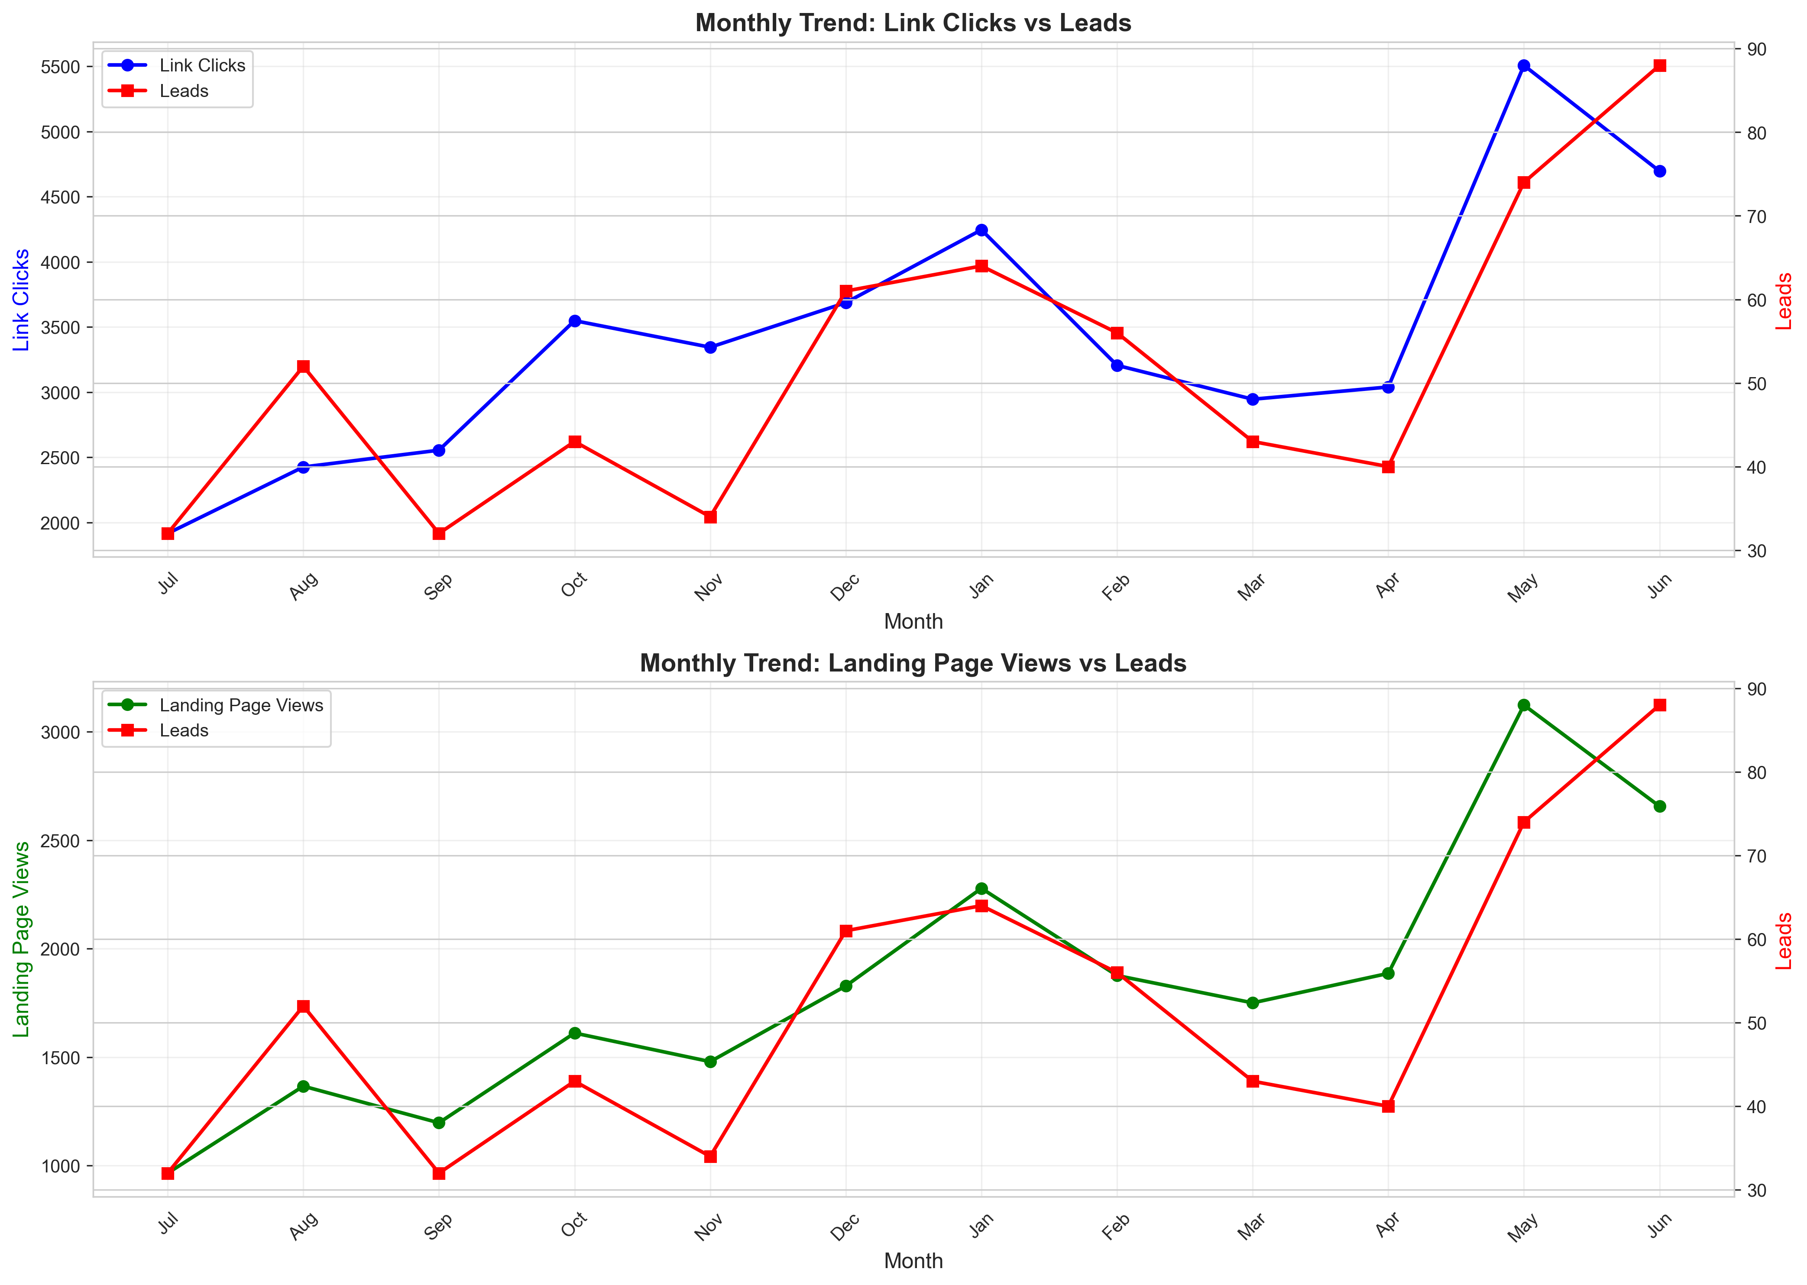
Ad Engagement Trends & Lead Correlation
Key Findings:
• Strong positive correlation between ad engagements and leads in following periods
• Clicks (1-week lag) correlation: 0.651
• Landing Page Views (1-week lag) correlation: 0.661
Recommendation: Increase ad spend during high-engagement periods to capitalize on delayed conversion patterns.

Slide 8
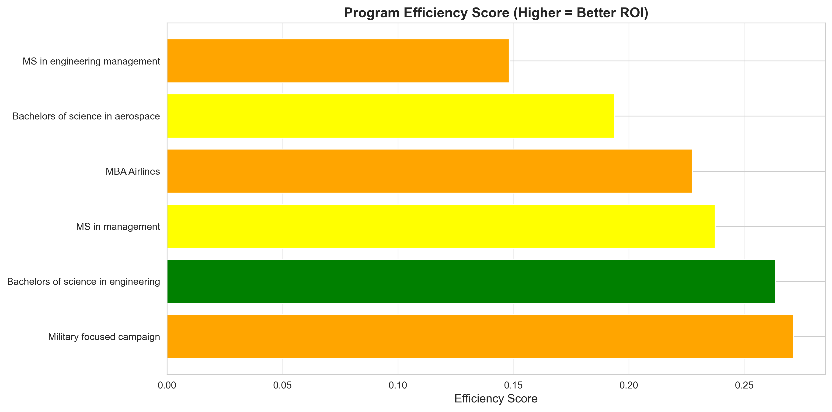
Budget Allocation Recommendations
Recommended Budget Reallocation:
INCREASE Budget:
  • Military focused campaign (Efficiency Score: 0.271)
  • Bachelors of science in engineering (Efficiency Score: 0.264)
  • MS in management (Efficiency Score: 0.237)
DECREASE/OPTIMIZE Budget:
  • MS in engineering management (High CPL)
  • Bachelors of science in aerospace (Low Conversion)

Slide 9
FY2025 Strategic Recommendations
Key Recommendations:
1. Seasonal Budget Planning
  Allocate 40-50% of Q4 budget to May-June period (peak lead months)
2. Program Optimization
  Pause or significantly reduce spend on 'Masters of Space Operations' (0 leads)
  Optimize 'MS in Engineering Management' (highest CPL at $177.39)
3. Landing Page Optimization
  Focus on improving LPV-to-submit rate (currently 2.81%)
4. Engagement-Based Budgeting
  Increase spend during high engagement weeks to capture delayed conversions

Slide 10
Conclusion & Next Steps
Summary:
• Strong seasonality patterns identified - peak performance in May-June
• Conversion rates show room for improvement, especially landing page optimization
• Clear opportunities for budget reallocation to high-performing programs
• Engagement trends indicate delayed conversion patterns to leverage
Next Steps:
  1. Implement seasonal budget allocation plan
  2. Conduct landing page A/B testing for underperforming programs
  3. Review and optimize 'Masters of Space Operations' campaign strategy
  4. Set up engagement-based budget triggers for Q1 2025

Slide 11
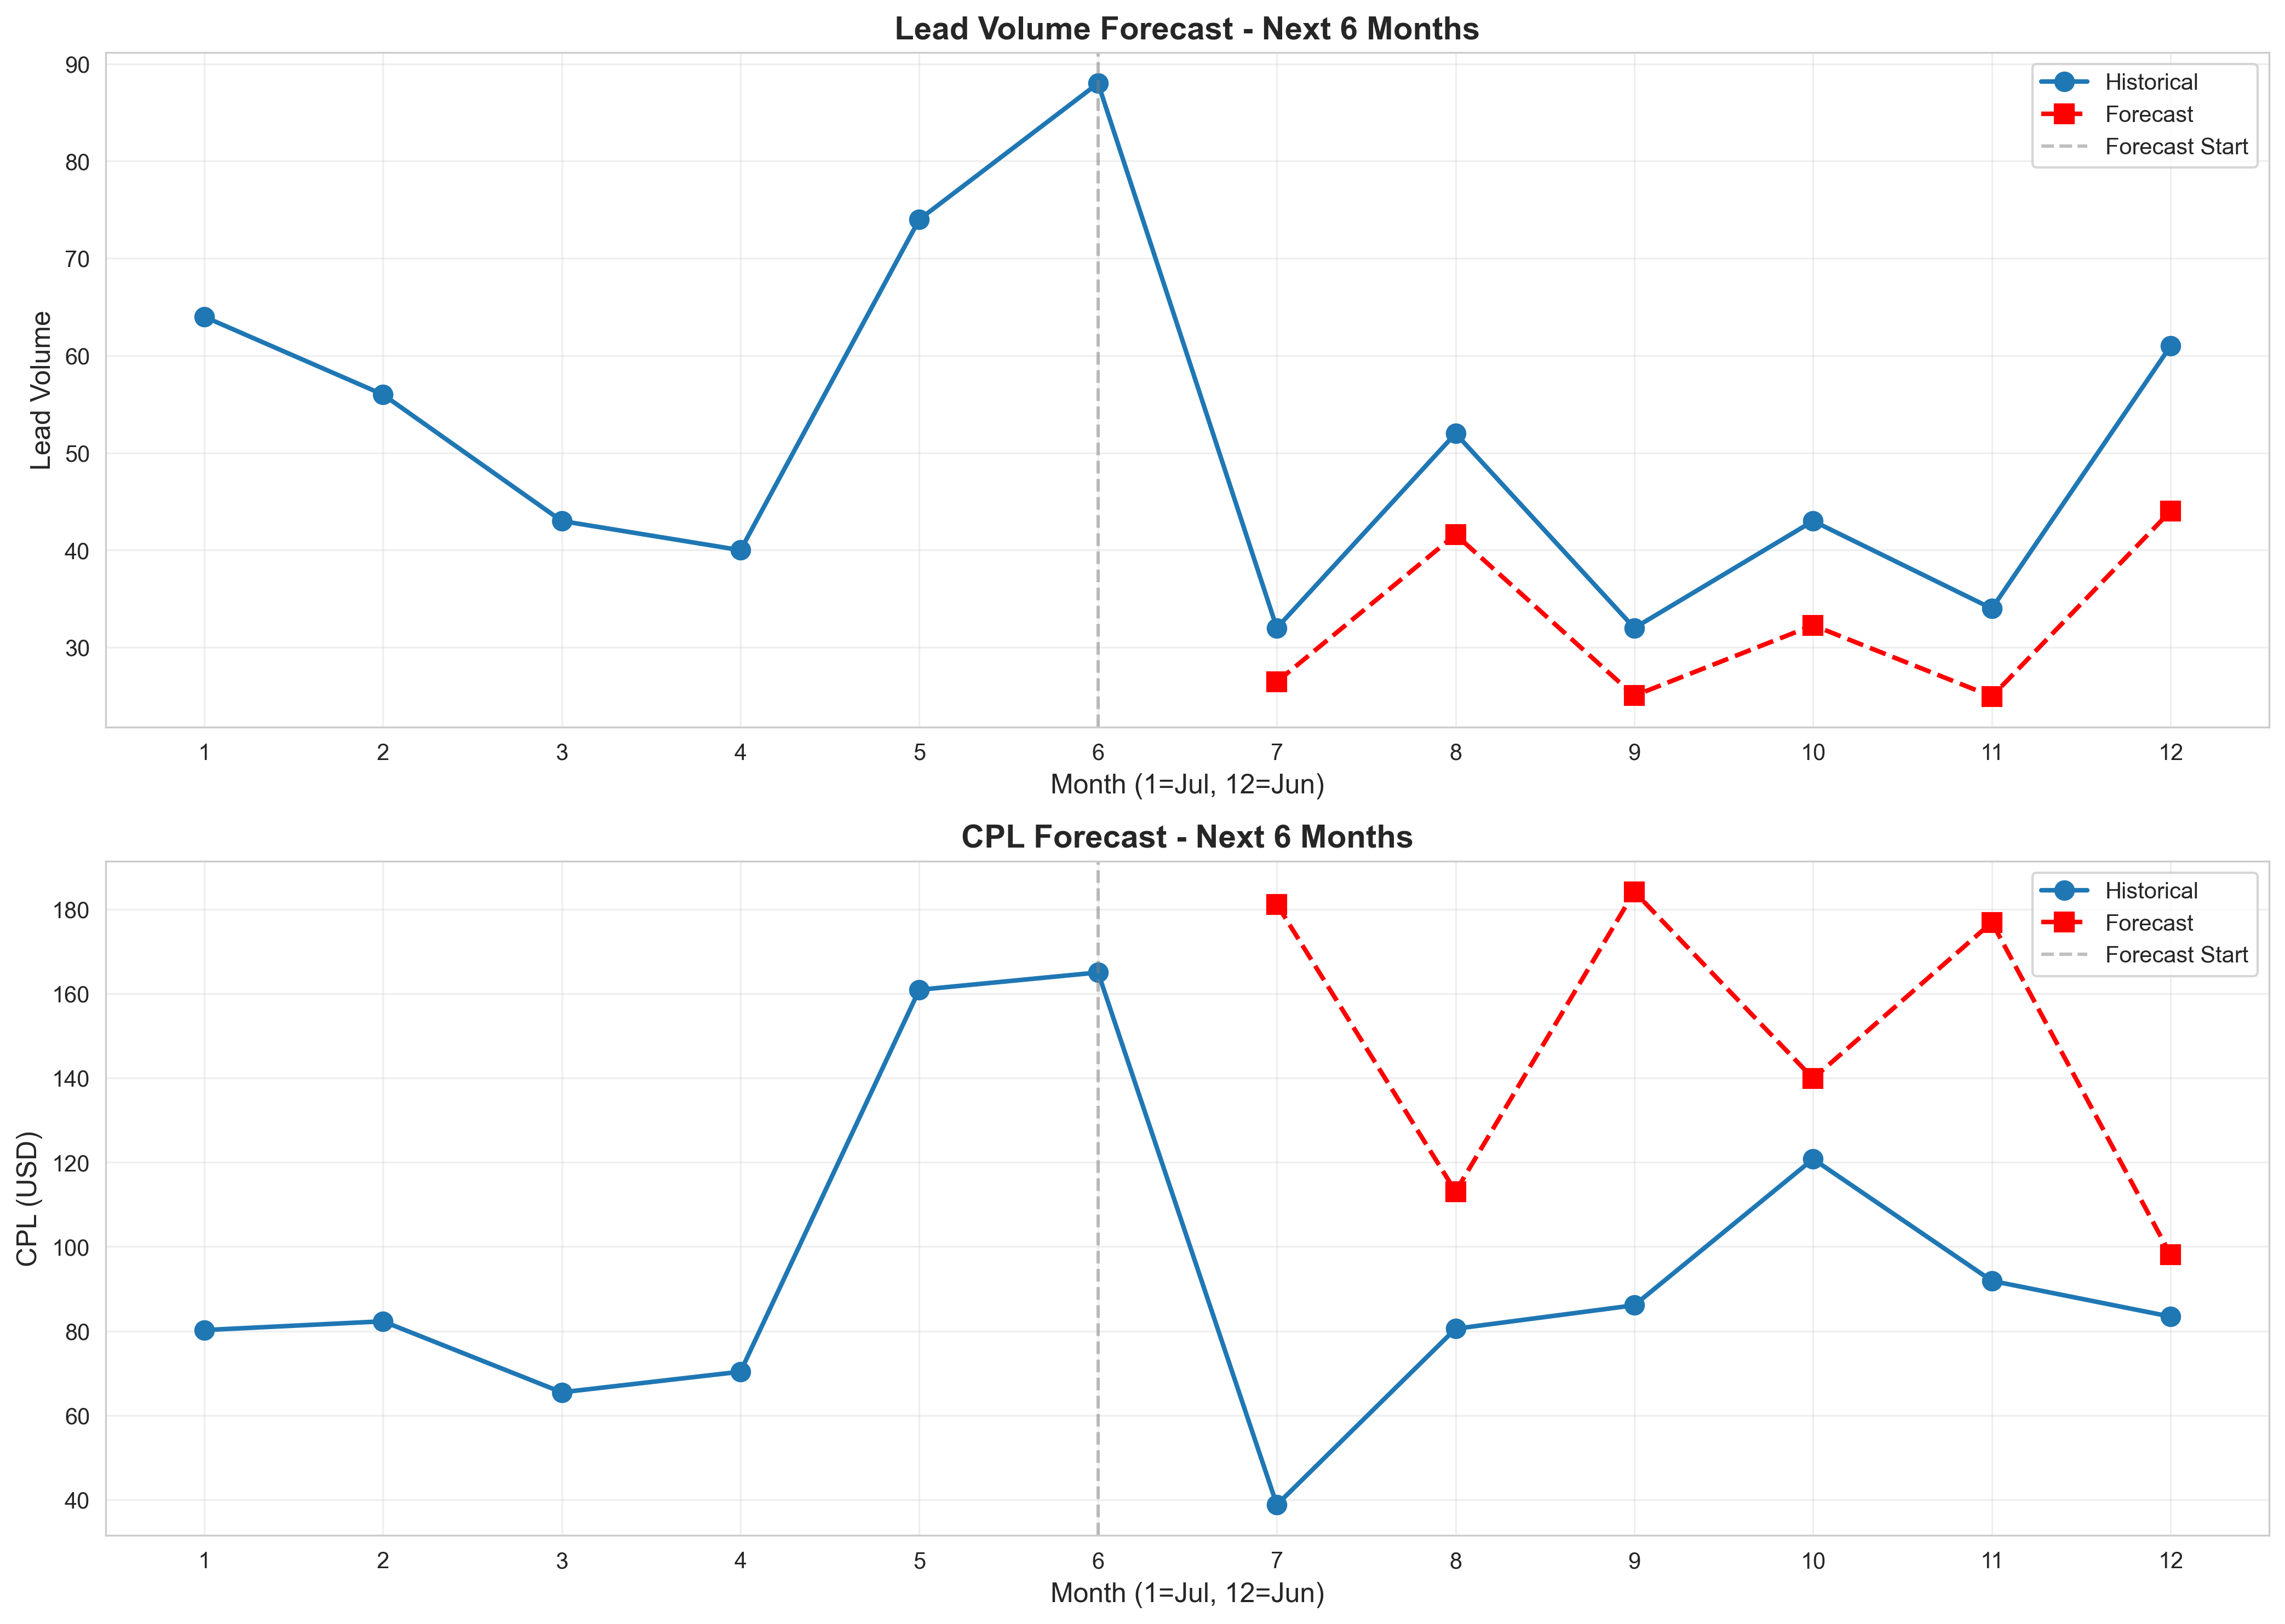
Predictive Analysis: FY2025 Forecast
6-Month Forecast (Jul-Dec 2025):
• December 2025: Best opportunity (44 leads, $98.06 CPL)
• September & November: Low volume, high CPL expected
• Q4 (Oct-Dec) forecasted stronger than Q1 (Jul-Sep)
Recommendation: Increase December budget by 20-30% to capitalize on forecasted strong performance.

Slide 12
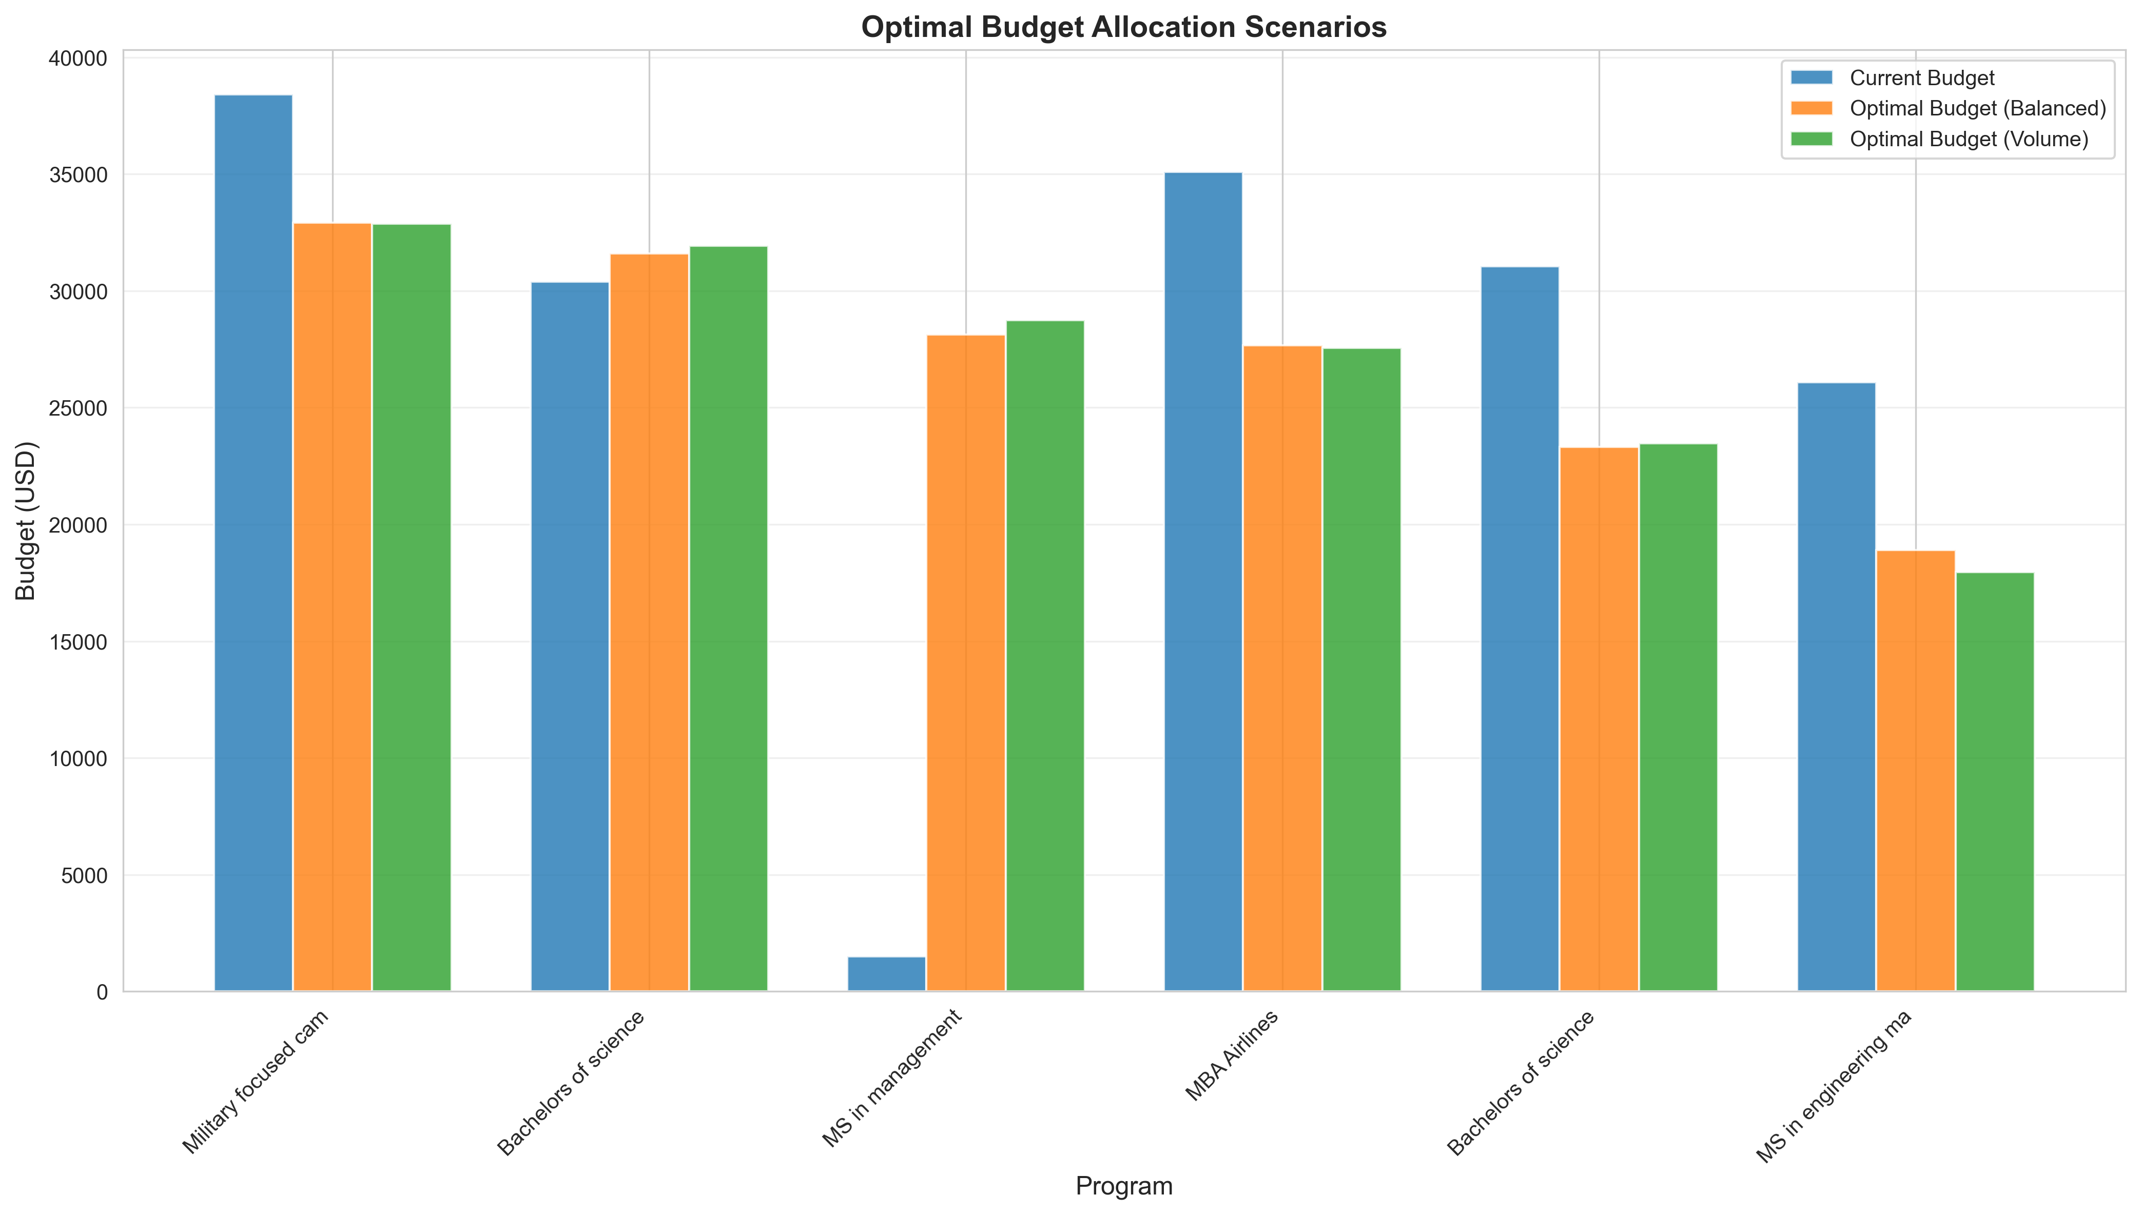
Prescriptive Analysis: Optimal Budget Allocation
Balanced Approach (Recommended):
• Predicted Leads: 1,890 (vs. current 619)
• Improvement: +205% lead volume
• Key Changes:
  - Increase MS in Management: $1,500 → $28,123
  - Increase Military Campaign: Maintain high investment
  - Reduce MSEM: $26,086 → $18,897 (optimize first)

Slide 13
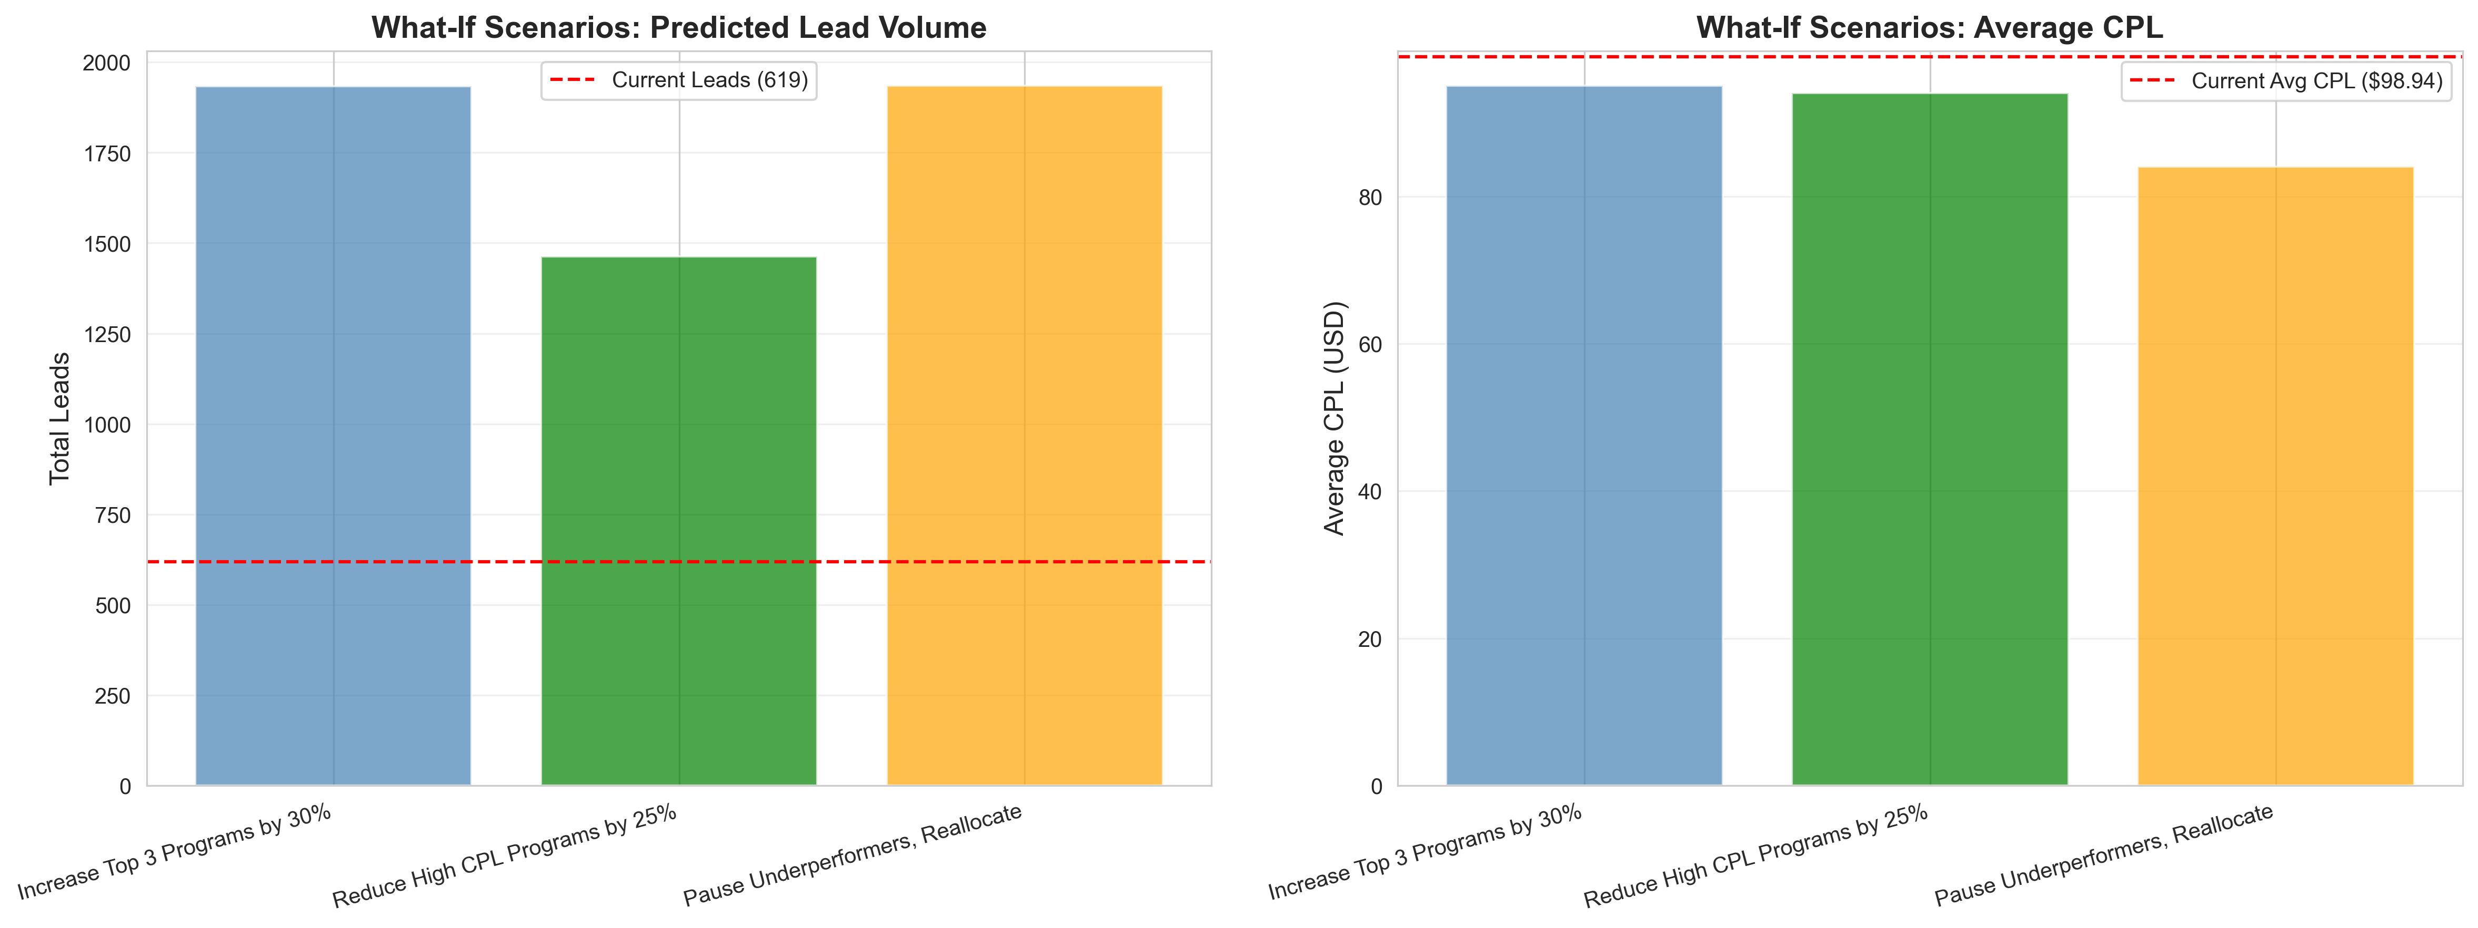
What-If Scenario Analysis
Scenario Comparison:
Best Scenario: Pause Underperformers, Reallocate
  • Predicted Leads: 1934 (+212.5%)
  • Average CPL: $84.02 (17.8% improvement)
  • Budget: $162,531
Recommendation: Implement 'Pause Underperformers, Reallocate' scenario for maximum impact.

Slide 14
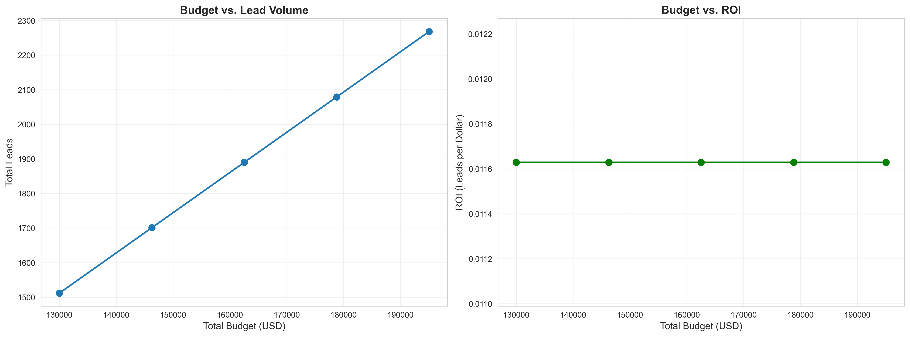
ROI Optimization Model
Budget Scaling Analysis:
• Optimal Budget Range: $130,025 - $195,037
• ROI: 0.0116 (constant across budget levels)
• Predicted Leads: 1890 - 2268
Insight: Budget scales linearly with leads - each 10% increase yields ~189 additional leads.

Slide 15
Enhanced FY2025 Strategic Recommendations
Based on Predictive & Prescriptive Analysis:
1. Optimal Budget Allocation
  Implement balanced approach: $162,531 budget → 1,890 leads (+205%)
2. What-If Scenario Implementation
  Pause underperformers, reallocate to top programs
  Expected: 1,934 leads, $84.02 CPL (+212.5% improvement)
3. Predictive Budget Planning
  Increase December 2025 budget by 20-30% (forecasted best month)
4. ROI Optimization
  Maintain budget range: $162,531 - $178,784 for optimal ROI

Slide 16
Expected Impact Summary
If All Recommendations Are Implemented:
• Lead Volume: 619 → 1,890-2,079 (+205-236%)
• Average CPL: $95.77 → $84.02-$85.99 (-10-12%)
• Total Budget: $209,548 → $162,531-$178,784 (-15-22%)
• ROI: 0.0030 → 0.0116 (+287%)
Key Benefits:
  ✓ 3x increase in lead volume
  ✓ 10-12% reduction in CPL
  ✓ 15-22% budget reduction while improving outcomes
  ✓ Nearly 4x improvement in ROI

