Slide 1
Market Basket Project on E-Commerce Big Data
Team-A
Ayushi
Anirudha
Kislay Srivastava
Ashwin Jain
Ishitha Maty
Basant
K Manasa
Sudha S
Puran Prakash Sinha

Slide 2
Brazilian E-Commerce Public Dataset by Olist
Problem statement
Most customers do not post a review rating or any comment after purchasing a product which is a challenge for any ecommerce platform to perform If a company predicts whether a customer liked/disliked a product so that they can recommend more similar and related products as well as they can decide whether or not a product should be sold at their end. This is crucial for ecommerce based company because they need to keep track of each product of each seller , so that none of products discourage their customers to come shop with them again. Moreover, if a specific product has very few rating and that too negetive, a company must not drop the product straight away, may be many customers who found the product to be useful haven't actually rated it.
Some reasons could possibly be comparing your product review with those of your competitors beforehand,gaining lots of insight about the product and saving a lot of manual data pre-processin,maintain good customer relationship with company,lend gifts, offers and deals if the company feels the customer is going to break the relation.
Objective of this case study is centered around predicting customer satisfaction with a product which can be deduced after predicting the product rating a user would rate after he makes a purchase.
Constraints
High Accuracy
Low latency (Rating should be known within the completion of the order)
Prone to outliers

Slide 3
In this project, we analyzed a Brazilian e-commerce public dataset of orders made at Olist Store, the largest department store in Brazilian marketplaces. The dataset has orders from Oct 2016 to Nov 2018 made at multiple marketplaces in Brazil. Its features allows viewing an order from multiple dimensions: from order status, price, payment and freight performance to customer location, product attributes and finally reviews written by customers. There was also a geolocation dataset that includes Brazilian zip codes with latitude and longitude.This dataset gave us an insight into the dynamics of an e-commerce industry. We used multiple methods to explore the data since we have different kinds of data sources. We also used the classification models to predict customer ratings (Low, Medium & High) and On-time Delivery Binary Classification. We also performed market segmentation based on the geolocation dataset through using k-means clustering and identified the different customer bases or possible market penetration locations. We also performed NLP and Sentimental Analysis on Comments/Reviews of Customers and identified the major features affecting the customer satisfaction. We believe our recommendations will enable Olist Store’s Operational Improvement and ultimately enable higher profits for the organisation.

Slide 4
Tasks:
Some of the information or analysis that we extracted from this dataset include:
Clustering: We performed several Clustering on the location of the customers based on various features such as Revenue earned, Freight Ratio and Carrier Delays.
Revenue: We noticed that majority of the revenue came from the metropolitan developed areas of Brazil (such as Rio, São Paulo) and there was an equitable distribution in the North & North-eastern areas. We analysed that there is very good possible market in these areas as the population density in these regions and the economic conditions of these regions were developing at a very fast pace.
Freight Ratio: Here , we noticed two interesting observations. First, maximum percent of Freight ratios were seen in northern areas, this was because the sellers are mostly located in southern areas and they charge more for the delivery to the Northern customers. Second, the higher ratio in the metro areas were seen to be because of the expedited shipments, which was observed as the products were delivered to the customer much earlier as compared to the expected delivery date.
Carrier Delays: We observed a major hits of delays because of carriers in the developed metropolitan regions with better infrastructure. These issues need to be addressed by the 3PL companies because the on-time delivery plays an important role in customer satisfaction (as seen from NLP & Classification analysis).
Sales Analysis: We analysed the performance of Olist platform from both customer side and seller side using Map-Reduce and tried to give some suggestions to the platform. In this part, we analysed:
The trend of the total sales volume in each month The total sales volume in each month kept increasing before Oct, 2017 while started to stagnate after that.
The number of the seller in each month The number of the seller kept increasing from 2016 to 2018.
New product categories put on the platform in each month There was a boost in 2016, and then the increasing went stable.
The most popular product categories in each year The results show that the most popular product categories were Health & Beauty, Bed Bath Table, Computers Accessories, etc.
Frequent items bought together Because of data safety, although we found the frequent items, we just analysed the product id and their categories but could not analyse their product names.
The tendency of the payment method We analysed both payment count (because people sometimes pay by instalments) and payment value show that credit card was used mostly in each month.
Dominant payment method used by the customers We also created a new variable, dominant payment method, based on the payment value and we found that credit card was still the most commonly used dominant payment method. Besides, we also tried to analyse the product sales based on time-series data (e.g. predict the sales volume of the most popular category in the future). However, since the whole timeline was too short -- we just had data in less than two years -- it was quite hard to find the seasonal factor or even use ARIMA to predict the sales in the future.
Delivery Performance Classification (Binary): We worked through on-time delivery and find significant features that can affect delivery times. And, we identified that customer zip codes (customer area), carrier delay, and order approval month are most significant features contributing to delivery times. Customer zip codes can affect the delivery time because most seller locations are concentrated in metropolitan areas. Out of these areas, customer cannot access the product easily. And, carrier delay is related with courier companies such as Fedex, USPS after shipping. If there are some issues in delivery services, the delivery can be delayed. And, order approval month can affect the delivery time because there is a rainy season from October to March in Brazil, it can influence the delivery.
Review Scores Classification (Multi-class): We built the multi-class classification models to predict the review scores from customers, which means the customer satisfaction and found out that on-time delivery can contribute to the satisfaction of the customer. If customers get their product on-time, they will be happy and satisfied.
Feature Engineering: We derived new variables from original data set. New features such as “year”, “month”, “day(weekday)”, “hour” can be derived from “date” variable and we identified that order approval month can be important ones. When we built the classification models, the accuracy is not high in the beginning so we created the significant variables and it works well.
Natural Language Processing: We performed natural language processing for review dataset. First, we read the review dataset. We split the multiple sentences into a sentence and then changed a sentence into a single word. We removed stop-words such as “a”, “the” and punctuations. After that, we did lemmatization, which unite the verbs into one verb (e.g “is”, “was”, “were” -> “be”). We used chinking, chunking, POS tagging to sort the verb from the sentence. After finishing cleaning the review data, we started NLP works. We extracted top 20 words and identified the important words from the customer review.

Slide 5
Challenges:
Data: The dataset was huge and merging 9 datasets to one single master dataset served lots of issues.
ARIMA Model: Despite having a good amount of data , we had very limited time-series related data points which gave us an Arima model which did not make much importance.
Only ID: Due to the data security issues, we had the seller/customer related data only in the form of ID. Hence, our market basket analysis didn't have much impact when observed in the form of ID.
Portuguese Dataset: The whole dataset was in a different language which was hard. We had to download another dataset to translate all of the text data(Headers, Product Categories) to English.
Recommendations:
Sellers: Good market exists in North & North Eastern regions and sellers should make more DCs or presence there for next further market penetration, preferably in ZIP starting with 71-92.
Targeted Marketing: Marketing must penetrate the north eastern market by targeting better coupons to attract new customers.
Carrier Delays: These must be addressed as delay from 3PL can be handled easily by the company by making the contracts much more stringent.
Frequent Item Sets: Olist can use the market basket analysis provided by us for their recommendations to users/customers.
On-Time Delivery: This is the most important feature which was concluded using both NLP and our classification models and Olist must give extra emphasis on this KPI.

Slide 6

Agenda
Data Aggregation &
Visualization
01
03
•
•
Data Schema
Feature Engineering
Step
Clustering
•
•
Total Payment
Freight/Ratio
Step
Sales Analysis:
02
04
•
Based on Sales
Volume
Based on Product
Categories
Based on Sellers
Based on Payment
Method
•
•
•
Step
Step
Classification
•
Binary (Late/On-
Time)
Step
•
Multiple (Ratings)
05
NLP
•
Sentimental
Analysis
Effect on Ratings
•
Consolidation and
Recommendations
Step
06

Slide 7
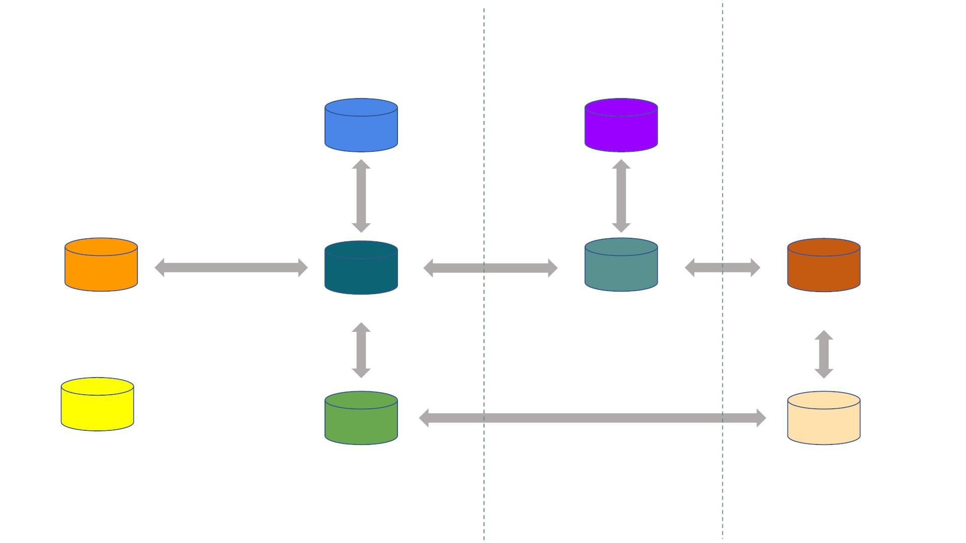
Data Schema
Order Payment Dataset
Product Dataset
Order id
Product id
Order id
Order id
Seller id
Review Dataset
Order Dataset
Order Item Dataset
Seller Dataset
Customer id
Zip-Code
Zip-Code
Product Category
Translation Data
Customer Dataset
Geolocation Dataset
Customer
Product Seller

Slide 8
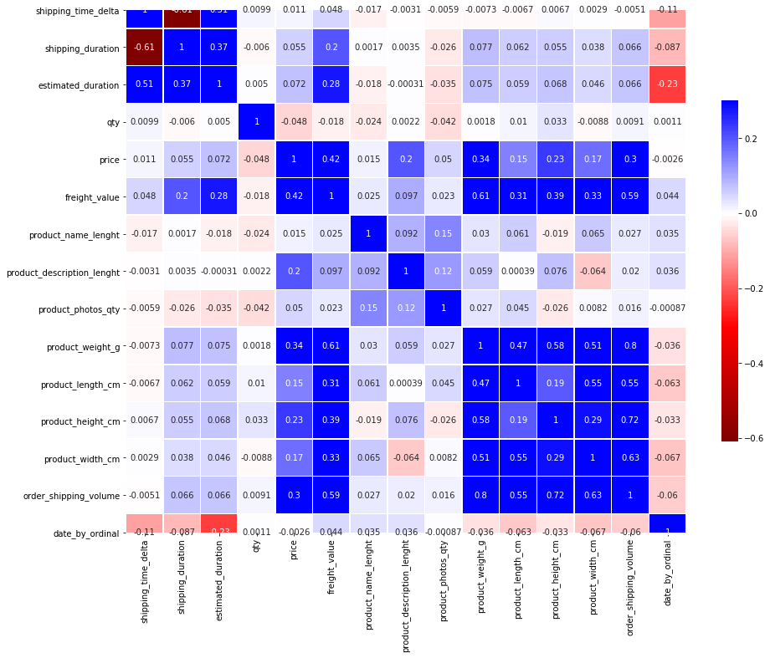
Feature Engineering
Correlations:
Customer geolocation Lat =>
Positive correlation with Carrier
Time, Delivery time & Freight
Values

Slide 9
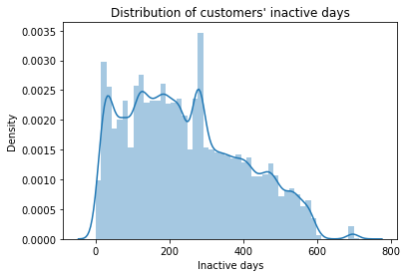
What is Customer Lifetime Value(CLV)?
In marketing, customer lifetime value(CLV or CLTV),lifetime customer value(LCV), or life-time value(LTV) is a prognostication of the net profit contributed to the whole future relationship with a customer. The prediction model can have verying levels of sophistication and accuracy, ranging from a crude heuristic to the use of complex predictive analytics techniques.
Customer lifetime value can also be defined as the monetary value of a customer relationship, based on the present value of the projected future cash flows from the customer relationship. Customer lifetime value is an important concept in that it encourages firms to shift their focus from quarterly profits to the long-term health of their customer relationships. Customer lifetime value is an important metric because it represents an upper limit on spending to acquire new customers. For this reason it is an important element in calculating payback of advertising spent in marketing mix modeling.
You can use CLV models to answer these types of questions about customers :
Number of purchases: How many purchases will the customer make in a given future time range?
Lifetime: How much time will pass before the customer becomes permanently inactive?
Monetary: How much monetary value will the customer generate in a given future time range?
CLV concepts: RFM (Customer Segmentation)
Three important inputs into CLV models are recency, frequency, and monetary value:
Recency: When was the customer's last order?
Frequency: How often do they buy?
Monetary: What amount do they spend? We will use RFM framework to build our customer segmentation model.

Slide 10
What is Customer Lifetime Value(CLV)?
In marketing, customer lifetime value(CLV or CLTV),lifetime customer value(LCV), or life-time value(LTV) is a prognostication of the net profit contributed to the whole future relationship with a customer. The prediction model can have verying levels of sophistication and accuracy, ranging from a crude heuristic to the use of complex predictive analytics techniques.
Customer lifetime value can also be defined as the monetary value of a customer relationship, based on the present value of the projected future cash flows from the customer relationship. Customer lifetime value is an important concept in that it encourages firms to shift their focus from quarterly profits to the long-term health of their customer relationships. Customer lifetime value is an important metric because it represents an upper limit on spending to acquire new customers. For this reason it is an important element in calculating payback of advertising spent in marketing mix modeling.
You can use CLV models to answer these types of questions about customers :
Number of purchases: How many purchases will the customer make in a given future time range?
Lifetime: How much time will pass before the customer becomes permanently inactive?
Monetary: How much monetary value will the customer generate in a given future time range?
CLV concepts: RFM (Customer Segmentation)
Three important inputs into CLV models are recency, frequency, and monetary value:
Recency: When was the customer's last order?
Frequency: How often do they buy?
Monetary: What amount do they spend? We will use RFM framework to build our customer segmentation model.

Slide 11
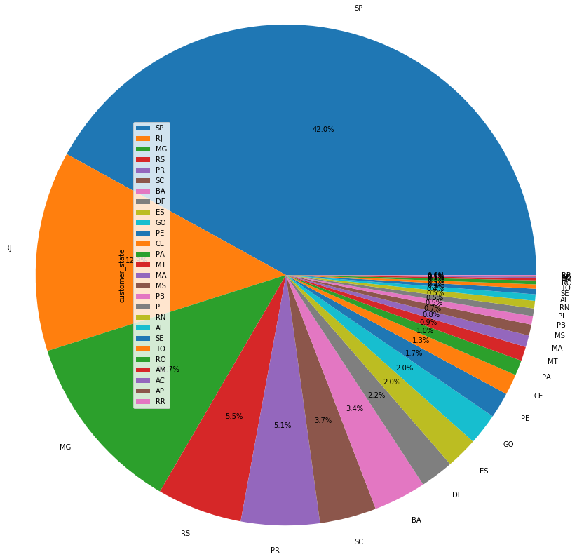
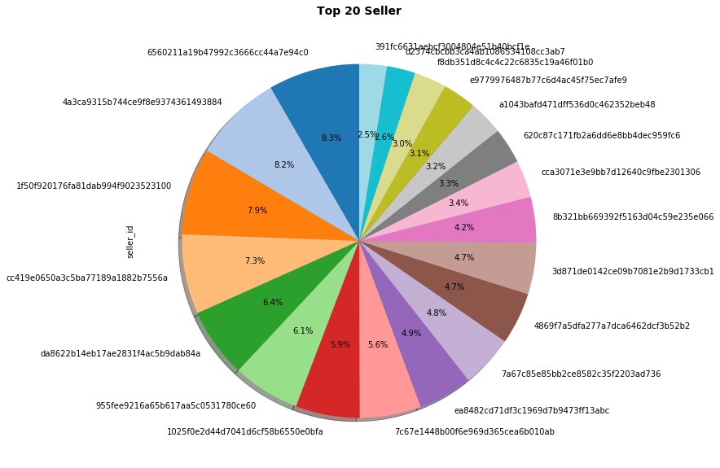
Seller & Customer Visualization
Customer View
Total Nos of Customers: 99441
Total generated IDs: 99441
Total Nos of Customers: 96096
Total generated unique IDs: 99441
Seller View
Total Nos of Customers: 99441
Total generated IDs: 99441
Total Nos of Customers: 96096
Total generated unique IDs: 99441

Slide 12
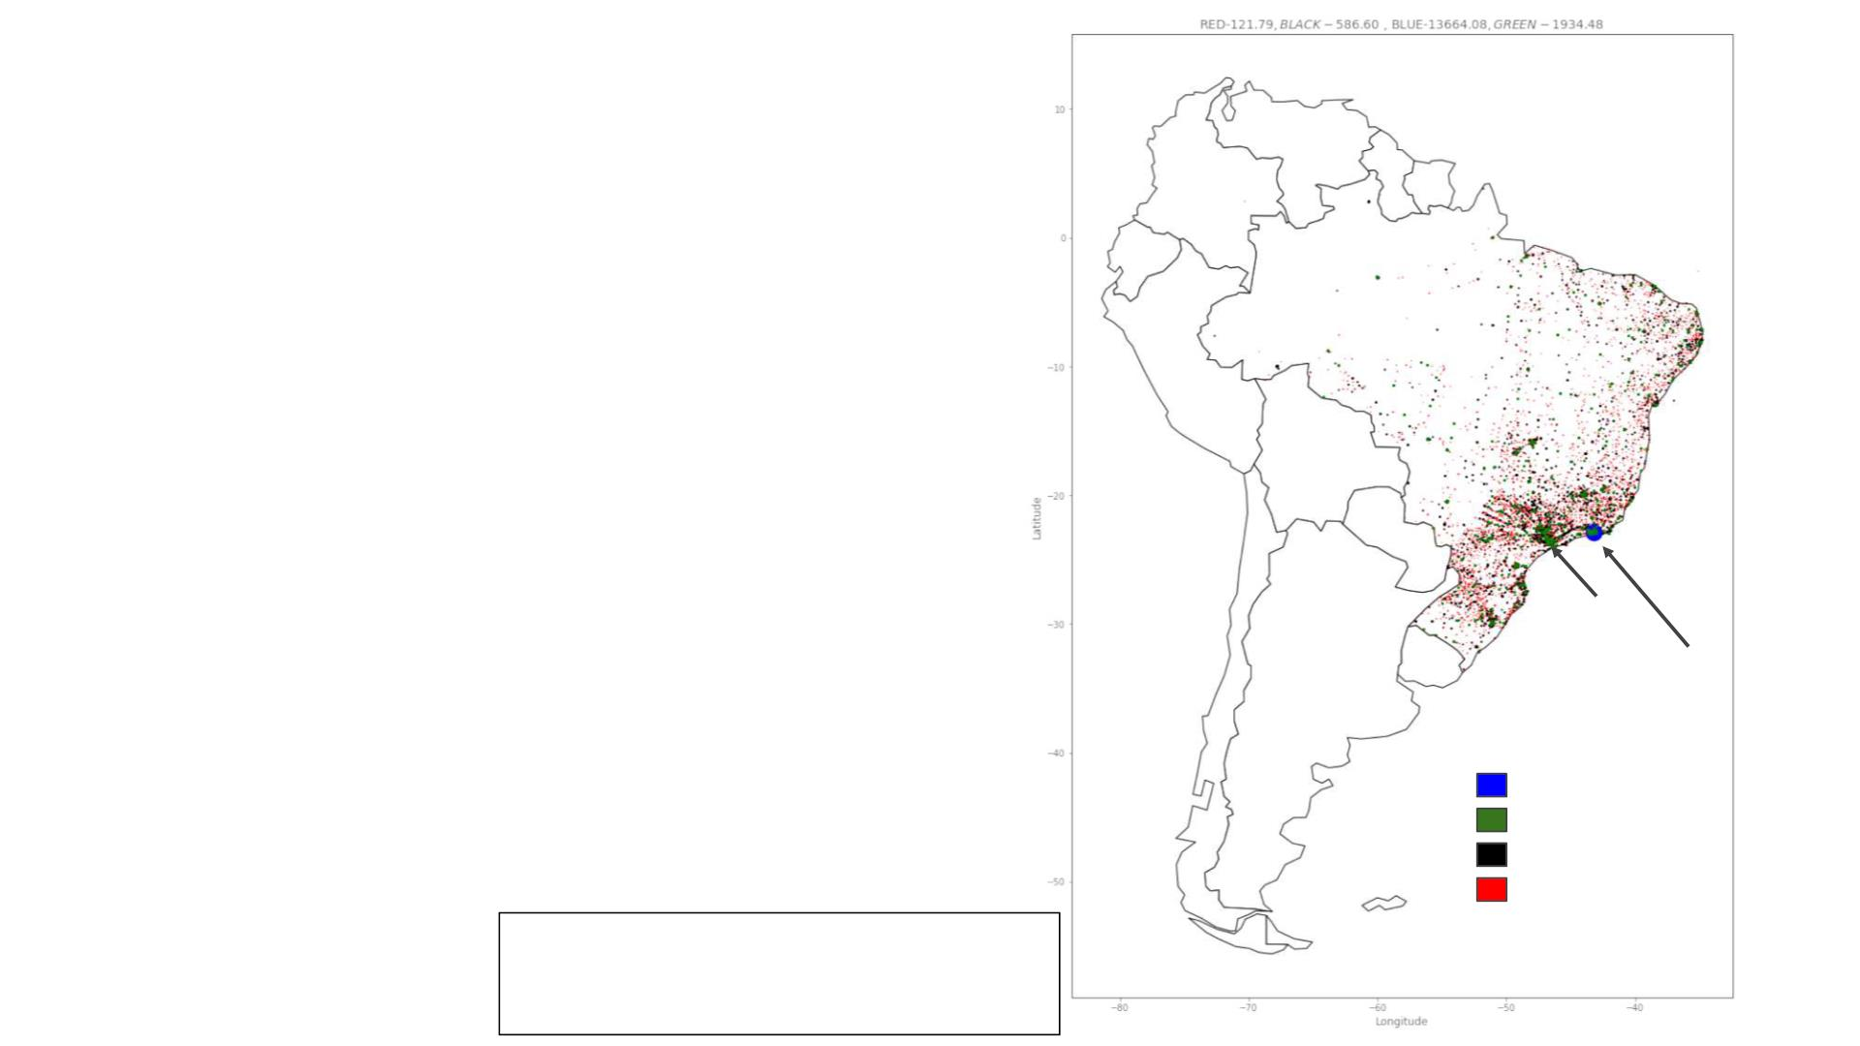
Clustering
Total Payments (mean)
-
• Most of the revenue came from South and
the Southeast regions of Brazil.
• It is also possible to see that large cities
and capitals, where population is bigger,
have larger participation on revenue.
Sao Paulo
Total
Rio
Payments
:$13664.08
:$1934.48
:$586.60
:$121.79

Slide 13
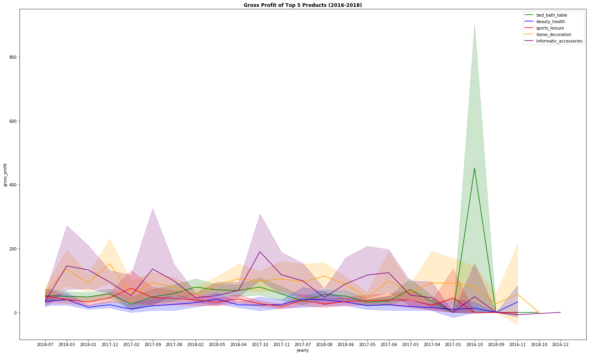
Gross Profit on Top 5 Products

Slide 14
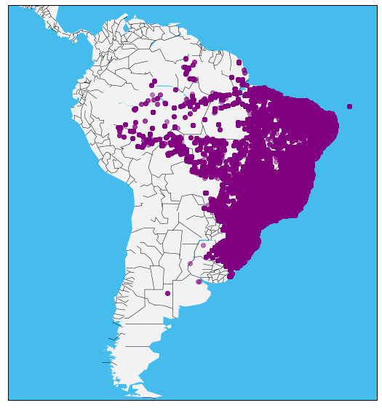
<class 'pandas.core.frame.DataFrame'>
Int64Index: 1000163 entries, 0 to 1000162
Data columns (total 14 columns):
# Column Non-Null Count Dtype
--- ------ -------------- -----
0 geolocation_zip_code_prefix 1000163 non-null int64
1 geolocation_lat 1000163 non-null float64
2 geolocation_lng 1000163 non-null float64
3 geolocation_city 1000163 non-null object
4 geolocation_state 1000163 non-null object
5 seller_id 3095 non-null object
6 seller_zip_code_prefix 3095 non-null float64
7 seller_city 3095 non-null object
8 seller_state 3095 non-null object
9 customer_id 93099 non-null object
10 customer_unique_id 93099 non-null object
11 customer_zip_code_prefix 93099 non-null float64
12 customer_city 93099 non-null object
13 customer_state 93099 non-null object
dtypes: float64(4), int64(1), object(9)
memory usage: 114.5+ MB

Slide 15
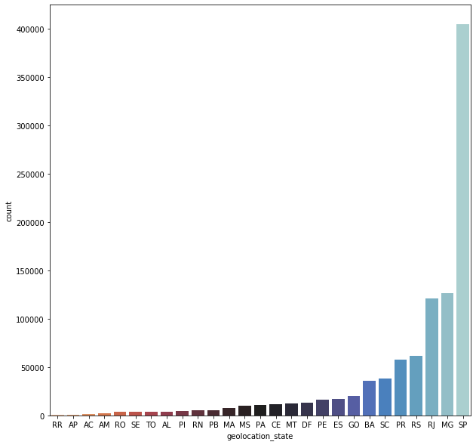
<class 'pandas.core.frame.DataFrame'>
Int64Index: 1000163 entries, 0 to 1000162
Data columns (total 14 columns):
# Column Non-Null Count Dtype
--- ------ -------------- -----
0 geolocation_zip_code_prefix 1000163 non-null int64
1 geolocation_lat 1000163 non-null float64
2 geolocation_lng 1000163 non-null float64
3 geolocation_city 1000163 non-null object
4 geolocation_state 1000163 non-null object
5 seller_id 3095 non-null object
6 seller_zip_code_prefix 3095 non-null float64
7 seller_city 3095 non-null object
8 seller_state 3095 non-null object
9 customer_id 93099 non-null object
10 customer_unique_id 93099 non-null object
11 customer_zip_code_prefix 93099 non-null float64
12 customer_city 93099 non-null object
13 customer_state 93099 non-null object
dtypes: float64(4), int64(1), object(9)
memory usage: 114.5+ MB

Slide 16
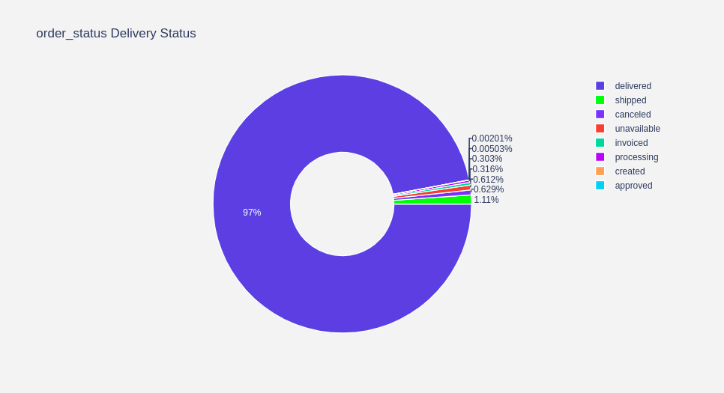
-Order Delivery Status

Slide 17

Sales Analysis

Slide 18
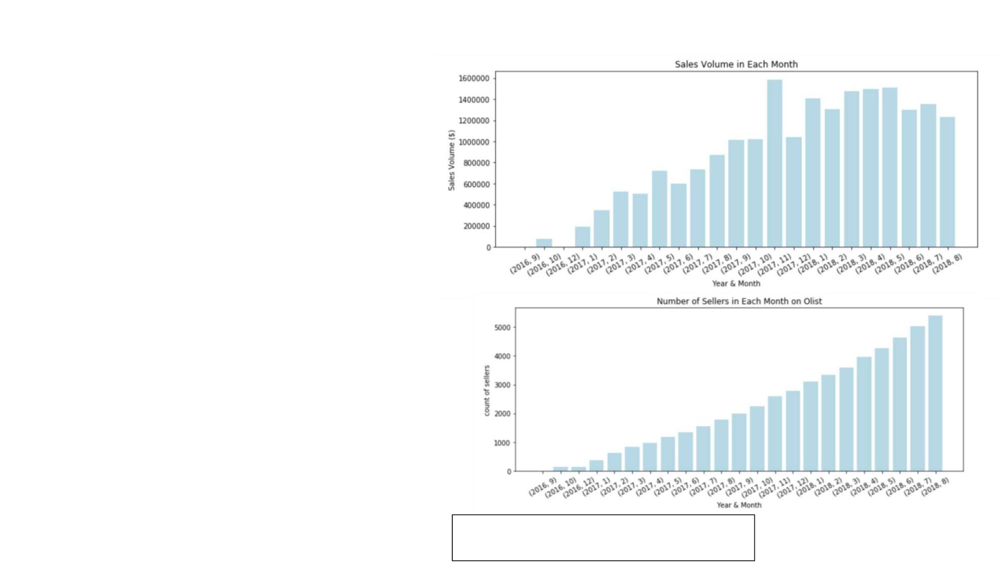
Based on Sales Volume
- Sales volume increased
before Oct, 2017, while went
steady after that.
Based on Sellers
-Number of sellers increased
steadily during 2016-2018.
The Data for the month of Nov 2016 and Dec 2016 had very
less Records
Notes:
<number>

Slide 19
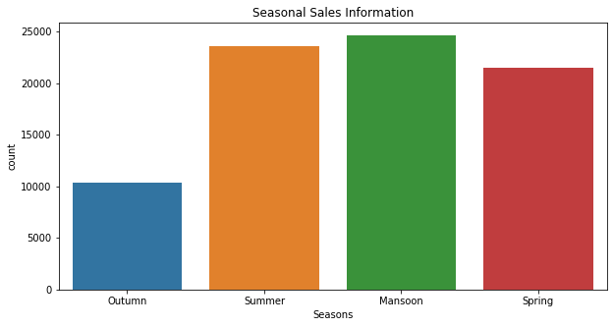
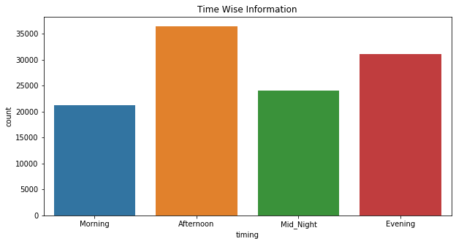
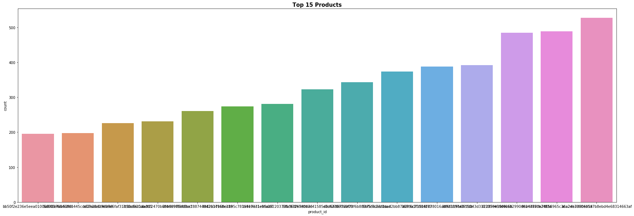
Sales Information

Slide 20
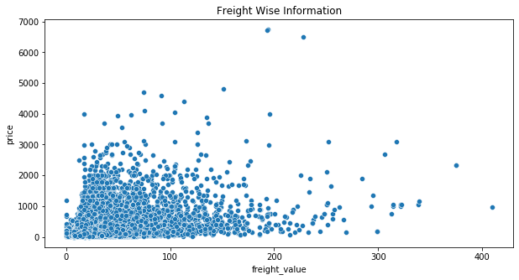
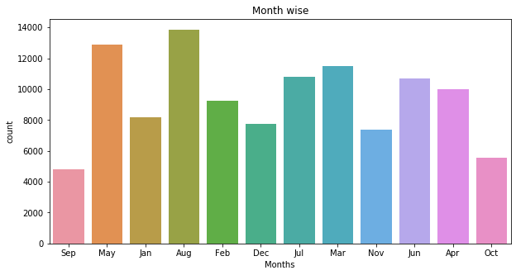
-Freight Ratio

Slide 21
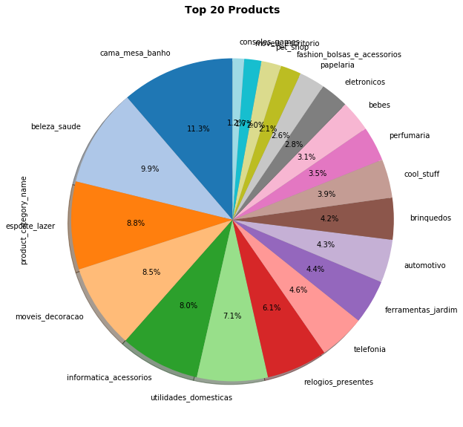
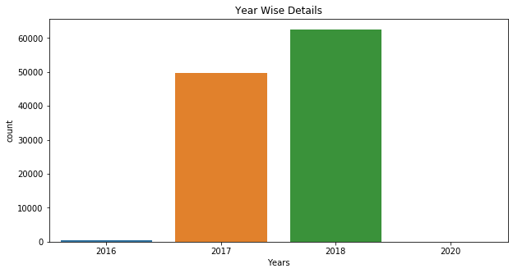
-Freight Ratio

Slide 22
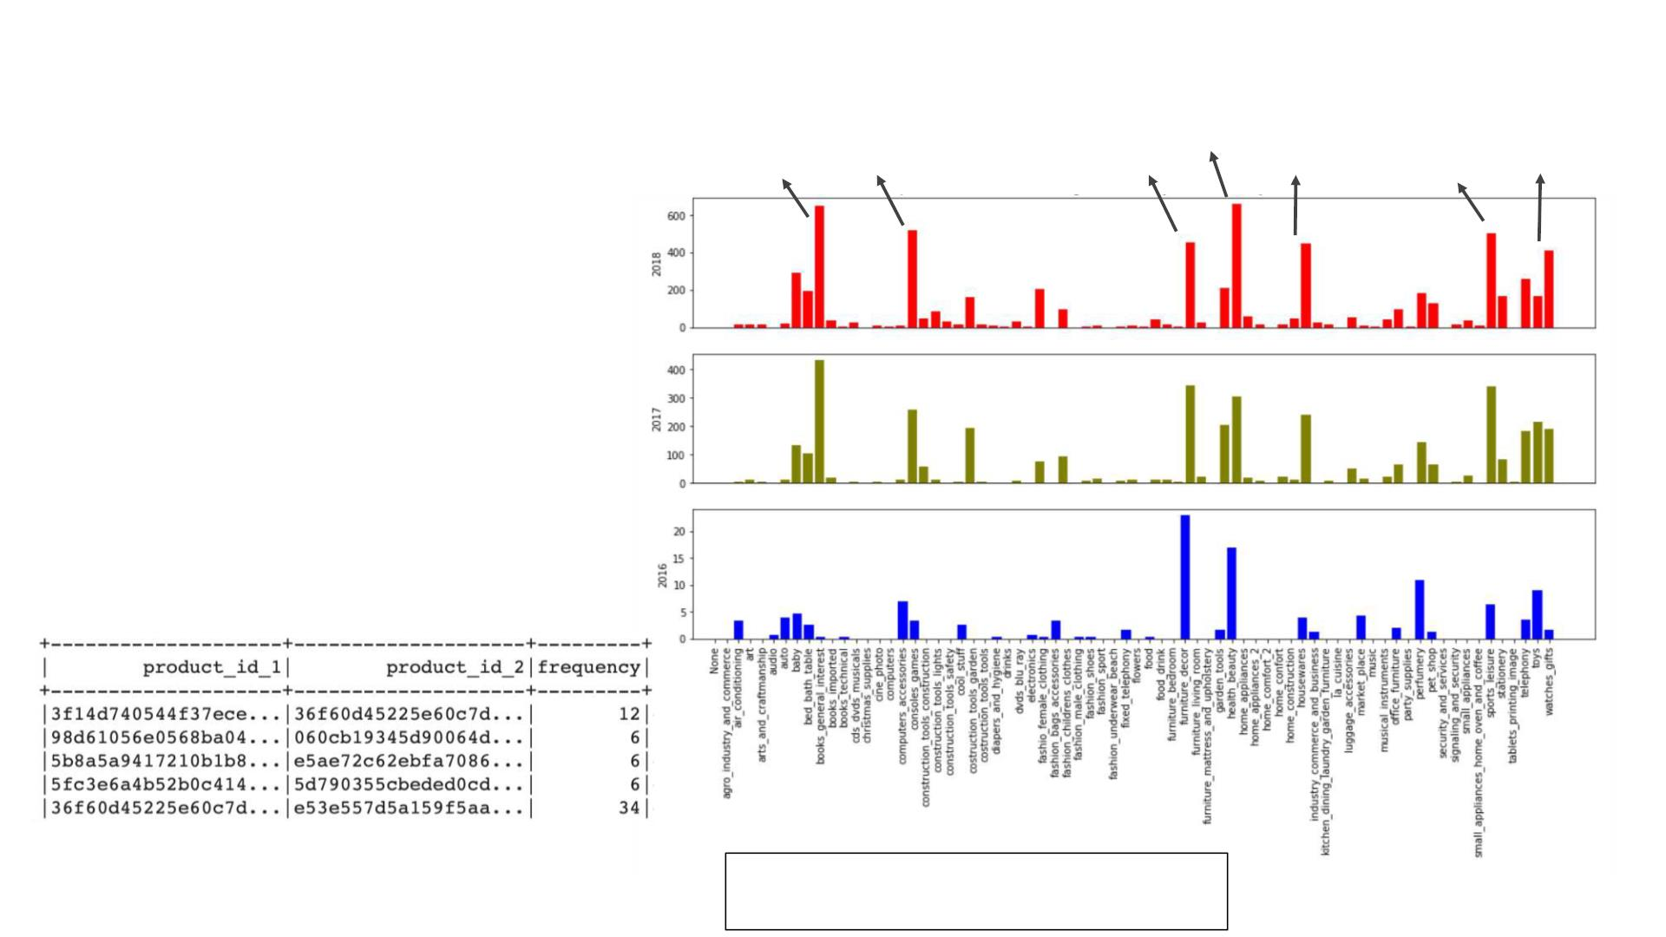
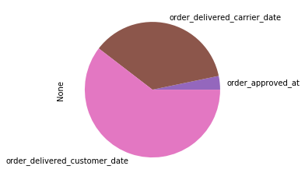
Based on Product Categories
Health and Beauty
Furniture Decoration
Bed Bath Table
Computers Accessories
Housewares
Sports Leisure
Watches Gifts
The Data for the month of Nov 2016 and Dec 2016 had very
less Records

Slide 23
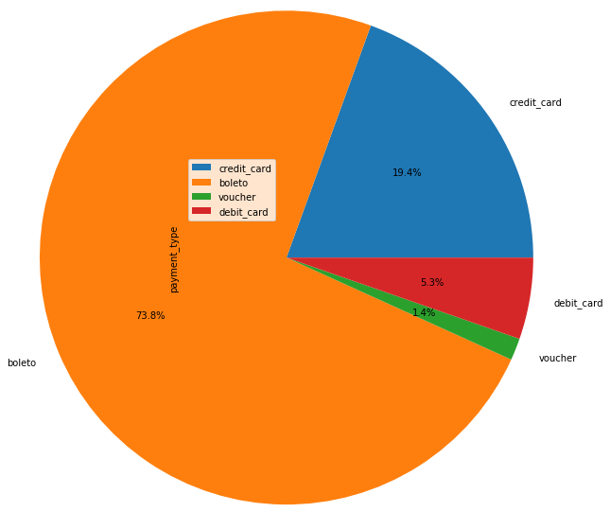
Payment Method

Slide 24
Binary classification: On-time delivery
Binary classification models: Predict the on-time delivery
with binary classification models
- Input variables: 'Carrier_Late/on-time', 'Weight/volume',
'Customer_zip_code', 'Freight_value', 'Seller_zip_code',
'Distance_seller_customer', 'Order_approved_year/month/day/hour'
,'Order_approval_diffDays'
- Target variables: 'On-time delivery'
- ML models: Logistic regression, Decision tree (Random forest, Gradient
Boosting tree), Naive Bayes, Linear SVM, Neural Network
- Best model: Gradient Boosting tree (80% accuracy)
- Hyperparameter Tuning:
• Identifying optimal parameters
• handling imbalanced datasets(classWeights)

Slide 25
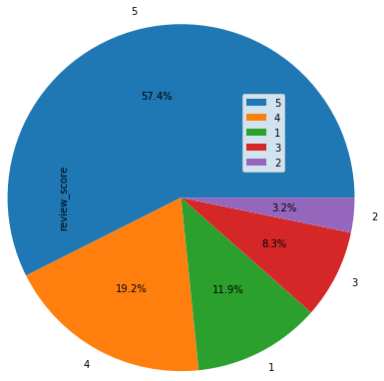
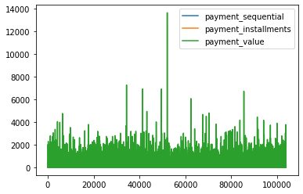
Multiclass classification: Customer Review scores

Slide 26
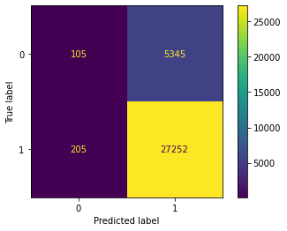
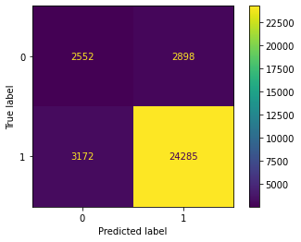
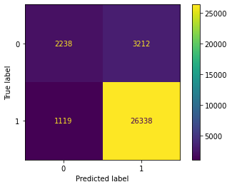
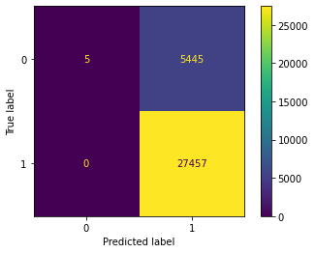
Linear Regression
Decision Tree Classifier
Random Forest Classifier
SVM

Slide 27
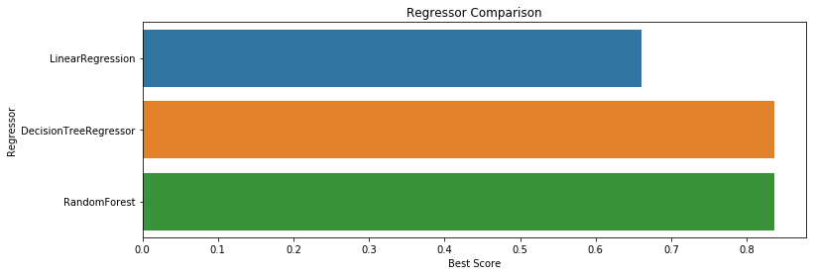
Model Summary
+---------------------+----------+-------------+------------+
| Model | F1_score | AUC_score | Accuracy |
+---------------------+----------+-------------+------------+
| Naive Bayes | 0.8575 | 0.694 | 0.7689 |
| Logistic Regression | 0.9217 | 0.699 | 0.8605 |
| Decision Tree | 0.8031 | 0.713 | 0.7021 |
| Random Forest | 0.9013 | 0.718 | 0.8315 |
| GBDT**(BEST) | 0.9243 | 0.745 | 0.8651 |
+---------------------+----------+-------------+------------+
Summary
GBDT performs better in comparision to rest of the model in terms of all the performance metric.
Logistic regression performs fairly similar to GBDT, but GBDT is more robust to outliers.
Rating prediction is not fairly dependent directly on most of the features, so the performance is not at its peak.
We have used f1 score as our primary performance metric.
We have taken care of overfitting in each model.
Each model performed better after we removed neutral review score from the data.

Slide 28
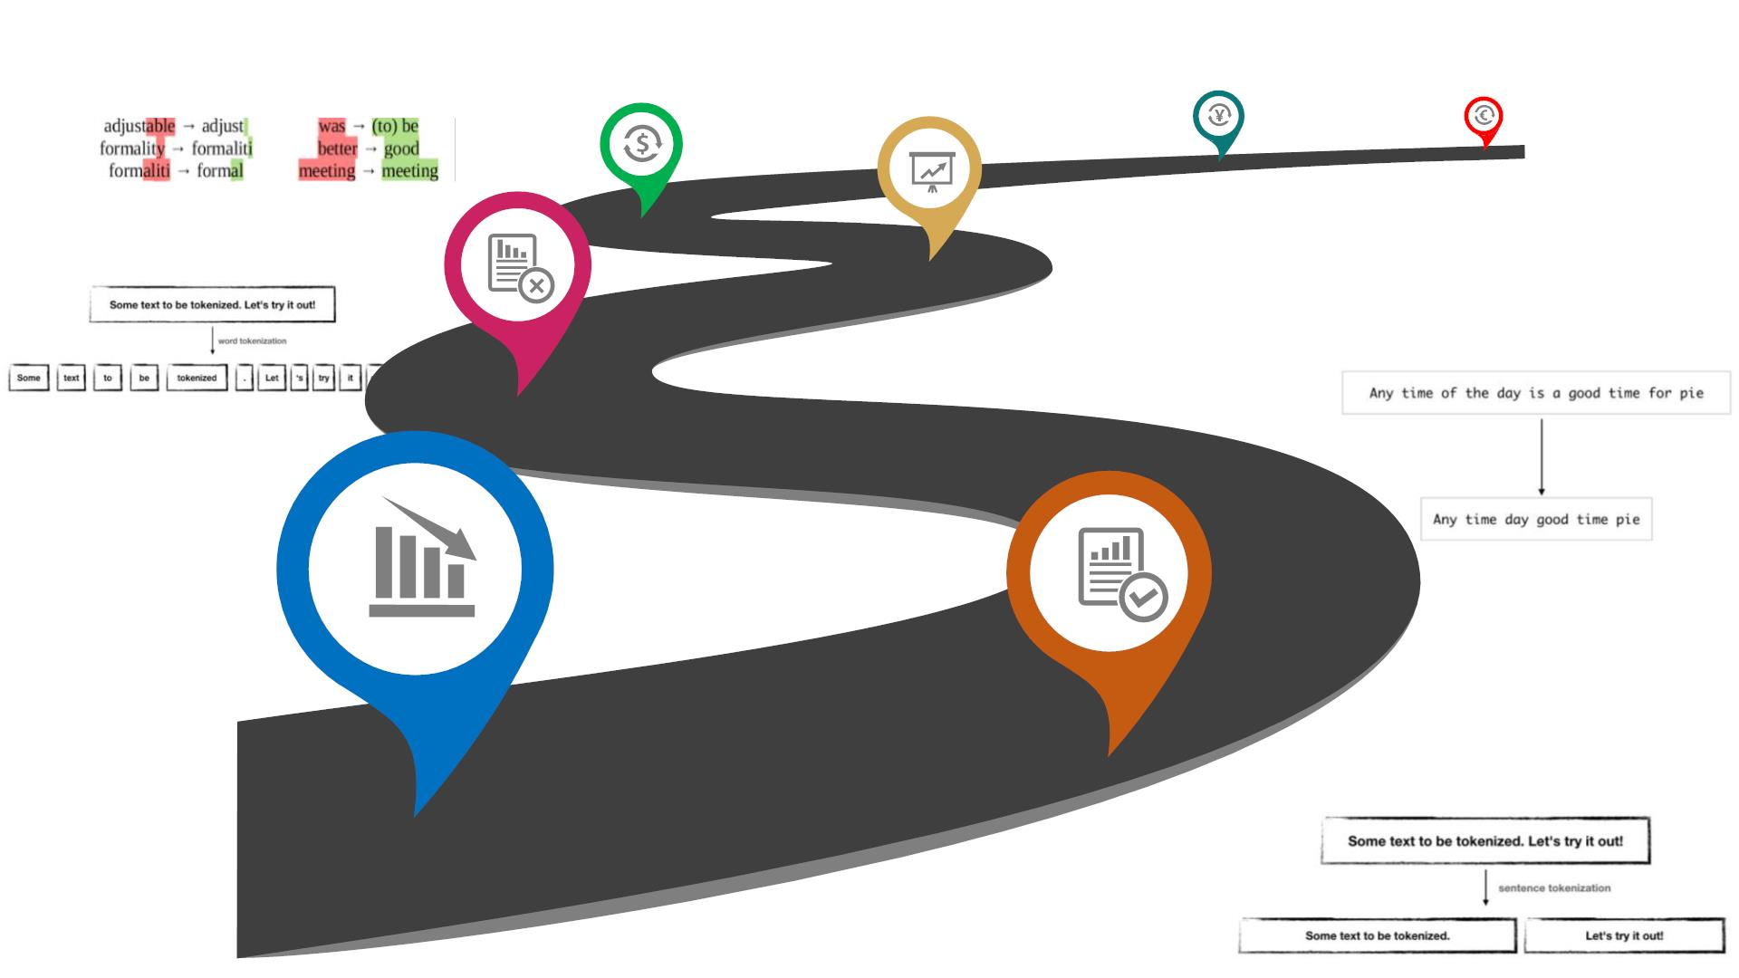
Natural language Processing
Step 5
Stemming and Lemmatization
Step 3
Word tokenization
Step 6
Chunking,
Chinking and
POS tagging
Results
Step 4
Stopwords,
Punctuation
Step 1
Review Comment
Messages
Step 2
Sentence tokenization
(all lower case)
.

Slide 29
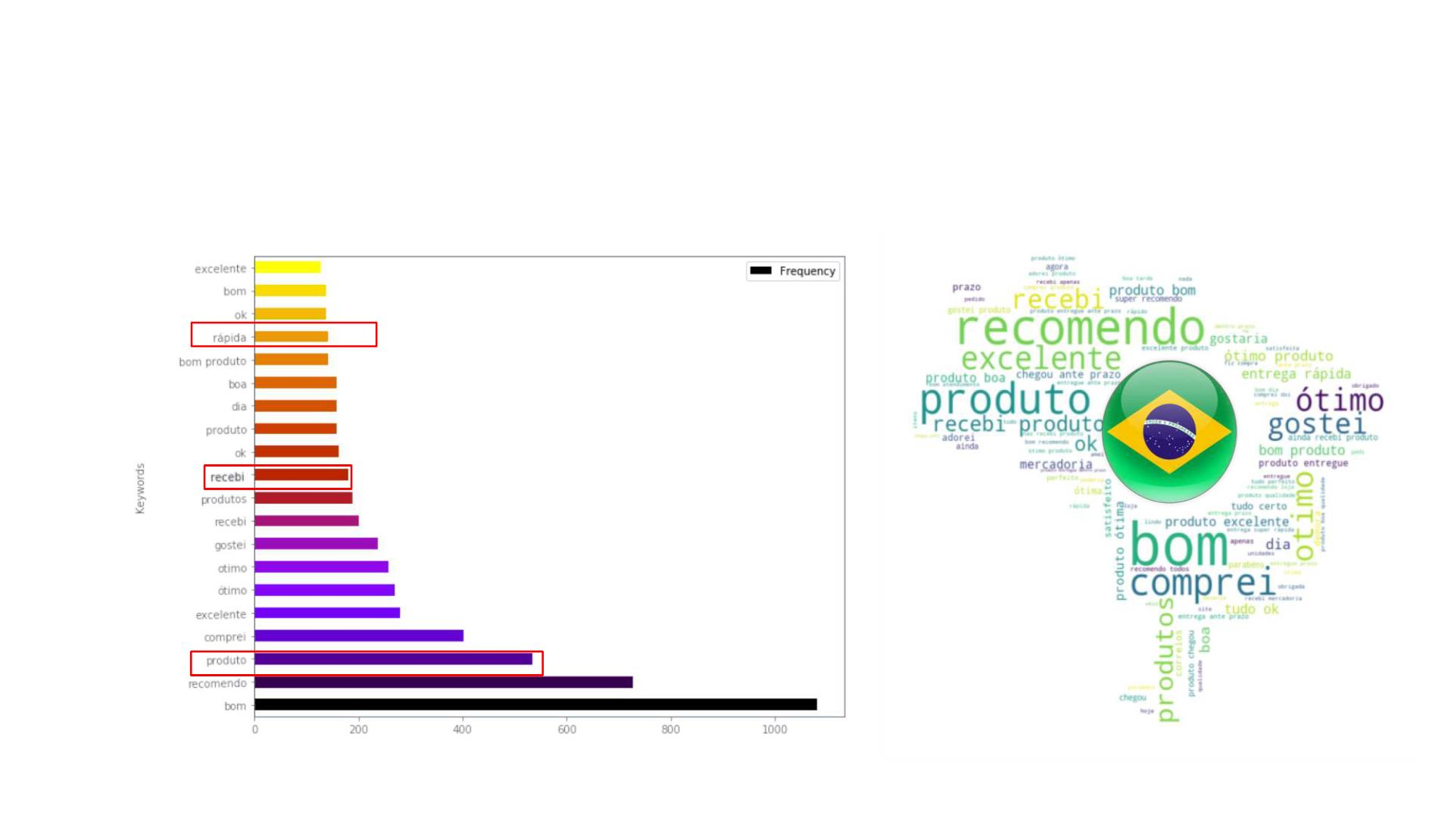
Natural language Processing
20 keywords and Visualizing the output
Word Frequencies
excellent
Good product
Everything is ok
Fast Delivery
Fast
Good
Good
Day
Great product
Okay
Receive
Received product
Products
Received
Like
Great
Great
Excellent
Purchase
Product
Product
Recommend
Good

Slide 30
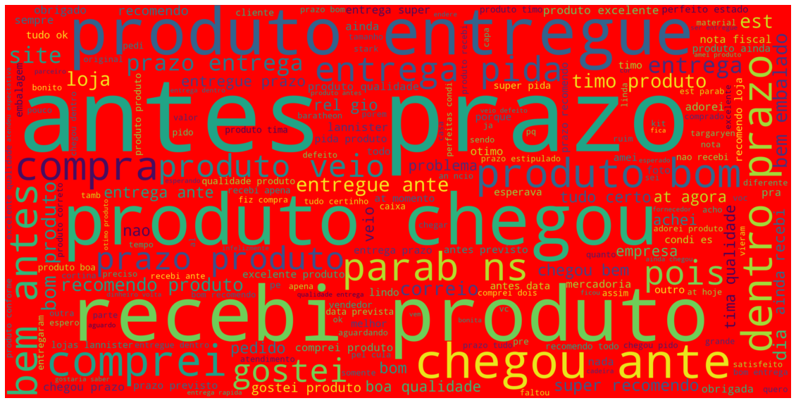

Slide 31
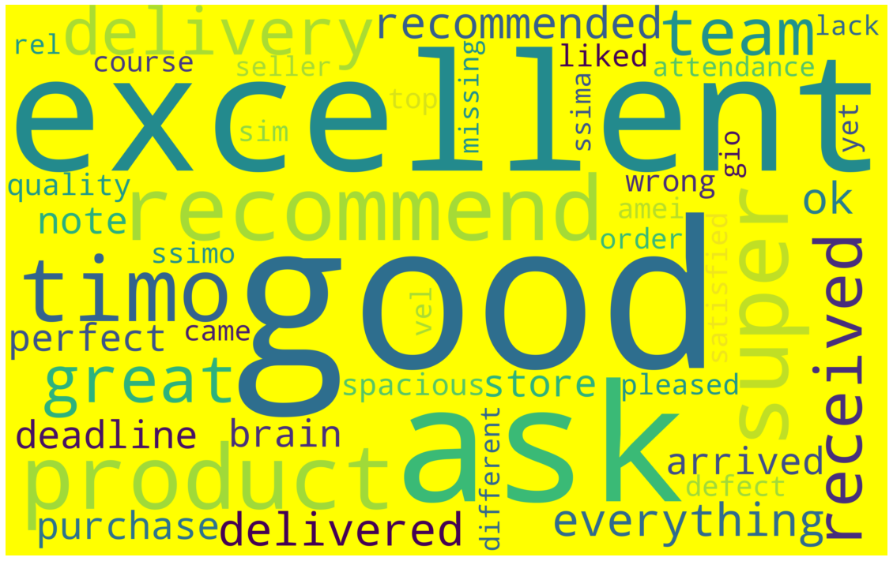

Slide 32
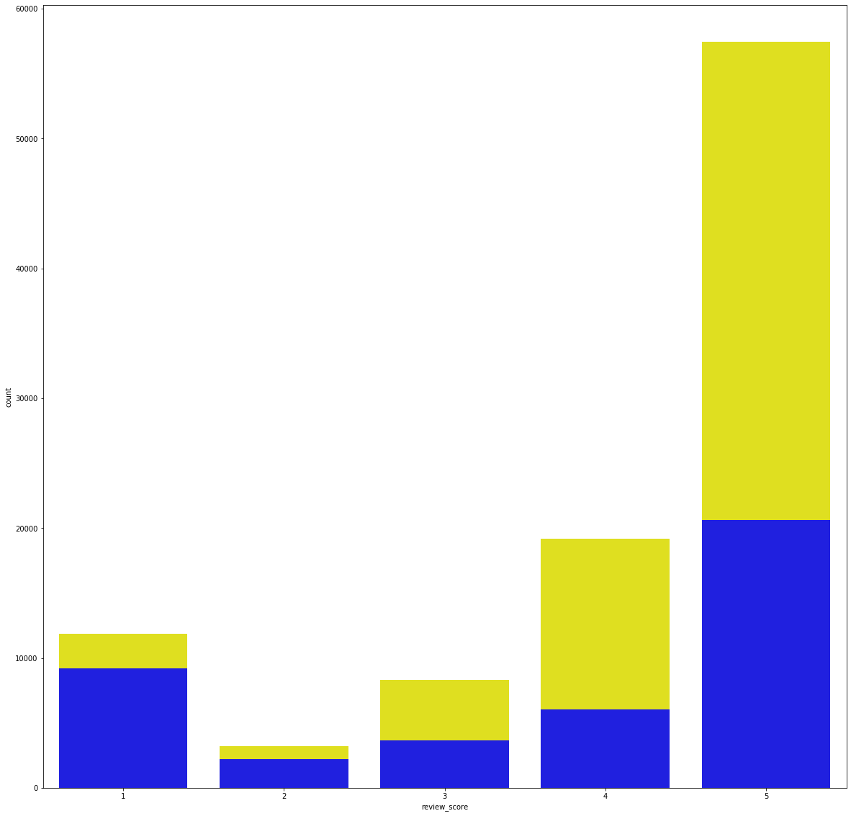
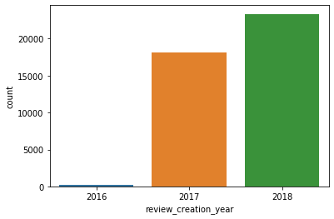
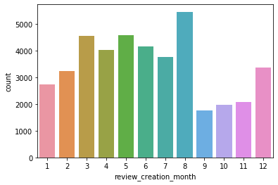
Customer Review Status
close to 60,000 people gave 5 star ratings and little above 10,000 people gave 1 star ratings(before removing nan values)
little above 20,000 people gave 5 star ratings and close to 10,000 people gave 1 star rating (after removing nan values)

Slide 33
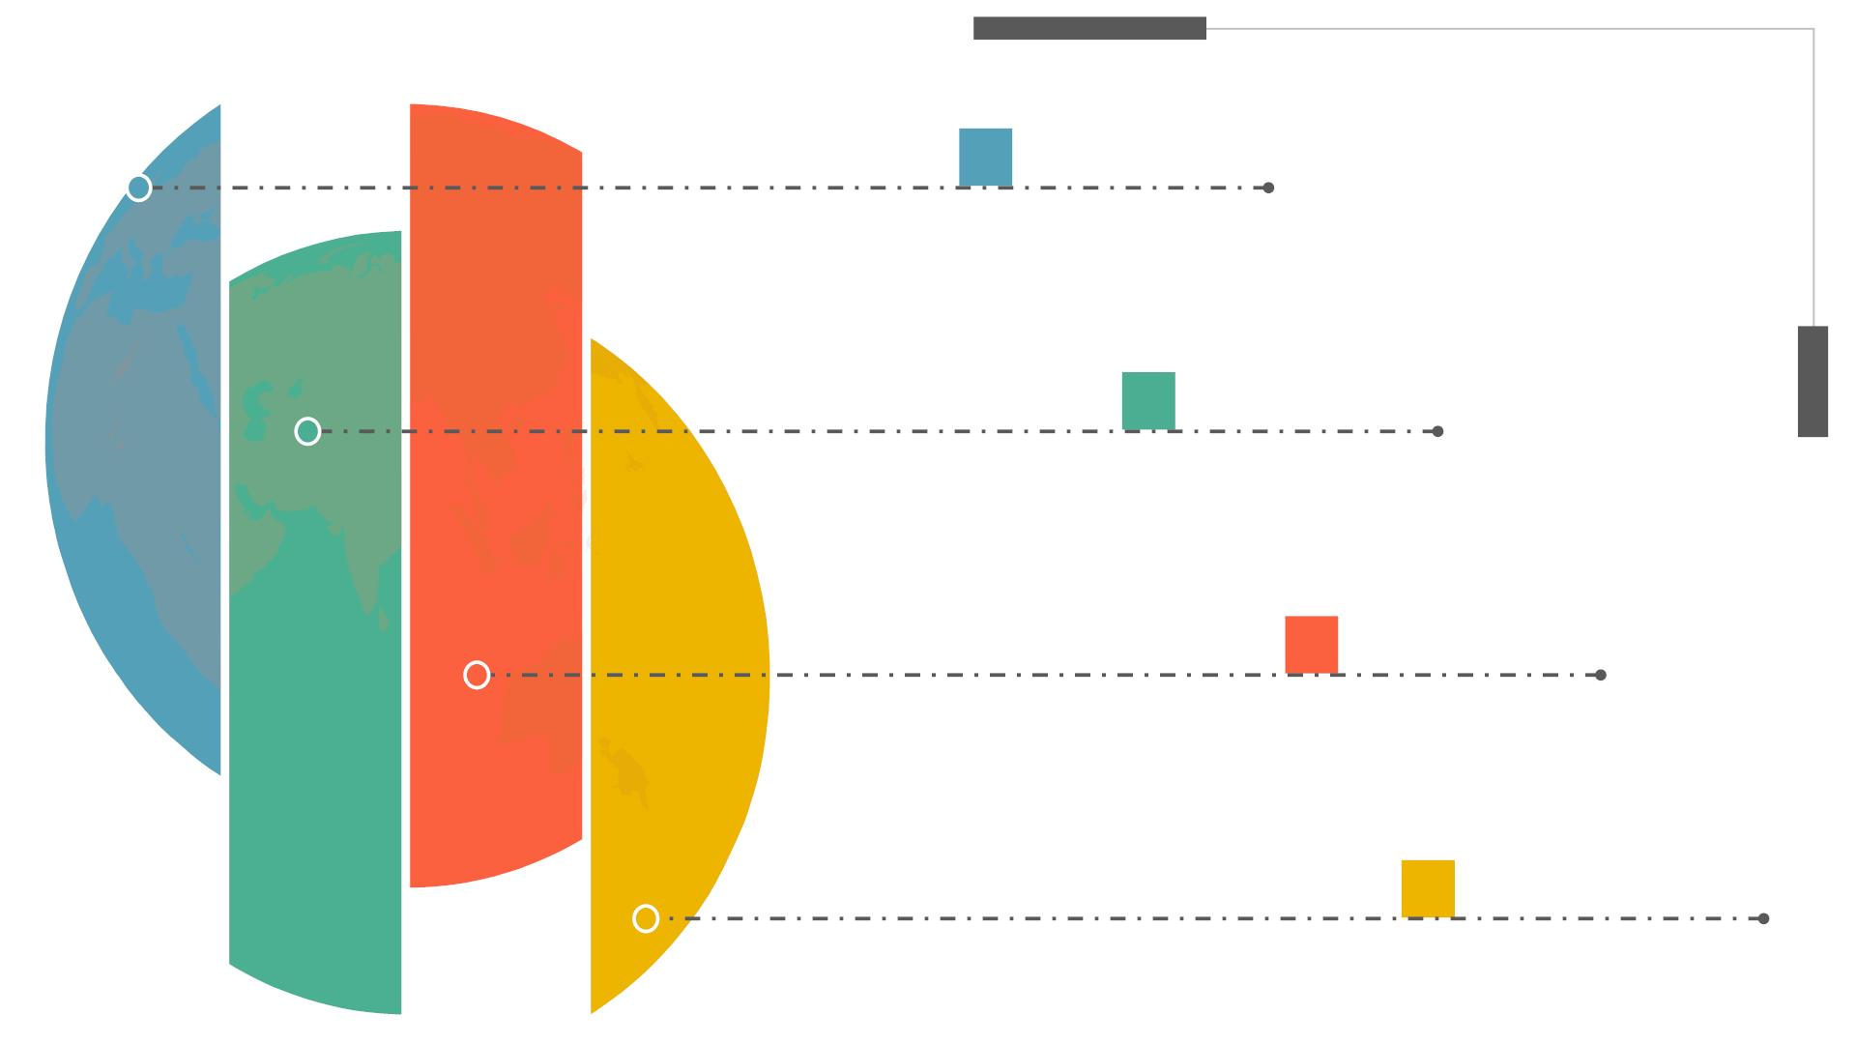
Challenges
A. Data
● Massive amounts of data, Joining
datasets, Missing values ,
Intuitive trends.
● Null values, different
dates,different sources, parsing
the data
B. ARIMA Model
● Low time series Data Points
C. Only ID
● No Product name
● No actual Market Basket
Analysis possible.
D. Portuguese
● Comments in different
language for NLP : Sentimental
Analysis

Slide 34
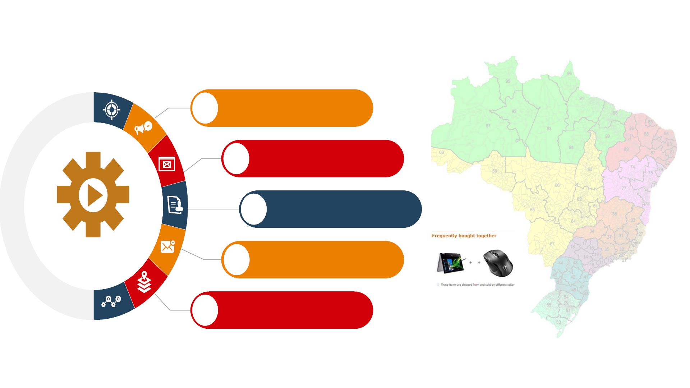
Recommendations
More concentration in North & North Eastern
(Good Population density): ZIP 71- ZIP92
01
Sellers
Targeted Marketing
Coupons
North & North Eastern ZIP
71- ZIP92
02
03
Carrier Delay
Highlights
Frequently Bought
Together
04
On-Time
Delivery
Most significant features
05

Slide 35


