Slide 1
The django CMS Cheatsheet
By Doug Purcell

Slide 2
Introducing The Presenter
What is up, I’m Doug Purcell! I’m a software engineer, internet entrepreneur, and author of Code Cool Stuff With Python available on Amazon.

Slide 3
3 Simple Goals for this presentation
You know how to install django CMS.
You understand a practical use case for it.
You know the options for deploying a django CMS site.

Slide 4
Software Explained in This Tutorial
python 3.6
django-version: 2.1
cms-version: 3.6

Slide 5
How We Learn By By Benedict Carey
Mentioned a research study which claimed that pretesting can help improve student's learning if followed by instructions and feedback.

Slide 6
Question #1: True or False
Django CMS is the same as the Django framework.

Slide 7
False
Django CMS is an open source content management system that uses Django and python.

Slide 8
Question #2: True or False
A common use case for django CMS is blogging.

Slide 9
True
django CMS is a content management system which helps simplify the publication process.

Slide 10
Question #3: True or False
django CMS is the only cms system inspired by Django.

Slide 11
False
It’s the most popular django inspired cms system but it is not the only one. There’s other cms systems such as Wagtail and Mezzanine.

Slide 12





Why Consider django CMS? These Companies Do...

Slide 13
Some Features of django CMS
Related content
Tag cloud
Comments
Slide show
News and blog
Bulletin board
Forms builder
Social media
Free and commercial themes
Large developer community
Opensource, released under the BSD 3 license
There’s a lot more, see the full feature list here: https://www.django-cms.org/en/features/list

Slide 14
Act I: Getting up and running with django CMS
Let’s get our hands dirty and learn how to install django CMS, how to access the admin web portal, how to create our first project, and how to make our very first post.

Slide 15
Formula for what we’ll need
pip + a virtual wrapper + django CMS = success!

Slide 16
Create a virtual environment
$ virtualenv cms

Slide 17
Step II: Activate the virtual environment
$ Scripts/activate

Slide 18
Step III: Install django CMS
$ pip install djangocms-installer

Slide 19
Now, create a new directory for your project
$ mkdir blog

Slide 20
Create the project with the following command
$ djangocms -p . blog

Slide 21
How everything should look thus far, similar to a traditional django project
blog
blog
__init__.py
settings.py
urls.py
wsgi.py
manage.py

Slide 22
Once done activate the server
$ python manage.py runserver

Slide 23
Access port 8000
http://127.0.0.1:8000

Slide 24
Login to admin interface
Default username/pass is admin/admin, but you can add an additional superuser by running the following command:
$ python manage.py createsuperuser

Slide 25
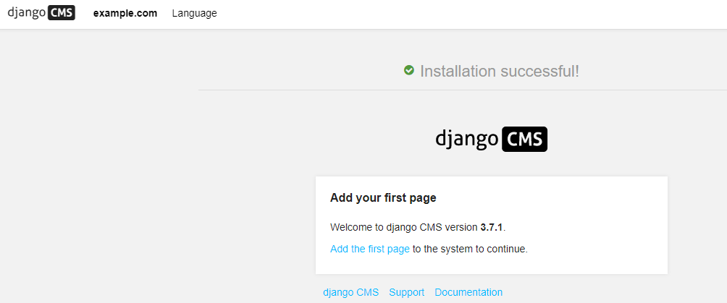
If install works it should look like this

Slide 26
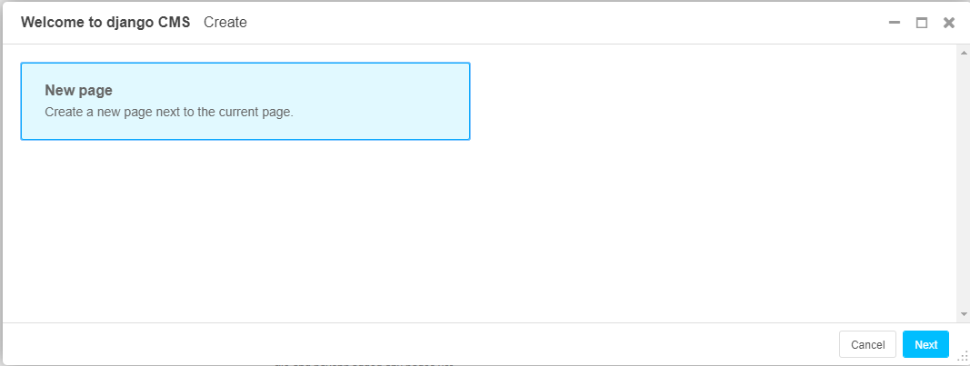
Let’s create a simple page

Slide 27
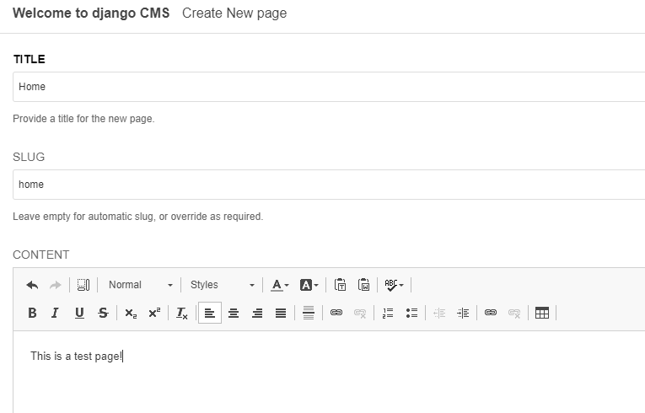
Create a new page

Slide 28
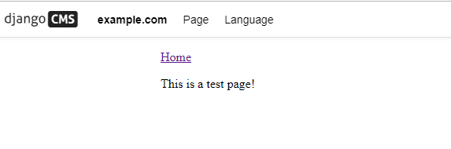
How everything looks thus far

Slide 29
Pretty plain but it does get better in Act II

Slide 30
Act II: Building Your First django CMS template

Slide 31
A shortcut is to use a prebuilt theme
There are a lot of free options, one such site is Start Bootstrap: https://startbootstrap.com
Let’s download and use the Modern Business theme: https://startbootstrap.com/templates/modern-business

Slide 32
Directories to Focus On
static
templates

Slide 33
Copy these files from the extracted theme
css
js
vendor

Slide 34
To your project’s static directory
The file structure should look like the following:
static
css
js
vendor

Slide 35
About base.html
base.html is a template in the project that all files inherit from.

Slide 36
Make some modifications to base.html
delete base.html and rename about.html to base.html

Slide 37
Let’s enable some basic features in base.html
Copy and paste this line at the very beginning of the file:
{% load staticfiles i18n cms_tags sekizai_tags menu_tags %}
It allows basic features in the template such as declaring the static files and i18n which is internalisation

Slide 38
How base.html should look thus far
{% load staticfiles i18n cms_tags sekizai_tags menu_tags %}
<!DOCTYPE html>
<html lang="en">
<head>
<meta charset="utf-8">
...

Slide 39
Couple of more things to edit in base.html...

Slide 40
Edit From This
<!-- Bootstrap core CSS -->
<link href="vendor/bootstrap/css/bootstrap.min.css" rel="stylesheet">
<!-- Custom fonts for this template -->
<link href="vendor/fontawesome-free/css/all.min.css" rel="stylesheet" type="text/css">
...
<!-- Custom styles for this template -->
<link href="css/clean-blog.min.css" rel="stylesheet">

Slide 41
To This
<!-- Bootstrap core CSS -->
<link href="{% static 'vendor/bootstrap/css/bootstrap.min.css' %}" rel="stylesheet">
<!-- Custom fonts for this template -->
<link href="{% static 'vendor/fontawesome-free/css/all.min.css' %}" rel="stylesheet" type="text/css">
...
<!-- Custom styles for this template -->
<link href="{% static 'css/clean-blog.min.css' %}" rel="stylesheet">

Slide 42
Why The Changes?
Allows us to load files from the django CMS static folder.

Slide 43
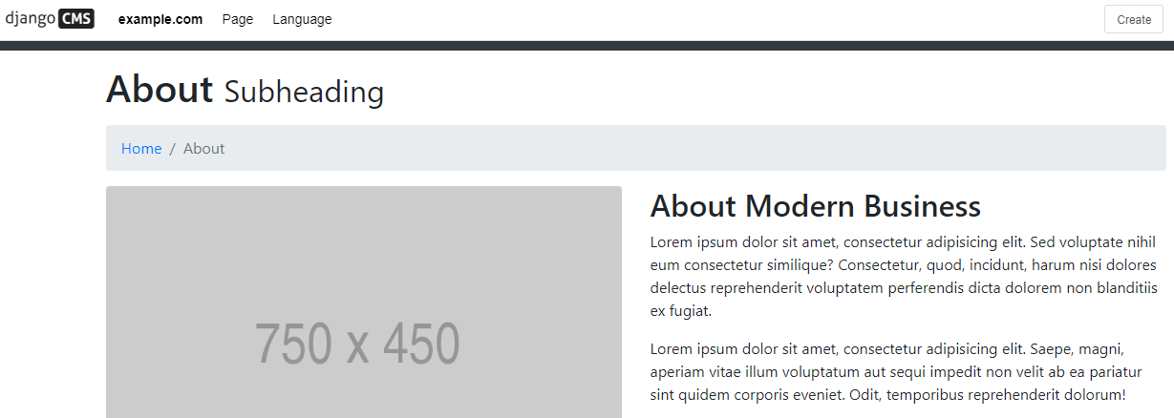
The Website is Looking Better

Slide 44
This is just the tip of the iceberg!
Lots of things you can do with django CMS, you can build a full fledged powerful CMS site with it. Go through the docs, they have a easy to follow tutorial: http://docs.django-cms.org/en/latest/user/tutorial/index.html

Slide 45
The Final Act: Options for Deploying Your django CMS Site

Slide 46
What options do you have?
Using the django development server is great for developing and testing your project, but it’s not meant to be used in production.
It comes with sqlite by default which is ok for testing your site locally, but not suitable for using in production.
Two options I recommend are Divio Cloud, and web hosts that specifically support Django.

Slide 47
Divio Cloud
Formally known as Aldryn, it’s created by the maintainers of django cms.
Automatic installation.
Automated deployments.
Management via web interface, desktop app, or cli.
Clean documentation.

Slide 48
Full Tutorial on getting started with Divio Cloud
https://readthedocs.com/projects/divio-divio-cloud-docs/downloads/pdf/latest

Slide 49
Django Hosting Providers
Digital Ocean
Heroku
AWS Elastic Beanstalk
Google Cloud
Azure app services

Slide 50
Finito! I’ll Be Back (Terminator Voice)
Some plugs for my upcoming talks
The Merry Overview of The Python Programming Language. 12/17/19, General Assembly San Francisco.
Carta The Merry Overview of The Python Programming Language: 01/7/20.

