Slide 1
Learn Database Programming in Python in 5 Examples

Slide 2
Course Overview
An overview of database programming in python
A look at the sqlite3 library in python
Analyzing the command line tool of the sqlite3 library
Analyzing code snippets from the sqlite3 library

Slide 3
Databases are Important!
Allows for efficient manipulation of large datasets
Very important for business. Can store the important details of the company such as the employees, transactional records, salaries, etc
Used in a myriad of software such as Desktop software, web software, etc

Slide 4
Python Supports Databases Out of The Box
Python can support a variety of databases such as MySQL, Oracle PostgreSQL, etc
The python standard databases interface is DB-API (PEP 249)
The database interface that we’re going to discuss is sqlite3
Python ships with it right out of the box and no additional configuration is required
sqlite3 is excellent for internal data storage, but it’s not recommended for production code due to security vulnerabilities. However, it’s a great tool to learn how to begin database programming with python.

Slide 5
To Flavors to Use sqlite3
We can import it and start building our database:
import sqlite3
Or, we can use the command line tool and practice our SQL skills. Let’s start with the later and work our way back up!

Slide 6
How to open the sqlite3 command tool
Search for the following executable file on your machine: sqlite3.exe
If it’s not on your machine you can download the command line tool here: https://www.sqlite.org/cli.html

Slide 7
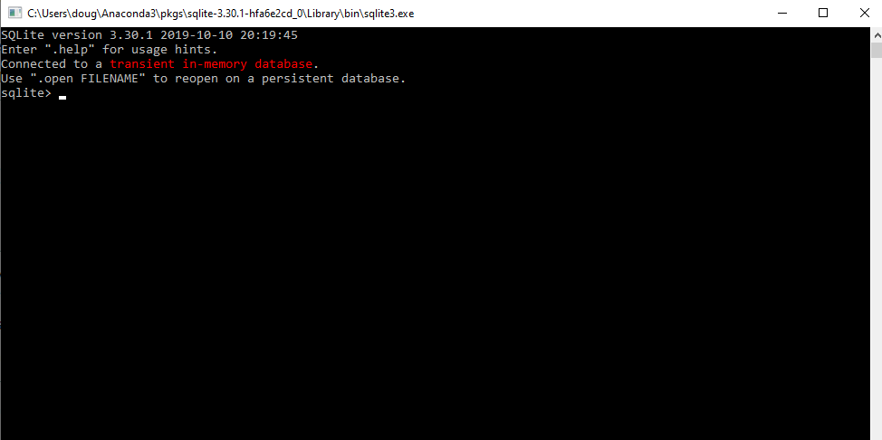
How the command line tool looks

Slide 8
Get acquainted with the command line tool
sqlite> .help

Slide 9
Some Useful Commands
.dbinfo: show status about the database
.databases: Lists names and files of attached databases
.dump: Render all database content as SQL
.exit: Exit the program
.save: Write the in memory database
.tables: List names of tables matching pattern

Slide 10
Creating a Table in Command Line Tool
sqlite> create table cart(one varchar(50), two smallint);
sqlite> insert into cart values('cookies', 4.00);
sqlite> insert into cart values('laptop', 650);
sqlite> insert into cart values('mask', 50);
sqlite> select * FROM cart;
cookies|4
laptop|650
mask|50

Slide 11
Tips
You can terminate the program anytime by typing the EOD
Make sure to terminate every statement with a semi colon
If you omit the semicolon then sqlite will give you a continuation step and wait for you to enter in more text to be added to the current SQL command

Slide 12
It’s a Good Way to Get Practice of sq l commands
Learn SQLite from the command shell: https://sqlite.org/cli.html
Now, we’ll be moving from the command line tool to doing our coding within PyCharm

Slide 13
Example # 1: Setting up your database
import sqlite3
conn = sqlite3.connect(r'C:\Users\Doug\Desktop\data.db')

Slide 14
You Can Also Create in Memory
I want the database to be created on my Desktop. You can explicitly set the path depending on your operating system.
If you’re using Windows make sure to use the r-string, short for raw strings. This always me to include my path as a literal, otherwise nasty escapes will be needed.
Python has a special name called :memory: and you can pass this into the connect function to instead create your database in memory vs. writing it and creating it on disk
Once you have a connection you can create what’s known as a Cursor object, and then call the execute method to perform SQL commands

Slide 15
Example # 2
c = conn.cursor() # create the table c.execute('''CREATE TABLE stock (date text, trans text, symbol text, qty real, price real) ''' )

Slide 16
Explanation
A cursor object is created. This allows us to execute the shell commands
The execute function is called and we’re wrapping our SQL statement in triple quotes. Remember, this always us to use multiline strings
A table called stock is created with five columns

Slide 17
How to view Our Database
You can’t view a .db file using a text editor like notepad. You have to use a specialized tool
One to use for this is called DB Browser for SQLite. Can download here: https://sqlitebrowser.org
Double click on test.db, and then find the DB Browser program. On Windows It’s located in: C:\Program Files

Slide 18
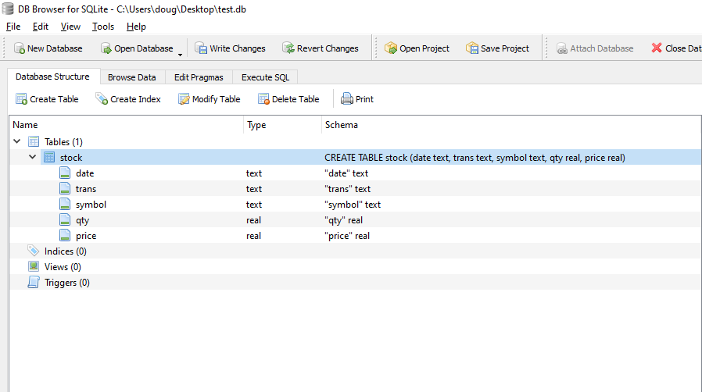
How the database looks

Slide 19
The data is now persistent
What this means? In computing this refers to the characteristic of a state that outlives the process that creates it.
This is achieved by storing the state as data in computer data storage

Slide 20
Here’s an Important Tip
If creating this in PyCharm or any other editor…
After the database is created, if you try and run this script again then python will give you an error
The reason for this is you don’t want to overwrite a database once it has been written to memory right?
You can commit it out once the database has been created

Slide 21
Example # 3
Let’s add data by using the sql INSERT command. Here’s the sample code snippet:
if c.execute("INSERT INTO stock VALUES ('2020-05-19', 'BUY', 'RHAT', 100, 35.18)"): print('Data inserted...') else: print('data not added...')
conn.commit()
conn.close()

Slide 22
Need to commit and close
commit() inserts the data into your database
close() prevents memory leaks by closing the connection when you’re done with it

Slide 23
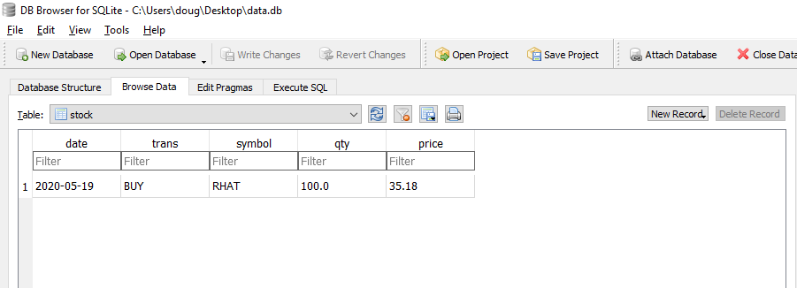
Run the File & Check Your Table by Clicking Browse Data

Slide 24
Example #4: Let’s run a SQL Query
Let’s assume that we want to scan the database and search for a record in the database and return the rows it belongs to
Let’s assume that the record we wanted to search for was RHAT. How can we do that?

Slide 25
Solution
t = ('RHAT',) c.execute('SELECT * FROM stock WHERE symbol=?', t) print(c.fetchone())

Slide 26
How Can we Insert Multiple Records
purchases = [('2006-03-28', 'BUY', 'IBM', 1000, 45.00), ('2006-04-05', 'BUY', 'MSFT', 1000, 72.00), ('2006-04-06', 'SELL', 'IBM', 500, 53.00), ] c.executemany('INSERT INTO stocks VALUES (?,?,?,?,?)', purchases)

Slide 27
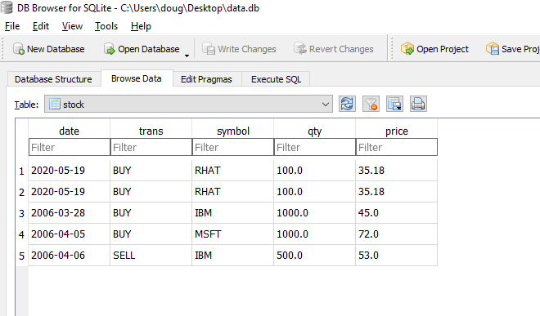
How our database now looks

Slide 28
Example # 5: How do we retrieve all the data ordered by price?
We can iterate over the database using a for loop
We can call c.execute()
We can do it by use the SELECT
And then use the ORDER BY keyword in SQL

Slide 29
Solution
for row in c.execute('SELECT * FROM stocks ORDER BY price'):
print(row)

Slide 30
A Recap of sqlite3 in python
The fist step is to import the sqlite3 module
Must create the database
Then, we create the Cursor object so that we can run various sql commands
Then, we can run various sql commands
Make sure to close the connection once done

Slide 31
Additional Database Info
Need to brush up on SQL? Read this article on Reddit on best resources for learning SQL: https://www.reddit.com/r/SQL/comments/9ojj1w/best_way_to_learn_sql_at_home/
Sqlite3: https://docs.python.org/3/library/sqlite3.html
MySQL connector library in python: https://dev.mysql.com/doc/connector-python/en
PostgreSQL connector adapter in python: https://www.psycopg.org/docs
Building web based app with python and Oracle: www.oracle.com/technical-resources/articles/database/python-with-database-11g.html
Apache Cassandra driver in Python: https://pypi.org/project/cassandra-driver
MongoDB driver in python: https://docs.mongodb.com/drivers/python
Python Redis Client: https://redislabs.com/lp/python-redis

