Slide 1
File Manipulation in Python
By Doug Purcell

Slide 2
Lesson Overview
Learn how tow read and write text files
Learn how to use the os module to rename, cleanup, and delete directories
Learn about JSON files and how to create them in python
Experiment with these modules by building some real world practical scripts

Slide 3
Processing a Text File in Python is Similar
Python will need to first locate the file. The way that computers do this is by using the file’s path.
Python will then need to read the file or locate it in memory.
Lastly, python will need to write or add new text to it.

Slide 4
We can use the open() function
open(file, mode='r', buffering=-1, encoding=None, errors=None, newline=None, closefd=True, opener=None)
open: The name of the function
file: The path of the file you want to open
buffering: Optional integer used to set buffering policy. Pass 0 to switch buffering off, 1 to select buffering, and > 1 to indicate size in bytes
encoding: If not specified, the default encoding used is platform dependent: locale.getpreferredencoding(False)
errors: Optional string which specifies how encoding and decoding errors is handled. Cannot be used in binary mode
newline: Controls how universal newlines mode works
closefd: If a file descriptor is given, it’s closed when the I/O object is closed, unless closefd is set to False
opener: Can use a custom opener by passing a callable as opener

Slide 5
The Hello World of Opening Files in Python
text = open('content.txt', 'w') text.write('Python\n') text.write('Is\n') text.write('A\n') text.write('Pretty\n') text.write('Wicked\n') text.write('Programming\n') text.write('Language') text.close()

Slide 6
Detangle That Code!
A file is created in our current directory by using the open function
The file name and extension is passed as the first argument
The second argument is 'w' which represents the mode we’re in which is write
The function write() is called to write content to the file

Slide 7
The Different Modes to Open a File using file()
Character | Meaning
'r' | Open for reading (default)
'w' | Open for writing, truncating the file first
'x' | Open for exclusive creation, failing if file exists
'a' | Open for writing, appending to the end if it exists
'b' | Binary mode
't' | Text mode (default)
'+' | Open for updating (reading and writing)

Slide 8
Reading the File We Created
read_file = open('content.txt', 'r')

Slide 9
Can call either one of the following functions
read(): Reads the whole entire file. Can pass in an integer argument to read in a certain number of characters from the file.
readline(): Reads a single line from the file. Can pass in an integer argument to read in a certain number of characters from the file.
readlines(): Reads in the whole entire file into a list in python.

Slide 10
Updating Our Code
When reading/writing files it’s very possible to have memory leaks
This happens when a file is opened yet never closed
One way to anticipate that a file has been closed is to use try/except/finally statements

Slide 11
Review of try/except/finally
In [12]: def divide_nums(x, y):
...: try:
...: divide = x / y
...: except ZeroDivisionError:
...: print('can\'t divide by 0!')
...: finally:
...: print('Try again...')
...:
In [13]: divide_nums(10, 0)
can't divide by 0!
Try again...

Slide 12
We Can Apply This to when We Read/Write Files
There’s several classes that’s been built for us that handle exceptions in python: https://docs.python.org/3/library/exceptions.html
The exception class that we want to use when reading/writing files is FileNotFoundError
Let’s wrap the portion in which we read/write a file in the try block, include the details to process the exception within the except block, and then close the file in the finally block

Slide 13
The Code Revised
try: file = open('content.txt', 'r+') file.writelines('\nPython') file.writelines('\nIs') file.writelines('\nA') file.writelines('\nReally') file.writelines('\nCool') file.writelines('\nLanguage') file.read() except FileNotFoundError as f: print('File is not found ') finally: file.close() print('The file was successfully opened...')

Slide 14
Could Use the with statement
The with statement clarifies code that previously would use try /except/finally blocks to ensure that cleanup code is executed

Slide 15
Example of with statement
with open('content.txt', 'r') as f: read_file = f.read() print(read_file)

Slide 16
Quick Quiz
Using the with statement and the randint function from the random module, create a function called process_nums that contains a file named random_nums.txt that contains 100 random numbers.

Slide 17
Solution
def process_nums(): """ Generates a text file of random numbers and then display those numbers to the console. :return: displays the random numbers printed to the console. """ with open('random_nums.txt', 'w') as nums: for x in range(100): rand_num = '\n'.join(str(randint(1, 100))) nums.write(rand_num)

Slide 18
Need to process multiple files simultaneously?
with open('test.txt', 'w'), open('another_test.txt', 'w'): pass

Slide 19
More about the with statement
The with statement is a context manager in python
Context managers allows you to allocate and release resources when you want.
To learn more about context managers check out this url here: https://docs.python.org/3/library/stdtypes.html#typecontextmanager

Slide 20
The os module
The os module provides several tools for handling filenames, paths, and directories
It contains two sub modules, os.sys and os.path
With this module you can change directories, delete directories, rename directories, get stats of directories
Read the documentation about the os module here: https://docs.python.org/3.8/library/os.html

Slide 21
A sample of the os module
In [61]: import os
In [62]: os.getcwd()
Out[62]: 'C:\\Users\\doug\\Desktop'
In [63]: os.chdir(r'../')
In [64]: os.getcwd()
Out[64]: 'C:\\Users\\doug'
In [65]: os.cpu_count()
Out[65]: 4
In [66]: os.curdir
Out[66]: '.'
In [67]: os.defpath

Slide 22
Using os module to create files
Let’s imagine that you’re writing some type of web development application
Let’s assume that the app will be able to auto magically create files or directories for the user
So that the user can start off with templates for their web development purposes
The os module will be a perfect solution for this use case

Slide 23
How to change paths using the os module
Use the chdir() function to change into a directory, and use the getcwd() function to get the current working directory
In [82]: os.chdir(r'C:\Users\Doug\Desktop')
In [83]: os.getcwd()
Out[83]: 'C:\\Users\\Doug\\Desktop'

Slide 24
How to Create a directory
Use the mkdir() function like in the following code snippet
In [84]: os.mkdir('Templates')
In [85]: os.chdir('Templates')
In [86]: os.listdir()

Slide 25
Now, create a basic.html file
The next step is to use the open() function to create a file named basic.html
Then, write to the file the basic template of a html file such as the below:
<!DOCTYPE html> <html> <body> <h1>My First Heading</h1> <p>My first paragraph.</p> </body> </html>

Slide 26
Then, write to it the html template
In [88]: with open('basic.html', 'w') as html:
...: template = """
...: <!DOCTYPE html>
...: <html>
...: <body>
...: <h1>My First Heading</h1>
...: <p>My first paragraph.</p>
...: </body>
...: </html>
...: """
...: html.writelines(template)
...:
...:

Slide 27
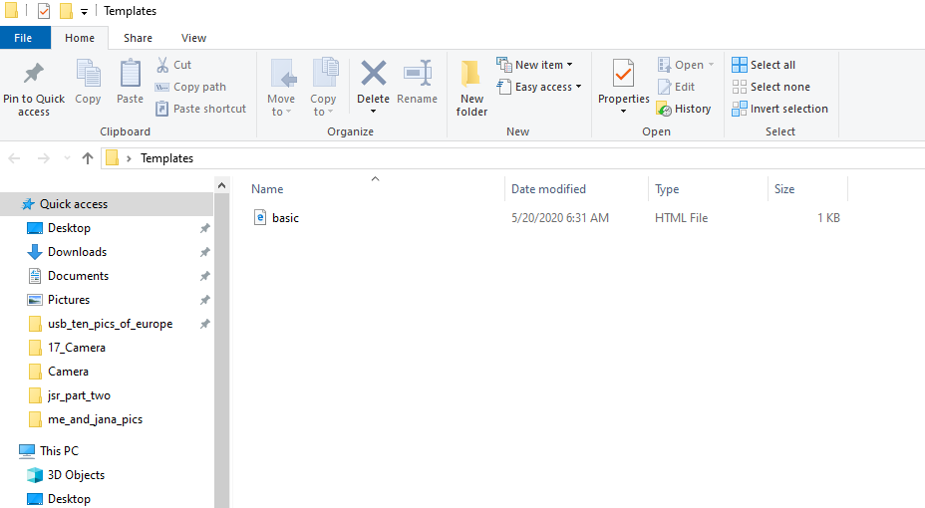
The Basic HTML File is Created

Slide 28
For Extra Practice try the Following…
To make this code more dynamic we can wrap this code inside of a function
Create a function called create_html_template
The function has one parameters: file_name which is by default set to Template
The file should be created on your Desktop.
Note, the path to your Desktop will depend on the operating system you’re using :
Windows: C:/Users/username/Desktop
Mac OS X: /Users/username/Desktop
Linux: /home/username/Desktop

Slide 29
Understanding JSON
JSON is short for JavaScript object notation language (JSON)
It’s an open standard file format, data interchange format, and more importantly human readable
Even though JSON was derived from JSON, its truly language independent because it consists of mainly key/value pairs. Most modern languages supports data structures like this, and python is no exception with the dictionary data structure

Slide 30
The Practical Use cases of JSON
JSON is used heavily in web services. Back in the day, web services used mainly XML as their primary data format for transmitting data back, but JSON created by Douglas Crockford is much more lightweight
Used for serializing and transmitting structured data over a network connection
Most web services provide REST APIs and transfer data in multiple formats. The data can be HTML, XML, YAML, etc. However, JSON is the most common data format.
You can read Roy Fielding’s dissertation on Rest APIs here: https://www.ics.uci.edu/~fielding/pubs/dissertation/fielding_dissertation.pdf

Slide 31
Quick JSON Tutorial
JSON is built on two data structures
A collection of name/value pairs. In various languages this is called an object, struct, hash table, keyed list, associative array or in python a dictionary
An ordered list of values. In most languages this is an array, vector, list, or sequence
Here’s an article that introduces JSON: https://www.json.org/json-en.html

Slide 32
JSON Code Snippet Example
{
"book": {
"title": "Treasure Island",
"author": "obert Louis Stevenson",
"Publication": 1881
}
}

Slide 33
The JSON Module in Python
Allows for the encoding and decoding of JSON objects
Encoding is synonymous with serialization, or the process of turning some object into a data format
Deserialization or decoding is the opposite of this process, or the taken of structured data in some format and then rebuilding it into an object

Slide 34
Example of encoding/decoding using Json module
Serialization/Encode
dump(): Encode JSON object from url
dumps():Encode object as a JSON string
Deserialization/Decode
load(): Use this if you’re getting a json from a url
loads(): Use this if your json is a string

Slide 35
Json loads Example
In [15]: import json
In [16]: phone_book = json.loads('{"Jeff": "273-283-91732", "Sally": "273-942-152
...: 3"}')
In [17]: phone_book['Sally']
Out[17]: '273-942-1523'

Slide 36
JSON dumps example (decoding from json to python)
In [23]: json_snippet = """
...: "book": {
...: "title": "Treasure Island",
...: "author": "obert Louis Stevenson",
...: "Publication": 1881
...: """
In [24]: json.loads(json_snippet)
Out[24]:
{'book': {'title': 'Treasure Island',
'author': 'obert Louis Stevenson',
'Publication': 1881}}

